Slide 1
CS386-Artificial Intelligence Lab
Report and Observations : Group 12
Sahil Jindal Abhishek Gupta Rohan Gyani Mridul Ravi Jain
110020043 110040067 110040001 110040083

Slide 2
Back Propagation on Feed Forward Neural Networks
Report and Observations

Slide 3
Assignment Specifications
Implement back propagation (BP) on feed forward neural n/w (FFNN). Give FFNNs for:
2-input XOR
2-input NAND
5-input palindrome
5-input majority
5-input parity
Digit recogniser
Choose the learning rate judiciously.
Study convergence time, local minima, saturation, effect of initialization, effect of learning rate and momentum factor.
1 and 0 decisions are based on the output being above the high water mark or being below the low water mark.

Slide 4
FFNN Pseudo Code
Apply the inputs to the network and work out the output.
Calculate errors of output neurons and then calculate Total Sum of Squares Error
while(Total Sum of Squares Error > Threshold)
Change output layer weights
Calculate errors for hidden layer neurons
Change hidden layer weights(backpropagation)
Apply the inputs to the network and work out the output.
Calculate errors of output neurons and then calculate Total Sum of Squares Error

Slide 5
Contents
Error v/s No of Iterations
Effect of Learning Rate
Effect of Momentum factor
Graphs for
2-input XOR
2-input NAND
5-input palindrome
5-input majority
5-input parity
Digit recogniser
Functionality of Hidden Layer Neurons
2-input XOR
3-input Palindrome
5-input Palindrome

Slide 6
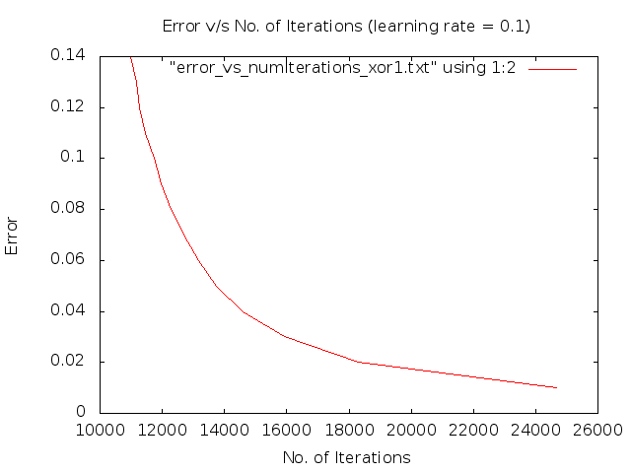
Effect of Learning Rate (XOR)

Slide 7

Effect of Learning Rate (XOR)

Slide 8
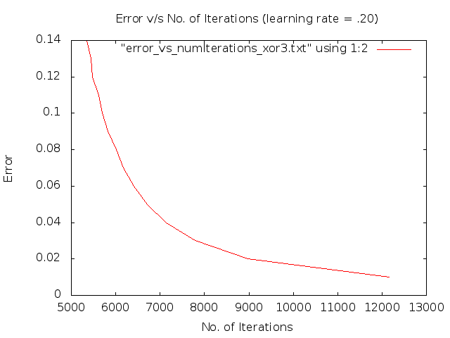
Effect of Learning Rate (XOR)

Slide 9
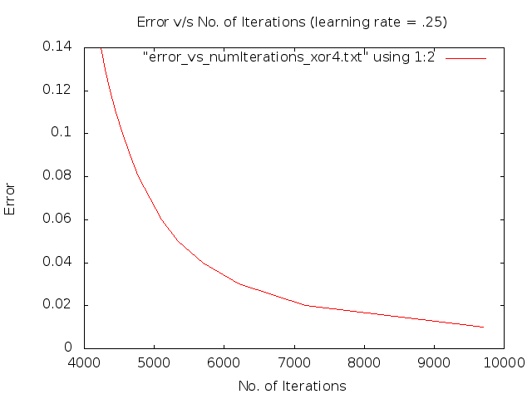
Effect of Learning Rate (XOR)

Slide 10
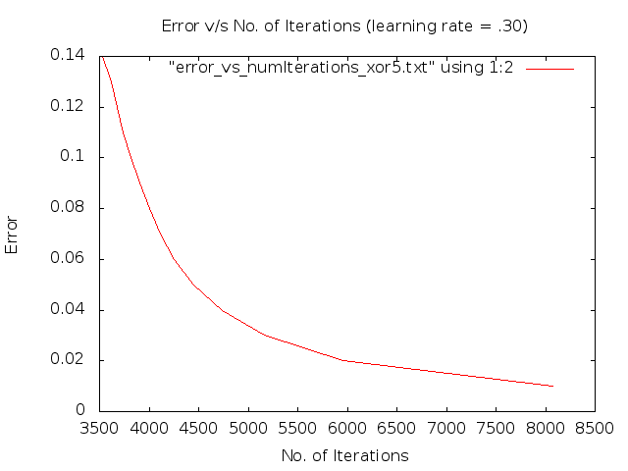
Effect of Learning Rate (XOR)

Slide 11
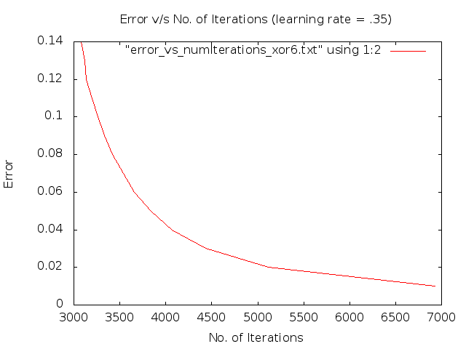
Effect of Learning Rate (XOR)

Slide 12
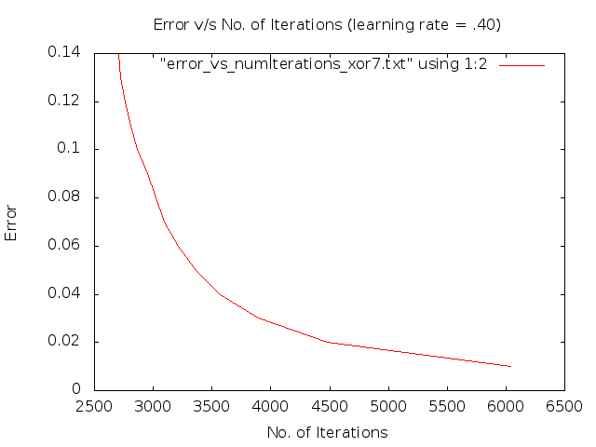
Effect of Learning Rate (XOR)

Slide 13
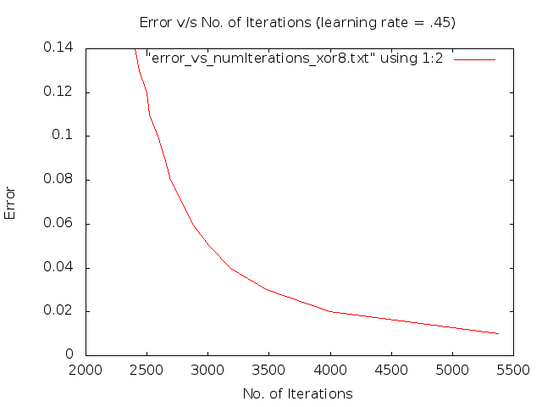
Effect of Learning Rate (XOR)

Slide 14
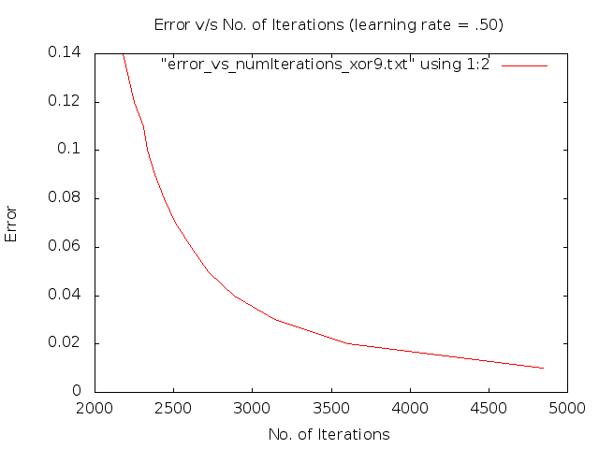
Effect of Learning Rate (XOR)

Slide 15
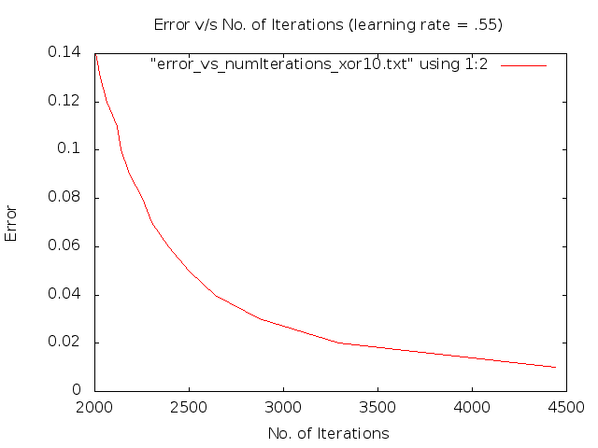
Effect of Learning Rate (XOR)

Slide 16
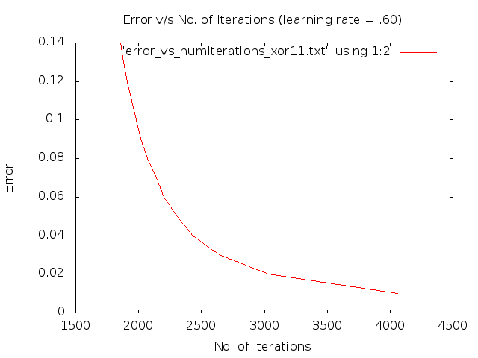
Effect of Learning Rate (XOR)

Slide 17
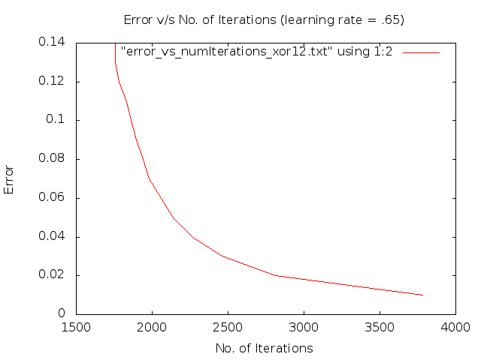
Effect of Learning Rate (XOR)

Slide 18

Effect of Learning Rate (XOR)

Slide 19
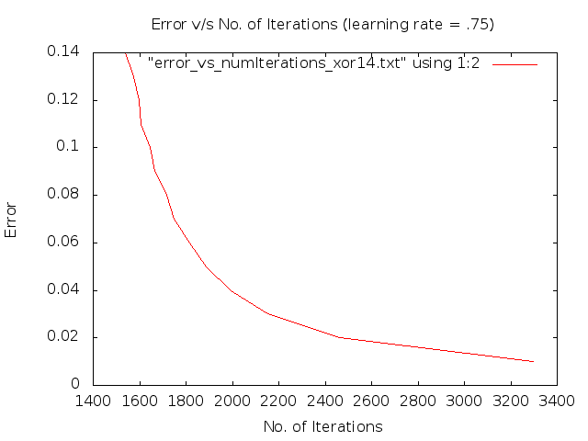
Effect of Learning Rate (XOR)

Slide 20
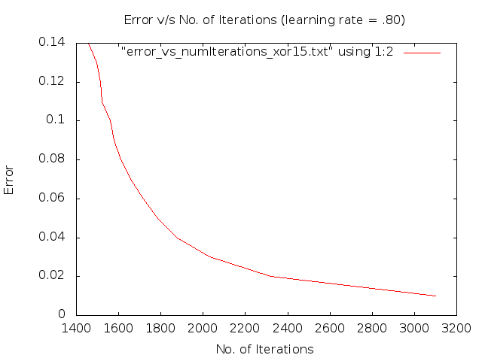
Effect of Learning Rate (XOR)

Slide 21
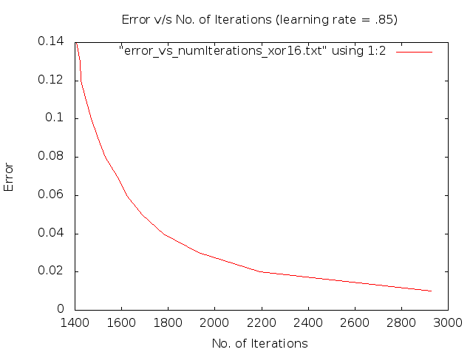
Effect of Learning Rate (XOR)

Slide 22
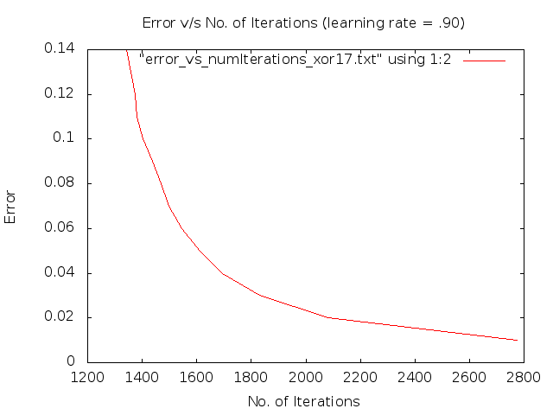
Effect of Learning Rate (XOR)

Slide 23
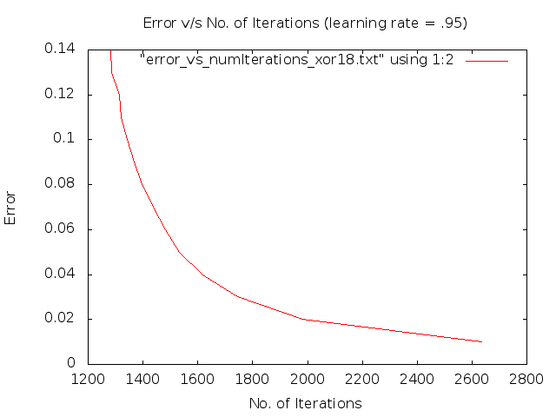
Effect of Learning Rate (XOR)

Slide 24
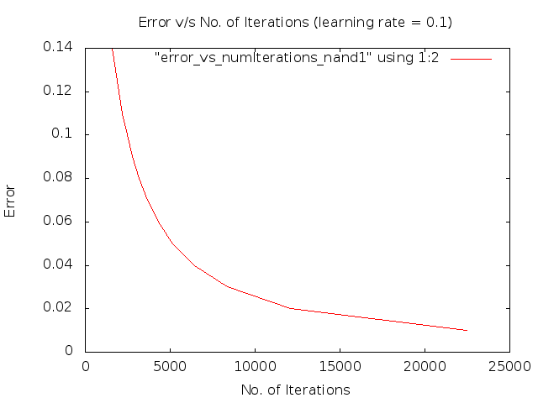
Effect of Learning Rate (NAND)

Slide 25
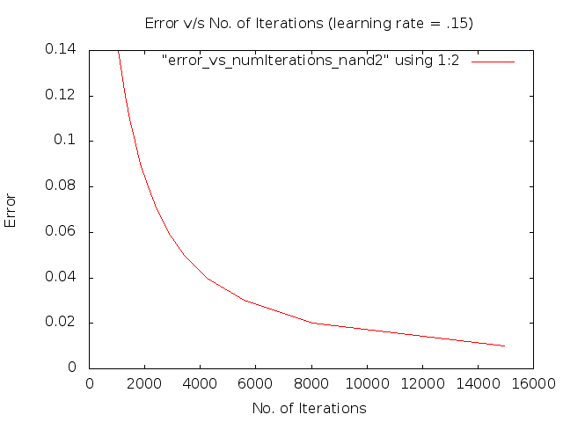
Effect of Learning Rate (NAND)

Slide 26
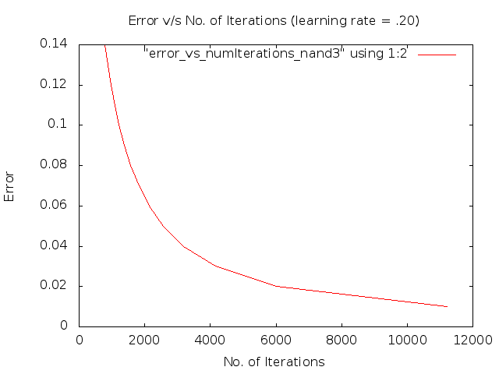
Effect of Learning Rate (NAND)

Slide 27
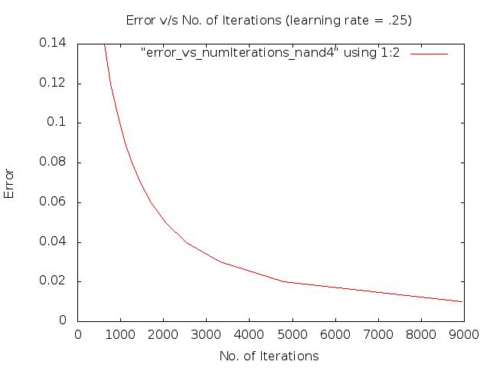
Effect of Learning Rate (NAND)

Slide 28
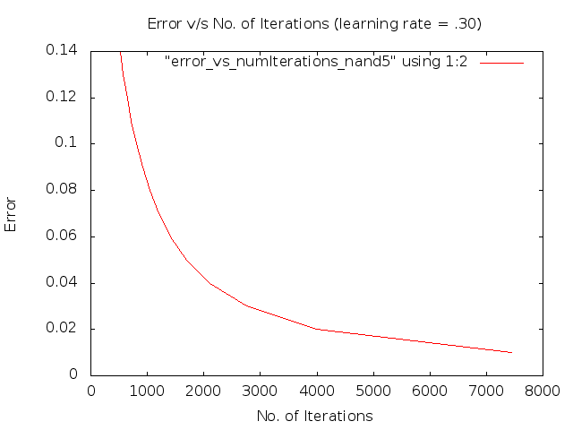
Effect of Learning Rate (NAND)

Slide 29

Effect of Learning Rate (NAND)

Slide 30

Effect of Learning Rate (NAND)

Slide 31
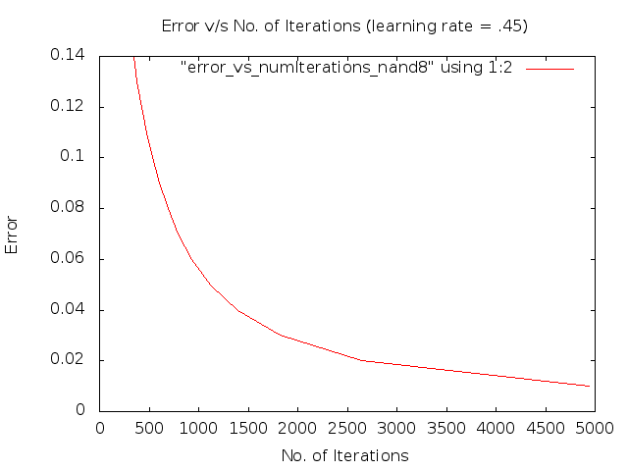
Effect of Learning Rate (NAND)

Slide 32
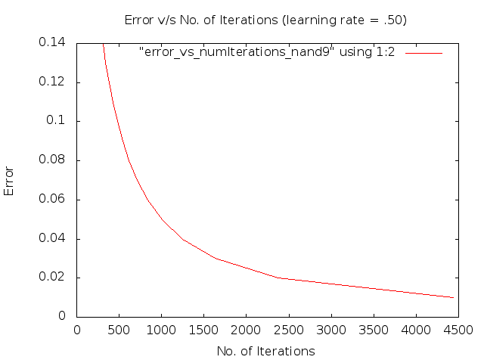
Effect of Learning Rate (NAND)

Slide 33

Effect of Learning Rate (NAND)

Slide 34
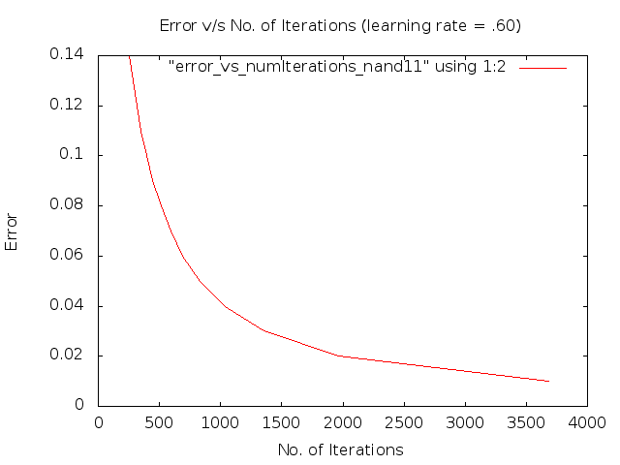
Effect of Learning Rate (NAND)

Slide 35

Effect of Learning Rate (NAND)

Slide 36

Effect of Learning Rate (NAND)

Slide 37
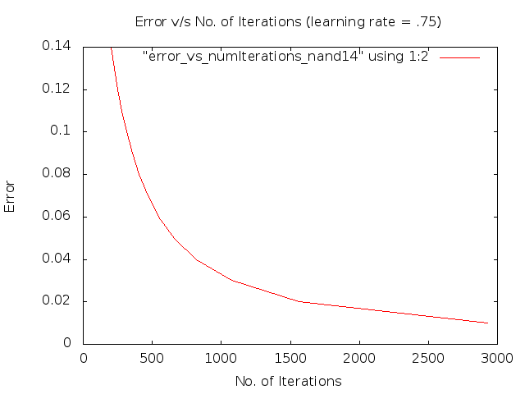
Effect of Learning Rate (NAND)

Slide 38
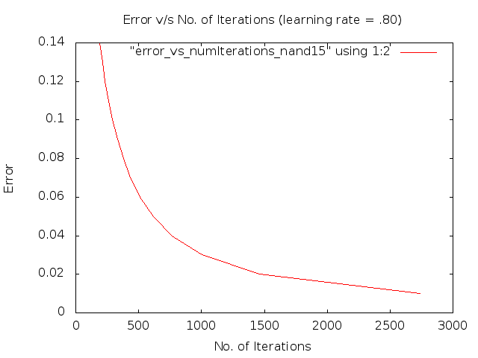
Effect of Learning Rate (NAND)

Slide 39
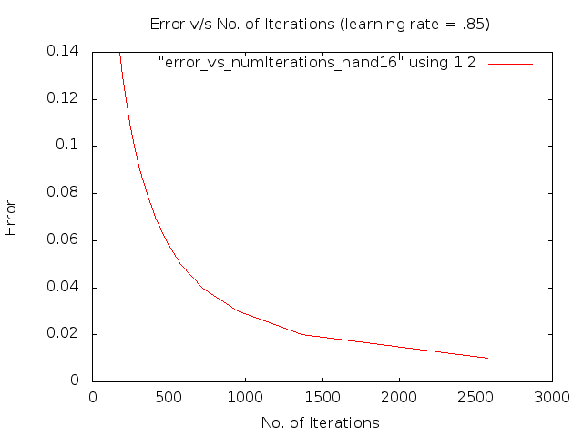
Effect of Learning Rate (NAND)

Slide 40

Effect of Learning Rate (NAND)

Slide 41

Effect of Learning Rate (NAND)

Slide 42
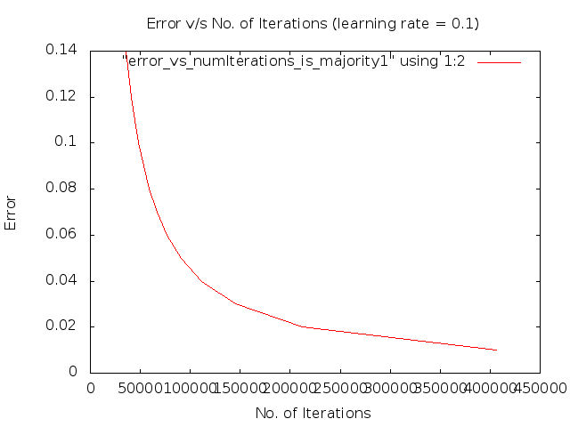
Effect of Learning Rate (Majority)

Slide 43

Effect of Learning Rate (Majority)

Slide 44

Effect of Learning Rate (Majority)

Slide 45

Effect of Learning Rate (Majority)

Slide 46
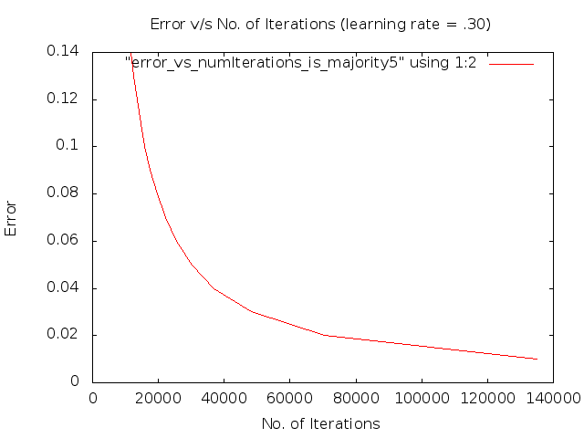
Effect of Learning Rate (Majority)

Slide 47
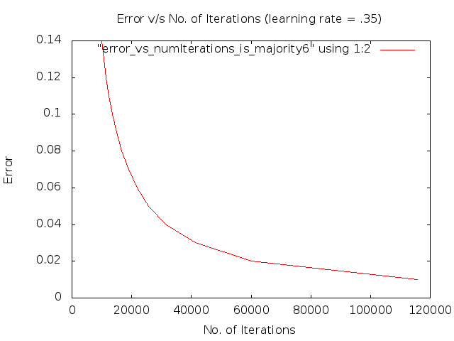
Effect of Learning Rate (Majority)

Slide 48
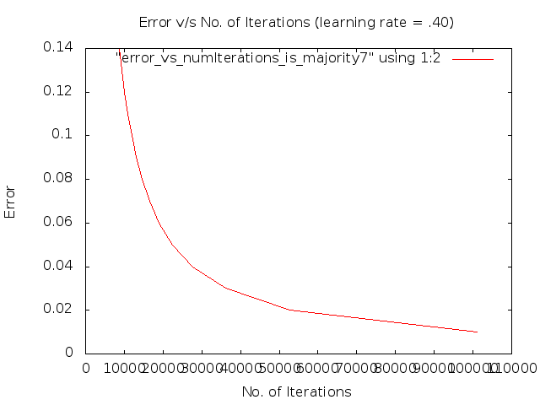
Effect of Learning Rate (Majority)

Slide 49
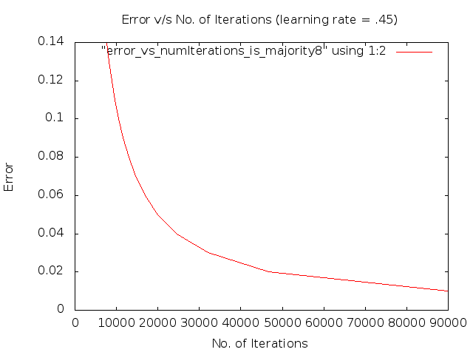
Effect of Learning Rate (Majority)

Slide 50

Effect of Learning Rate (Majority)

Slide 51
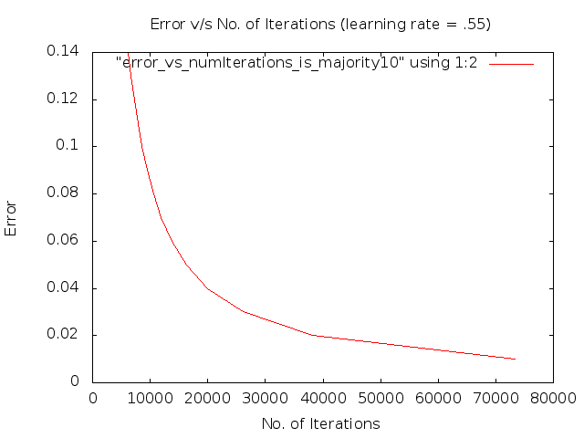
Effect of Learning Rate (Majority)

Slide 52
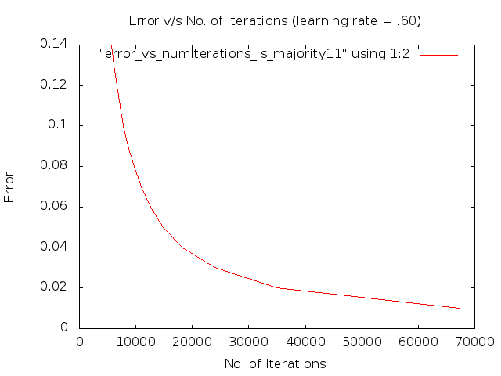
Effect of Learning Rate (Majority)

Slide 53
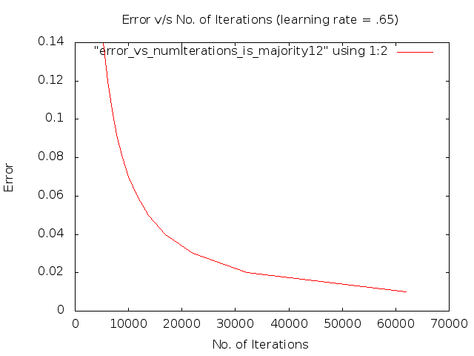
Effect of Learning Rate (Majority)

Slide 54
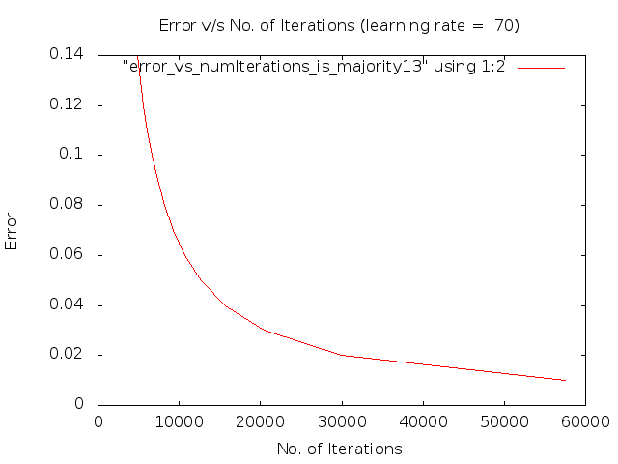
Effect of Learning Rate (Majority)

Slide 55

Effect of Learning Rate (Majority)

Slide 56

Effect of Learning Rate (Majority)

Slide 57

Effect of Learning Rate (Majority)

Slide 58

Effect of Learning Rate (Majority)

Slide 59

Effect of Learning Rate (Majority)

Slide 60
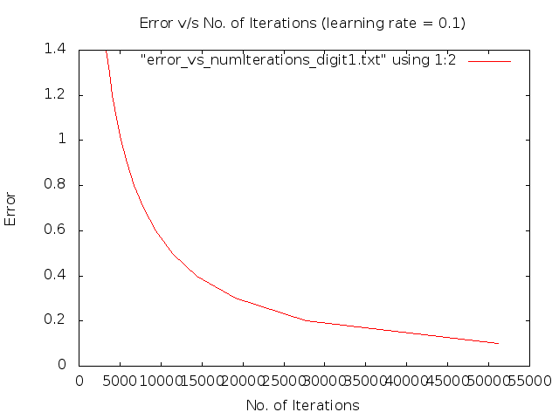
Effect of Learning Rate (Digit Recogniser)

Slide 61
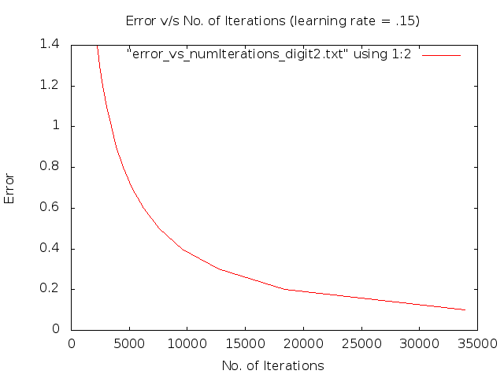
Effect of Learning Rate (Digit Recogniser)

Slide 62
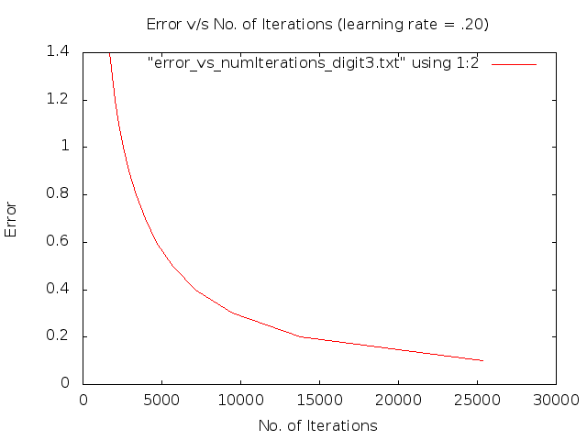
Effect of Learning Rate (Digit Recogniser)

Slide 63
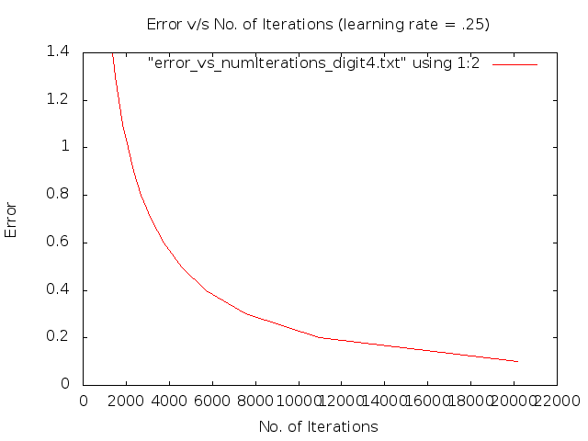
Effect of Learning Rate (Digit Recogniser)

Slide 64
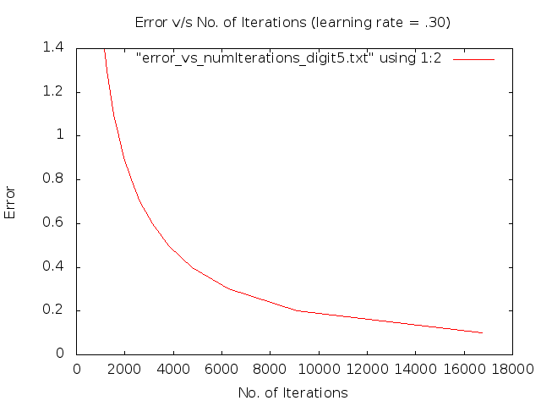
Effect of Learning Rate (Digit Recogniser)

Slide 65
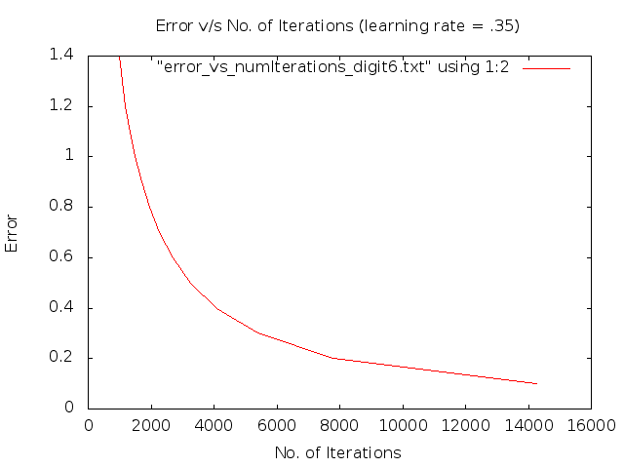
Effect of Learning Rate (Digit Recogniser)

Slide 66

Effect of Learning Rate (Digit Recogniser)

Slide 67
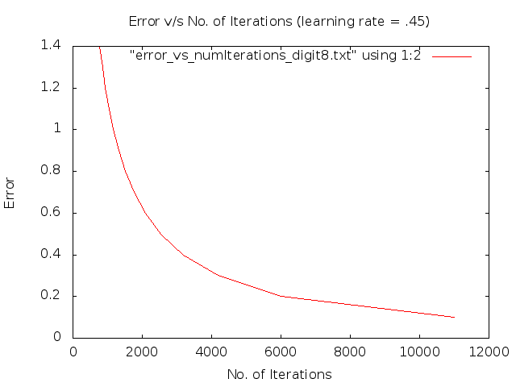
Effect of Learning Rate (Digit Recogniser)

Slide 68
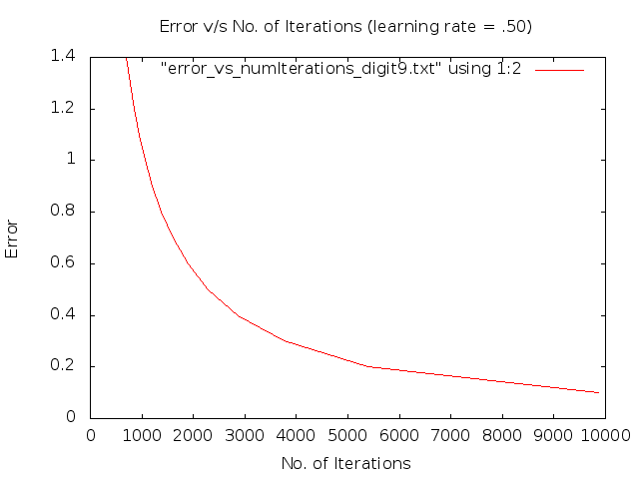
Effect of Learning Rate (Digit Recogniser)

Slide 69
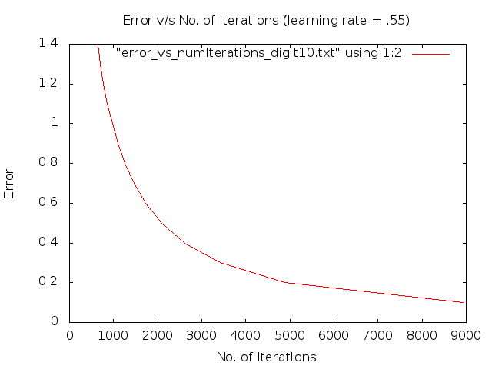
Effect of Learning Rate (Digit Recogniser)

Slide 70

Effect of Learning Rate (Digit Recogniser)

Slide 71

Effect of Learning Rate (Digit Recogniser)

Slide 72
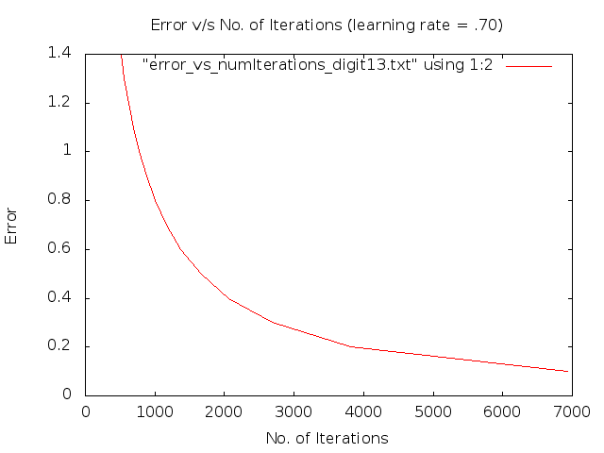
Effect of Learning Rate (Digit Recogniser)

Slide 73

Effect of Learning Rate (Digit Recogniser)

Slide 74
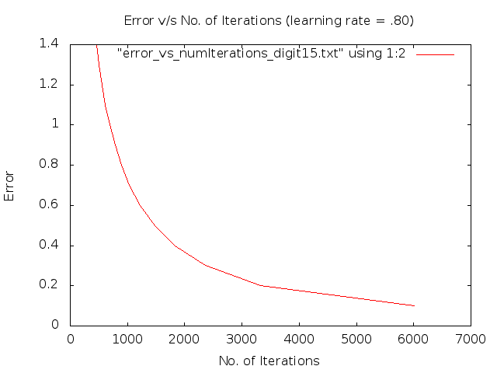
Effect of Learning Rate (Digit Recogniser)

Slide 75
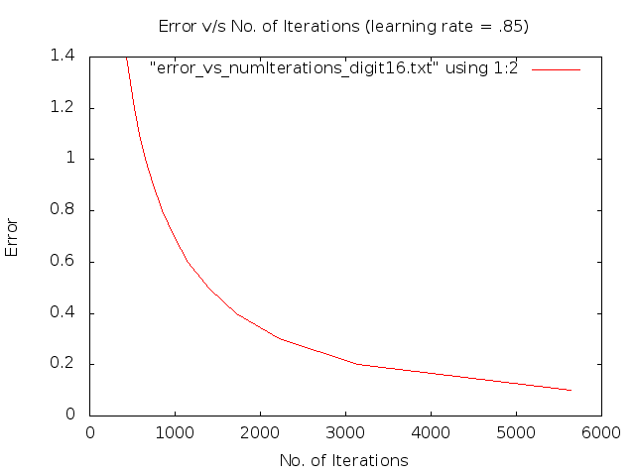
Effect of Learning Rate (Digit Recogniser)

Slide 76
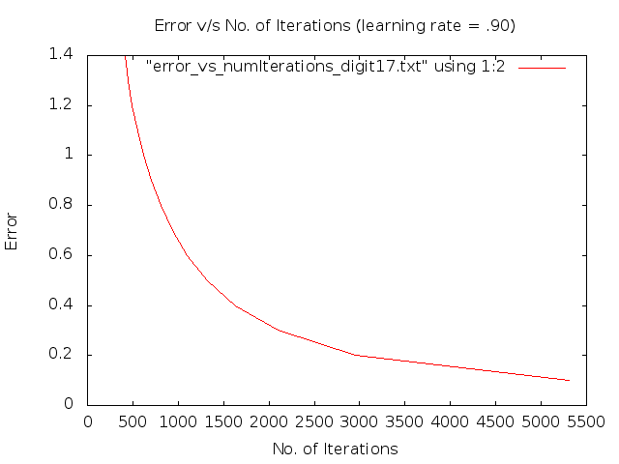
Effect of Learning Rate (Digit Recogniser)

Slide 77

Effect of Learning Rate (Digit Recogniser)

Slide 78
Effect of Learning Rate (Parity)

Slide 79
Effect of Learning Rate (Parity)

Slide 80
Effect of Learning Rate (Parity)

Slide 81
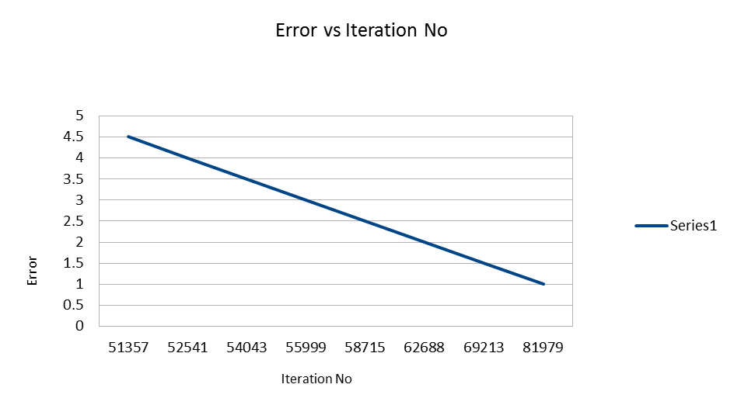
Effect of Learning Rate (Parity)
Eta=0.7, Momentum Factor=0.05

Slide 82
Effect of Learning Rate (Parity)
Eta=0.9, Momentum Factor=0.05

Slide 83
Effect of Learning Rate (Palindrome)
Eta=0.1 Momentum Factor=0.05

Slide 84
Effect of Learning Rate (Palindrome)
Eta=0.3 Momentum Factor=0.05

Slide 85
Effect of Learning Rate (Palindrome)
Eta=0.5 Momentum Factor=0.05

Slide 86
Effect of Learning Rate (Palindrome)
Eta=0.7 Momentum Factor=0.05

Slide 87
Effect of Learning Rate (Palindrome)
Eta=0.9 Momentum Factor=0.05

Slide 88
Effect of Learning Rate
We varied the learning rate from 0.10 to 0.95 in intervals of 0.05 and observed the effect of learning rate.
In general, as the learning rate increases, no of iterations required to converge to a solution decreases.
The speed of convergence of a network can be improved by increasing the learning rate.
Unfortunately, increasing learning rate usually results in increasing network instability, with weight values oscillating erratically as they converge on a solution.
Higher values of learning rate may provide faster convergence on a solution, but may also increase instability and may lead to a failure to converge.

Slide 89

Effect of Momentum Factor (XOR)

Slide 90

Effect of Momentum Factor (XOR)

Slide 91

Effect of Momentum Factor (XOR)

Slide 92

Effect of Momentum Factor (XOR)

Slide 93

Effect of Momentum Factor (XOR)

Slide 94

Effect of Momentum Factor (XOR)

Slide 95

Effect of Momentum Factor (XOR)

Slide 96

Effect of Momentum Factor (XOR)

Slide 97

Effect of Momentum Factor (XOR)

Slide 98

Effect of Momentum Factor (XOR)

Slide 99

Effect of Momentum Factor (XOR)

Slide 100

Effect of Momentum Factor (XOR)

Slide 101

Effect of Momentum Factor (XOR)

Slide 102

Effect of Momentum Factor (XOR)

Slide 103

Effect of Momentum Factor (XOR)

Slide 104

Effect of Momentum Factor (XOR)

Slide 105

Effect of Momentum Factor (XOR)

Slide 106

Effect of Momentum Factor (XOR)

Slide 107

Effect of Momentum Factor (XOR)

Slide 108

Effect of Momentum Factor (XOR)

Slide 109

Effect of Momentum Factor (NAND)

Slide 110

Effect of Momentum Factor (NAND)

Slide 111

Effect of Momentum Factor (NAND)

Slide 112

Effect of Momentum Factor (NAND)

Slide 113

Effect of Momentum Factor (NAND)

Slide 114

Effect of Momentum Factor (NAND)

Slide 115

Effect of Momentum Factor (NAND)

Slide 116

Effect of Momentum Factor (NAND)

Slide 117

Effect of Momentum Factor (NAND)

Slide 118

Effect of Momentum Factor (NAND)

Slide 119

Effect of Momentum Factor (NAND)

Slide 120

Effect of Momentum Factor (NAND)

Slide 121

Effect of Momentum Factor (NAND)

Slide 122

Effect of Momentum Factor (NAND)

Slide 123

Effect of Momentum Factor (NAND)

Slide 124

Effect of Momentum Factor (NAND)

Slide 125

Effect of Momentum Factor (NAND)

Slide 126

Effect of Momentum Factor (NAND)

Slide 127

Effect of Momentum Factor (NAND)

Slide 128

Effect of Momentum Factor (NAND)

Slide 129

Effect of Momentum Factor (Majority)

Slide 130

Effect of Momentum Factor (Majority)

Slide 131

Effect of Momentum Factor (Majority)

Slide 132

Effect of Momentum Factor (Majority)

Slide 133

Effect of Momentum Factor (Majority)

Slide 134

Effect of Momentum Factor (Majority)

Slide 135

Effect of Momentum Factor (Majority)

Slide 136

Effect of Momentum Factor (Majority)

Slide 137

Effect of Momentum Factor (Majority)

Slide 138

Effect of Momentum Factor (Majority)

Slide 139

Effect of Momentum Factor (Majority)

Slide 140

Effect of Momentum Factor (Majority)

Slide 141

Effect of Momentum Factor (Majority)

Slide 142

Effect of Momentum Factor (Majority)

Slide 143

Effect of Momentum Factor (Majority)

Slide 144

Effect of Momentum Factor (Majority)

Slide 145

Effect of Momentum Factor (Majority)

Slide 146

Effect of Momentum Factor (Majority)

Slide 147

Effect of Momentum Factor (Majority)

Slide 148

Effect of Momentum Factor (Majority)

Slide 149

Effect of Momentum Factor (Digit Recogniser)

Slide 150

Effect of Momentum Factor (Digit Recogniser)

Slide 151

Effect of Momentum Factor (Digit Recogniser)

Slide 152

Effect of Momentum Factor (Digit Recogniser)

Slide 153

Effect of Momentum Factor (Digit Recogniser)

Slide 154

Effect of Momentum Factor (Digit Recogniser)

Slide 155

Effect of Momentum Factor (Digit Recogniser)

Slide 156

Effect of Momentum Factor (Digit Recogniser)

Slide 157

Effect of Momentum Factor (Digit Recogniser)

Slide 158

Effect of Momentum Factor (Digit Recogniser)

Slide 159

Effect of Momentum Factor (Digit Recogniser)

Slide 160

Effect of Momentum Factor (Digit Recogniser)

Slide 161

Effect of Momentum Factor (Digit Recogniser)

Slide 162

Effect of Momentum Factor (Digit Recogniser)

Slide 163

Effect of Momentum Factor (Digit Recogniser)

Slide 164

Effect of Momentum Factor (Digit Recogniser)

Slide 165

Effect of Momentum Factor (Digit Recogniser)

Slide 166

Effect of Momentum Factor (Digit Recogniser)

Slide 167

Effect of Momentum Factor (Digit Recogniser)

Slide 168

Effect of Momentum Factor (Digit Recogniser)

Slide 169
Effect of Momentum Factor (Parity)
Eta=0.3 Momentum Factor=0.05

Slide 170
Effect of Momentum Factor (Parity)
Eta=0.3 Momentum Factor=0.1

Slide 171
Effect of Momentum Factor (Parity)
Eta=0.3 Momentum Factor=1

Slide 172
Effect of Momentum Factor(Palindrome)

Slide 173
Effect of Momentum Factor(Palindrome)

Slide 174
Effect of Momentum Factor(Palindrome)

Slide 175
Effect of Momentum Factor
We observed the effect of increasing the momentum too from close to 0 (0. 001) to close to 1(1.05) in steps of 0.05
In general, as the momentum factor increased the no of iterations required to converge to a solution also decreased.
We also observed that as the momentum factor increases, iteration-to-iteration variation in error was greatly increased.

Slide 176
Functionality of Hidden Layer Neurons 2-Input XOR
Input1 | Input2 | HiddenLayerOp1 | HiddenLayerOp2 | Output
0 | 0 | 0 | 0 | 0
0 | 1 | 1 | 0 | 1
1 | 0 | 1 | 0 | 1
1 | 1 | 1 | 1 | 0
HiddenLayerOp1 = Input1 OR Input2
HiddenLayerOp2 = Input1 AND Input2
Output = HiddenLayerOp1 AND ( NOT (HiddenLayerOp2))

Slide 177
Functionality of Hidden Layer Neurons 2-Input XOR
(X1 + X2) . (X1.X2)
= X1.X2 + X2.X1
X1 + X2
X1.X2
X1
X2

Slide 178
Functionality of Hidden Layer Neurons 3-Input Palindrome
Input1 | Input2 | Input3 | HiddenLayerOp1 | HiddenLayerOp2 | Output
0 | 0 | 0 | 1 | 1 | 1
0 | 0 | 1 | 1 | 0 | 0
0 | 1 | 0 | 1 | 1 | 1
0 | 1 | 1 | 1 | 0 | 0
1 | 0 | 0 | 1 | 0 | 0
1 | 0 | 1 | 0 | 0 | 1
1 | 1 | 0 | 1 | 0 | 0
1 | 1 | 1 | 0 | 0 | 1
HiddenLayerOp1: NOT(Input1) OR NOT(Input3)
HiddenLayerOp2 : NOT(Input1) AND NOT(Input3)
Output = NOT(HiddenLayerOp1) OR HiddenLayerOp1

Slide 179
Functionality of Hidden Layer Neurons 3-Input Palindrome
(X1 + X3) + (X1.X3)
X1 + X3
X1.X3
X1
X2
X3
For Palindrome, the X2 should not matter. Interestingly, X2 is not even taken into consideration in hidden layer.

Slide 180
Functionality of Hidden Layer Neurons 5-Input Palindrome
Input 1 | Input2 | Input3 | Input 4 | Input5 | HiddenLayerOp1 | HiddenLayerOp2 | Output
0 | 0 | 0 | 0 | 0 | 0 | 0 | 1
0 | 0 | 0 | 0 | 1 | 1 | 0 | 0
0 | 0 | 0 | 1 | 0 | 1 | 0 | 0
0 | 0 | 0 | 1 | 1 | 1 | 0 | 0
0 | 0 | 1 | 0 | 0 | 0 | 0 | 1
0 | 0 | 1 | 0 | 1 | 1 | 0 | 0
0 | 0 | 1 | 1 | 0 | 1 | 0 | 0
0 | 0 | 1 | 1 | 1 | 1 | 0 | 0
Error Threshold = 5%
Initial Weights = Random between -1 & 1
Learning Rate = 0.34

Slide 181
Functionality of Hidden Layer Neurons 5-Input Palindrome
Input 1 | Input2 | Input3 | Input 4 | Input5 | HiddenLayerOp1 | HiddenLayerOp2 | Output
0 | 1 | 0 | 0 | 0 | 0 | 1 | 1
0 | 1 | 0 | 0 | 1 | 0 | 1 | 0
0 | 1 | 0 | 1 | 0 | 0 | 0 | 0
0 | 1 | 0 | 1 | 1 | 1 | 0 | 0
0 | 1 | 1 | 0 | 0 | 0 | 1 | 1
0 | 1 | 1 | 0 | 1 | 0 | 1 | 0
0 | 1 | 1 | 1 | 0 | 0 | 0 | 0
0 | 1 | 1 | 1 | 1 | 1 | 0 | 0
Error Threshold = 5%
Initial Weights = Random between -1 & 1
Learning Rate = 0.34

Slide 182
Functionality of Hidden Layer Neurons 5-Input Palindrome
Input 1 | Input2 | Input3 | Input 4 | Input5 | HiddenLayerOp1 | HiddenLayerOp2 | Output
1 | 0 | 0 | 0 | 0 | 0 | 1 | 0
1 | 0 | 0 | 0 | 1 | 0 | 0 | 1
1 | 0 | 0 | 1 | 0 | 1 | 0 | 0
1 | 0 | 0 | 1 | 1 | 1 | 0 | 0
1 | 0 | 1 | 0 | 0 | 0 | 1 | 0
1 | 0 | 1 | 0 | 1 | 0 | 0 | 1
1 | 0 | 1 | 1 | 0 | 1 | 1 | 0
1 | 0 | 1 | 1 | 1 | 1 | 0 | 0
Error Threshold = 5%
Initial Weights = Random between -1 & 1
Learning Rate = 0.34

Slide 183
Functionality of Hidden Layer Neurons 5-Input Palindrome
Input 1 | Input2 | Input3 | Input 4 | Input5 | HiddenLayerOp1 | HiddenLayerOp2 | Output
1 | 1 | 0 | 0 | 0 | 0 | 1 | 0
1 | 1 | 0 | 0 | 1 | 0 | 1 | 0
1 | 1 | 0 | 1 | 0 | 0 | 1 | 0
1 | 1 | 0 | 1 | 1 | 0 | 0 | 1
1 | 1 | 1 | 0 | 0 | 0 | 1 | 0
1 | 1 | 1 | 0 | 1 | 0 | 1 | 0
1 | 1 | 1 | 1 | 0 | 0 | 1 | 0
1 | 1 | 1 | 1 | 1 | 0 | 0 | 1
After Solving through Karnaugh Map, we get
Output = (H1 NOR H2)

Slide 184
Functionality of Hidden Layer Neurons 5-Input Palindrome
X0
X1
X2
X3
X4
For Palindrome, the X2 should not matter. Interestingly, X2 is not even taken into consideration in hidden layer.

Slide 185
Twitter Sentiment Analysis
Results & Observations

Slide 186
Assignment Specifications
Give a neural network for recognizing the sentiments of tweets.
Download tweets, do feature engineering on them.
A naïve feature vector is the set of words in the tweets.
Collect all the words in the tweets, sort them, remove duplicates.
Each tweet will be represented by a 1/0 vector depending on the presence/absence of the word in the tweet.

Slide 187
Feature Engineering On Tweets
We need to construct a feature vector large enough so that it can capture the essential sentiment of a tweet.
A naïve feature vector is the set of all words in tweets. This has a large size.
If our feature vector is too large, learning take long time and network learns unessential features which are not important for a sentiment.
So, we consider only those words of the tweets that may constitute a sentiment and remove everything else.

Slide 188
Decreasing the Feature Vector Size
Initially, total number of words in all tweets = 24680
Convert all the words to lower case.
Remove all Numbers.
Remove special characters at start and at end of words such as
? , . [ ] ; _ ! = | - & ‘ # URLs
Don't put certain common words, symbols, numbers in the vector of words such as:
the, is, a, an, this, that, are my with, I’m, he, she, our, were, can, do, had….
Finally we remove those words that occur only once in the entire set of words in the tweets because they are highly unlikely to contribute to a sentiment
This results in a lot of unnecessary words being removed from our feature vector and finally we get a feature vector whose size is 1958

Slide 189
Methodology
We used a neural network with 3 output neurons and 1958 input neurons. (No hidden layer)
We performed 5-fold cross validation on the given tweet corpus.
We divided the tweets into 5 partitions & used 4 partitions for training the neural network and the remaining one for measuring accuracy
Coded in C++, it took approx. 6 min to converge to a solution for training and testing on a single partition.
Learning rate was kept at 0.5, Momentum Factor = 0.

Slide 190
Results Obtained (5-fold)
Set 1 : 56.25%
Set 2 : 47.25%
Set 3 : 48%
Set 4 : 53.25%
Set 5 : 55.8603%
Here, Set ‘n’ corresponds to n^{th} partition for testing and remaining for training.

Slide 191
Testing & Training of FFNN on IRIS Data Set
Results & Observations

Slide 192
Assignment Specifications
Download any classification benchmark data from ML repositories (University of California at Irwine).
Train and test FFNN on such data. Of particular note is a classic problem called IRIS data.

Slide 193
Data Set Specifications
Number of Instances: 150
Classes:
Iris Setosa
Iris Versicolour
Iris Virginica
Number of Attributes: 4 numeric, predictive attributes
Class Distribution: 33.3% for each of 3 classes

Slide 194
Neural Network Structure
Corresponding to 3 classes
Output
Layer
Hidden Layer
Input Layer
Corresponding to 4 attributes

Slide 195
Testing & Training Methodology
We performed N-fold cross validation with N=5.
We divided our classification data into 5 partitions & used 4 partitions for training the neural network and the remaining one for measuring accuracy.
We also observed the effect of changing the order of data set elements i.e. we shuffled the elements of training data set so that instances of data belonging to a single class do not occur together.

Slide 196

Result-Using 5 Fold Validation Data Partition-1
Initialization - random between -0.5 to 0.5
Accuracy – 1 (30/30)
Snapshot of
Result
Momentum Factor : 0.1
Learning Rate : 0.1
Threshold Error: 50%

Slide 197

Result-Using 5 Fold Validation Data Partition-2
Initialization - random between -0.5 to 0.5
Accuracy – 0.96667 (29/30)
Snapshot of
Result
Momentum Factor : 0.1
Learning Rate : 0.1
Threshold Error: 50%

Slide 198

Result-Using 5 Fold Validation Data Partition-3
Initialization - random between -0.5 to 0.5
Accuracy – 0.96667 (29/30)
Snapshot of
Result
Momentum Factor : 0.1
Learning Rate : 0.1
Threshold Error: 50%

Slide 199

Result-Using 5 Fold Validation Data Partition-4
Initialization - random between -0.5 to 0.5
Accuracy – 0.96667 (29/30)
Snapshot of
Result
Momentum Factor : 0.1
Learning Rate : 0.1
Threshold Error: 50%

Slide 200

Result-Using 5 Fold Validation Data Partition-5
Initialization - random between -0.5 to 0.5
Accuracy – 1 (30/30)
Snapshot of
Result
Momentum Factor : 0.1
Learning Rate : 0.1
Threshold Error: 50%

Slide 201

Shuffled Data Set Partition-1
Initialization - random between -0.25 to 0.25
Accuracy – 1 (30/30)
Snapshot of
Result
Momentum Factor : 0.1
Learning Rate : 0.1
Threshold Error: 50%

Slide 202

Shuffled Data Set Partition-2
Initialization - random between -0.25 to 0.25
Accuracy – 0.93333 (28/30)
Snapshot of
Result
Momentum Factor : 0.1
Learning Rate : 0.1
Threshold Error: 50%

Slide 203

Shuffled Data Set Partition-3
Initialization - random between -0.25 to 0.25
Accuracy – 0.966667 (29/30)
Snapshot of
Result
Momentum Factor : 0.1
Learning Rate : 0.1
Threshold Error: 50%

Slide 204

Shuffled Data Set Partition-4
Initialization - random between -0.25 to 0.25
Accuracy – 1 (30/30)
Snapshot of
Result
Momentum Factor : 0.1
Learning Rate : 0.1
Threshold Error: 50%

Slide 205

Shuffled Data Set Partition-5
Initialization - random between -0.25 to 0.25
Accuracy – 1 (30/30)
Snapshot of
Result
Momentum Factor : 0.1
Learning Rate : 0.1
Threshold Error: 50%

Slide 206
Observations
A shuffled data sets usually leads to better learning than cyclic, fixed orders of training patterns. However, it also takes more time to train the Network.
An ordered presentation of the training cases to the network can cause weights/error to move very erratically over the error surface.
Any given series of an individual class’ training patterns potentially causes the network to move in weight-space in a direction that is very different from the overall desired direction

Slide 207
Implementation of the A-star Algorithm
Observations & Analysis

Slide 208
Assignment Specifications
Code A*; keep it general enough to be able to adapt to any search problem.
Write modules for open and closed list management. Similarly for parent pointer redirection.
Verify experimentally the intuition, "better heuristic performs better".
Verify that "if h(n)>h*(n), for all n, A* may find the goal faster, but may discover a suboptimal path".
Verify that monotone restriction is satisfied, parent pointer redirection for nodes on closed list is not needed.
Come up with new heuristics for 8-puzzle and missionaries and cannibals; establish their admissibility and monotonicity or otherwise and measure performance.
Carry out bidirectional A* search S-->G and G-->S.

Slide 209

A* Pseudo-Code

Slide 210
A-star Algorithm On a Simple Graph
Without parent pointer redirection
1
3
2
1
4
Start Node: 0
Goal Node: 6
h(i)= 0 for i=1,2…7
0
6
2
3
4
7
10
5
5

Slide 211
A-star Algorithm On a Simple Graph
Node picked by algorithm from open list:
Iteration 1: Node 0
1
3
2
1
4
0
6
2
3
4
7
10
5
5

Slide 212
A-star Algorithm On a Simple Graph
Node picked by algorithm from open list:
Iteration 1: Node 0
Iteration 2 : Node 1
1
3
2
1
4
0
6
2
3
4
7
10
5
5

Slide 213
A-star Algorithm On a Simple Graph
Node picked by algorithm from open list:
Iteration 1: Node 0
Iteration 2 : Node 1
Iteration 3 : Node 3
1
3
2
1
4
0
6
2
3
4
7
10
5
5

Slide 214
A-star Algorithm On a Simple Graph
Node picked by algorithm from open list:
Iteration 1: Node 0
Iteration 2 : Node 1
Iteration 3 : Node 3
Iteration 4 : Node 2
1
3
2
1
4
0
6
2
3
4
7
10
5
5

Slide 215
A-star Algorithm On a Simple Graph
Node picked by algorithm from open list:
Iteration 1: Node 0
Iteration 2 : Node 1
Iteration 3 : Node 3
Iteration 4 : Node 2
Iteration 5 : Node 5
1
3
2
1
4
0
6
2
3
4
7
10
5
5

Slide 216
A-star Algorithm On a Simple Graph
Final Output
The optimal path is: 0 1 2 6
Optimal path cost is 8
Number of iterations taken by the A* Algo =5
Number of Parent Pointer Redirections =0
1
3
2
1
4
0
6
2
3
4
7
10
5
5

Slide 217
Parent Pointer Redirection
We shall use the following graph & heuristic, to see a case where parent pointer redirection takes place.
1
5
1
6
1
2
1
1
1
1
0
4
7
1
1
8
1
3
Start Node: 0 Goal Node: 8 h(i) = 5 for i=3
0 otherwise

Slide 218
Parent Pointer Redirection
Iteration 1:
1
5
1
6
1
2
1
1
1
1
0
4
7
1
1
8
1
3
The node chosen to be expanded from the open list: 0

Slide 219
Parent Pointer Redirection
Iteration 2:
1
5
1
6
1
2
1
1
1
1
0
4
7
1
1
8
1
3
The node chosen to be expanded from the open list: 1

Slide 220
Parent Pointer Redirection
Iteration 3:
1
5
1
6
1
2
1
1
1
1
0
4
7
1
1
8
1
3
The node chosen to be expanded from the open list: 2

Slide 221
Parent Pointer Redirection
Iteration 4:
1
5
1
6
1
2
1
1
1
1
0
4
7
1
1
8
1
3
The node chosen to be expanded from the open list: 4

Slide 222
Parent Pointer Redirection
Iteration 5:
1
5
1
6
1
2
1
1
1
1
0
4
7
1
1
8
1
3
The node chosen to be expanded from the open list: 5

Slide 223
Parent Pointer Redirection
Iteration 6:
1
5
1
6
1
2
1
1
1
1
0
4
7
1
1
8
1
3
The node chosen to be expanded from the open list: 6

Slide 224
Parent Pointer Redirection
Iteration 7:
1
5
1
6
1
2
1
1
1
1
0
4
7
1
1
8
1
3
The node chosen to be expanded from the open list: 3
1 Parent Pointers Redirected: 3 4
g values changed for 3 nodes: 4 5 6

Slide 225
Parent Pointer Redirection
Iteration 8:
1
5
1
6
1
2
1
1
1
1
0
4
7
1
1
8
1
3
The node chosen to be expanded from the open list: 7

Slide 226
Parent Pointer Redirection
Final Output:
1
5
1
6
1
2
1
1
1
1
0
4
7
1
1
8
1
3
The optimal path is:0 3 4 5 6 7 8
Optimal path cost is 6
Number of iterations taken by the A* Algo =8
Number of Parent Pointer Redirections =3

Slide 227
Better Heuristic Performs Better
We now change the heuristic of previous case as follows:
h(0) = 6 h(5) = 3
h(1) = 6 h(6) = 2
h(2) = 5 h(7) = 1
h(3) = 5 h(8) = 0
h(4) = 4
Clearly above heuristic is better than the previous heuristic which was h(i) = 5 for i=3
0 otherwise

Slide 228
Better Heuristic Performs Better
Iteration 1:
1
5
1
6
1
2
1
1
1
1
0
4
7
1
1
8
1
3
The node chosen to be expanded from the open list: 0

Slide 229
Better Heuristic Performs Better
Iteration 2:
1
5
1
6
1
2
1
1
1
1
0
4
7
1
1
8
1
3
The node chosen to be expanded from the open list: 3

Slide 230
Better Heuristic Performs Better
Iteration 3:
1
5
1
6
1
2
1
1
1
1
0
4
7
1
1
8
1
3
The node chosen to be expanded from the open list: 4

Slide 231
Better Heuristic Performs Better
Iteration 4:
1
5
1
6
1
2
1
1
1
1
0
4
7
1
1
8
1
3
The node chosen to be expanded from the open list: 5

Slide 232
Better Heuristic Performs Better
Iteration 5:
1
5
1
6
1
2
1
1
1
1
0
4
7
1
1
8
1
3
The node chosen to be expanded from the open list: 6

Slide 233
Better Heuristic Performs Better
Iteration 6:
1
5
1
6
1
2
1
1
1
1
0
4
7
1
1
8
1
3
The node chosen to be expanded from the open list: 7

Slide 234
Better Heuristic Performs Better
Final Output:
1
5
1
6
1
2
1
1
1
1
0
4
7
1
1
8
1
3
The optimal path is:0 3 4 5 6 7 8
Optimal path cost is 6
Number of iterations taken by the A* Algo =6(as opposed to 8 previously)
Number of Parent Pointer Redirections =0
So we see that with a better heuristic A* algorithms converges faster

Slide 235
h greater than h*
We now verify that “if h(n)>h*(n)”, for all n, A* may find the goal faster, but may discover a suboptimal path.
We consider the graph used initially and run the A* algorithm on it using a heuristic such that h > h*(n) for all n
1
3
2
1
4
Start Node: 0
Goal Node: 6
h(1)= 20
h(1)= 30
h(1)= 40
h(1)= 10
h(1)= 10
h(1)= 10
h(1)= 0
0
6
2
3
4
7
10
5
5

Slide 236
h greater than h*
Node picked by algorithm from open list:
Iteration 1: Node 0
1
3
2
1
4
0
6
2
3
4
7
10
5
5

Slide 237
h greater than h*
Node picked by algorithm from open list:
Iteration 1: Node 0
Iteration 2: Node 3
1
3
2
1
4
0
6
2
3
4
7
10
5
5

Slide 238
h greater than h*
Node picked by algorithm from open list:
Iteration 1: Node 0
Iteration 2: Node 3
Iteration 3: Node 5
1
3
2
1
4
0
6
2
3
4
7
10
5
5

Slide 239
h greater than h*
Node picked by algorithm from open list:
Iteration 1: Node 0
Iteration 2: Node 3
Iteration 3: Node 5
Iteration 4: Node 4
1
3
2
1
4
0
6
2
3
4
7
10
5
5

Slide 240
h greater than h*
Final Output:
Number of iterations taken by the A* Algo =4
Number of Parent Pointer Redirections =0
Found path is:0 3 4 6
Found path cost is 19
The discovered path is
a suboptimal path.
1
3
2
1
4
0
6
2
3
4
7
10
5
5

Slide 241
Monotone Restriction
We now change the heuristic of second case as follows:
h(0) = 6 h(5) = 3
h(1) = 6 h(6) = 2
h(2) = 5 h(7) = 1
h(3) = 5 h(8) = 0
h(4) = 4
Note that in the above case MR is satisfied i.e.
h(parent) <= h(child) + C(parent, child)

Slide 242
Monotone Restriction
Iteration 1:
1
5
1
6
1
2
1
1
1
1
0
4
7
1
1
8
1
3
The node chosen to be expanded from the open list: 0

Slide 243
Monotone Restriction
Iteration 2:
1
5
1
6
1
2
1
1
1
1
0
4
7
1
1
8
1
3
The node chosen to be expanded from the open list: 3

Slide 244
Monotone Restriction
Iteration 3:
1
5
1
6
1
2
1
1
1
1
0
4
7
1
1
8
1
3
The node chosen to be expanded from the open list: 4

Slide 245
Monotone Restriction
Iteration 4:
1
5
1
6
1
2
1
1
1
1
0
4
7
1
1
8
1
3
The node chosen to be expanded from the open list: 5

Slide 246
Monotone Restriction
Iteration 5:
1
5
1
6
1
2
1
1
1
1
0
4
7
1
1
8
1
3
The node chosen to be expanded from the open list: 6

Slide 247
Monotone Restriction
Iteration 6:
1
5
1
6
1
2
1
1
1
1
0
4
7
1
1
8
1
3
The node chosen to be expanded from the open list: 7

Slide 248
Monotone Restriction
Final Output:
1
5
1
6
1
2
1
1
1
1
0
4
7
1
1
8
1
3
The optimal path is:0 3 4 5 6 7 8
Optimal path cost is 6
Number of iterations taken by the A* Algo =6
Number of Parent Pointer Redirections =0
So we see that with a when Monotone Restriction is satisfied, parent pointer redirection is not needed

Slide 249
Bidirectional Search Algorithm
Carry out the Forward and Backward search parallely.
For both Forward Search & Backward Search, maintain separate Open Lists and Closed Lists.
Push the Start Node in Open List of Forward Search and Goal Node in Open List of Backward Search.
In each iteration of A* Algorithm,
Carry out Forward Search.
Carry out Backward Search.
Check the intersection of CL of Forward Search & CL of Backward Search.
If intersection is not NULL, Stop!
Otherwise carry out another iteration of A* Search
The path discovered is given by :
Following the parent pointers from Start Node to Intersection Node in Forward Search
Reversing the direction of Parent Pointers from intersection node to Start node of Backward Search

Slide 250
Bidirectional Search
We shall use the following graph & heuristic, to do a bidirectional search.
1
5
1
6
1
2
1
1
1
1
0
4
7
1
1
8
1
3
Heuristic h(i) = 5 for i=3
0 otherwise
Forward Pass: Start Node: 0 Goal Node: 8
Reverse Pass: Start Node: 8 Goal Node: 0
We chose a node to be expanded from the Open List in forward direction and similarly in backward direction.

Slide 251
Bidirectional Search
Iteration 1:
1
5
1
6
1
2
1
1
1
1
0
4
7
1
1
8
1
3
The node chosen to be expanded from the open list in FORWARD direction: 0
The node chosen to be expanded from the open list in BACKWARD direction: 8

Slide 252
Bidirectional Search
Iteration 2:
1
5
1
6
1
2
1
1
1
1
0
4
7
1
1
8
1
3
The node chosen to be expanded from the open list in FORWARD direction: 1
The node chosen to be expanded from the open list in BACKWARD direction: 7

Slide 253
Bidirectional Search
Iteration 3:
1
5
1
6
1
2
1
1
1
1
0
4
7
1
1
8
1
3
The node chosen to be expanded from the open list in FORWARD direction: 2
The node chosen to be expanded from the open list in BACKWARD direction: 6

Slide 254
Bidirectional Search
Iteration 4:
1
5
1
6
1
2
1
1
1
1
0
4
7
1
1
8
1
3
The node chosen to be expanded from the open list in FORWARD direction: 4
The node chosen to be expanded from the open list in BACKWARD direction: 5

Slide 255
Bidirectional Search
Stop Condition Reached:
1
5
1
6
1
2
1
1
1
1
0
4
7
1
1
8
1
3
The search stops when the two searches meet at a common node.
The Algorithm takes only 4 iterations to converge.
However the path found is NOT an optimal path.
Cost of discovered path = 7
Cost of optimal path = 6 (via 0-3-4-5-6-7-8)

Slide 256
Missionaries and Cannibals
Constraints
The boat can carry at most 2 people
On no bank should the cannibals outnumber the missionaries
State : <#M, #C, P>
#M = Number of missionaries on bank L
#C = Number of cannibals on bank L
P = Position of the boat
Start State = <3, 3, L>
Goal State = < 0, 0, R >
Operations
M2 = Two missionaries take boat
M1 = One missionary takes boat
C2 = Two cannibals take boat
C1 = One cannibal takes boat
MC = One missionary and one cannibal takes boat

Slide 257
Missionaries and Cannibals
Heuristic, h(n) = 2n-1
where n=number of people on left bank
if n = 0 , h = 0 as we have reached the goal state
Nodes chosen to be expanded from the open list: 0 1 3 2 4 5 6 7 8 9 10 11 12
Optimal Path discovered:
0 1 4 5 6 7 8 9 10 11 12 14
Optimal Path cost = 11
Number of iterations taken by A* Algorithm = 13
Number of parent pointer redirections = 0
Note that this heuristic is Neither Admissible Nor Monotone
Consider state S = <2,2,L>
h*(S) = 5 (optimal path : <2,2,L> - <0,2,R> - <0,3,L> - <0,1,R> - <0,2,L> - <0,0,R>)
h(S) = 7 (2*4-1 = 7) Hence Not Admissible
Also for P = <2,2,L> C = <0,2,L>
h(P) = 7 h(C) = 3
C(P,C) = 1 Hence Not Monotone

Slide 258
Missionaries and Cannibals
Heuristic, h(n) = 2n+1
where n=number of people on left bank
if n = 0 , h = 0 as we have reached the goal state
Nodes chosen to be expanded from the open list: 0 1 3 2 4 5 6 7 8 9 10 11 12
Optimal Path discovered:
0 1 4 5 6 7 8 9 10 11 12 14
Optimal Path cost = 11
Number of iterations taken by A* Algorithm = 13
Number of parent pointer redirections = 0
Note that this heuristic is Neither Admissible Nor Monotone
Consider state S = <2,2,L>
h*(S) = 5 (optimal path : <2,2,L> - <0,2,R> - <0,3,L> - <0,1,R> - <0,2,L> - <0,0,R>)
h(S) = 9 (2*4+1 = 9) Hence Not Admissible
Also for P = <2,2,L> C = <0,2,L>
h(P) = 9 h(C) = 5
C(P,C) = 1 Hence Not Monotone

Slide 259
Missionaries and Cannibals
Heuristic, h(n) = n-1
where n=number of people on left bank
if n = 0 , h = 0 as we have reached the goal state
Nodes chosen to be expanded from the open list: 0 1 3 2 4 5 6 7 8 9 10 11 12 13
Optimal Path discovered:
0 1 4 5 6 7 8 9 10 11 12 14
Optimal Path cost = 11
Number of iterations taken by A* Algorithm = 13
Number of parent pointer redirections = 0
Note that this heuristic is Admissible but Not Monotone
Consider P = <2,2,L> C = <0,2,L>
h(P) = 3 h(C) = 1
C(P,C) = 1 Hence Not Monotone

Slide 260
Missionaries and Cannibals
Heuristic, h(n) = n/2
where n=number of people on left bank
if n = 0 , h = 0 as we have reached the goal state
Nodes chosen to be expanded from the open list: 0 3 4 1 2 5 6 7 8 9 10 11 12 13
Optimal Path discovered:
0 3 4 5 6 7 8 9 10 11 12 14
Optimal Path cost = 11
Number of iterations taken by A* Algorithm = 14
Number of parent pointer redirections = 0
This heuristic is Admissible as well as Monotone.

Slide 261
8-Puzzle Problem
2 |  | 3
1 | 8 | 5
4 | 7 | 6
1 | 2 | 3
4 | 5 | 6
7 | 8
Start State
Goal State
Tile movement represented as the movement of the blank space.
Operators:
L : Blank moves left
R : Blank moves right
U : Blank moves up
D : Blank moves down
C(L) = C(R) = C(U) = C(D) = 1

Slide 262
8-Puzzle Problem
Heuristic, h(n) = sum of Manhattan distances of tiles from their destined position
h(n) = X-dist + Y-dist from Goal State
The optimal path is:0-1- 4-10-22-39-69-119
Optimal path cost is 7
Number of nodes expanded from Open List =7
Number of Parent Pointer Redirections =0

Slide 263
8-Puzzle Problem
Heuristic, h(n) = no. of tiles displaced from their destined position.
The optimal path is:0 1 4 10 22 39 69 119
Optimal path cost is 7
Number of nodes expanded from Open List = 8
Number of Parent Pointer Redirections =0
Here also we see that Manhattan Distance, which is a better heuristic than No. of Displaced Tiles heuristic performs better(converges faster).

Slide 264
8-Puzzle Problem(our own heuristic)
Heuristic, h(n) = Manhattan distances of only the blank tile
The optimal path is:0-1- 4-10-22-39-69-119
Optimal path cost is 7
Number of nodes expanded from Open List =53
Number of Parent Pointer Redirections =0
Now we observe that this heuristic expands a lot higher number of nodes from the Open List as this is a very poor heuristic.

Slide 265
8-Puzzle Problem(our own heuristic)
Heuristic, h(n) = 0 for all nodes
The optimal path is:0-1- 4-10-22-39-69-119
Optimal path cost is 7
Number of nodes expanded from Open List =103
Number of Parent Pointer Redirections =0
Now we observe that this heuristic expands even a lot higher number of nodes from the Open List as this is a very poor heuristic.

Slide 266
Comparing Heuristics (8-Puzzle)
2 |  | 3
1 | 8 | 5
4 | 7 | 6
Start State

Slide 267
Comparing Heuristics (8-Puzzle)
2 | 1 | 3
5 | 4 | 6
7 | 8
Start State

Slide 268
8-Puzzle Non Reachability
Start State
Goal State
2 | 1 | 3
5 | 4 | 7
6 | 8
1 | 2 | 3
4 | 5 | 6
7 | 8
We now have a start state from which we can not reach to the goal state.
However, we can figure the non-reachability before running the A* Algorithm
by using the following strategy:
Write the start state puzzle in row major form i.e. in above case start state can be written as [2 1 3 5 4 7 6 8].
Count the no. of inversions in this array.
Repeat the above steps (I) & (II) for goal state. Since Goal State is fixed, row major form is [1 2 3 4 5 6 7 8] & its no of inversions are zero.
Now we Use the following rule:
“Start State with even no of inversions can reach a Goal State with even no. of inversions and
Start State with odd no of inversions can reach a Goal State with odd no. of inversions”
V. Since our goal state contains 0 (even) inversions, so our start state must have even no. of inversions.

Slide 269
Automatic Theorem Prover
CS386-Assignment
Sahil Jindal Abhishek Gupta Rohan Gyani Mridul Ravi Jain
110020043 110040067 110040001 110040083

Slide 270
Assignment Specifications
You will have to create an automatic theorem prover for propositional logic.
The input is any well formed formula in PL.
The output is yes/no depending on the formula being a theorem or not
The proof must be SYNTACTIC. You cannot use a truth table.
Go from 1st principles OR use Deduction theorem
After outputting the result, you have to DISPLAY the proof path
You can take human help if stuck in between in the proof. For example, you can ask for a hint as to which axiom will be needed.

Slide 271
Theorem Input Format
Elements are propositions : Capital letters
Operator is only one : → (called implies)
Special symbol f (called 'false')
Two other symbols : '(' and ')'
Well formed formula is constructed according to the grammar
WFF → P | f |WFF → WFF
Inference rules:
Modes Ponens
Axioms:
A1: (A→(B→ A))
A2: ((A →(B → C)) →((A → B) →(A → C)))
A3: (((A → f ) → f ) → A)

Slide 272
Techniques Applied
Every theorem to be proved is brought down to deriving WFF1, WFF2, WFF3….. Ⱶ f
by applying Deduction Theorem
Put all existing hypothesis in the proof vector
All subsequent statements are pushed into this proof vector.

Slide 273
Techniques Applied
Then in a loop continuously check if one of the following conditions can be applied until proof is reached:
Check if Modem Ponens can be applied on any two quantities in the proof vector
If there are 2 statements S1 & S2 such that
S2: (L→ S1) → R
Then apply Axiom1 with A as S1 and B as L
If the LHS of any hypothesis is of the form A → (B →A), then apply Axiom1 on it
If any statement is of the form A → (B→C) apply Axiom2
If any statement is of the form ((A → f )→f) apply Axiom3
If LHS of any statement is of the form (((A → f )→f ) → A) apply Axiom3
If none of the above conditions can be applied, then apply Brute Force and finally ask for Human Help

Slide 274
Brute Force
Pick all elements from the proof vector of the form:
P
(P→Q)
Construct a vector ‘X’ of these elements
Generate statements by plugging in the elements from Vector ‘X’ in placeholders in Axioms (using all permutations). Put these statements in another vector ‘Y’.
For every statement in vector ‘Y’ and proof vector, check if Modus Ponen can be applied.
If MP can be applied, put the corresponding statement from Y and the result of MP in the proof vector.

Slide 275
Human Help
Human help can be provided in the form of:
Applying transitivity:
(A→B) and (B→C) => (A→C)
Applying contraposition:
(A→B) => (~B→~A)
Apply De Morgan's 1st law:
(~(P ^ Q)) => (~P v ~Q)
Apply De Morgan's 2nd law:
(~(P v Q)) => (~P ^ ~Q)
Apply:
f → P
Apply any user specified statement(if provable)
Apply axioms
Continue.

Slide 276
Final Result
Whenever applying any standard result using Human help, we also print the corresponding proof.
In the end, we print a final proof that consists of only the relevant statements.

Slide 277
Circuit Verification
Methods & Explanation

Slide 278
Assignment Specifications
A circuit is defined by its input, output, gates and connectivity.
There is circuit specific knowledge and circuit independent knowledge.
Circuit independent knowledge is properties of gates (AND, OR, NOT etc) and the meaning of connectivity. You should read all this knowledge into the PROLOG memory.
However, keep the circuit independent knowledge memory resident.
The final goal is to verify the input and output in each row of the truth table

Slide 279
Rules Defined
type(X, a).
a: 'AND', 'OR', 'NOT','XOR'
Represents type of gate X
no_of_inputs(X, val).
val : 1, 2, ....
Gate X has val inputs
count_1s(X , num_inputs, val, acc).
Counts number of 1s as input to gate X
num_inputs: input index to gate X
acc: accumulator variable(initialised to zero)
val: final result is stored in this variable
signal(x_{n},a).
Signal at x_{n} is a (x_{n} is input to circuit)

Slide 280
Rules Defined
in(n,X, val).
n^{th} input to gate ‘X’ is ‘val’
in(n,X).
n^{th} input to gate ‘X’
connected(x1, x2).
Used to specify connections in the circuit
Eg: connected(x1,in(1,a1))
x1 is connected to 1st input of gate a1
out(X,Val).
Output of gate ‘X’ is stored in ‘Val’
out(X).
Output of gate ‘X’

Slide 281

5-input Palindrome Circuit
x₀
x₄
x₂
x₃
x₁
Output= ( x₀ x₄ ) . ( x₁ x₃ )
+
+

Slide 282

5-input Weighted Majority Circuit
X₄
X₃
X₂
X₁
X₀

