Slide 1
Back Propagation on Feed Forward Neural Networks
Report and Observations
Group 12:
Sahil Jindal 110020043
Rohan Gyani 110040001
Abhishek Gupta 110040067
Mridul Ravi Jain 110040083

Slide 2
Assignment Specifications
Implement back propagation (BP) on feed forward neural n/w (FFNN). Give FFNNs for:
2-input XOR
2-input NAND
5-input palindrome
5-input majority
5-input parity
Digit recogniser
Choose the learning rate judiciously.
Study convergence time, local minima, saturation, effect of initialization, effect of learning rate and momentum factor.
1 and 0 decisions are based on the output being above the high water mark or being below the low water mark.

Slide 3
FFNN Pseudo Code
Apply the inputs to the network and work out the output.
Calculate errors of output neurons and then calculate Total Sum of Squares Error
while(Total Sum of Squares Error > Threshold)
Change output layer weights
Calculate errors for hidden layer neurons
Change hidden layer weights(backpropagation)
Apply the inputs to the network and work out the output.
Calculate errors of output neurons and then calculate Total Sum of Squares Error

Slide 4
Contents
Error v/s No of Iterations
Effect of Learning Rate
Effect of Momentum factor
Graphs for
2-input XOR
2-input NAND
5-input palindrome
5-input majority
5-input parity
Digit recogniser
Functionality of Hidden Layer Neurons
2-input XOR
3-input Palindrome
5-input Palindrome

Slide 5
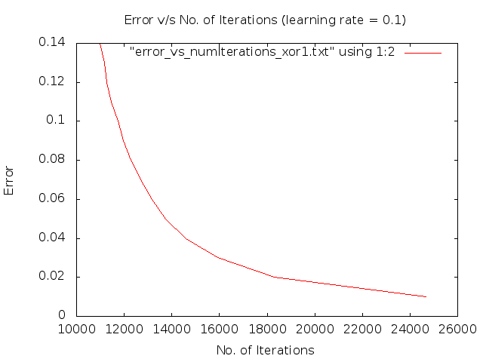
Effect of Learning Rate (XOR)

Slide 6

Effect of Learning Rate (XOR)

Slide 7
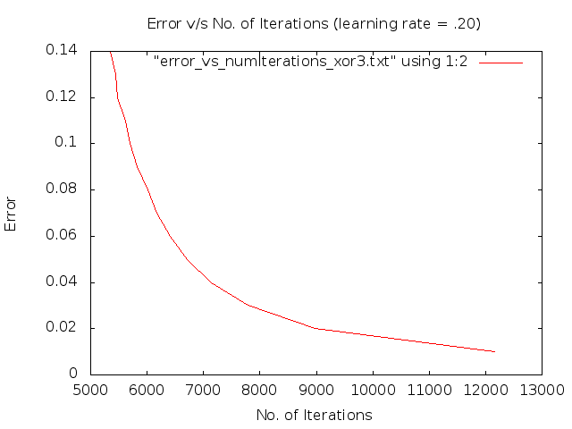
Effect of Learning Rate (XOR)

Slide 8
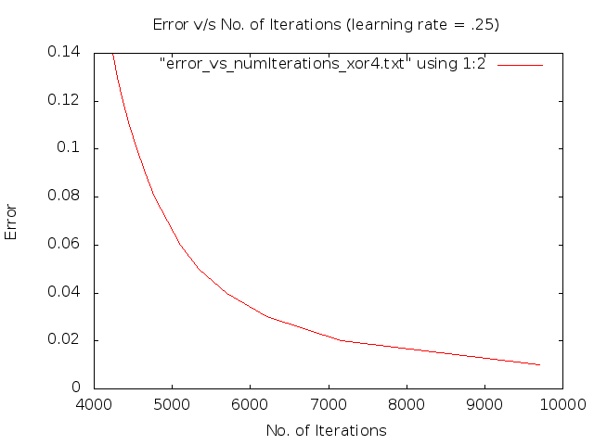
Effect of Learning Rate (XOR)

Slide 9
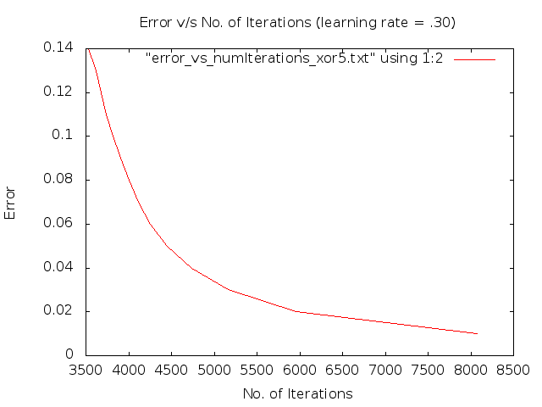
Effect of Learning Rate (XOR)

Slide 10
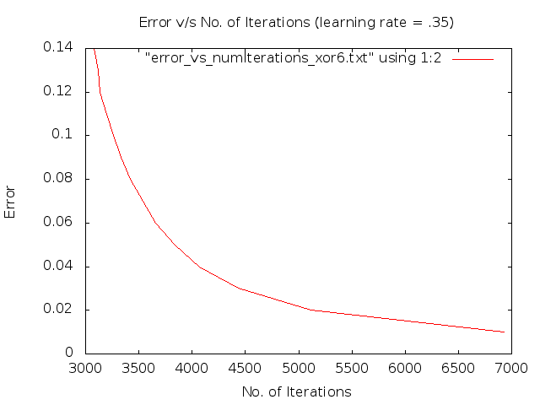
Effect of Learning Rate (XOR)

Slide 11
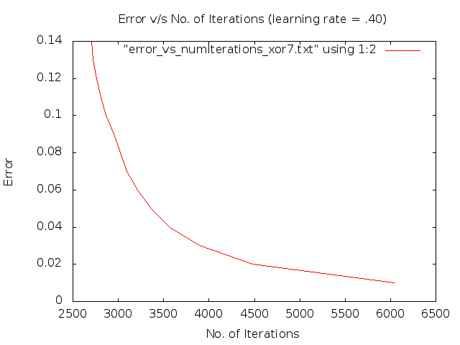
Effect of Learning Rate (XOR)

Slide 12
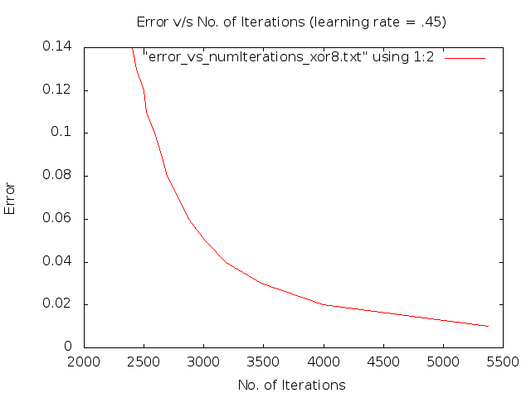
Effect of Learning Rate (XOR)

Slide 13
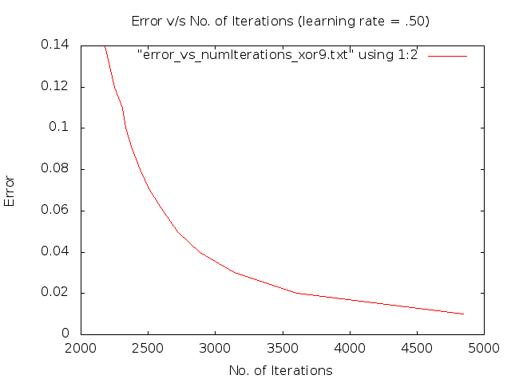
Effect of Learning Rate (XOR)

Slide 14
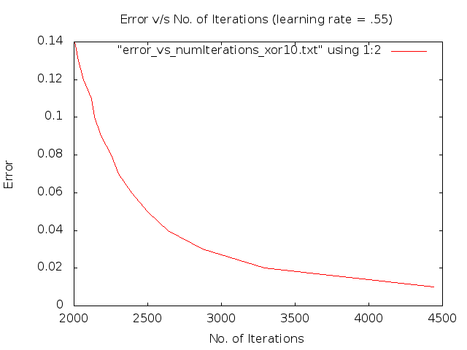
Effect of Learning Rate (XOR)

Slide 15
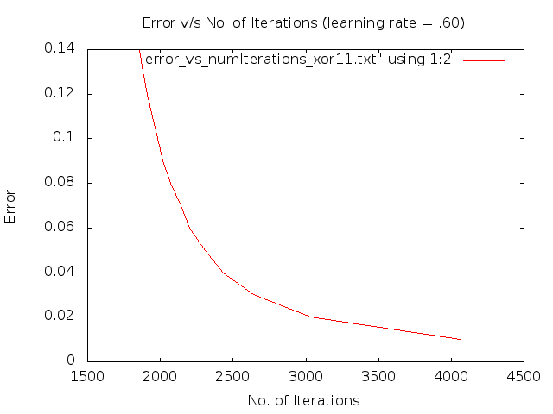
Effect of Learning Rate (XOR)

Slide 16
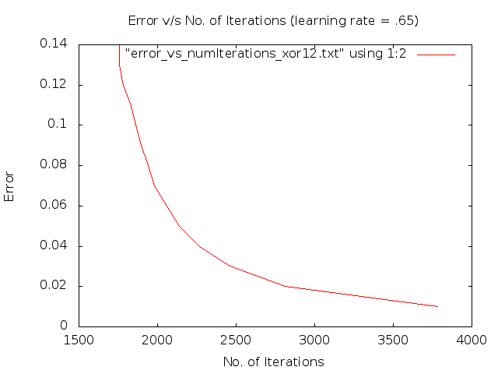
Effect of Learning Rate (XOR)

Slide 17

Effect of Learning Rate (XOR)

Slide 18
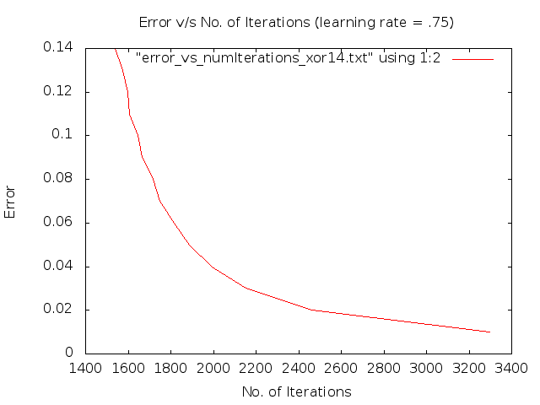
Effect of Learning Rate (XOR)

Slide 19
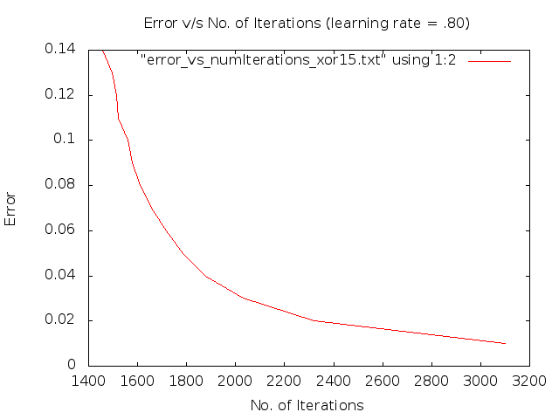
Effect of Learning Rate (XOR)

Slide 20
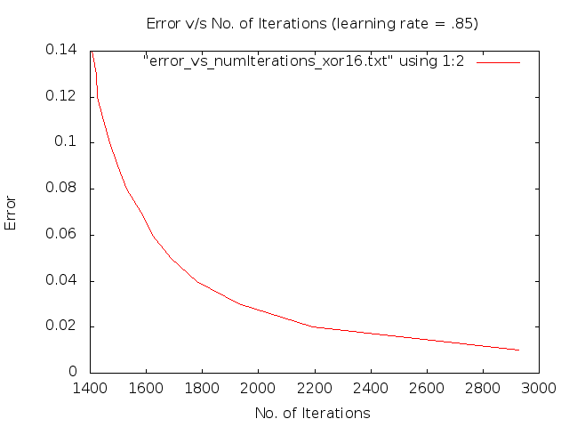
Effect of Learning Rate (XOR)

Slide 21
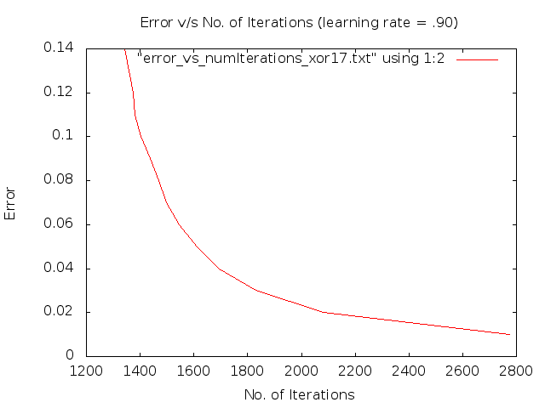
Effect of Learning Rate (XOR)

Slide 22
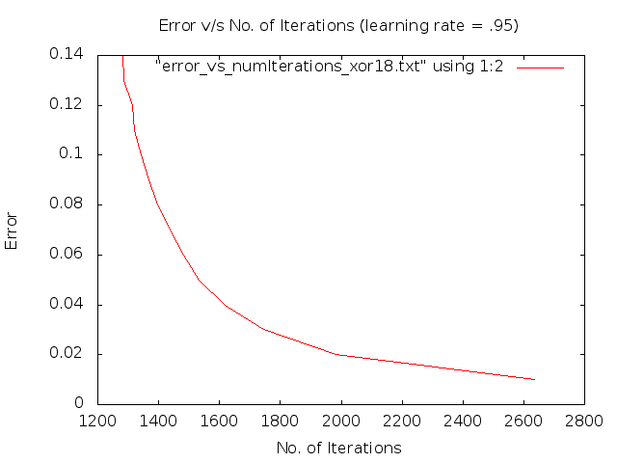
Effect of Learning Rate (XOR)

Slide 23
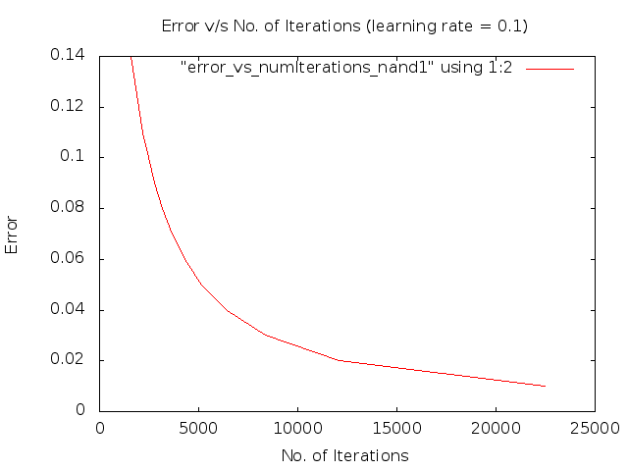
Effect of Learning Rate (NAND)

Slide 24
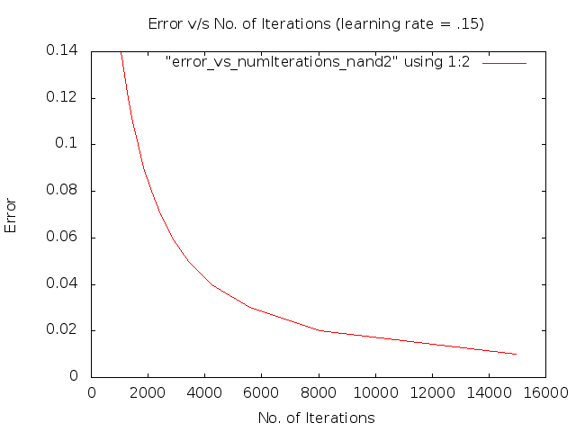
Effect of Learning Rate (NAND)

Slide 25
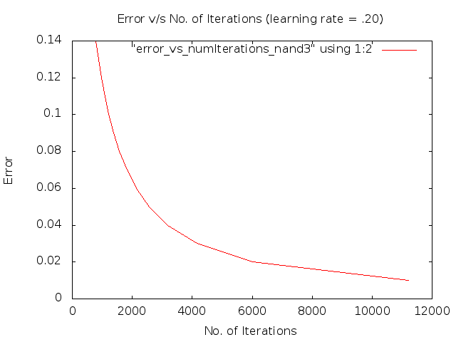
Effect of Learning Rate (NAND)

Slide 26
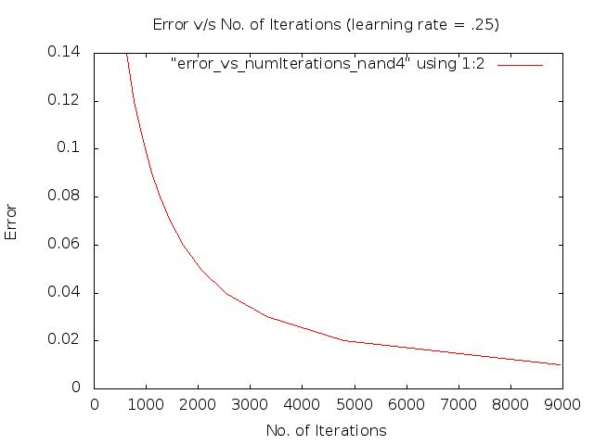
Effect of Learning Rate (NAND)

Slide 27
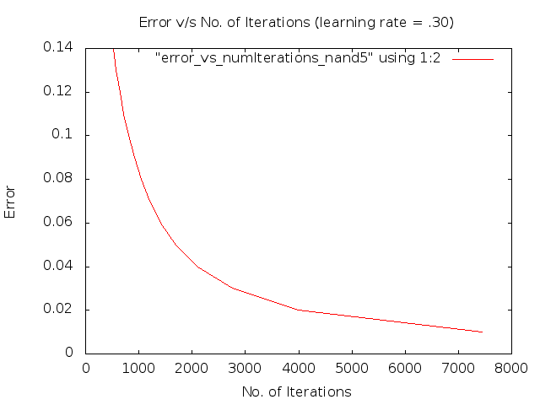
Effect of Learning Rate (NAND)

Slide 28

Effect of Learning Rate (NAND)

Slide 29

Effect of Learning Rate (NAND)

Slide 30
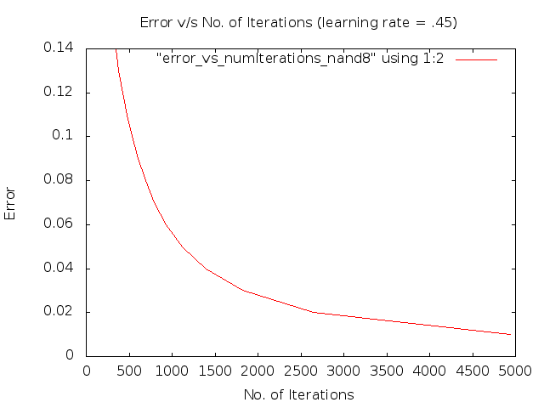
Effect of Learning Rate (NAND)

Slide 31
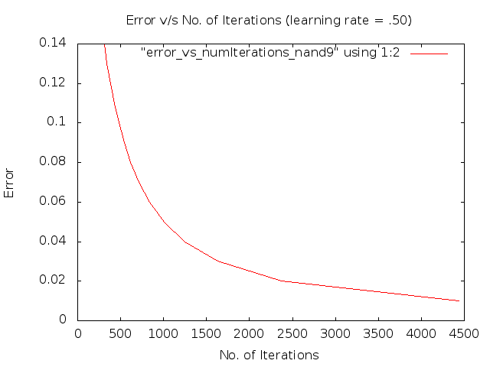
Effect of Learning Rate (NAND)

Slide 32

Effect of Learning Rate (NAND)

Slide 33
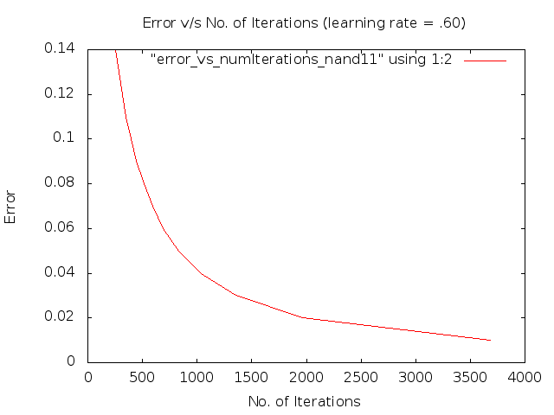
Effect of Learning Rate (NAND)

Slide 34

Effect of Learning Rate (NAND)

Slide 35

Effect of Learning Rate (NAND)

Slide 36
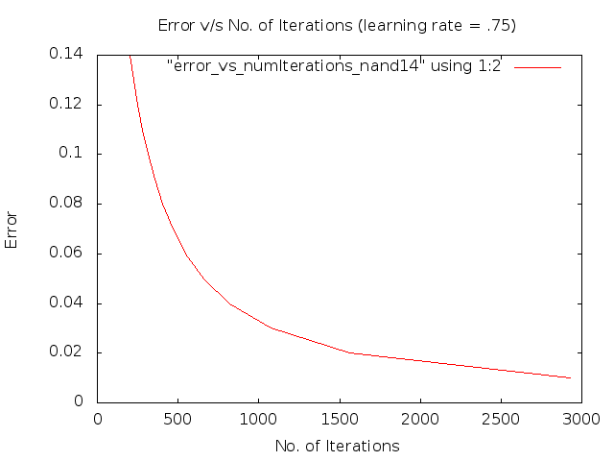
Effect of Learning Rate (NAND)

Slide 37
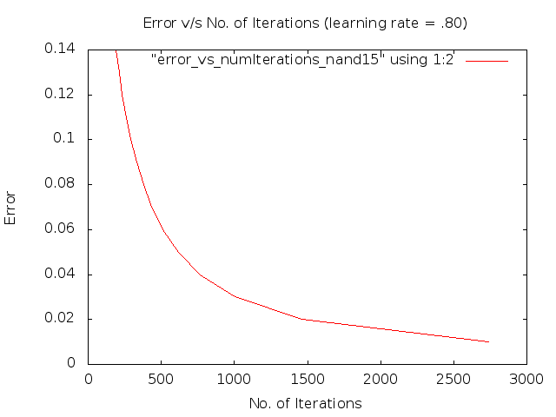
Effect of Learning Rate (NAND)

Slide 38
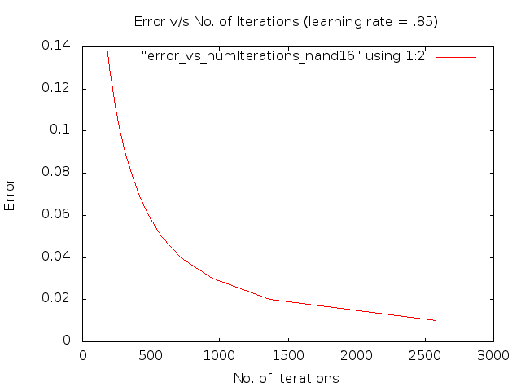
Effect of Learning Rate (NAND)

Slide 39

Effect of Learning Rate (NAND)

Slide 40

Effect of Learning Rate (NAND)

Slide 41
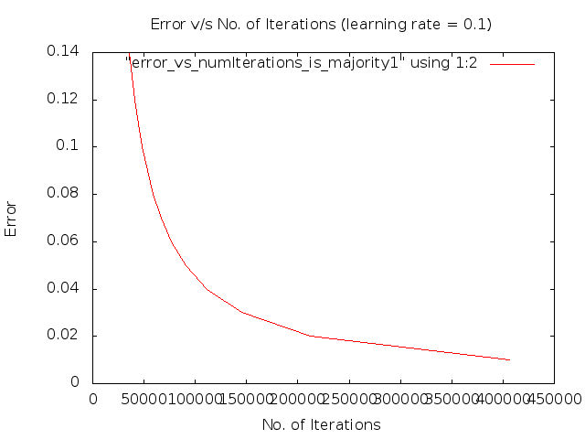
Effect of Learning Rate (Majority)

Slide 42

Effect of Learning Rate (Majority)

Slide 43

Effect of Learning Rate (Majority)

Slide 44

Effect of Learning Rate (Majority)

Slide 45
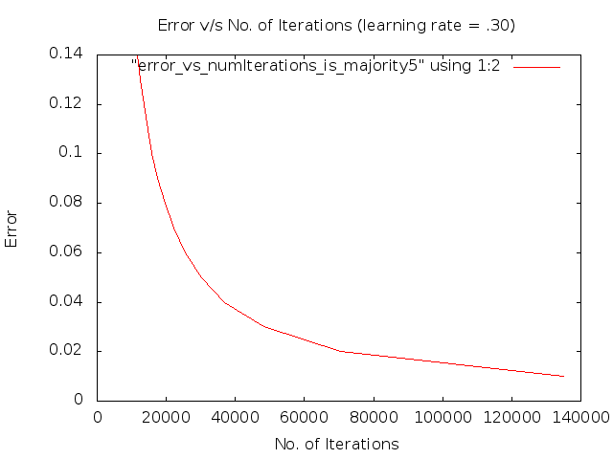
Effect of Learning Rate (Majority)

Slide 46
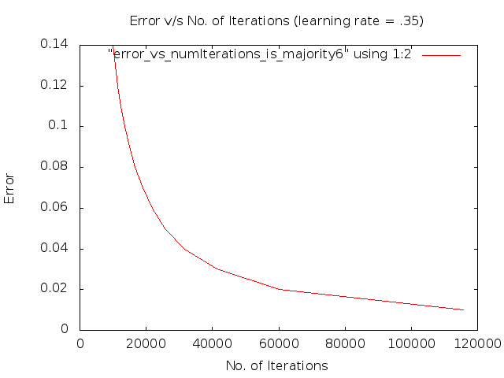
Effect of Learning Rate (Majority)

Slide 47
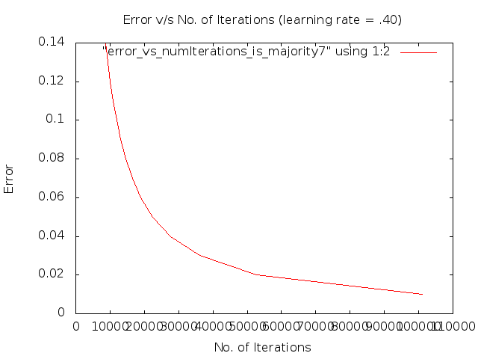
Effect of Learning Rate (Majority)

Slide 48
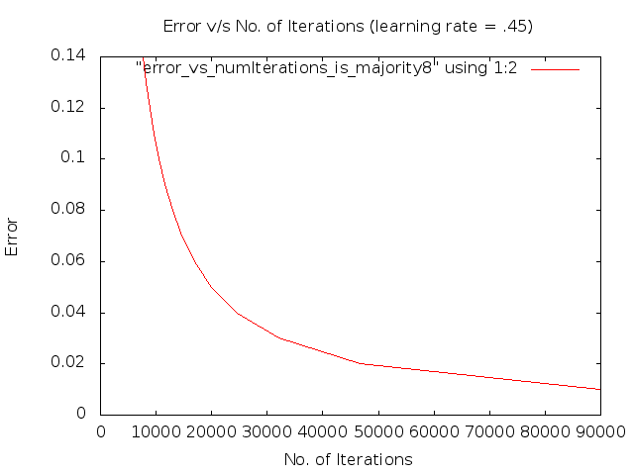
Effect of Learning Rate (Majority)

Slide 49

Effect of Learning Rate (Majority)

Slide 50
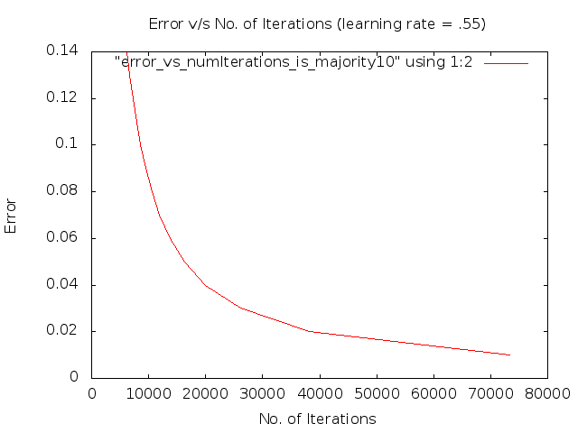
Effect of Learning Rate (Majority)

Slide 51
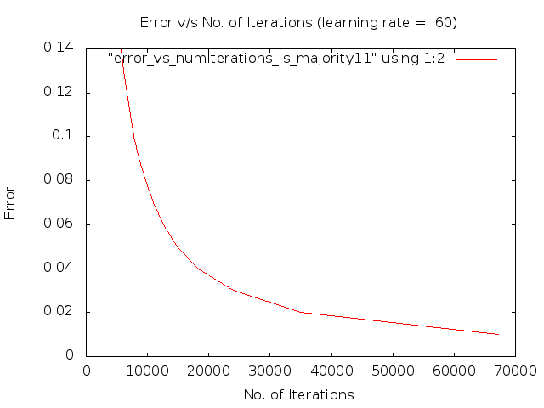
Effect of Learning Rate (Majority)

Slide 52
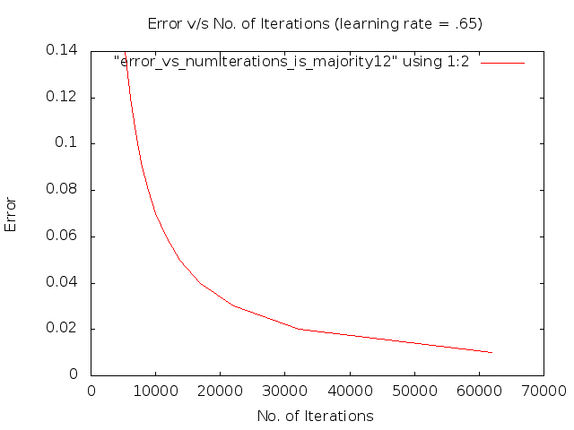
Effect of Learning Rate (Majority)

Slide 53
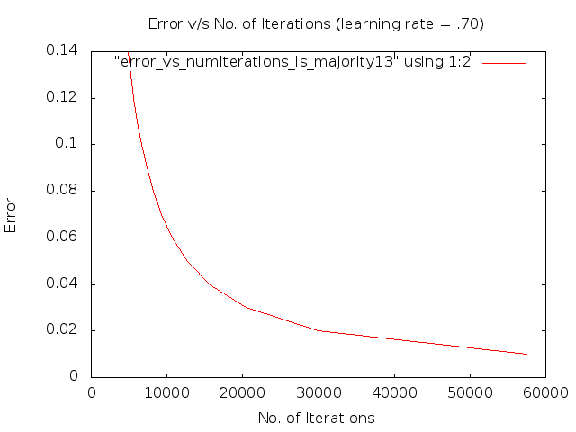
Effect of Learning Rate (Majority)

Slide 54

Effect of Learning Rate (Majority)

Slide 55

Effect of Learning Rate (Majority)

Slide 56

Effect of Learning Rate (Majority)

Slide 57

Effect of Learning Rate (Majority)

Slide 58

Effect of Learning Rate (Majority)

Slide 59
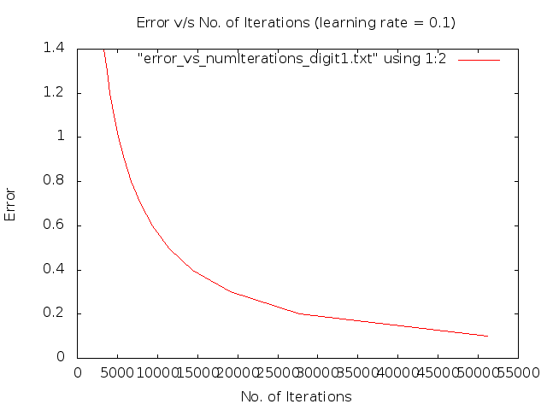
Effect of Learning Rate (Digit Recogniser)

Slide 60
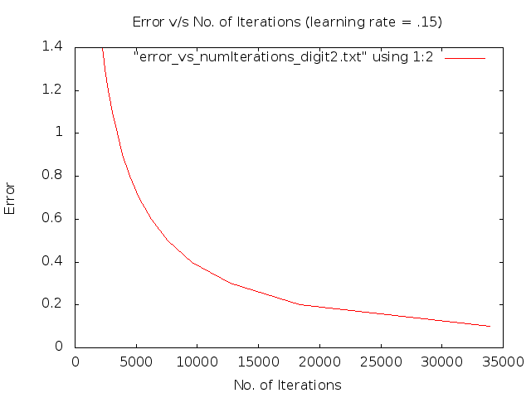
Effect of Learning Rate (Digit Recogniser)

Slide 61
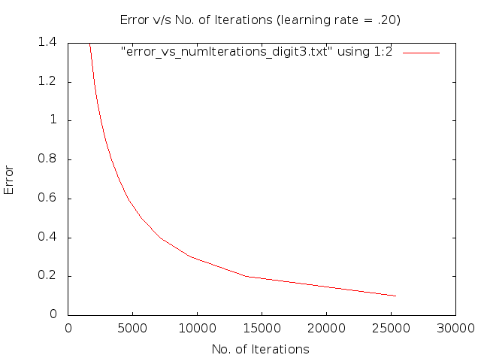
Effect of Learning Rate (Digit Recogniser)

Slide 62
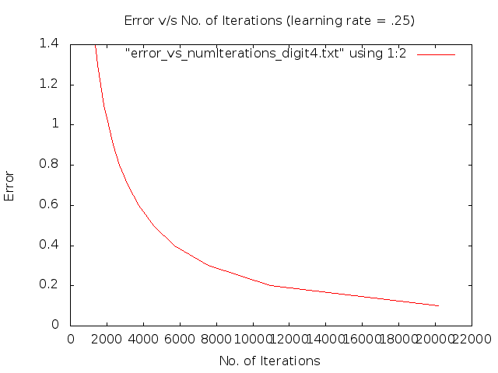
Effect of Learning Rate (Digit Recogniser)

Slide 63
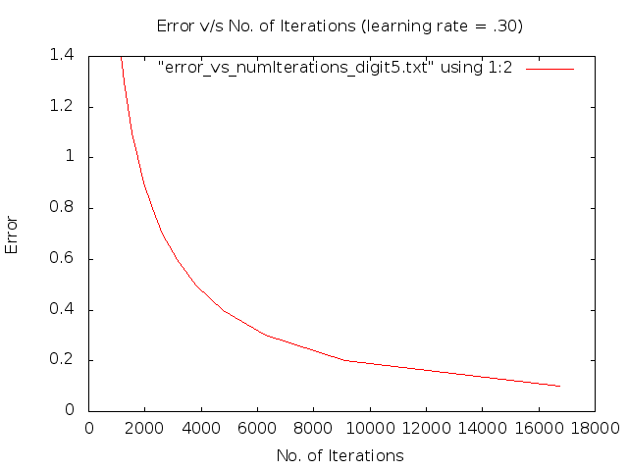
Effect of Learning Rate (Digit Recogniser)

Slide 64
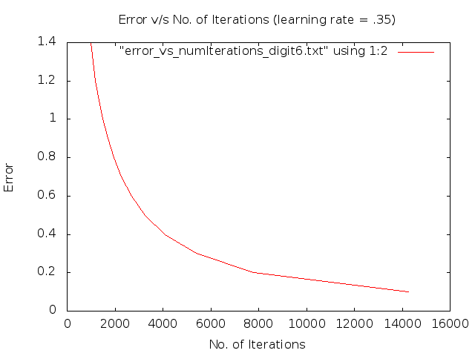
Effect of Learning Rate (Digit Recogniser)

Slide 65

Effect of Learning Rate (Digit Recogniser)

Slide 66
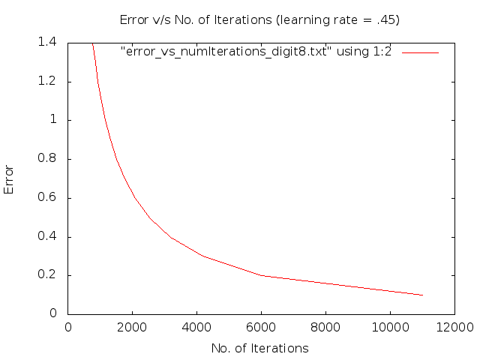
Effect of Learning Rate (Digit Recogniser)

Slide 67
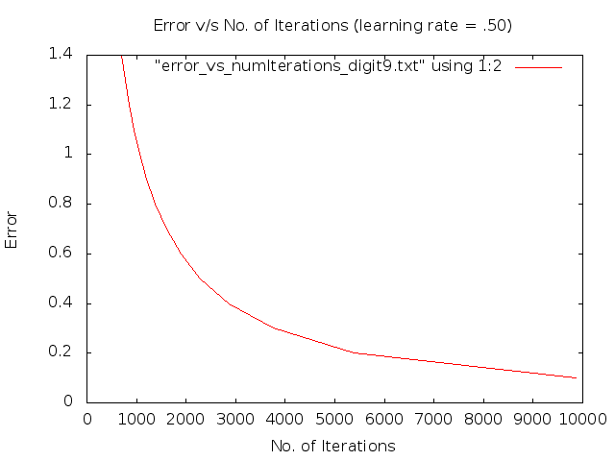
Effect of Learning Rate (Digit Recogniser)

Slide 68
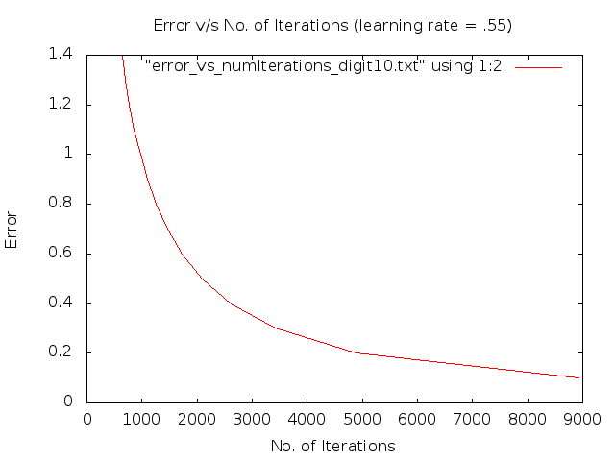
Effect of Learning Rate (Digit Recogniser)

Slide 69

Effect of Learning Rate (Digit Recogniser)

Slide 70

Effect of Learning Rate (Digit Recogniser)

Slide 71
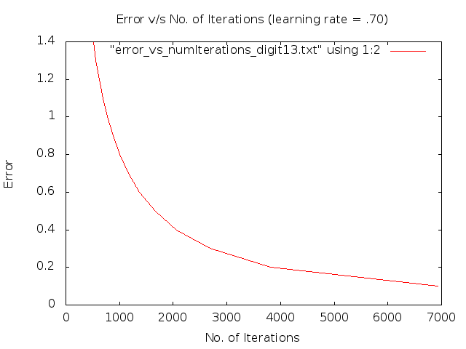
Effect of Learning Rate (Digit Recogniser)

Slide 72

Effect of Learning Rate (Digit Recogniser)

Slide 73
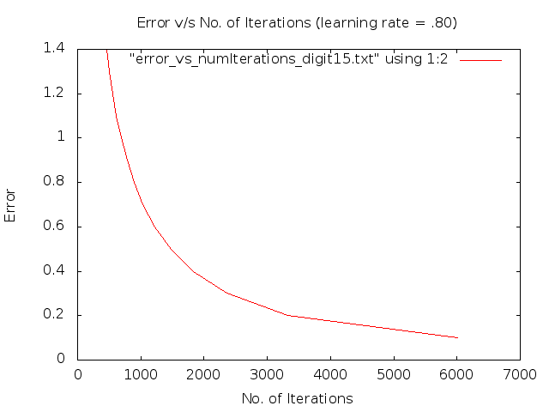
Effect of Learning Rate (Digit Recogniser)

Slide 74
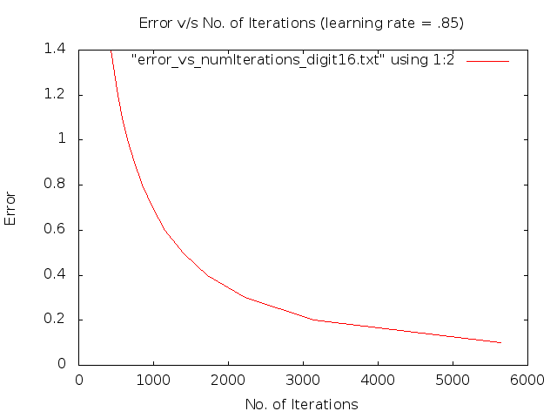
Effect of Learning Rate (Digit Recogniser)

Slide 75
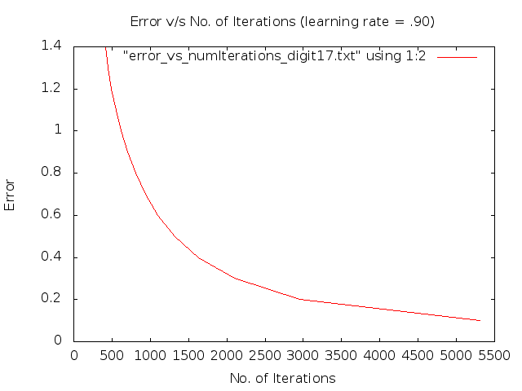
Effect of Learning Rate (Digit Recogniser)

Slide 76

Effect of Learning Rate (Digit Recogniser)

Slide 77
Effect of Learning Rate (Parity)

Slide 78
Effect of Learning Rate (Parity)

Slide 79
Effect of Learning Rate (Parity)

Slide 80
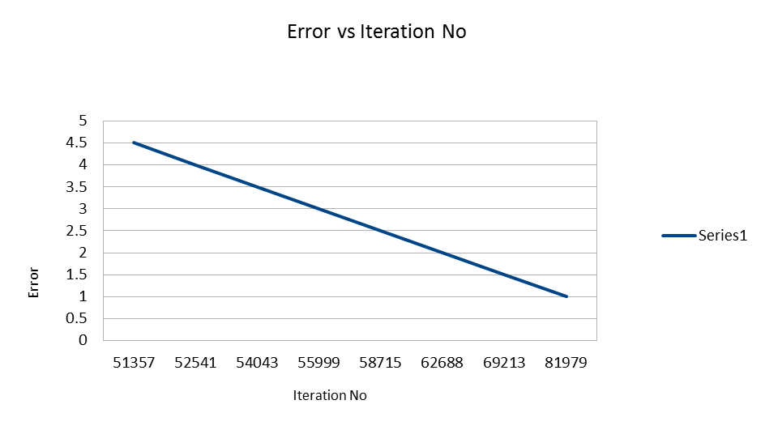
Effect of Learning Rate (Parity)
Eta=0.7, Momentum Factor=0.05

Slide 81
Effect of Learning Rate (Parity)
Eta=0.9, Momentum Factor=0.05

Slide 82
Effect of Learning Rate (Palindrome)
Eta=0.1 Momentum Factor=0.05

Slide 83
Effect of Learning Rate (Palindrome)
Eta=0.3 Momentum Factor=0.05

Slide 84
Effect of Learning Rate (Palindrome)
Eta=0.5 Momentum Factor=0.05

Slide 85
Effect of Learning Rate (Palindrome)
Eta=0.7 Momentum Factor=0.05

Slide 86
Effect of Learning Rate (Palindrome)
Eta=0.9 Momentum Factor=0.05

Slide 87
Effect of Learning Rate
We varied the learning rate from 0.10 to 0.95 in intervals of 0.05 and observed the effect of learning rate.
In general, as the learning rate increases, no of iterations required to converge to a solution decreases.
The speed of convergence of a network can be improved by increasing the learning rate.
Unfortunately, increasing learning rate usually results in increasing network instability, with weight values oscillating erratically as they converge on a solution.
Higher values of learning rate may provide faster convergence on a solution, but may also increase instability and may lead to a failure to converge.

Slide 88

Effect of Momentum Factor (XOR)

Slide 89

Effect of Momentum Factor (XOR)

Slide 90

Effect of Momentum Factor (XOR)

Slide 91

Effect of Momentum Factor (XOR)

Slide 92

Effect of Momentum Factor (XOR)

Slide 93

Effect of Momentum Factor (XOR)

Slide 94

Effect of Momentum Factor (XOR)

Slide 95

Effect of Momentum Factor (XOR)

Slide 96

Effect of Momentum Factor (XOR)

Slide 97

Effect of Momentum Factor (XOR)

Slide 98

Effect of Momentum Factor (XOR)

Slide 99

Effect of Momentum Factor (XOR)

Slide 100

Effect of Momentum Factor (XOR)

Slide 101

Effect of Momentum Factor (XOR)

Slide 102

Effect of Momentum Factor (XOR)

Slide 103

Effect of Momentum Factor (XOR)

Slide 104

Effect of Momentum Factor (XOR)

Slide 105

Effect of Momentum Factor (XOR)

Slide 106

Effect of Momentum Factor (XOR)

Slide 107

Effect of Momentum Factor (XOR)

Slide 108

Effect of Momentum Factor (NAND)

Slide 109

Effect of Momentum Factor (NAND)

Slide 110

Effect of Momentum Factor (NAND)

Slide 111

Effect of Momentum Factor (NAND)

Slide 112

Effect of Momentum Factor (NAND)

Slide 113

Effect of Momentum Factor (NAND)

Slide 114

Effect of Momentum Factor (NAND)

Slide 115

Effect of Momentum Factor (NAND)

Slide 116

Effect of Momentum Factor (NAND)

Slide 117

Effect of Momentum Factor (NAND)

Slide 118

Effect of Momentum Factor (NAND)

Slide 119

Effect of Momentum Factor (NAND)

Slide 120

Effect of Momentum Factor (NAND)

Slide 121

Effect of Momentum Factor (NAND)

Slide 122

Effect of Momentum Factor (NAND)

Slide 123

Effect of Momentum Factor (NAND)

Slide 124

Effect of Momentum Factor (NAND)

Slide 125

Effect of Momentum Factor (NAND)

Slide 126

Effect of Momentum Factor (NAND)

Slide 127

Effect of Momentum Factor (NAND)

Slide 128

Effect of Momentum Factor (Majority)

Slide 129

Effect of Momentum Factor (Majority)

Slide 130

Effect of Momentum Factor (Majority)

Slide 131

Effect of Momentum Factor (Majority)

Slide 132

Effect of Momentum Factor (Majority)

Slide 133

Effect of Momentum Factor (Majority)

Slide 134

Effect of Momentum Factor (Majority)

Slide 135

Effect of Momentum Factor (Majority)

Slide 136

Effect of Momentum Factor (Majority)

Slide 137

Effect of Momentum Factor (Majority)

Slide 138

Effect of Momentum Factor (Majority)

Slide 139

Effect of Momentum Factor (Majority)

Slide 140

Effect of Momentum Factor (Majority)

Slide 141

Effect of Momentum Factor (Majority)

Slide 142

Effect of Momentum Factor (Majority)

Slide 143

Effect of Momentum Factor (Majority)

Slide 144

Effect of Momentum Factor (Majority)

Slide 145

Effect of Momentum Factor (Majority)

Slide 146

Effect of Momentum Factor (Majority)

Slide 147

Effect of Momentum Factor (Majority)

Slide 148

Effect of Momentum Factor (Digit Recogniser)

Slide 149

Effect of Momentum Factor (Digit Recogniser)

Slide 150

Effect of Momentum Factor (Digit Recogniser)

Slide 151

Effect of Momentum Factor (Digit Recogniser)

Slide 152

Effect of Momentum Factor (Digit Recogniser)

Slide 153

Effect of Momentum Factor (Digit Recogniser)

Slide 154

Effect of Momentum Factor (Digit Recogniser)

Slide 155

Effect of Momentum Factor (Digit Recogniser)

Slide 156

Effect of Momentum Factor (Digit Recogniser)

Slide 157

Effect of Momentum Factor (Digit Recogniser)

Slide 158

Effect of Momentum Factor (Digit Recogniser)

Slide 159

Effect of Momentum Factor (Digit Recogniser)

Slide 160

Effect of Momentum Factor (Digit Recogniser)

Slide 161

Effect of Momentum Factor (Digit Recogniser)

Slide 162

Effect of Momentum Factor (Digit Recogniser)

Slide 163

Effect of Momentum Factor (Digit Recogniser)

Slide 164

Effect of Momentum Factor (Digit Recogniser)

Slide 165

Effect of Momentum Factor (Digit Recogniser)

Slide 166

Effect of Momentum Factor (Digit Recogniser)

Slide 167

Effect of Momentum Factor (Digit Recogniser)

Slide 168
Effect of Momentum Factor (Parity)
Eta=0.3 Momentum Factor=0.05

Slide 169
Effect of Momentum Factor (Parity)
Eta=0.3 Momentum Factor=0.1

Slide 170
Effect of Momentum Factor (Parity)
Eta=0.3 Momentum Factor=1

Slide 171
Effect of Momentum Factor(Palindrome)

Slide 172
Effect of Momentum Factor(Palindrome)

Slide 173
Effect of Momentum Factor(Palindrome)

Slide 174
Effect of Momentum Factor
We observed the effect of increasing the momentum too from close to 0 (0. 001) to close to 1(1.05) in steps of 0.05
In general, as the momentum factor increased the no of iterations required to converge to a solution also decreased.
We also observed that as the momentum factor increases, iteration-to-iteration variation in error was greatly increased.

Slide 175
Functionality of Hidden Layer Neurons 2-Input XOR
Input1 | Input2 | HiddenLayerOp1 | HiddenLayerOp2 | Output
0 | 0 | 0 | 0 | 0
0 | 1 | 1 | 0 | 1
1 | 0 | 1 | 0 | 1
1 | 1 | 1 | 1 | 0
HiddenLayerOp1 = Input1 OR Input2
HiddenLayerOp2 = Input1 AND Input2
Output = HiddenLayerOp1 AND ( NOT (HiddenLayerOp2))

Slide 176
Functionality of Hidden Layer Neurons 2-Input XOR
(X1 + X2) . (X1.X2)
= X1.X2 + X2.X1
X1 + X2
X1.X2
X1
X2

Slide 177
Functionality of Hidden Layer Neurons 3-Input Palindrome
Input1 | Input2 | Input3 | HiddenLayerOp1 | HiddenLayerOp2 | Output
0 | 0 | 0 | 1 | 1 | 1
0 | 0 | 1 | 1 | 0 | 0
0 | 1 | 0 | 1 | 1 | 1
0 | 1 | 1 | 1 | 0 | 0
1 | 0 | 0 | 1 | 0 | 0
1 | 0 | 1 | 0 | 0 | 1
1 | 1 | 0 | 1 | 0 | 0
1 | 1 | 1 | 0 | 0 | 1
HiddenLayerOp1: NOT(Input1) OR NOT(Input3)
HiddenLayerOp2 : NOT(Input1) AND NOT(Input3)
Output = NOT(HiddenLayerOp1) OR HiddenLayerOp1

Slide 178
Functionality of Hidden Layer Neurons 3-Input Palindrome
(X1 + X3) + (X1.X3)
X1 + X3
X1.X3
X1
X2
X3
For Palindrome, the X2 should not matter. Interestingly, X2 is not even taken into consideration in hidden layer.

Slide 179
Functionality of Hidden Layer Neurons 5-Input Palindrome
Input 1 | Input2 | Input3 | Input 4 | Input5 | HiddenLayerOp1 | HiddenLayerOp2 | Output
0 | 0 | 0 | 0 | 0 | 0 | 0 | 1
0 | 0 | 0 | 0 | 1 | 1 | 0 | 0
0 | 0 | 0 | 1 | 0 | 1 | 0 | 0
0 | 0 | 0 | 1 | 1 | 1 | 0 | 0
0 | 0 | 1 | 0 | 0 | 0 | 0 | 1
0 | 0 | 1 | 0 | 1 | 1 | 0 | 0
0 | 0 | 1 | 1 | 0 | 1 | 0 | 0
0 | 0 | 1 | 1 | 1 | 1 | 0 | 0
Error Threshold = 5%
Initial Weights = Random between -1 & 1
Learning Rate = 0.34

Slide 180
Functionality of Hidden Layer Neurons 5-Input Palindrome
Input 1 | Input2 | Input3 | Input 4 | Input5 | HiddenLayerOp1 | HiddenLayerOp2 | Output
0 | 1 | 0 | 0 | 0 | 0 | 1 | 1
0 | 1 | 0 | 0 | 1 | 0 | 1 | 0
0 | 1 | 0 | 1 | 0 | 0 | 0 | 0
0 | 1 | 0 | 1 | 1 | 1 | 0 | 0
0 | 1 | 1 | 0 | 0 | 0 | 1 | 1
0 | 1 | 1 | 0 | 1 | 0 | 1 | 0
0 | 1 | 1 | 1 | 0 | 0 | 0 | 0
0 | 1 | 1 | 1 | 1 | 1 | 0 | 0
Error Threshold = 5%
Initial Weights = Random between -1 & 1
Learning Rate = 0.34

Slide 181
Functionality of Hidden Layer Neurons 5-Input Palindrome
Input 1 | Input2 | Input3 | Input 4 | Input5 | HiddenLayerOp1 | HiddenLayerOp2 | Output
1 | 0 | 0 | 0 | 0 | 0 | 1 | 0
1 | 0 | 0 | 0 | 1 | 0 | 0 | 1
1 | 0 | 0 | 1 | 0 | 1 | 0 | 0
1 | 0 | 0 | 1 | 1 | 1 | 0 | 0
1 | 0 | 1 | 0 | 0 | 0 | 1 | 0
1 | 0 | 1 | 0 | 1 | 0 | 0 | 1
1 | 0 | 1 | 1 | 0 | 1 | 1 | 0
1 | 0 | 1 | 1 | 1 | 1 | 0 | 0
Error Threshold = 5%
Initial Weights = Random between -1 & 1
Learning Rate = 0.34

Slide 182
Functionality of Hidden Layer Neurons 5-Input Palindrome
Input 1 | Input2 | Input3 | Input 4 | Input5 | HiddenLayerOp1 | HiddenLayerOp2 | Output
1 | 1 | 0 | 0 | 0 | 0 | 1 | 0
1 | 1 | 0 | 0 | 1 | 0 | 1 | 0
1 | 1 | 0 | 1 | 0 | 0 | 1 | 0
1 | 1 | 0 | 1 | 1 | 0 | 0 | 1
1 | 1 | 1 | 0 | 0 | 0 | 1 | 0
1 | 1 | 1 | 0 | 1 | 0 | 1 | 0
1 | 1 | 1 | 1 | 0 | 0 | 1 | 0
1 | 1 | 1 | 1 | 1 | 0 | 0 | 1
After Solving through Karnaugh Map, we get
Output = (H1 NOR H2)

Slide 183
Functionality of Hidden Layer Neurons 5-Input Palindrome
X0
X1
X2
X3
X4
For Palindrome, the X2 should not matter. Interestingly, X2 is not even taken into consideration in hidden layer.

