Slide 1
Testing & Training of FFNN on IRIS Data Set
Results & Observations
Sahil Jindal Abhishek Gupta Rohan Gyani Mridul Ravi Jain
110020043 110040067 110040001 110040083

Slide 2
Assignment Specifications
Download any classification benchmark data from ML repositories (University of California at Irwine).
Train and test FFNN on such data. Of particular note is a classic problem called IRIS data.

Slide 3
Data Set Specifications
Number of Instances: 150
Classes:
Iris Setosa
Iris Versicolour
Iris Virginica
Number of Attributes: 4 numeric, predictive attributes
Class Distribution: 33.3% for each of 3 classes

Slide 4
Neural Network Structure
Corresponding to 3 classes
Output
Layer
Hidden Layer
Input Layer
Corresponding to 4 attributes

Slide 5
Testing & Training Methodology
We performed N-fold cross validation with N=5.
We divided our classification data into 5 partitions & used 4 partitions for training the neural network and the remaining one for measuring accuracy.
We also observed the effect of changing the order of data set elements i.e. we shuffled the elements of training data set so that instances of data belonging to a single class do not occur together.

Slide 6
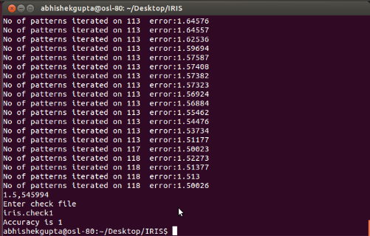
Result-Using 5 Fold Validation Data Partition-1
Initialization - random between -0.5 to 0.5
Accuracy – 1 (30/30)
Snapshot of
Result
Momentum Factor : 0.1
Learning Rate : 0.1
Threshold Error: 50%

Slide 7
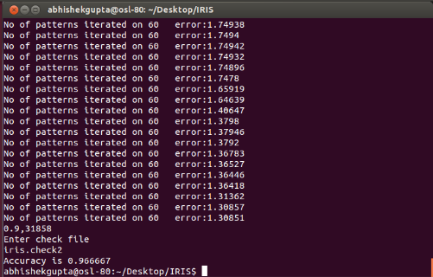
Result-Using 5 Fold Validation Data Partition-2
Initialization - random between -0.5 to 0.5
Accuracy – 0.96667 (29/30)
Snapshot of
Result
Momentum Factor : 0.1
Learning Rate : 0.1
Threshold Error: 50%

Slide 8
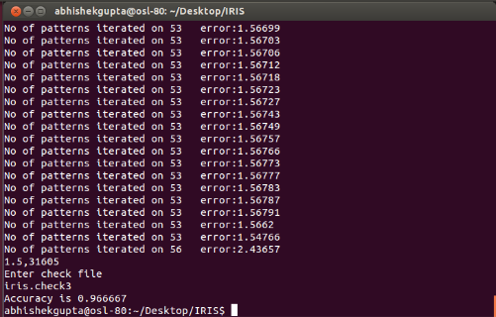
Result-Using 5 Fold Validation Data Partition-3
Initialization - random between -0.5 to 0.5
Accuracy – 0.96667 (29/30)
Snapshot of
Result
Momentum Factor : 0.1
Learning Rate : 0.1
Threshold Error: 50%

Slide 9
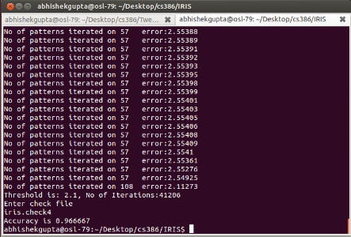
Result-Using 5 Fold Validation Data Partition-4
Initialization - random between -0.5 to 0.5
Accuracy – 0.96667 (29/30)
Snapshot of
Result
Momentum Factor : 0.1
Learning Rate : 0.1
Threshold Error: 50%

Slide 10
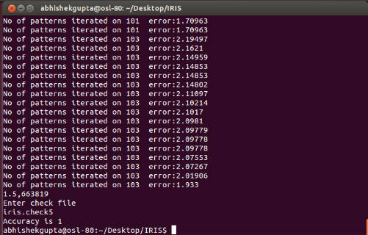
Result-Using 5 Fold Validation Data Partition-5
Initialization - random between -0.5 to 0.5
Accuracy – 1 (30/30)
Snapshot of
Result
Momentum Factor : 0.1
Learning Rate : 0.1
Threshold Error: 50%

Slide 11
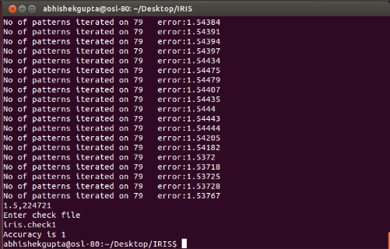
Shuffled Data Set Partition-1
Initialization - random between -0.25 to 0.25
Accuracy – 1 (30/30)
Snapshot of
Result
Momentum Factor : 0.1
Learning Rate : 0.1
Threshold Error: 50%

Slide 12
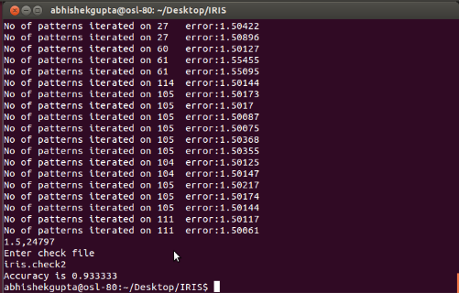
Shuffled Data Set Partition-2
Initialization - random between -0.25 to 0.25
Accuracy – 0.93333 (28/30)
Snapshot of
Result
Momentum Factor : 0.1
Learning Rate : 0.1
Threshold Error: 50%

Slide 13
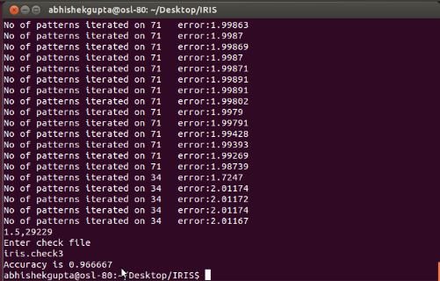
Shuffled Data Set Partition-3
Initialization - random between -0.25 to 0.25
Accuracy – 0.966667 (29/30)
Snapshot of
Result
Momentum Factor : 0.1
Learning Rate : 0.1
Threshold Error: 50%

Slide 14
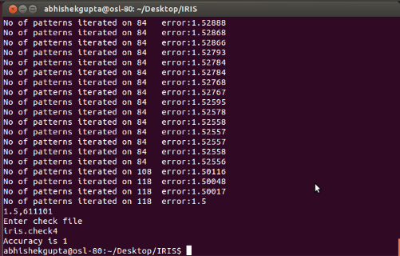
Shuffled Data Set Partition-4
Initialization - random between -0.25 to 0.25
Accuracy – 1 (30/30)
Snapshot of
Result
Momentum Factor : 0.1
Learning Rate : 0.1
Threshold Error: 50%

Slide 15
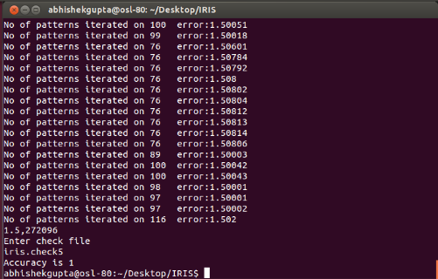
Shuffled Data Set Partition-5
Initialization - random between -0.25 to 0.25
Accuracy – 1 (30/30)
Snapshot of
Result
Momentum Factor : 0.1
Learning Rate : 0.1
Threshold Error: 50%

Slide 16
Observations
A shuffled data sets usually leads to better learning than cyclic, fixed orders of training patterns. However, it also takes more time to train the Network.
An ordered presentation of the training cases to the network can cause weights/error to move very erratically over the error surface.
Any given series of an individual class’ training patterns potentially causes the network to move in weight-space in a direction that is very different from the overall desired direction

