Slide 1
Singapore Housing Data Set Challenge
By Mridul Samaddar
IIM Bangalore BAI-2020

Slide 2
Singapore Housing Data Set Challenge
Data used for this analysis was from 1990 to 2014.
The variable present in this data set were
Month : Year-Month format (1990-1 to 2014-12)
Town: 27 unique town over the time period
flat_type: 7 unique flat type
Block: 2059 unique blocks
street_name: 538 unique street names
storey_range: Storey ranges from 01 to 42
floor_area_sqm: Ranges from 28 sqm to 307 sqm
flat_model: 18 unique model of flats
lease_commence_date: Year format
resale_price: Range from 5000 to 1088888

Slide 3
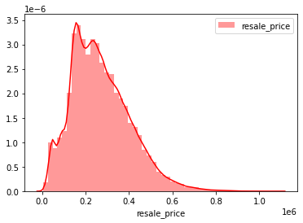
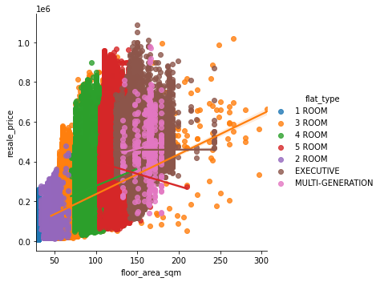
Descriptive analytics with reference to Resale price
Distribution of Resale price
Distribution of floor area sqm vs Resale price
Regress line for different flat types where we
can see the relation with respect to flat type

Slide 4
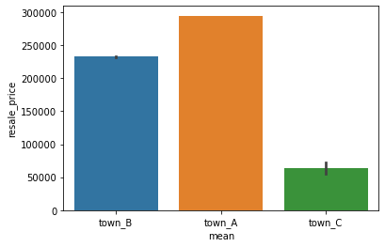

Descriptive analytics with reference to town
We have 27 unique town’s which we have divide it into three categories
town A : town whose average resale price > 250000
town B : town whose average resale price > 200000 - 249999
town C : town whose average resale price <= 200000
One Way ANOVA
H0: There is no difference between the groups and equality between means
H1: there is a difference between the groups and means.

Slide 5
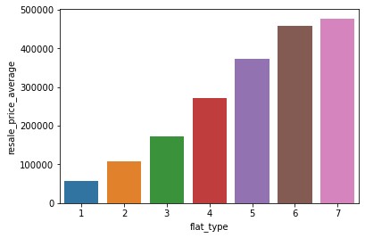

Descriptive analytics with reference to flat type
We have 7 unique flat type which we have converted to ordinal variable
1 Room as 1
2 Room as 2
3 Room as 3
4 Room as 4
5 Room as 5
EXECUTIVE as 6
MULTI-GENERATION as 7
We can see the relationship between
flat type and average resale price.
One Way ANOVA
H0: There is no difference between the groups and equality between means
H1: there is a difference between the groups and means.

Slide 6
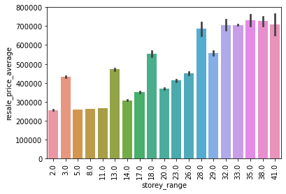
Descriptive analytics with reference to storey range
We have taken the average of each group and assign a continues variable so that we can convert the nominal variable to ordinal variable.
07 TO 09 takes a value of (7+9)/2 = 8
In the bar graph we can see the relation with respect to average resale price.
Average resale price increase with increase storey range

Slide 7
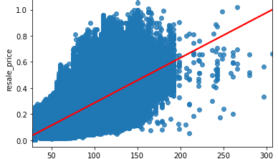
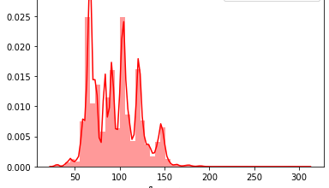
Descriptive analytics with reference to floor area sqm
Distribution of floor area sqm
Distribution of floor area sqm vs resale price
we can clear see a linear relationship between
this two variables

Slide 8
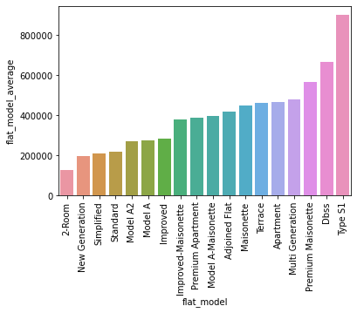

Descriptive analytics with reference to flat model
There 18 unique flat model
we can see a clear relationship
between flat model and
average resale price.
as the flat model get premium
the flat price increases
One Way ANOVA:

Slide 9
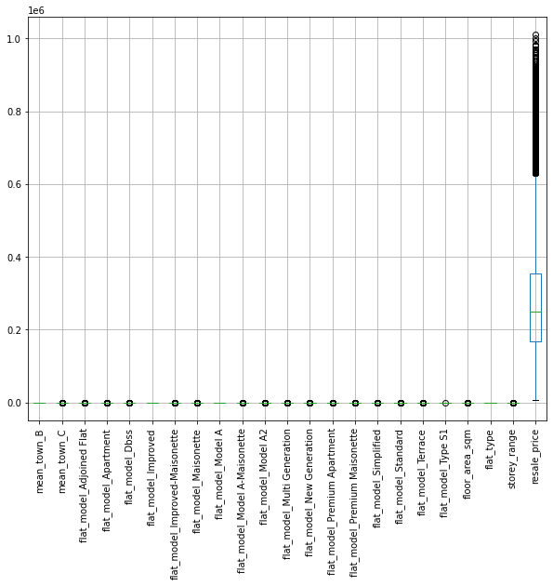
Outlire Treatment
To check outlier we have plotted a box pot
Using Z-score for the continues variables (target variable) and 3rd standard deviation as the cut off we have deleted all rows which has z-score values below -3 and above +3.

Slide 10
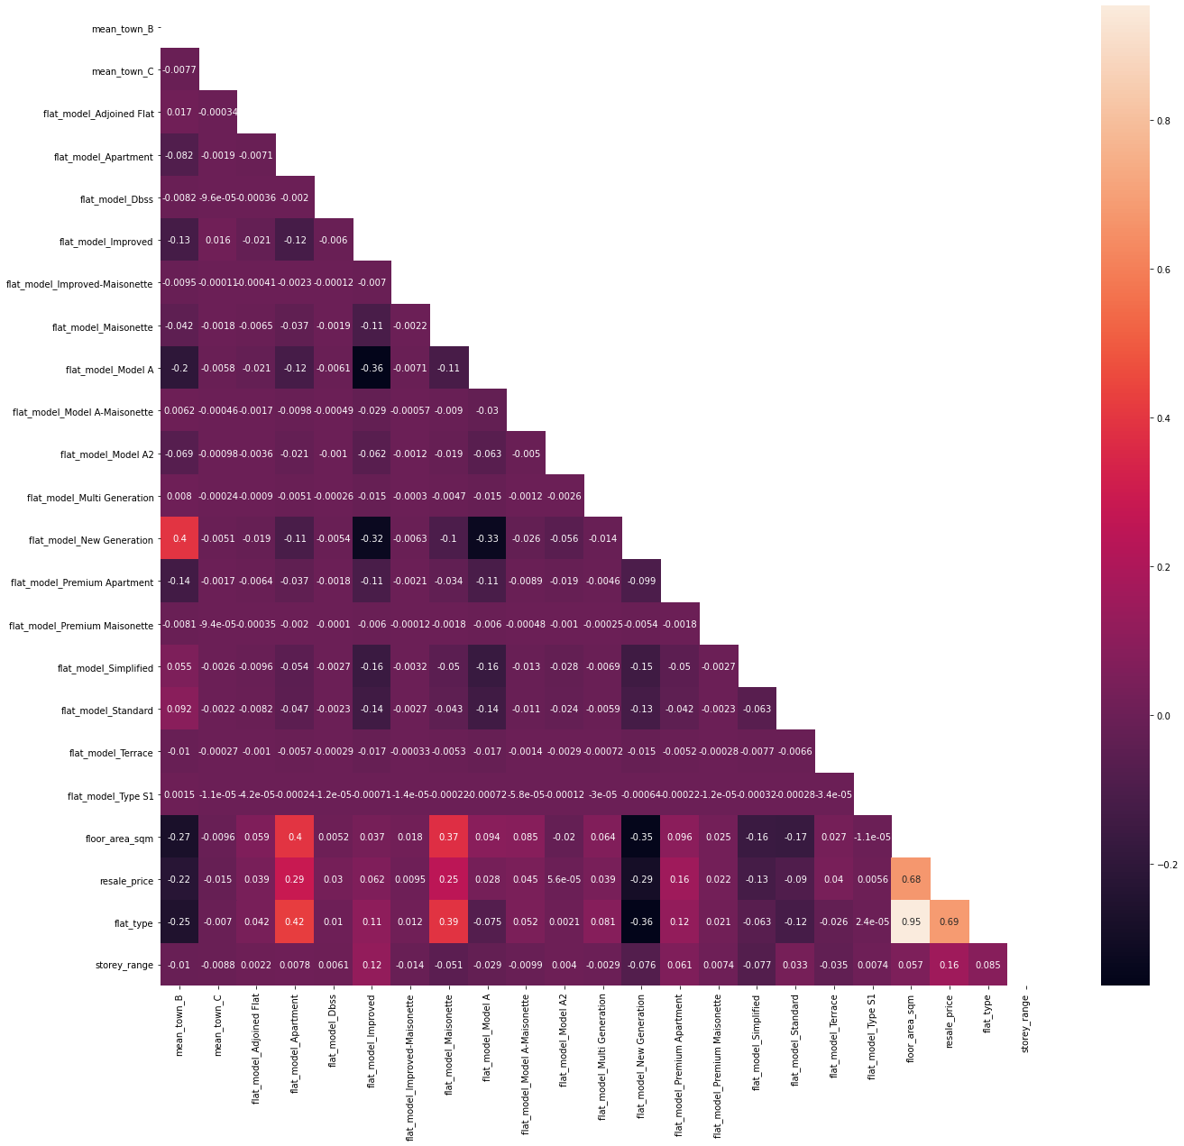
Correlation matrix of all variable vs resale price
This table give correlation between resale price and other variables
Flat type has highest correlation with resale price
Flat model New Generation has lease correlation with resale

Slide 11
Regress all independent variable individually on dependent variable
This table is sorted by standard coefficient
Std coef = coef * (std_dev of X / std_dev of Y)
Looking at this table we can say variable floor_area_sqm has the highest R2 which says it explains 47.8% of the dependent variable

Slide 12
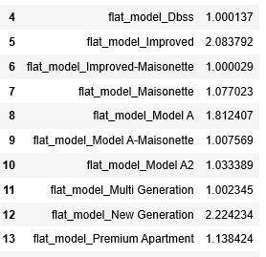
Multicollinearity for all independent variable
We checked multicollinearity using variance inflation factor
Variables which have vif more or equal to 4 we excluded those variables.
Variables which we have excluded are
flat_type
floor_area_sqm

Slide 13
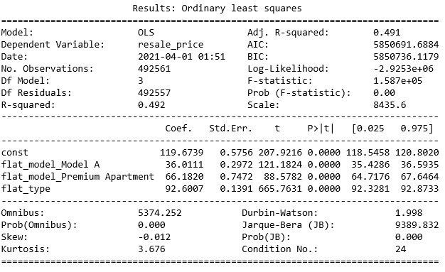

Multiple linear regression with a square root transformation of the dependent variable
We can see that variable flat_type has the larges coefficient.
To check which coefficient has higher impact on resale price we need to find the standardized regression coefficients
Standardized Beta =
Std flat_model_Model A = 36.0111*0.000003 = 0.0001080333
Std flat_model_Premium Apartment = 0.000198546
Std flat_type = 0.0002778021
Hence from the standardized beta we can say flat_type has the
highest impact on resale price

Slide 14
THANK YOU

