Slide 1




What Is a Band-Join?
3D band-join:
SELECT * FROM Birds B, Weather W
WHERE |B.latitude – W.latitude| < 0.5
AND |B.longitude – W.longitude| < 0.3
AND |B.time – W.time| < 10
1D band-join:
SELECT * FROM S, T
WHERE |S.A – T.A| ≤ ε
Equi-join
Cartesian product
T
T
T
T
S
1
2
3
4
5
6
...
S
1
2
3
4
5
6
...
S
1
2
3
4
5
6
...
S
1
2
3
4
5
6
...
1
1
1
1
2
2
2
2
3
3
3
3
4
4
4
...
4
5
5
5
5
6
6
6
6
...
...
...
...
$ε$ = 0
$ε$ = 1
$ε$ = 2
...
$ε$ = ∞
Increasing band width
Notes:
Dimensionality of band-join (1D vs 3D) vs number of relations joined (always 2 in this paper).

Slide 2
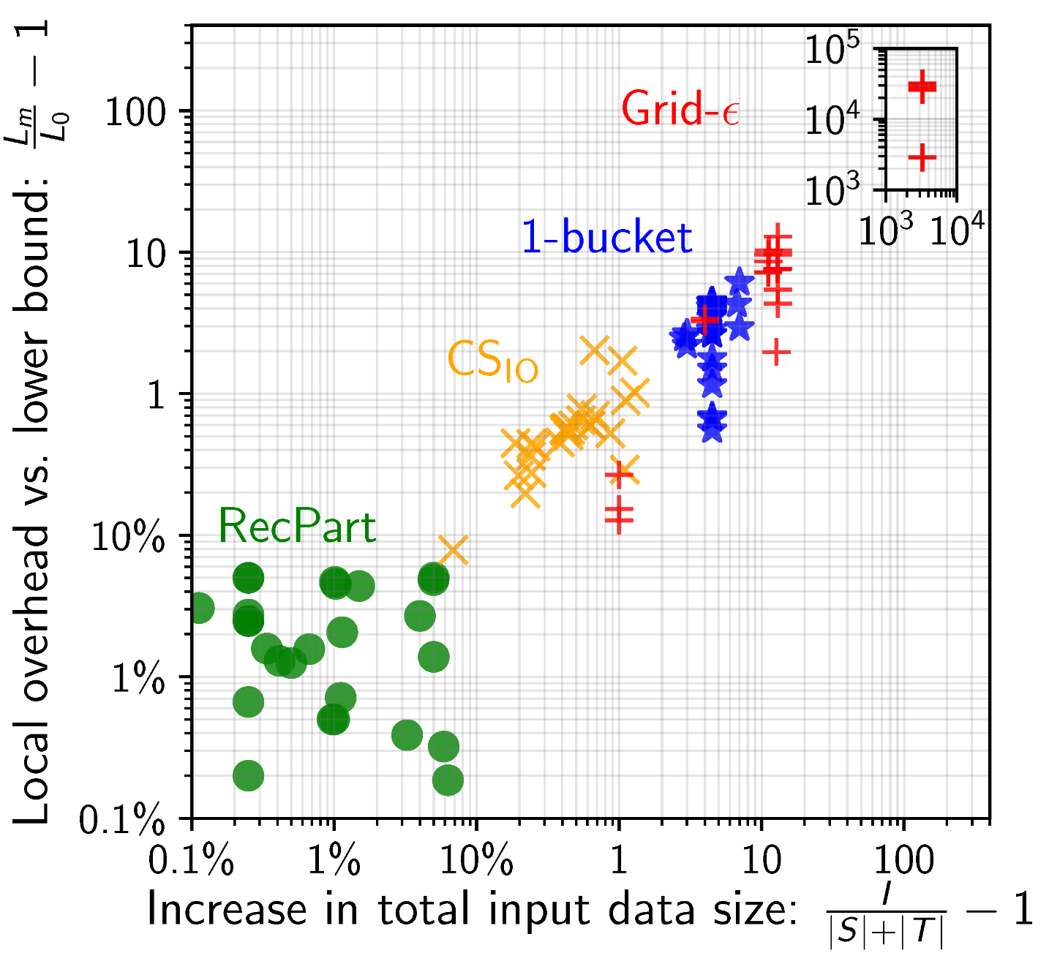
Experiments
Synthetic data (power law, various skews), real data (eBird, cloud cover, celestial objects)
Small to large band width in 1D, 3D, 8D
15-60 AWS workers
Optimization time:
RecPart: ~3sec
CS_{IO}: 20sec…25min
1-Bucket: 0
Grid-ε: 0
Notes:
Evidence for RecPart near-optimality claim and superiority over competitors. These near-optimal partitionings are found in negligibly time.

Slide 3

Optimization Goal
Oracle recently added band-join-specific optimizations
We are interested in distributed band-joins
Minimize sum of optimization time and join time
Join time depends on the join partitioning
Total amount of input moved between workers
Load on most loaded worker: max worker load
Input sample
Output sample
Shuffle
output
Input chunk
Input chunk
RecPart
Join Partitioning
Input chunk
Input incl. duplicates
Partition, duplicate
Local joins
Running-time model
Optimization time
Join time
Notes:
We care about distributed systems. Both optimization and join time matter. For join time, we need to find a good join partitioning.

Slide 4
Partitioning shown on the join matrix
S1
S2
S3
S4
worker w1
worker w2
worker w3
worker w4
S1
w1
S2
w2
T
S3
w3
S4
w4
T

Slide 5
Partitioning shown on the join matrix
S1
w1
w2
S2
w3
w4
T1
T2

Slide 6
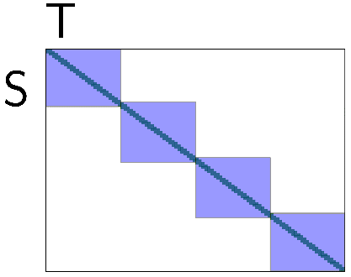
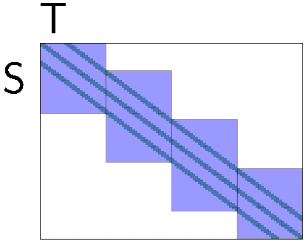
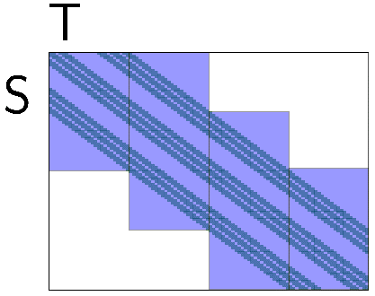

RecPart vs State of the Art
1-Bucket
CS_{IO}
Grid-ε
RecPart
Dim
T
S
$$ε$$
1
Domain of A₁
Domain of A₁
T
A₁
A₁
S
A₂
A₂
2
T
S
3
A₂
A₂
A₃
A₃
A₁
A₁

