Slide 1
Predicting Fantasy Points for NFL Quarterbacks
Mike Ries
Springboard Capstone 2

Slide 2
Problem Statement
We want to predict how many points NFL quarterbacks will score in any particular game
Be able to identify quarterbacks who are undervalued in a given week by the fantasy community
Help create better FanDuel lineups – QB’s are the backbone of your lineup

Slide 3
Attributes
A quarterback’s matchup – how good/bad is the defense he is playing against
Odds data – is he favored to win? Is it a game that is expected to have a high score?
Home/Away
PFF grades
FootballOutsiders team metrics – how efficient are teams offensively and defensively?

Slide 4
Data Collection
Built web scrapers using Python’s BS4 library
Pro-football-reference.com
Fantasydata.com
Footballoutsiders.com
2010 data onward
Loaded all data into Pandas DataFrames

Slide 5
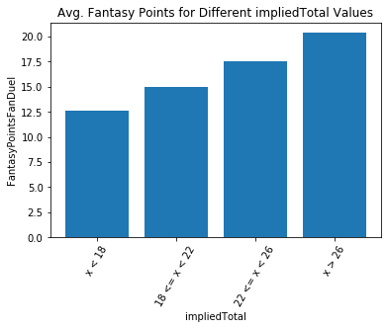
Exploratory Analysis
Efficiency trumps volume
High amount of passing attempts isn’t enough
Quarterbacks in high ‘total’ games are good
Quarterbacks with high ‘impliedTotal’ are better

