Slide 1


SEARCH ENGINE
COMP-8547 ADVANCED COMPUTING CONCEPTS
Instructor: Dr. Abedalrhman Alkhateeb

Slide 2
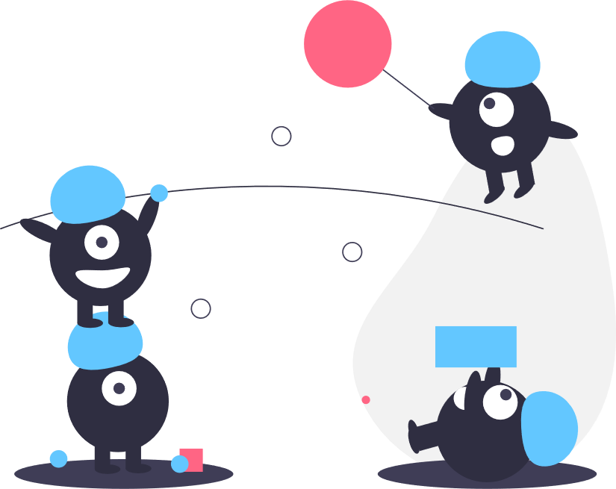
Team members:
Nency Kundaliya (110039032)
Ifaz Mahmud (110058097)
Kumar Guddepogu (110073537)
Likhitha Seethamsetti (110073915)

Slide 3

Outline
INTRODUCTION
WORKING OF SEARCH ENGINE
USED CONCEPTS
FLOW AND FUNCTIONALITY
FEATURES
IMPLEMENTATION
CONCLUSION
REFERENCES
DEMO

Slide 4
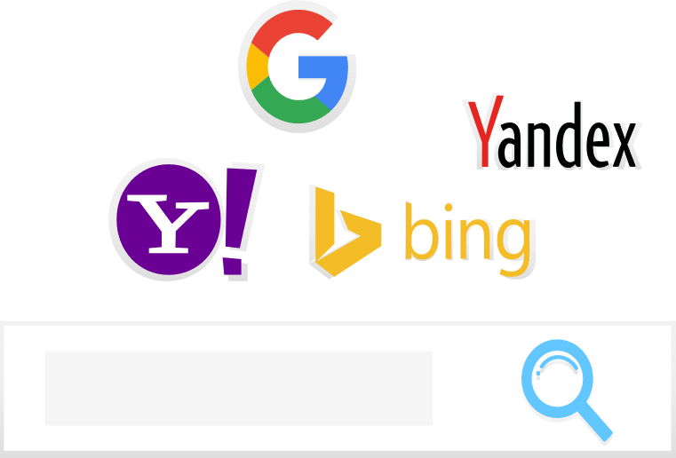
A Web Search Engine is a software system that performs searches on the web and give desired search result to the searcher.
It takes input from the searcher in the text format and perform systematic search for the specified input over world wide web and gives the output as lines of results.
Web Search Engine follows a systematic process involving:
Collection of information from internet called as Crawling.
Crawled data is organized, which is Indexing.
Using Indexing, Ranking of the page is done and then displayed to searchers.
Introduction

Slide 5

Crawling
Collects the information by Crawling the webpages
Analysis
Contents in the page are analysed
Index storage
Analysed content is stored in the index
Ranking Algorithms
Results are fetched from index and they are displayed.
End User
Working of Search Engine

Slide 6

Concepts Used
Regular Expression (Regex) – URL’s
Hash Table – Storing above URL’s
Boyer Moore Algorithm – Find words in stored indexed databases.
Edit Distance – Word Suggestions
Sorting Algorithm (Merge Sort) – Ranking

Slide 7
Start
User input
Enter/Select URL
no
Flow & Functionality
URL Validation
yes
Hash set containing unique Url’s
Web Crawling
Java Regex
List of URL’s
Jsoup HTML parser
HTML to Text
.txt files
User input
Boyer Moore
Searching Word
Word Found
Edit Distance
no
yes
Ranking of Webpages
End

Slide 8
Web Crawler
Web Crawling can be referred as the process of searching or crawling the web for any kind of information. For example, Google has its crawler which is Googlebot which includes mobile and desktop crawling.
A web crawler(a web spider or web robot) is a program which browses the World Wide Web in a methodical, automated manner.
The main use of Web Crawler is to create a copy of all the visited pages for later processing by a search engine, that will index the downloaded pages for providing the fast results.

Slide 9
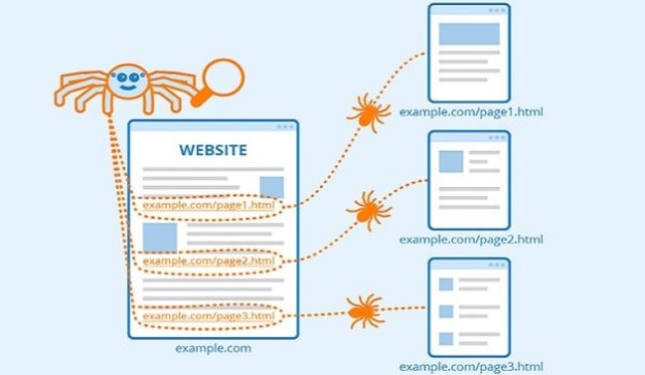
How Web Crawler works?

Slide 10
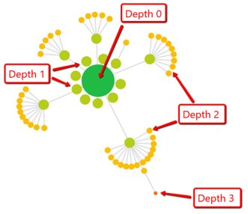
Terminology
RegEx : A regular expression is a sequence of characters that specifies a search pattern. It is helpful in checking for patterns in text strings.
Crawl depth: It refers to how many pages a search engine's bot will access and index on a site during a single crawl.

Slide 11
HTML to Text conversion
It is the process used for extracting the data of HTML files and then, store it into the text format files.
These text files can be used for searching the word.

Slide 12
What is Jsoup?
It is an open-source Java library which is used mainly for extracting data from HTML files.
It provides a suitable API for fetching the URLs and extracting and manipulating the data.
It uses the HTML5 DOM methods as well as CSS selectors.
With the help of Jsoup one can:
Parse HTML from a URL, file or string.
Find and extract the data by using DOM traversal or CSS selectors
Manipulate HTML elements, attributes and text

Slide 13
Implementation
There are two methods which we have implemented in this project:
To save the HTML file
To save the Text file
The HTML documents are retrieved from the fixed path and are added into a hash table to prevent delicacy.
After retrieving, they are converted into the text files and after that, it is saved into the system in a different location.
These stored .txt files will be helpful in searching for a word.
We have provided a link that runs all the operations on predefined data. However, user can enter the URLs of their choice for performing all the operations.

Slide 14
Pattern Matching
Pattern matching is the checking and locating of specific sequences of data of some pattern among raw data or a sequence of tokens.
The Java Regex package is the Java Regular Expression API, to define a pattern for searching.
A Regex is used to find website URL and also to find words in the text files.
Pattern Matching in Java is referred as Regular expression, which is widely used to search, edit and manipulate text.

Slide 15
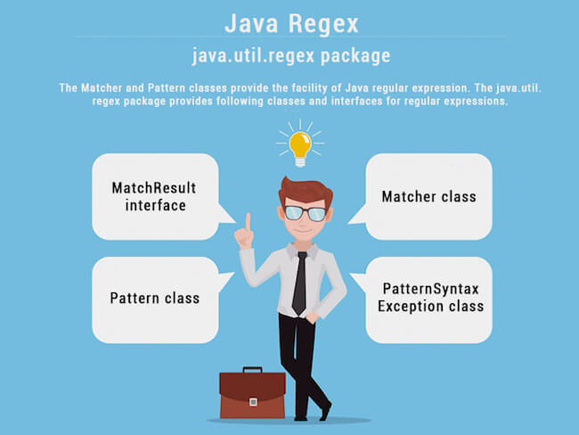
Regex Implementation
Importing java.util.regex package
Creating pattern instance using Pattern.compile()
Pattren used pattern = "https?:\\/\\/(www\\.)?[-a-zA-Z0-9@:%._\\+~#=]{1,256}\\.[a-zA-Z0-9()]{1,6}\\b([-a-zA-Z0-9()@:%_\\+.~#?&//=]*)";
After Pattern instance is created then used Matcher instance.
The Matcher instance is used to find matches of the pattern in texts.

Slide 16
Word Search
Word search is one of the most important feature in web search engine, it is implemented through pattern searching algorithms.
There are several pattern search algorithm like The brute force algorithm, The Boyer-Moore algorithm, The Knuth Morris Pratt (KMP) algorithm etc.
We have used Boyer Moore algorithm because it uses information gathered during the preprocess step to skip sections of the text, resulting in a lower constant factor than many other string search algorithms. In general, the algorithm runs faster as the pattern length increases.
If the given word is found it gives the offset of the index of the word and if not found it returns N, length of the text.
The performance of the Boyer-Moore algorithm:
the worst-case is O(mn)
The Average case is O(n)
The number of occurrence and the file name is stored in a hash table for page ranking.

Slide 17
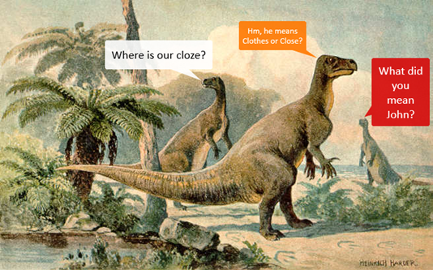
Word Suggestion(Spell Auto checker):
•Auto spell is indeed a very great perk that is widely used in several system applications that aids users to find good outcomes and webmasters avoid losing a user disappointed about no data due to a mistyped or simply wrong query. This feature is available on almost all search engines.
•Generally there two different types
of approaches this feature:
In the first one itself the systems helps to
correct the text that as we type it.
Another approach is to give suggestions for the word we type. In many cases these are combined and given as a single feature.

Slide 18
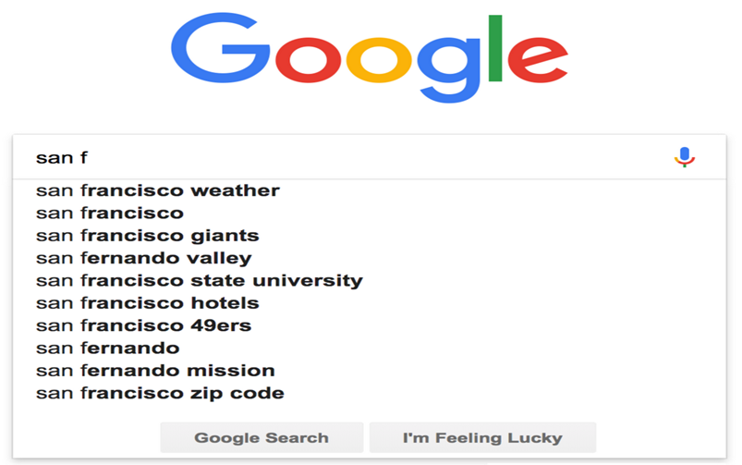
•Google primarily makes use of this functionality by cross-referencing the keywords that we enter with the dictionary, If it is not found , it suggests a possible replacement.
•For this, we have used edit distance concept to implement this functionality in our project .

Slide 19
Implementation:
Edit distances are often used in natural language processing when automatic spelling modification can evaluate applicant modifications for a spelling error by originally referred out of a dictionary that are similar to misspelt word.
•The edit distance measures how dissimilar two variables (for example, words) are to each other by calculating the number of operational processes necessary to convert one string into the other.
•Given two strings X and Y , Consider X as the initial string and Y as the target string , Find the minimum number of changes to transform X into Y. The operations substitution, insertion, removal of a character in a string is referred to as Levenshtein distance operation.

Slide 20
If the searchable word is not discovered with in records, a method has been implemented to calculate the edit distance between both the searched word and all other words throughout the records. If it resembles the edit distance of one, the user will then be proposed an alternative word.
•The steps for determining how a word would be most comparable entered are as follows:
It is the most closely related to the input string in terms of edit distance.
If two or more words have about the same edit distance, the most related word was the one with nearest edit distance that appears the most frequently with in dictionary.
If numerous words have same distance measure and count, the most related word is the one which comes first in alphabetical order.
•If there are no words with maximum edit distance of two are found, the message with the same will be displayed to the user.

Slide 21
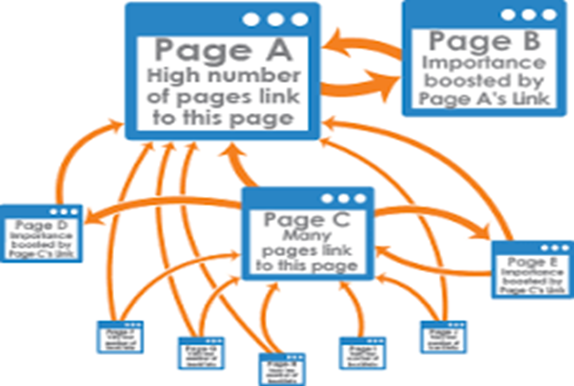
Page Ranking
•Page Rank is a Google search technique that ranks sites on the internet in search engine results.
•PageRank computes a rough figure of how relevant a site is by calculating the number as well as reliability of links to that page.
•The estimation of page rank necessitates several repetitions through the collection to modify roughly PageRank values to more closely resemble the hypothetical true worth.

Slide 22
Implementation
•Sorting is an important part of a web browser which is used to rank pages. To rank web page in our project, we have used merge sort approach. Merge sort runs in O(n logn) time.
•First, all pages will be screened for information retrieval.
•Following Scanning, all web sites at which identified word occurs are indexed depending on the frequency.
•The pages were being sorted utilizing Java's collection methods, which by default uses the merge sort algorithm.
•In our execution, we will show the user our top 5 search engine results based on page ranking.

Slide 23
References:
https://en.wikipedia.org/wiki/Edit_distance
https://www.geeksforgeeks.org/page-rank-algorithm-implementation/
https://jsoup.org/
https://towardsdatascience.com/autocorrect-in-google-amazon-and-pinterest-and-how-to-write-your-own-one-6d23bc927c81

Slide 24

LIVE DEMO

