Slide 1
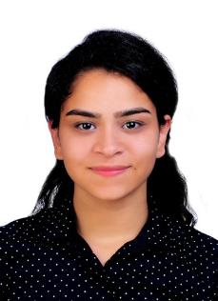
Shell Bootcamp 2024 3 Reflections for Week #<>
Mriga Arora
Date : 30-Aug-2024

Slide 2

About Me
Great men are not born great, they are made great. – Don Vito Corleone
Please share an image / visual that best represents you

Slide 3

My learnings from this week!

Slide 4
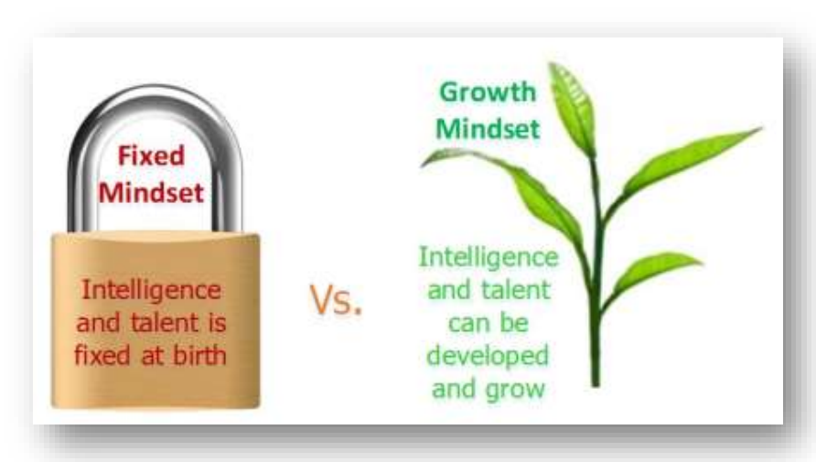
Learning 1 | My takeaways
Soft Skills Day 1: 26th August 2024
Types of performers (CART Analogy)
Neuroplasticity [Fixed mindset Vs Growth mindset]
POWER technique
Etiquettes
Qualities and attributes of a professional

Slide 5
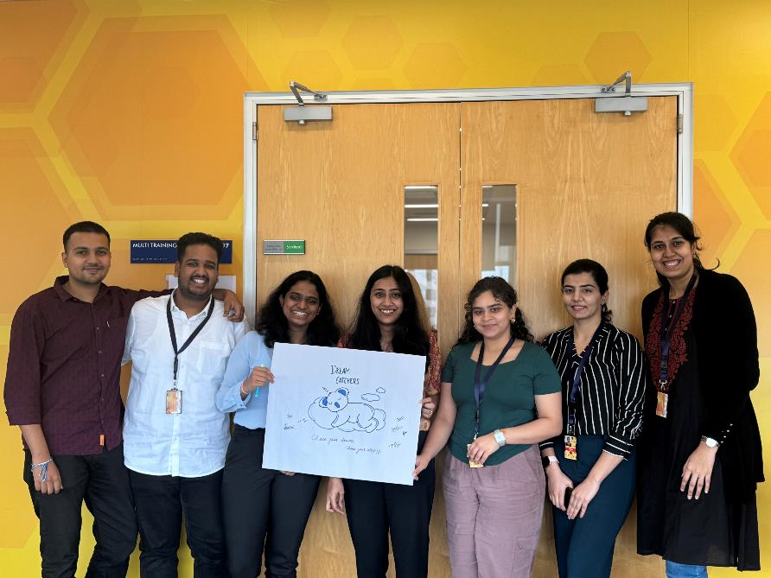
Learning 2 | My takeaways
Soft Skills Day 2 and Day 3: 27th August 2024 to 28th August 2024.
Email etiquettes
Stakeholder management
Tucker Model
Self Orientation
Grooming
Presentation skills
Team work

Slide 6
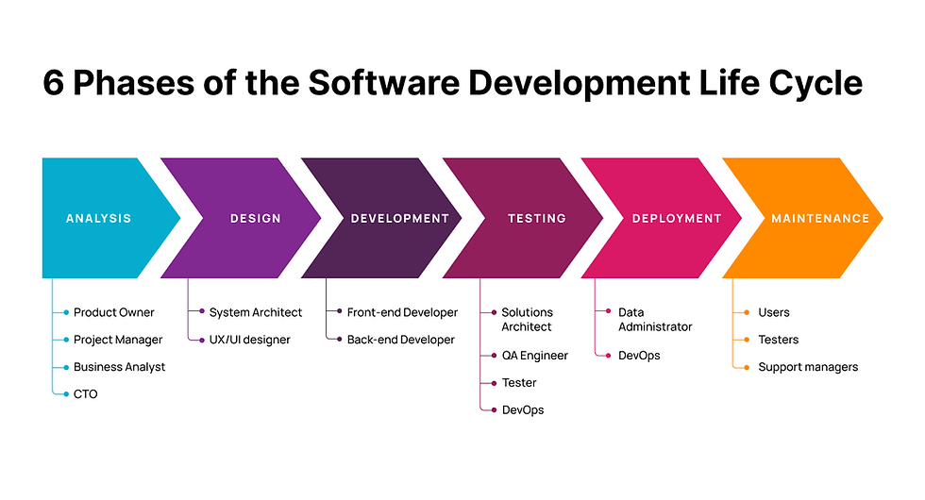
Learning 3 | My takeaways
Technical Boot Camp Day 4 and Day 5: 29th August 2024 to 30th August 2024
Introduction to Business Analytics
SDLC and its models
Requirement Analysis
Requirement Elicitation
Requirement Management
[Add a graphic that provides evidence of what you learned]

Slide 7

Relevance of learnings for my organization

Slide 8
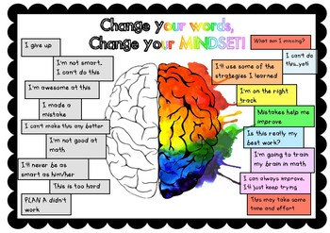
Learning 1 | Relevance for Shell
A examples to give how Shell implements Day 1 learnings can be: CART analogy to identify and support top performers while helping others reach their potential. The POWER technique could be embedded in Shell’s communication training to ensure clarity and effectiveness in interactions.
By fostering a growth mindset and professional qualities, Shell enhances employee performance, innovation and overall productivity. This culture of continuous improvement can lead to better problem-solving increased efficiency, and a more engaged workforce, ultimately contributing to Shell’s success.
[Add a graphic that provides view of how Shell implements this learning]

Slide 9
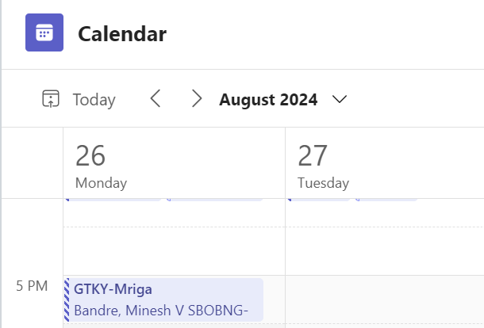
Learning 2 | Relevance for Shell
GTKYs method held in Shell emphasizes on Shell’s communication and network capabilities. They follow a safe and open culture for everyone to feel included.
Stakeholder management is highly relevant for Shell due to the complex and multifaceted nature of its operations, which involves internal and external stakeholder.
[Add a graphic that provides view of how Shell implements this learning]

Slide 10
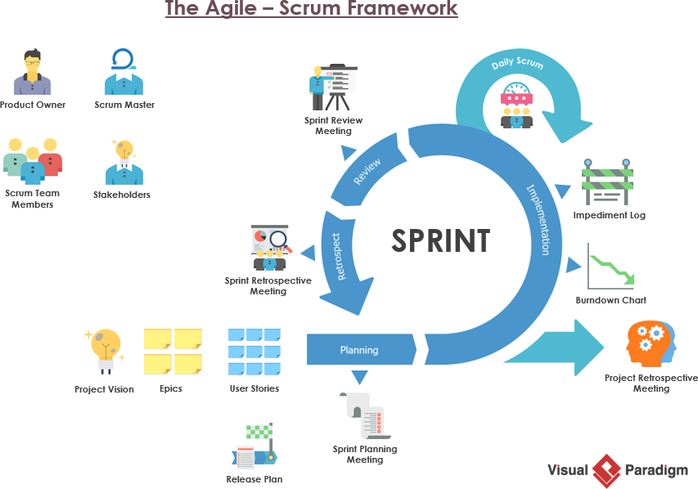
Learning 3 | Relevance for Shell
Agile methodology offers numerous benefits, including cost reduction, quality improvement, shorter timelines, risk mitigation, enhanced flexibility and continuous improvement. Shell adopts a Scrum-based Agile approach as told by my Team lead, which significantly enhances the efficiency and effectiveness of its work processes.
The SRS and BRD documentation learnings will make it easier for me to read and maybe document them in my journey in Shell.
[Add a graphic that provides view of how Shell implements this learning]

Slide 11

Challenges in implementing learning

Slide 12

Challenge faced while implementing Learning 1
Challenge faced: Interaction and initiative was less on the first day as everyone was new to each other and could not open up.
Solution: Games and interactive sessions were conducted to resolve this.
https://github.com/mrigaarora/Unext.TechBootcamp/blob/main/JourneyPPT1.MrigaArora.pptx

Slide 13
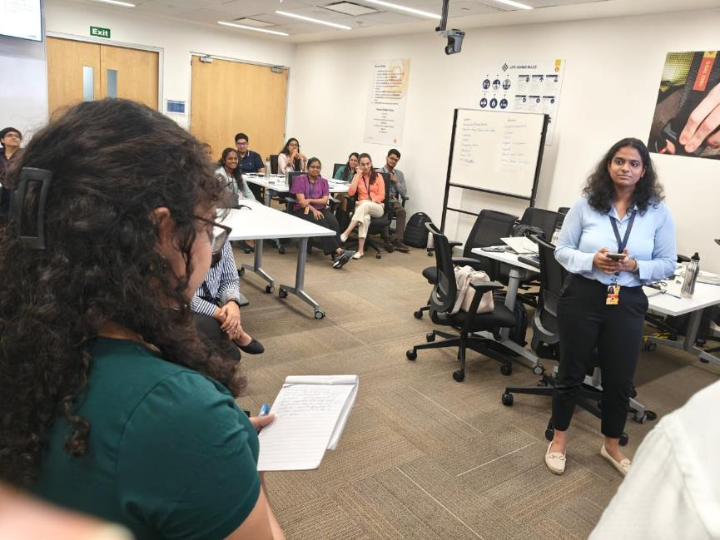
Challenge faced while implementing Learning 2
Challenge faced: Stakeholder management was a dry and tough topic to get through. The presentation activity required us to thoroughly read material and present according to our audience analysis.
Solution: Engaging activities and thorough teaching by the teacher Nitya made it easier to work around the challenges.
https://github.com/mrigaarora/Unext.TechBootcamp/blob/main/JourneyPPT1.MrigaArora.pptx
[Add a graphic that provides evidence of what you did to overcome this challenge]

Slide 14
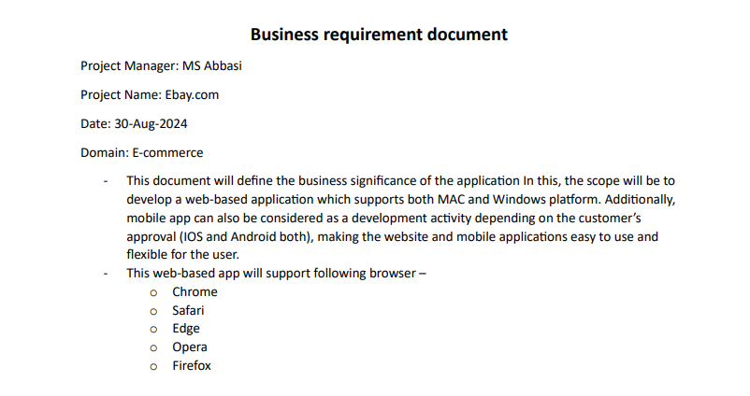
Challenge faced while implementing Learning 3
Challenge Faced: Though SRS Documentation was taught to us in college, the implementation of it made it seem hard.
Solution: Engaging team activity to document both the SRS and BRD document with the help of the teacher MS Abbasi made it easier to understand.
https://github.com/mrigaarora/Unext.TechBootcamp/blob/main/JourneyPPT1.MrigaArora.pptx

Slide 15

Action Plan

Slide 16
My Action Plan for this Week
Actions
Timeline
Status
Reading and reviewing all the notes and activities done during Soft Skills bootcamp
1. Reviewing the concepts covered in Business Analytics
Gaining a clear understanding of the Agile process and SCRUM workflow
Saturday: Brush up concepts of Business Analytics and SDLC Models.
Sunday: Go through the SCRUM framework and practice a few soft skills
Status of the same by the end of the week

Slide 17

Learning is also Fun!

Slide 18
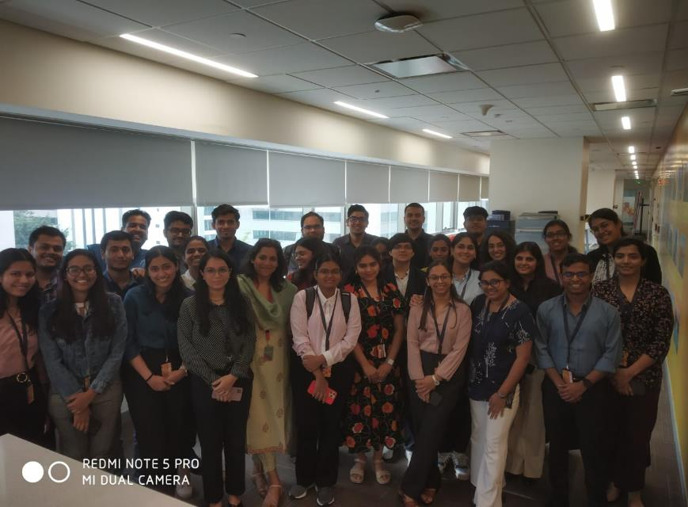
Learning is also Fun!
Nitya Ma’am was a fun and engaging teacher who made soft skills session enjoyable, leaving a lasting impact. Even made the efforts to talk to us one on one.
MS Abassi sir simplified technical concept with real world scenarios, making learning both effective and “cool” as to say.
The activity to make a product logo, name and tagline to wake us up from sleep was done through making a product logo based on sleep which in turn woke us up and made us interested in the topics even more.
[Add a graphic or a picture of how you/your team enjoyed the new learning]

Slide 19

Summary
This week, I gained a strong understanding of essential concepts like the Power Interest Grid, Neuroplasticity, teamwork and the key elements of delivering effective presentations. Learned the concepts and working of business analytics and product owner, I also delved into the Software Development Life Cycle and explored its different models. I believe these insights will be instrumental in both my professional and personal life.
As I look forward to the next set of topics, including the Scrum Agile model, hands-on experience with Azure DevOps, and testing practices, I see how crucial they will be for my future role as a Software Engineer. These topics are pivotal in building my expertise in software development.
The knowledge I’ve acquired about documentation and Software models and the functions of a Business Analyst this week forms a strong foundation for the upcoming material. These concepts are closely intertwined with software engineering and will be key as I move forward.

Slide 20
Thank You

