Slide 1
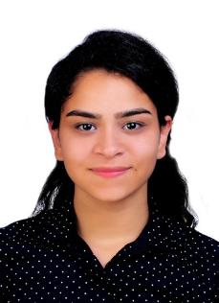
Shell Bootcamp 2024 3 Reflections for Week 2
Mriga Arora
Date : 6th-Sep-2024

Slide 2

About Me
Great men are not born great, they are made great. – Don Vito Corleone
Please share an image / visual that best represents you

Slide 3

My learnings from this week!

Slide 4
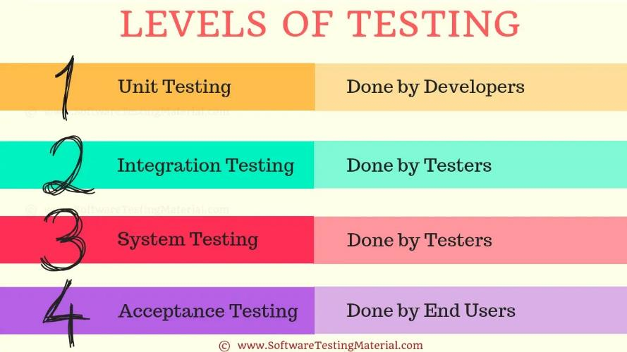
Learning 1 | My takeaways
Day 3 of Technical Bootcamp: 2nd September, 2024
Azure DevOps: Project Management tool
Types of testing: Whitebox, Blackbox, Greybox, Smoke, Regression, Performance, etc
Levels of Testing: Unit, Integration, System, Acceptance

Slide 5
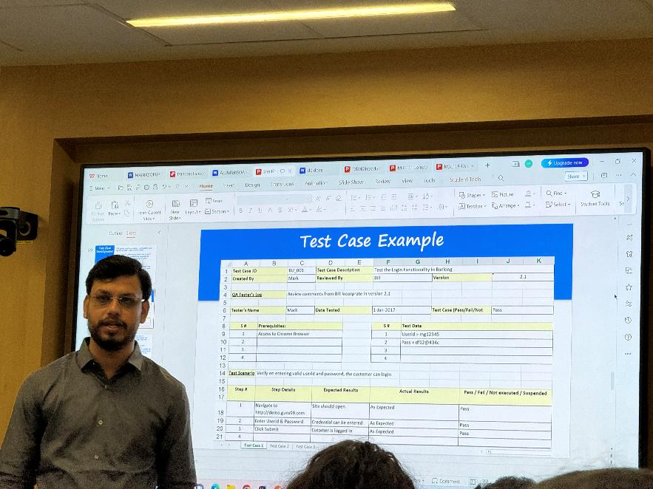
Learning 2 | My takeaways
Day 4 of Technical bootcamp: 3rd September, 2024
Software Testing Life Cycle (STLC)
Test plan document
QA testers’ log
BDD, TDD (fitnesse), DDT
Test Environments
Bug reports: Priority and Severity categorization
Bug life cycle

Slide 6
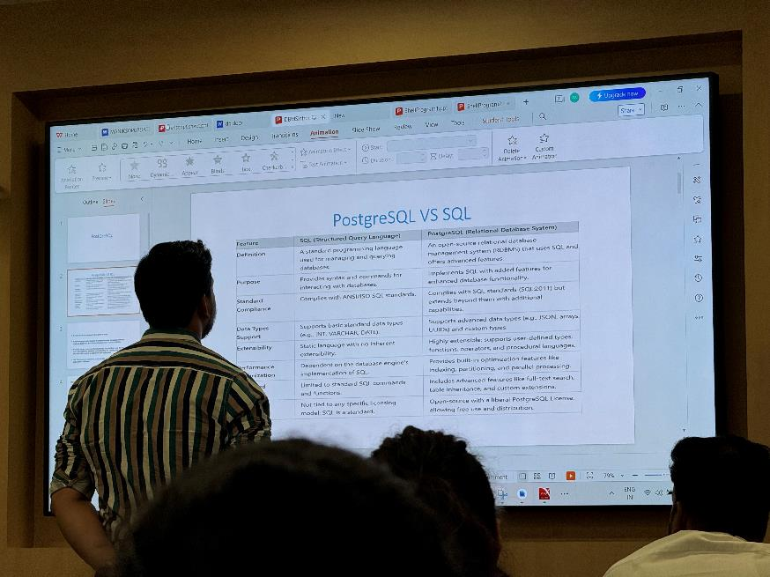
Learning 3 | My takeaways
Day 5 of Technical Bootcamp: 4th September, 2024
Tier architectures
REST and SOAP
Stateless and stateful applications
DevOps: CI/CD, Build management tool
Cloud
PostgreSQL

Slide 7
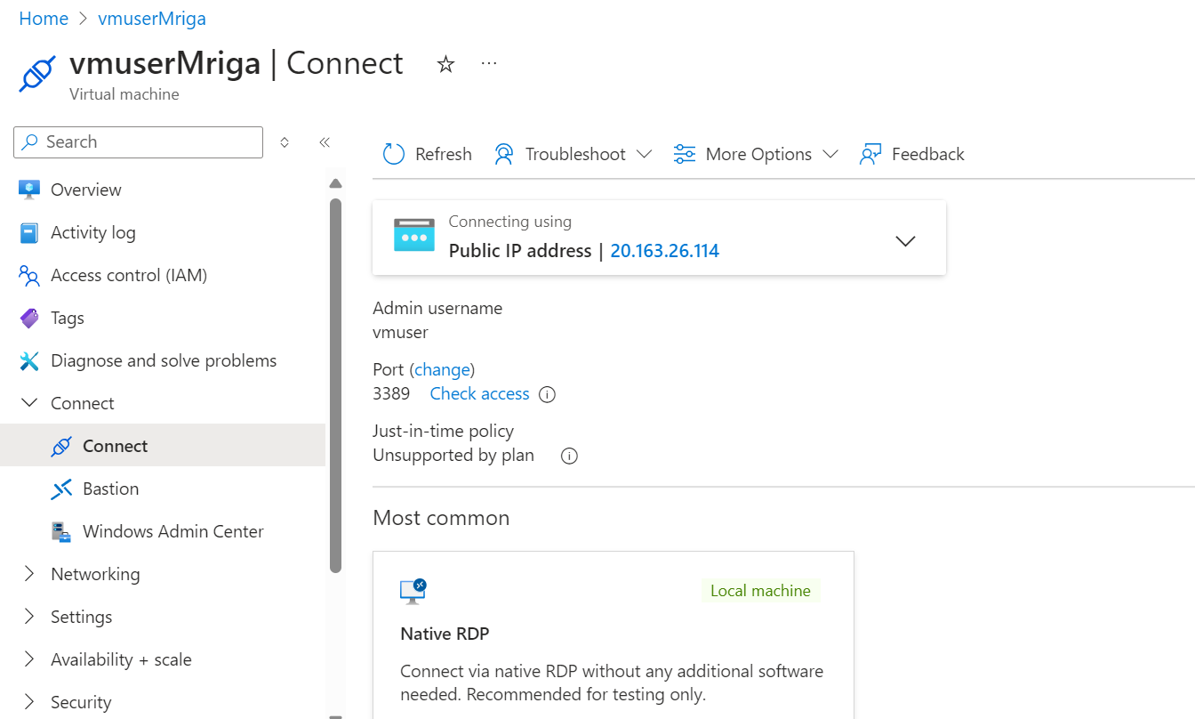
Learning 4 | My takeaways
Day 6 of Technical Bootcamp: 5th September, 2024
Practice to make a virtual machine
DBMS
QUERY writing
[Add a graphic that provides evidence of what you learned]

Slide 8
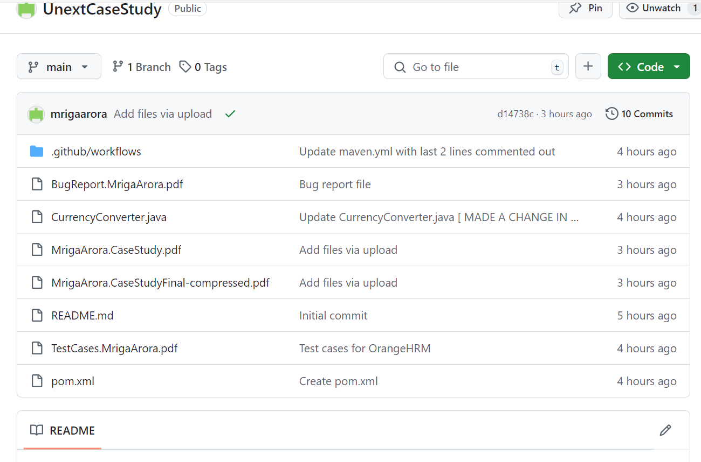
Learning 5 | My takeaways
Day 7 of Technical Bootcamp: 6th September, 2024
CASE STUDY:
Product and sprint backlogs, user stories, test cases and bug reports
Virtual Machine
Github actions
Link: https://github.com/mrigaarora/UnextCaseStudy

Slide 9

Relevance of learnings for my organization

Slide 10
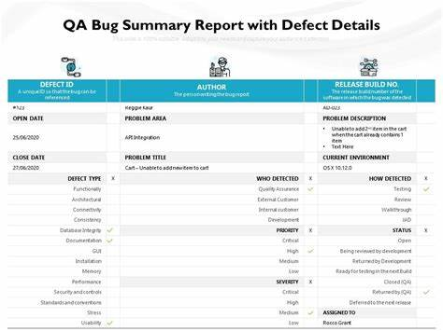
Learning 1 and 2 | Relevance for Shell
Shell can leverage Azure DevOps to streamline its CI/CD processes, enhance collaboration, and scale development efforts. By integrating automated, performance, and security testing within Azure DevOps, Shell ensures robust and secure software. Effective bug report management and analytics help in promptly addressing issues and improving software quality. Comprehensive test documentation supports regulatory compliance, knowledge sharing, and provides an audit trail, ultimately enhancing the overall software development lifecycle and ensuring reliable, high-quality products
[Add a graphic that provides view of how Shell implements this learning]

Slide 11
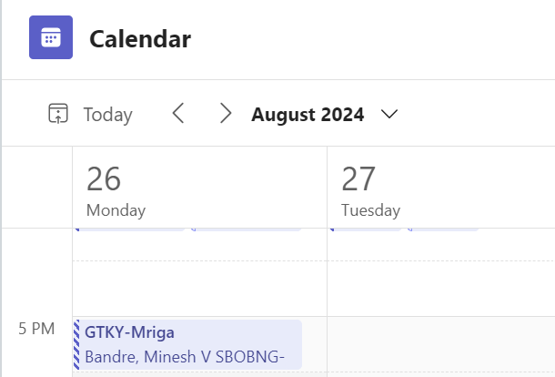
Learning 3 and 4 | Relevance for Shell
Shell can utilize Database Management Systems (DBMS) to efficiently store, manage, and retrieve vast amounts of data, ensuring data integrity and accessibility for critical operations. By deploying Azure Virtual Machines, Shell can create scalable, flexible, and secure environments for running applications and databases, enabling rapid provisioning and management of resources. Integrating DBMS with Azure VMs allows Shell to optimize performance, enhance data security, and support disaster recovery, ultimately improving operational efficiency and reliability.
[Add a graphic that provides view of how Shell implements this learning]

Slide 12
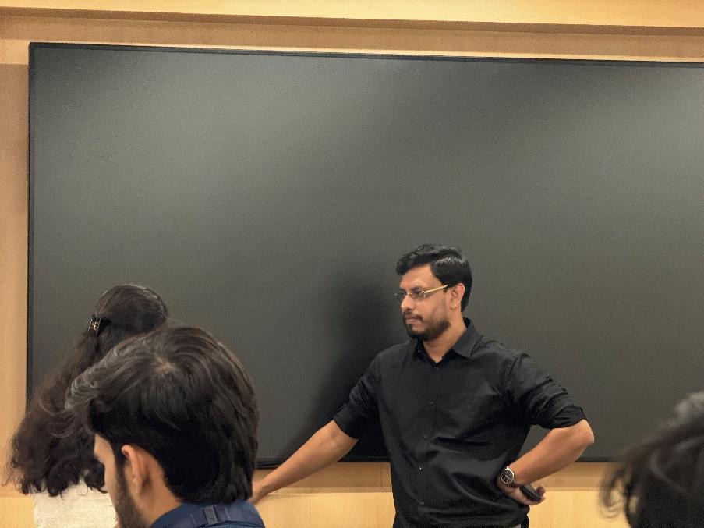
Learning 5 | Relevance for Shell
The case study conducted by Unext helped us to apply all the topics that were taught to us, which will in turn help us to apply the learning in the Shell IT environment.
[Add a graphic that provides view of how Shell implements this learning]

Slide 13

Challenges in implementing learning

Slide 14
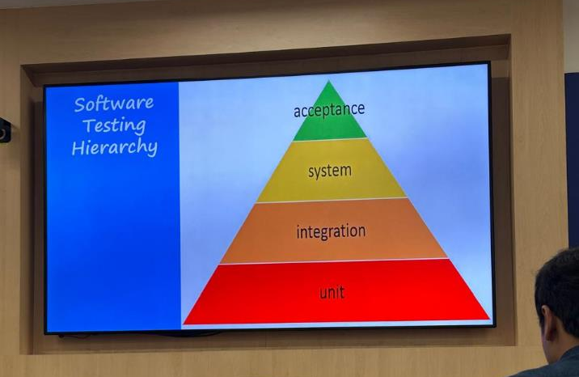
Challenge faced while implementing Learning 1 and 2
Challenge faced: Multiple test types and levels were discussed which felt hard to remember
Solution: Multiple examples and scenarios given by MS Abbasi sir helped to understand and memorize the types better
https://github.com/mrigaarora/Unext.TechBootcamp/blob/main/JourneyPPT2.MrigaArora.pptx

Slide 15
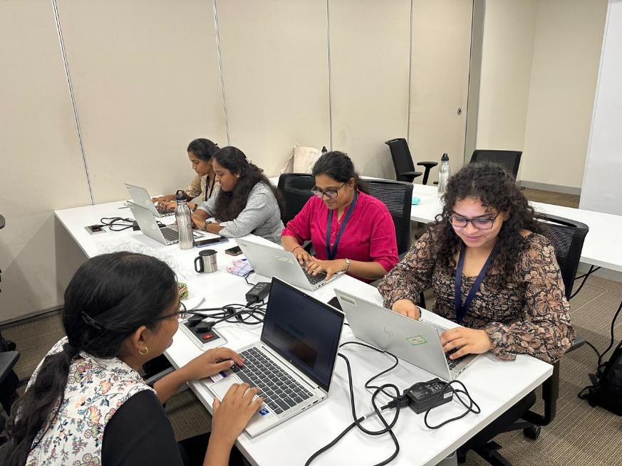
Challenge faced while implementing Learning 3 and 4
Challenge faced: Team activities had a few conflicts which were hard to maintain the decorum
Solution: The conflict management and patience taught to us during soft skills helped us here
https://github.com/mrigaarora/Unext.TechBootcamp/blob/main/JourneyPPT2.MrigaArora.pptx
[Add a graphic that provides evidence of what you did to overcome this challenge]

Slide 16

Challenge faced while implementing Learning 5
Challenge Faced: Virtual machine creation and heavy documentation within less period of time
Solution: Help from Unext team and team members helped to finish the task.
https://github.com/mrigaarora/Unext.TechBootcamp/blob/main/JourneyPPT2.MrigaArora.pptx

Slide 17

Action Plan

Slide 18
My Action Plan for this Week
Actions
Timeline
Status
Reading and reviewing all the notes and activities done during Technical bootcamp
Saturday: Brush up concepts of Day 3 and 4.
Sunday: Go through concepts done till Day 7
Implement all the learning in working journey in Shell

Slide 19

Learning is also Fun!

Slide 20
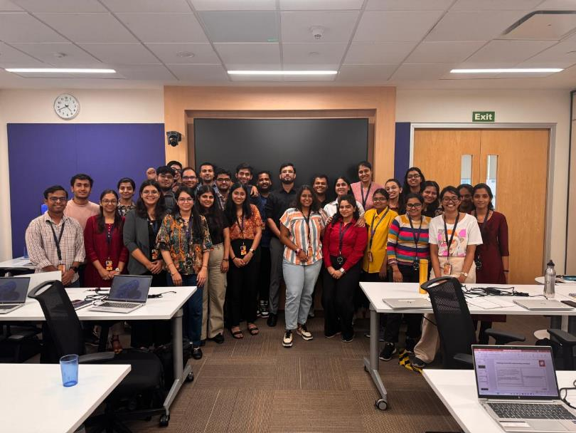
Learning is also Fun!
MS Abassi sir simplified technical concepts with real world scenarios, making learning both effective and “cool” as to say.
The case study to make a virtual machine, not only helped me to learn the way around it but also collaborative skills to resolve the issues with multiple team members and teachers from Unext.
[Add a graphic or a picture of how you/your team enjoyed the new learning]

Slide 21

Summary
Through my journey, I’ve learned how to leverage Azure DevOps to streamline CI/CD processes, enhance collaboration, and scale development efforts. By integrating automated, performance, and security testing within Azure DevOps, I ensure robust and secure software. Effective bug report management and analytics help in promptly addressing issues and improving software quality. Comprehensive test documentation supports regulatory compliance, knowledge sharing, and provides an audit trail, ultimately enhancing the overall software development lifecycle and ensuring reliable, high-quality products. Additionally, I learned to utilize Database Management Systems (DBMS) to efficiently manage data, and deploy Azure Virtual Machines to create scalable, flexible, and secure environments for running applications and databases. A case study on GitHub Actions demonstrated how automated workflows can significantly improve efficiency and collaboration in software development. Thank you to the uNext team for your support and collaboration in these initiatives.

Slide 22
Thank You

