Slide 1
CRYPTOCURRENCY & ITS SECURITY
Meet Guleria 1271815
Mrigakshi Goel 1265566
Smita Jahan 1270465
Mohammed Rayees Ali Khan 1269414

Slide 2
Cryptocurrency
A cryptocurrency is a new form of digital asset based on a network that is distributed across a large number of computers.
Digital asset designed to work as a medium of exchange.
Uses strong cryptography to secure financial transactions.
Are designed to let you store, send and receive value without any third parties.
Notes:
https://www.upfolio.com/ultimate-cryptocurrency-guide

Slide 3
Why to use cryptocurrency
Fast, Safe, Cheap
Easy transferable
Divisible
Fungible
More confidential transaction
Notes:
Easy transferable:- easy to transfer ownership from one person to another
Divisible:- can be divided into smaller units of money
Fungible:- One unit of money can be substitute with other
More confidential transaction:- each transaction you make is a unique exchange between two parties, the terms of which may be negotiated and agreed in each case.

Slide 4
Most used Cryptocurrency.
Top Cryptocurrency
Bitcoin
Etherium
Ripple
Litecoin

Slide 5

Bitcoin
Satoshi Nakamoto registered it in 2008
First decentralised digital currency
Completely open source
System is peer to peer
1 BTC = 9,114.57 CAD ( current)
Electronic payment system
Notes:
Satoshi could be a woman, a man, or a group of people. Nobody knows! What we do know is that the bitcoin.org domain was registered in August 2008. Then, in November, Satoshi posted the famous Bitcoin Whitepaper. The first bitcoin were issued in January 2009.
Embedded in the first Bitcoin code was the message “Chancellor on Brink of Second Bailout for Banks.” - hinting at Bitcoin’s creation because of the 2008 financial crisis.

Slide 6
How Bitcoin works?
Works on a shared public ledger called blockchain.
All transactions are shared on the network.
To track a wallet you just need the wallet address.

Slide 7
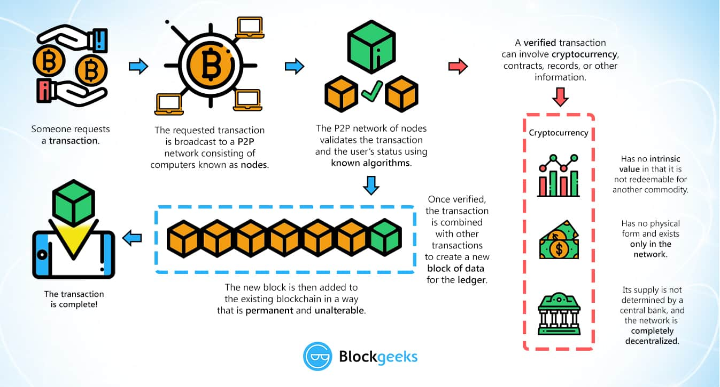

Slide 8
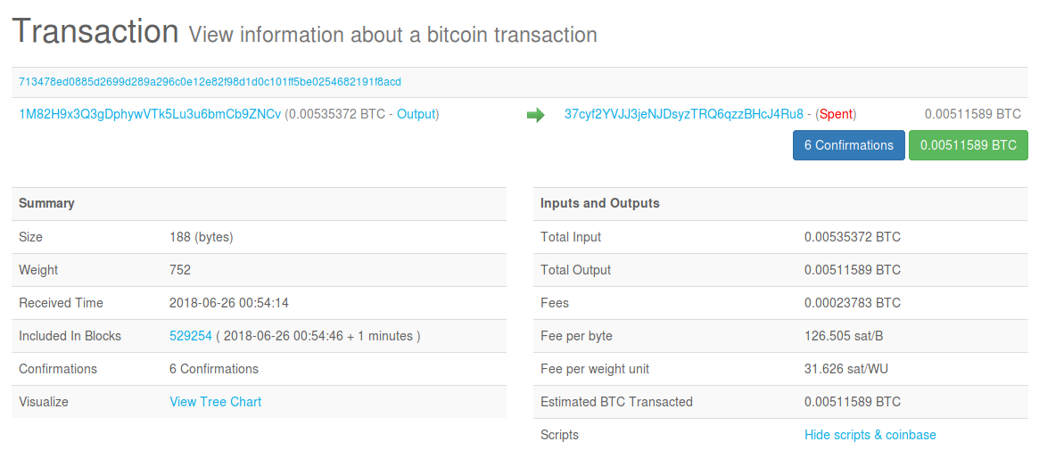
Example Transaction

Slide 9
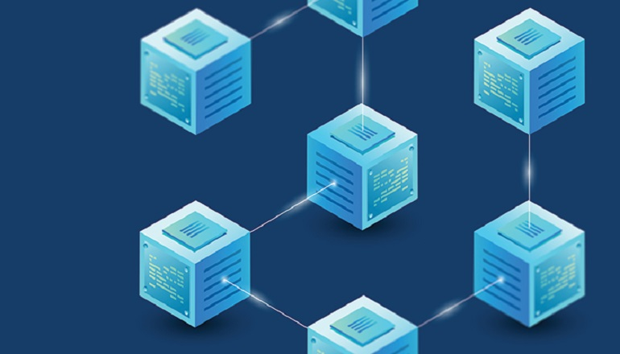
Blockchain Technology
A chain of blocks linked using cryptographic hash.
Difficult to change or alter information.
Previous block contains the cryptographic hash.

Slide 10
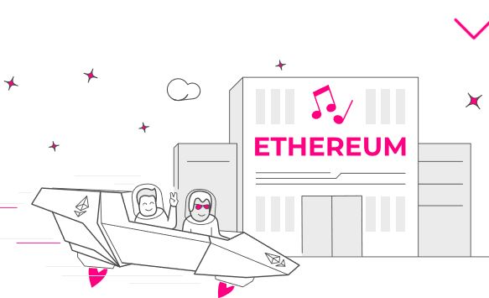
Ethereum
Open source like bitcoin
Public blockchain no one owns or controls.
Also called “Smart Contracts.”
Those are computer programs that run exactly as promised -
No downtime,
No censorship, or interference.
All participants in the Smart Contracts can trust that what they agreed on
Automatic, For example, if your purchase gets delivered, the seller will automatically be paid.

Slide 11
Ethereum
General purpose :
Supports bitcoin like value transactions.
Smart Contract :
Turing complete languages allow the ethereum transactions to be programmed to do different transactions.
Decentralized apps :
GUIs for smart contract allows user to interact in ways similar to web 2.0.

Slide 12
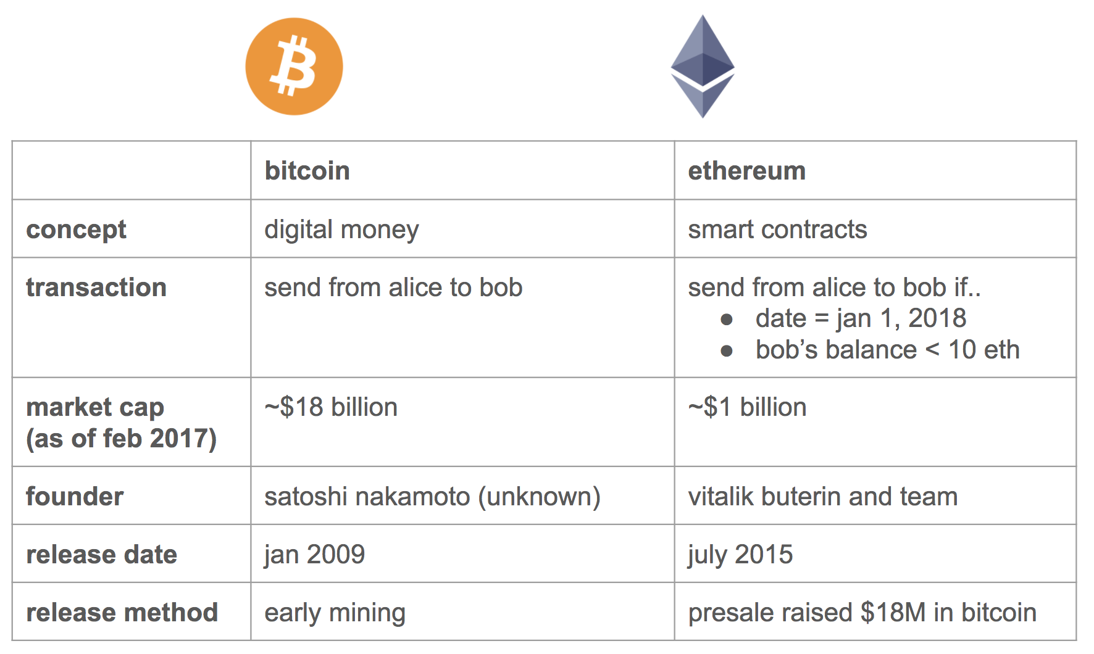

Slide 13
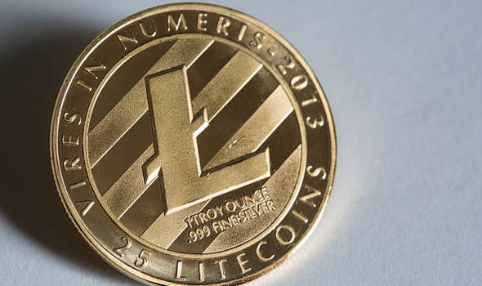
Litecoin
Litecoin is based on the ideas behind Bitcoin but is focused on being able to process more payments in a shorter period of time.
1 Litecoin = $44.50
Litecoin was released via on GitHub on October 7, 2011 by Charlie Lee
Notes:
The goal is to make cryptocurrency ready for millions of everyday transactions.
It also enables instant payments to anyone in the world and that can be efficiently mined with consumer-grade hardware.

Slide 14
Differences from Bitcoin
Litecoin network aims to process a block every 2.5 minutes whereas bitcoin takes 10 minutes
Bitcoin makes use of the longstanding SHA-256 algorithm, whereas Litecoin makes use of comparatively new algorithm known as Scrypt

Slide 15

Why Do we trust Printed currencies?

Slide 16
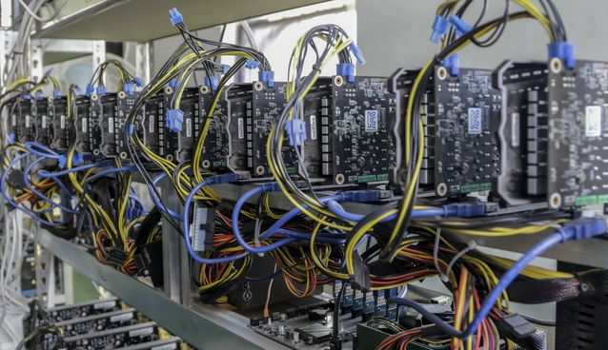
Cryptocurrency Mining
Cryptocurrency mining is a process in which transactions for various forms of cryptocurrency are verified and added to the blockchain.
In order to be competitive with
other cryptominers,
though, a cryptocurrency miner
needs a computer with specialized
hardware.

Slide 17
Different Methods Of Cryptocurrency Mining
There are three main sorts of mining machines – CPU, GPU, and ASIC:
CPU (Central Processing Unit)
GPU-based mining machine
ASIC (Application-Specific Integrated Circuit)
Notes:
ASIC - Because cryptocurrency mining is essentially guesswork, arriving at the right answer before another miner has almost everything to do with how fast your computer can produce hashes. Just a decade ago, bitcoin mining could be performed competitively on normal desktop computers. Over time, however, miners realized that graphics cards commonly used for video games were more effective at mining than desktops and graphics processing units (GPU) came to dominate the game. In 2013, bitcoin miners began to use computers designed specifically for mining cryptocurrency as efficiently as possible, called Application-Specific Integrated Circuits (ASIC).

Slide 18

Risks
Instability of values
Lack of acceptance
Transactional errors
Theft
Notes:
Although it's designed to be more secure through encryption, there are still risks of using cryptocurrency.
Instability of values:- Using Cryptocurrency such as bitcoin to purchase goods carries certain amount of risk, for instance it has gone from zero to $20,000 in Dec 2017
Lack of acceptence:- A lack of acceptance is another risk involved while using cryptocurrency. Some fear it due to the change in its value, Additionally it is not classified as leagal tender in US
Transactional errors:- as humans we are bound to do mistakes, What if an exchange is taking place and the wrong wallet address is entered? You could lose thousands if not tens of thousands or more.
Theft ;-
Even with encryption to protect cryptocurrency transactions there have been hacks resulting in notable losses. This is another of the risks of using cryptocurrency.

Slide 19
Security Issues of Cryptocurrencies.
Malware stealing
Ransomware
Unauthorized Mining
Notes:
Malware:- Some malware can steal private keys for bitcoin wallets allowing the bitcoins themselves to be stolen. The most common type searches computers for cryptocurrency wallets to upload to a remote server where they can be cracked and their coins stolen. log keystrokes to record passwords, often avoiding the need to crack the keys.One virus, spread through the Pony botnet, was reported in February 2014
Ransomeware:- demand payment in bitcoin
Uanuthorized mining :- botnets could mine covertly for bitcoins. average PC with an integrated graphics processor is virtually useless for bitcoin mining, but combining many computer could produce some result. August 2011, bitcoin mining botnets were detected,^{[47]} and less than three months later, bitcoin mining trojans had infected Mac OS X

Slide 20
References
https://www.upfolio.com/ultimate-cryptocurrency-guide
https://ethereum.org/
https://www.investopedia.com/terms/b/bitcoin-mining.asp
https://en.wikipedia.org/wiki/Cryptocurrency_and_security#Malware
https://litecoin.org/

Slide 21


