Slide 1

Cross Site Scripting
By
Mrigakshi Goel

Slide 2

About Me
Student of Cybersecurity, M.S. at NYIT, Vancouver
Worked about 6 years at Accenture and would start with bugcrowd soon
Very excited to speak here for the first time
Notes:
Before we start, just a small introduction about myself.
Talk about incorrect thing inside

Slide 3
Agenda
XSS Overview
Impact & types
Public exploits
Prevention
Notes:
We will start with an overview of the vulnerability, a short demo, and the impacts of the attack.
We will continue with the types of XSS, and
Finally, we will end with a few pubic exploits and measures to prevent XSS.

Slide 4
NOTE: Identify one incorrect slide
One slide in this presentation will not state facts

Slide 5

Do you know who is Samy Kamkar?
Right now: Security Researcher
In 2005 : “Samy is my hero” said the description of millions of Myspace accounts
Why?
Answer: The Samy Worm
Notes:
Do you know who is Samy Kamkar?
Well, now he is a well-known security researcher, but in 2005 - “Samy is my hero” said the description of millions of Myspace accounts. How did this happen?
Samy created a javascript code that could replicate itself, this was called the Samy Worm attack. Within 20 hours, over a million users had fallen victim to the attack. This happened in 2005, but even today there are several examples showing that XSS is a vulnerability type to keep an eye on. This worm had the ability to spread exponentially as a replica of the code was inserted into every profile that visited the infected profile. Within 24 hours Samy had a million emails from MySpace users "wanting" to be his friend and to whom he was their "hero". MySpace was forced to shut down and make changes to stop Samy's code spreading. The MySpace Worm, as it came to be called, served as an alarming example of what malicious hackers could do, even if they only had access to your browser.

Slide 6
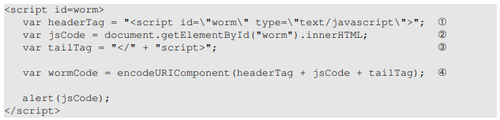
Samy Worm code
Notes:
Surely, Javascript and Ajax have an important role to play in XSS ATTACK, knowledge of these languages help in executing these attacks by manipulating the front end and injecting code through a data channel.
A malicious JavaScript can have access to all the objects that the rest of the web page has access to. This includes access to the user’s cookies.
If you look at the code snippet on the screen, we divided the code into three components, line 1 and line 3 adds the header and tail script tag respectively, and innerHTML in line 2 helps in giving the inside part of the code. Finally, encodeURIcomponent in line 4 is used to URLencode a string,i.e., it replaces non-alphanumeric characters in the data with %HH. So when data are sent in HTTP POST requests with the Content-Type set to application/x-wwwform-urlencoded, it is encoded. HTTP GET request was also used as GET request was the way to add new friends in myspace at that time.
Demo
Let us now see a short demo of the XSS attack in Myspace -like website. Elgg is an open source web based social networking application.
6:03
Now I am going to log in as Samy. We will edit the about me section
Notice that there are both post and get request here.
We save it
Login as another user charie.
Charlie will now visit samys profile
We observe that Charlie's profile now says 'Samy is my hero'..and also Charlie is now a friend with Samy.
Let's login as boby, and visit Charlie's profile
Let's login as Alice now, I am deleting the earlier descriptions Alice had in the about me section, notice that there is nothing written in the HTml editor as well.
Now Alice will visit Samy's profile.Notice that html editor is now infected with worm

Slide 7


Slide 8
Cross-site scripting (XSS)
Type of injection attack
Malicious client-side scripts are injected
Attacks are super common and difficult to prevent holistically
Common occurrence within the OWASP Top 10
Notes:
Cross-site scripting is a type of injection attack that can be carried out to compromise users of a website
The exploitation of a XSS flaw enables the attacker to inject client-side scripts into web pages viewed by users
These attacks are super common and it is very difficult to prevent, even if you have a framework that is built to prevent these sort of attacks
XSS has been on the list of OWASP Top 10 vulnerabilities to quiet some time
#7 on the 2017 OWASP Top 10
#3 on the 2013 OWASP Top 10
#2 on the 2010 OWASP Top 10

Slide 9
XSS Impact
Users and/or employees
Website’s ability to generate revenue
PR damage
Crashing social media, plugins and online news sites or other online businesses
Impacts the users first; bad user experience may lead to decreased customer base
Data theft
Notes:
Attack impacts your users and/or employees and may have serious repercussions on your business. Employees may become the victims of XSS attacks and their ability to use the production web application may be limited.
your organization can be impacted if the attackers successfully damage your website’s ability to generate revenue or your production web applications.
presence of an XSS vulnerability can cause significant PR damage
Attackers choose organizations that accommodate large online communities of users, such as social media, plugins, and online news sites or people who generate business from online services. They can crash such online businesses.
Cross-site scripting is a client-side attack, so it will impact your users first and a bad User Experience May Lead to Decreasing Customer Base.
The timing between identifying an XSS attack and resolving it is crucial. According to a study on the Cost of Cyber Crime, by the Ponemon Institute, the average time it took to resolve a cyber attack was 32 days – with an average cost of more than 32000 dollars per day for the participating sample of organizations.
For organizations that rely on internet-facing web applications as part of the production flow, XSS vulnerabilities are, again, a major point of concern.
XSS vulnerabilities that are successfully exploited by an attacker would generally lead to data theft

Slide 10
XSS types
Four types of XSS vulnerabilities
Stored
XML-based
Reflected
DOM
Notes:
There are Four types of XSS vulnerabilities: Stored XSS, XML based, Reflected XSS, and DOM XSS.? am I correct? Just answer in the chat window if you know something is wrong here.

Slide 11
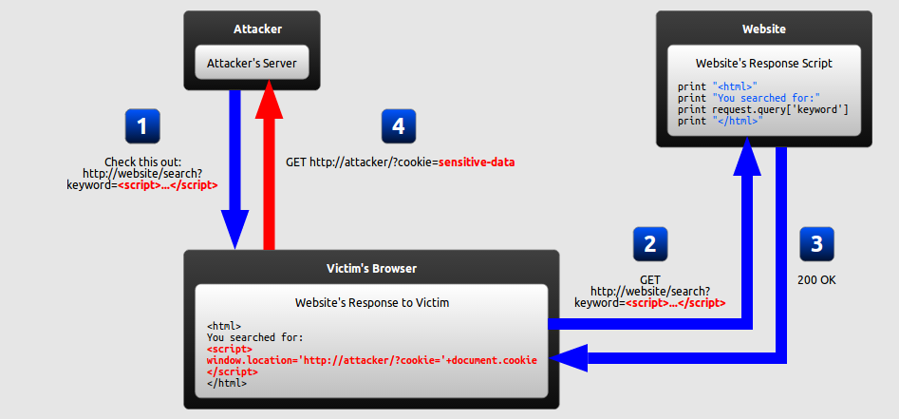
Reflected Cross-Site Scripting
Notes:
Let’s talk about reflected XSS.
The reflected XSS Just echoes back the unsanitized data back into the page
the first attack with script tag was Reflected XSS.
Reflected XSS occurs when user input is immediately returned by a web application in an error message, search result, or any other response that includes some or all of the input provided by the user as part of the request, without that data being made safe to render in the browser, and without permanently storing the user-provided data.

Slide 12
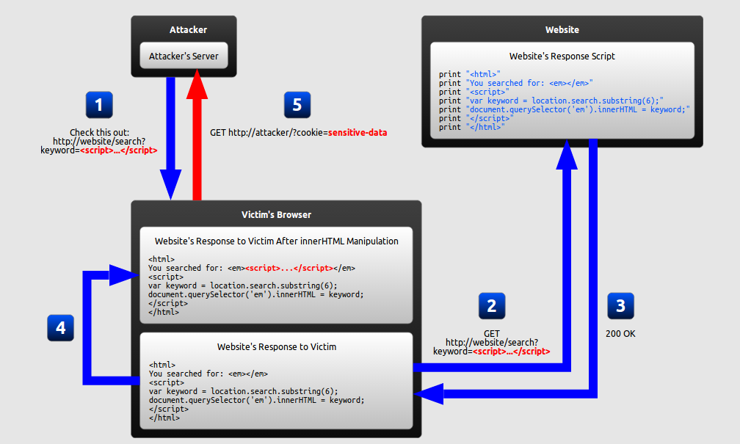
DOM Cross-Site Scripting
Notes:
Just like we saw in the case of Samy worm attack, the use of inner HTML helps in giving the inner part of the code and the flow of data remains in browser.
DOM XSS is Very similar to reflected, but with DOM you are modifying the pages DOM
It is also quite possible that the data will not be saved to the DB like in British Airways Attack which we will see towards the end of this presentation.
DOM Based XSS is a form of XSS where the entire tainted data flow from source to sink takes place in the browser, i.e., the source of the data is in the DOM, the sink is also in the DOM, and the data flow never leaves the browser. For example, the source could be the URL of the page, or it could be an element of the HTML, and the sink is a sensitive method call that causes the execution of the malicious data.

Slide 13
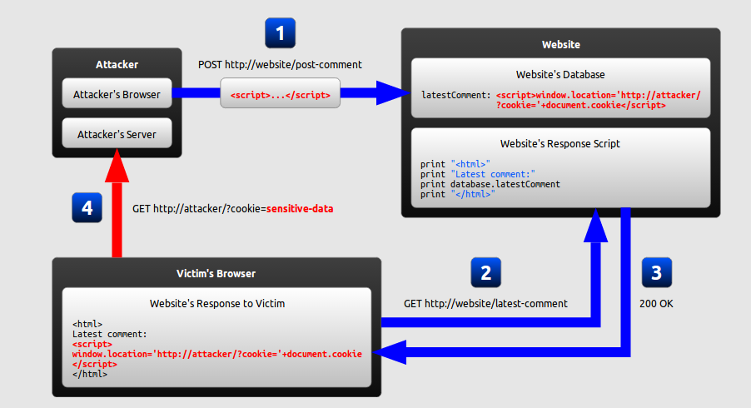
Stored Cross-Site Scripting
Notes:
If you look into this example, unlike the XSS attacks shown before, the malicious script sits in the website’s database.
Stored XSS generally occurs when user input is stored on the target server, just like a database in a message forum, visitor log, comment field, etc.
And then a victim retrieves the stored data from the web application.

Slide 14
A few more recent hacks
TweetDeck, 2014
British Airways, 2018
Fortnite-Epic Games, 2019
WordPress Plugin, 2020
Notes:
There have been a lot of XSS attacks in the history, A few more recent hacks involve
TweetDeck, 2014
British Airways, 2018
WordPress Plugin, 2020

Slide 15
TweetDeck, 2014
XSS Worm - everyone who fell victim for it retweeted it
Retweet of itself, and spread 38,000 times in two minutes
Changed the font to Comic Sans
No monetary loss at first
Ultimately tweetDeck had to be shut down
Notes:
Let’s now discuss a few more recent attacks.
TweetDeck was a social media dashboard application for management of Twitter accounts
TweetDeck faced a cross site scripting attack in 2014, and everyone who became a victim for it retweeted it. This means it quickly turned into a worm that spread itself. Most attacks using the vulnerability are no more than irritations, -opening warning dialogues on users' computers - a tweet created a retweet of itself and spread 38,000 times in two minutes, - viewing a malicious tweet changed the font on Tweetdeck itself to Comic Sans.
Since the flaw was harmless, it did not lead to any immediate losses but ultimately the tweetDeck has to be shut down .

Slide 16
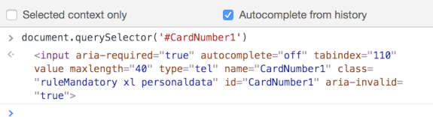
British Airways, 2018
How many customers were impacted? Any guesses?
Customer Information stolen
No <iframe> isolation of the payment card fields on the BA payment
Notes:
British Airways attack happened in 2018 what do do you think was the number of customers impacted? Any guesses?END. And the stolen information included personal and payment information but not passport information Payments through its main website were affected Payments through its mobile app were affected. On studying more about it, BA found out that it was an XSS attack as the website’s database was not affected, payments were affected from Aug 21 2018 to Sep 5, 2018 only. They further found that the attack took place as there was no <iframe> isolation of the payment card fields on the BA payment page. "The card number field resides in the top frame as you can see below." It was analysed that if the card details were collected in a third party domain <iframe>, it would prevent this basic XSS attack vector because JavaScript files loaded in the main window would not have been able to access the contents of a third party domain<iframe>.

Slide 17
WordPress Plugin, 2020
Over 900,000 WordPress websites targeted
Website takeover by creation of new administrator accounts
The plugin accounts for over one million active installations
Vulnerability disclosed by Wordfence Threat Intelligence team on April 29, 2020
Issued with a CVSS score of 8.8
Notes:
Over 900,000 WordPress websites were targeted in 2020.
The wordpress websites that used plugins like Easy2Map, BlogDesigner, Newspaper theme and few others had a severe XSS security flaws which were patched already but were not updated by their users.
The vulnerability in Ninja forms could have led to website takeover through the creation of new administrator accounts
Ninja Forms is a drag-and-drop contact form creator for websites running on the WordPress Content Management System (CMS). The plugin accounts for over one million active installations.
XSS Vulnerability was disclosed by Wordfence Threat Intelligence team on April 29, 2020., just two days after the initial discovery.
According a cybersecurity researcher, this was a high-severity bug with CVSS score of 8.8, and had a Cross-Site Request Forgery (CSRF) to Stored Cross-Site Scripting (XSS) vulnerability in the Ninja Forms "legacy" mode.

Slide 18
A Few Prevention techniques
Determine safe UI and reject others
Restrict/limit text characters
Improperly formatted data shouldn’t be inserted in code
Input validation for database queries
Security of third-party/ in-house web apps
Continuous scanning in real-time to detect any unauthorized code
Use modern frameworks like React
Notes:
We can definitely prevent this attack by using the following secure programming skills.
First of all, Developers should determine what is safe user input and reject all others, be they text, javascript, or any unauthorized code.
like sanitizing the inputs or using markdown
Depending on the text box, developers can restrict text to certain characters and limit the number of characters.
The code should have checks to ensure that improperly formatted data is never inserted directly into the HTML content that comprises the web application.
Website operators should carefully vet third-party web app providers to ensure their products have the right security measures in place.
Website operators should test their web apps to ensure that they are not vulnerable to attacks involving cross-site scripting or SQL injections.
continuous scanning of websites in real-time to detect any unauthorized code is crucial to prevent such attacks.

Slide 19
Takeaways
Immediate Victim of XSS are the users
Updating the plugins could have prevented WordPress plugin attack
Best defense is sanitization of any and all user input
Notes:
We learnt that the Immediate Victim of XSS are the users, although the organisation may get impacted and loose their business but XSS impacts users first leading to a bad user experience or stolen data.
Filters to eliminate html tags like script tag should never be turned off, which happened inn the case of TweetDeck. British Airways attack could have been prevented if they did a routine scan of all their website and third party applications and Updating the plugins could have prevented the WordPress plugin attack.The vulnerability in Wordpress plugins were already fixed, but the hackers managed to target the users of the plugins who were still using an old version. Overall, the Best defense is thorough and well-tested sanitization of any and all user input so that code is never inserted through a data channel.

Slide 20

Special thanks to Jeevan, Arti and Betsy for helping me prepare this presentation

Slide 21
XSS types
Three types of XSS vulnerabilities
Reflected
DOM
Stored
XML-based
Notes:
There are three types of XSS vulnerabilities: Stored XSS, Reflected XSS, and DOM XSS.

Slide 22
British Airways Attack
380,000 customers were affected

Slide 23
References
https://github.com/OWASP/wstg/blob/master/document/4-Web_Application_Security_Testing/07-Input_Validation_Testing/01-Testing_for_Reflected_Cross_Site_Scripting.md
https://owasp.org/www-community/attacks/DOM_Based_XSS
https://www.geeksforgeeks.org/what-is-cross-site-scripting-xss/
https://portswigger.net/web-security/csrf/xss-vs-csrf
https://www.owasp.org/index.php/Cross-Site_Request_Forgery_(CSRF)_Prevention_Cheat_Sheet)2 .
https://www.techrepublic.com/article/british-airways-data-theft-demonstrates-need-for-cross-site-scripting-restrictions/#:~:text=A%20major%20airline%20suffered%20a,a%20cross%2Dsite%20scripting%20attack.&text=Researchers%20from%20RiskIQ%20have%20published,and%20September%20of%20this%20year.
https://www.oreilly.com/library/view/oracle-jet-for/9781787284746/assets/361a1477-5e08-4b94-92a8-785446e9eae8.png
https://evilhacker.lol/card-details.php%E2%80%99
https://www.conceptatech.com/blog/how-does-reactjs-solve-the-problem-of-data-changing-over-time#:~:text=js%20solves%20problems%20of%20better,for%20a%20smooth%20user%20experience.
https://www.wordfence.com/blog/2020/04/high-severity-vulnerability-patched-in-ninja-forms/
https://www.supinfo.com/articles/single/8197--security-breach

