Slide 1
Stateful Web Application Development with Spring Web Flow

Slide 2
Trendz (vendor)
Alchemy (vendor)
JavaPoint (Trainer)
Client (Verizon)
XYZ (vendor)

Slide 3
Agenda
Stateful web application development
Model business process as a single unit
Processes are reusable across different areas of the application
Testing

Slide 4
Stateful Web Application
Most web based applications are stateful
Any application in which the user enters all data required for a single business transaction across multiple pages
  Shopping Cart Checkout
  Booking a flight online
Partial data from early pages is either stored in HTTP Session or written to a database
  Explicitly managed by the application

Slide 5
Stateful Web Application Challenges
HTTP is an inherently stateless protocol
  Each request is an event unto itself
Traditional Web Frameworks rely on a request driven approach
  Each page submits to a distinct controller
  Each controller only responsible for a single step in the overall process
Notes:
Example for Request/Session scope statement:
It would be nice if all form submissions resulted in an HTTP redirect to GET the next view.
This eliminates double posting problem, browser refresh will simply GET the view again instead of re-POSTing the previous form.
This is often not done because request scoped variables will be lost and we don’t want to litter the session.

Slide 6
Stateful Web Application Challenges
Many navigation paths can be difficult to manage
  No central place to manage all navigation
Request and Session scopes often not sufficient
  Client side redirects clear out request scope
  Double post and back button problems
Difficult to test

Slide 7
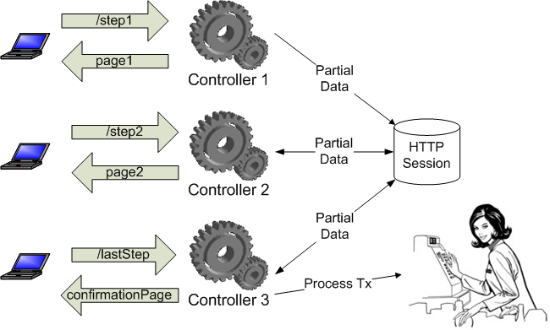
Traditional Stateful Web Application
Notes:
This is a typical web application for a multi step process. Note how it is the responsibility of the client to know which controller to post to at each step of the process.

Slide 8
Agenda
Stateful web application development
Model business process as a single unit
Processes are reusable across different areas of the application
Testing

Slide 9
Process Driven Application
Define all navigation in a central location
Treat the entire interaction as one algorithm
Let the framework decide what to do and where to go based on events triggered by the user
Notes:
This is what we want to do.

Slide 10
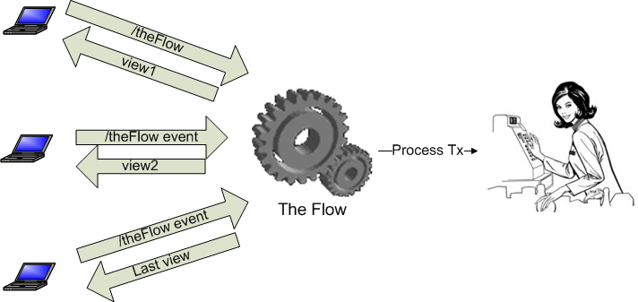
Process Driven Application

Slide 11
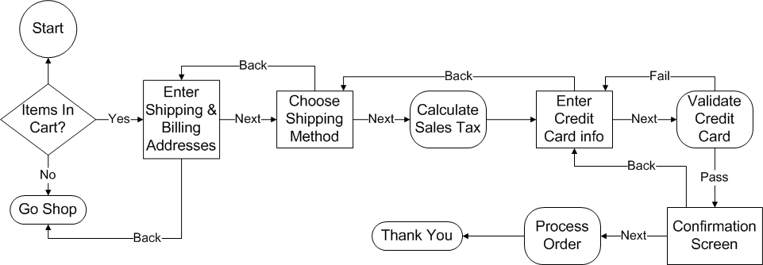
Shopping Cart Flow Diagram
Notes:
Note that this is not our entire application. Many times it may make sense to write the majority of the application using regular SpringMVC, but write certain protions of it using WebFlow.
No need to walk through the entire diagram. Just point out that there are different kinds of states. Some have multiple transitions, some have only a single transition

Slide 12
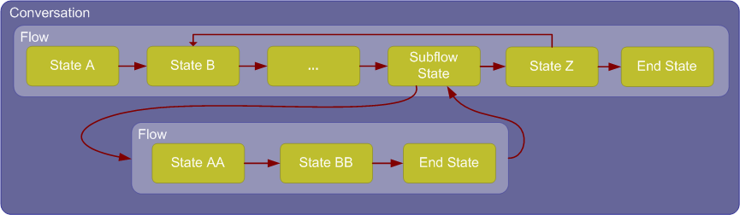
High Level Concepts
Notes:
There are different kinds of states
Note how the execution of the sub-flow is just like a method call. Execution transfers to the sub-flow and then returns to the same state after the subflow completes
TALK ABOUT METHOD ANALOGY HERE.
INPUTS AND OUTPUTS

Slide 13
States
View State
  Pause execution and render a view to obtain user input
Action State
  Execute Java code
  Can transition to different states depending on outcome
Decision State
  Branch logic

Slide 14
States
Subflow State
  Transfer execution to a different flow
  Execution will return to this state when the subflow has completed
End State
  Final state of the flow
  May or may not define a view to render

Slide 15
Variables
WebFlow allows you to define variables as part of the process model
Variables can be stored in one of several different scopes
  Conversation, Flow, Flash, View, Request

Slide 16
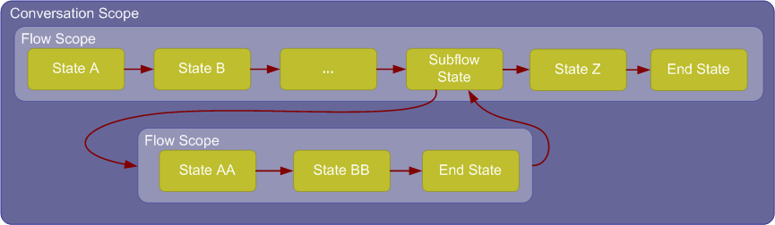
Conversation And Flow Scopes
Conversation scope available to all flows
Flow scope limited only to a single flow

Slide 17
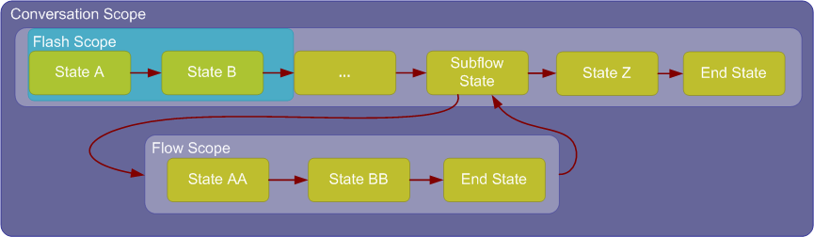
Flash Scope
Cleared once a view is rendered
Useful for temporarily saving results from action states
Live through client-side redirects
Notes:
Cleared once a view is rendered.
Useful for temporarily saving results from action states and referencing in decision state or displaying in view state
Live through client-side redirects. Fixes problems with request scope discussed earlier.

Slide 18
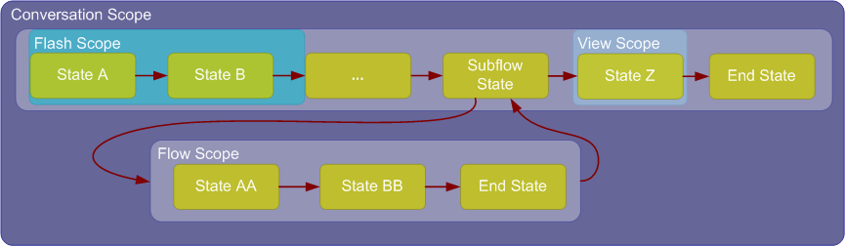
View Scope
Created once a view-state is entered
Destroyed when that view is exited
Useful on pages that submit many AJAX requests
Notes:
Created once a view is entered. Destroyed when that view is exited.
Really useful for working with AJAX requests, where the flow stays in the same view state across multiple AJAX requests

Slide 19
Request and Session Scopes
Standard request scope still available
  Same life span as always
  Does not live across client-side redirects
Session scope is not easily accessible
  Is larger than conversation scope
  Does not make sense from within WebFlow
  Interact with session via input and output attributes of the flow

Slide 20
Modeling the Process
Domain Specific Language (DSL) provided out of the box
  XML
It is possible to define a flow programmatically
Implement FlowAssembler and FlowBuilder to create your own flow definition language
Notes:
The main point I’m trying to drive here is that WebFlow separates the flow model from the execution engine. WebFlow doesn’t really care where the flow came from or how it was defined. As long as you are able to build a valid Flow object the engine can execute it.

Slide 21
Packaging
A flow is a self contained unit
Flow definition and associated JSP pages packaged in the same directory
Flows are registered with the FlowController by name

Slide 22
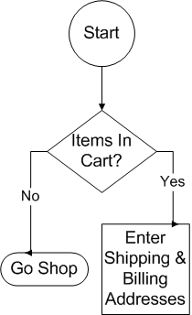
Shopping Cart Flow Definition
<flow xmlns=“…”>
<input name="cart“
required="true“
type=“com.mycomp…" />
<decision-state id=“hasItems">
<if test="cart.empty" then="goShopping“
else="enterAddresses"/>
</decision-state>
Notes:
INPUT VARIABLES: START STATE: DECISION STATE
Cart variable demonstrates flow input
By convention, all input params are placed into flow scope
By convention, the first state in the file is the first state executed.
This can be overridden by setting a start-state attribute on flow element

Slide 23

Shopping Cart Flow Definition
<view-state id="enterAddresses“ >
<transition
on="next“
to="shipMethod" />
</view-state>
<view-state id="shipMethod">
<transition
on="back“
to="enterAddresses" />
<transition
on="next“
to="calculateTax" />
</view-state>
Notes:
VIEW STATES: TRANSITIONS ON EVENTS
By convention, the id of the view state indicates which JSP to display
The value in the “on” attribute is the name of the event fired by the client.

Slide 24

Shopping Cart Flow Definition
<action-state id="calculateTax">
<evaluate
expression=“basketService.calcTax(cart)" />
<transition to="ccInfo" />
</action-state>
<view-state id="ccInfo">
…
</view-state>
Notes:
ACTION STATES – SINGLE TRANSITION
Value in expression attribute is an Unified EL expression (default) or OGNL
Unified EL allows you to directly reference Spring Beans (basketService)
Note that Spring wants to expand use of Unified EL in Spring 3.0, will be able to use in in core bean configs etc.
<evaluate> can be called from many different places. Action state shown here.
Other places <on-entry>, <on-render>, <on-exit> of view states.
<on-enter> <on-exit> of flows.
Within <transition> tags wherever <transition> is allowed
The result of an <evaluate> can be stored to any scope (conversation, flow, flash, view, request)

Slide 25
Evaluate
Primary connection point between WebFlow and the back end services
Expression in the evauate tag is Unified EL
  Same expression language as JSP 2.1
  Can directly reference Spring beans by name
  Access to scoped variables
    flashScope.foo
  Expect to see more of this in Core Spring 3.0

Slide 26
Evaluate
Use in action states
Use in view states
  on-entry
  on-render
  on-exit

Slide 27
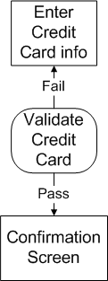
Shopping Cart Flow Definition
<action-state id="validateCC">
<evaluate
expression=“basketService.validateCC(cart)" />
<transition on=“yes" to="confirm" />
<transition on=“no" to="ccInfo" />
</action-state>
Notes:
ACTION STATE WITH MULTIPLE TRANSITIONS
Here is an example of driving the flow based the return value from an action.
Result types: Boolean (use yes/no in transitions as shown), String, Enum
This is different from WebFlow 1.x where you would have to store the method result in flash scope, then transition to a decision-state to determine what the next state would be.

Slide 28
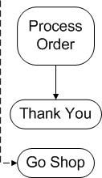
Shopping Cart Flow Definition
<action-state id="processOrder">
<evaluate expression=“…”/>
<transition to="thankYou" />
</action-state>
<end-state id="thankYou“ view=“thankYou”>
<output name=“confirmationNumber”
value=“cart.confirmationNumber” />
</end-state>
<end-state id="goShopping" view="externalRedirect:servletRelative:/home" />
Notes:
END STATE; END STATE WITH OUTPUT
The output element is how a flow “returns” a value
goShopping end state illustrates the externalRedirect:servletRelative: pseudo URLs.
externalRedirect means the view is external to the flow.
servletRelative:/home = go to the controller mapped /home on the same dispatcherServlet as this flow

Slide 29
Coding the View
Standard HTML forms
Can use Spring MVC form tags
Variables from all scopes are available to EL expressions as request scoped variables
Always POST to the flow controller
  EL Variable: ${flowExecutionURL}

Slide 30
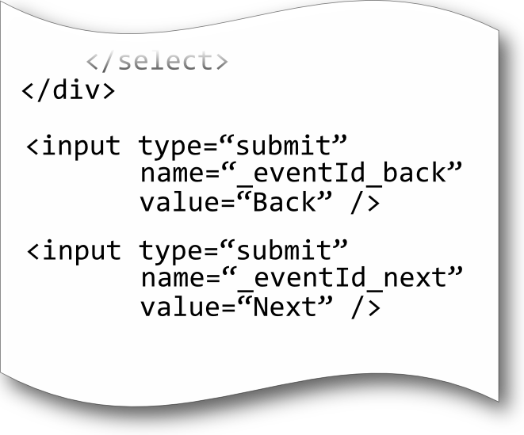
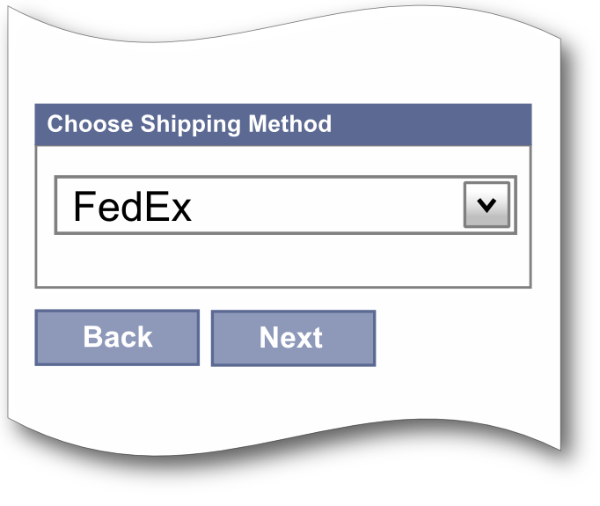
Triggering an Event:
Named Button

Slide 31
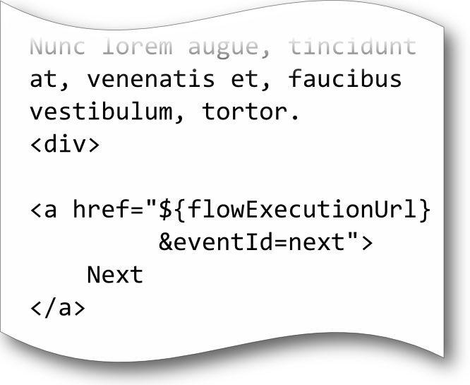
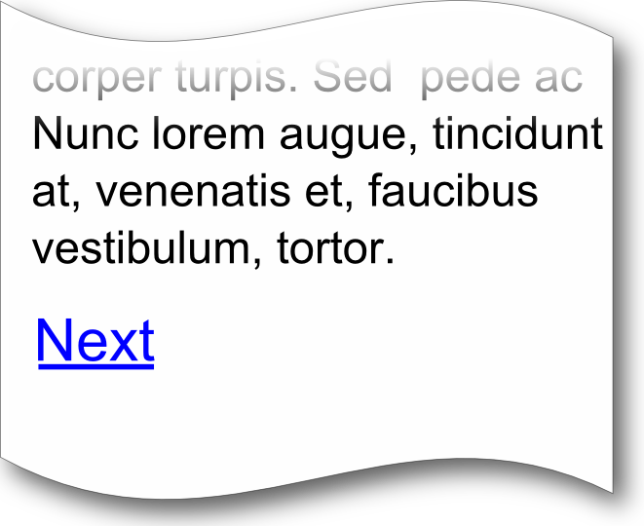
Triggering an Event:
Link

Slide 32
Agenda
Stateful web application development
Model business process as a single unit
Processes are reusable across different areas of the application
Testing

Slide 33
Subflows
No different than a flow
Call a flow from another flow
Has its own variable namespace
  Flow scope not shared between flows
  Conversation scope is shared between flows
Analogous to a method call in Java code

Slide 34
Shopping Cart Flow Diagram
Notes:
This is just a copy of the original flow diagram from before.
Talk about how we want to add the ability to add our shipping or billing address to an address book.
This functionality should only be available to users who are logged on.
The address book functionality has already been written when the account management piece was written.
Transition to next slide to show what we’re adding.

Slide 35
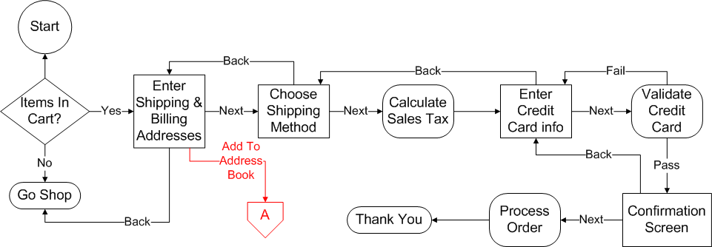
Shopping Cart Flow Diagram
Notes:
The only thing added is a callout to a separate flow.

Slide 36
High Level Concepts

Slide 37

Subflow Definition
<view-state id="enterAddresses">
<transition on="next" to="shipMethod" />
<transition on="addrBook" to="addrBook" />
</view-state>
<subflow-state id="addrBook“
subflow="addressBookFlow">
<attribute name="user" value="cart.user" />
<transition to=“enterAddresses” />
</subflow-state>
Notes:
Point out how a subflow is just a state in the calling flow. It can be transitioned to and from just like any other flow state.
Note the secured element in the subflow state definition. Secured can be applied to flows, transitions, or states. There is an optional “match” attribute with possible values of “any” or “all” to use when you specify multiple roles (comma separated)
Result is that an “AccessDeniedException” will be thrown and will be automatically handled by the Spring Security component.
Talk about security requirement before next slide!

Slide 38

Securing WebFlow
<view-state id="enterAddresses">
<transition on="next" to="shipMethod" />
<transition on="addrBook" to="addrBook" />
</view-state>
<subflow-state id="addrBook“
subflow="addressBookFlow">
<secured attributes="ROLE_AUTHENTICATED" />
<attribute name="user" value="cart.user" />
<transition to=“enterAddresses” />
</subflow-state>
<view-state id="enterAddresses">
<transition on="next" to="shipMethod" />
<transition on="addrBook" to="addrBook" />
</view-state>
<subflow-state id="addrBook“
subflow="addressBookFlow">
<secured attributes=“ROLE_AUTHENTICATED” />
<attribute name="user" value="cart.user" />
<transition to=“enterAddresses” />
</subflow-state>
Notes:
Attributes attribute is a comma delimited list of roles.
“Match” attribute values “any” or “all”

Slide 39
Securing WebFlow
Integrates with Spring Security
<secured> tag can be applied to
  States
  Transitions
  Flows
AccessDeniedException thrown
  Handled by Spring Security according to its own configuration

Slide 40
Agenda
Stateful web application development
Model business process as a single unit
Processes are reusable across different areas of the application
Testing

Slide 41
Testing WebFlow
Testing a multi page web process can be very difficult
  Usually involves setting up a test server and actually running the application
  Difficult to isolate the process flow definition from the execution
  Difficult to test middle steps without executing all previous steps
Notes:
First sub point: Could either be manual testing on an actual running application, or if you’re a testing ninja setting up something like HTTPUnit and running automated tests.
Second sub point: It would be nice to test that the application executes action A when you would expect it without actually executing the action.

Slide 42
Testing WebFlow
WebFlow ships with the AbstractXmlFlowExecutionTests class
  JUnit test
  All tests run inside of a full Spring container, with all objects wired up
At minimum, give it the location of your XML flow definition
Provides other useful hooks
  Register stubs and mocks with the Spring container
  Provide path to parent flow definition if necessary
Notes:
Just like all other Spring test classes, these tests run inside of a Spring container which creates all beans. The first hook provides the ability to override the ShoppingCartService with a Mock.
Path to parent flow might be useful for testing proper return from a sub-flow for example.

Slide 43
AbstractXmlFlowExecutionTests
Drive Flow Execution
  startFlow(), setCurrentState(), resumeFlow()
Assertions
  assertCurrentStateEquals()
  assertFlowExecutionEnded()
  more
Scoped Variable Access
  Get and set

Slide 44
MockExternalContext
Use this class to populate whatever external state you expect for the portion of the flow under test
  setCurrentUser()
  setEventId()
  getRequestParameterMap().put(“name”, “value”)

Slide 45
Example Test: Making Transitions
public void testSomething() throws Exception {
setCurrentState(“enterAddresses”);
MockExternalContext context =
new MockExternalContext(); context.setEventId(“next”);
resumeFlow(context);
assertCurrentStateEquals(“shipMethod”);
}

Slide 46
Summary
Stateful web application development
  Process driven approach very different from request driven approach of traditional MVC frameworks
Model business process as a single unit
  WebFlow uses a Domain Specific Language (DSL) analogous to a flow chart to model the process in a single file

Slide 47
Summary
Processes are reusable across different areas of the application
  Flows can be called by other flows just like a method call in Java code. Flows can accept input parameters and can return output values.
Easily Testable
  AbstractXmlFlowExecutionTests and MockExecutionContext provide a valuable harness for testing flow definitions in isolation from application logic.

Slide 48
Thank You!

