Slide 1
SIMulating Energy Transfer and UpConversion: SIMETUC
Pedro Villanueva Delgado

Slide 2
Outline
What kind of problems does it solve?
How does it solve them?
How to download and install it?
How to use it?
About the code.

Slide 3
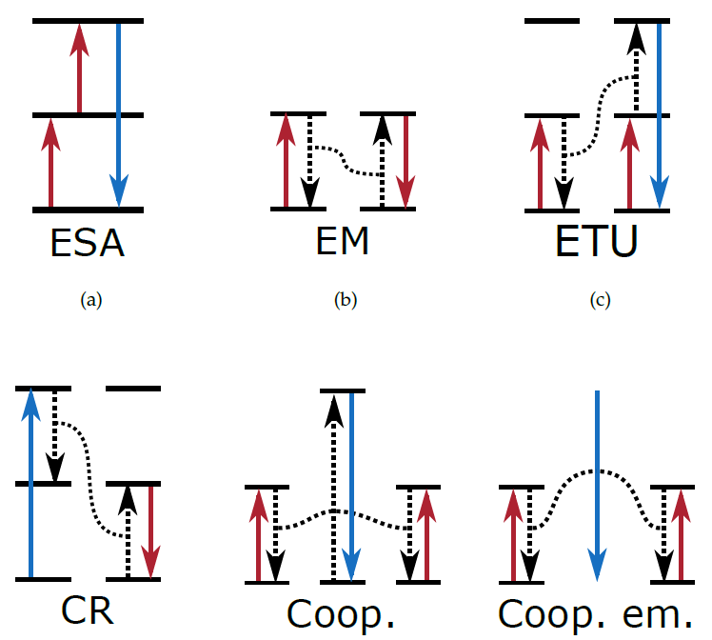
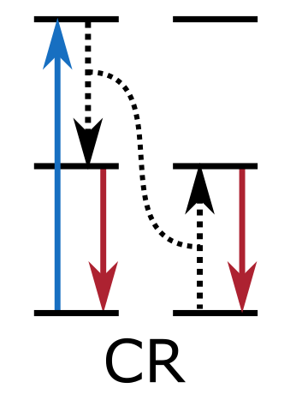
ET problems
Upconversion: The emission of higher energy photons after absorbing lower energy ones
Non-linear process.
ET and UC mechanisms:
ESA, ETU, Cooperative.
Different dynamics (lifetimes).
Different dependence with
Excitation power.
Dopant concentration.
Excited states
Metastable states
Ground states

Slide 4
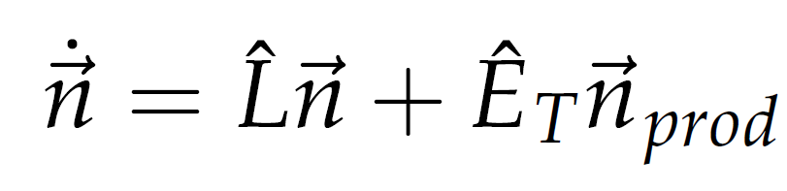
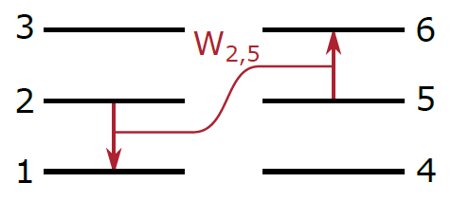
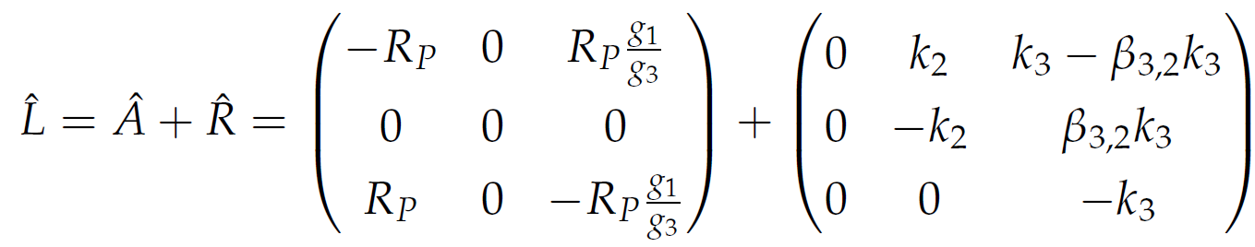
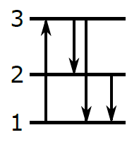
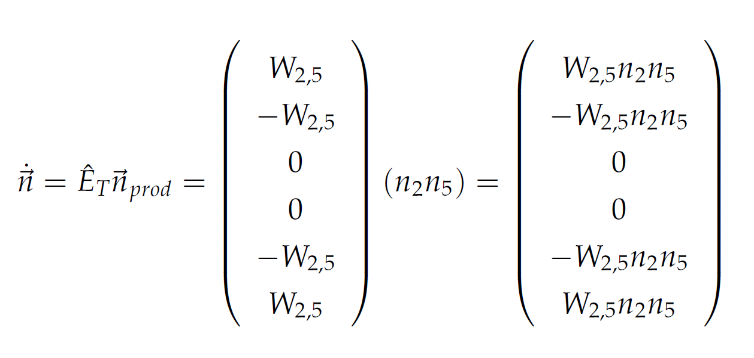
Solving SODEs
Systems of Ordinary Differential Equations (SODE).
β_{3,2}k₃
R_{p}
(1-β_{3,2})k₃
k₂

Slide 5
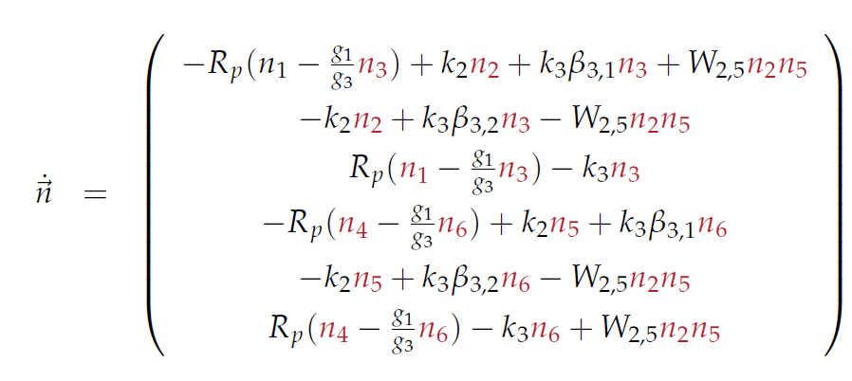
Solving SODEs
Systems of Ordinary Differential Equations (SODE).
Solver: Backward differentiation formulas (BDF).
β_{3,2}k₃
R_{p}
(1-β_{3,2})k₃
k₂

Slide 6
Installation of simetuc
Code available at https://github.com/pedvide/simetuc
Easiest for any operative system (Windows 32/64, Linux 32/64 and OSX 64 bits):
Install Anaconda (preferably 64 bits) from https://anaconda.org/
About 400 MB.
Miniconda is a lighter option.
Then install the simetuc package:
That will install all necessary packages.
A configuration file is required to use the program!
Download an example from https://github.com/pedvide/simetuc/blob/master/simetuc/config_file.txt
Create a folder for all your work with the config file.
And add an additional folder expData for the experimental data.
conda install –c pedvide simetuc

Slide 7
How to use simetuc
Current features:
Lattice creation.
Dynamics (rise and decay).
Optimization of ET parameters.
Minimize the deviation between experiment and simulation.
Steady state.
Power dependence of the emission.
Concentration dependence of the dynamics or the steady state.
Plot solutions.
All simulated data is saved in a standard .hdf5 format.
Simulated data can be saved and loaded at a later time.
Some data can be saved as a text file.

Slide 8
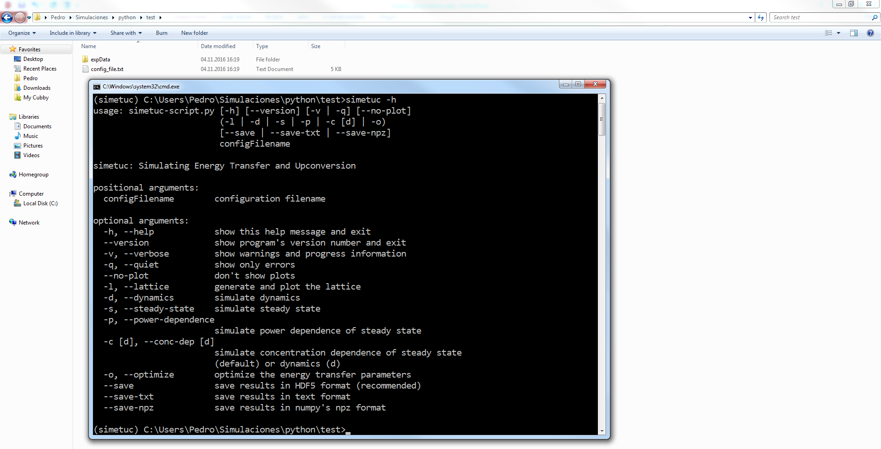
How to use simetuc

Slide 9
How to use simetuc
Configuration file:
Lattice:
version: 1
lattice:
name: bNaYF4
N_uc: 50
# concentration
S_conc: 0
A_conc: 0.3
# unit cell
a: 5.9738 # distances in Angstrom
b: 5.9738
c: 3.5297
alpha: 90 # angles in degree
beta: 90
gamma: 120
# the number is also ok for the spacegroup
spacegroup: P-6
# info about sites
sites_pos: [[0, 0, 0], [2/3, 1/3, 1/2]]
sites_occ: [1, 1/2]
# maximum distance of interaction for normal ET and for cooperative
d_max: 100.0 # optional, not yet implemented
# it's strongly advised to keep this number low
d_max_coop: 25.0 # optional
Use 4 spaces (no tabs!) to indent entries.

Slide 10
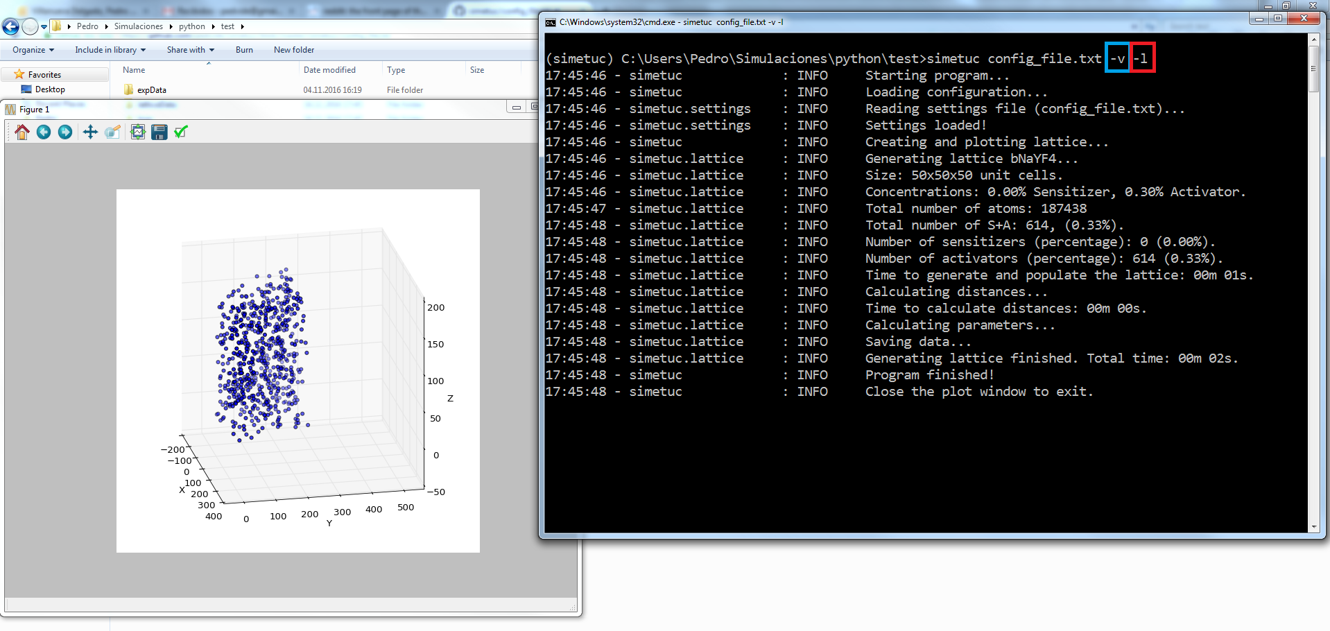
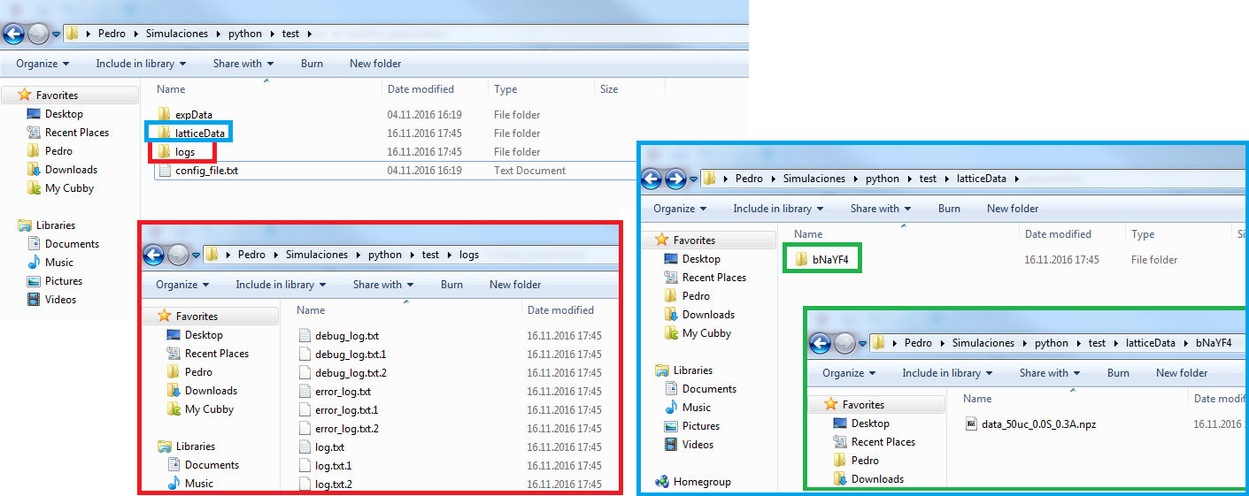
How to use simetuc
Lattice:

Slide 11
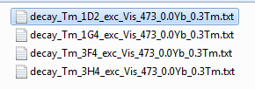
How to use simetuc
Experimental data:
Inside folder expData/latticeName/
Name format: data_ION_STATE_exc_EXCLABEL_xx.xION_yy.yION.txt
ION: ion label
STATE: state label
EXCLABEL: excitation label
xx.x: concentration of sensitizer
yy.y: concentration of activator
File format: two columns.
First: time in seconds
Second: emission intensity (any units).
Labels defined in the configuration file

Slide 12
How to use simetuc
Configuration file:
Dynamics (not ET):
# lifetimes in s
sensitizer_decay:
ES: 2.5e-3
activator_decay:
3F4: 12e-3
3H5: 25e-6
3H4: 2e-3
3F3: 2e-6
1G4: 760e-6
1D2: 67.5e-6
activator_branching_ratios:
# 3H5 and 3H4 to 3F4
3H5->3F4: 0.4
3H4->3F4: 0.3
3H4->3H5: 0.1
# 3F3 to 3H4
3F3->3H4: 0.999
# 1G4 to 3F4, 3H5, 3H4, 3F3
1G4->3F4: 0.15
1G4->3H5: 0.16
1G4->3H4: 0.04
1G4->3F3: 0.00
# 1D2 to 3F4
1D2->3F4: 0.43
states:
sensitizer_ion_label: Yb
sensitizer_states_labels: [GS, ES]
activator_ion_label: Tm
activator_states_labels: [3H6, 3F4, 3H5, 3H4, 3F3, 1G4, 1D2]
excitations:
Vis_473:
active: True
power_dens: 1e6 # power density W/cm^2
t_pulse: 1e-8 # optional: pulse width, seconds
process: Tm(3H6) -> Tm(1G4)
degeneracy: 13/9 # initial_state_g/final_state_g
pump_rate: 9.3e-4 # cross-section/energy cm2/J
NIR_800:
active: False
power_dens: 1e7
process: [Tm(3H6)->Tm(3H4), Tm(3H5)->Tm(1G4)]
degeneracy: [13/9, 11/9]
pump_rate: [4.4e-3, 4e-3]

Slide 13
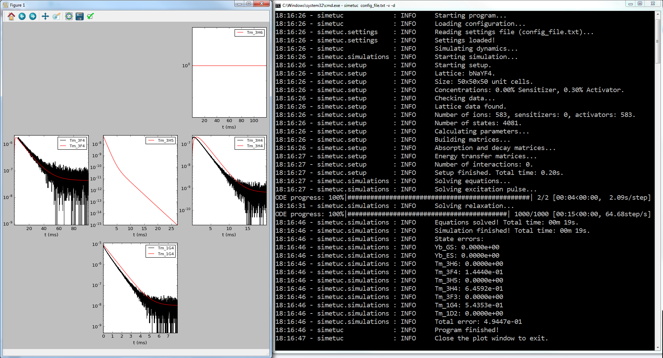
How to use simetuc
Dynamics (not ET):

Slide 14
How to use simetuc
Configuration file:
Dynamics (with ET):
enery_transfer:
# strength in s^(-1)*Angstrom^(multipolarity)
CR50:
process: Tm(1G4) + Tm(3H6) -> Tm(3H4) + Tm(3H5)
multipolarity: 6
strength: 2.89319954e+09
ETU53:
process: Tm(1G4) + Tm(3H4) -> Tm(1D2) + Tm(3F4)
multipolarity: 6
strength: 2.54295690e+08

Slide 15
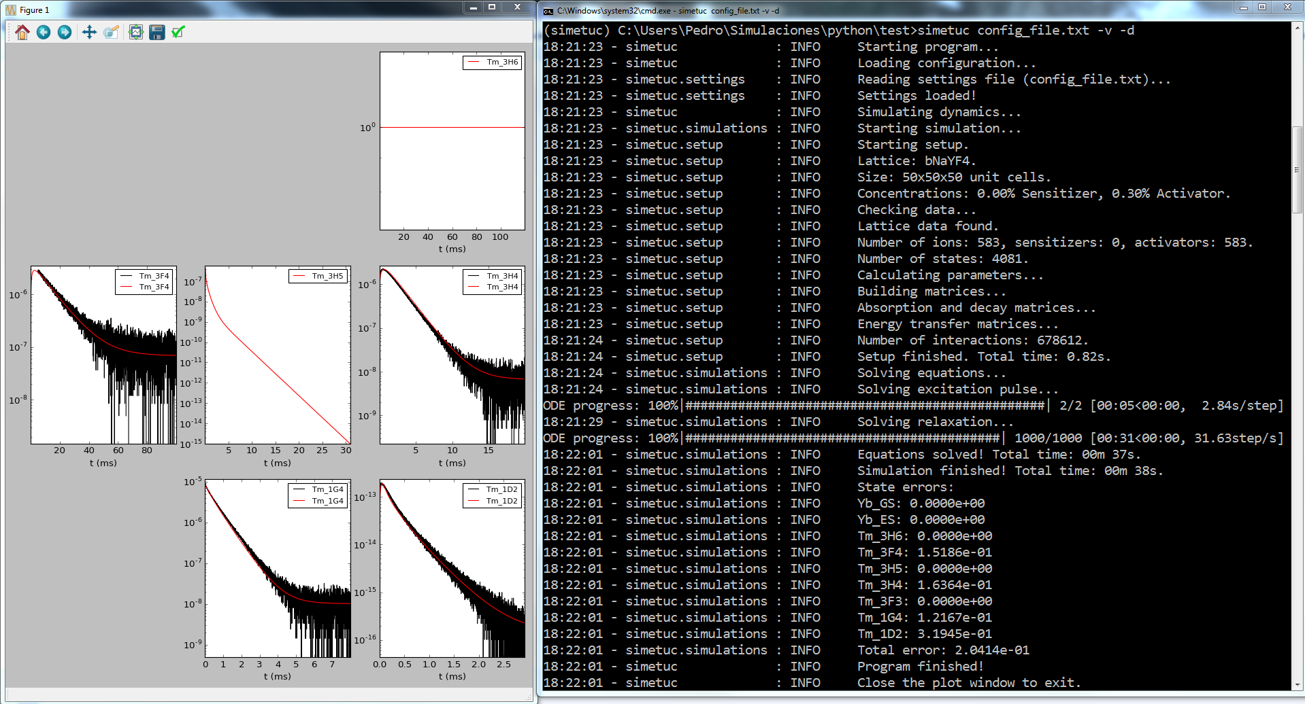
How to use simetuc
Dynamics (with ET):

Slide 16
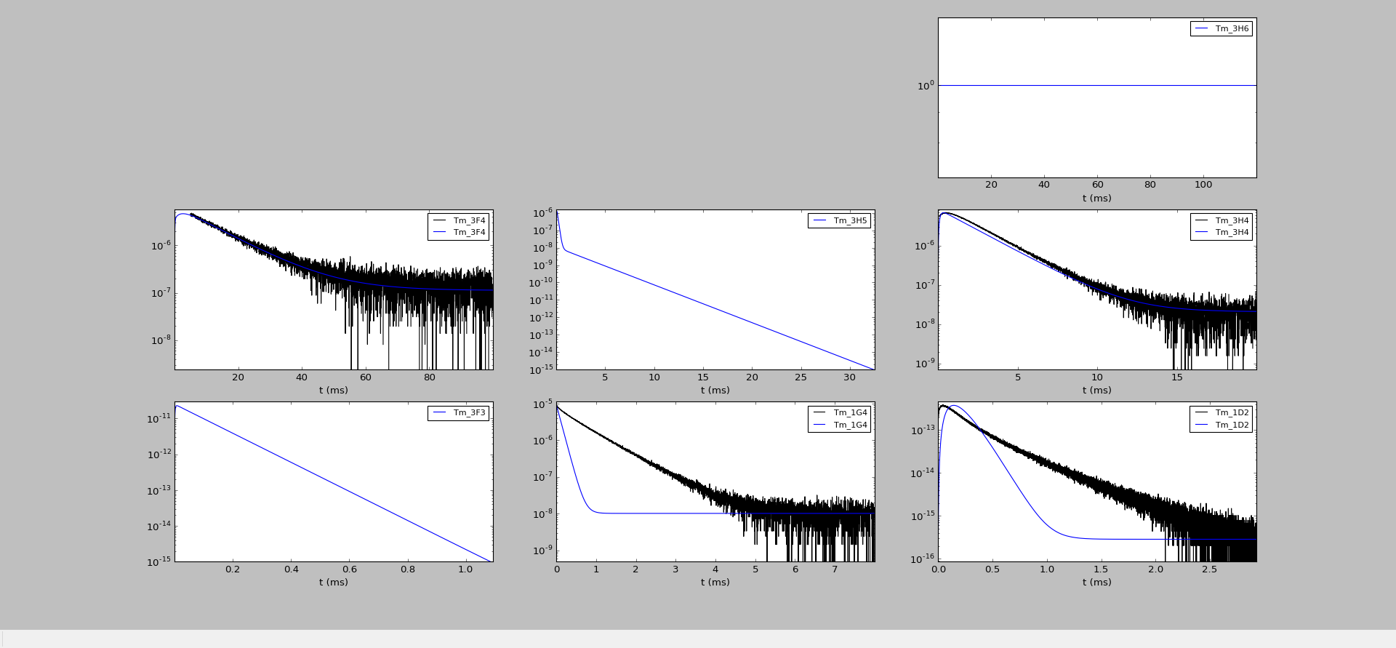
How to use simetuc
Dynamics (with ET):
Average rate equations

Slide 17
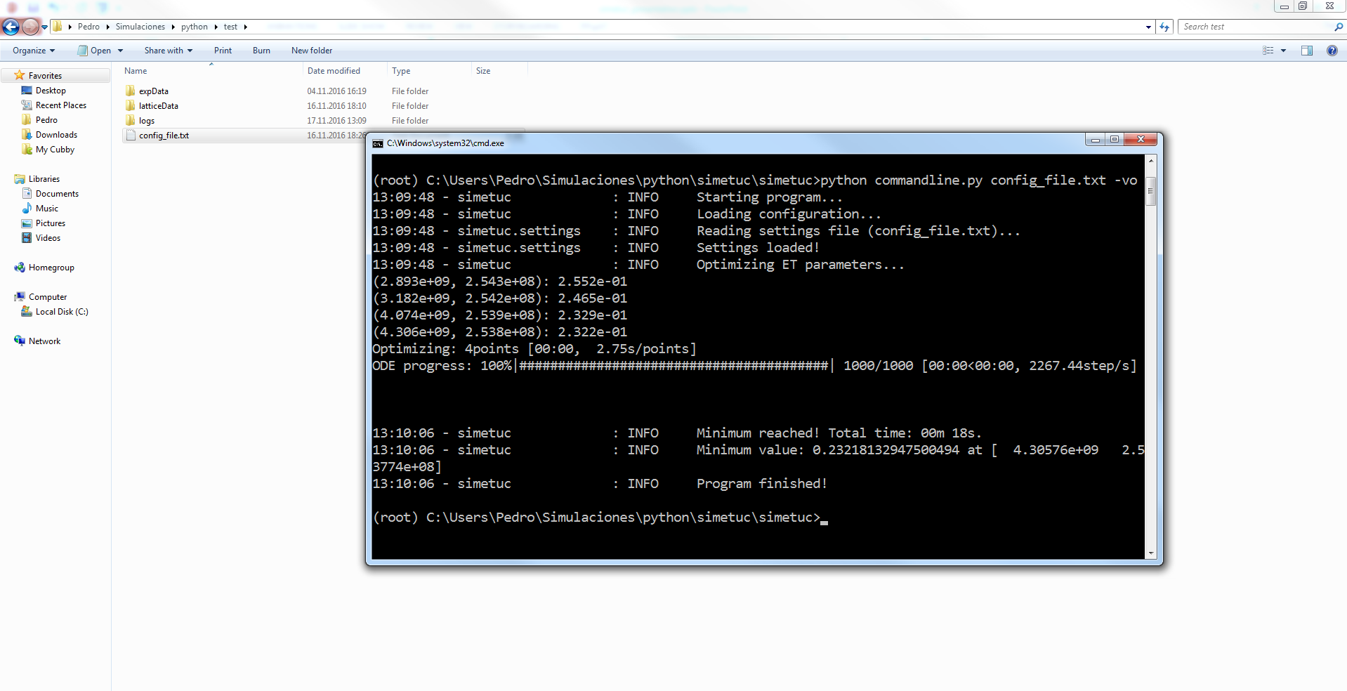
How to use simetuc
Optimize ET parameters:

Slide 18
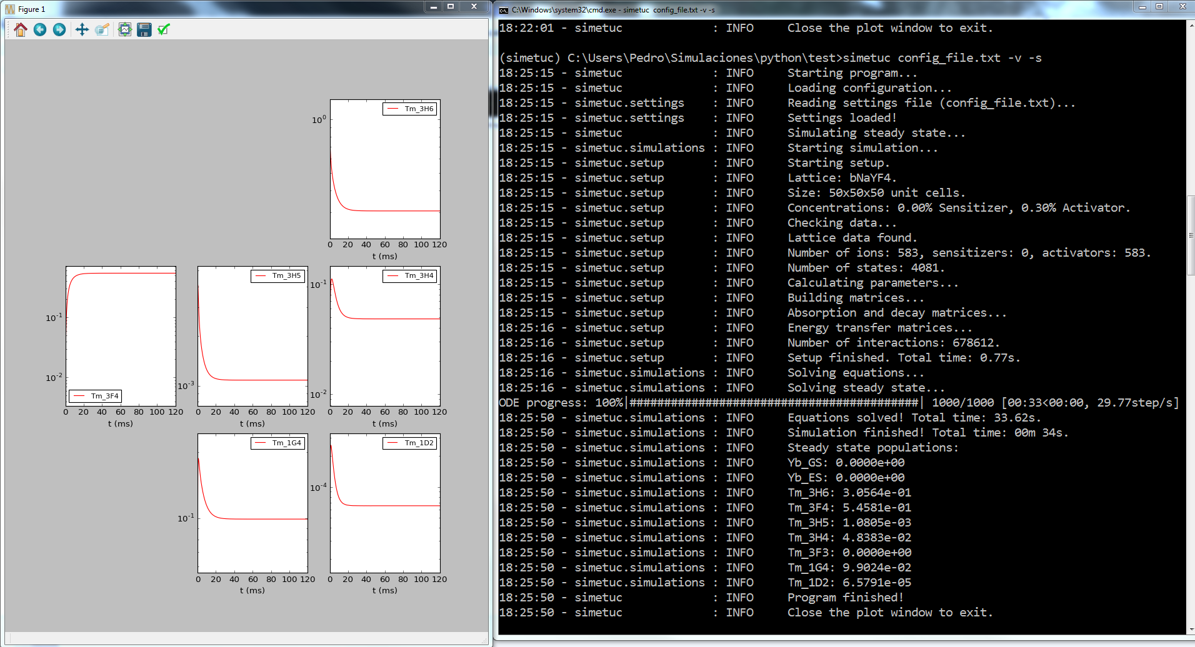
How to use simetuc
Steady state

Slide 19
How to use simetuc
Configuration file:
Power dependence.
# minimum and maximum excitation powers (in W/cm^2) and the number of points
# to calculate the power dependence
# note: a logarithmic scale is used
power_dependence: [1e1, 1e8, 8]

Slide 20
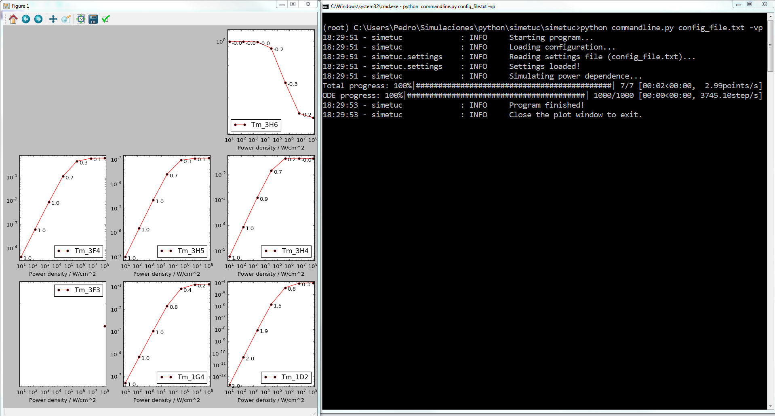
How to use simetuc
Power dependence

Slide 21
How to use simetuc
Configuration file:
Concentration dependence.
# list of two lists:
# with the sensitizer and the activator concentrations
# to simulate for the concentration dependence
concentration_dependence: [[0, 0.1, 0.5], [0.01, 0.1, 0.2, 0.3, 0.4, 0.5]]
or
concentration_dependence: [[0], [0.01, 0.1, 0.2, 0.3, 0.4, 0.5]]
or
concentration_dependence: [[0, 0.1, 0.5], [0.01]]

Slide 22
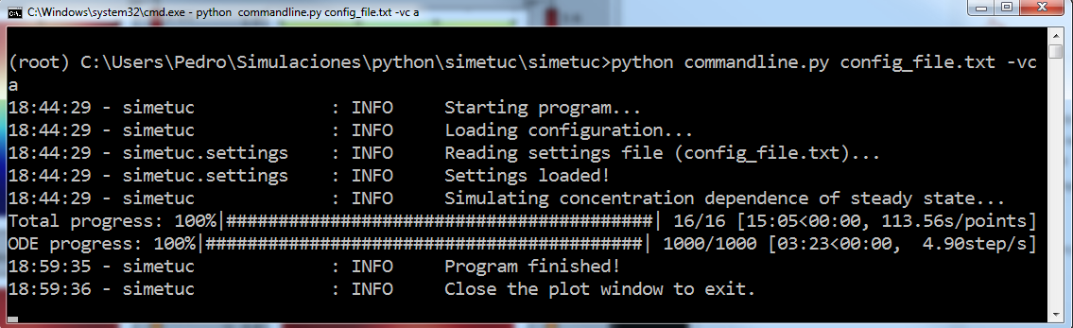
How to use simetuc
Concentration dependence

Slide 23
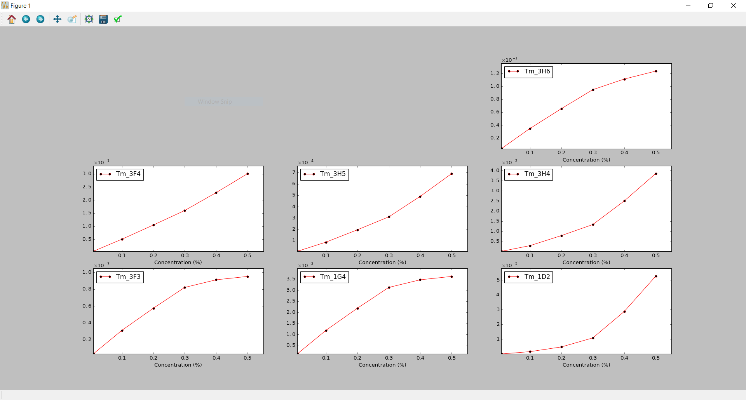
How to use simetuc
Concentration dependence

Slide 24
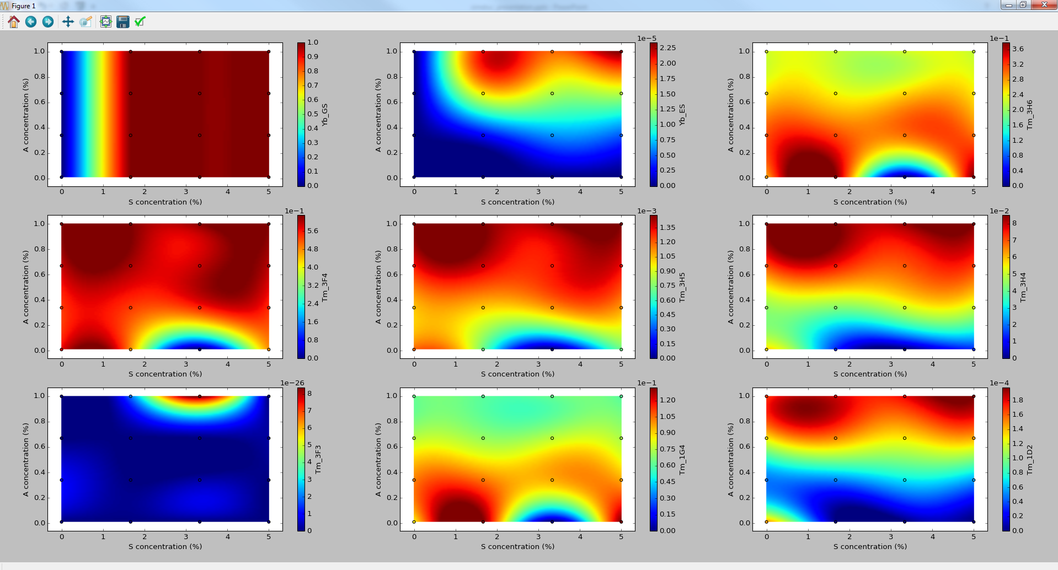
How to use simetuc
Concentration dependence

Slide 25
About the code
Code available at https://github.com/pedvide/simetuc
MIT license (open source).
Written in Python.
Thank you!

