Slide 1
SIMulating Energy Transfer and UpConversion: SIMETUC
Pedro Villanueva Delgado
University of Bern
Group seminar Nov. 2016

Slide 2
Outline
What kind of problems does it solve?
How does it solve them?
How to download and install it?
How to use it?
About the code.

Slide 3
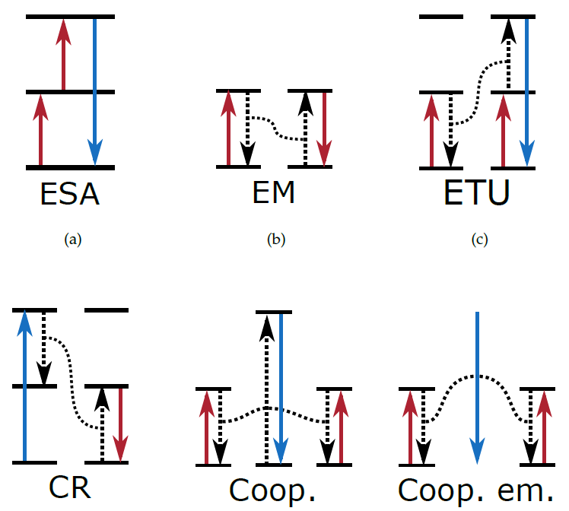
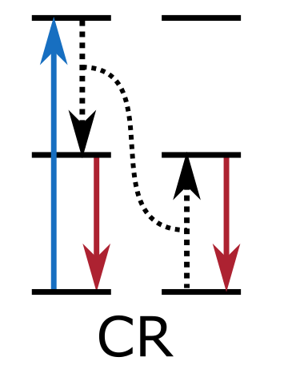
ET problems
Upconversion: The emission of higher energy photons after absorbing lower energy ones
Non-linear process.
ET and UC mechanisms:
ESA, ETU, Cooperative.
Different dynamics (lifetimes).
Different dependence with
Excitation power.
Dopant concentration.
Excited states
Metastable states
Ground states

Slide 4
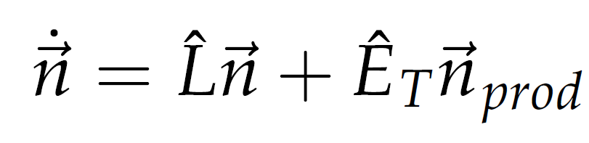
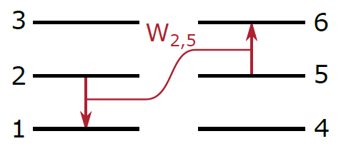
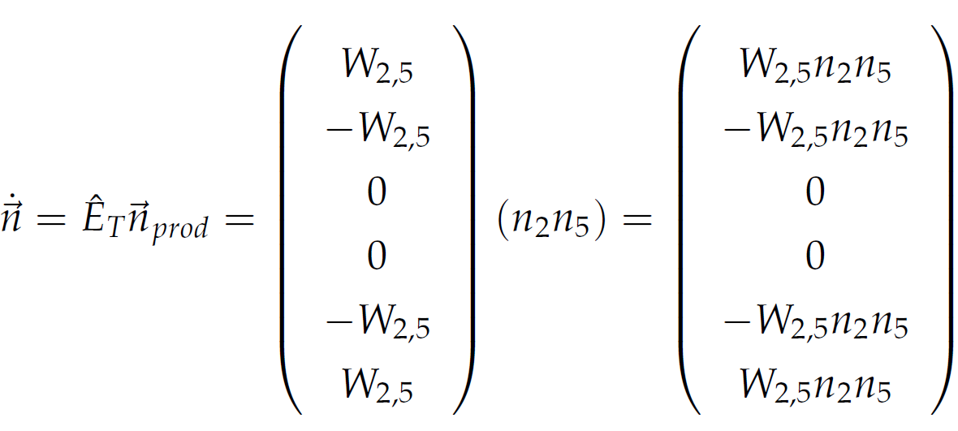
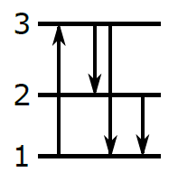
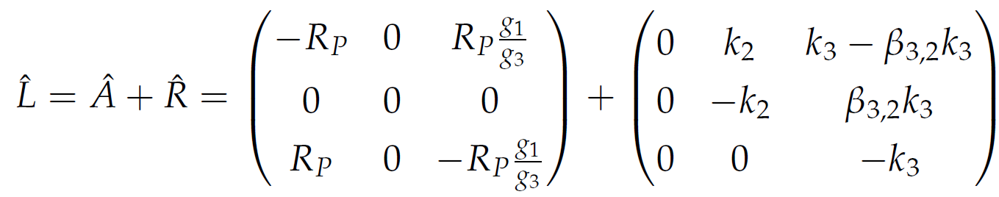
Solving SODEs
Systems of Ordinary Differential Equations (SODE).

Slide 5
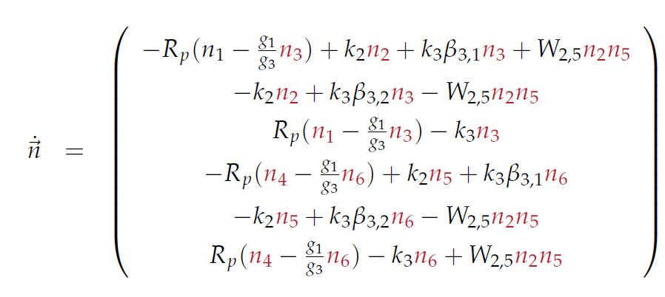
Solving SODEs
Systems of Ordinary Differential Equations (SODE).
Solver: Backward differentiation formulas (BDF).

Slide 6
Installation of simetuc
Easiest for any operative system:
Install Anaconda (preferably 64 bits) from https://anaconda.org/
About 400 MB.
Miniconda is a lighter option.
Then install the simetuc package:
About 100 KB.
That will install all necessary packages.
A configuration file is required to use the program!
Download an example from https://github.com/pedvide/simetuc/blob/master/simetuc/config_file.txt
Create a folder for all your work with the config file.
And an additional folder expData for the experimental data.
conda install –c pedvide simetuc

Slide 7
How to use simetuc
Current features:
Lattice creation.
Dynamics (rise and decay).
Optimization of ET parameters.
Steady state.
Power dependence.
Concentration dependence of the dynamics or the steady state.
Plot solutions.
All simulated data is saved in a standard .hdf5 format.
Simulated data can be saved and loaded at a later time.
Some data can be saved as a text file.

Slide 8
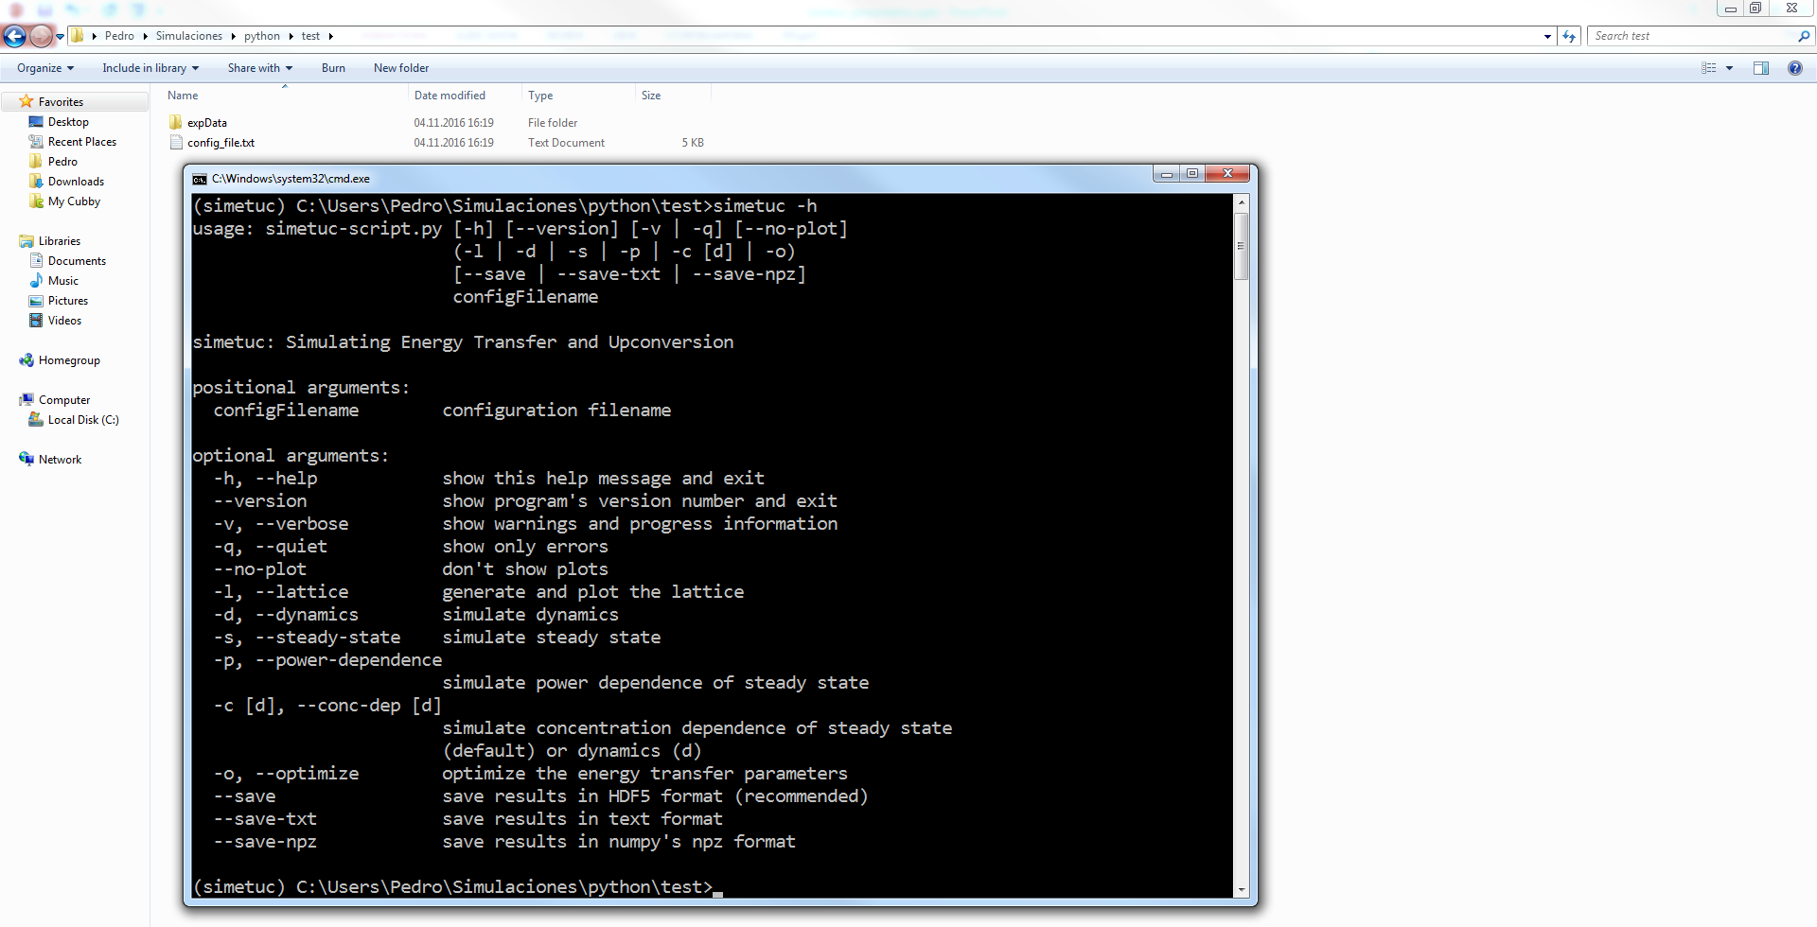
How to use simetuc

Slide 9
How to use simetuc
Configuration file:
Lattice:
version: 1
lattice:
name: bNaYF4
N_uc: 50
# concentration
S_conc: 0
A_conc: 0.3
# unit cell
# distances in Angstrom
a: 5.9738
b: 5.9738
c: 3.5297
# angles in degree
alpha: 90
beta: 90
gamma: 120
# the number is also ok for the spacegroup
spacegroup: P-6
# info about sites
sites_pos: [[0, 0, 0], [2/3, 1/3, 1/2]]
sites_occ: [1, 1/2]
Use 4 spaces (no tabs!) to indent entries.

Slide 10
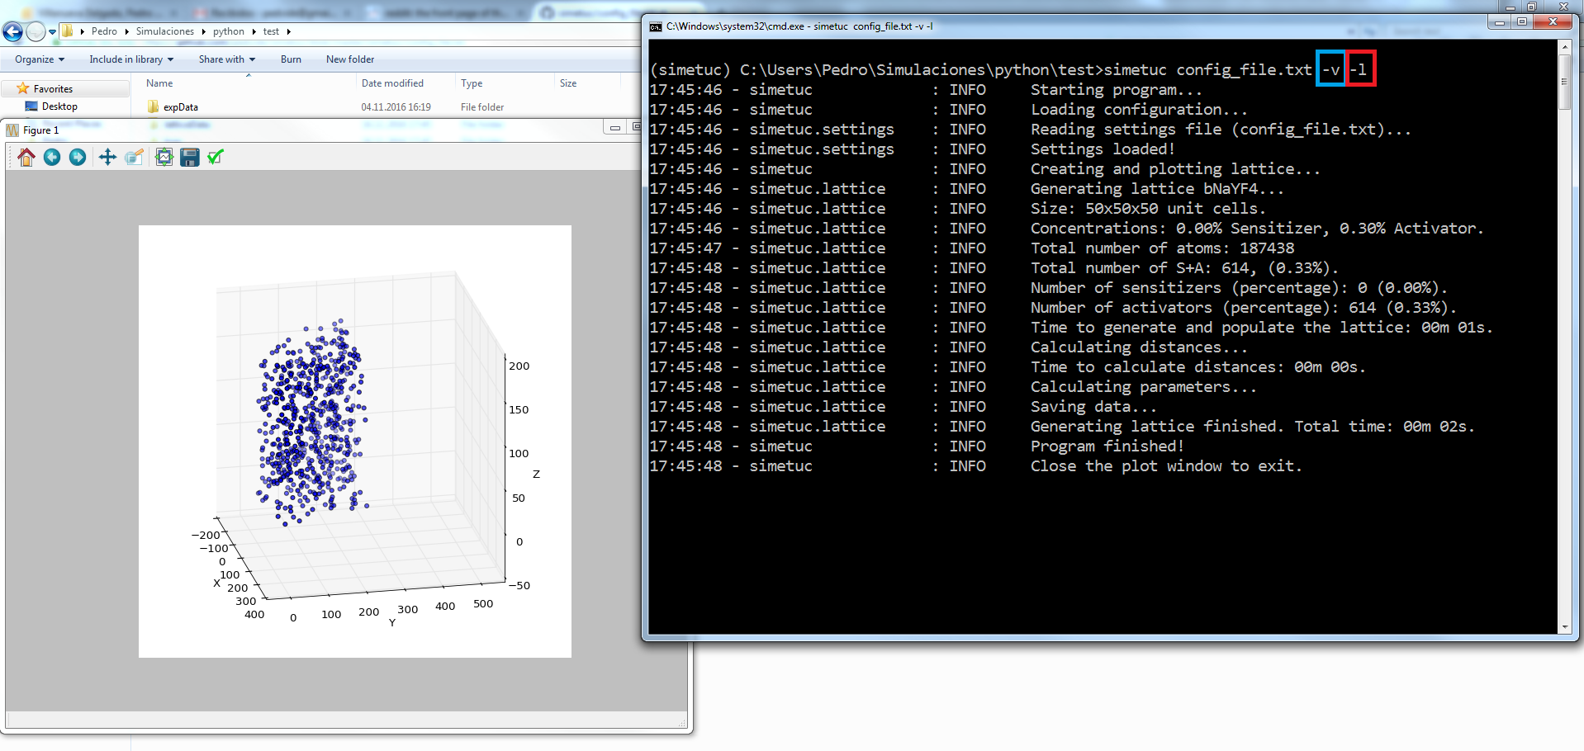
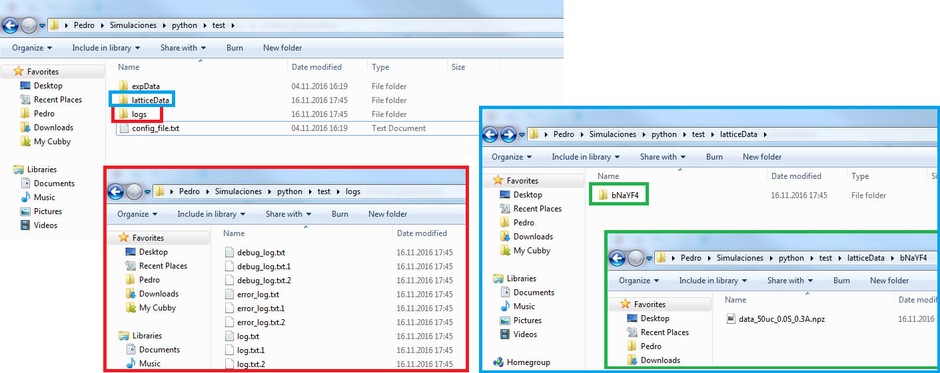
How to use simetuc
Lattice:

Slide 11
How to use simetuc
Configuration file:
Dynamics (not ET):
# lifetimes in s
sensitizer_decay:
ES: 2.5e-3
activator_decay:
3F4: 12e-3
3H5: 25e-6
3H4: 2e-3
3F3: 2e-6
1G4: 760e-6
1D2: 67.5e-6
activator_branching_ratios:
# 3H5 and 3H4 to 3F4
3H5->3F4: 0.4
3H4->3F4: 0.3
3H4->3H5: 0.1
# 3F3 to 3H4
3F3->3H4: 0.999
# 1G4 to 3F4, 3H5, 3H4, 3F3
1G4->3F4: 0.15
1G4->3H5: 0.16
1G4->3H4: 0.04
1G4->3F3: 0.00
# 1D2 to 3F4
1D2->3F4: 0.43
states:
sensitizer_ion_label: Yb
sensitizer_states_labels: [GS, ES]
activator_ion_label: Tm
activator_states_labels: [3H6, 3F4, 3H5, 3H4, 3F3, 1G4, 1D2]
excitations:
Vis_473:
active: True
power_dens: 1e6 # power density W/cm^2
t_pulse: 1e-8 # pulse width, seconds
process: Tm(3H6) -> Tm(1G4)
degeneracy: 13/9 # initial_state_g/final_state_g
pump_rate: 9.3e-4 # cm2/J
NIR_800:
active: False
power_dens: 1e7
process: [Tm(3H6)->Tm(3H4), Tm(3H5)->Tm(1G4)]
degeneracy: [13/9, 11/9]
pump_rate: [4.4e-3, 4e-3]

Slide 12
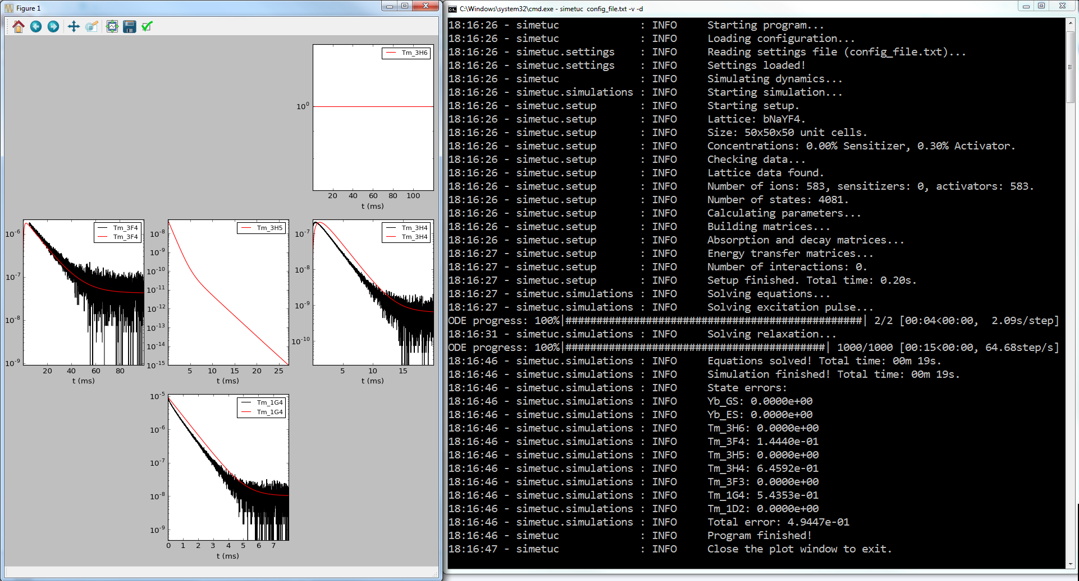
How to use simetuc
Dynamics (not ET):

Slide 13
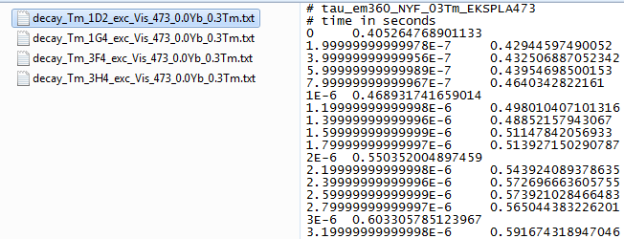
How to use simetuc
Experimental data:
Inside folder expData/latticeName/

Slide 14
How to use simetuc
Configuration file:
Dynamics (with ET):
enery_transfer:
# strength in s^(-1)*Angstrom^(multipolarity)
CR50:
process: Tm(1G4) + Tm(3H6) -> Tm(3H4) + Tm(3H5)
multipolarity: 6
strength: 2.89319954e+09
ETU53:
process: Tm(1G4) + Tm(3H4) -> Tm(1D2) + Tm(3F4)
multipolarity: 6
strength: 2.54295690e+08

Slide 15
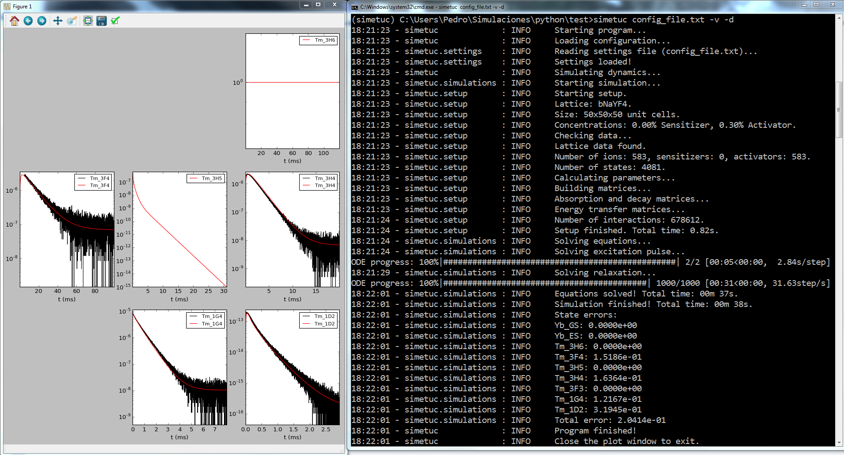
How to use simetuc
Dynamics (with ET):

Slide 16
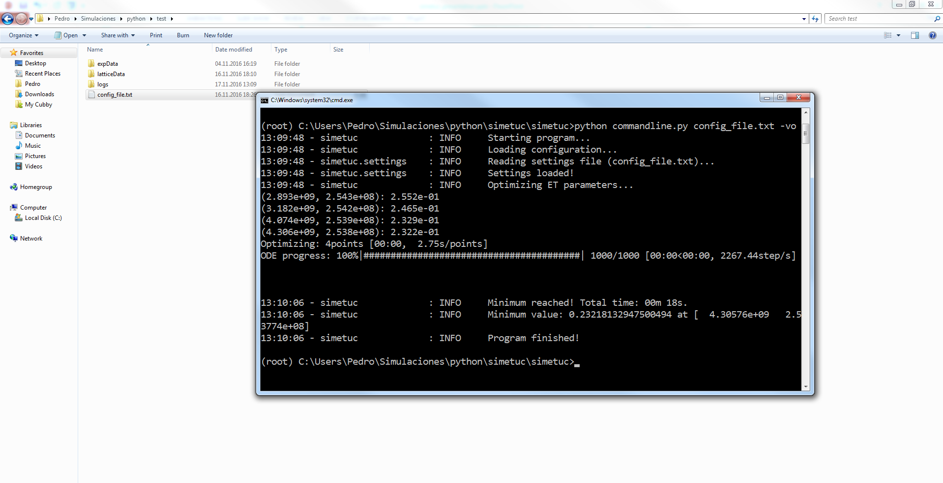
How to use simetuc
Optimize ET parameters:

Slide 17
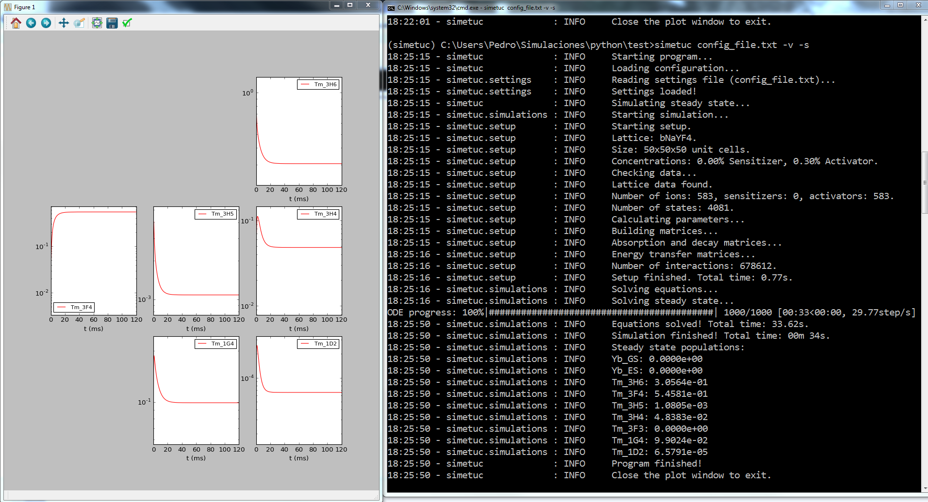
How to use simetuc
Steady state

Slide 18
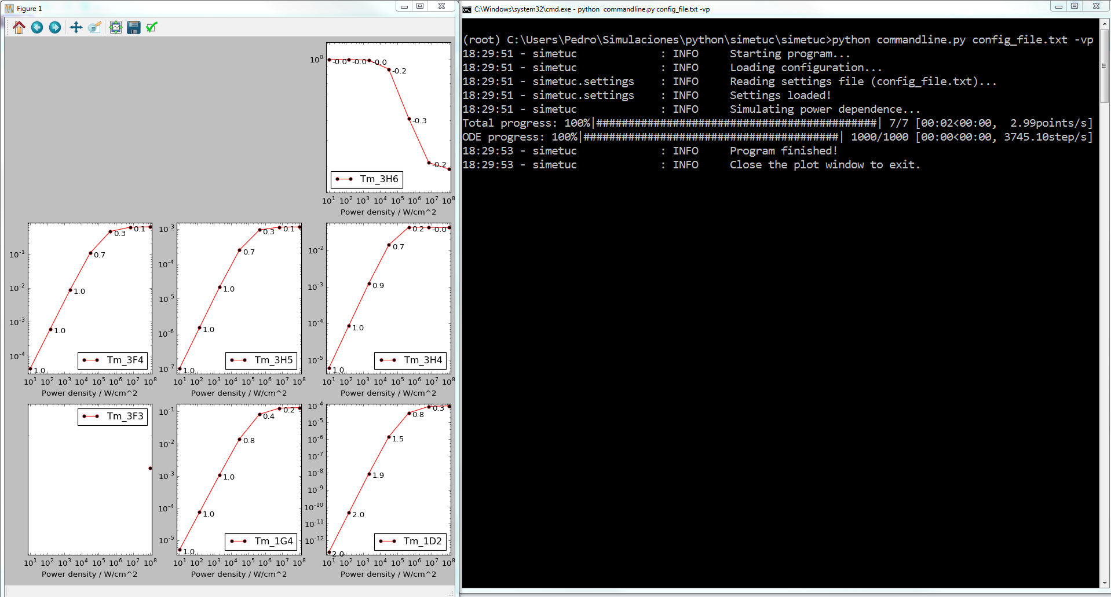
How to use simetuc
Power dependence

Slide 19
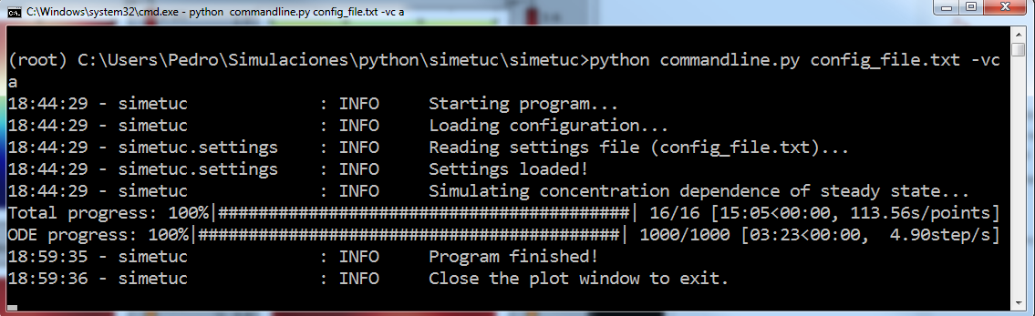
How to use simetuc
Concentration dependence

Slide 20
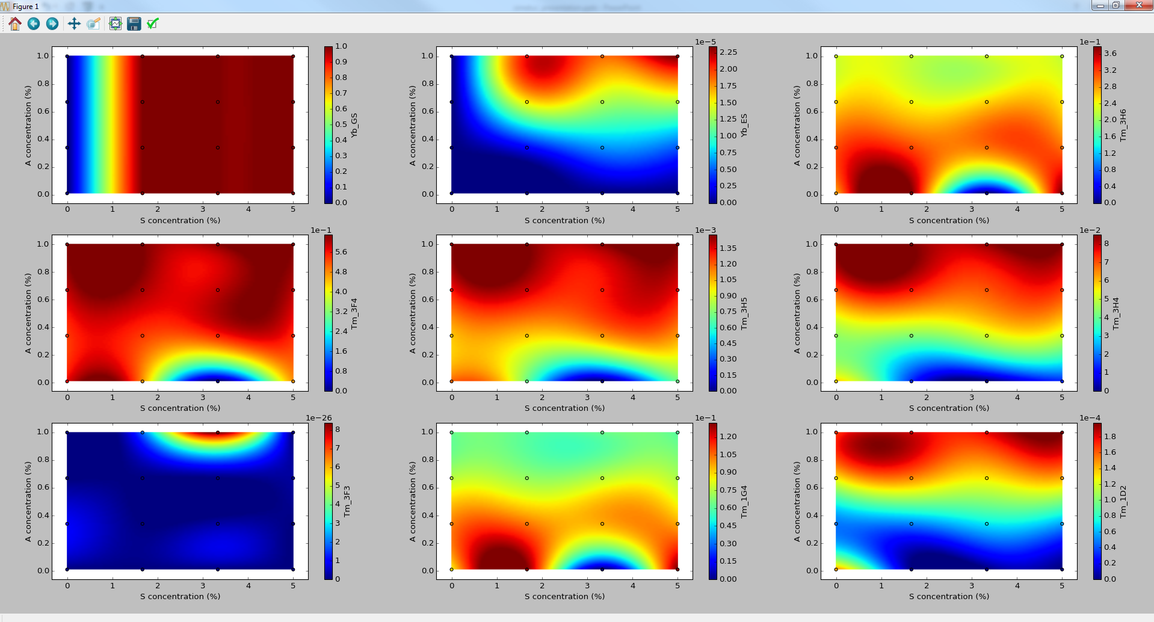
How to use simetuc
Concentration dependence

Slide 21
About the code
Code available at https://github.com/pedvide/simetuc
MIT license (open source).
Written in Python.
Thank you!

