Slide 1
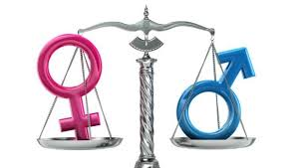
Global Gender Gap Report
Mrigank Twari
Teresalina Paez

Slide 2

Gender Equality - why do we need
→ Huge ramifications for lives of girls and women
→ Also stores huge improvements to
→ human development
→ labor markets
→ GDP growth
→ productivity

Slide 3
Clarifications
→ Where men & women stand wrt some fundamental indicators.
→ It is NOT same as women empowerment.
→ AIM: where do men and women stand wrt the indicators
(Gender equality)

Slide 4
Data / resources used
→ World Bank data from multiple indicators
→ World Economic forum reports
→ McKinsey Global Institute’s work on gender gap reports

Slide 5
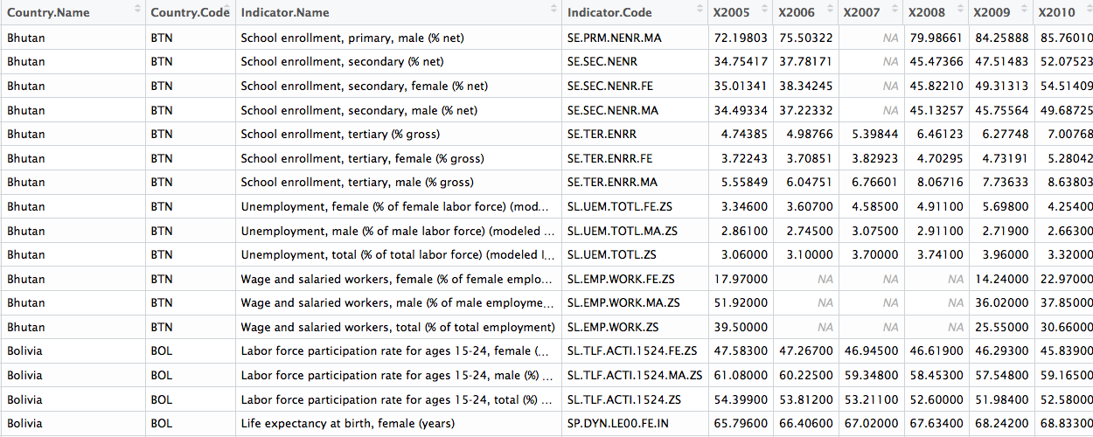
Data overview

Slide 6
Methodologies
Data pre-processing:
→ Indicators selection
→ Combining the data for past 10 years
→ Merging the countries data with regions
Issues:
→ Many NA values
Solution:
→ decided NOT to use any replacement techniques
→ because interpolation or econometric techniques would replace those with an assumption of certain trend.

Slide 7
What is happening with the gender inequality in the last ten years?
Educational attainment:
→ difference in % literacy b/w male & female on an average has come down in past 10 years
→ but it has become stagnant since 2009.
→ Africa, Middle east and South-East Asian regions show biggest gap in gender equality
→ European union, North Asia, some parts of South America show lowest gap in gender equality

Slide 8
What is happening with the gender inequality in the last ten years?
Economic participation:
→ On an average, unemployment rate for women is higher than men.
→ The gap b/w the two, has gone down over the past 10 years.

Slide 9
What is happening with the gender inequality in the last ten years?
Health:
→ Life expectancy is higher for women than men.
→ The life expectancy does not significantly change.

Slide 10
What is happening with the gender inequality in the last ten years?
Political empowerment:
→ We do not see any significant change in this indicator
→ As the elections happen over a period of 4-5 years
→ Bringing new reservations take some significant time.

