Slide 1


Slide 2

Team Name - Tech Wizards
Problem Statement- The expansion of COVID-19 has had an effect on all of us. Furthermore, children are unsure of how to shield themselves from the infection. As a result, it is more important to educate primary school children about the importance of cleanliness and proper handwashing, so we devised a simple solution to address this problem.

Slide 3
TECHNOLOGY USED
Arduino UNO
IR Sensor
OLED Screen
Piezoelectric buzzer
Resistor’s, LED’s and Bread Board

Slide 4
SOLUTION
We developed a simple and compact device using inexpensive and readily available components such as an ARDUINO, an IR sensor, an O-LED screen, PIEZO electric buzzer, some resistor’s and LED’s.
The IR sensor detects hand movement and sends a signal to the ARDUINO, causing the LED to turn red from green, signaling the start of the 20-second hand wash timer.
When the 20 seconds are up, the buzzer beeps, signaling that the red led has turned green, indicating that you have successfully washed your hands and are no longer transmitting the COVID virus.

Slide 5
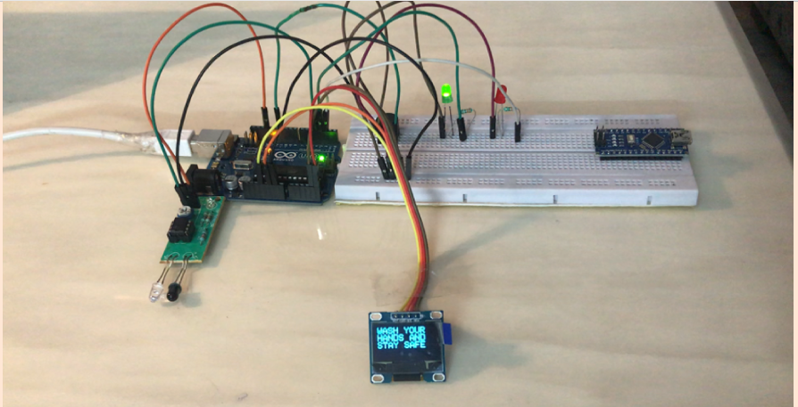
PROTOTYPE OF DEVICE

Slide 6
THANK YOU

