Slide 1

The Importance and Benefits of Open Science Practical Lessons for Sustainable MR Research
Open Science for MR in RT,
MR in Radiation Therapy Study Group Virtual Meeting
2026-03-02
Lars Kasper, PhD
Toronto Neuroimaging Facility, Dept of Psychology, University of Toronto
Secretary, Open and Reproducible Research Study Group (OR₂), ISMRM
With many thanks for slides and input:
Johanna Bayer
These slides are openly licensed (CC-BY 4.0).
© 2026 Lars Kasper — CC BY 4.0
Slides available on: mrikasper.github.io
Notes:
Thank you so much, Erin and Petra, for the kind introduction, and the opportunity to speak today about Open Science
I am a fervent supporter of open science and also active in different roles related to that
But non of those have any financial compensation, therefore…

Slide 2

ISMRM Workshop Series
Declaration of Financial Interests or Relationships
Speaker Name: Lars Kasper, PhD
I have no financial interests or relationships to disclose with regard to the subject matter of this presentation.
Notes:
I have nothing to declare wrt to the subject matter of this presentation

Slide 3
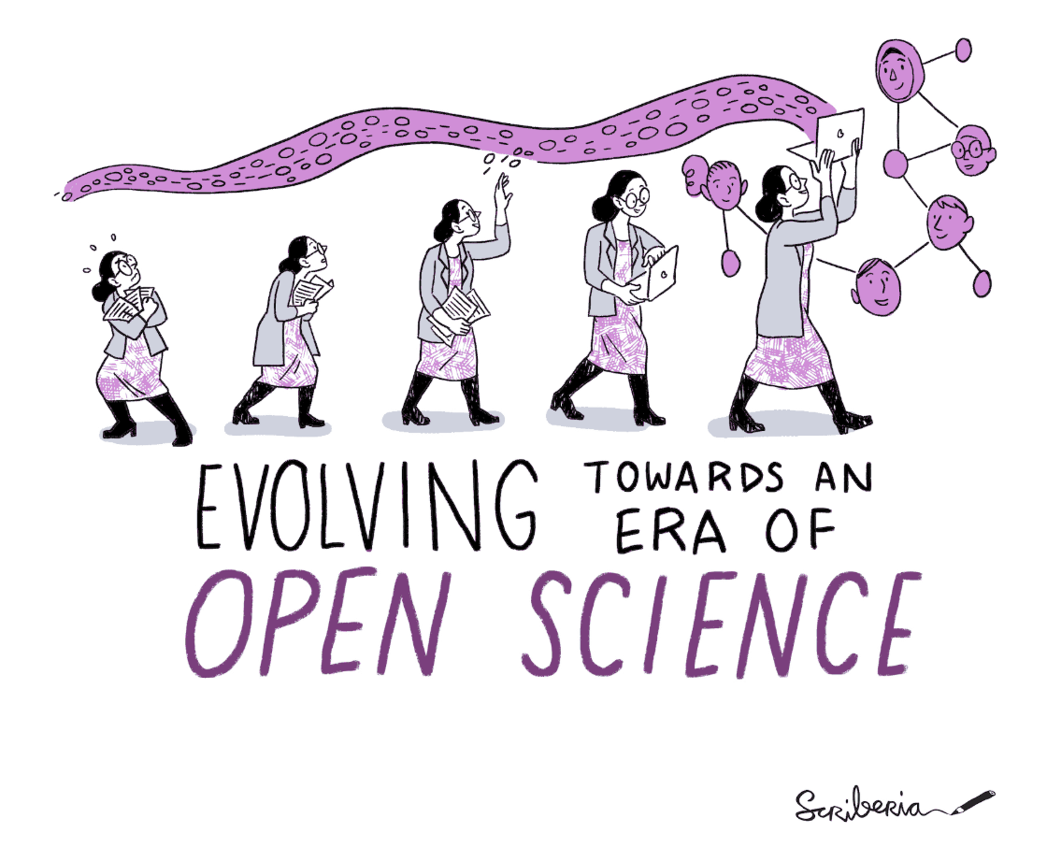
Why I care about this …
MR Physicist — from reconstruction to clinical translation (psychiatry)
Built tools used beyond my own lab (TAPAS, PhysIO, UniQC, GIRFReco.jl)
Learned the hard way about legacy code, lost detail, and sustainability
Realized open science is not idealism, but effective infrastructure
for yourself and others
More info (incl. these slides): mrikasper.github.io
The Turing Way project illustration by Scriberia. Used under a CC-BY 4.0 licence. DOI: The Turing Way Community & Scriberia (2024).
Notes:
I didn’t start in open science as a policy position
I am collaborative in nature and started as an MRI physicist, working from reconstruction all the way to translational applications in psychiatry.
I built tools that ended up being used beyond my own lab — TAPAS, PhysIO, UniQC, GIRFReco.jl.
And over time, I learned the hard way what happens when code isn’t documented, when detail is missing, when projects outlive the people who built them – I moved from Switzerland to Canada, for example and switched labs repeatedly.
For me, open science became a way to make research more efficient, sustainable, and reusable -

Slide 4
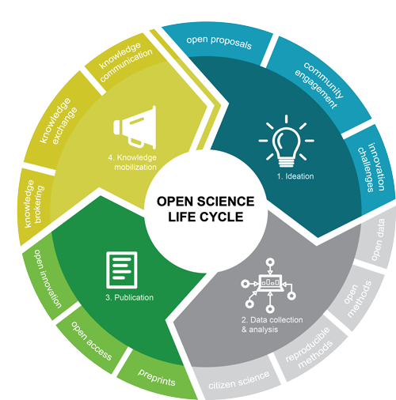
What is Open Science?
Open science means structuring the entire research lifecycle for transparency and reuse
Ideation: Registered reports
Data Collection & Analysis: Data Sharing, Open Source Code, Open Hardware
Publication: Open Access, standardized reporting (protocols), preprints, Open & Code Review
Knowledge Mobilization: Communities, Challenges, Reuse/Reproduce
Gaspar et al. (2025), “Advancing MRI, together: open science in MR research” (MAGMA, doi:10.1007/s10334-025-01286-8)
https://science.gc.ca/site/science/en/open-science
Notes:
Open Science means structuring the entire research lifecycle
…
In MR, where complexity is high and pipelines are long, lifecycle framing is especially important. It also means this is iterative, so you can start today implementing some aspects of it!

Slide 5
Example (Step 2): FAIR Data & Code
Findable
The first step in (re)using data/code is to find it!
Accessible
Once the user finds data and software they need to know how to access it.
Data could be openly available;
Also possible that authentication and authorisation is necessary.
Interoperable
Reusable
Data needs to be integrated with other data and interoperate with applications or workflows.
Data should be well-described so that they can be used, combined, and extended in different settings.
Code should be deposited in a repository with a persistent identifier (e.g., DOI)
The repository should be publicly available or provide clear access procedures, version control, and instructions for installation and dependencies.
Follow community standards and use interoperable formats
Libraries, and APIs integrated with other software, workflows, or data. Clear documentation of inputs and outputs supports interoperability.
Data and code need to be interoperable for humans and machines!
Share all information about your data, code and its provenance.
Code should be well-documented, versioned, and released under an explicit open-source license.
Include examples or tests so that others can understand, adapt, and extend it for new contexts.
Descriptive metadata (title, authors, keywords, version) is essential
https://www.openaire.eu/how-to-make-your-data-fair
Slide courtesy of Johanna Bayer

Slide 6
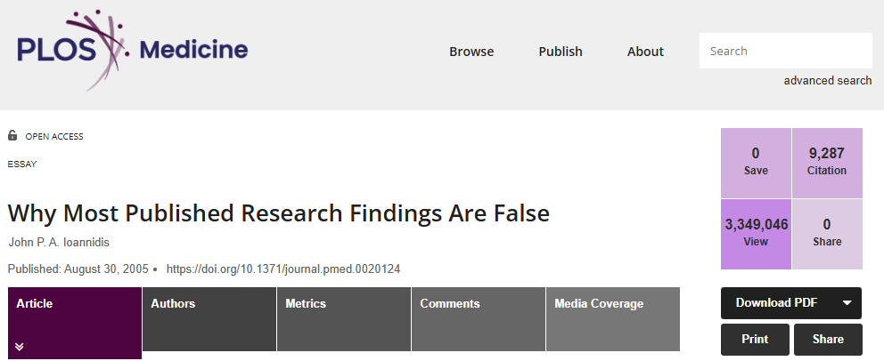
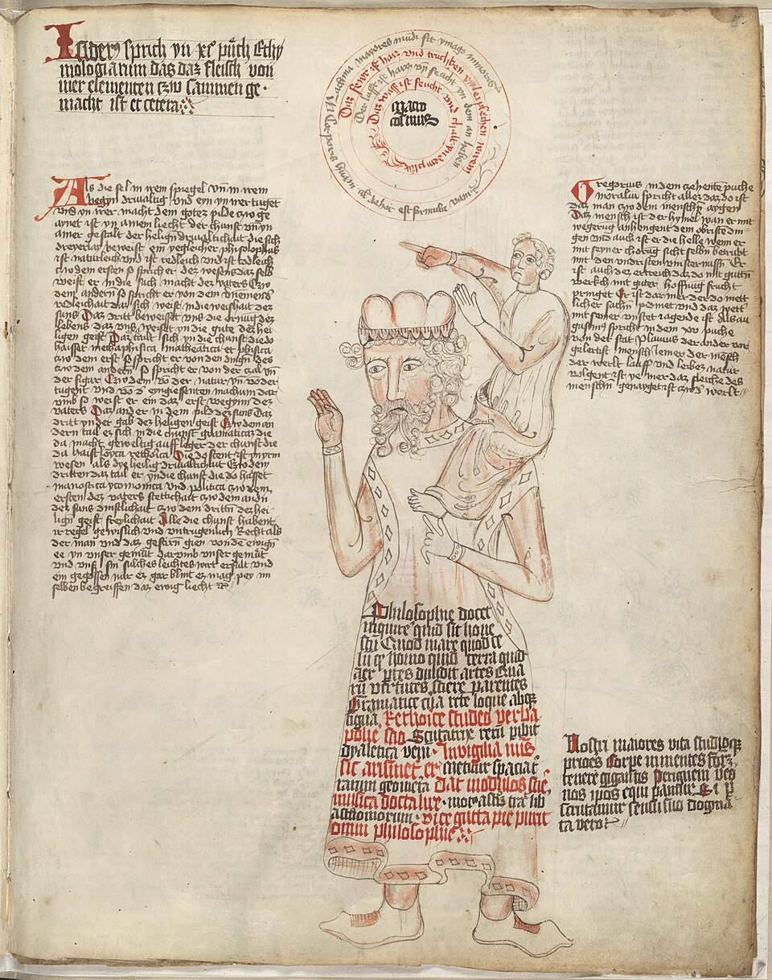
Why Open Science?
There are strong systemic and ethical arguments for open science,
Improving reproducibility
Reducing false positives^{[1]}
This sounds like a lot of work…what’s in it for me?
Today: Practical (and slightly selfish) arguments^{[2]}
Efficiency & Error Reduction
Collaboration & Continuity
Impact & Influence
https://lccn.loc.gov/50041709, Public domain, via Wikimedia Commons
[1] Ioannidis, J.P.A., 2005. Why Most Published Research Findings Are False. PLOS Medicine 2, e124. https://doi.org/10.1371/journal.pmed.0020124
[2] Markowetz, F., 2015. Five selfish reasons to work reproducibly. Genome Biol 16, 274. https://doi.org/10.1186/s13059-015-0850-7
Notes:
Why would we want to engage in open science? There are many good systemic and ethical arguments for open science, e.g., increasing reproducibility
A famous study by Ioannidis, for example, showed that closed research practices can lead to more false positives
And, from a higher level, we can only advance science if we stand on the shoulders of giants, i.e., if we trust previous research findings, can reproduce and then go from there
Florian Markowetz, however, asked: with all the limited resources I have as a scientist, “what’s in it for me?”I think this is a very conducive and relevant framing

Slide 7
Practical Lesson 1: Reduce Friction - Efficiency & Error Reduction
Saves time when revisiting analyses
Prevents silent errors before submission
Makes debugging and parameter tracking feasible
Makes writing and revising papers easier
Strengthens your position during peer review
“I did this analysis 6 months ago. Of course I can’t remember all the details after such a long time”^{[1]}
E.g., Code Review by other co-author^{[2]}
Method section writes itself
“Rev 2 wants to try a different setting for a processing step”
[1] Markowetz, F., 2015. Five selfish reasons to work reproducibly. Genome Biol 16, 274. https://doi.org/10.1186/s13059-015-0850-7
[2] Pereira, I., et al., (2025). Structured Code Review in Translational Neuromodeling and Computational Psychiatry. https://doi.org/10.20944/preprints202510.0133.v1
Notes:
“The first practical lesson is about reducing friction.
Reproducible workflows save time when you revisit an analysis six or eighteen months later. You don’t rely on memory — you rely on scripts.
They also prevent silent errors. In MR pipelines, small preprocessing changes can propagate into meaningful downstream differences. When everything is scripted and version-controlled, those errors surface earlier.
But there’s another benefit Markowetz emphasized: reproducibility makes writing papers easier. When parameters and preprocessing decisions are documented programmatically, your methods section writes itself.
And during peer review, transparency strengthens your position. Reviewers can see exactly what you did — and increasingly, journals require this.”

Slide 8
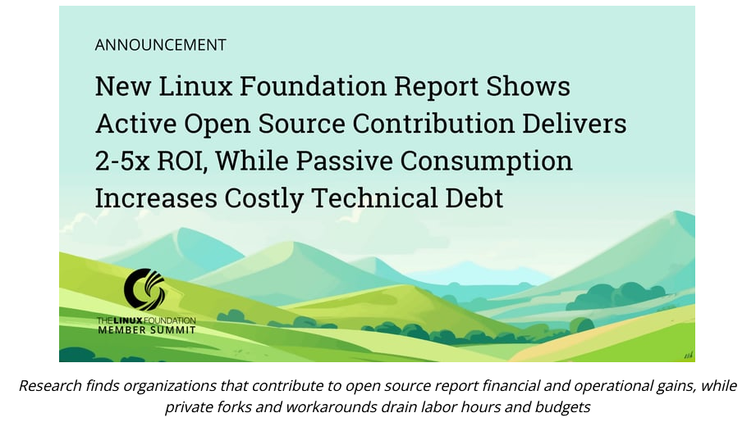
Practical Lesson 2: Enable Sustainability Collaboration & Continuity
Faster onboarding of students and staff
Pipelines survive personnel changes
Multi-center validation becomes feasible
Infrastructure outlives individual projects
Reduces technical debt
What’s documented for the public, is well documented for your own lab/center^{[1]}
Proprietary software or private branches of open source software: licensing or internal software engineering costs^{[2]}
[1] Frässle, S. et al. (2021) TAPAS: An Open-Source Software Package for Translational Neuromodeling and Computational Psychiatry. Front. Psychiatry 12. https://doi.org/10.3389/fpsyt.2021.680811
[2] https://www.linuxfoundation.org/press/new-linux-foundation-report-shows-active-open-source-contribution-delivers-2-5x-roi-while-passive-consumption-increases-costly-technical-debt
Notes:
“The second lesson is about continuity and sustainability.
In MR research — especially in MR in Radiation Therapy — our pipelines are long and technically complex. Reconstruction, segmentation, dose calculation, post-processing — often across vendors and sites.
When code and workflows are open, documented, and version-controlled, onboarding new students or clinical staff becomes dramatically easier.
What is open
More importantly, your pipeline survives personnel changes. Anyone who has inherited a folder called ‘final_final_v3’ knows the alternative.
I have changed institutions, but my tools are still used indepdently now in Zurich
The other great thing is, because the tool is open, I can now use it at my new institution, because it’s not fenced off by the old institution IP
Open science reduces technical debt. It turns a collection of scripts into infrastructure that can support multi-center validation and long-term deployment.”
The linux foundation just showed that using AND contributing to open source software has a 2-5x return on investment compared to licensing costs or employing software engineers for private branch development

Slide 9
Practical Lesson 3: Increase Leverage Impact & Influence
Shared data and code are reused — and reused work is cited more
Methods become benchmarks, not just papers
Stronger position in multi-center collaborations
Alignment with evolving journal and funder requirements
Reputation for rigor and transparency
Up to 25% higher citation rates^{[1]}
E.g., conjugate gradient SENSE for image reconstruction challenge of ISMRM RRSG^{[2]}
Code and Data Sharing increasingly recommended or even required by journals^{[3]}
[1] Colavizza, G., et al. (2020). The citation advantage of linking publications to research data. PLOS ONE 15, e0230416. https://doi.org/10.1371/journal.pone.0230416
[2] Maier, O.,et al (2021). CG-SENSE revisited: Results from the first ISMRM reproducibility challenge. MRM 85, 1821–1839. https://doi.org/10.1002/mrm.28569
[3] Pariente, N., Cadwallader, L., Editors, on behalf of the P.B.S., 2026. Formalizing our commitment to code sharing. PLOS Biology 24, e3003678. https://doi.org/10.1371/journal.pbio.3003678
Notes:
The third lesson is about leverage.
Openly shared data and code tend to be reused — and reused work is cited more (up to 25%)
But beyond citations, something more important happens: your method can become a benchmark rather than just a publication.
In fields like MR in Radiation Therapy, where multi-center validation is critical, being known as a transparent and rigorous partner increases your influence in collaborations and consortia.
And increasingly, journals and funders expect code and data sharing. Moving early aligns you with where the field is going.”

Slide 10
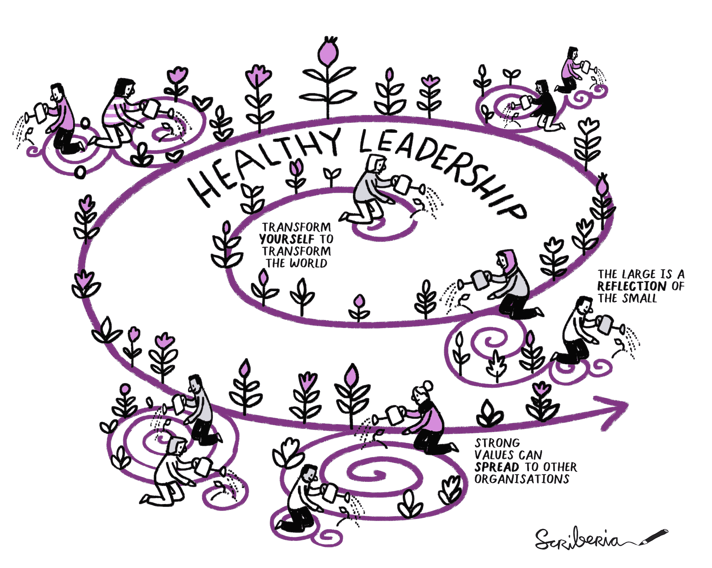
The lids on unopened science – What is holding us back?
Resource scarcity: Time and staff
Activation energy:
Where do I start?
Perfectionism
Institutional/domain incentive structure
Lab culture
Career progression
Prestige
Legal Concerns
Personal Health Information,
Data Sharing/GDPR
Intellectual Property/Licensing
Templates, AI coding tools (e.g., Claude, Codex, Copilot, Cursor)
Seek out communities
Education: Turing Way, Software Carpentry, Domain-specific special issues/review papers
One commit(ment) at a time
Advocacy & Communities:
PIs: Collaborative Group culture
Publishers/Editors
Study/Special Interest Groups of Academic Societies
Funders/Paper/Grant Reviewers (Data Availability statements.)
The Turing Way Community & Scriberia (2024) https://doi.org/10.5281/ZENODO.3332807
Notes:
If open science has these advantages, why isn’t everyone doing it?
In my experience, it’s rarely resistance to transparency. People want to be good!
It’s time pressure. Resource constraints. Not knowing where to start.
Sometimes perfectionism — feeling that everything must be perfectly cleaned before sharing.
And in clinical MR environments, legitimate legal concerns around patient data and GDPR.”

Slide 11
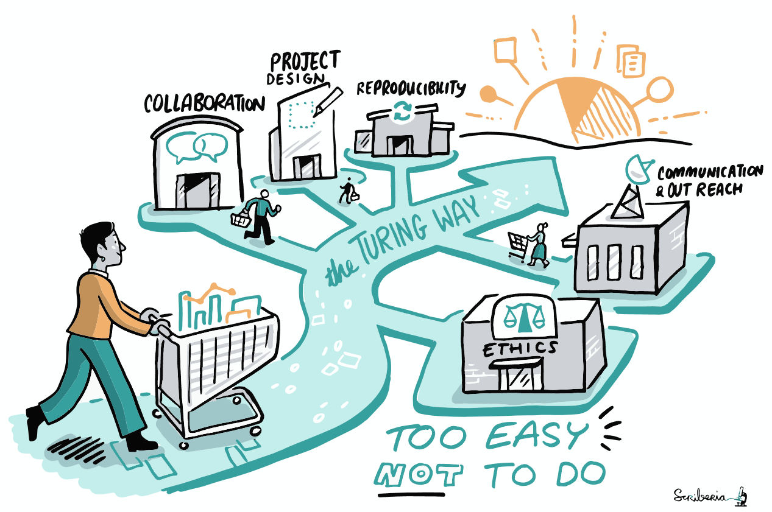
Getting started with Open Science Today
Find a great community
Open and Reproducible Research Study Group (ISMRM)
Open Source Hardware Initiative (https://opensourceimaging.org)
Open Science Initiative for Perfusion Imaging (https://osipi.ismrm.org/)
Glioma MR Imaging 2.0 (GliMR) Network^{[1]}
Ultimate consent form - GDPR edition — Open Brain Consent 1.1.0+some documentation
Open and Reproducible MSK Imaging Research Community (https://www.ormir.org/)
MRITogether (ESMRMB)
The Turing Way^{[2]}, Slogan: The Turing Way – Make Open Science “too easy NOT to do” it
Nice special issues/primers to start reading:
Gaspar, A et al. (2025). Advancing MRI, together: open science in MR research. MAGMA 38, 635–638. https://doi.org/10.1007/s10334-025-01286-8
Tamir, J.I., et al. (2025. MRI acquisition and reconstruction cookbook: recipes for reproducibility, served with real-world flavour (MAGMA 38), 367–385. https://doi.org/10.1007/s10334-025-01236-4
[1] Clement, P., et al. (2021). GliMR: Cross-Border Collaborations to Promote Advanced MRI Biomarkers for Glioma. J. Med. Biol. Eng. 41, 115–125. https://doi.org/10.1007/s40846-020-00582-z
[2] The Turing Way Community & Scriberia (2024) https://doi.org/10.5281/ZENODO.3332807
Notes:
If you are convinced now and want to engage in open science, and you asked me what is the one thing you should do today
I would suggest that you find a good, supportive community in your research area or more generally that support open science practices
There are many options:
GliMR -> GDPR conforming data sharing consent
Finally, I really like the aspirational goal of the Turing Way community: You can create guidelines to make open science so easy for your research life cycle that it is too easy not to do it.

Slide 12
Resources I
Clement, P., Booth, T., Borovečki, F., Emblem, K.E., Figueiredo, P., Hirschler, L., Jančálek, R., Keil, V.C., Maumet, C., Özsunar, Y., Pernet, C., Petr, J., Pinto, J., Smits, M., Warnert, E.A.H., 2021. GliMR: Cross-Border Collaborations to Promote Advanced MRI Biomarkers for Glioma. J. Med. Biol. Eng. 41, 115–125. https://doi.org/10.1007/s40846-020-00582-z
Colavizza, G., Hrynaszkiewicz, I., Staden, I., Whitaker, K., McGillivray, B., 2020. The citation advantage of linking publications to research data. PLOS ONE 15, e0230416. https://doi.org/10.1371/journal.pone.0230416
Community, T.T.W., 2025. The Turing Way: A handbook for reproducible, ethical and collaborative research. https://doi.org/10.5281/zenodo.15213042
Frässle, S., Aponte, E.A., Bollmann, S., Brodersen, K.H., Do, C.T., Harrison, O.K., Harrison, S.J., Heinzle, J., Iglesias, S., Kasper, L., Lomakina, E.I., Mathys, C., Müller-Schrader, M., Pereira, I., Petzschner, F.H., Raman, S., Schöbi, D., Toussaint, B., Weber, L.A., Yao, Y., Stephan, K.E., 2021. TAPAS: An Open-Source Software Package for Translational Neuromodeling and Computational Psychiatry. Front. Psychiatry 12. https://doi.org/10.3389/fpsyt.2021.680811
Gaspar, A., Nagtegaal, M., Santini, F., Schauman, S., Shahdloo, M., Van Houdt, P.J., Wang, Y.-F., Webb, A., 2025. Advancing MRI, together: open science in MR research. Magn Reson Mater Phy 38, 635–638. https://doi.org/10.1007/s10334-025-01286-8
Ioannidis, J.P.A., 2005. Why Most Published Research Findings Are False. PLOS Medicine 2, e124. https://doi.org/10.1371/journal.pmed.0020124
Maier, O., Baete, S.H., Fyrdahl, A., Hammernik, K., Harrevelt, S., Kasper, L., Karakuzu, A., Loecher, M., Patzig, F., Tian, Y., Wang, K., Gallichan, D., Uecker, M., Knoll, F., 2021. CG-SENSE revisited: Results from the first ISMRM reproducibility challenge. Magnetic Resonance in Medicine 85, 1821–1839. https://doi.org/10.1002/mrm.28569
Markowetz, F., 2015. Five selfish reasons to work reproducibly. Genome Biol 16, 274. https://doi.org/10.1186/s13059-015-0850-7
Masum, H., Rao, A., Good, B.M., Todd, M.H., Edwards, A.M., Chan, L., Bunin, B.A., Su, A.I., Thomas, Z., Bourne, P.E., 2013. Ten Simple Rules for Cultivating Open Science and Collaborative R&D. PLOS Computational Biology 9, e1003244. https://doi.org/10.1371/journal.pcbi.1003244
Maumet, C., n.d. Open science practices for keeping inventions alive after project ends. Statistical analysis. https://inria.hal.science/hal-04236827v1/file/Maumet_ESMRMB_keeping%20inventions%20alive%20after%20project%20ends.pdf
New Linux Foundation Report Shows Active Open Source Contribution Delivers 2-5x ROI, While Passive Consumption Increases Costly Technical Debt [WWW Document], n.d. URL https://www.linuxfoundation.org/press/new-linux-foundation-report-shows-active-open-source-contribution-delivers-2-5x-roi-while-passive-consumption-increases-costly-technical-debt (accessed 3.2.26).
Pariente, N., Cadwallader, L., Editors, on behalf of the P.B.S., 2026. Formalizing our commitment to code sharing. PLOS Biology 24, e3003678. https://doi.org/10.1371/journal.pbio.3003678
Pereira, I., Galioulline, H., Enz, R., Hess, A., Müller-Schrader, M., Von Werder, D., Kertesz, I., Schönleitner, F., Brand, K., Kasper, L., Weber, L., Petzschner, F., Iglesias, S., Heinzle, J., Stephan, K., 2025a. Structured Code Review in Translational Neuromodeling and Computational Psychiatry. https://doi.org/10.20944/preprints202510.0133.v1
Pereira, I., Galioulline, H., Enz, R., Hess, A., Müller-Schrader, M., Von Werder, D., Kertesz, I., Schönleitner, F., Mellor, S., Brand, K., Kasper, L., Weber, L., Petzschner, F., Iglesias, S., Heinzle, J., Stephan, K., 2025b. Structured Code Review in Mental Health Research. https://doi.org/10.20944/preprints202510.0133.v2
Reproducibility and Quality Assurance [WWW Document], n.d. . SpringerLink. URL https://link.springer.com/collections/ehhdhbedab (accessed 2.27.26).
Tamir, J.I., Blumenthal, M., Wang, J., Oved, T., Shimron, E., Zaiss, M., 2025. MRI acquisition and reconstruction cookbook: recipes for reproducibility, served with real-world flavour. Magn Reson Mater Phy 38, 367–385. https://doi.org/10.1007/s10334-025-01236-4
The Turing Way [WWW Document], n.d. URL https://book.the-turing-way.org/ (accessed 3.2.26).
Zuckerman, A.L., Faber, S., Shen, K., McIntosh, A.R., Juavinett, A.L., 2026. Ten simple rules for building a collaborative coding culture. PLOS Computational Biology 22, e1013970. https://doi.org/10.1371/journal.pcbi.1013970

Slide 13
Resources II – Easy Listening
MRI Together 2021 - Opening (Atlantic) - Introduction to Open Science... (C. Gould van Praag)
A much more in-depth introduction on open science and its development
MRITogether2024-S7T1: Open Science and Data Sharing using the CAMH BrainHealth Databank (Nicole Schoer)
Data Sharing – Legal Concerns; Example for North America (mental health)
MRI Together 2023 - Session 6 Talk 4 - PhysIO, UniQC and a TAPAStry of Tools... (L. Kasper)
An intro into open-source tools and their development philopsophy I am heavily involved in

Slide 14
Thank you for your attention!
Finally: The slides in this presentation are openly licensed (CC-BY 4.0). Please reuse, adapt, improve.
© 2026 Lars Kasper — CC BY 4.0 https://creativecommons.org/licenses/by/4.0/

