Slide 1
Super Resolution of occluded or unclear faces
using Generative Adversarial Networks
Akhil Nair | Mounica Subramani | Mrinal Soni | SuRui Yang

Slide 2
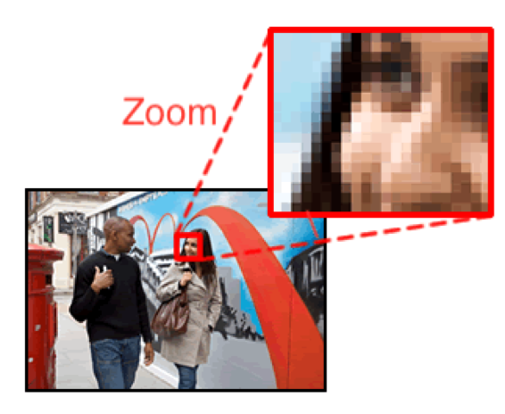
Introduction
Challenge: Inability to capture perceptually satisfying features in an image.
Goal: Reconstruct high quality images, ensuring perceptual quality is preserved.
Low-resolution
Super-resolution
High-resolution
low-resolution
high-resolution

Slide 3
Generative Adversarial Network
GAN applies a deep network in combination with an adversary network to generate new data.
GAN generator (deep neural net) creates fake data.
Discriminator (another deep neural net) is a classifier model.
Training GAN.
Notes:
Adversarial : two deep neural nets, they are generator model and discriminator model.
The generator takes in random numbers ( fixed length random vectors) as input and learns to create fake data.
Vector is drawn randomly from gaussian distribution
This generated fake data is fed into the discriminator alongside a stream of original data taken from the actual, ground-truth dataset.
The discriminator is a normal (and well understood) classification model.
It could use any network architecture appropriate to the type of data it's classifying.
The discriminator takes in both real and fake data and returns probabilities, a number between 0 and 1, with 1 representing real and 0 representing fake.
As training progresses, the generator gets closer to producing output that can fool the discriminator.
Finally, if generator training goes well, the discriminator gets worse at telling the difference between real and fake.
It starts to classify fake data as real, and its accuracy decreases.
that level of fake data is what we are aiming from Generator
The generator output is connected directly to the discriminator input.
Through backpropagation, the discriminator’s classification provides a signal that the generator uses to update its weights. The generator and discriminator loss functions are used to train the models.
After the training process, the discriminator model is discarded as we are interested in the generator.
So the fake data here will be the images generated from downsampled low resolution images. Those fake images will be labelled as SR images.

Slide 4
Proposed Plan
Implement SRGAN (variant of GAN)
Training
Traditional Loss vs Perceptual Loss
Need for Perceptual Loss?
Content & Adversarial Loss
Implement Tensorflow’s TFGAN

Slide 5
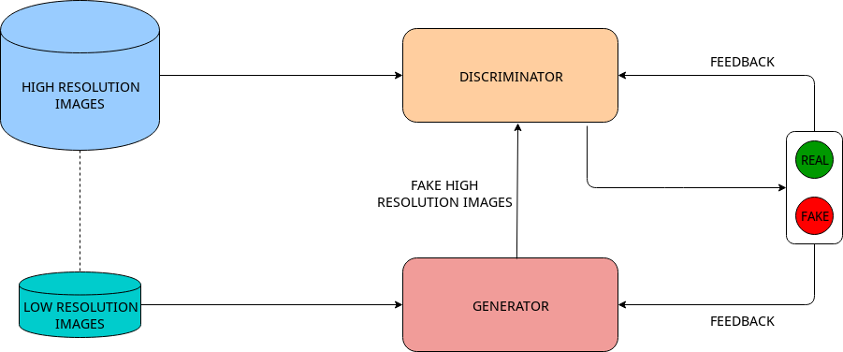
Workflow in Generative Adversarial Network

Slide 6
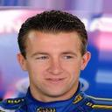

Dataset
The benchmark dataset we use is The CelebA dataset
The dataset consists of 202,599 face images of 10,177 unique identities
Images are frontal images with less occlusion and mostly clear faces
Chances of creating bias in the model

Slide 7
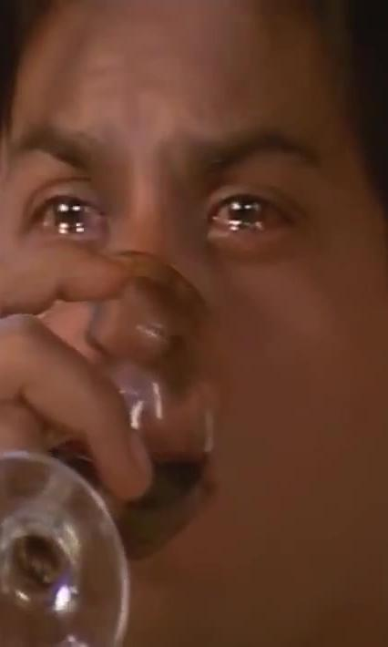
Dataset
To avoid bias we would train our model on a second dataset Indian Movie Face Database
The dataset contains 34512 images of 100 actors collected from 100 videos
Images have a lot of diversity in pose, expression, occlusion, resolution
Harder to train as original images are of low resolution

Slide 8


Preprocessing
Low resolution images for training generator network is obtained by downsampling
Lanczos Resampling Algorithm used for downsampling
2X and 4X downsampling

