Slide 1
Paper ID: 43 Memory Efficient Federated Recommendation Model
By:
Mrinaal Dogra
Beda Prakash Meher
Parameswaranath Vadackupurath Mani
Hwang-Ki Min

Slide 2
Table of Contents
Problem Motivation
Major Contributions
Proposed Framework
Next App Recommendation
Results
Conclusion

Slide 3
Problem Motivation
There are many real-world scenarios where recommendation systems (RS) have to work with an indefinitely large number of items and/or users
Using any traditional class based encoding scheme to incorporate huge number of items and users in a RS model could result in very large number of trainable parameters
Such huge sized models will incur large amount of memory consumption, computation power, and network bandwidth on edge devices while training in a Federated Learning (FL) environment
Thus, there is a need of a model framework for FL based RS which is independent of number of items & users, therefore memory efficient and well suited for large scale RS.

Slide 4
Major Contributions
Proposed a novel generic model framework for developing FL based RS with the capability to work with indefinite items and users.
Proposed a memory efficient Item Encoder and User Encoder independent of the number of items and users.
Developed a Next App recommendation model based on proposed framework which performs close to the SOTA solution even with much smaller model size.

Slide 5
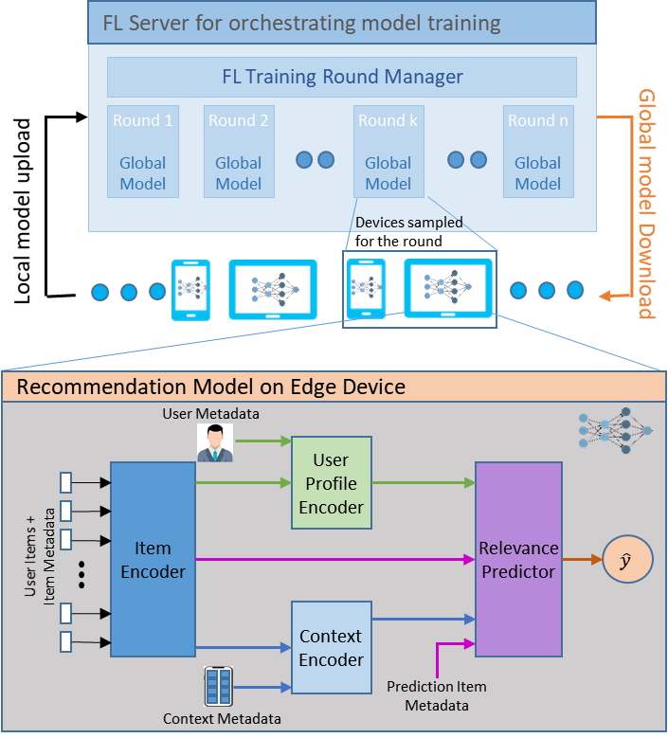
Proposed Framework
FL Server Orchestration Overview
FL Server shares global model to selected users.
Model is trained locally on individual user edge devices.
Model updates (gradients) are sent back to the server after local training.
Server aggregates the received gradients and updates the global model.
This process is repeated until model convergence.
Recommendation Model Framework Overview
Item Encoder: Generates a unique Item encoding which is consistent across all devices.
User Profile Encoder: Generates a User encoding and tries to captures certain features/properties of a user.
Context Encoder: Generates a Context encoding to attribute the properties of the prediction context.
Relevance Predictor: Predicts output relevance score

Slide 6
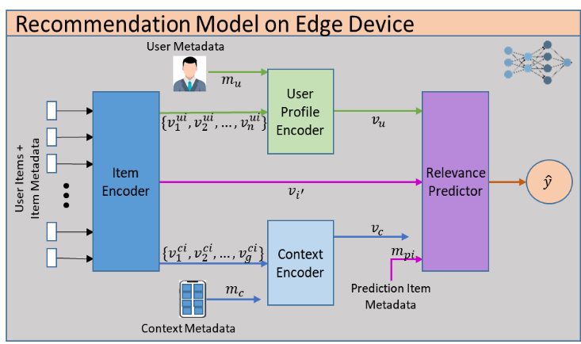








Proposed Framework
Item Encoder
$$v_{i}=f_{I}\left(i, m_{i}\right)$$
$$i$$ | -> | Uniquely identifiable property of item
$$m_{i}$$ | -> | Additional features related to that item
User Profile Encoder
$$v_{u}=f_{U}\left(v_{1}^{ui}, v_{2}^{ui}, …, v_{n}^{ui}, m_{u}\right)$$
$v_{1}^{ui}$, …, $v_{n}^{ui}$ | -> | Encodings of items associated with user
$$m_{u}$$ | -> | Additional meta-data of user
Context Encoder
$$v_{c}=f_{C}\left(v_{1}^{ci}, v_{2}^{ci}, …, v_{g}^{ci}, m_{c}\right)$$
$v_{1}^{ci}$, …, $v_{g}^{ci}$ | -> | Encodings of items associated with current context
$$m_{c}$$ | -> | Additional meta-data related to prediction context
Relevance Predictor
$$\hat{y}=f_{R}\left(v_{i^{′}}, v_{u}, v_{c}, m_{pi}\right)$$
$$v_{i^{′}}$$ | -> | Target item’s encoding
$$m_{pi}$$ | -> | Additional meta-data specific to the target item

Slide 7
Next App Recommendation
SCORE
Dataset
App usage records of 3000 users containing a total of 7,318,525 records
Split into train and test users containing 2000 and 1000 users’ data respectively.
Relevance Predictor
Sigmoid Activation
Dense
Dot Product
Concatenate
Dense
Dense
Hadamard Product
Last used time
Frequency of usage
User Profile Encoder
Context Encoder
Synthetic Samples (Negative Sampling)
Defined the learning problem as a Binary Classification problem.
Used Negative Sampling strategy for training.
Positive sample -> Comprised of relevant inputs and the target app as observed in the app sequence of a user.
Negative sample -> Unused apps installed on user devices.
1:3 Positive to Negative sample ratio.
No. of training records increased to ~18 million
Dense Layer
Dense Layer
Concatenate
Concatenate
Dense Layer
Dense Layer
Dense Layer
Dense Layer
Dense Layer
Average Layer
App Attention
User Profile
App Encoder
Context
Current Time
[DAY_OF_WEEK, HOUR]
Dense Layer
Concatenate
LSTM Layer
Char Embedding
Embedding
App Package Name
App Category

Slide 8

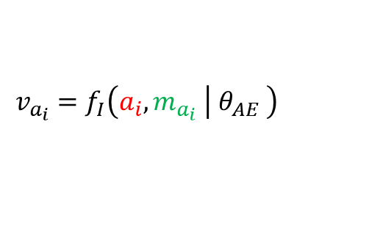


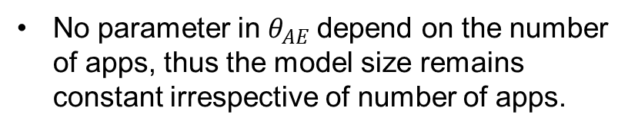

Next App Recommendation – App Encoder
App Encoding
$$v_{a_{i}}$$
App Encoder
Generates unique item encoding for an app.
Analogous to Item Encoder module of the proposed framework
App Encoder
Dense Layer
$$\left.v_{a_{i}}=f_{I}\left(a_{i}, m_{a_{i}} \right| θ_{AE} \right)$$
Concatenate
LSTM Layer
Char Embedding
Embedding
$$v_{i}=f_{I}\left(i , m_{i}\right)$$
App Package Name
$$a_{i}$$
App Category
$$m_{a_{i}}$$
No parameter in $θ_{AE}$depend on the number of apps, thus the model size remains constant irrespective of number of apps.

Slide 9



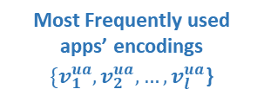

Next App Recommendation – User Profile Encoder
User Profile Encoding
$$v_{u}$$
User Profile Encoder
User Profile Encoder
Generates an encoding for each user.
Analogous to User Profile Encoder module of the proposed framework
Dense Layer
Concatenate
Dense Layer
Dense Layer
$$v_{u}=f_{U}\left(v_{1}^{ua}, v_{2}^{ua}, …, v_{l}^{ua}, T_{agg}^{u} ∣ θ_{UE}\right)$$
Average Layer
User Profile Metadata
$$T_{agg}^{u}$$
Most Frequently used apps’ encodings
$\{v_{1}^{ua}, v_{2}^{ua}, …, v_{l}^{ua}$}
$$v_{u}=f_{U}\left(v_{1}^{ui}, v_{2}^{ui}, …, v_{p}^{ui}, m_{u}\right)$$

Slide 10



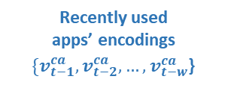


Next App Recommendation – Context Encoder
Context Encoding
$$v_{c}$$
Context Encoder
Context Encoder
Generates encoding of current context.
Analogous to Context Encoder module of the proposed framework.
Dense Layer
Concatenate
Dense Layer
Dense Layer
Dense Layer
$$v_{c}=f_{C}\left(v_{t−1}^{ca}, v_{t−2}^{ca}, …, v_{t−w}^{ca}, T_{p}^{c}, t_{p}^{c} ∣ θ_{CE}\right)$$
App Attention
Recently used apps’ encodings
$\{v_{t−1}^{ca}, v_{t−2}^{ca}, …, v_{t−w}^{ca}$}
Context
$$T_{p}^{c}$$
Current Time
$$t_{p}^{c}$$
$$v_{c}=f_{C}\left(v_{1}^{ci}, v_{2}^{ci}, …, v_{g}^{ci}, m_{c}\right)$$

Slide 11







Next App Recommendation – Relevance Predictor
SCORE
$$\hat{y}$$
Relevance Predictor
Predicts the relevance score (between 0 to 1) of the input target app as the next app to be launched by a user.
Analogous to Relevance Predictor module of the proposed framework.
Relevance Predictor
Sigmoid Activation
Dense
Dot Product
Concatenate
Dense
Dense
Hadamard Product
$$\hat{y}=f_{R}\left(v_{a_{p}}, v_{u}, v_{c},t_{d}^{p},f_{r}^{p} ∣ θ_{RP}\right)$$
Last used time
$$t_{d}^{p}$$
Frequency of usage
$$f_{r}^{p}$$
Target App Encoding
$$v_{a_{p}}$$
User Profile Encoding
$$v_{u}$$
Context Encoding
$$v_{c}$$
$$\hat{y}=f_{R}\left(v_{i^{′}}, v_{u}, v_{c}, m_{pi}\right)$$

Slide 12
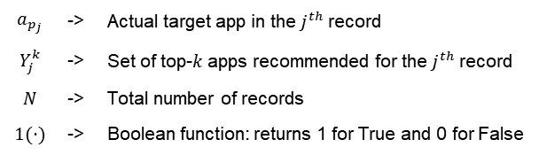
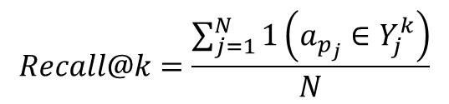
Experimental Results
$$Recall@k=\frac{\sum_{j=1}^{N}{1\left(a_{p_{j}}∈Y_{j}^{k}\right)}}{N}$$
$$a_{p_{j}}$$ | -> | Actual target app in the $j^{th}$ record
$$Y_{j}^{k}$$ | -> | Set of top-$k$ apps recommended for the $j^{th}$ record
$$N$$ | -> | Total number of records
$$1(⋅)$$ | -> | Boolean function: returns 1 for True and 0 for False
Evaluation Criteria:
 | AppUsage2Vec[2] | Proposed Model
Number of Apps = 2000
No. of Model Parameters | 806,020 | 123,666
Model Size | 6.14 MB | 0.94 MB
Recall@5 | 84.47% | 81.11%
No. of Apps = 140000
No. of Model Parameters | 32,822,020 | 123,666
Model Size | 250.41 MB | 0.94 MB
Recall@5 | 78.89% | 80.70%

Slide 13
Conclusion
Proposed a novel model framework to develop memory efficient FL based RS for large scale applications.
Discussed how fixed size encoding scheme could be implemented, thus being able to work with indefinite number of user and items
Validated the proposed framework with the help of Next App Recommendation use-case, and compared the performance with SOTA solution.
Results demonstrated that the proposed framework with much smaller memory and computation requirements outperforms SOTA for large number of items, proving an ideal candidate for developing RS for edge devices like smart phones

Slide 14
References
[1] B. McMahan, E. Moore, D. Ramage, S. Hampson, and B. A. y. Arcas, “Communication-Efficient Learning of Deep Networks from Decentralized Data”, in Proceedings of the 20th International Conference on Artificial Intelligence and Statistics, Apr 2017, vol 54, pp. 1273–1282.
[2] S. Zhao et al., “AppUsage2Vec: Modeling smartphone app usage for prediction”, in 2019 IEEE 35th International Conference on Data Engineering (ICDE), 2019, pp. 1322–1333.

Slide 15
Q&A
For any queries, please reach out to me at:
Email: azadmrinaal@gmail.com
LinkedIn: mrinaald

Slide 16
Thank You

