Slide 1
TASK-1
Submitted by
Mrinal Murali M

Slide 2
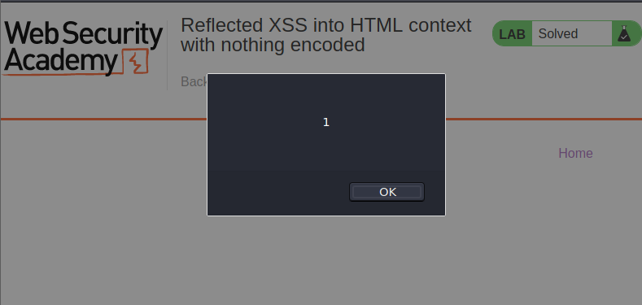
TASK-1
Solving Post swigger labs
Reflected XSS into HTML context with nothing encoded

Slide 3
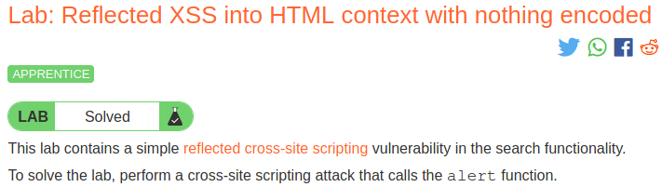
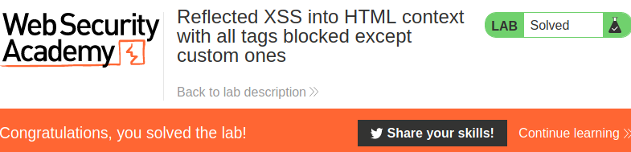
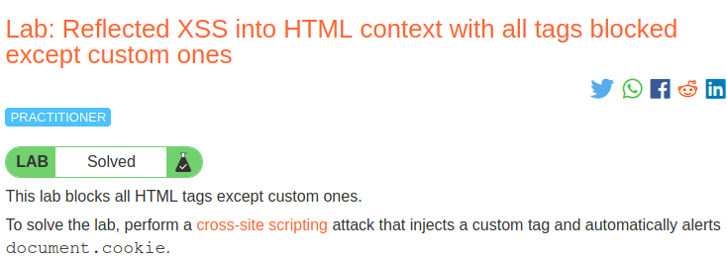
Reflected XSS into HTML context with all tags blocked except custom ones

Slide 4
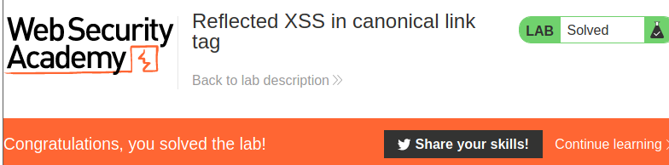
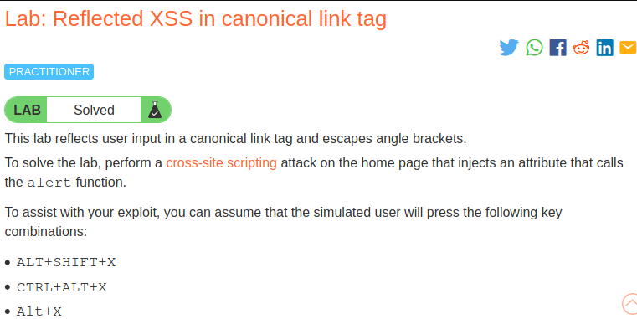
Reflected XSS in canonical link tag

Slide 5
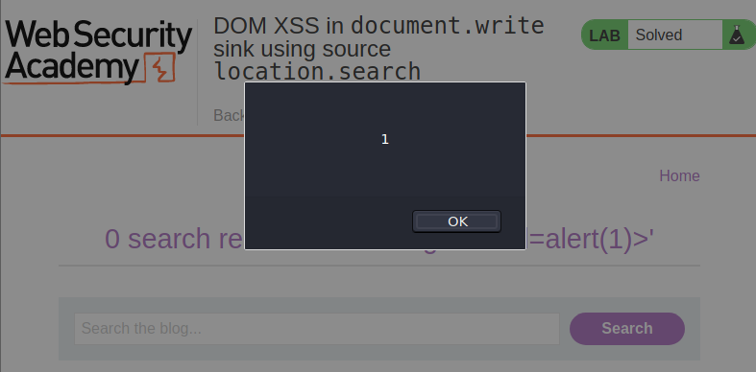
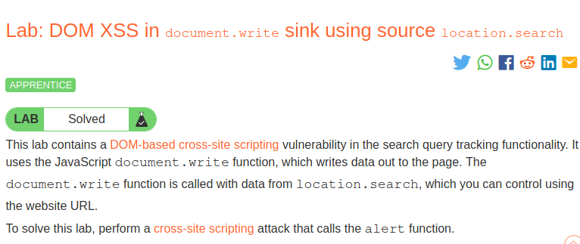
DOM XSS in document.write sink using source location.search

Slide 6
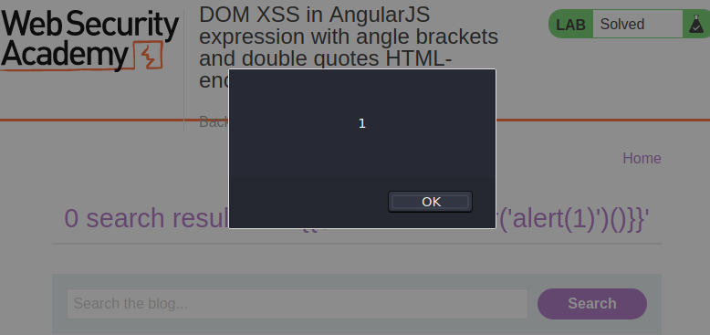
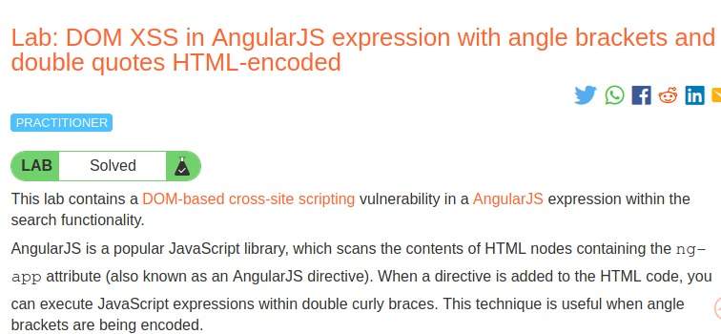
DOM XSS in AngularJS expression with angle brackets and double quotes
HTML-encoded

