Slide 1
TASK-2
Submitted by
Mrinal Murali M

Slide 2
The vulnerabilities that are present on: http://zero.webappsecurity.com/ website are
Password Transmitted over HTTP
Cross-site Scripting via Remote File Inclusion
Insecure Transportation Security Protocol Supported (SSLv2)
Out-of-date Version (Apache)
Out-of-date Version (Tomcat)
Out-of-date Version (OpenSSL)
The main vulnerabilities are the first three and the later three are because of not updating the software which can simply be rectified by updating the software but the first three can only be done by modification of code

Slide 3
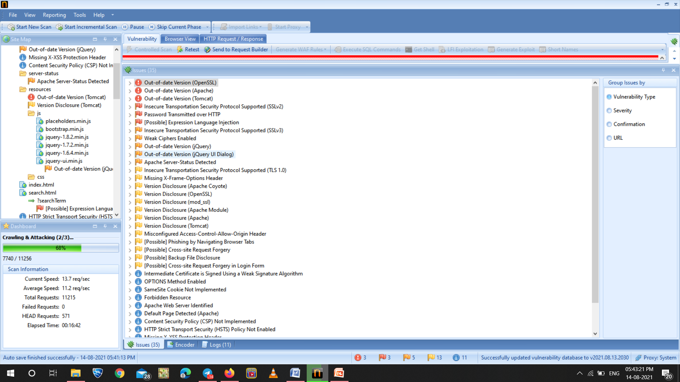
NETSPARKER

Slide 4
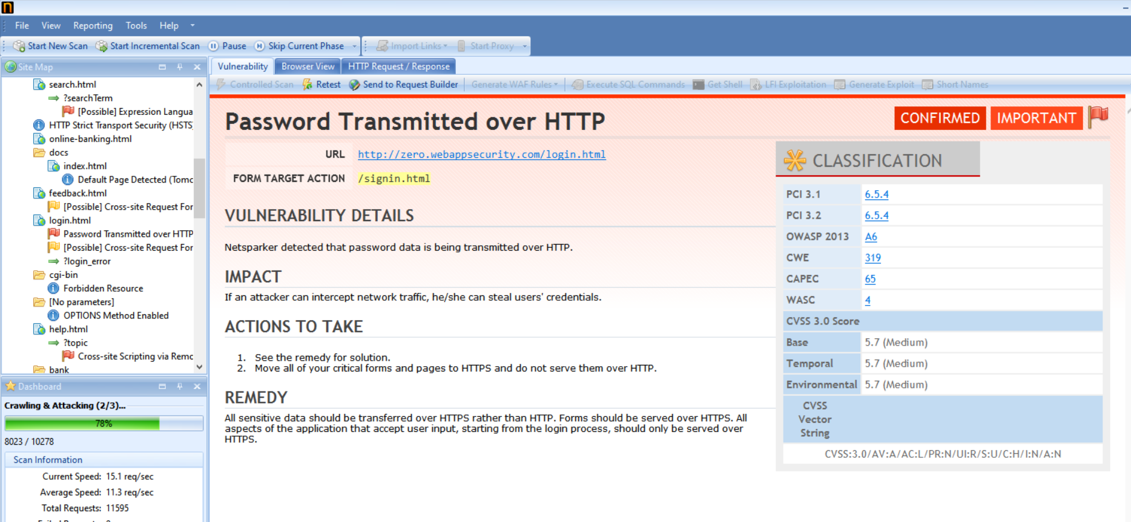

Slide 5
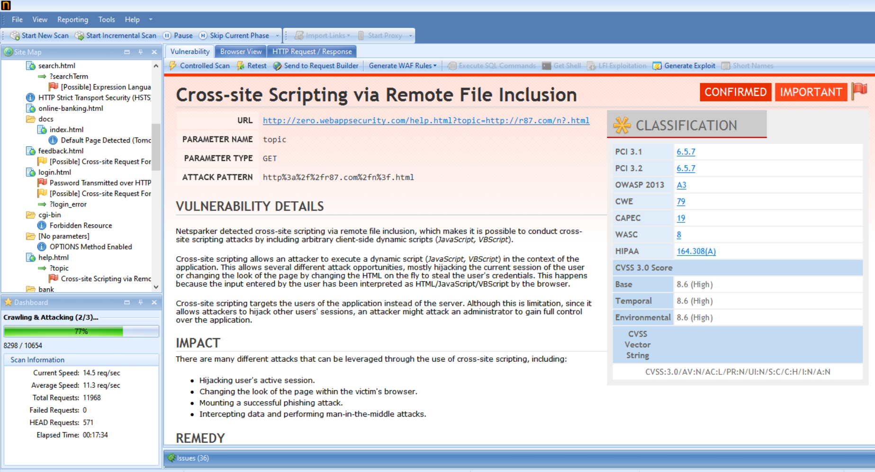

Slide 6
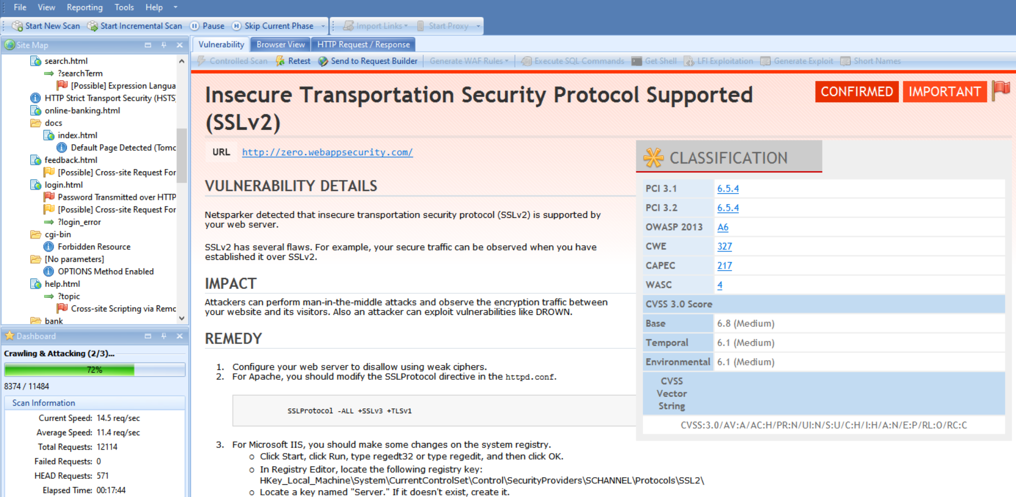

Slide 7
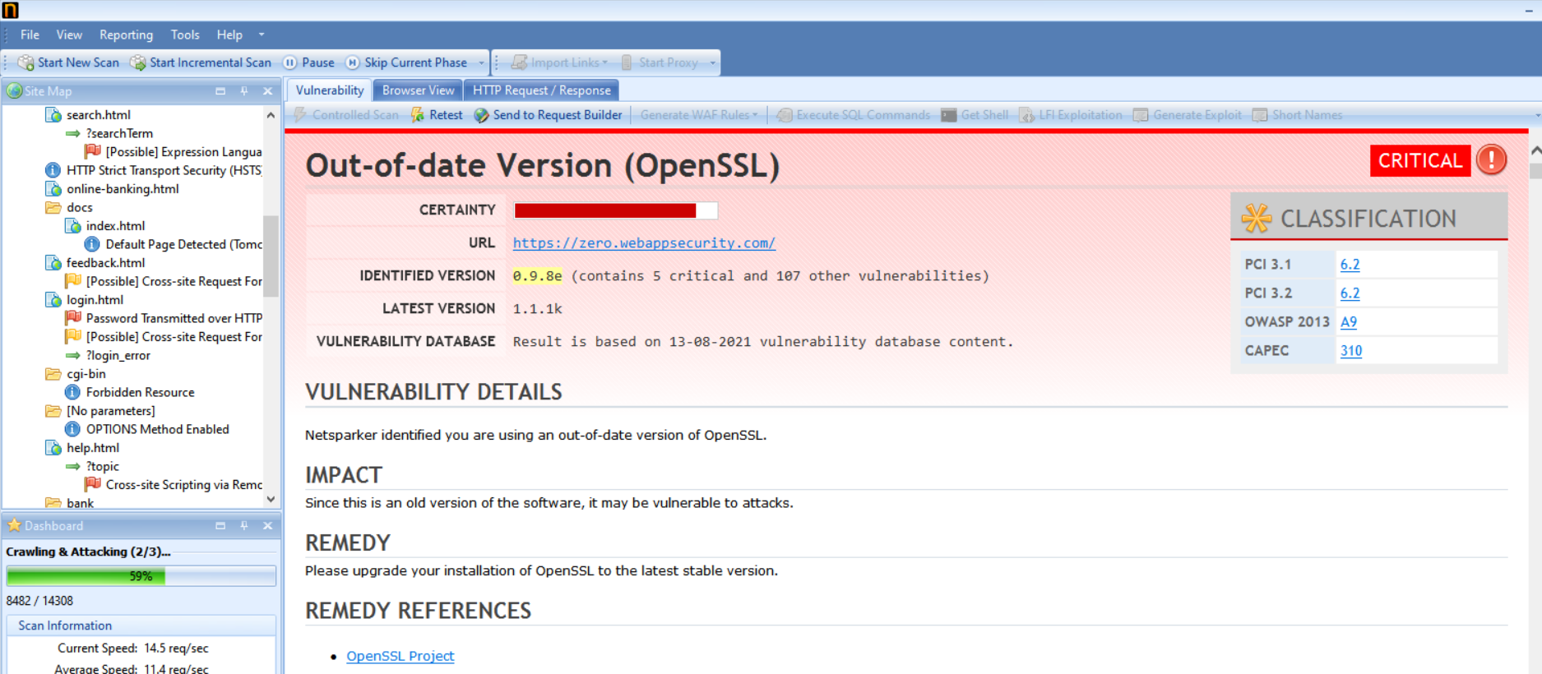

Slide 8
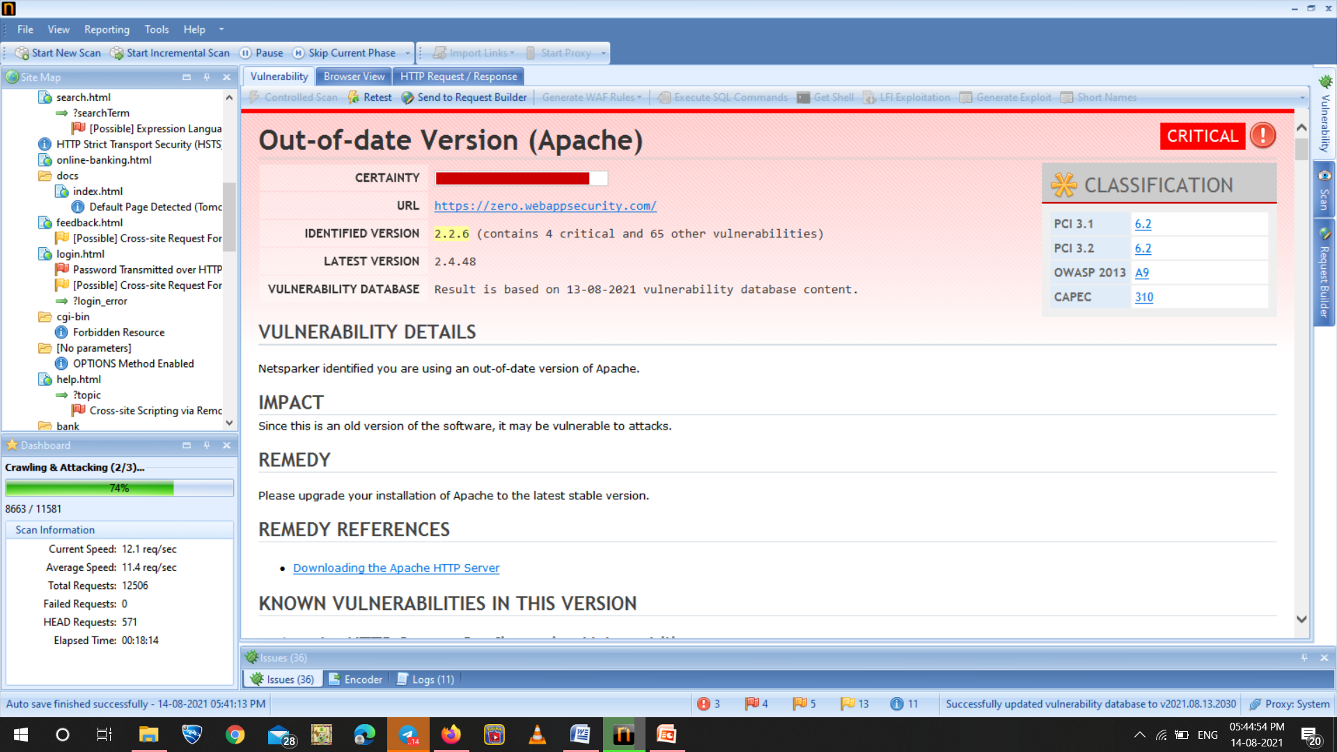

Slide 9
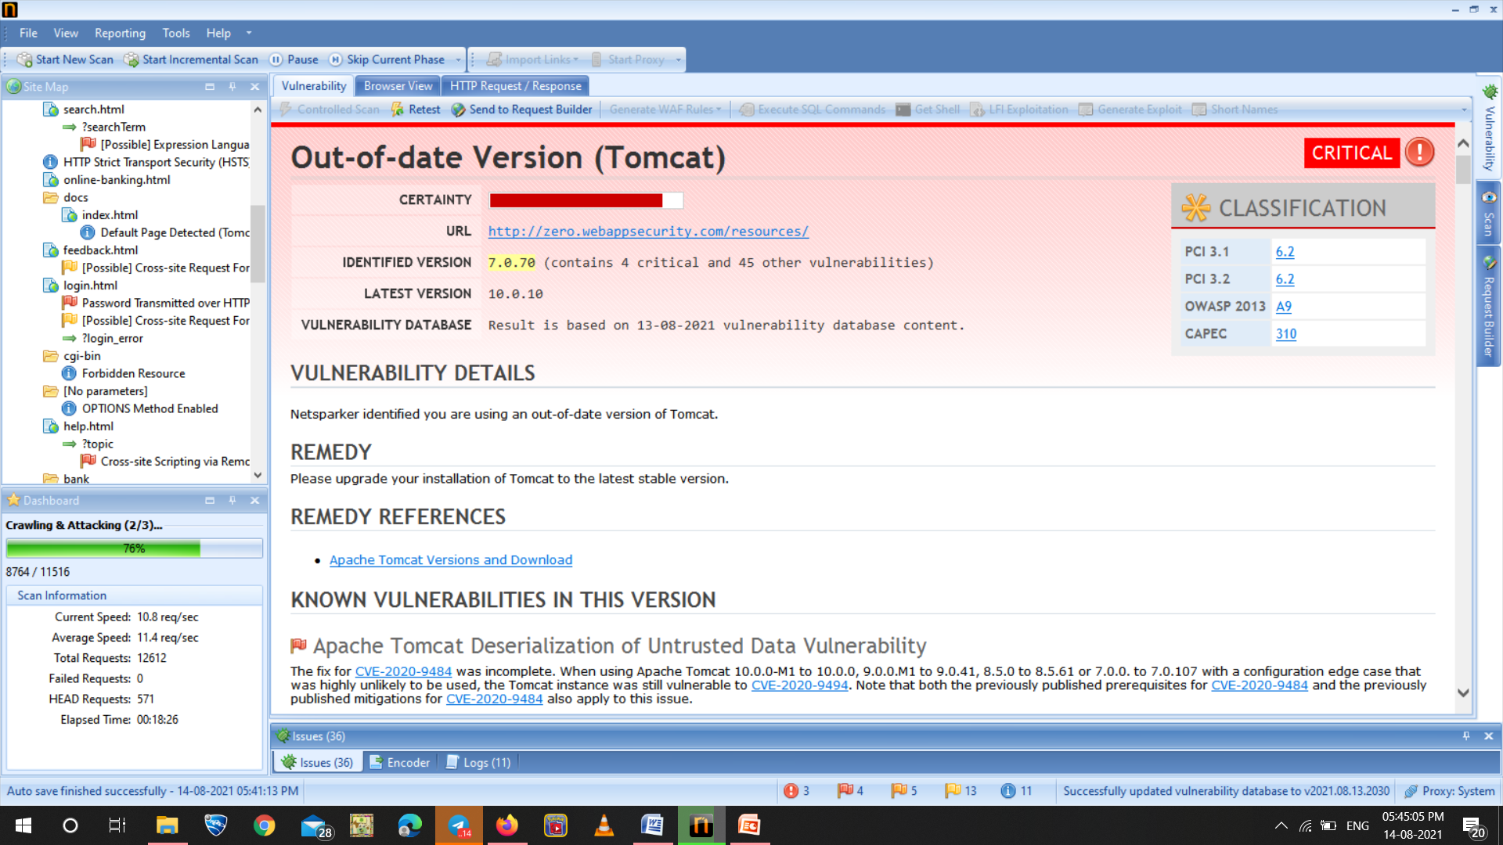

Slide 10
The main vulnerabilities are the first three and the later three are because of not updating the software which can simply be rectified by updating the software but the first three can only be done by modification of code.
The most vulnerable of the first three is:
Cross-site Scripting via Remote File Inclusion
URL | http://zero.webappsecurity.com/help.html?topic=http://r87.com/n?.html
Parameter Name | topic
Parameter Type | GET
Attack Pattern | http%3a%2f%2fr87.com%2fn%3f.html

Slide 11
Vulnerability Details
Netsparker is a tool for auto detection of vulnerabilities .The netsparker detected cross-site scripting via remote file inclusion, which makes it is possible to conduct cross-site scripting attacks by including arbitrary client-side dynamic scripts (JavaScript, VBScript).
Cross-site scripting allows an attacker to execute a dynamic script (JavaScript, VBScript) in the context of the application. This allows several different attack opportunities, mostly hijacking the current session of the user or changing the look of the page by changing the HTML on the fly to steal the user's credentials. This happens because the input entered by the user has been interpreted as HTML/JavaScript/VBScript by the browser.
Cross-site scripting targets the users of the application instead of the server. Although this is limitation, since it allows attackers to hijack other users' sessions, an attacker might attack an administrator to gain full control over the application.

Slide 12
Impact
There are many different attacks that can be leveraged through the use of cross-site scripting, including:
Hijacking user's active session.
Changing the look of the page within the victim's browser.
Mounting a successful phishing attack.
Intercepting data and performing man-in-the-middle attacks.
Remedy
The issue occurs because the browser interprets the input as active HTML, Javascript or VbScript. To avoid this, all input and output from the application should be filtered. Output should be filtered according to the output format and location. Typically, the output location is HTML. Where the output is HTML, ensure all active content is removed prior to its presentation to the server.

Slide 13
The second one is:
Password Transmitted over HTTP
URL http://zero.webappsecurity.com/login.html
Form target action /signin.html
Vulnerability Details
Netsparker detected that password data is being transmitted over HTTP.
Impact
If an attacker can intercept network traffic, he/she can steal users' credentials.
Actions to Take
See the remedy for solution.
Move all of your critical forms and pages to HTTPS and do not serve them over HTTP.

Slide 14
Remedy
All sensitive data should be transferred over HTTPS rather than HTTP. Forms should be served over HTTPS. All aspects of the application that accept user input, starting from the login process, should only be served over HTTPS.

