Slide 1
TASK-3
BY
MRINAL MURALI M

Slide 2
Title: Cross Site Scripting
Domain: vulnweb.com
Sub domain: testasp.vulnweb.com
Steps to do:
Step 1: Visit http://testasp.vulnweb.com/
Step 2: On the top menu you will find a search option.
Step 3: Click on it and you will be prompted with the Search box.
Step 4: You can intercept the request in Burp Suite
Step 5: Now you can find different payloads for XSS.
Step 6: Send the request to the intruder and paste all the payloads.
Step 7: Try to find a successful payload for XSS.
Step 8: Prepare a report for it.

Slide 3
Vulnerabilities:
Out of Band SQL Injection
Password Transmitted over HTTP
Cross-site Scripting
Local File Inclusion

Slide 4
Impacts:
Depending on the backend database, the database connection settings, and the operating system, an attacker can mount one or more of the following attacks successfully:
Reading, updating and deleting arbitrary data or tables from the database
Executing commands on the underlying operating system
2. If an attacker can intercept network traffic, he/she can steal users' credentials.
3. There are many different attacks that can be leveraged through the use of cross-site scripting, including:
Hijacking user's active session.
Mounting phishing attacks.
Intercepting data and performing man-in-the-middle attacks.

Slide 5
4. The impact can vary, based on the exploitation and the read permission of the web server user. Depending on these factors, an attacker might carry out one or more of the following attacks:
Gather usernames via an "/etc/passwd" file
Harvest useful information from the log files, such as "/apache/logs/error.log" or "/apache/logs/access.log"
Remotely execute commands by combining this vulnerability with some other attack vectors, such as file upload vulnerability or log injection

Slide 6
Remedy:
1. A robust method for mitigating the threat of SQL injection-based vulnerabilities is to use parameterized queries (prepared statements). Almost all modern languages provide built-in libraries for this. Wherever possible, do not create dynamic SQL queries or SQL queries with string concatenation
2. All sensitive data should be transferred over HTTPS rather than HTTP. Forms should be served over HTTPS. All aspects of the application that accept user input, starting from the login process, should only be served over HTTPS.
3. The issue occurs because the browser interprets the input as active HTML, JavaScript or VBScript. To avoid this, output should be encoded according to the output location and context. For example, if the output goes in to a JavaScript block within the HTML document, then output needs to be encoded accordingly. Encoding can get very complex, therefore it's strongly recommended to use an encoding library such as OWASP ESAPI and Microsoft Anti-cross-site scripting.

Slide 7
4. For local file inclusion there are many remedies which include:
If possible, do not permit appending file paths directly. Make them hard-coded or selectable from a limited hard-coded path list via an index variable.
If you definitely need dynamic path concatenation, ensure you only accept required characters such as "a-Z0-9" and do not allow ".." or "/" or "%00" (null byte) or any other similar unexpected characters.
It is important to limit the API to allow inclusion only from a directory and directories below it. This way you can ensure any potential attack cannot perform a directory traversal attack.

Slide 8
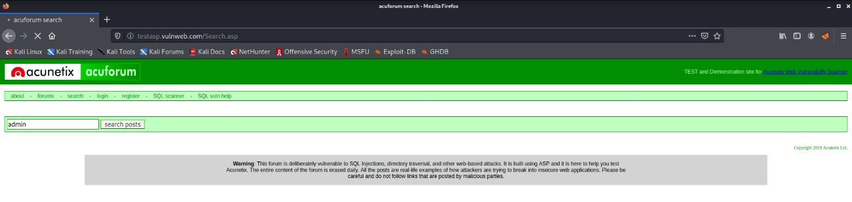
Screenshots of above task is shown below in step wise order

Slide 9
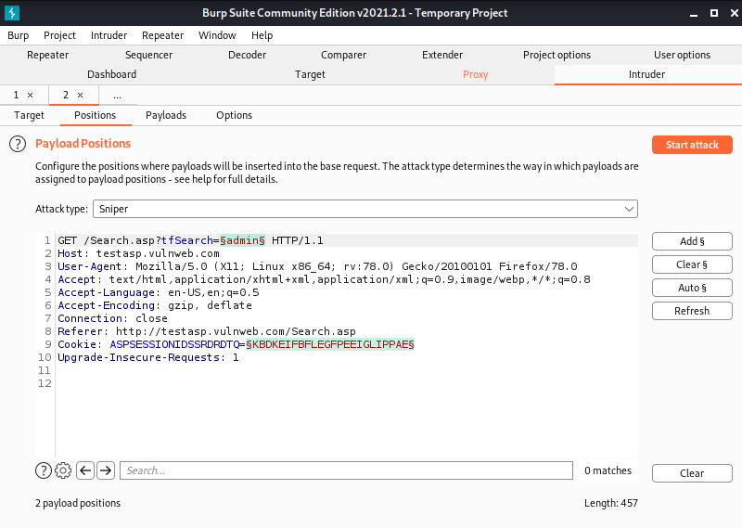

Slide 10
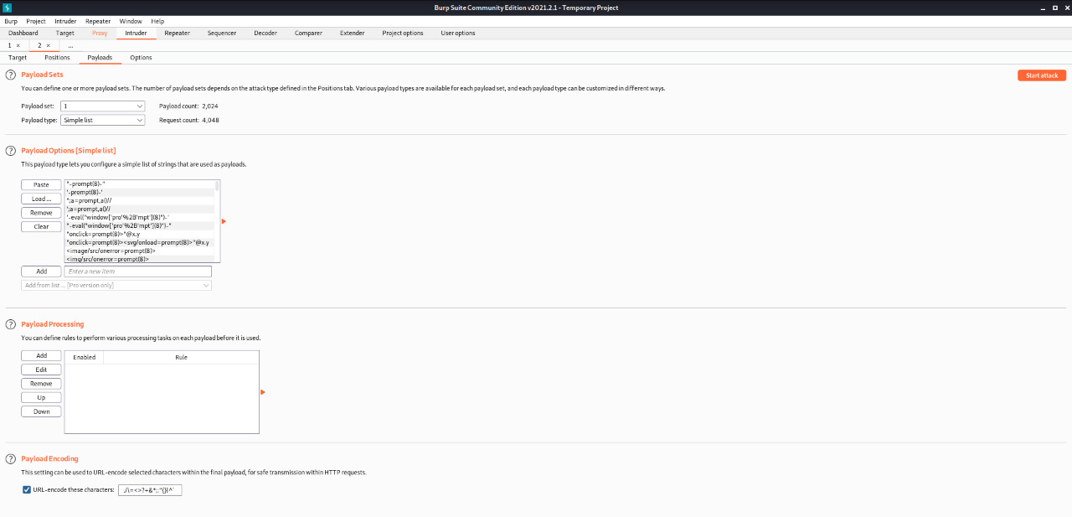

Slide 11
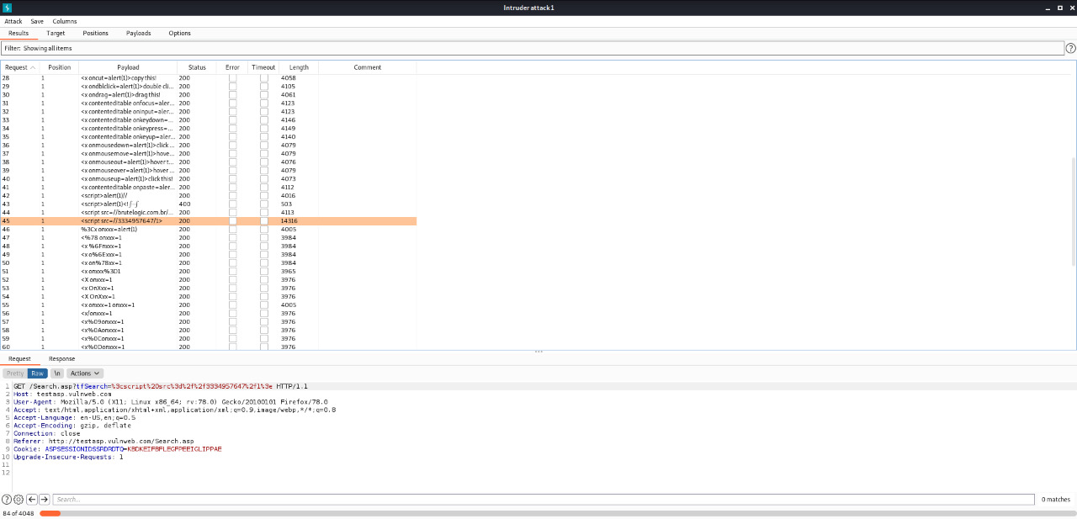

Slide 12

Double click to access the videos

