Slide 1


NEXT GEN EMPLOYABILITY PROGRAM
CREATING A FUTURE-READY WORKFORCE
Student Name :
Mrinal More
Student ID :
College Name :
STU67820a18a63661736575512
Trinity College of Engineering and Research

Slide 2
CAPSTONE PROJECT SHOWCASE
Project Title
Online Auction Platform with React and ExpressJS Framework
Abstract | Problem Statement | Project Overview | Proposed Solution | Technology Used | Modelling & Results | Conclusion | Q&A

Slide 3
Abstract
1
Frontend (React.js) – Build a user-friendly interface with React, using components for listing auctions, bidding, and user authentication.
2
Backend (Node.js/Express) – Set up a RESTful API to handle user authentication, auction creation, bidding logic, and real-time updates.
3
Database (MongoDB/MySQL) – Store auction items, user details, and bid histories, ensuring efficient retrieval and updates.
4
Real-Time Bidding (WebSockets/Firebase) – Implement WebSockets (Socket.io) or Firebase to allow real-time bid updates and notifications.

Slide 4

Problem Statement
Lack of Accessibility & Transparency – Traditional auctions are limited by location and lack real-time engagement, making it hard for buyers and sellers to interact efficiently.
Need for Real-Time Bidding – Users require a dynamic system that updates bids instantly, ensuring fair competition and eliminating bid delays.
Secure & Scalable Auction Management – The platform should support user authentication, auction creation, bid tracking, and secure transactions.
User-Friendly & Responsive Interface – A seamless frontend with React to enhance usability, backed by Node.js/Express and WebSockets/Firebase for real-time updates.

Slide 5

Project Overview
Auction Creation: Users can add title, description, price, and upload an image with a preview.
State Management: Uses useState to handle input changes and form submission.
Dashboard Integration: New auctions are added dynamically to the auction list.
Enhanced UX: Image preview and form reset improve user experience.
Search & Filtering: Users can search for auctions using keywords.
Local Storage: Auctions can be saved in local storage for persistence.

Slide 6
Proposed Solution
User-Friendly Auction Form: Provide a simple form for users to enter auction details and upload images.
Real-Time Image Preview: Display a preview of the uploaded image before submission.
State Management: Use useState to handle form inputs and updates dynamically.
Seamless Dashboard Integration: Automatically add new auctions to the dashboard upon submission.
Search & Filter Functionality: Allow users to search for specific auctions by title.
Local Storage Support: Save auction data locally to retain listings across sessions.
Buy & Add to Cart Options: Enable users to purchase items directly or add them to a cart.
Scalability & API Integration: Plan for future backend integration to store auctions in a database.
Bid Button with Value Increase: Add a "Place Bid" button that updates the auction price only if the new bid is higher than the current price.

Slide 7
Technology used
Frontend: React.js for building a dynamic and interactive UI.
State Management: useState for handling form inputs, bidding, and updates.
Styling: CSS for responsive and visually appealing design.
Local Storage: Used to retain auction and cart data across sessions.
Image Handling: URL.createObjectURL() for real-time image previews.
Scalability: Designed for future API and backend integration for real-time bidding.

Slide 8
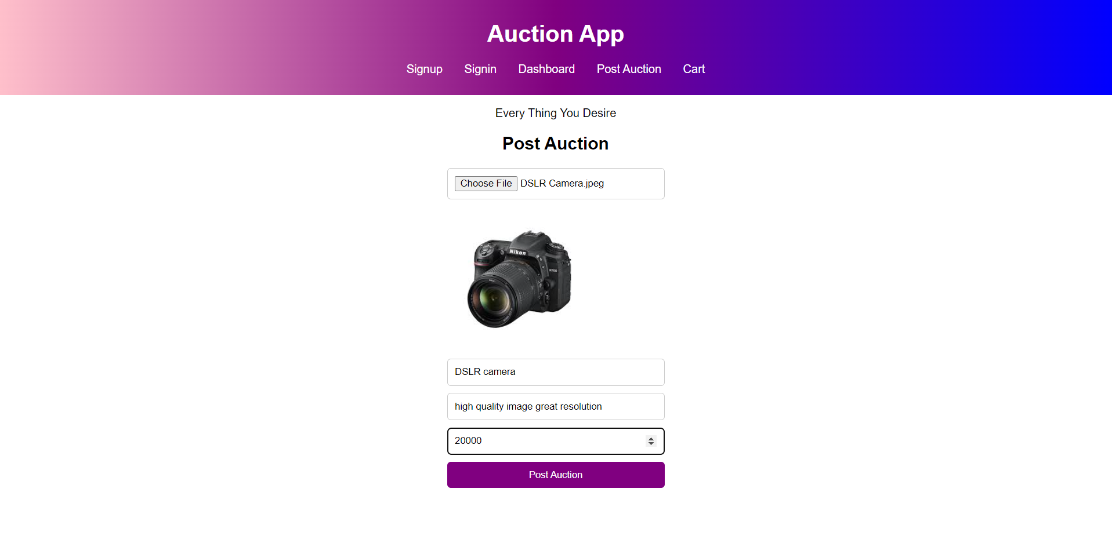
Modelling & Result

Slide 9
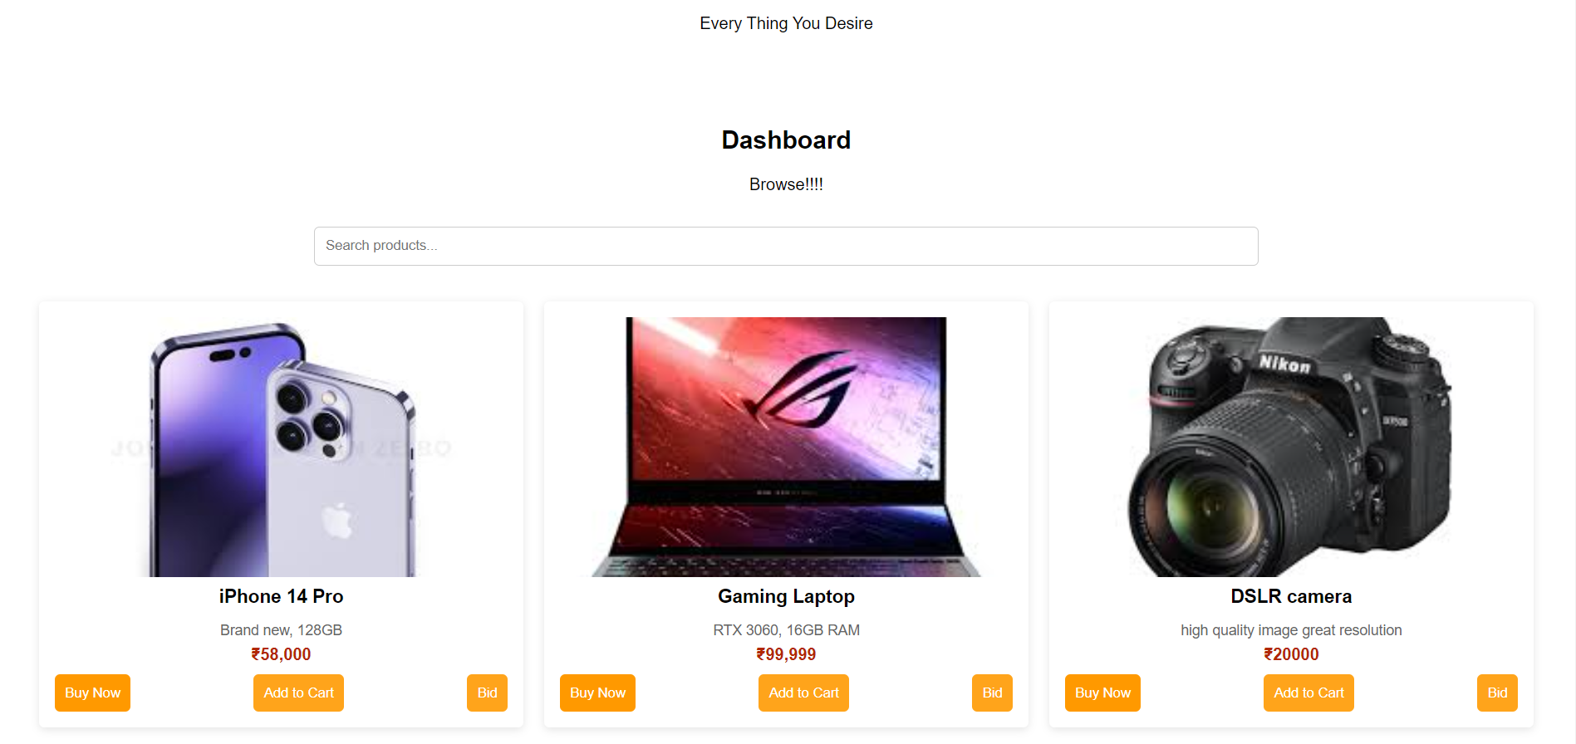
Modelling & Result

Slide 10
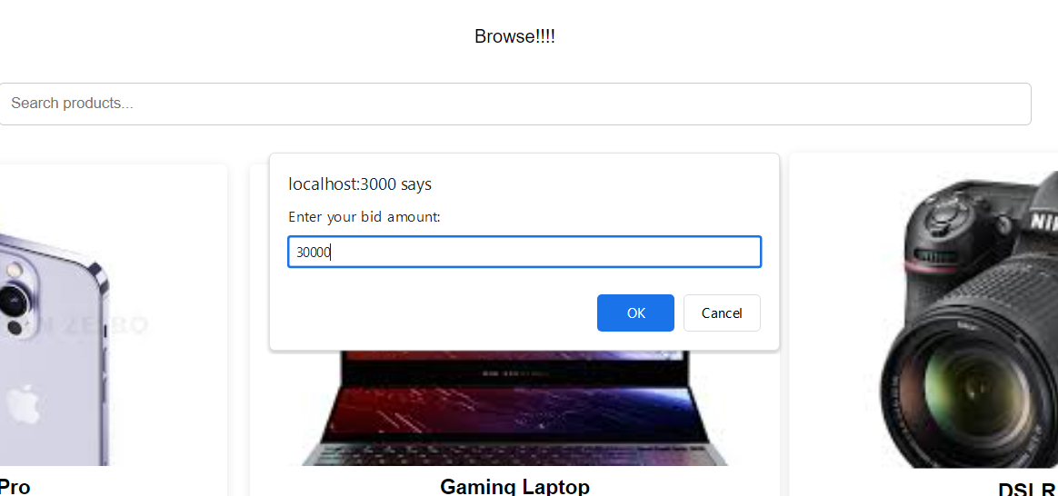
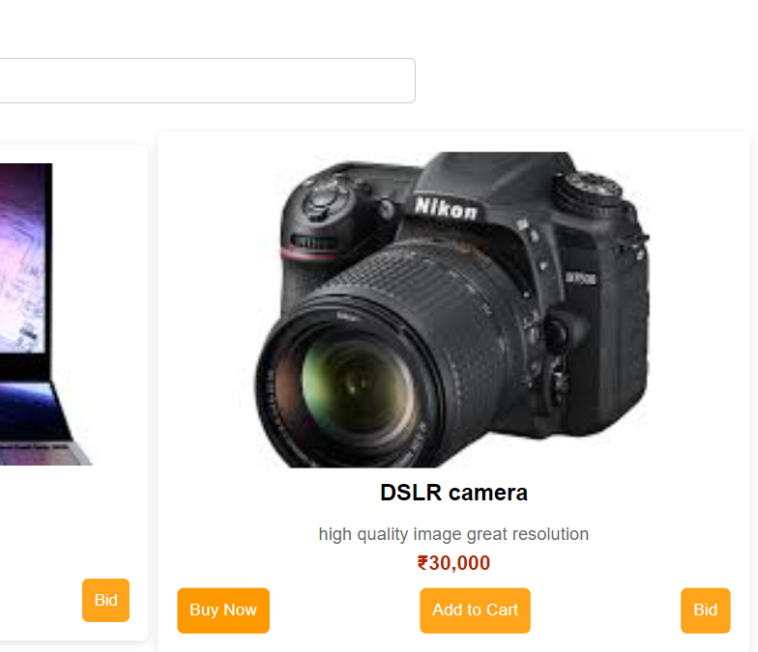
Modelling & Result

Slide 11

Conclusion
This auction platform enables users to create, browse, and bid on auctions effortlessly. It supports image uploads with real-time previews, dynamic dashboard updates, and a search/filter option for better navigation.
A bidding system ensures price updates only when a higher bid is placed, enhancing fairness. Features like "Buy Now" and Add to Cart improve user engagement. Local storage retains auction data across sessions, ensuring a smooth experience.
Designed for scalability, this system can integrate real-time bidding, countdown timers, and authentication in the future, making it a solid foundation for a full-fledged auction platform.

Slide 12


Notes:
Thank You !!

