Slide 1
SYLLABUS OF SEMESTER –I, M.C.A. (Master In Computer Application)
Course Code: MCT543 Course: Concept in Software Engineering
Syllabus Section -I (Weightage – 20%, Minimum Theory Teaching Hours-7)
Introduction to Software Engineering: Software engineering paradigms, Generic view of software engineering, Software metrics, Measures and metrics, Scheduling, Metrics of software quality.

Slide 2
Section -II (Weightage – 50%, Minimum Theory Teaching Hours -15 )
Software Project Management : Software project estimation and planning, Decomposition techniques, Risk Management, Requirement analysis.
Object Oriented Analysis: Object oriented analysis and data modeling, Object oriented concepts, Class Based Modeling.
Agile Development: About Agility, Agility and cost of change, Agile process, Agile process models (Adaptive software development, Scrum, Dynamic system development method), Agile Software development Approaches
Software Design Engineering: The design process and fundamentals, Effective modular Design, Data flow oriented design, Transform analysis, Transaction analysis, Design heuristics.

Slide 3
Section -III ( Weightage – 30% , Minimum Theory Teaching Hours -8 )
Software Quality Management: Software quality assurance, Software testing techniques, S/W testing fundamentals, White box testing, Black box testing, Validation testing, System testing, Debugging, software maintenance: maintainability, Maintenance tasks, Reverse engineering and reengineering, Importance of Release Engineering.
Text Books
Software Engineering : Roger S. Pressman, TMH
Software Engineering For Students : D. Bell, Addison Wisley,
Reference Books
Fundamentals of Software Engineering: Ghezzi, Jazayeri & Mandrioli, PHI.
Software Engineering concept: Richard Fairley, Tata McGraw Hill. 3. Fundamental of Software Engineering,:Mall, PHI.

Slide 4
Course Objectives
To enable the development of skills through which the student will gain expertise to engineer software of high quality by following sound analysis and design principles.
Learn to plan and execute the project effectively through requirements analysis, estimation, risk management and project scheduling activities.
To develop various project management techniques for managing real world projects and object oriented approach towards software engineering.
To inculcate quality consciousness in students through effective testing strategies and software quality management.

Slide 5
Course Outcomes On successful completion of the course students will be able to:
Develop skills to engineer software of high quality by following sound analysis and design principles.
Learn successful project execution strategies like requirements analysis, estimation, risk management and project scheduling activities.
Use various project management techniques for managing real world projects and to develop an object oriented approach towards software engineering.
Inculcate quality consciousness through effective software quality management.

Slide 6
SOFTWARE
A textbook description of software might take the following form:
Software is (1) instructions (computer programs) that when executed provide desired function and performance, (2) data structures that enable the programs to adequately manipulate information, and (3) documents that describe the operation and use of the programs.
Software Characteristics
Software is a logical rather than a physical system element. Therefore, software has characteristics that are considerably different than those of hardware:
Software is developed or engineered, it is not manufactured in the classical sense.
In both activities (development and manufacturing), high quality is achieved through good design, but the manufacturing phase for hardware can introduce quality problems that are nonexistent (or easily corrected) for software.
Both activities are dependent on people, but the relationship between people applied and work accomplished is entirely different.
Both activities require the construction of a "product" but the approaches are different. Software costs are concentrated in engineering.
This means that software projects cannot be managed as if they were manufacturing projects.

Slide 7
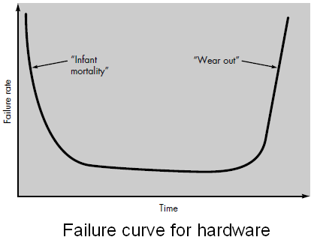
2. Software doesn't "wear out."
Figure shows failure rate as a function of time for hardware.
The relationship, often called the “bathtub curve”, indicates that hardware exhibits relatively high failure rates early in its life; defects are corrected and the failure rate drops to a steady-state level (ideally, quite low) for some period of time.
As time passes, however, the failure rate rises again as hardware components suffer from the cumulative affects of dust, vibration, abuse, temperature extremes, and many other environmental maladies.
Stated simply, the hardware begins to wear out.

Slide 8
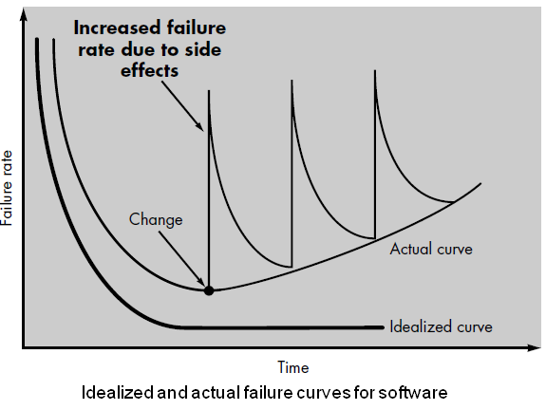
When a hardware component wears out, it is replaced by a spare part. There are no software spare parts. Every software failure indicates an error in design or in the process through which design was translated into machine executable code. Therefore, software maintenance involves considerably more complexity than hardware maintenance.
3. Although the industry is moving toward component-based assembly, most software continues to be custom built.
The design engineer draws a simple schematic of the digital circuitry, does some fundamental analysis to assure that proper function will be achieved, and then goes to the shelf where catalogs of digital components exist. Each integrated circuit (called an IC or a chip) has a part number, a defined and validated function, a well-defined interface, and a standard set of integration guidelines. After each component is selected, it can be ordered off the shelf.

Slide 9
The reusable components have been created so that the engineer can concentrate on the truly innovative elements of a design, that is, the parts of the design that represent something new. In the hardware world, component reuse is a natural part of the engineering process. In the software world, it is something that has only begun to be achieved on a broad scale.
A software component should be designed and implemented so that it can be reused in many different programs. Today, we have extended our view of reuse to encompass not only algorithms but also data structure. Modern reusable components encapsulate both data and the processing applied to the data, enabling the software engineer to create new applications from reusable parts.
For example, today's graphical user interfaces are built using reusable components that enable the creation of graphics windows, pull-down menus, and a wide variety of interaction mechanisms. The data structure and processing detail required to build the interface are contained with a library of reusable components for interface construction.

Slide 10
Software Applications
Software may be applied in any situation for which a pre specified set of procedural steps (i.e., an algorithm) has been defined (notable exceptions to this rule are expert system software and neural network software).
Information content and determinacy are important factors in determining the nature of a software application. Content refers to the meaning and form of incoming and outgoing information.
It is somewhat difficult to develop meaningful generic categories for software applications.

Slide 11
The following software areas indicate the breadth of potential applications:
System software. System software is a collection of programs written to service other programs. Some system software (e.g., compilers, editors, and file management utilities) process complex, but determinate, information structures. Other systems applications (e.g., operating system components, drivers, telecommunications processors) process largely indeterminate data.
Real-time software. Software that monitors/analyzes/controls real-world events as they occur is called real time. Elements of real-time software include a data gathering component that collects and formats information from an external environment, an analysis component that transforms information as required by the application, a control/output component that responds to the external environment, and a monitoring component that coordinates all other components so that real-time response (typically ranging from 1 millisecond to 1 second) can be maintained.

Slide 12
Business software. Business information processing is the largest single software application area. Discrete "systems" (e.g., payroll, accounts receivable/payable, inventory) have evolved into management information system (MIS) software that accesses one or more large databases containing business information.
Engineering and scientific software. Engineering and scientific software have been characterized by "number crunching" algorithms. Applications range from astronomy to volcanology, from automotive stress analysis to space shuttle orbital dynamics, and from molecular biology to automated manufacturing.
Embedded software. Intelligent products have become commonplace in nearly every consumer and industrial market. Embedded software resides in read-only memory and is used to control products and systems for the consumer and industrial markets.
Examples of embedded software include those found in dedicated GPS devices, factory robots, some calculators and even modern smartwatches.

Slide 13
Personal computer software. The personal computer software market has burgeoned over the past two decades. Word processing, spreadsheets, computer graphics, multimedia, entertainment, database management, personal and business financial applications, external network, and database access are only a few of hundreds of applications.
Web-based software. The Web pages retrieved by a browser are software that incorporates executable instructions (e.g., CGI, HTML, Perl, or Java), and data (e.g., hypertext and a variety of visual and audio formats).
There are popular email programs like Yahoo and Gmail, and instant messaging services are web applications too
Artificial intelligence software. Artificial intelligence (AI) software makes use of non numerical algorithms to solve complex problems that are not amenable to computation or straightforward analysis.
Expert systems, also called knowledge based systems, pattern recognition (image and voice), artificial neural networks, theorem proving, and game playing are representative of applications within this category.
Voice assistants are the best AI examples in real life such as, Google Assistant, Alexa, or Siri.

Slide 14
Software engineering
Software engineering is defined as a process of analyzing user requirements and then designing, building, and testing software application which will satisfy those requirements.
A definition proposed by Fritz Bauer [NAU69] at the seminal conference on the subject still serves as a basis for discussion:
Software engineering is the establishment and use of sound engineering principles in order to obtain economically software that is reliable and works efficiently on real machines.
The IEEE [IEE93] has developed a more comprehensive definition when it states:
Software Engineering: (1) The application of a systematic, disciplined, quantifiable approach to the development, operation, and maintenance of software; that is, the application of engineering to software. (2) The study of approaches as in (1).

Slide 15
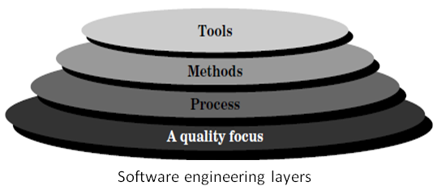
Process, Methods, and Tools
Software engineering is a layered technology.
Any engineering approach (including software engineering) must rest on an organizational commitment to quality.
Total quality management and similar philosophies foster a continuous process improvement culture, and this culture ultimately leads to the development of increasingly more mature approaches to software engineering.
The bedrock that supports software engineering is a quality focus.

Slide 16
Process, Methods, and Tools (Continue...)
The foundation for software engineering is the process layer.
Software engineering process is the glue that holds the technology layers together and enables rational and timely development of computer software.
Process defines a framework for a set of key process areas that must be established for effective delivery of software engineering technology.
The key process areas form the basis for management control of software projects and establish the context in which technical methods are applied, work products (models, documents, data, reports, forms, etc.) are produced, milestones are established, quality is ensured, and change is properly managed.
Software engineering methods provide the technical how-to's for building software.
Methods encompass a broad array of tasks that include requirements analysis, design, program construction, testing, and support.
Software engineering methods rely on a set of basic principles that govern each area of the technology and include modeling activities and other descriptive techniques.
Software engineering tools provide automated or semi-automated support for the process and the methods.
When tools are integrated so that information created by one tool can be used by another, a system for the support of software development, called computer-aided software engineering, is established.
CASE combines software, hardware, and a software engineering database (a repository containing important information about analysis, design, program construction, and testing) to create a software engineering environment analogous to CAD/CAE (computer-aided design/engineering) for hardware.

Slide 17
A Generic View of Software Engineering
Engineering is the analysis, design, construction, verification, and management of technical (or social) entities.
Regardless of the entity to be engineered, the following questions must be asked and answered:
• What is the problem to be solved?
• What characteristics of the entity are used to solve the problem?
• How will the entity (and the solution) be realized?
• How will the entity be constructed?
• What approach will be used to uncover errors that were made in the design and construction of the entity?
• How will the entity be supported over the long term, when corrections, adaptations, and enhancements are requested by users of the entity.
The work associated with software engineering can be categorized into three generic phases, regardless of application area, project size, or complexity.
1. The definition phase focuses on what.
That is, during definition, the software engineer attempts to identify what information is to be processed, what function and performance are desired, what system behavior can be expected, what interfaces are to be established, what design constraints exist, and what validation criteria are required to define a successful system. The key requirements of the system and the software are identified.

Slide 18
A Generic View of Software Engineering (Continue…)
2. The development phase focuses on how.
That is, during development a software engineer attempts to define how data are to be structured, how function is to be implemented within a software architecture, how procedural details are to be implemented, how interfaces are to be characterized, how the design will be translated into a programming language (or nonprocedural language), and how testing will be performed.
The methods applied during the development phase will vary, but three specific technical tasks should always occur: software design, code generation, and software testing.
3. The support phase focuses on change associated with error correction, adaptations required as the software's environment evolves, and changes due to enhancements brought about by changing customer requirements.
The support phase reapplies the steps of the definition and development phases but does so in the context of existing software.
Four types of change are encountered during the support phase:
Correction. Even with the best quality assurance activities, it is likely that the customer will uncover defects in the software. Corrective maintenance changes the software to correct defects.
Adaptation. Over time, the original environment (e.g., CPU, operating system, business rules, external product characteristics) for which the software was developed is likely to change. Adaptive maintenance results in modification to the software to accommodate changes to its external environment.

Slide 19
A Generic View of Software Engineering (Continue…)
Enhancement. As software is used, the customer/user will recognize additional functions that will provide benefit. Perfective maintenance extends the software beyond its original functional requirements.
Prevention. Computer software deteriorates due to change, and because of this, preventive maintenance, often called software reengineering, must be conducted to enable the software to serve the needs of its end users.
In essence, preventive maintenance makes changes to computer programs so that they can be more easily corrected, adapted, and enhanced.
The phases and related steps described in our generic view of software engineering are complemented by a number of umbrella activities.
Typical activities in this category include:
• Software project tracking and control
• Formal technical reviews
• Software quality assurance
• Software configuration management
• Document preparation and production
• Reusability management
• Measurement
• Risk management

Slide 20
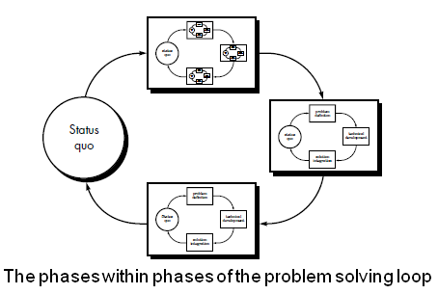
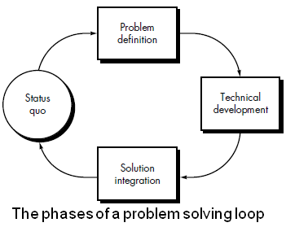
SOFTWARE PROCESS MODELS
To solve actual problems in an industry setting, a software engineer or a team of engineers must incorporate a development strategy that encompasses the process, methods, and tools.
This strategy is often referred to as a process model or a software engineering paradigm.
A process model for software engineering is chosen based on the nature of the project and application, the methods and tools to be used, and the controls and deliverables that are required.

Slide 21
All software development can be characterized as a problem solving loop in which four distinct stages are encountered: status quo, problem definition, technical development, and solution integration.
Status quo “represents the current state of affairs”
problem definition identifies the specific problem to be solved
technical development solves the problem through the application of some technology
solution integration delivers the results (e.g., documents, programs, data, new business function, new product) to those who requested the solution in the first place.
This problem solving loop applies to software engineering work at many different levels of resolution.

Slide 22
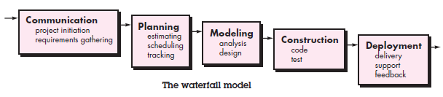
PRESCRIPTIVE PROCESS MODELS
Prescriptive process models were originally proposed to bring order to the chaos of software development.
History has indicated that these traditional models have brought a certain amount of useful structure to software engineering work and have provided a reasonably effective road map for software teams.
The Waterfall Model
The waterfall model, sometimes called the classic life cycle, suggests a systematic, sequential approach to software development that begins with customer specification of requirements and progresses through planning, modeling, construction, and deployment, culminating in ongoing support of the completed software.

Slide 23
Among the problems that are sometimes encountered when the waterfall model is applied are:
1. Real projects rarely follow the sequential flow that the model proposes.
Although the linear model can accommodate iteration, it does so indirectly.
As a result, changes can cause confusion as the project team proceeds.
2. It is often difficult for the customer to state all requirements explicitly.
The waterfall model requires this and has difficulty accommodating the natural uncertainty that exists at the beginning of many projects.
3. The customer must have patience.
A working version of the program(s) will not be available until late in the project time span.
A major blunder, if undetected until the working program is reviewed, can be disastrous.
A variation in the representation of the waterfall model is called the V-model.
The V-model depicts the relationship of quality assurance actions to the actions associated with communication, modeling, and early construction activities.

Slide 24
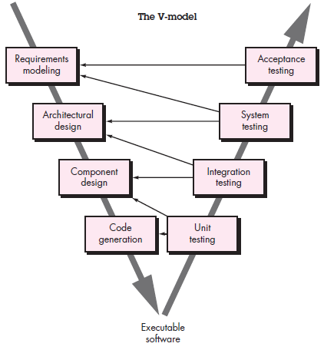
As a software team moves down the left side of the V, basic problem requirements are refined into progressively more detailed and technical representations of the problem and its solution.
Once code has been generated, the team moves up the right side of the V, essentially performing a series of tests (quality assurance actions) that validate each of the models created as the team moved down the left side.
In reality, there is no fundamental difference between the classic life cycle and the V-model. The V-model provides a way of visualizing how verification and validation actions are applied to earlier engineering work.

Slide 25
Incremental Process Models
The incremental model combines elements of linear and parallel process flows.
Incremental model applies linear sequences in a staggered fashion as calendar time progresses.
Each linear sequence produces deliverable “increments” of the software in a manner that is similar to the increments produced by an evolutionary process flow.
For example, word-processing software developed using the incremental paradigm might deliver basic file management, editing, and document production functions in the first increment; more sophisticated editing and document production capabilities in the second increment; spelling and grammar checking in the third increment; and advanced page layout capability in the fourth increment.
It should be noted that the process flow for any increment can incorporate the prototyping paradigm.
When an incremental model is used, the first increment is often a core product. That is, basic requirements are addressed but many supplementary features (some known, others unknown) remain undelivered.
The core product is used by the customer (or undergoes detailed evaluation). As a result of use and/or evaluation, a plan is developed for the next increment.
The plan addresses the modification of the core product to better meet the needs of the customer and the delivery of additional features and functionality. This process is repeated following the delivery of each increment, until the complete product is produced.

Slide 26
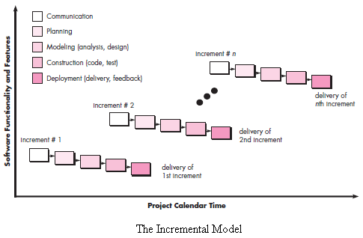

Slide 27
The incremental process model focuses on the delivery of an operational product with each increment.
Early increments are stripped-down versions of the final product, but they do provide capability that serves the user and also provide a platform for evaluation by the user.
Incremental development is particularly useful when staffing is unavailable for a complete implementation by the business deadline that has been established for the project.
Early increments can be implemented with fewer people. If the core product is well received, then additional staff (if required) can be added to implement the next increment.
In addition, increments can be planned to manage technical risks. For example, a major system might require the availability of new hardware that is under development and whose delivery date is uncertain.
It might be possible to plan early increments in a way that avoids the use of this hardware, thereby enabling partial functionality to be delivered to end users without inordinate delay.

Slide 28
THE RAD MODEL
Rapid application development (RAD) is an incremental software development process model that emphasizes an extremely short development cycle.
The RAD model is a “high-speed” adaptation of the linear sequential model in which rapid development is achieved by using component-based construction. If requirements are well understood and project scope is constrained, the RAD process enables a development team to create a “fully functional system” within very short time periods (e.g., 60 to 90 days).
Used primarily for information systems applications, the RAD approach encompasses the following phases :
Business modeling. The information flow among business functions is modeled in a way that answers the following questions:
What information drives the business process?
What information is generated?
Who generates it?
Where does the information go?
Who processes it?

Slide 29
Data modeling. The information flow defined as part of the business modeling phase is refined into a set of data objects that are needed to support the business. The characteristics (called attributes) of each object are identified and the relationships between these objects defined.
Process modeling. The data objects defined in the data modeling phase are transformed to achieve the information flow necessary to implement a business function. Processing descriptions are created for adding, modifying, deleting, or retrieving a data object.
Application generation. RAD assumes the use of fourth generation techniques. Rather than creating software using conventional third generation programming languages the RAD process works to reuse existing program components (when possible) or create reusable components (when necessary). In all cases, automated tools are used to facilitate construction of the software.
Testing and turnover. Since the RAD process emphasizes reuse, many of the program components have already been tested. This reduces overall testing time. However, new components must be tested and all interfaces must be fully exercised.

Slide 30
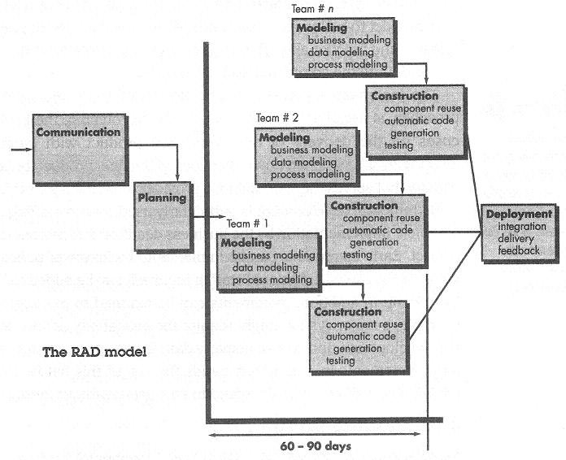
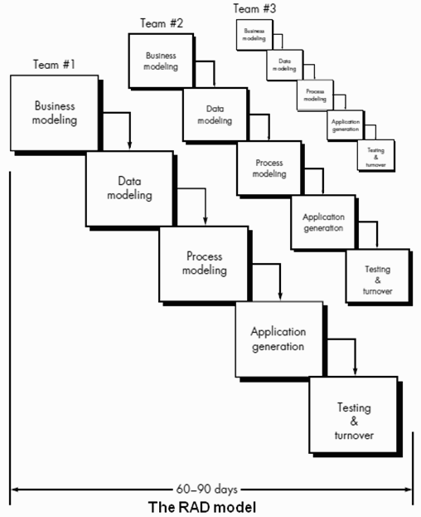

Slide 31
Obviously, the time constraints imposed on a RAD project demand “scalable scope”. If a business application can be modularized in a way that enables each major function to be completed in less than three months, it is a candidate for RAD. Each major function can be addressed by a separate RAD team and then integrated to form a whole.
Like all process models, the RAD approach has drawbacks:
• For large but scalable projects, RAD requires sufficient human resources to create the right number of RAD teams.
• RAD requires developers and customers who are committed to the rapid-fire activities necessary to get a system complete in a much abbreviated time frame. If commitment is lacking from either constituency, RAD projects will fail.
• Not all types of applications are appropriate for RAD. If a system cannot be properly modularized, building the components necessary for RAD will be problematic. If high performance is an issue and performance is to be achieved through tuning the interfaces to system components, the RAD approach may not work.
• RAD is not appropriate when technical risks are high. This occurs when a new application makes heavy use of new technology or when the new software requires a high degree of interoperability with existing computer programs.

Slide 32
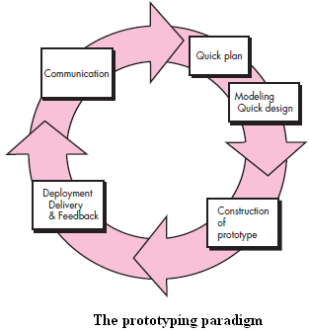
Evolutionary Process Models
Evolutionary models are iterative. They are characterized in a manner that enables you to develop increasingly more complete versions of the software.
Prototyping
Often, a customer defines a set of general objectives for software, but does not identify detailed requirements for functions and features. In other cases, the developer may be unsure of the efficiency of an algorithm, the adaptability of an operating system, or the form that human-machine interaction should take. In these, and many other situations, a prototyping paradigm may offer the best approach.
Regardless of the manner in which it is applied, the prototyping paradigm assists you and other stakeholders to better understand what is to be built when requirements are fuzzy.

Slide 33
The prototyping paradigm begins with communication. You meet with other stakeholders to define the overall objectives for the software, identify whatever requirements are known, and outline areas where further definition is mandatory.
A prototyping iteration is planned quickly, and modeling (in the form of a “quick design”) occurs.
A quick design focuses on a representation of those aspects of the software that will be visible to end users (e.g., human interface layout or output display formats).
The quick design leads to the construction of a prototype.
The prototype is deployed and evaluated by stakeholders, who provide feedback that is used to further refine requirements.
Iteration occurs as the prototype is tuned to satisfy the needs of various stakeholders, while at the same time enabling you to better understand what needs to be done.
The prototype can serve as “the first system.” The one that Brooks recommends you throw away. But this may be an idealized view.
Although some prototypes are built as “throwaways,” others are evolutionary in the sense that the prototype slowly evolves into the actual system.

Slide 34
Both stakeholders and software engineers like the prototyping paradigm.
Users get a feel for the actual system, and developers get to build something immediately. Yet, prototyping can be problematic for the following reasons:
Stakeholders see what appears to be a working version of the software, unaware that the prototype is held together haphazardly, unaware that in the rush to get it working you haven’t considered overall software quality or long-term maintainability. When informed that the product must be rebuilt so that high levels of quality can be maintained, stakeholders cry foul and demand that “a few fixes” be applied to make the prototype a working product. Too often, software development management relents.
As a software engineer, you often make implementation compromises in order to get a prototype working quickly. An inappropriate operating system or programming language may be used simply because it is available and known; an inefficient algorithm may be implemented simply to demonstrate capability. After a time, you may become comfortable with these choices and forget all the reasons why they were inappropriate. The less-than-ideal choice has now become an integral part of the system.

Slide 35
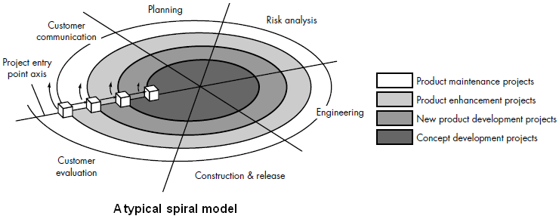
The Spiral Model
The spiral model is an evolutionary software process model that couples the iterative nature of prototyping with the controlled and systematic aspects of the waterfall model.
It provides the potential for rapid development of increasingly more complete versions of the software.
Using the spiral model, software is developed in a series of evolutionary releases. During early iterations, the release might be a model or prototype. During later iterations, increasingly more complete versions of the engineered system are produced.

Slide 36
A spiral model is divided into a number of framework activities, also called task regions.
Typically, there are between three and six task regions. Figure depicts a spiral model that contains six task regions:
• Customer communication— tasks required to establish effective communication between developer and customer.
• Planning— tasks required to define resources, timelines, and other project related information.
• Risk analysis— tasks required to assess both technical and management risks.
• Engineering— tasks required to build one or more representations of the application.
• Construction and release— tasks required to construct, test, install, and provide user support (e.g., documentation and training).
• Customer evaluation— tasks required to obtain customer feedback based on evaluation of the software representations created during the engineering stage and implemented during the installation stage.
Each of the regions is populated by a set of work tasks, called a task set, that are adapted to the characteristics of the project to be undertaken.
For small projects, the number of work tasks and their formality is low.
For larger, more critical projects, each task region contains more work tasks that are defined to achieve a higher level of formality.

Slide 37
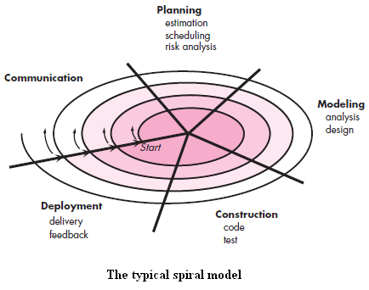
The first circuit around the spiral might result in the development of a product specification; subsequent passes around the spiral might be used to develop a prototype and then progressively more sophisticated versions of the software.
Each pass through the planning region results in adjustments to the project plan.
Cost and schedule are adjusted based on feedback derived from the customer after delivery.
In addition, the project manager adjusts the planned number of iterations required to complete the software.

Slide 38
Unlike other process models that end when software is delivered, the spiral model can be adapted to apply throughout the life of the computer software. Therefore, the first circuit around the spiral might represent a “concept development project” that starts at the core of the spiral and continues for multiple iterations until concept development is complete. If the concept is to be developed into an actual product, the process proceeds outward on the spiral and a “new product development project” commences.
The new product will evolve through a number of iterations around the spiral.
Later, a circuit around the spiral might be used to represent a “product enhancement project.”
In essence, the spiral, when characterized in this way, remains operative until the software is retired.
There are times when the process is dormant, but whenever a change is initiated, the process starts at the appropriate entry point (e.g., product enhancement).

Slide 39
Concurrent Models
The concurrent development model, sometimes called concurrent engineering, allows a software team to represent iterative and concurrent elements of any of the process models.
For example, the modeling activity defined for the spiral model is accomplished by invoking one or more of the following software engineering actions: prototyping, analysis, and design.
Figure provides a schematic representation of one software engineering activity within the modeling activity using a concurrent modeling approach.
The activity—modeling—may be in any one of the states noted at any given time. Similarly, other activities, actions, or tasks (e.g., communication or construction) can be represented in an analogous manner.
All software engineering activities exist concurrently but reside in different states.

Slide 40
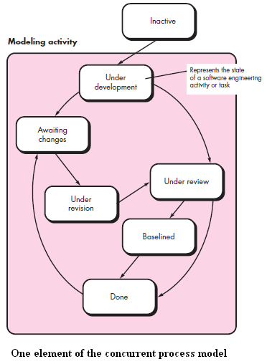

Slide 41
For example, early in a project the communication activity has completed its first iteration and exists in the awaiting changes state.
The modeling activity (which existed in the inactive state while initial communication was completed), now makes a transition into the under development state. If, however, the customer indicates that changes in requirements must be made, the modeling activity moves from the under development state into the awaiting changes state.
Concurrent modeling defines a series of events that will trigger transitions from state to state for each of the software engineering activities, actions, or tasks.
For example, during early stages of design (a major software engineering action that occurs during the modeling activity), an inconsistency in the requirements model is uncovered.
This generates the event analysis model correction, which will trigger the requirements analysis action from the done state into the awaiting changes state.
Concurrent modeling is applicable to all types of software development and provides an accurate picture of the current state of a project.
Rather than confining software engineering activities, actions, and tasks to a sequence of events, it defines a process network.
Each activity, action, or task on the network exists simultaneously with other activities, actions, or tasks. Events generated at one point in the process network trigger transitions among the states.

Slide 42
MEASURES, METRICS, AND INDICATORS
Although the terms measure, measurement, and metrics are often used interchangeably, it is important to note the subtle differences between them.
Within the software engineering context, a measure provides a quantitative indication of the extent, amount, dimension, capacity, or size of some attribute of a product or process. Measurement is the act of determining a measure.
-----------------------------------------------------------------
The IEEE Standard Glossary of Software Engineering Terms defines metric as “a quantitative measure of the degree to which a system, component, or process own’s a given attribute.”
A software metric is a measure of software characteristics which are measurable or countable.
-----------------------------------------------------------------
A software engineer collects measures and develops metrics so that indicators will be obtained.
An indicator is a metric or combination of metrics that provide insight into the software process, a software project, or the product itself.
An indicator provides insight that enables the project manager or software engineers to adjust the process, the project, or the process to make things better.

Slide 43
Measurement Principles
Roche suggests a measurement process that can be characterized by five activities:
• Formulation. The derivation of software measures and metrics appropriate for the representation of the software that is being considered.
• Collection. The mechanism used to accumulate data required to derive the formulated metrics.
• Analysis. The computation of metrics and the application of mathematical tools.
• Interpretation. The evaluation of metrics resulting in insight into the quality of the representation.
• Feedback. Recommendations derived from the interpretation of product metrics transmitted to the software team.

Slide 44
The following principles are representative of many that can be proposed for metrics characterization and validation:
• A metric should have desirable mathematical properties. That is, the metric’s value should be in a meaningful range (e.g., 0 to 1, where 0 truly means absence, 1 indicates the maximum value, and 0.5 represents the “halfway point”).
• When a metric represents a software characteristic that increases when positive traits occur or decreases when undesirable traits are encountered, the value of the metric should increase or decrease in the same manner.
• Each metric should be validated empirically in a wide variety of contexts before being published or used to make decisions. A metric should measure the factor of interest, independently of other factors. It should “scale up” to large systems and work in a variety of programming languages and system domains.

Slide 45
Roche suggests the following principles for these activities:
whenever possible, data collection and analysis should be automated;
valid statistical techniques should be applied to establish relationships between internal product attributes and external quality characteristics (e.g., whether the level of architectural complexity correlates with the number of defects reported in production use); and
interpretative guidelines and recommendations should be established for each metric.

Slide 46
METRICS IN THE PROCESS
Metrics should be collected so that process and product indicators can be ascertained. Process indicators enable a software engineering organization to gain insight into the efficacy of an existing process (i.e., the paradigm, software engineering tasks, work products, and milestones). They enable managers and practitioners to assess what works and what doesn’t.
Process metrics are collected across all projects and over long periods of time. Their intent is to provide indicators that lead to long-term software process improvement.
Project indicators enable a software project manager to:
assess the status of an ongoing project,
track potential risks,
uncover problem areas before they go “critical,”
adjust work flow or tasks, and
evaluate the project team’s ability to control quality of software work products.

Slide 47
Process Metrics and Software Process Improvement
The only rational way to improve any process is to measure specific attributes of the process, develop a set of meaningful metrics based on these attributes, and then use the metrics to provide indicators that will lead to a strategy for improvement.
Grady argues that there are “private and public” uses for different types of process data. Because it is natural that individual software engineers might be sensitive to the use of metrics collected on an individual basis, these data should be private to the individual and serve as an indicator for the individual only.
Examples of private metrics include defect rates (by individual), defect rates (by module), and errors found during development.
Public metrics generally assimilate information that originally was private to individuals and teams. Project level defect rates (absolutely not attributed to an individual), effort, calendar times, and related data are collected and evaluated in an attempt to uncover indicators that can improve organizational process performance.
Software process metrics can provide significant benefit as an organization works to improve its overall level of process maturity.

Slide 48
Grady suggests the development of a fishbone diagram to help in diagnosing the data represented in the frequency diagram.
Referring to Figure, the spine of the diagram (the central line) represents the quality factor under consideration (in this case specification defects that account for 25 percent of the total).
Each of the ribs (diagonal lines) connecting to the spine indicate potential causes for the quality problem (e.g., missing requirements, ambiguous specification, incorrect requirements, changed requirements).
The spine and ribs notation is then added to each of the major ribs of the diagram to expand upon the cause noted. Expansion is shown only for the incorrect cause in Figure.
The collection of process metrics is the driver for the creation of the fishbone diagram.
A completed fishbone diagram can be analyzed to derive indicators that will enable a software organization to modify its process to reduce the frequency of errors and defects.

Slide 49
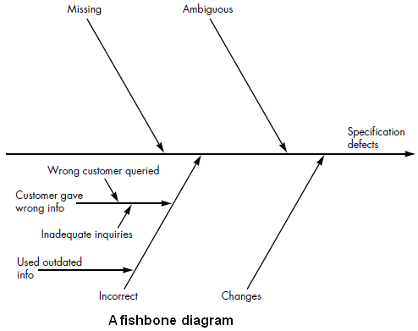

Slide 50
Project Metrics
Software process metrics are used for strategic purposes.
Software project measures are tactical. That is, project metrics and the indicators derived from them are used by a project manager and a software team to adapt project work flow and technical activities.
The first application of project metrics on most software projects occurs during estimation. Metrics collected from past projects are used as a basis from which effort and time estimates are made for current software work.
As a project proceeds, measures of effort and calendar time expended are compared to original estimates (and the project schedule). The project manager uses these data to monitor and control progress.
As technical work commences, other project metrics begin to have significance. Production rates represented in terms of pages of documentation, review hours, function points, and delivered source lines are measured.
In addition, errors uncovered during each software engineering task are tracked.
As the software evolves from specification into design, technical metrics are collected to assess design quality and to provide indicators that will influence the approach taken to code generation and testing.

Slide 51
The intent of project metrics is twofold.
First, these metrics are used to minimize the development schedule by making the adjustments necessary to avoid delays and mitigate potential problems and risks.
Second, project metrics are used to assess product quality on an ongoing basis and, when necessary, modify the technical approach to improve quality.
As quality improves, defects are minimized, and as the defect count goes down, the amount of rework required during the project is also reduced. This leads to a reduction in overall project cost.

Slide 52
SOFTWARE MEASUREMENT
Measurements in the physical world can be categorized in two ways: direct measures (e.g., the length of a bolt) and indirect measures (e.g., the "quality" of bolts produced, measured by counting rejects). Software metrics can be categorized similarly.
Direct measures of the software engineering process include cost and effort applied. Direct measures of the product include lines of code (LOC) produced, execution speed, memory size, and defects reported over some set period of time. Indirect measures of the product include functionality, quality, complexity, efficiency, reliability, maintainability, and many other "–abilities”.
The cost and effort required to build software, the number of lines of code produced, and other direct measures are relatively easy to collect, as long as specific conventions for measurement are established in advance. However, the quality and functionality of software or its efficiency or maintainability are more difficult to assess and can be measured only indirectly.

Slide 53
The Attributes of Effective Software Metrics
Hundreds of metrics have been proposed for computer software, but not all provide practical support to the software engineer.
Ejiogu defines a set of attributes that should be encompassed by effective software metrics. The derived metric and the measures that lead to it should be:
Simple and computable. It should be relatively easy to learn how to derive the metric, and its computation should not demand inordinate effort or time.
Empirically and intuitively persuasive. The metric should satisfy the engineer’s intuitive notions about the product attribute under consideration (e.g., a metric that measures module cohesion should increase in value as the level of cohesion increases).
Consistent and objective. The metric should always yield results that are unambiguous. An independent third party should be able to derive the same metric value using the same information about the software.

Slide 54
Consistent in its use of units and dimensions. The mathematical computation of the metric should use measures that do not lead to bizarre combinations of units. For example, multiplying people on the project teams by programming language variables in the program results in a suspicious mix of units that are not intuitively persuasive.
Programming language independent. Metrics should be based on the requirements model, the design model, or the structure of the program itself. They should not be dependent on the vagaries of programming language syntax or semantics.
An effective mechanism for high-quality feedback. That is, the metric should provide you with information that can lead to a higher-quality end product.

Slide 55
Function-Based Metrics
The function point (FP) metric can be used effectively as a means for measuring the functionality delivered by a system.
Using historical data, the FP metric can then be used to (1) estimate the cost or effort required to design, code, and test the software; (2) predict the number of errors that will be encountered during testing; and (3) forecast the number of components.
Function points are derived using an relationship based on countable (direct) measures of software’s information domain and qualitative assessments of software complexity. Information domain values are defined in the following manner:
Number of external inputs (EIs). Each external input originates from a user or is transmitted from another application and provides distinct application-oriented data or control information. Inputs are often used to update internal logical files (ILFs). Inputs should be distinguished from inquiries, which are counted separately.
Number of external outputs (EOs). Each external output is derived data within the application that provides information to the user. In this context external output refers to reports, screens, error messages, etc. Individual data items within a report are not counted separately.
Number of external inquiries (EQs). An external inquiry is defined as an online input that results in the generation of some immediate software response in the form of an online output (often retrieved from an ILF).

Slide 56
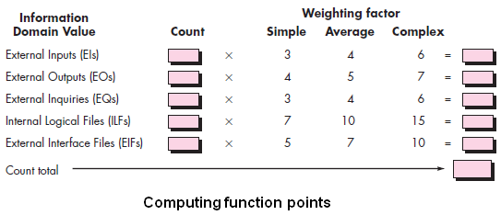
Number of internal logical files (ILFs). Each internal logical file is a logical grouping of data that resides within the application’s boundary and is maintained via external inputs.
Number of external interface files (EIFs). Each external interface file is a logical grouping of data that resides external to the application but provides information that may be of use to the application.
Once these data have been collected, the table in Figure is completed and a complexity value is associated with each count. Organizations that use function point methods develop criteria for determining whether a particular entry is simple, average, or complex. To compute function points (FP), the following relationship is used:
FP = count total x [0.65 + 0.01 x ∑(Fi)]

Slide 57
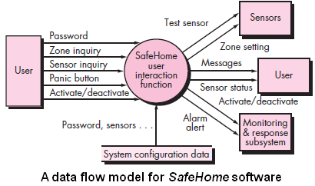
The function manages user interaction, accepting a user password to activate or deactivate the system, and allows inquiries on the status of security zones and various security sensors.
The data flow diagram is evaluated to determine a set of key information domain measures required for computation of the function point metric. Three external inputs—password, panic button, and activate/deactivate—are shown in the figure along with two external inquiries—zone inquiry and sensor inquiry. One ILF (system configuration file) is shown. Two external outputs (messages and sensor status) and four EIFs (test sensor, zone setting, activate/deactivate, and alarm alert) are also present.

Slide 58
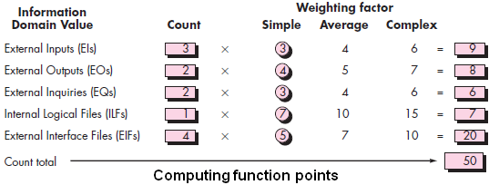
The count total shown in Figure must be adjusted using Equation. For the purposes of this example, we assume that (Fi) is 46 (a moderately complex product). Therefore,
FP = 50 x [0.65 + (0.01 x 46)] = 56
Based on the projected FP value derived from the requirements model, the project team can estimate the overall implemented size of the SafeHome user interaction function. Assume that past data indicates that one FP translates into 60 lines of code (an object-oriented language is to be used) and that 12 FPs are produced for each person-month of effort. These historical data provide the project manager with important planning information that is based on the requirements model rather than preliminary estimates. Assume further that past projects have found an average of three errors per function point during requirements and design reviews and four errors per function point during unit and integration testing.

Slide 59
PROJECT SCHEDULING
Software project scheduling is an action that distributes estimated effort across the planned project duration by allocating the effort to specific software engineering tasks.
During early stages of project planning, a macroscopic schedule is developed. This type of schedule identifies all major process framework activities and the product functions to which they are applied.
As the project gets under way, each entry on the macroscopic schedule is refined into a detailed schedule. Here, specific software actions and tasks (required to accomplish an activity) are identified and scheduled.

Slide 60
Scheduling for software engineering projects can be viewed from two rather different perspectives.
In the first, an end date for release of a computer-based system has already (and irrevocably) been established. The software organization is constrained to distribute effort within the prescribed time frame.
The second view of software scheduling assumes that rough chronological bounds have been discussed but that the end date is set by the software engineering organization.
Effort is distributed to make best use of resources, and an end date is defined after careful analysis of the software. Unfortunately, the first situation is encountered far more frequently than the second.

Slide 61
Basic Principles
Like all other areas of software engineering, a number of basic principles guide software project scheduling:
Compartmentalization. The project must be compartmentalized into a number of manageable activities and tasks. To accomplish compartmentalization, both the product and the process are refined.
Interdependency. The interdependency of each compartmentalized activity or task must be determined. Some tasks must occur in sequence, while others can occur in parallel. Some activities cannot commence until the work product produced by another is available. Other activities can occur independently.

Slide 62
Time allocation. Each task to be scheduled must be allocated some number of work units (e.g., person-days of effort). In addition, each task must be assigned a start date and a completion date that are a function of the interdependencies and whether work will be conducted on a full-time or part-time basis.
Effort validation. Every project has a defined number of people on the software team. As time allocation occurs, you must ensure that no more than the allocated number of people has been scheduled at any given time. For example, consider a project that has three assigned software engineers (e.g., three person-days are available per day of assigned effort). On a given day, seven concurrent tasks must be accomplished. Each task requires 0.50 person-days of effort. More effort has been allocated than there are people to do the work.

Slide 63
Defined responsibilities. Every task that is scheduled should be assigned to a specific team member.
Defined outcomes. Every task that is scheduled should have a defined outcome. For software projects, the outcome is normally a work product (e.g., the design of a component) or a part of a work product. Work products are often combined in deliverables.
Defined milestones. Every task or group of tasks should be associated with a project milestone. A milestone is accomplished when one or more work products has been reviewed for quality and has been approved.
Each of these principles is applied as the project schedule evolves.

Slide 64
METRICS FOR SOFTWARE QUALITY
The quality of a system, application, or product is only as good as the requirements that describe the problem, the design that models the solution, the code that leads to an executable program, and the tests that exercise the software to uncover errors.
A good software engineer uses measurement to assess the quality of the analysis and design models, the source code, and the test cases that have been created as the software is engineered.
The project manager must also evaluate quality as the project progresses. Private metrics collected by individual software engineers are assimilated to provide project level results.

Slide 65
Although many quality measures can be collected, the primary thrust at the project level is to measure errors and defects. Metrics derived from these measures provide an indication of the effectiveness of individual and group software quality assurance and control activities.
Metrics such as work product (e.g., requirements or design) errors per function point, errors uncovered per review hour, and errors uncovered per testing hour provide insight into the efficacy of each of the activities implied by the metric. Error data can also be used to compute the defect removal efficiency (DRE) for each process framework activity.

Slide 66
An Overview of Factors That Affect Quality
McCall and Cavano defined a set of quality factors that were a first step toward the development of metrics for software quality.
These factors assess software from three distinct points of view: (1) product operation (using it), (2) product revision (changing it), and (3) product transition (modifying it to work in a different environment; i.e., "porting" it).
In their work, the authors describe the relationship between these quality factors (what they call a framework) and other aspects of the software engineering process:
First, the framework provides a mechanism for the project manager to identify what qualities are important. These qualities are attributes of the software in addition to its functional correctness and performance which have life cycle implications. Such factors as maintainability and portability have been shown in recent years to have significant life cycle cost impact . . .

Slide 67
Secondly, the framework provides a means for quantitatively assessing how well the development is progressing relative to the quality goals established . . .
Thirdly, the framework provides for more interaction of QA personnel throughout the development effort . . .
Lastly, . . . quality assurance personal can use indications of poor quality to help identify [better] standards to be enforced in the future.

