Slide 1
The Chomsky Hierarchy
Non-recursively enumerable
Recursively-enumerable
Recursive
Context-sensitive
Context-free
Regular

Slide 2
Decidability

Slide 3


Consider problems with answer YES or NO
Examples:
Does Machine have three states ?
Is string a binary number?
Does DFA accept any input?

Slide 4
A problem is decidable if some Turing machine
Solves (decides) the problem
Decidable problems:
Does Machine have three states ?
Is string a binary number?
Does DFA accept any input?

Slide 5
The Turing machine that solves a problem
answers YES or NO for each instance(example
, case, sample)
Input
problem
instance
YES
Turing Machine
NO

Slide 6
The machine that decides a problem:
If the answer is YES
then halts in a yes state
If the answer is NO
then halts in a no state
These states may not be final states

Slide 7
Turing Machine that decides a problem
YES
NO
YES and NO states are halting states

Slide 8
Difference between
Recursive Languages and Decidable problems
For decidable problems:
The YES states may not be final states

Slide 9
Some problems are undecidable:
There is no Turing Machine that
solves all instances of the problem

Slide 10
A simple undecidable problem:
The membership problem

Slide 11


The Membership Problem
Input:
Turing Machine
String
Question:
Does accept ?

Slide 12
Theorem:
The membership problem is undecidable
Proof:
Assume for contradiction that
the membership problem is decidable

Slide 13


There exists a Turing Machine
that solves the membership problem
YES
accepts
NO
rejects

Slide 14

Let be a recursively enumerable language
Let be the Turing Machine that accepts
We will prove that is also recursive:
we will describe a Turing machine that
accepts and halts on any input

Slide 15
Turing Machine that accepts
and halts on any input
YES
accept
accepts ?
NO
reject

Slide 16
Therefore,
is recursive
Since is chosen arbitrarily, we have
proven that every recursively enumerable
language is also recursive
But there are recursively enumerable
languages which are not recursive
Contradiction!!!!

Slide 17
Therefore, the membership problem
is undecidable
END OF PROOF

Slide 18
A famous undecidable problem:
The halting problem

Slide 19
The Halting Problem
Input:
Turing Machine
String
Question:
Does halt on ?

Slide 20
Theorem:
The halting problem is undecidable
Proof:
Assume for contradiction that
the halting problem is decidable

Slide 21
There exists Turing Machine
that solves the halting problem
YES
halts on
NO
doesn’t
halt on

Slide 22
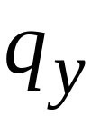
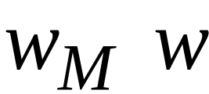


Construction of
Input:
initial tape contents
YES
NO
Encoding
of
String

Slide 23


Construct machine :
If returns YES then loop forever
If returns NO then halt

Slide 24


Loop forever
YES
NO

Slide 25


Construct machine :
Input:
(machine )
If
halts on input
Then loop forever
Else halt

Slide 26

copy

Slide 27
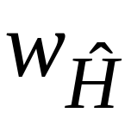
Run machine with input itself:
Input:
(machine )
If
halts on input
Then loop forever
Else halt

Slide 28
on input
:
If halts then loops forever
If doesn’t halt then it halts
NONSENSE !!!!!

Slide 29
Therefore, we have contradiction
The halting problem is undecidable
END OF PROOF

Slide 30
Another proof of the same theorem:
If the halting problem was decidable then
every recursively enumerable language
would be recursive

Slide 31
Theorem:
The halting problem is undecidable
Proof:
Assume for contradiction that
the halting problem is decidable

Slide 32
There exists Turing Machine
that solves the halting problem
YES
halts on
NO
doesn’t
halt on

Slide 33
Let be a recursively enumerable language
Let be the Turing Machine that accepts
We will prove that is also recursive:
we will describe a Turing machine that
accepts and halts on any input

Slide 34
Turing Machine that accepts
and halts on any input
NO
reject
halts on ?
YES
accept
Halts on final state
Run
with input
reject
Halts on non-final
state

Slide 35
Therefore
is recursive
Since is chosen arbitrarily, we have
proven that every recursively enumerable
language is also recursive
But there are recursively enumerable
languages which are not recursive
Contradiction!!!!

Slide 36
Therefore, the halting problem is undecidable
END OF PROOF

Slide 37
Theorem:
For a recursively enumerable language
it is undecidable to determine whether
is finite
Proof:
We will reduce the halting problem
( undecidable ) to this problem

Slide 38
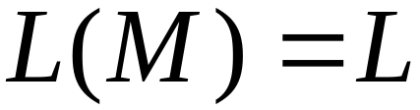
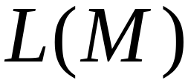
Let be the machine that accepts
Assume we have the finite language algorithm:
YES
finite
Algorithm for
finite language
problem
NO
not finite

Slide 39
We will design the halting problem algorithm:
YES
halts on
Algorithm for
Halting problem
NO
doesn’t
halt on

Slide 40
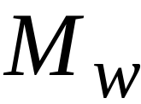
First construct machine :
Initially, simulates on input
When enters a halt state,
accept any input (inifinite language)
Otherwise accept nothing (finite language)

Slide 41
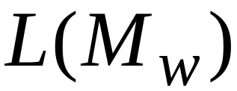
halts on
if and only if
is not finite

Slide 42
Algorithm for halting problem:
Inputs: machine and string
1. Construct
2. Determine if is finite
YES: then doesn’t halt on
NO: then halts on

Slide 43
Machine for halting problem
YES
NO
Check if
construct
YES
is finite
NO

Slide 44
Theorem:
For a recursively enumerable language
it is undecidable to determine whether
contains two different strings of same length
Proof:
We will reduce the halting problem
to this problem

Slide 45
Let be the machine that accepts
Assume we have the two-strings algorithm:
YES
contains
Algorithm for
two-strings
problem
Doesn’t
contain
NO
two equal length strings

Slide 46
We will design the halting problem algorithm:
YES
halts on
Algorithm for
Halting problem
NO
doesn’t
halt on

Slide 47


First construct machine :
Initially, simulates on input
When enters a halt state,
accept symbols or
(two equal length strings)

Slide 48

halts on
if and only if
accepts and
(two equal length strings)

Slide 49
Algorithm for halting problem:
Inputs: machine and string
1. Construct
2. Determine if accepts
two strings of equal length
YES: then halts on
NO: then doesn’t halt on

Slide 50
Machine for halting problem
YES
YES
Check if
construct
NO
NO
has two
equal length
strings

