Slide 1
Context-Free Languages

Slide 2

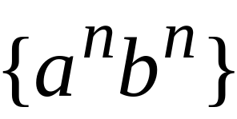
Regular Languages

Slide 3
Context-Free Languages
Regular Languages

Slide 4
Context-Free Languages
Context-Free
Grammars
Pushdown
Automata
stack
automaton

Slide 5
Context-Free Grammars

Slide 6


Example
A context-free grammar :
A derivation:

Slide 7
A context-free grammar :
Another derivation:

Slide 8


(((( ))))

Slide 9
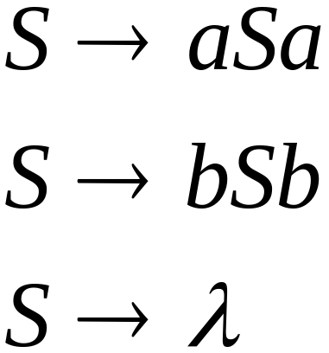
Example
A context-free grammar :
A derivation:

Slide 10
A context-free grammar :
Another derivation:

Slide 11


Slide 12
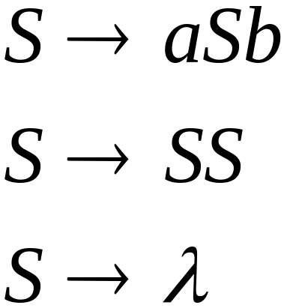
Example
A context-free grammar :
A derivation:

Slide 13
A context-free grammar :
A derivation:

Slide 14
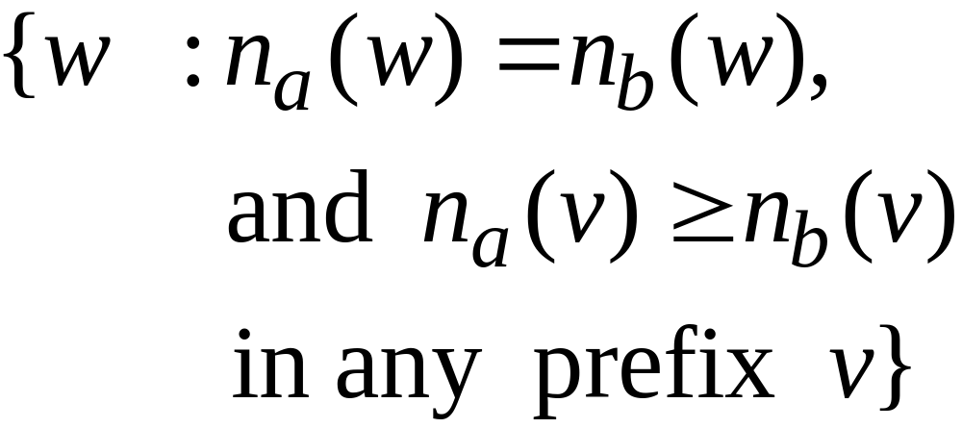
() ((( ))) (( ))

Slide 15



Definition: Context-Free Grammars
Grammar
Variables
Terminal
symbols
Start
variables
Productions of the form:
is string of variables and terminals

Slide 16

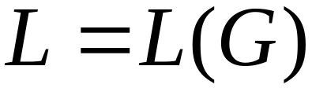
Definition: Context-Free Languages
A language is context-free
if and only if
there is a grammar with

Slide 17
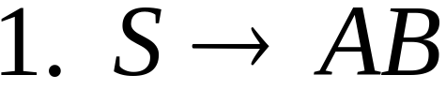
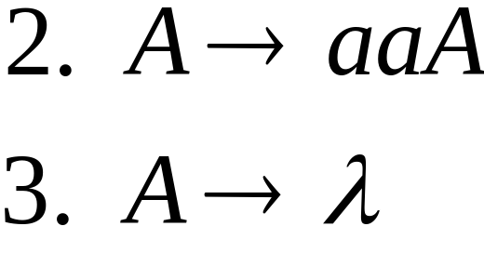
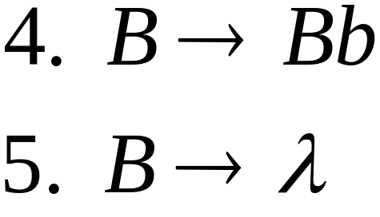


Derivation Order
Leftmost derivation:
Rightmost derivation:

Slide 18
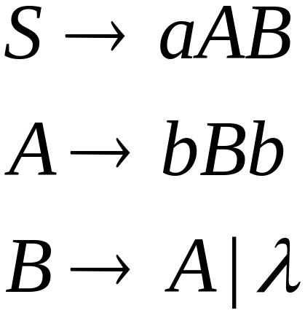
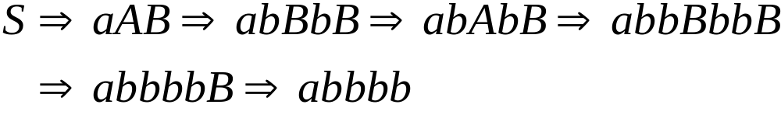
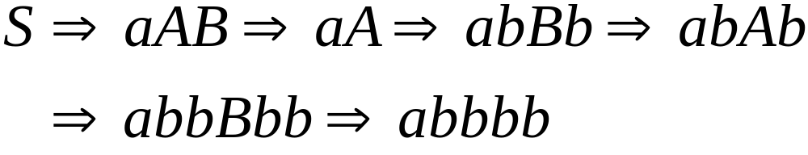
Leftmost derivation:
Rightmost derivation:

Slide 19
Derivation Trees

Slide 20

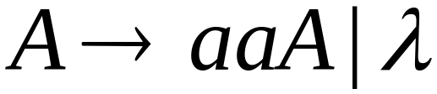
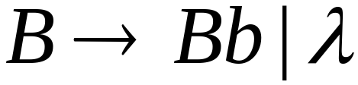





Slide 21



Slide 22


Slide 23


Slide 24
Derivation Tree

Slide 25
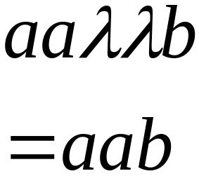
Derivation Tree
yield

Slide 26
Partial Derivation Trees
Partial derivation tree

Slide 27
Partial derivation tree

Slide 28

sentential
form
Partial derivation tree
yield

Slide 29
Sometimes, derivation order doesn’t matter
Leftmost:
Rightmost:
Same derivation tree

Slide 30
Ambiguity

Slide 31





leftmost derivation

Slide 32

leftmost derivation

Slide 33
Two derivation trees

Slide 34
The grammar
is ambiguous:
string
has two derivation trees

Slide 35
The grammar
is ambiguous:
string
has two leftmost derivations

Slide 36

Definition:
A context-free grammar is ambiguous
if some string has:
two or more derivation trees

Slide 37
In other words:
A context-free grammar is ambiguous
if some string has:
two or more leftmost derivations
(or rightmost)

Slide 38

Why do we care about ambiguity?
take

Slide 39



Slide 40






Slide 41
Correct result:

Slide 42
Ambiguity is bad for programming languages
We want to remove ambiguity

Slide 43
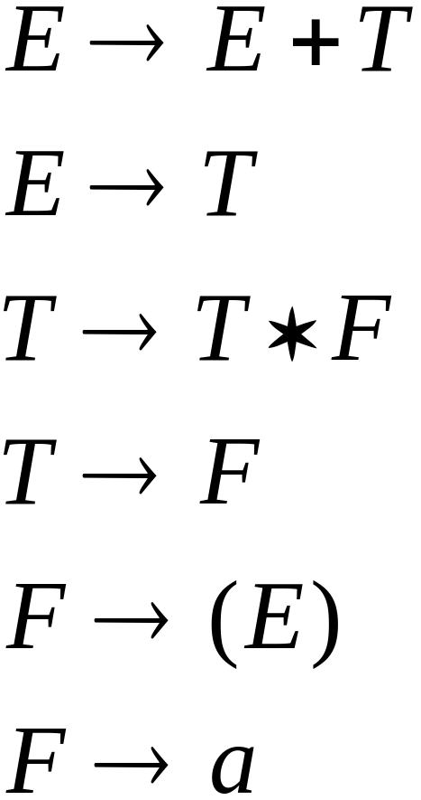
We fix the ambiguous grammar:
New non-ambiguous grammar:

Slide 44




Slide 45
Unique derivation tree

Slide 46
The grammar :
is non-ambiguous:
Every string has
a unique derivation tree

Slide 47
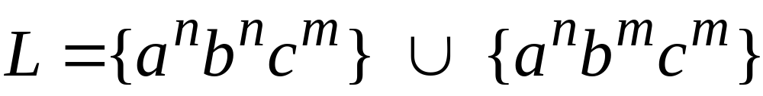

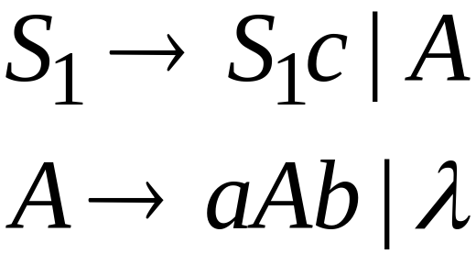
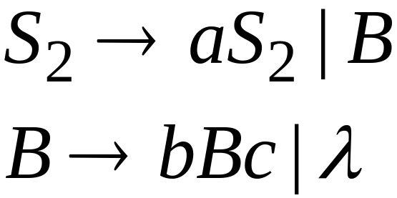
Inherent Ambiguity
Some context free languages
have only ambiguous grammars
Example:

Slide 48
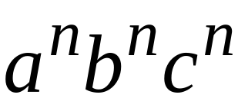



The string
has two derivation trees

