Slide 1

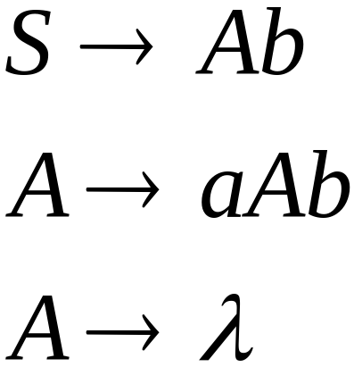
Linear Grammars
Grammars with
at most one variable at the right side
of a production
Examples:

Slide 2

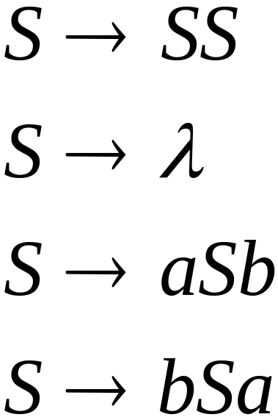
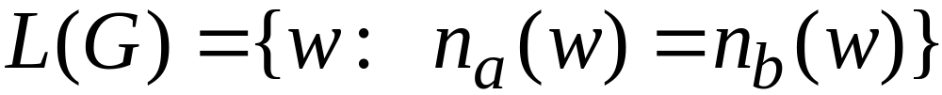


A Non-Linear Grammar
Grammar :
Number of in string

Slide 3
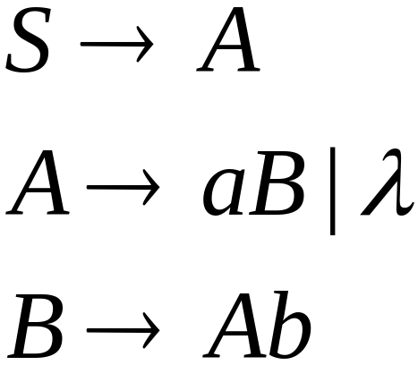
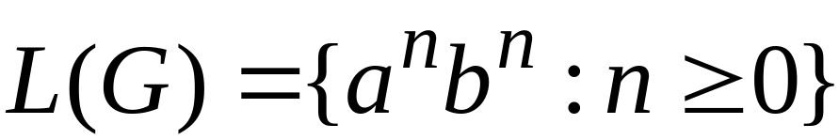
Another Linear Grammar
Grammar :

Slide 4


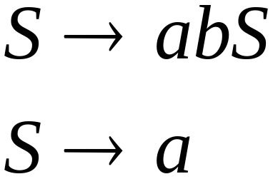
Right-Linear Grammars
All productions have form:
Example:
or
string of
terminals

Slide 5

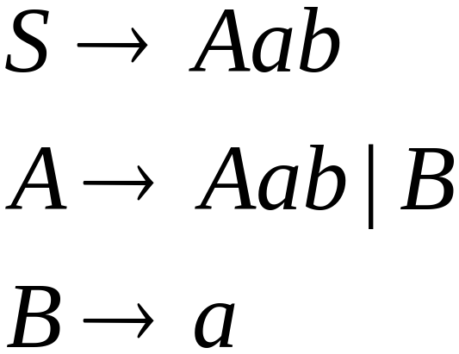
Left-Linear Grammars
All productions have form:
Example:
or
string of
terminals

Slide 6
Regular Grammars

Slide 7
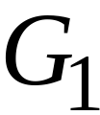
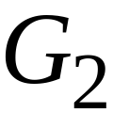
Regular Grammars
A regular grammar is any
right-linear or left-linear grammar
Examples:

Slide 8
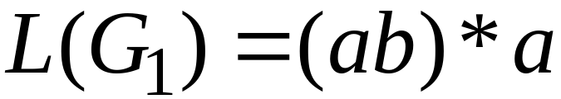
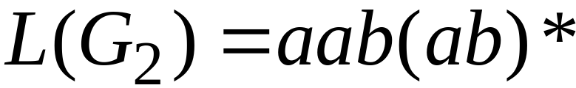
Observation
Regular grammars generate regular languages
Examples:

Slide 9
Regular Grammars
Generate
Regular Languages

Slide 10

Theorem
Languages
Generated by
Regular Grammars
Regular
Languages

Slide 11

Theorem - Part 1
Languages
Generated by
Regular Grammars
Regular
Languages
Any regular grammar generates
a regular language

Slide 12

Theorem - Part 2
Languages
Generated by
Regular Grammars
Regular
Languages
Any regular language is generated
by a regular grammar

Slide 13
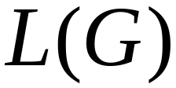
Proof – Part 1
Languages
Generated by
Regular Grammars
Regular
Languages
The language generated by
any regular grammar is regular

Slide 14

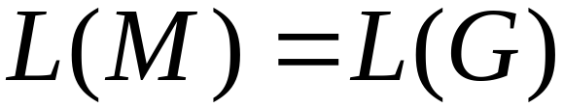
The case of Right-Linear Grammars
Let be a right-linear grammar
We will prove: is regular
Proof idea: We will construct NFA
with

Slide 15
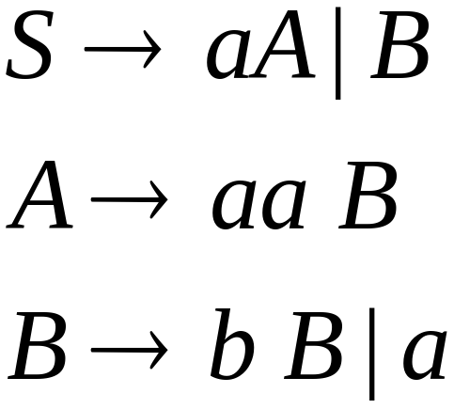
Grammar is right-linear
Example:

Slide 16



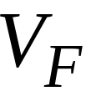

Construct NFA such that
every state is a grammar variable:
special
final state

Slide 17


Add edges for each production:

Slide 18

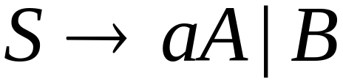

Slide 19
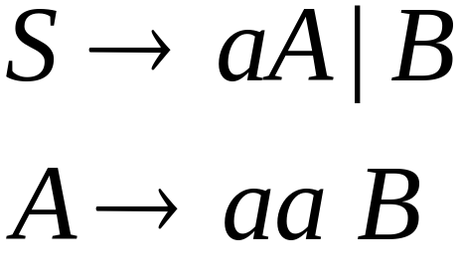

Slide 20
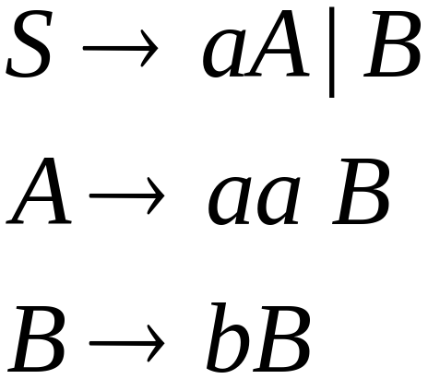


Slide 21
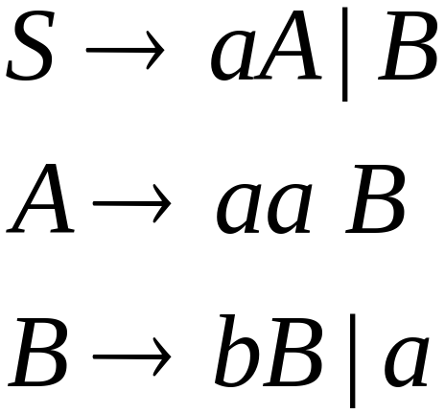

Slide 23
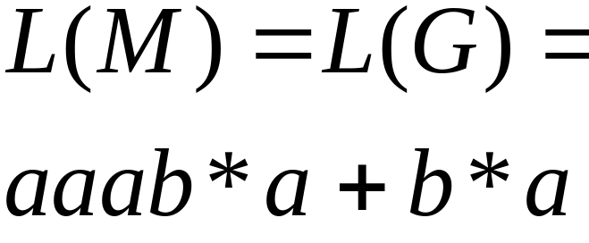
NFA
Grammar

Slide 24
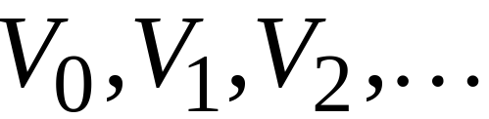
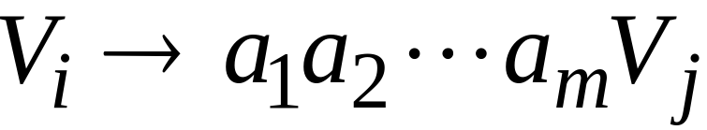
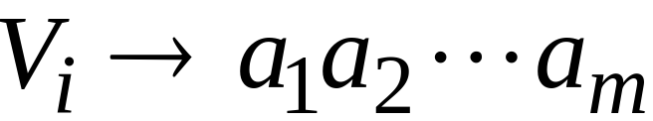
In General
A right-linear grammar
has variables:
and productions:
or

Slide 25






We construct the NFA such that:
each variable corresponds to a node:
special
final state

Slide 26


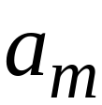


For each production:
we add transitions and intermediate nodes
………

Slide 27
For each production:
we add transitions and intermediate nodes
………

Slide 28







Resulting NFA looks like this:
It holds that:

Slide 29
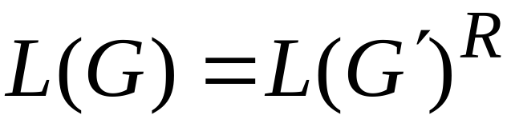

The case of Left-Linear Grammars
Let be a left-linear grammar
We will prove: is regular
Proof idea:
We will construct a right-linear
grammar with

Slide 30
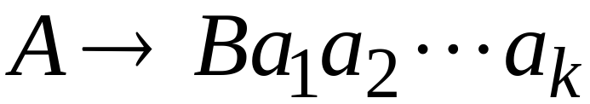
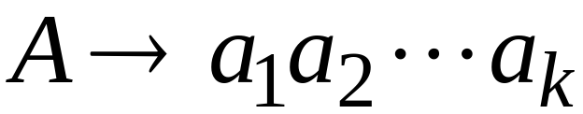
Since is left-linear grammar
the productions look like:

Slide 31

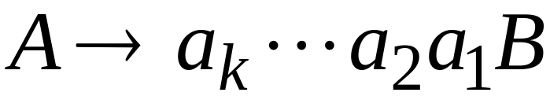
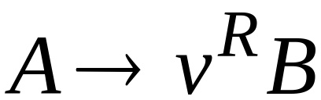
Construct right-linear grammar
Left
linear
Right
linear

Slide 32

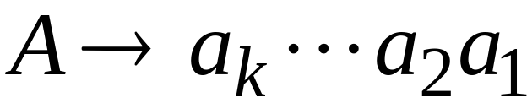
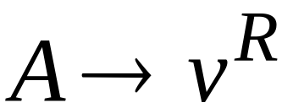
Construct right-linear grammar
Left
linear
Right
linear

Slide 33
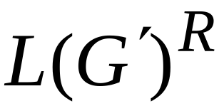
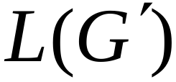
It is easy to see that:
Since is right-linear, we have:
Regular
Language
Regular
Language
Regular
Language

Slide 34

Proof - Part 2
Languages
Generated by
Regular Grammars
Regular
Languages
Any regular language is generated
by some regular grammar

Slide 35
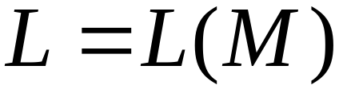
Any regular language is generated
by some regular grammar
Proof idea:
Let be the NFA with .
Construct from a regular grammar
such that

Slide 36


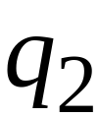
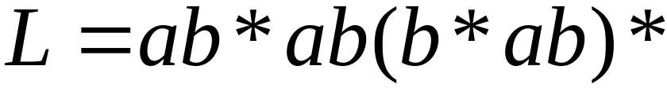

Since is regular
there is an NFA such that
Example:

Slide 37


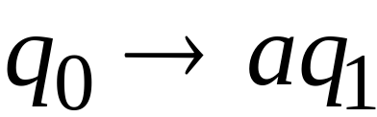

Convert to a right-linear grammar

Slide 38
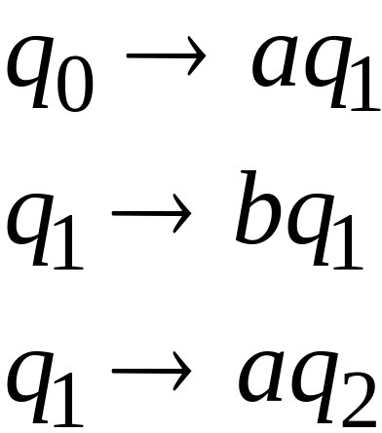

Slide 39
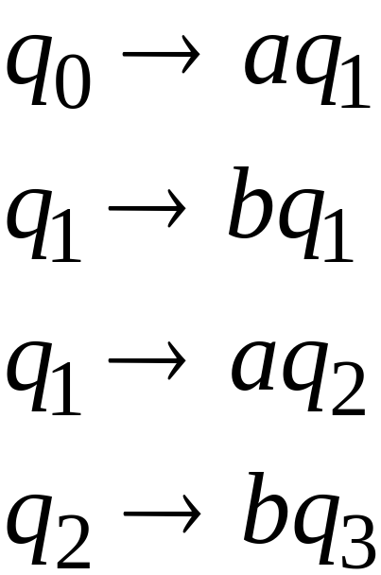

Slide 40
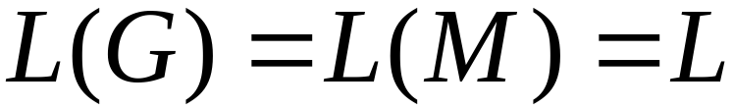
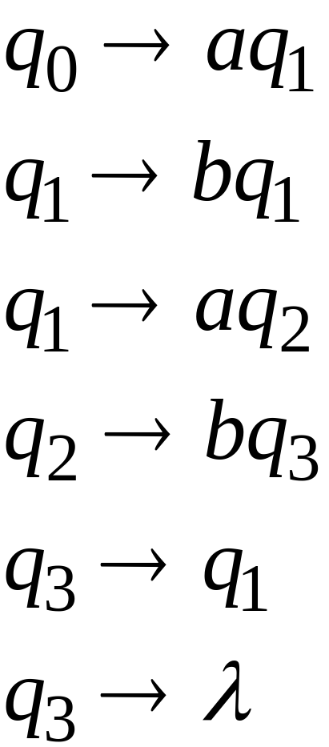

Slide 41



In General
For any transition:
Add production:
variable
terminal
variable

Slide 42

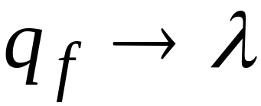
For any final state:
Add production:

Slide 43
Since is right-linear grammar
is also a regular grammar
with

