Slide 1
Distribution Ray Tracing
Kumar Mrinal, 2022258
mrinal22258@iiitd.ac.in
Project-2 Group-20
Computer Graphics project

Slide 2
Motivation
I chose distribution ray tracing because it's just cool tech that makes things look awesome! Here's why:
Soft Shadows: The objects come to life by making their shadows look natural and smooth, like in real life when light isn't just one harsh beam.
Motion Blur: Things look like they're really moving—capturing that cinematic, action-packed feel.
Depth of Field: Adding that blur to the background? Totally pro-photographer vibes, making the scene look super realistic and stylish.

Slide 3
Literature review
Introduced by Cook et al. (1984), distributed ray tracing enhances traditional ray tracing.
Key Limitations of Traditional Ray Tracing
Produces sharp shadows and reflections due to defined rays.
Lacks natural fuzziness or blurring in effects.
Advancements in Distributed Ray Tracing
Soft shadows, depth of field, and motion blur simulated through ray dispersion.
Integrates with visible surface calculations for high-quality visuals.

Slide 4
Literature review
Distributed ray tracing, introduced by Cook et al. (1984), enhances traditional ray tracing by utilizing multi-dimensional sampling techniques to simulate effects like:
Soft Shadows: Achieved by sampling light rays across an area, creating realistic penumbras.
Depth of Field: Simulated by distributing rays across the camera lens aperture for realistic focus effects.
Motion Blur: Implemented by distributing rays over time intervals to capture object motion.
These techniques address the shortcomings of traditional ray tracing by introducing natural transitions and eliminating harsh visual artifacts.

Slide 5
Milestones
Mid-Evaluation:
Soft Shadows: Implementing ray distribution techniques.
Motion Blur: Designing sampling methods.
Final Evaluation:
Depth of Field: Developing lens-based sampling for realistic focus.
Trying out optimizations and finalizing/documenting the effects.

Slide 6
Methodology
SOFT SHADOWS
1 Ray/px: Cast single rays, leading to noise and harsh transitions.
Multi-Ray Sampling: Multiple rays jittered across the light source area improve gradient smoothness and reduce noise.
Video Link

Slide 7
Methodology
Procedure ComputeLighting(point, normal, viewDir, timeDelta, hitSphere)
do
lighting = Vec3(0.1f, 0.1f, 0.1f) // Start with ambient light
for each light in lights do
jitter light position for soft shadows
calculate light direction and intensity
create shadow ray from point to light
check for intersections (shadows) with other spheres
if shadowed, reduce intensity for a dim shadow effect
else, apply full intensity
endfor
return final lighting
end
EndProcedure

Slide 8
Methodology
MOTION BLUR
1 Ray/px: Basic motion capture with temporal artifacts.
Multi-Ray Sampling: Jittering rays over time intervals ensures smooth, artifact-free motion blur.

Slide 9
Methodology
For 1 ray/px
Procedure RenderFrame(timeDelta, effectValue)
do
for each pixel (x, y) do
calculate normalized screen coordinates (u, v)
create primary ray from camera position through (u, v)
apply jitter to the ray for motion blur
trace the jittered ray to compute pixel color
store the color in the framebuffer
endfor
end
EndProcedure

Slide 10
Methodology
For multi-ray/px
Procedure RenderFrame(timeDelta, effectValue, samplesPerPixel)
do
for each pixel (x, y) do
initialize colorSum to zero
for each sample (sample) do
randomly jitter pixel coordinates for supersampling
create ray from camera position through (u, v)
apply jitter for motion blur
accumulate the color from the traced ray
endfor
average the colors and store in framebuffer
endfor
end
EndProcedure

Slide 11
Methodology
Depth of Field
Multi-ray sampling with aperture jittering creates realistic blur effects for objects outside the focal plane. Adjusting the focal distance dynamically enables targeted focus.
Implemented the Bokeh effect by applying depth of field (DOF), where the background and objects outside the focal plane are blurred, creating a realistic soft-focus effect. This was achieved by jittering rays based on aperture size and focal point distance.

Slide 12
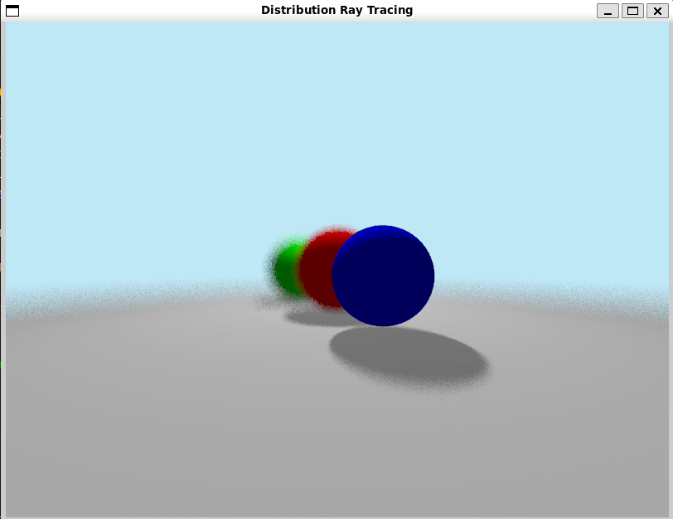
Methodology
Procedure RenderFrame(timeDelta, effectValue, useDOF, samplesPerPixel) FOCUSED ON BLUE SPHERE
do
aspectRatio = width / height
for each pixel (x, y) do
colorSum = Vec3(0, 0, 0)
for each sample (sample) do
jitter pixel coordinates for anti-aliasing
transform coordinates to viewport space
create primary ray from camera
if useDOF then
calculate focal point
apply aperture jitter for DOF
endif
accumulate color from traced primary ray
endfor
average colors and store in framebuffer
endfor
end
EndProcedure

Slide 13
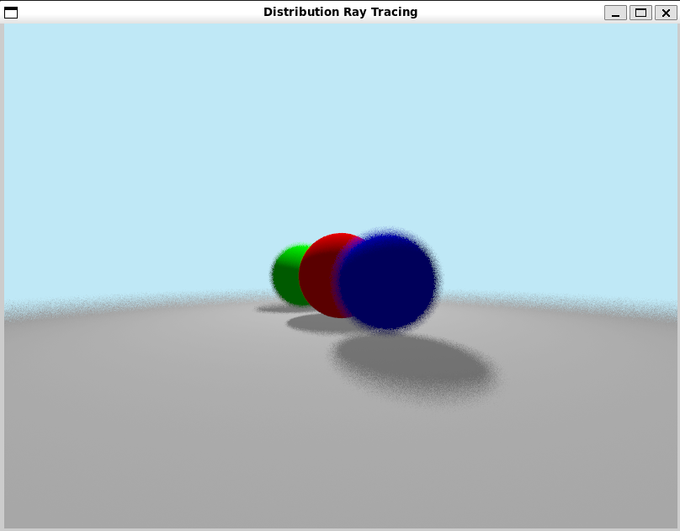

Methodology
Focused on Red Sphere Focused on Green Sphere

Slide 14
Methodology
Vertex Shader
The vertex shader transforms the vertex positions of a 2D object and passes texture coordinates to the fragment shader.
[1] Vertex Position: Transforms 2D positions from model space to clip space.
[2] Texture Coordinates: Maps texture to the object, defining how the texture wraps around.
[3] Transformation: Sets Z and W components for clip space positioning.
[4] Passing Texture Coordinates: passes texture coordinates to the fragment shader for sampling. In short, the vertex shader prepares positions and texture coordinates for rendering.
In short, the vertex shader prepares positions and texture coordinates for rendering.

Slide 15
Methodology
Fragment Shader
The fragment shader computes the final color of each pixel using texture coordinates passed from the vertex shader.
[1] Texture Sampling: Samples color from the texture at the given coordinates.
[2] Gamma Correction: Adjusts colors for accurate screen display.
[3] Setting Final Color: Outputs the color with full opacity.
In short, the fragment shader applies the texture, adjusts for gamma, and outputs the final color.

Slide 16
Challenges
Soft Shadows: Balancing the number of light source samples for multi-ray sampling was crucial for reducing computational costs. The multi-ray method significantly increased rendering time, but the quality improvements were substantial.
Motion Blur: Achieving artifact-free temporal sampling, especially in high-velocity scenarios, proved challenging. Multi-ray sampling provided substantial improvements, but the performance required further optimization.

Slide 17
Challenges
Depth of Field Rendering: While multi-ray sampling improved visual quality, the increased number of rays per pixel significantly impacted rendering performance. Balancing computational cost with visual quality required careful adjustment of the number of samples per pixel. Achieving high-quality DOF effects necessitated more samples, which increased rendering time for complex scenes.
Parallelization with OpenMP: I explored the possibility of using OpenMP to parallelize the rendering process, aiming to improve performance for multi-ray sampling. The overhead introduced by thread management in OpenMP was not justified for the scale and complexity of the workload. Therefore, the idea was dropped to maintain simplicity and avoid unnecessary complexity in the codebase.

Slide 18
Results
Soft Shadows:
1 Ray/px: Produced basic soft shadows but showed visible banding and noise in the penumbra region.
Multi-Ray Sampling: Rendered smoother, more natural shadows with gradual transitions, mimicking the soft shadows seen in real-world lighting.
Motion Blur:
1 Ray/px: Captured motion trails but lacked continuity and exhibited artifacts in the blur of high-velocity objects.
Multi-Ray Sampling: Delivered artifact-free, smooth motion blur with accurate representation of object trajectories.

Slide 19
Results
Depth of Field (DOF):
Multi-Ray Sampling: The implementation of DOF using multi-ray sampling produced smooth, artifact-free results. The jittered aperture sampling technique successfully simulated realistic bokeh effects and smooth transitions in out-of-focus regions. By dynamically adjusting the focal plane, the algorithm precisely rendered focused objects while achieving natural blurring of objects in front of or behind the focal plane.

Slide 20
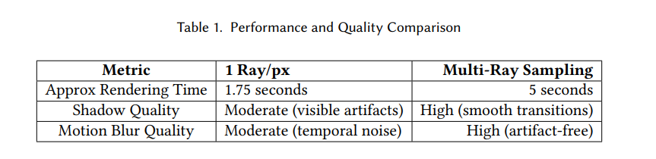
Analysis
The performance of the 1 ray/px and multi-ray sampling techniques was compared in terms of rendering time and image quality:
• 1 Ray/px: Faster rendering times but with visible artifacts in both shadows and motion blur.
• Multi-Ray Sampling: Higher-quality images were produced with more realistic shadows and motion blur, at the cost of increased computational time.

Slide 21
Analysis
Depth of Field (DOF):
Multi-Ray Sampling: The implementation of DOF using multi-ray sampling produced smooth, artifact-free results. The jittered aperture sampling technique successfully simulated realistic bokeh effects and smooth transitions in out-of-focus regions. By dynamically adjusting the focal plane, the algorithm precisely rendered focused objects while achieving natural blurring of objects in front of or behind the focal plane.

Slide 22
Conclusion
Both 1 ray/px and multi-ray sampling methods were implemented and tested. While 1 ray/px provided a fast baseline, multi-ray sampling greatly improved visual quality, particularly for soft shadows and motion blur. This highlights the strength of distributed ray tracing in producing realistic images.
The Depth of Field (DoF) implementation added realistic focus effects, rendering objects at the focal distance sharply while blurring others. Aperture-based jittered ray sampling and multi-sample rendering effectively simulated real-world camera optics, enhancing the rendering system. DoF significantly elevated the realism and immersive quality of the results.

Slide 23
References
[1] Robert L. Cook, Thomas Porter, and Loren Carpenter. 1984. Distributed ray tracing.
https://graphics.pixar.com/library/DistributedRayTracing/

Slide 24
Thank You

