Slide 1

TRAFFIC ACCIDENT DATA ANALYSIS IN INDIA IN 2021
SUBMITTED BY
ROHIT JANA
B.SC.(HONOURS) IN STATISTICS, SEMESTER-VI
ROLL NO: BSC(SEM-VI) STAT-08

Slide 2
contents
Introduction
2. Descriptive Statistics basic plots
3. Simple linear regression model and corresponding parametric test and non-parametric test
4. Non-parametric test
5. Multiple linear regression model
6. Analysis of variance(ANOVA)
7. Model detecting

Slide 3
INTRODUCTION
Road accidents have become very common nowadays. As more and people are buying automobiles, the incidences of road accidents are just increasing day by day. Furthermore, people have also become more careless now. Not many people follow the traffic rules. Especially in big cities, there are various modes of transports. Moreover, the roads are becoming narrower and the cities have become more populated.
Thus, road accidents are bound to happen. You pick up a newspaper and you will find at least one or two news about road accidents daily. They cause loss of life as well as material. People need to be more careful when on the road, no matter which mode of transport you are from. Even the ones on foot are not safe because of the rise in these incidences. Every day people witness accidents in the news, from relatives and even with their own eyes.

Slide 4
AIMS&OBJECTIVES
In this project, we are going to analyze “Road accident data in India in the year of 2021”. Here we will do some descriptive statistical analysis that is basic plots, simple linear regression, multiple linear regression, parametric test, non-parametric test, analysis of variance of multiple linear regression model and model detecting over different cases from our available data. And our aim is to see how different died and injured cases depend on various cases or not . Our data is specially divided Uts, cities and states but we have analyzed only states.

Slide 5
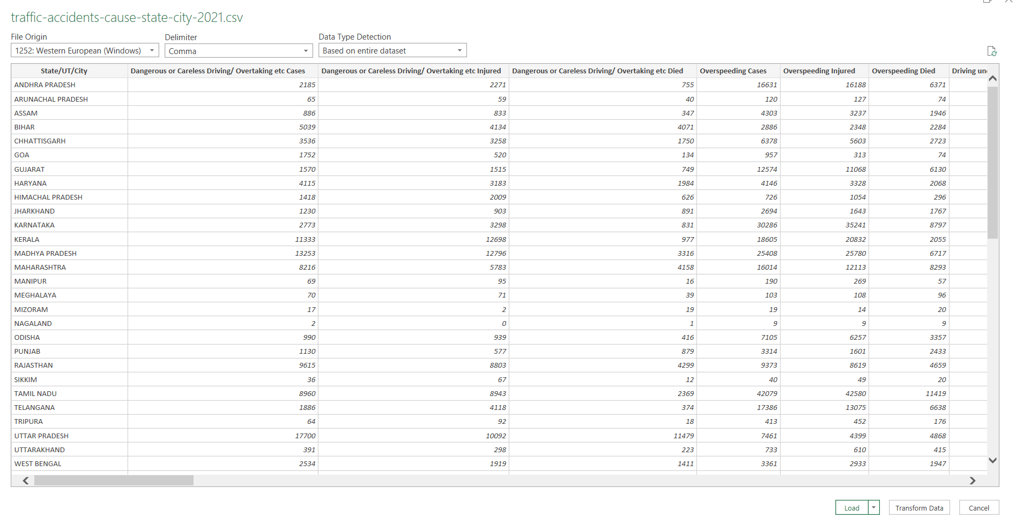
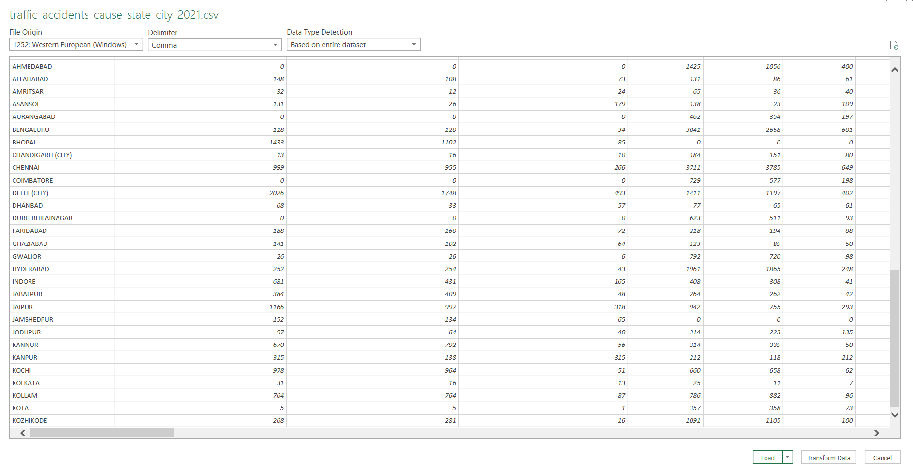
THE DATA IS COLLECTED FROM THE WEBSITE:
https://data.opencity.in/dataset/national-crime-data-2021/resource/traffic-accidents-in-india-2021---split-by-states-%26-cities-cause-wise
DATA DESCRIPTION

Slide 6
DESCRIPTIVE STATISTICS –BASIC PLOTS
BARPLOT
State/UT/City | overspeeding cases
MALAPPURAM | 637
MEERUT | 191
MUMBAI | 235
NAGPUR | 504
NASIK | 33
PATNA | 175
PUNE | 165
RAIPUR | 634
RAJKOT | 346
RANCHI | 84
SRINAGAR | 331
SURAT | 660
THIRUVANANTHAPURAM | 833
THRISSUR | 1476
TIRUCHIRAPPALLI | 353
VADODARA | 436
VARANASI | 36
VASAI VIRAR | 276
VIJAYAWADA | 1101
VISHAKHAPATNAM | 1785

Slide 7
PIE CHART
From the pie diagram, we see that Madhya Pradesh has highest and Nagaland has lowest dangerous or careless driving and overtaking cases.

Slide 8
MULTIPLE BAR DIAGRAM
State | Driving under Influence of Drug/Alcohol Cases |  | Driving under Influence of Drug/Alcohol Injured |  |  |  | Driving under Influence of Drug/Alcohol Died
ANDHRA PRADESH | 119 |  | 64 |  |  |  | 50
ARUNACHAL PRADESH | 3 |  | 6 |  |  |  | 0
ASSAM | 288 |  | 201 |  |  |  | 154
BIHAR | 51 |  | 53 |  |  |  | 12
CHHATTISGARH | 145 |  | 159 |  |  |  | 44
GOA | 122 |  | 21 |  |  |  | 10
GUJARAT | 100 |  | 116 |  |  |  | 47
HARYANA | 124 |  | 96 |  |  |  | 47
HIMACHAL PRADESH | 71 |  | 96 |  |  |  | 31
JHARKHAND | 204 |  | 253 |  |  |  | 326
KARNATAKA | 178 |  | 167 |  |  |  | 71
KERALA | 156 |  | 142 |  |  |  | 12
MADHYA PRADESH | 1875 |  | 1208 |  |  |  | 271
MAHARASHTRA | 311 |  | 180 |  |  |  | 189
MANIPUR | 17 |  | 18 |  |  |  | 6
MEGHALAYA | 39 |  | 60 |  |  |  | 30
MIZORAM | 7 |  | 3 |  |  |  | 5
NAGALAND | 3 |  | 3 |  |  |  | 2
ODISHA | 275 |  | 261 |  |  |  | 104
PUNJAB | 166 |  | 78 |  |  |  | 109

Slide 9
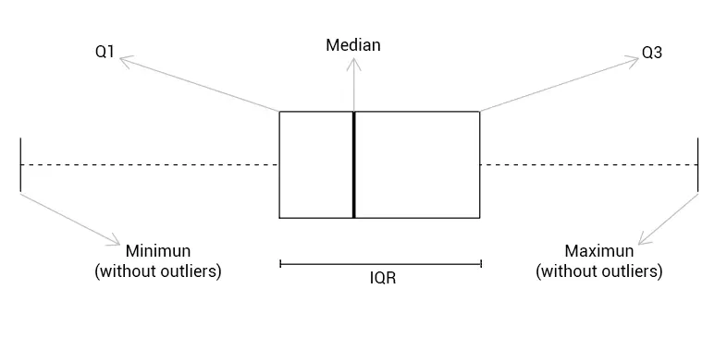
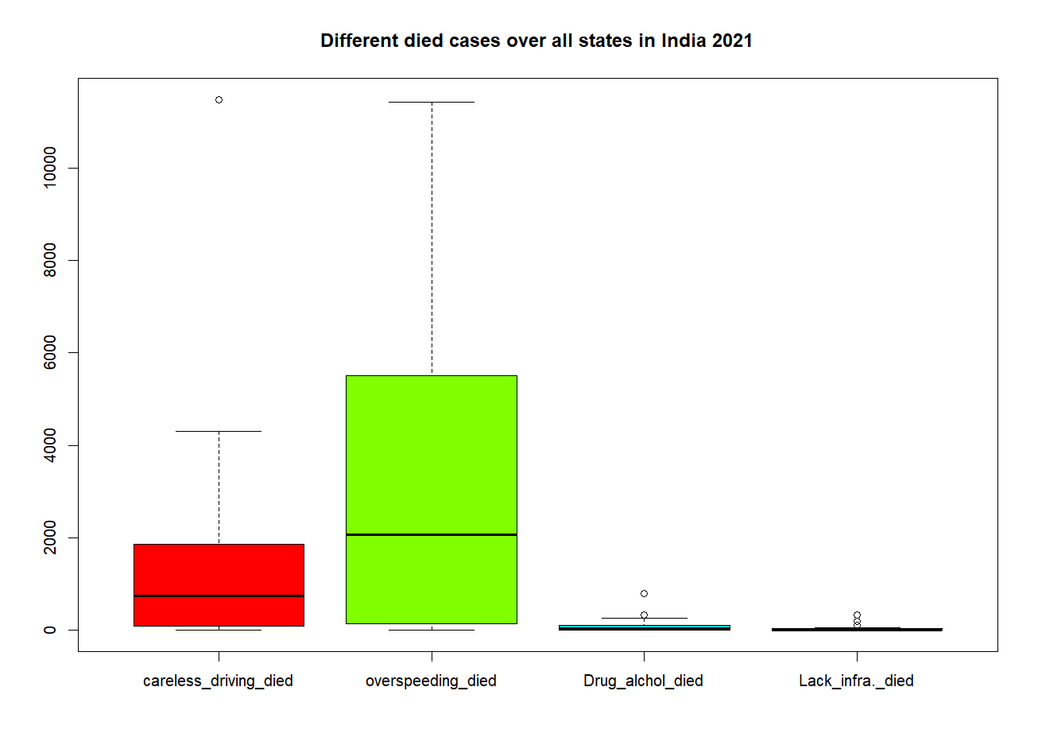
MULTIPLE BOX PLOT

Slide 10
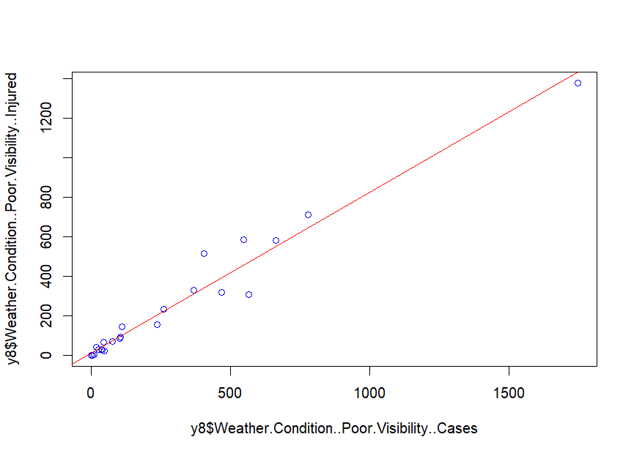
SIMPLE LINEAR RGRESSION MODEL AND CORRESPONDING PARAMETRIC AND NON-PARAMETRIC TEST
Simple linear regression on weather poor visibility cases vs injured over 28 states in India
Where y=Weather Condition Poor Visibility Injured and
x=Weather Condition Poor Visibility Cases.
So our linear regression model is :
y=b0+b1x+e; where e is the error which follows normal distribution having mean 0 and constant variance. We will use to estimate b0 and b1 by least square principal which is nothing but the minimizing the sum of square of errors with respect to b0 and b1.
So our fitted regression equation is y=12.1927+0.8132x

Slide 11
Normality test to check data of weather poor visibility cases and injured are coming from the normal distribution or not.
Shapiro wilk test:
The Shapiro-Wilk test is a test of normality. It is used to determine whether a sample comes from a normal distribution.
We can easily perform a Shapiro-Wilk test on a given dataset using the following built-in function in R:
shapiro.test(x)
where:
x: A numeric vector of data values.
This function produces a test statistic W along with a corresponding p-value. If the p-value is less than α =.05, there is sufficient evidence to say that the sample does not come from a population that is normally distributed.
Note: The sample size must be between 3 and 5,000 in order to use the shapiro.test() function.
Conclusion:
As p value is less than 0.05 so we reject our null hypothesis (that is data are coming from the normal distribution). So, data are not following normal distribution but for in practice we assume that the data are coming from normal distribution and after that we will go to correlation test.

Slide 12
Correlation test
(Parametric test)
R CODE:
cor.test(y8$Weather.Condition..Poor.Visibility..Cases,y8$Weather.Condition..Poor.Visibility..Injured,method = c("pearson","kendall","spearman"))
One way to quantify the relationship between two variables is to use the Pearson correlation coefficient, which is a measure of the linear association between two variables.
It always takes on a value between -1 and 1 where:
-1 indicates a perfectly negative linear correlation between two variables
0 indicates no linear correlation between two variables
1 indicates a perfectly positive linear correlation between two variables
To determine if a correlation coefficient is statistically significant, you can calculate the corresponding t-score and p-value.
The formula to calculate the t-score of a correlation coefficient (r) is:
t = r * √n-2 / √1-r2
The p-value is calculated as the corresponding two-sided p-value for the t-distribution with n-2 degrees of freedom.
To determine if the correlation coefficient between two variables is statistically significant, you can perform a correlation test in R using the following syntax:
cor.test(x, y, method=c(“pearson”, “kendall”, “spearman”))
where:
x, y: Numeric vectors of data.
method: Method used to calculate correlation between two vectors. Default is “pearson.”

Slide 13
Mood’s median test
(Non-parametric test)
Conclusion:
As p-value is grater than 0.05 so we do not reject our null hypothesis that is the median of two group that is : y8$Weather.Condition..Poor.Visibility..Injured and y8$Weather.Condition..Other.Causes..Cases are equal.

Slide 14
Maan-Whitney U test
(Non-Parametric test)
A Mann-Whitney U test (sometimes called the Wilcoxon rank-sum test) is used to compare the differences between two independent samples when the sample distributions are not normally distributed and the sample sizes are small (n <30).
A very general formulation is to assume that:
All the observations from both groups are independent of each other,
The responses are at least ordinal (i.e., one can at least say, of any two observations, which is the greater),
Under the null hypothesis H₀, the distributions of both populations are identical.
The alternative hypothesis H₁ is that the distributions are not identical.
Maan-Whitney U test over dangerous or careless driving died cases and lack of road infrastructure died cases
R-CODE:
wilcox.test(y8$Dangerous.or.Careless.Driving..Overtaking.etc.Died,y8$Lack.of.Road.Infrastructure.Died)
OUTPUT:
Wilcoxon rank sum test with continuity correction
data: y8$Dangerous.or.Careless.Driving..Overtaking.etc.Die and y8$Lack.of.Road.Infrastructure.Died,W = 697, p-value = 5.983e-07
alternative hypothesis: true location shift is not equal to 0
Conclusion:
As the p-value is less than 0.05 so we reject our null hypothesis that is the distribution of ‘y8$Dangerous.or. Careless.Driving..Overtaking.etc.Died’ and ‘y8$Lack.of.Road.Infrastructure.Died’ are not same.

Slide 15
MULTIPLE REGRESSION
Multiple regression is an extension of linear regression into relationship between more than two variables. In simple linear relation we have one predictor and one response variable, but in multiple regression we have more than one predictor variable and one response variable.
The general mathematical equation for multiple regression is −
y = a + b1x1 + b2x2 +...bnxn + e
Following is the description of the parameters used −
y is the response variable.
a, b1, b2...bn are the coefficients.
x1, x2, ...xn are the predictor variables.

Slide 16
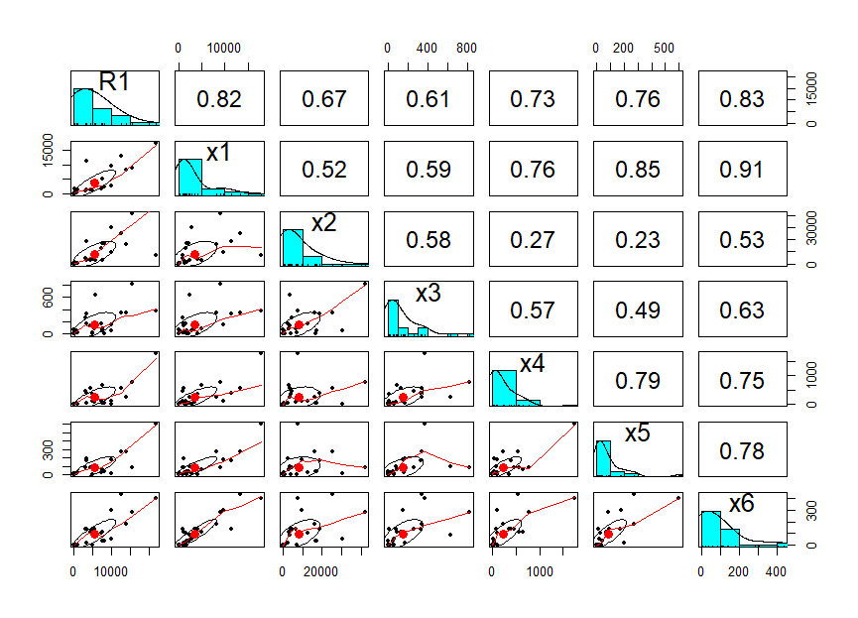
Multiple Linear Regression Model-1
Multiple regression model is on how total died of road accident depends on some cases.
R1=y8$Total.Road.Accidents.Died.
x1=y8$Dangerous.or.Careless.Driving..Overtaking.etc.Cases.
x2=y8$Overspeeding.Cases.
x3=y8$Defect.in.Mechanical.Condition.of.Vehicle.Cases.
x4=y8$Weather.Condition..Poor.Visibility..Cases.
x5=y8$Lack.of.Road.Infrastructure.Cases.
x6=y8$Vehicles.Parking.at.Road.Shoulders.Cases .
our multiple regression model is:
R₁=a+b₁x₁+b₂x₂+b₃x₃+b₄x₄+b₅x₅+b₆x₆+e; where e is error which follows normal distribution having mean 0 with constant variance sigma square.
Correlation matrix
Correlation
plot

Slide 17
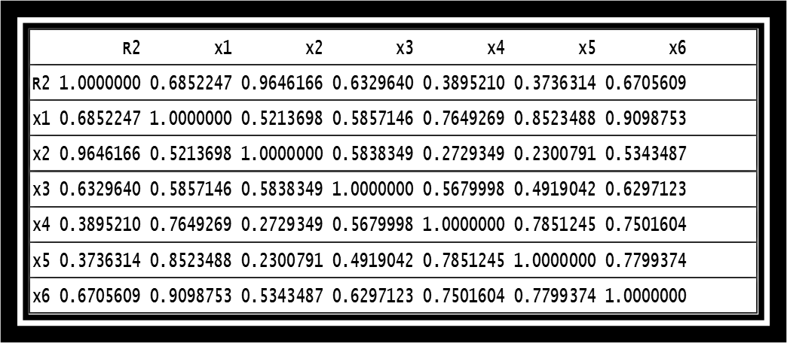
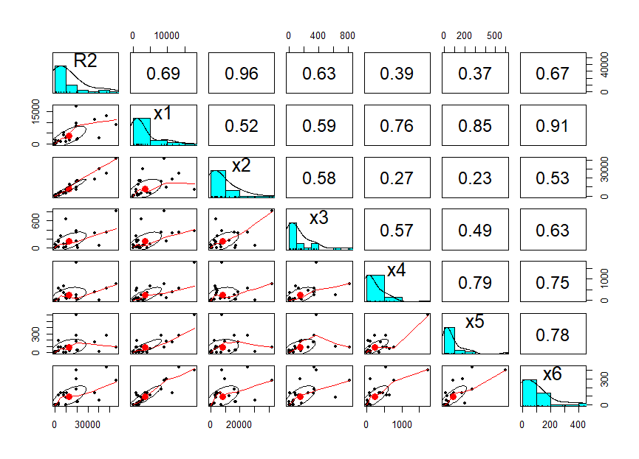

Multiple Linear Regression Model-2
CORRELATION MATRIX
CORRELATION PLOT

Slide 18
ANALYSIS OF VARIANCE (ANOVA) FOR MULIPLE LINEAR REGRESSION MODEL
Typically, ANOVA is used for continuous data, but discrete data are also common in practice.
Here we will test one way analysis of variance.
The Df column displays the degrees of freedom for the independent variable (the number of levels in the variable minus 1), and the degrees of freedom for the residuals (the total number of observations minus one and minus the number of levels in the independent variables).
The Sum Sq column displays the sum of squares (a.k.a. the total variation between the group means and the overall mean).
The Mean Sq column is the mean of the sum of squares, calculated by dividing the sum of squares by the degrees of freedom for each parameter.
The F value column is the test statistic from the F test. This is the mean square of each independent variable divided by the mean square of the residuals. The larger the F value, the more likely it is that the variation caused by the independent variable is real and not due to chance.
The Pr(>F) column is the p value of the F statistic. This shows how likely it is that the F value calculated from the test would have occurred if the null hypothesis of no difference among group means were true.
If the p-value is less than our chosen significance level (e.g. 0.05), then you can reject the null hypothesis and conclude that at least one of the population means is different from the others.

Slide 19
ANOVA FOR MODEL-1
ANOVA TABLE
Now our 1st multiple linear model is:
R₁=a+b₁x₁+b₂x₂+b₃x₃+b₄x₄+b₅x₅+b₆x₆+e; where e is error which follows normal distribution having mean 0 with constant variance sigma square.
Null Hypothesis: Number of died depends on various cases
Alternate Hypothesis: Number of died does not depend on various cases
Also from summary of lm1 we get Adjusted R-squared: 0.8383
Conclusion:
From the ANOVA table we see that x3 and x6 are insignificant and rests are significant based on p values.
As well as from adjusted R-squared we say that total died is linearly explained 83.83 percent by some other cases.
R-CODE:
lm1= lm(R1~x1+x2+x3+x4+x5+x6,dataframe)
> anova(lm1)

Slide 20
ANOVA FOR MODEL-2
ANOVA TABLE
Now our 2nd multiple linear model is
R₂=a+b₁x₁+b₂x₂+b₃x₃+b₄x₄+b₅x₅+b₆x₆+e; where e is error which follows normal distribution having mean 0 with constant variance sigma square.
As well as from the summary of lm2 we get Adjusted R-squared: 0.977
Null hypothesis: Injured depends on various cases.
Alternative hypothesis: Injured does not depend on various cases.
Conclusion:
From this ANOVA table we get two cases that is x1 and x2 are effecting on total injured. And rest cases are not effecting because p values are grater than 0.05.
As well as from adjusted R-square we say that total injured is linearly explained 97.7percent by some other cases.
R-CODE:
lm2= lm(R2~x1+x2+x3+x4+x5+x6,dataframe1)
> anova(lm2)

Slide 21
MODEL DETECTING
Introduction of AIC:
Akaike information criterion (AIC) is a single number score that can be used to determine which of multiple models is most likely to be the best model for a given data set. It estimates models relatively, meaning that AIC scores are only useful in comparison with other AIC scores for the same data set. A lower AIC score is better.
We have to check between two multiple linear regression model which model is better
For model-1 AIC Score is 51610 and for model-2, AIC Score is 70430.
Here we will see which model is best out of two multiple linear model is best. And using R programming we determine it using glm() function corresponding AIC( Akaike information criterion). Lowest AIC gives better fitting of a model.
Conclusion:
So clearly, AIC of model 1 is less than AIC of model 2, so model 1 gives best fit.

Slide 22
REFERENCES

Slide 23
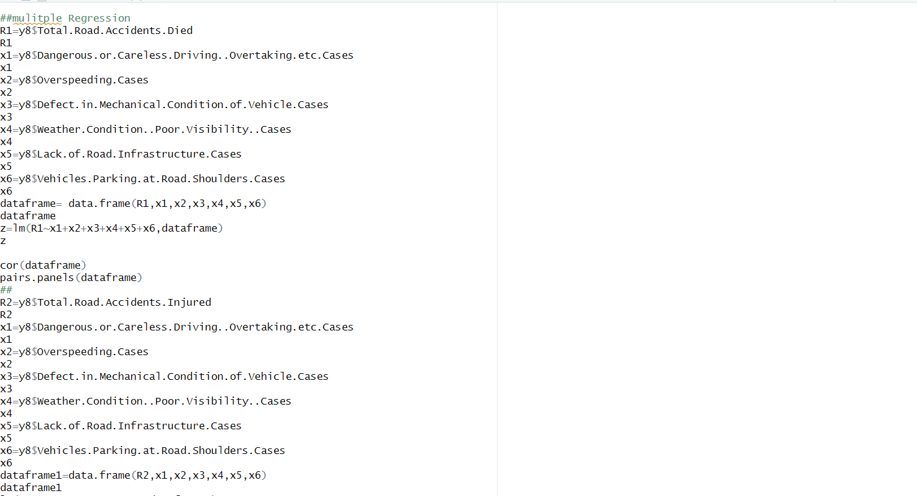
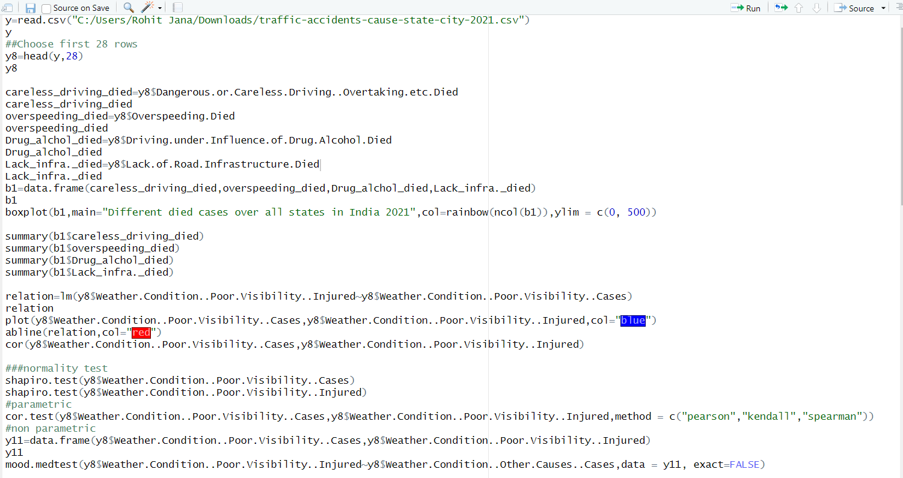
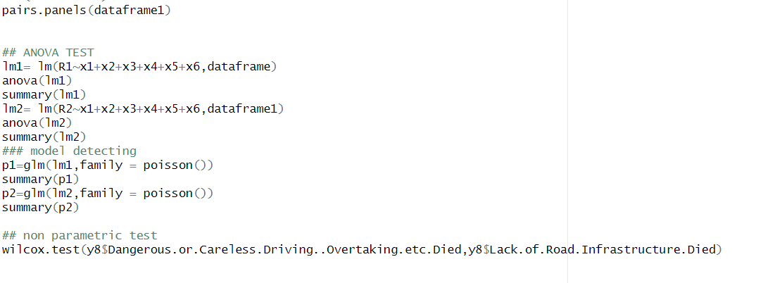
APPENDIX

Slide 24
Acknowledgement
I am indebted to so many people for helping me in the preparation of this project. I owe a deep debt of gratitude to my supervisor Dr. Debashis Chatterjee for necessary guidance, for this presentation of this dissertation, valuable comments and suggestions. I am extremely grateful to him for the necessary stimulus, support and valuable time.
Special thanks to Dr. Sudhansu Sekhar Maiti, Head of the Department of Statistics, Visva Bharati University. I am greatly indebted to Dr. Arindam Chakraborty, Dr. Tirthankar Ghosh, Dr. Saran Ishika Maiti, Dr. Soumalaya Mukhopadhyay, Dr. Sourav Rana; Faculty members often took pain and stood by me in adverse circumstances. Without their encouragement and inspiration, it was not possible for me to complete this project. Finally, my earnest thanks go to my friends who were always beside me when I needed them without any excuses and made these three years worthwhile. This project is not only a mere project. It is the memories spend with the whole department which has created a mutual understanding among us. There are many emotions related to this piece of work, especially respect and duty towards teachers and vice versa, educational attachment with my friends and social attachment with my college.

Slide 25
THANK YOU

