Slide 1

STATISTICAL ANALYSIS ON THE DIFFERENT MURDER MOTIVES IN INDIA (2001-2013)
Sukanta Malick
B.sc(Hons) in Statistics , Semester-VI
Roll Number: B.Sc(Sem-VI)Stat-16
Registration Number:VB-2558 of 2020-21
Department of Statistics
Visva-Bharati University
Santiniketan

Slide 2













1
INTRODUCTION
2
OBJECTIVE OF THE PROJECT
3
DESCRIPTION OF THE DATA
4
METHODS AND METARIALS
CONTENTS
5
GRAPHICAL REPRESENTATION
6
ANALYSIS AND INTERPRETATION
7
CONCLUSION
8
REFERENCE

Slide 3
INTRODUCTION
Murder is the unlawful killing of another human without justification or valid excuse.
First Degree Murder (Intentional killing of another person by someone who has acted willfully)
Second Degree Murder (murder with malicious intent but not premeditated)
Third Degree Murder (killing was not premeditated, but there is some intent to cause harm but not to kill victim)

Slide 4

MOTIVES OF MURDER
Gain
Property Dispute
Personal Vendetta or Enmity
Love Affairs/Sexual Relations
Dowry
Lunacy
Witchcraft
Communalism
Casteism
Class conflict
Political Reasons
Terrorism

Slide 5
Objective of the project
The data contains state-wise distribution of different murder motives in India from 2001-2013.
Hence, our objective is ,
To check if there is any association between different motives of murder and different zones of India.
To find the year-wise trend to study if there is any trend pattern in the different murder motives of India.
All the analysis of the data is being done by R-programming.

Slide 6
Description of the data Data Source :
https://www.kaggle.com/datasets/paramamithra/motives-of-murder-in-india-from-2001-to-2013
The data contains state-wise distribution of different murder motives in India from 2001-2013.
STATE | Gain | Property Dispute | Personal Vendetta or Enemity | Love Affairs/ Sexual relations | Dowry | Lunacy | Witchcraft | Communalism | Casteism | Class Conflict | Political Reasons | Terrorists/ Extremists | Other Causes
ANDHRA PRADESH | 122 | 159 | 332 | 355 | 96 | 7 | 20 | 1 | 1 | 2 | 39 | 120 | 1348
ARUNACHAL PRADESH | 8 | 2 | 16 | 5 | 0 | 0 | 0 | 0 | 0 | 0 | 0 | 4 | 48
ASSAM | 94 | 125 | 83 | 37 | 62 | 1 | 3 | 0 | 1 | 25 | 2 | 111 | 812
BIHAR | 310 | 888 | 579 | 178 | 288 | 4 | 1 | 0 | 27 | 6 | 47 | 22 | 1293
CHHATTISGARH | 25 | 81 | 129 | 75 | 21 | 21 | 14 | 0 | 1 | 0 | 0 | 57 | 456
GOA | 8 | 0 | 4 | 4 | 0 | 0 | 0 | 0 | 0 | 0 | 0 | 0 | 20
GUJARAT | 89 | 127 | 133 | 152 | 24 | 14 | 2 | 1 | 2 | 0 | 0 | 1 | 681
HARYANA | 41 | 184 | 134 | 54 | 3 | 0 | 2 | 27 | 0 | 0 | 0 | 0 | 336
HIMACHAL PRADESH | 4 | 16 | 15 | 11 | 1 | 0 | 0 | 0 | 0 | 0 | 0 | 0 | 72
JAMMU & KASHMIR | 0 | 23 | 18 | 4 | 1 | 0 | 1 | 0 | 0 | 1 | 0 | 958 | 69
JHARKHAND | 84 | 141 | 160 | 69 | 31 | 1 | 21 | 0 | 13 | 8 | 4 | 38 | 937
KARNATAKA | 66 | 91 | 140 | 143 | 33 | 0 | 0 | 3 | 1 | 0 | 7 | 0 | 1142
KERALA | 27 | 14 | 188 | 5 | 1 | 6 | 0 | 0 | 0 | 0 | 16 | 0 | 215
MADHYA PRADESH | 86 | 240 | 440 | 149 | 67 | 5 | 13 | 7 | 0 | 1 | 9 | 1 | 1407
MAHARASHTRA | 96 | 150 | 228 | 338 | 112 | 9 | 6 | 4 | 2 | 43 | 4 | 10 | 1837
MANIPUR | 8 | 0 | 0 | 0 | 0 | 0 | 0 | 0 | 0 | 0 | 0 | 129 | 72
MEGHALAYA | 11 | 8 | 7 | 2 | 0 | 1 | 0 | 0 | 0 | 0 | 0 | 13 | 122
MIZORAM | 3 | 0 | 9 | 3 | 0 | 0 | 0 | 0 | 0 | 0 | 0 | 0 | 16
NAGALAND | 0 | 1 | 1 | 0 | 0 | 0 | 0 | 5 | 0 | 0 | 4 | 4 | 86
ODISHA | 37 | 49 | 145 | 51 | 133 | 0 | 30 | 0 | 0 | 0 | 17 | 2 | 523
PUNJAB | 33 | 72 | 57 | 82 | 13 | 0 | 0 | 0 | 0 | 2 | 0 | 0 | 479
RAJASTHAN | 76 | 80 | 110 | 43 | 36 | 1 | 0 | 0 | 0 | 0 | 0 | 0 | 913
SIKKIM | 3 | 0 | 5 | 2 | 0 | 0 | 0 | 0 | 0 | 0 | 0 | 0 | 9
TAMIL NADU | 79 | 132 | 443 | 194 | 3 | 0 | 0 | 0 | 2 | 0 | 4 | 0 | 805
TRIPURA | 7 | 12 | 35 | 6 | 14 | 0 | 0 | 0 | 0 | 0 | 0 | 82 | 84
UTTAR PRADESH | 289 | 496 | 1207 | 424 | 0 | 1 | 0 | 7 | 0 | 0 | 0 | 0 | 5177
UTTARAKHAND | 2 | 23 | 19 | 18 | 0 | 0 | 0 | 0 | 0 | 0 | 0 | 0 | 254
WEST BENGAL | 16 | 29 | 158 | 39 | 9 | 0 | 13 | 0 | 0 | 0 | 21 | 1 | 1308
A & N ISLANDS | 1 | 1 | 4 | 0 | 0 | 0 | 0 | 0 | 0 | 0 | 0 | 0 | 7
CHANDIGARH | 0 | 2 | 2 | 0 | 0 | 0 | 0 | 0 | 0 | 0 | 0 | 0 | 11
D & N HAVELI | 0 | 0 | 0 | 1 | 0 | 0 | 0 | 0 | 0 | 0 | 0 | 0 | 2
DAMAN & DIU | 1 | 1 | 0 | 1 | 0 | 0 | 0 | 0 | 0 | 0 | 0 | 0 | 4
DELHI | 36 | 56 | 56 | 67 | 20 | 3 | 0 | 0 | 0 | 0 | 0 | 2 | 307
LAKSHADWEEP | 0 | 0 | 0 | 0 | 0 | 0 | 0 | 0 | 0 | 0 | 0 | 0 | 1
PUDUCHERRY | 2 | 0 | 13 | 0 | 0 | 0 | 0 | 0 | 0 | 0 | 0 | 0 | 10

Slide 7
Description of the data
Zones | State/UT
Eastern Zone | Bihar, Jharkhand, Odisha, West Bengal
Western Zone | Dadra and Nagar Haveli, Daman and Diu, Goa, Gujarat, Maharashtra
Northern Zone | Chandigarh, Delhi, Haryana, Himachal Pradesh, Jammu and Kashmir, Punjab, Rajasthan, Uttar Pradesh, Uttarakhand
Southern Zone | Andaman and Nicobar Island, Andhra Pradesh, Karnataka, Kerala, Lakshadweep, Puducherry, Tamil Nadu
Central Zone | Chhattisgarh, Madhya Pradesh
North-Eastern Zone | Arunachal Pradesh, Assam, Manipur, Meghalaya, Mizoram, Nagaland, Sikkim Tripura
We have divided the data into different zones for ease of calculation. The zones have been divided as shown

Slide 8

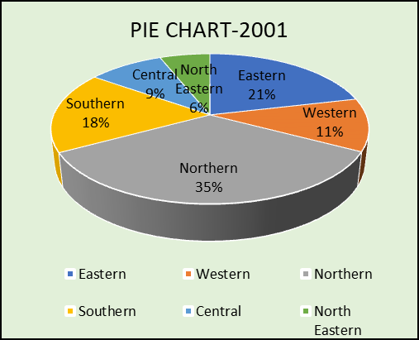
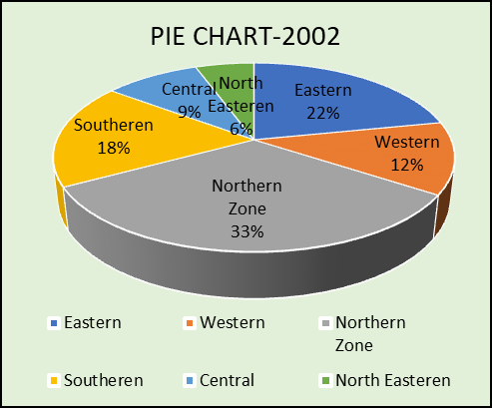
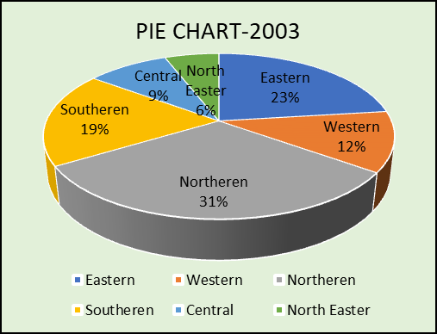
Graphical Representation
Pie chart representation

Slide 9
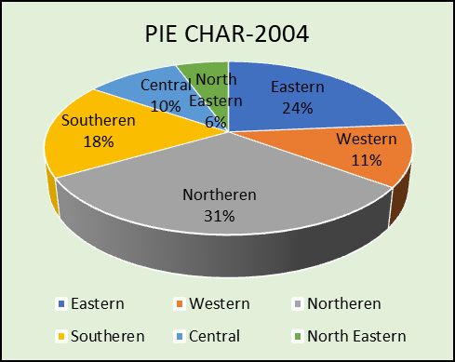
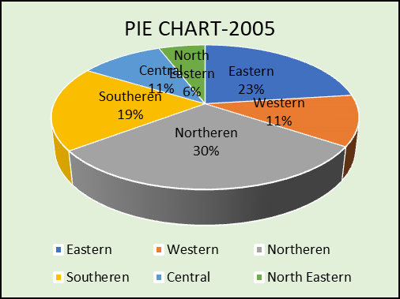
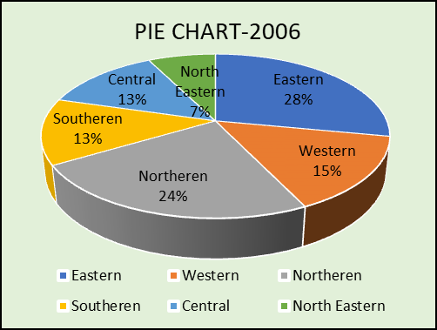
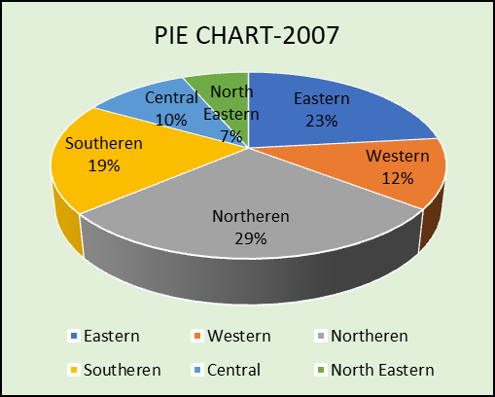
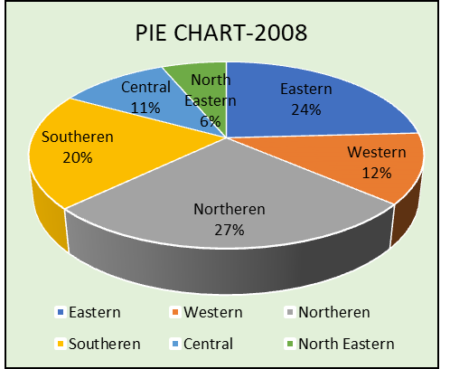

Slide 10
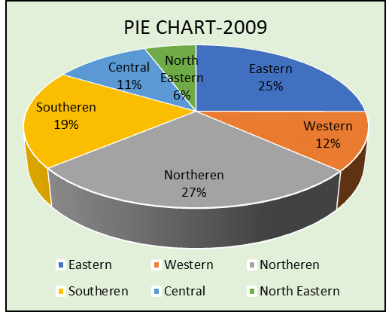
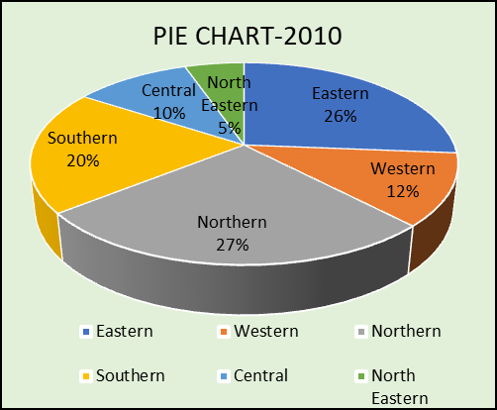
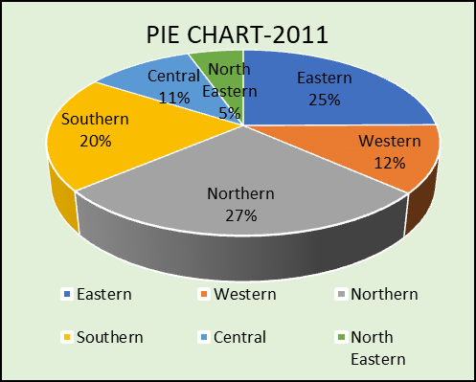
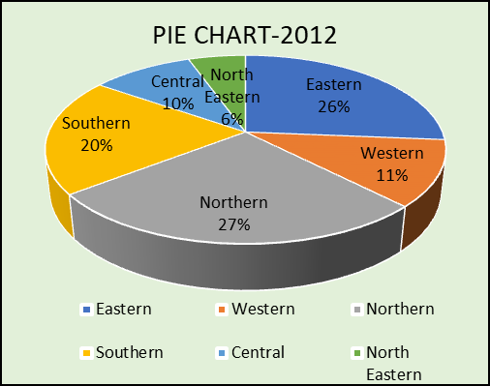
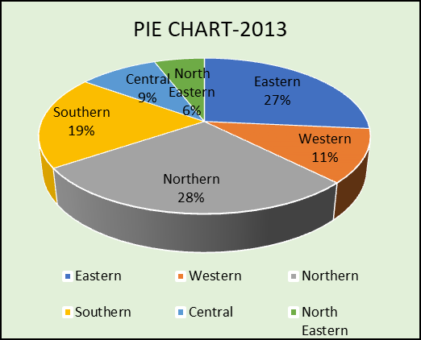
Conclusion :
From the pie chart representation, we can see
that the maximum number of murder cases is
reported in the northern zone followed by the
eastern, southern and so on

Slide 11

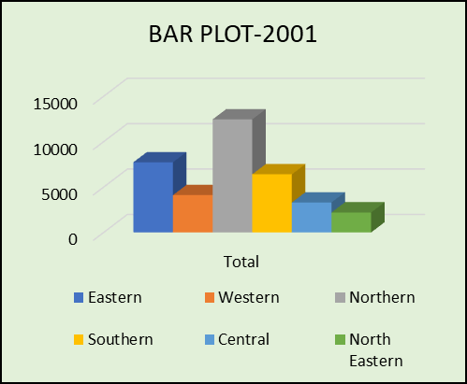
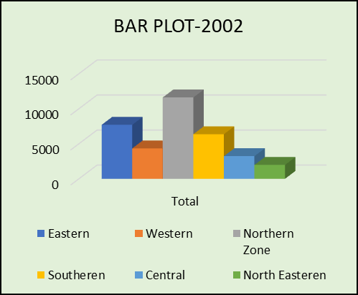
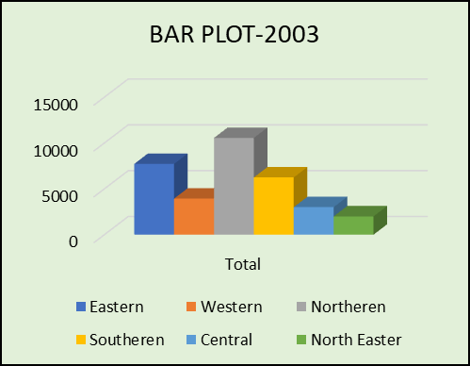
Bar Plot Representation

Slide 12
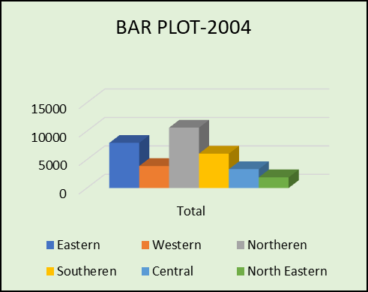
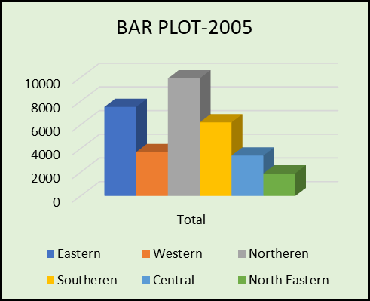
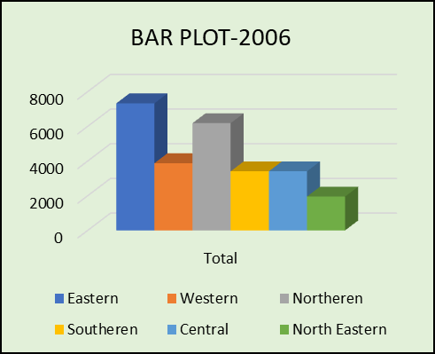
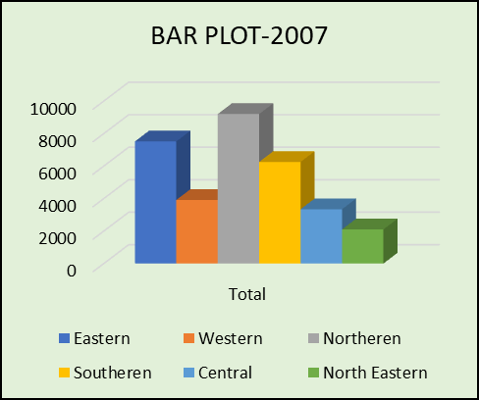


Slide 13
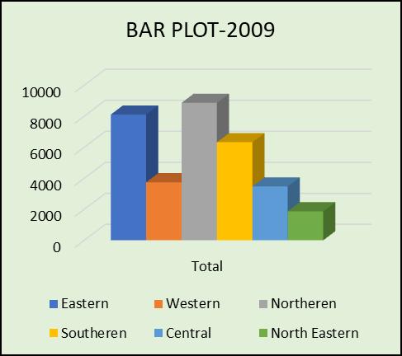
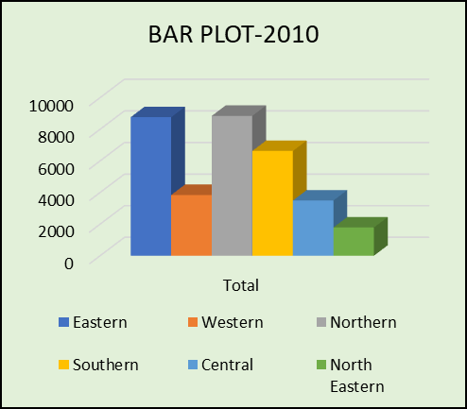
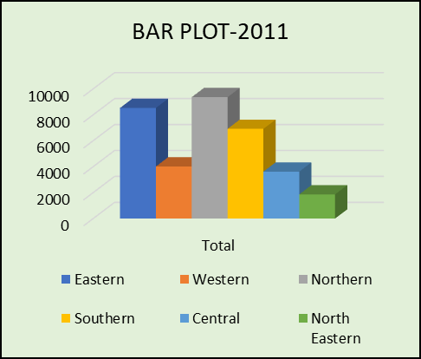
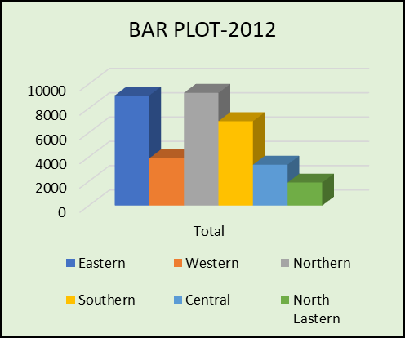
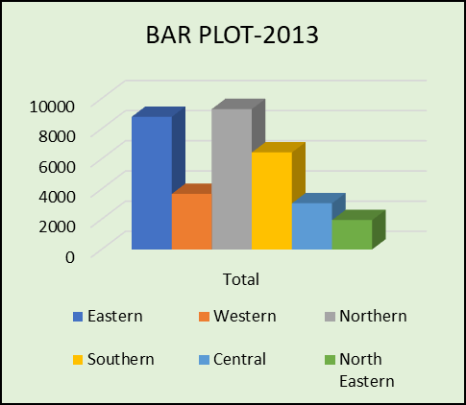
Conclusion :
From the bar plot representation, we can see
that the maximum number of murder cases is
reported in the northern zone followed by the
eastern, southern and so on

Slide 14


MATERIALS AND METHODS
Pearson's Chi Square Test of Independence :
Pearson’s chi square test is a test of independence which assesses whether unpaired observations on two variables, expressed in a contingency table, are independent of each other
Hypothesis :
H₀: attribute 1 is independent of attribute 2
H₁: attribute 1 is not independent of attribute 2
Test Statistic :
The test statistic for the Chi-Square Test of Independence is denoted X², and is c computed as
where,
o_{ij} is the observed cell count in the i-th row and j-th column of the table
e_{ij} is the expected cell count in the i-th row and j-th column of the table,
computed as e_{ij} = (row i total∗col j total) = grand total
df = (R - 1)(C - 1)
C is the total number of columns
R is the total number of rows
Decision :
For the level of significance, α, if 𝑝 < 𝛼(𝑝 refers to p-value),we reject the null hypothesis otherwise we fail to reject the null hypothesis.

Slide 15


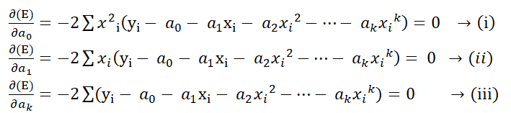
Trend Analysis :
Trend analysis is a statistical technique used to examine and predict movements of an item based on current and historical data.it may be useful to determine if measurements exhibit an increasing or decreasing trend which is statistically distinguished from random behaviour.
Least Square Method:
Least square method is the process of finding a regression line or best-fitted line for any data set that is described by an equation. This method requires reducing the sum of the squares of the residual parts of the points from the curve or line and the trend of outcomes is found quantitatively. The sum of squared errors helps in finding the variation in observed data.
The mathematical estimation:
Fitting of Polynomial of kth degree:
Let , Y = a₀ + a₁ X + a₂ X² + … + a_{k} X^{k} be the second kth polynomial of best fit to set of n points (x_{i}, y_{i}); i = 1, 2, ... , n, Using the principle of least squares, we have to determine the constants a₀, a₁, … , a_{k} so that is minimum.
Equating to zero the partial derivatives of E with respect to a₀, a₁, … , a_{k} separately, we get the normal equations for estimating a₀, a₁, … , a_{k} as
These are (k + 1) equations in (k + 1) unknowns a₀, a₁, … , a_{k} and can be solved with the help of algebra.

Slide 16

ANALYSIS AND INTERPRETATION
To fulfill our objective with Pearson's Chi-square Test of Independence we have to make the contingency tables for observed and expected values corresponding each year
Contingency table with observed figure :
Year 2001
Zones | Gain | Property Dispute | Personal Vendetta or Enmity | Love Affairs/ Sexual relations | Dowry | Lunacy | Witchcraft | Communalism | Casteism | Class Conflict | Political Reasons | Terrorists/ Extremists | Other Causes
Eastern | 447 | 1107 | 1042 | 337 | 461 | 5 | 65 | 0 | 40 | 14 | 89 | 63 | 4061
Western | 194 | 278 | 365 | 496 | 136 | 23 | 8 | 5 | 4 | 43 | 4 | 11 | 2544
Northern | 481 | 952 | 1618 | 703 | 74 | 5 | 3 | 34 | 0 | 3 | 0 | 960 | 7618
Southern | 297 | 397 | 1120 | 697 | 133 | 13 | 20 | 4 | 4 | 2 | 66 | 120 | 3528
Central | 111 | 321 | 569 | 224 | 88 | 26 | 27 | 7 | 1 | 1 | 9 | 58 | 1863
North -Eastern | 134 | 148 | 156 | 55 | 76 | 2 | 3 | 5 | 1 | 25 | 6 | 343 | 1249

Slide 17
Year 2001
Contingency Table with expected figure :
Zones | Gain | Property Dispute | Personal Vendetta or Enmity | Love Affairs/ Sexual relations | Dowry | Lunacy | Witchcraft | Communalism | Casteism | Class Conflict | Political Reasons | Terrorists/ Extremists | Other Causes
Eastern | 355.35 | 684.006 | 1040 | 536.442 | 206.718 | 15.8028 | 26.9075 | 11.7453 | 10.6776 | 18.7926 | 37.158 | 332.073 | 4455.33
Western | 188.959 | 363.724 | 553.024 | 285.256 | 109.923 | 8.40324 | 14.3082 | 6.24565 | 5.67786 | 9.99304 | 19.759 | 176.582 | 2369.15
Northern | 572.302 | 1101.61 | 1674.95 | 863.955 | 332.925 | 25.4509 | 43.3353 | 18.9162 | 17.1966 | 30.266 | 59.844 | 534.813 | 7175.44
Southern | 294.218 | 566.333 | 861.081 | 444.155 | 171.155 | 13.0842 | 22.2785 | 9.72474 | 8.84067 | 15.5596 | 30.7655 | 274.945 | 3688.86
Central | 151.912 | 292.412 | 444.598 | 229.329 | 88.3719 | 6.7557 | 11.503 | 5.02113 | 4.56467 | 8.03381 | 15.885 | 141.961 | 1904.65
North Eastern | 101.259 | 194.912 | 296.354 | 152.863 | 58.9057 | 4.50312 | 7.66748 | 3.34692 | 3.04265 | 5.35506 | 10.5884 | 94.6264 | 1269.58
Hypothesis to be considered here,
H₀ : There is no association among the Two Variables Zones and Murder Motives
Against
H₁ : Two variables Associated Zones and Murder Motives among Themselves
The test statistic for the Chi-Square Test of Independence is denoted χ² :-
χ² = 4028.3
Here the degrees of freedom (df) :- 60. Hence, χ² (0.05,60)= 79.08 .Here, p-value < 2.2e-16.
Interpretation:
Our observed p-value is (<2.2e-16) which is less than the chosen level of significance 0.05. So we reject the null hypothesis. Therefore, there is a significant association between the murder motives and zones.

Slide 18
Year 2002
Contingency table with observed figure :
Zones | Gain | Property Dispute | Personal Vendetta or Enmity | Love Affairs/ Sexual relations | Dowry | Lunacy | Witchcraft | Communalism | Casteism | Class Conflict | Political Reasons | Terrorists/ Extremists | Other Causes
Eastern | 432 | 1142 | 1118 | 399 | 494 | 5 | 80 | 0 | 35 | 12 | 108 | 55 | 3839
Western | 184 | 261 | 385 | 485 | 124 | 23 | 18 | 280 | 4 | 16 | 21 | 19 | 2529
Northern Zone | 387 | 897 | 1348 | 681 | 139 | 1 | 0 | 7 | 2 | 25 | 13 | 889 | 7230
Southeren | 265 | 406 | 1033 | 717 | 149 | 6 | 23 | 12 | 8 | 7 | 50 | 64 | 3635
Central | 131 | 354 | 579 | 282 | 49 | 17 | 28 | 7 | 5 | 14 | 2 | 11 | 1760
North Easteren | 136 | 165 | 229 | 62 | 65 | 3 | 2 | 2 | 0 | 0 | 6 | 274 | 1045
Contingency table with expected figure :
Zones | Gain | Property Dispute | Personal Vendetta or Enmity | Love Affairs/ Sexual relations | Dowry | Lunacy | Witchcraft | Communalism | Casteism | Class Conflict | Political Reasons | Terrorists/ Extremists | Other Causes
Eastern | 335.751 | 705.406 | 1026.28 | 574.386 | 223.105 | 12.0302 | 33.0283 | 67.369 | 11.8114 | 16.1861 | 43.7461 | 286.974 | 4382.92
Western | 189.167 | 397.436 | 578.224 | 323.618 | 125.701 | 6.77798 | 18.6086 | 37.9567 | 6.65475 | 9.11947 | 24.6472 | 161.686 | 2469.4
Northern | 505.389 | 1061.81 | 1544.81 | 864.593 | 335.828 | 18.1084 | 49.7158 | 101.407 | 17.7791 | 24.364 | 65.8487 | 431.967 | 6597.38
Southern | 277.292 | 582.584 | 847.591 | 474.377 | 184.259 | 9.93553 | 27.2776 | 55.639 | 9.75489 | 13.3678 | 36.1292 | 237.008 | 3619.79
Central | 140.886 | 295.998 | 430.643 | 241.021 | 93.618 | 5.04803 | 13.8591 | 28.269 | 4.95625 | 6.7919 | 18.3565 | 120.418 | 1839.14
North Eastern | 86.515 | 181.766 | 264.449 | 148.006 | 57.4888 | 3.09989 | 8.5106 | 17.3594 | 3.04353 | 4.17076 | 11.2723 | 73.9464 | 1129.37
Considering the same hypothesis we have test statistic for the Chi-Square Test of Independence is denoted χ² :-
χ² = 5451.9
Here the degrees of freedom (df) :- 60. Hence, χ² (0.05,60)= 79.08. Here, p-value < 2.2e-16.
Interpretation:
Our observed p-value is (<2.2e-16) which is less than the chosen level of significance 0.05. So we reject the null hypothesis. Therefore, there is a significant association between the murder motives and zones.

Slide 19
Year 2003
Contingency table with observed figure :
Zones | Gain | Property Dispute | Personal Vendetta or Enmity | Love Affairs/ Sexual relations | Dowry | Lunacy | Witchcraft | Communalism | Casteism | Class Conflict | Political Reasons | Terrorists/ Extremists | Other Causes
Eastern | 472 | 1074 | 1155 | 340 | 451 | 0 | 54 | 0 | 39 | 19 | 73 | 84 | 3961
Western | 168 | 243 | 340 | 470 | 130 | 16 | 11 | 4 | 3 | 16 | 13 | 29 | 2494
Northern Zone | 412 | 770 | 1138 | 619 | 96 | 13 | 11 | 35 | 19 | 18 | 7 | 805 | 6619
Southern | 314 | 467 | 1044 | 782 | 169 | 14 | 37 | 11 | 16 | 27 | 56 | 119 | 3193
Central | 101 | 341 | 529 | 284 | 101 | 17 | 35 | 17 | 7 | 15 | 6 | 32 | 1518
North Eastern | 162 | 183 | 222 | 49 | 52 | 6 | 1 | 1 | 0 | 2 | 4 | 270 | 1046
Contingency table with expected figure :
Zones | Gain | Property Dispute | Personal Vendetta or Enmity | Love Affairs/ Sexual relations | Dowry | Lunacy | Witchcraft | Communalism | Casteism | Class Conflict | Political Reasons | Terrorists/ Extremists | Other Causes
Eastern | 375.822 | 710.117 | 1021.57 | 586.919 | 230.476 | 15.2267 | 34.3754 | 15.6881 | 19.3794 | 22.3786 | 36.6824 | 308.917 | 4344.45
Western | 191.61 | 362.047 | 520.84 | 299.236 | 117.507 | 7.7632 | 17.526 | 7.99845 | 9.88043 | 11.4095 | 18.7023 | 157.499 | 2214.98
Northern | 514.042 | 971.284 | 1397.29 | 802.776 | 315.241 | 20.8267 | 47.018 | 21.4579 | 26.5068 | 30.609 | 50.1735 | 422.53 | 5942.25
Southern | 304.133 | 574.659 | 826.703 | 474.962 | 186.512 | 12.3221 | 27.8181 | 12.6955 | 15.6827 | 18.1098 | 29.6851 | 249.99 | 3515.73
Central | 146.153 | 276.157 | 397.278 | 228.246 | 89.6297 | 5.92148 | 13.3682 | 6.10092 | 7.53644 | 8.70279 | 14.2654 | 120.134 | 1689.51
North Eastern | 97.2407 | 183.737 | 264.323 | 151.86 | 59.6338 | 3.93977 | 8.89433 | 4.05916 | 5.01425 | 5.79027 | 9.49126 | 79.9296 | 1124.09
Considering the same hypothesis we have test statistic for the Chi-Square Test of Independence is denoted χ² :-
χ² = 3276.8
Here the degrees of freedom (df) :- 60. Hence, χ² (0.05,60)= 79.08. Here, p-value < 2.2e-16.
Interpretation:
Our observed p-value is (<2.2e-16) which is less than the chosen level of significance 0.05. So we reject the null hypothesis. Therefore, there is a significant association between the murder motives and zones.

Slide 20
We represent the χ² value and p-value with suitable decision corresponding the years 2001-2013 through the following table
Year | χ² value | df | P-value | Decision
2001 | 4028.3 | 60 | <2.2e-16 | Reject null hypothesis. There is a significant association between murder motives and zones.
2002 | 5451.9 | 60 | <2.2e-16 | Reject null hypothesis. There is a significant association between murder motives and zones.
2003 | 3276.8 | 60 | <2.2e-16 | Reject null hypothesis. There is a significant association between murder motives and zones.
2004 | 3400.8 | 60 | <2.2e-16 | Reject null hypothesis. There is a significant association between murder motives and zones.
2005 | 2711.2 | 60 | <2.2e-16 | Reject null hypothesis. There is a significant association between murder motives and zones.
2006 | 2545.7 | 60 | <2.2e-16 | Reject null hypothesis. There is a significant association between murder motives and zones.
2007 | 3075.7 | 60 | <2.2e-16 | Reject null hypothesis. There is a significant association between murder motives and zones.
2008 | 3755.6 | 60 | <2.2e-16 | Reject null hypothesis. There is a significant association between murder motives and zones.
2009 | 3358.2 | 60 | <2.2e-16 | Reject null hypothesis. There is a significant association between murder motives and zones.
2010 | 3134.5 | 60 | <2.2e-16 | Reject null hypothesis. There is a significant association between murder motives and zones.
2011 | 4247.1 | 60 | <2.2e-16 | Reject null hypothesis. There is a significant association between murder motives and zones.
2012 | 4500.5 | 60 | <2.2e-16 | Reject null hypothesis. There is a significant association between murder motives and zones.
2013 | 3680.4 | 60 | <2.2e-16 | Reject null hypothesis. There is a significant association between murder motives and zones.

Slide 21

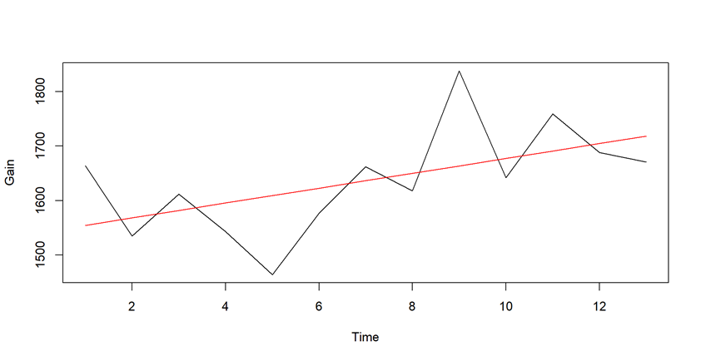
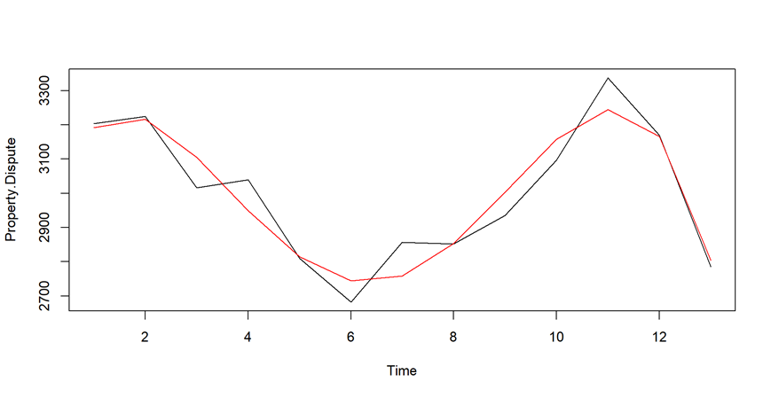
YEAR-WISE TREND OF THE DIFFERENT MURDER MOTIVES
Gain : Linear Trend
Coefficients:
(Intercept) 1540.96
X 13.63
The trend equation is:
Y_{t} = 1540.96+13.63t
Property Dispute: Polynomial trend of degree 4
Coefficients:
(Intercept) x x2 x3 x4
2919.7413 439.7496 -191.2416 24.6616 -0.9697
The trend equation is:
Y_{t} = 2919.7413 + 439.7496t - 191.2416t² + 24.6616t³ - 0.9697t⁴

Slide 22
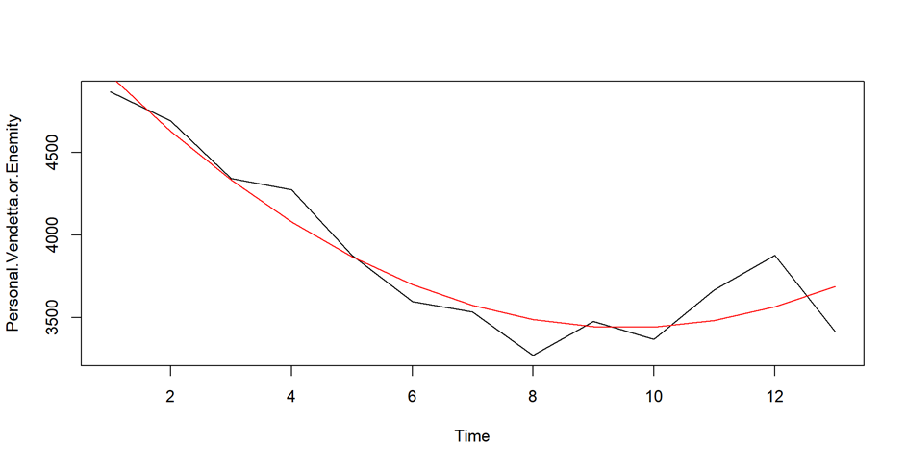
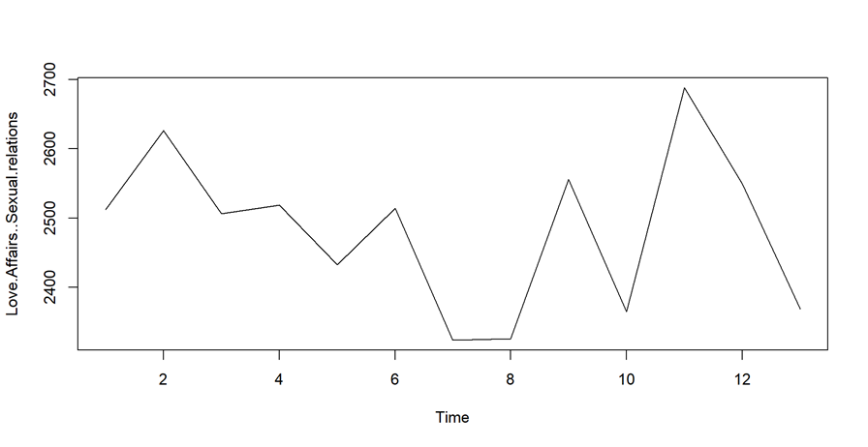
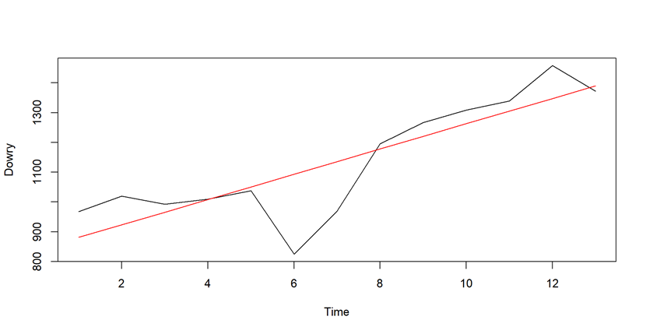
Personal Vendetta/Enmity: Quadratic Trend
Coefficients:
(Intercept) x x2
5345.48 -400.03 20.97
The trend equation is: Y_{t} = 5345.48 - 400.03t + 20.97t²
Love Affairs/Sexual relations: No trend
Dowry: Linear
Coefficients:
(Intercept) x
838.62 42.42
The trend equation is:
Y_{t} = 838.62 + 42.42t

Slide 23
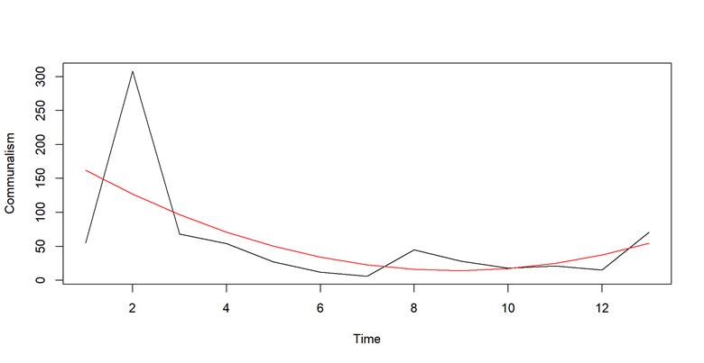
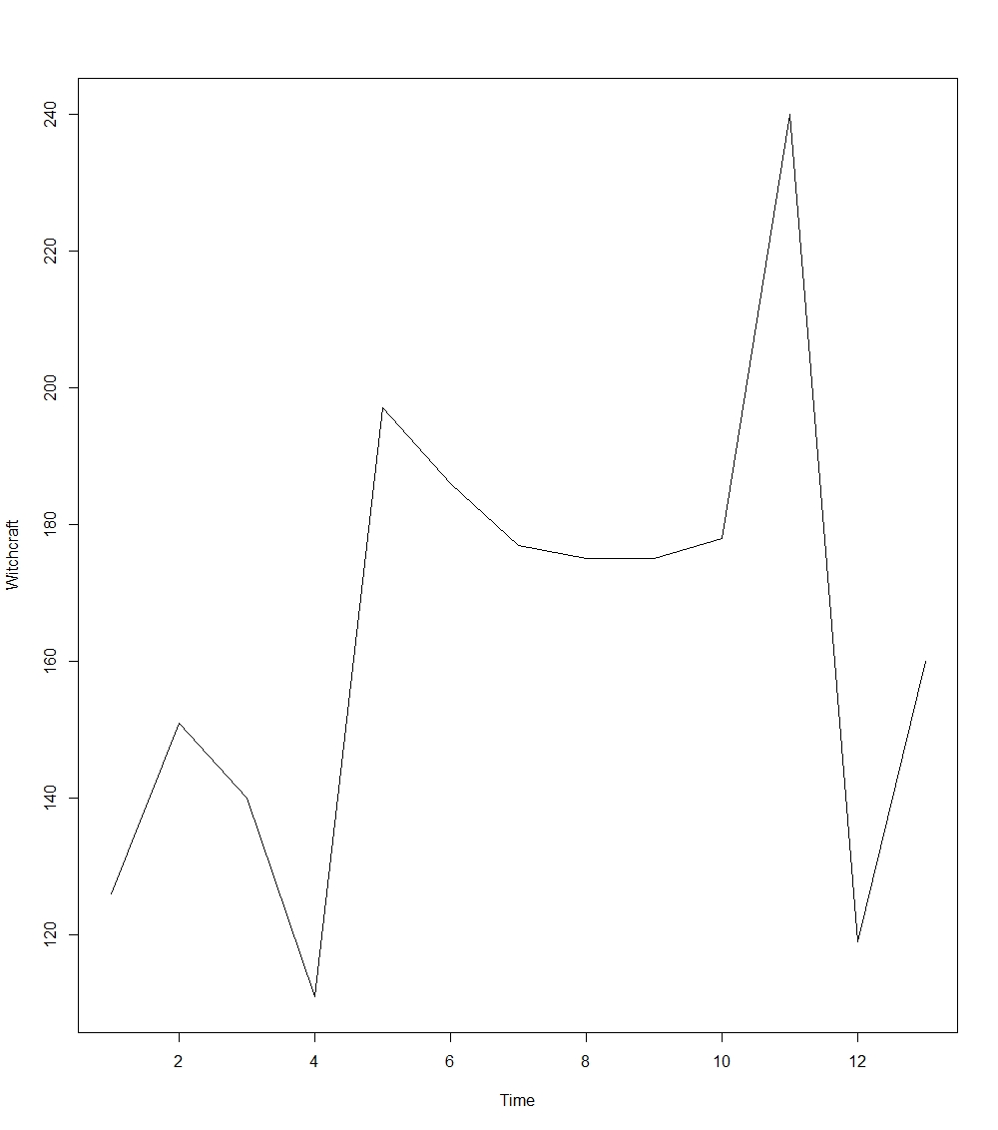
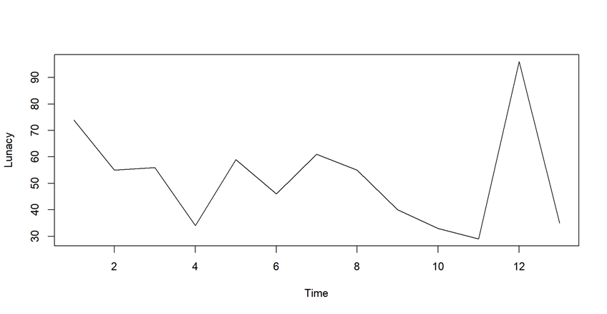
Communalism: Quadratic trend
Coefficients:
(Intercept) x x2
202.049 -42.299 2.382
The trend equation is: Y_{t} = 202.049 - 42.299t + 2.382t²
Lunacy: No trend
Witchcraft: No trend

Slide 24
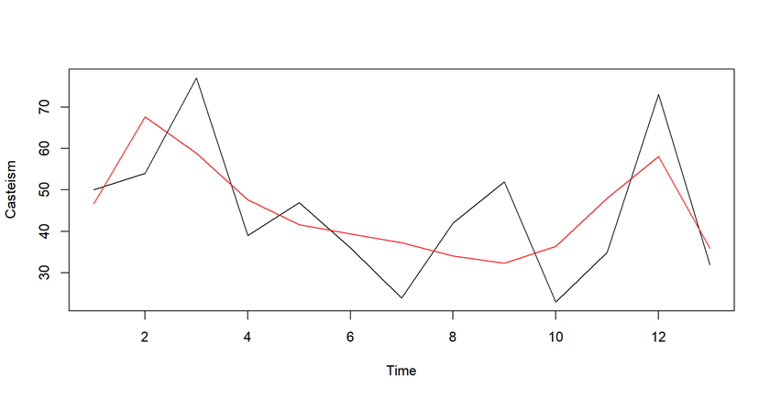
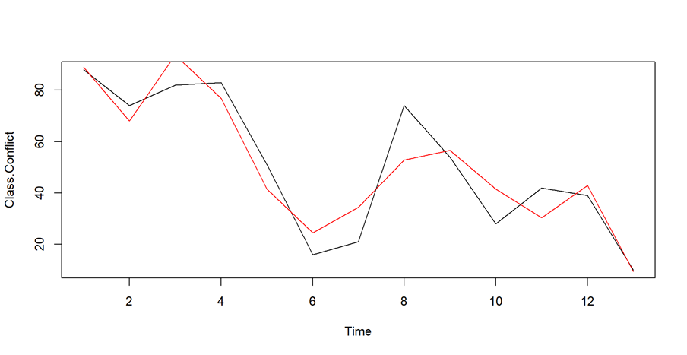
Casteism: Polynomial trend of degree 6
Coefficients:
(Intercept) x x2 x3 x4 x5 x6
-64.895105 188.467979 -97.518355 23.267077 -2.860821 0.175258 -0.004216
The trend equation is:
Y_{t} = -64.895105 + 188.467979t - 97.518355t² + 23.267077t³ - 2.860821t⁴ +0.175258t⁵ - 0.004216t⁶
Class Conflict: Polynomial trend of degree 7
Coefficients:
(Intercept) x x2 x3
5.400e+02 -9.198e+02 6.544e+02 -2.216e+02
x4 x5 x6 x7
3.963e+01 -3.851e+00 1.923e-01 -3.864e-03
The trend equation is:
Y_{t}=5.400e+02-9.198e+02t+6.544e+02t²-2.216e+02t³+3.963e+01t⁴-3.851e+00t⁵+1.923e-01t⁶ -3.864e-03t⁷

Slide 25
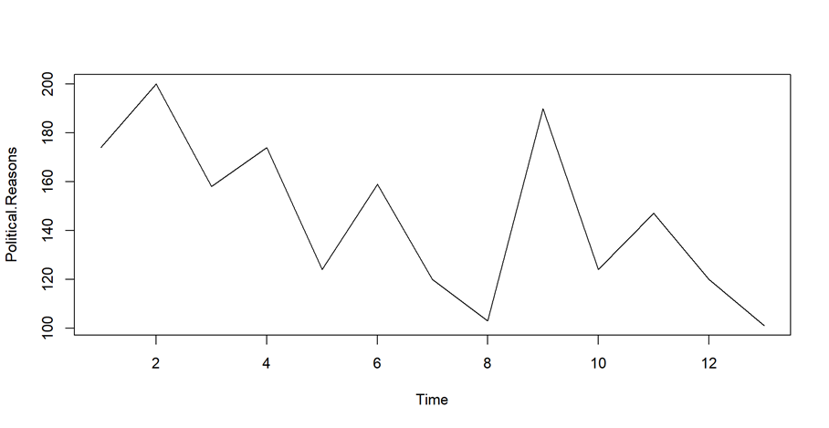
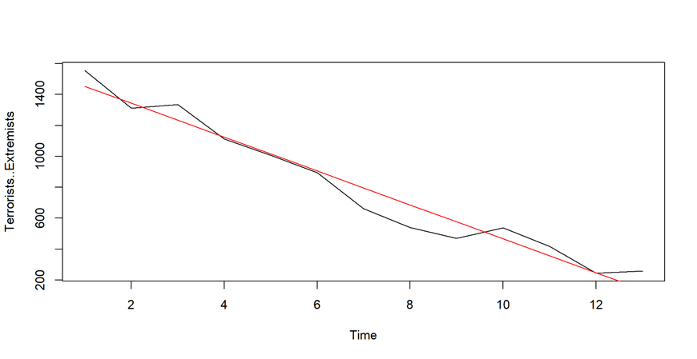
Political Reasons: No trend
Terrorists, Extremists: Linear Trend
Coefficients:
(Intercept) x
1562.6 -109.5
The trend equation is: Y_{t} = 1562.6 - 109.5t

Slide 26
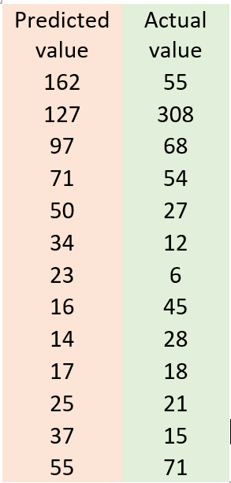
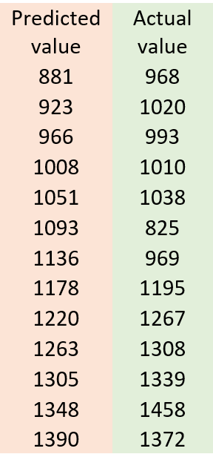
Now we want to show predicted and actual value of five different murder motives:
Communalism:
Dowry:

Slide 27
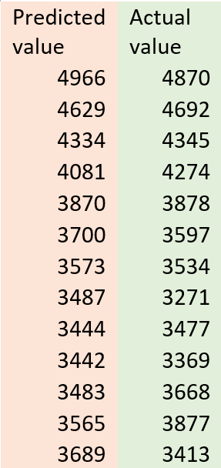
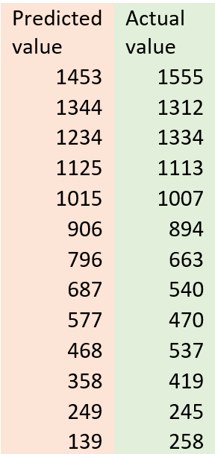
Property Dispute:
Personal Vendetta/Enmity:
Dowry:
Predicted value | Actual value
3192 | 3203
3216 | 3225
3105 | 3016
2949 | 3039
2814 | 2810
2744 | 2682
2758 | 2856
2853 | 2852
3003 | 2935
3158 | 3097
3244 | 3337
3165 | 3169
2803 | 2785

Slide 28

CONCLUSION
Most studies conclude that the murder rate is higher in the urban than the rural areas.
In the urban areas even though the people are well educated but personal enmity, property dispute, love affairs are very common in these areas.
In rural areas ,low literacy rate leads to dowry system and witchcraft followed by property dispute are some major reasons for murder cases.
From the analysis,
We find a significant association among the murder motives and the different zones of India.
The maximum number of murder cases is reported in the northern zone followed by eastern and southern and minimum in the north-eastern zone followed by central and western from the year 2001 to 2013 in India.
For gain and dowry, the murder cases increases over the years. While for personal vendetta/enmity, communalism and terrorists/extremists, the murder cases decrease over the years.
In order to reduce murder rate, tougher punishments for murder, like longer sentences, may not be a deterrence, science can show us how to reduce the murder rate, by leaving ideological bubbles, officials can follow an evidence-based strategy to reduce murder rates.

Slide 29
Reference
1. Fundamental of applied statistics
2. Fundamental of statistics vol 2
3.Websites: -
https://www.kaggle.com/datasets/paramamithra/motives-of-murder-in-india-from-2001-to-2013

Slide 30
Thank You

