Slide 1
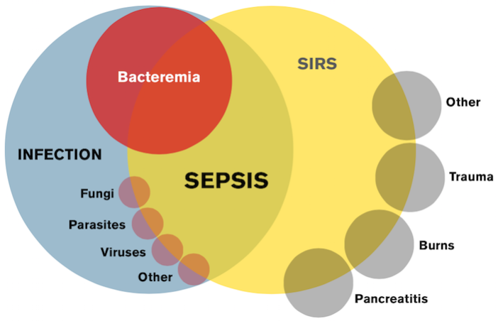
Prediction of being sepsis positive
SOUMYA SARKAR
Roll no: B.sc(sem-vi)stat-12
Department of Statistics
Visva-Bharati, Santiniketan

Slide 2
CONTENTS
• Introduction
• Objective of the project
• Data Description
• Graphical Representation of whole data
• Normality test of the of whole data
• Splitting data into train and test data
• Graphical representation of train data
Analysis of train data
o Logistic Regression
o 7.2 Model fitting and improvisation
o Accuracy and Precision of model
o 8.1 Confusion matrix
o Prediction with new data
o Conclusion

Slide 3

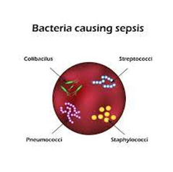
INTRODUCTION
What is sepsis:-Sepsis is the body’s extreme response to an infection. It is a life-threatening medical emergency. Sepsis happens when an infection you already have triggers a chain reaction throughout your body. Infections that lead to sepsis most often start in the lung, urinary tract, skin, or gastrointestinal tract. Without timely treatment, sepsis can rapidly lead to tissue damage, organ failure, and death.
Germs :- Staphylococcus aureus (staph) ,Escherichia coli (E. coli), Some types of Streptococcus.

Slide 4
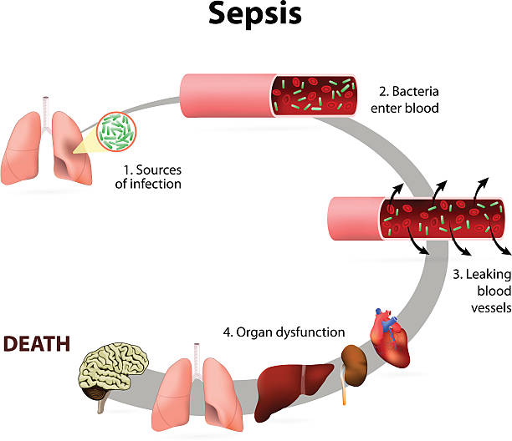
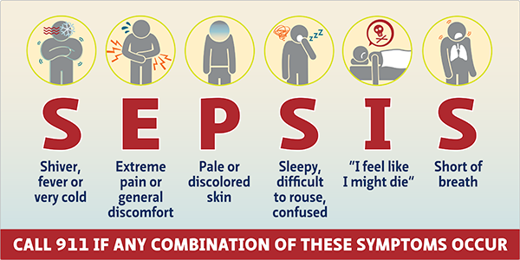
DIFFERENT STAGES OF SEPSIS:-
Healthcare providers used to organize sepsis into three stages: sepsis, severe sepsis and septic shock. Now, they identify the condition on a more fluid scale. This scale ranges from infection and bacteremia (bacteria in your bloodstream) to sepsis and septic shock, which can lead to dysfunction of multiple organs and even death.
Symptoms
Sepsis can affect many different areas of your body, so there are many possible symptoms.
If an infection such as blood poisoning (septicemia) triggered your condition, you may develop a sepsis rash on your skin. The rash makes your skin appear red and discoloured. You may see small, dark-red spots on your skin.
Other common sepsis symptoms include:
Urinary issues, such as reduced urination or an urge to urinate.
Low energy/weakness. Fast heart rate.
Low blood pressure.
Fever or hypothermia (very low body temperature).
Shaking or chills.
Warm or clammy/sweaty skin.
Confusion or agitation.
Hyperventilation (rapid breathing) or shortness of breath.
.

Slide 5
MANAGEMENT AND TREATMENT:
Sepsis treatment needs to begin immediately. The most important concern in sepsis protocol is a quick diagnosis and prompt treatment.
If your provider diagnoses you with sepsis, they’ll usually place you in the intensive care unit (ICU) of the hospital for special treatment. You may receive the following treatment for sepsis:
Antibiotics: You’ll receive antibiotics if you have a bacterial infection.
IV (intravenous) fluids: You’ll need fluids to maintain blood flow to your organs and prevent your blood pressure from dropping too low.
Vasopressor medications: Vasopressors tighten blood vessels. In some cases, you may need them to reach an adequate blood pressure.
Appropriate supportive care: If organ failures occur, you’ll need other sepsis treatments such as dialysis for kidney failure or mechanical ventilation for respiratory failure.
Surgery: You may need surgery to remove damaged tissue.
You may need to stay in hospital for several weeks.

Slide 6
Recovering from sepsis:
Most people make a full recovery from sepsis. But it can take time.
You might continue to have physical and emotional symptoms. These can last for months, or even years, after you had sepsis.
These long-term effects are sometimes called post-sepsis syndrome, and can include:
feeling very tired and weak, and difficulty sleeping
lack of appetite
getting ill more often
changes in your mood, or anxiety or depression
nightmares or flashbacks
post-traumatic stress disorder (PTSD)

Slide 7


OBJECTIVE
Descriptive analysis: Describe the incidence, prevalence, and distribution of sepsis in a specific population
Risk factor analysis: Identify the risk factors associated with the development of sepsis
Data
description
The data set contains 11 columns (attributes) and 599 rows (entries). The summary is as follows.

Slide 8
Column Name | Attribute/Target | Description
ID | N/A | Unique number to represent patient ID
PRG | Attribute1 | Plasma glucose
PL | Attribute 2 | Platelet count (mu U/ml)
PR | Attribute 3 | Blood Pressure (mm Hg)
SK | Attribute 4 | Blood Work Result-2 (mm)
TS | Attribute 5 | Transferrin saturation 380 (mg/dL)
M11 | Attribute 6 | Body mass index (weight in kg/(height in m)^2
BD2 | Attribute 7 | β Defensin-2 (mu U/ml)
Age | Attribute 8 | patients age (years)
Insurance | N/A | If a patient holds a valid insurance card
Sepsis | Target | Positive: if a patient in ICU will develop a sepsis , and Negative: otherwise

Slide 9
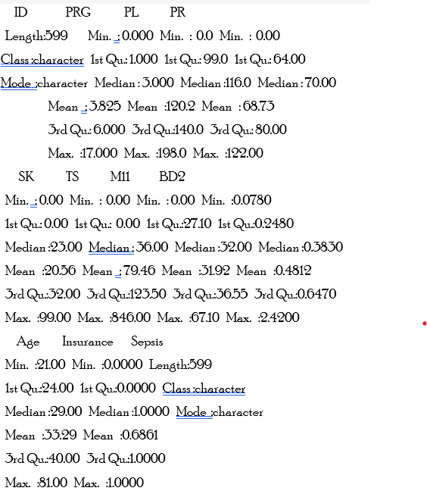
SUMMARY OF THE DATA SET ANDAttributes Summary & Domain Knowledge:
The features can be divided into the following types:
Numerical:
Continuous:
PRG: Plasma glucose
3.9 < PRG < 5.6 (mmol/L): Normal
5.6 < PRG < 6.9 (mmol/L): Monitoring recommended
PRG > 7.0 (mmol/L): Diabetes
PL: platelet count-100(mmol/ml):Normal
PR: Blood Pressure (mmHg)
PR < 90/60 (mmHg): Low blood pressure
90/60 < PR < 120/80 (mmHg): Normal blood pressure
PR > 140/90 (mmHg): High blood pressure
SK: Blood Work Result-2 (mm)
Normal Range: 3.5 - 5.6 (mmol/l)
TS: Transferrin saturation
Normal Range: 215 - 380 (mg/dL)
M11: Body mass index (weight in kg/(height in m)22
M11 < 18.5: Underweight
18.5 < M11 < 24.9: Healthy weight
25 < M11 < 29.9: Overweight
M11 > 30:
BD2: β Defensin-2(BD2) (μU/ml)
Standard Range: 7.8 - 500 (pg/ml)
Discrete:
Age: Patient's age (years)
Categorical:
Binary
Insurance: If a patient holds a test insurance card
Sepsis(Target): If a patient in ICU will develop a sepsis.

Slide 10
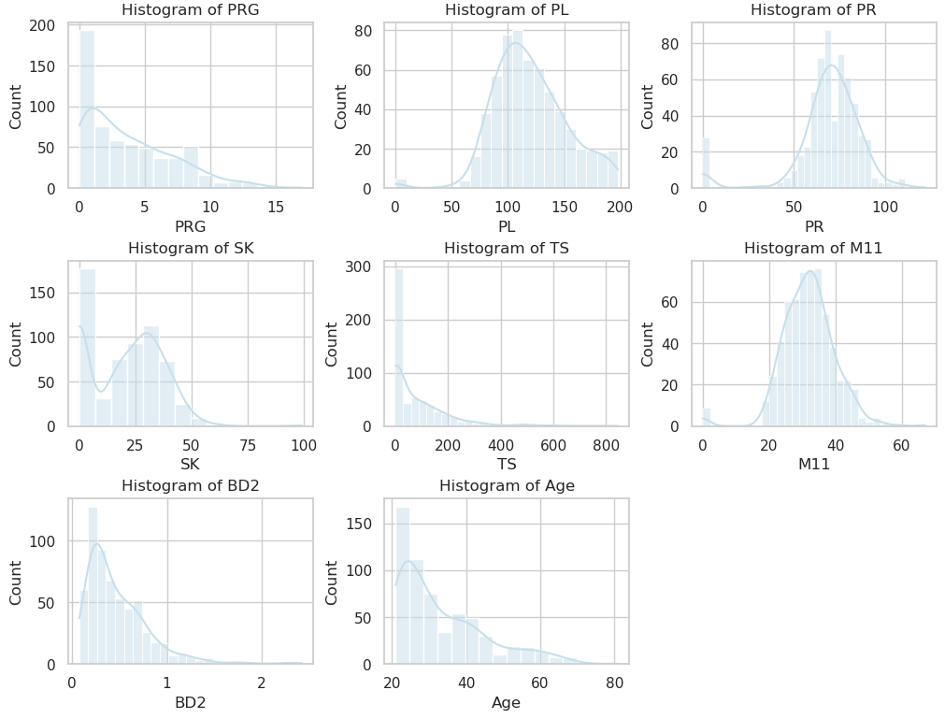
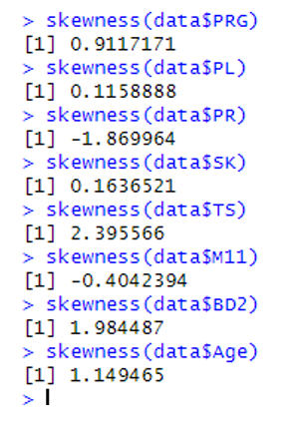
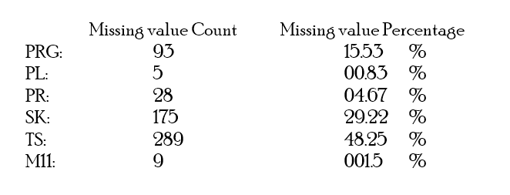
The skewness of the features in the train set can be summarized as follows:
Positively-skewed: TS, BD2, Age, PRG
Negatively-skewed: PR
Normally-distributed (approximately): SK, PL, M11
From the descriptive statistics of the data set there are some columns that have entries with value of 0 - PRG, PL, PR, SK , TS, and M11, these columns should not have a value of 0. Therefore, it is reasonable to assume that any missing value was filled out with 0.
Graphical representation of whole data set:-
Concurring with the initial inspection, the distribution of the features are:
Right-skewed: PRG, SK, TS, BD2, Age.
Normally-distributed: PL, PR, M11..

Slide 11

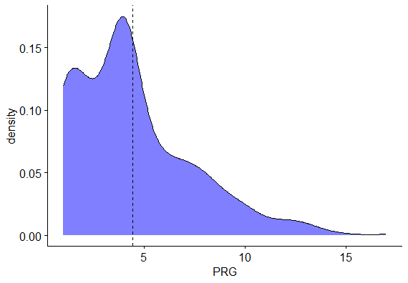
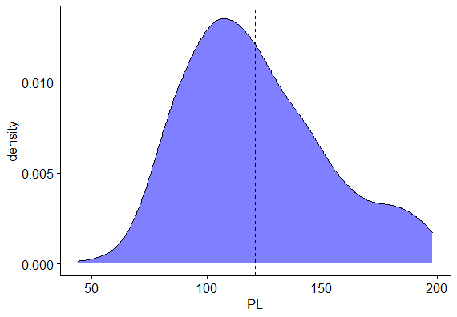
Normality Tests
Normal distribution: A normal random variable, y, has the normal density function, f, given as follows:
Now we will do various tests to see that if our data comes from normal distribution or not . Graphical representation of the whole data after replacing null values with median and checking the normality of the dataset by density plot.

Slide 12
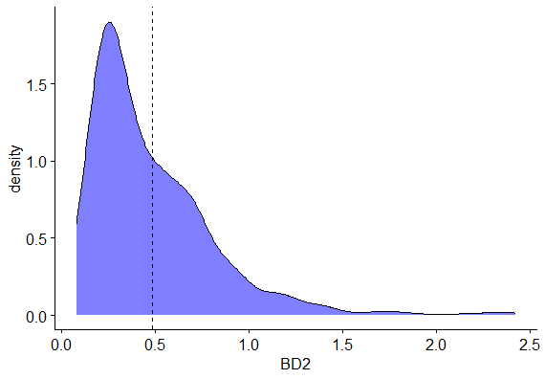
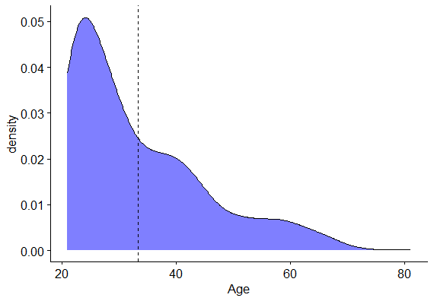
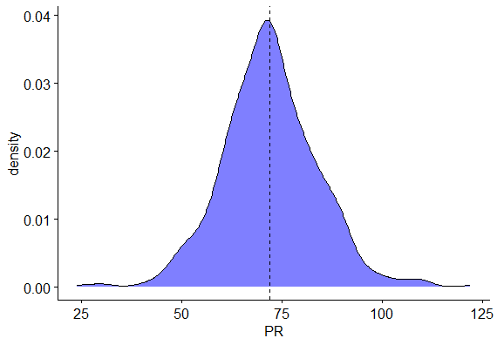
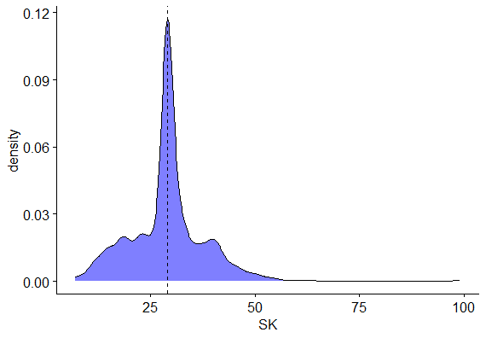

Slide 13
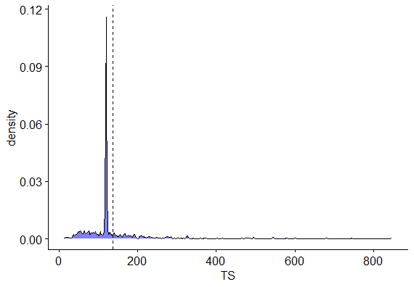
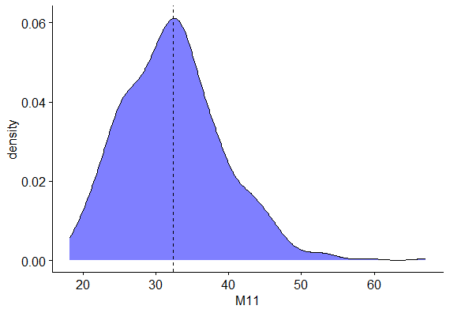
From the above 8 graphs, we can say that the variables PL,PR,M11 are approximately following normal distribution.

Slide 14
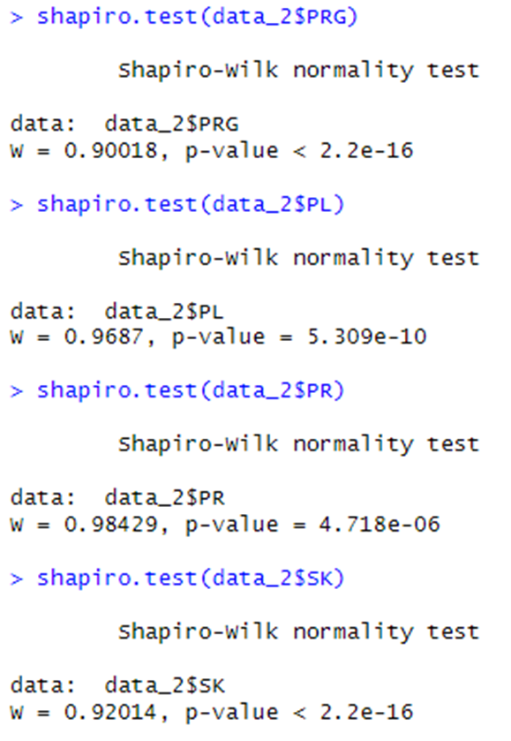
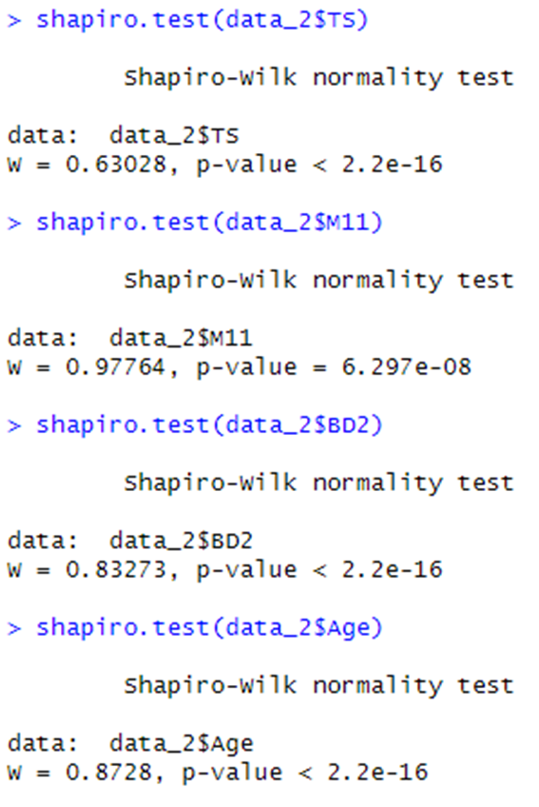
Shapiro-Wilk’s Normality Test
H₀ : The data follows N(µ,σ²)Against H₁ : The data does not follow N(µ,σ²)
For level of significance α = 0.05, it can be seen that all the p-values of the 8 variables are less than i.e. <0.05. So, the null hypothesis is rejected and we conclude that the datasets are not from the normal distribution.

Slide 15
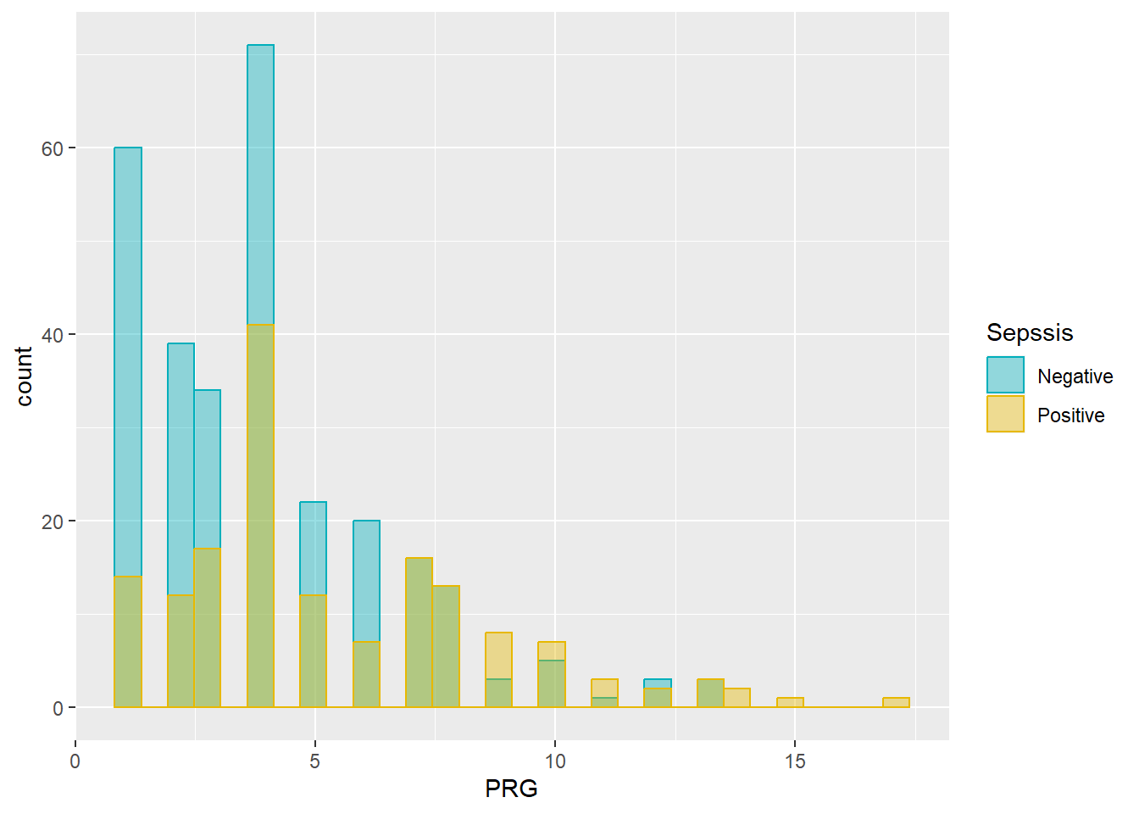
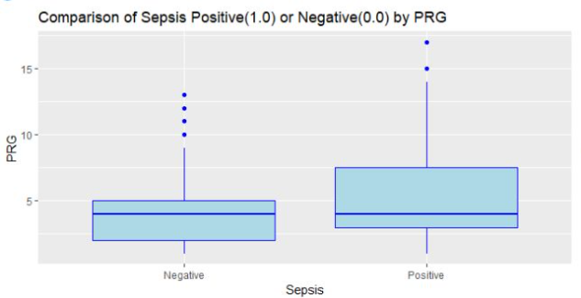
As from the above boxplot , outliers are more in the case of patients who are not being effected by the disease . Though in general it shows less outlier values compared to other variables .
Splitting the data After this realization , we will move forward to the splitting of the dataset on the basis of train and test data where the ratio of the split is 3:1 .
Graphical representation of the train data:
#### Diagram for PRG ####
As most of the patient results in Plasma Glucose level in range 3.9-5.6 , it indicates most of the patients should show a high peak in frequency in the histogram , which is evident in the above plot. It is a rightly skewed pattern .

Slide 16
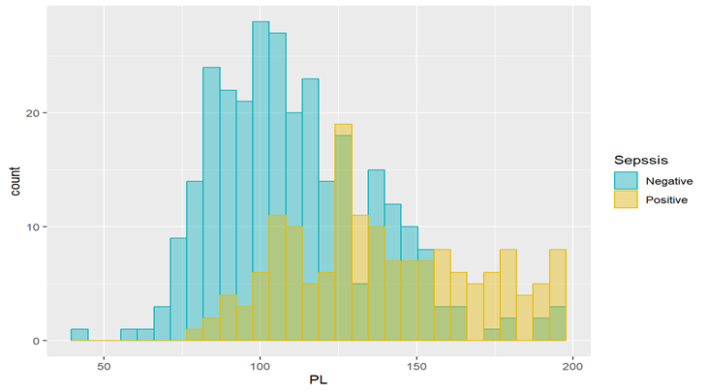
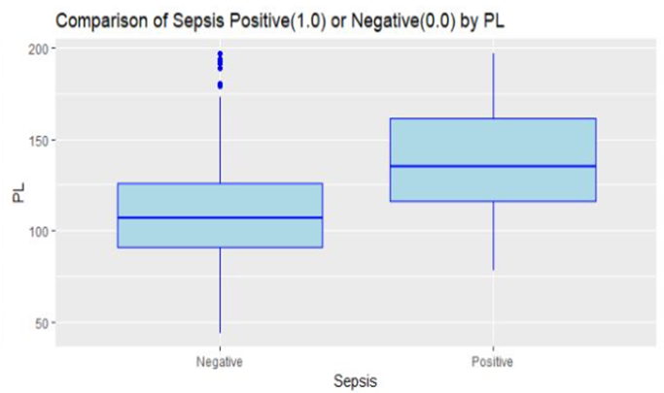
This histogram shows that a normal person , who has not been effected by Sepsis has more or less platelet count of around 100 mmol/mL.
As from the above boxplot , outliers are more in the case of patients who are not being effected by the disease . Though in general it shows less outlier values compared to other variables .

Slide 17
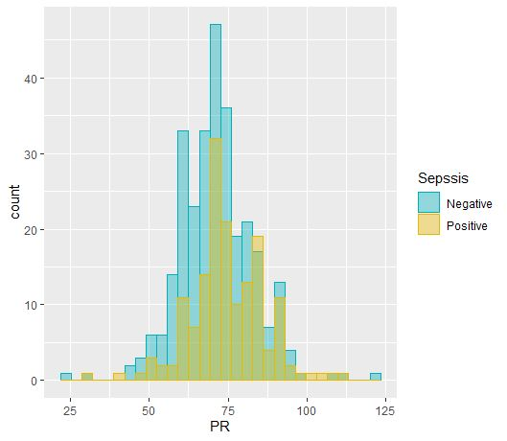
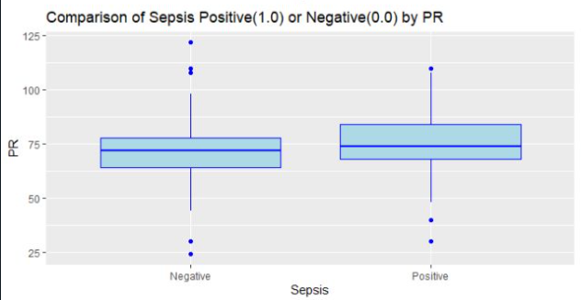
Blood pressure on the other hand is quite obviously showing a higher normal representation as the highest peak of the histogram is around 70 mm Hg , which is average systolic pressure .People , both with disease or not , posses the same distribution . .
#### Diagram for PR ####
Boxplot for the PR ranges with more outliers for the negative response people with Sepsis.
Which means people with very high or very low Blood pressure(who are less in numbers) are safe from sepsis ! Quite interesting !

Slide 18
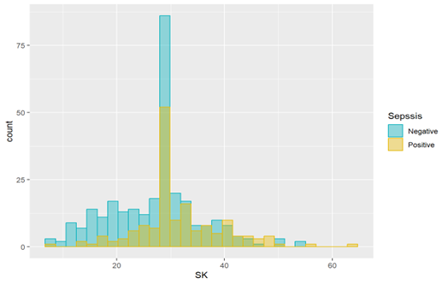
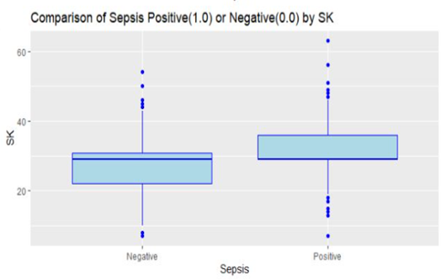
#### Diagram for SK ####
I didn’t found any conclusive information about the effect of SK on sepsis , but I can see that positive response people (effected with the disease) are more likely to contain it . The highest peak of the histogram is at around 30 , (negative response) .
Patients who are largely effected by sepsis , are showing scattered SK values , with median ranges just around 30 . This clearly indicates that outliers are evident for both positive and negative response .

Slide 19
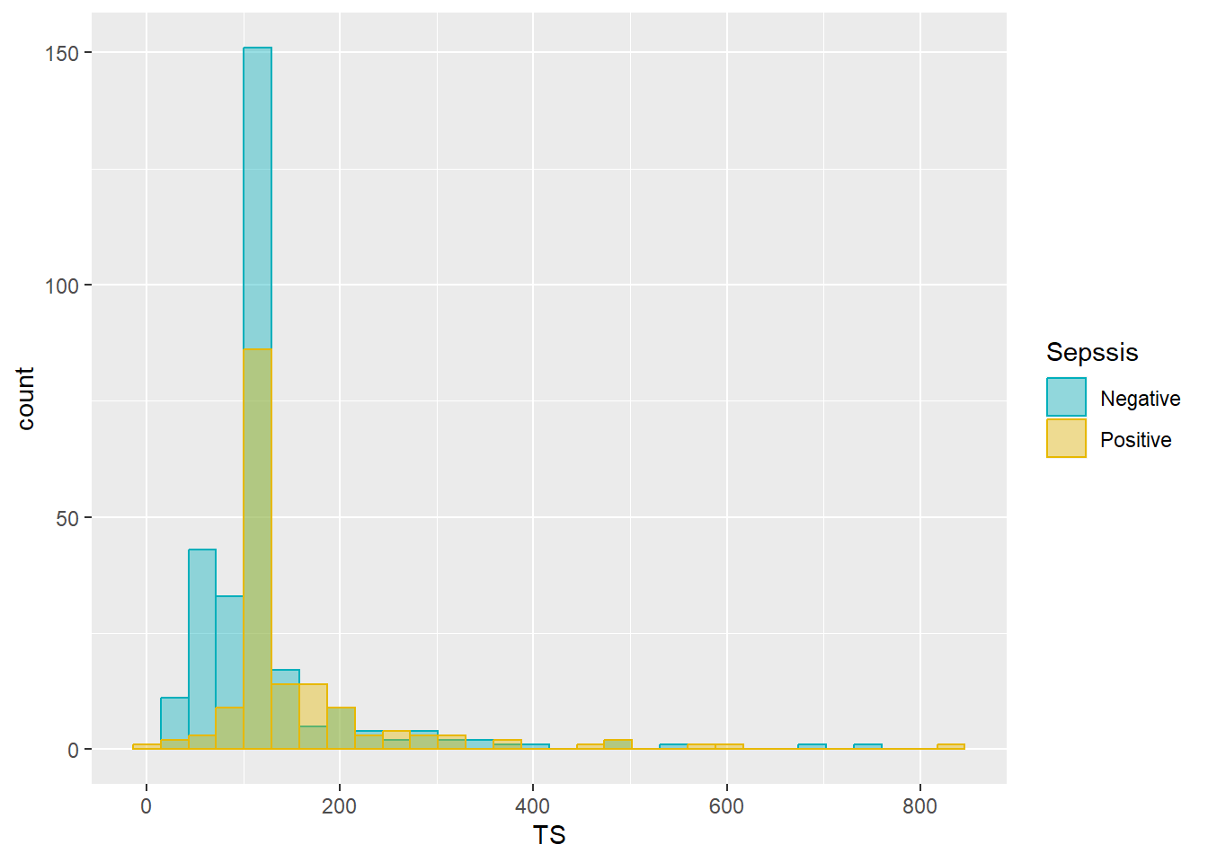
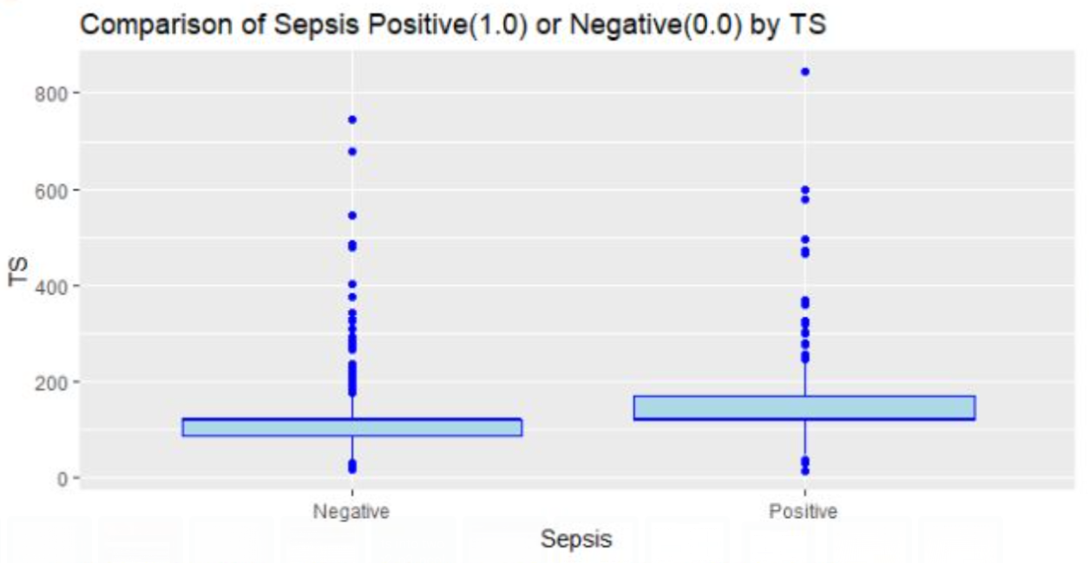
The normal range for TS is between 215-380 mg/dL . But surprisingly , the histogram shows no similarity with this range . Hence we expect more values to be out of normal range i.e.no. of outliers should be high !
#### Diagram for TS ####
And yes ! we interpreted correctly as a high percentage of variable values lie outside the perfect range . This means replacing this particular column vector with median is resulting in a different manner as there were too many null values before the replacement . So it is better to reject the vector .

Slide 20
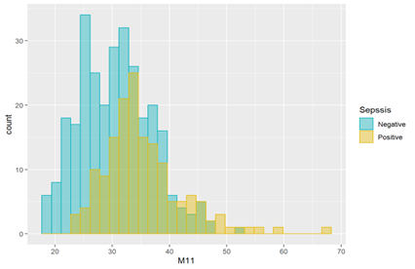
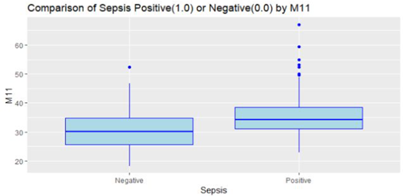
#### Diagram for M11 ####
Quite intuitively from the histogram , it is evident that patients with BMI 18-25 kg/cm², which is quite normal , are free of risk of sepsis somehow. Talking about the positive response , we have seen BMI rate higher than 30 are effecting patients more .
Patients with positive sepsis response are more to have higher BMI . So the outliers in the right boxplot is intuitively obvious with values over 45 as outliers( some values are approaching 60 and above!) . On the other hand negative sepsis response boxplot is much stable with a median value 30 .

Slide 21
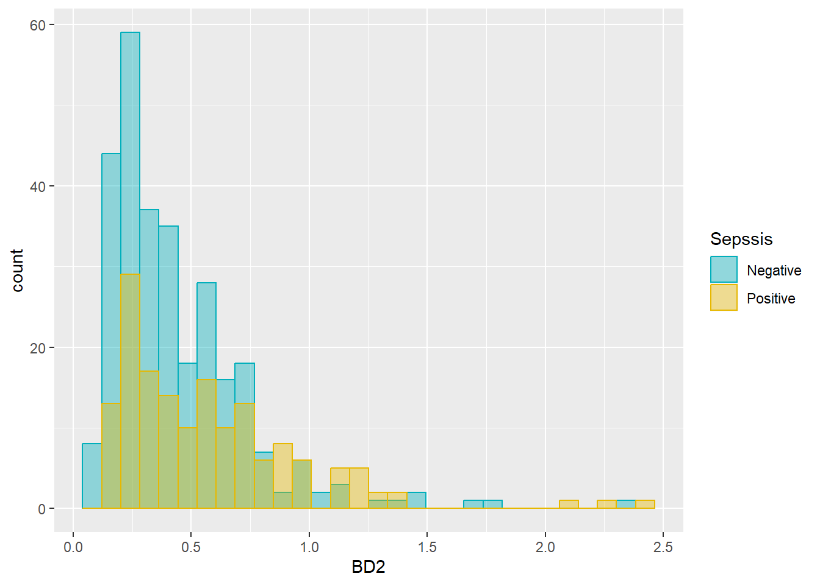
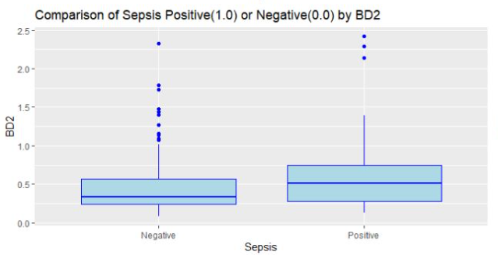
β Defensin-2 / Blood working result with a high count value are in a negative response patient , which means person with fluency in blood has less possibility to have sepsis.
#### Diagram for BD2 ####
The boxplot representation is also denoting the same thing as negative response people are showing high blood fluency . Outliers are thus denoting high values of BD2.

Slide 22
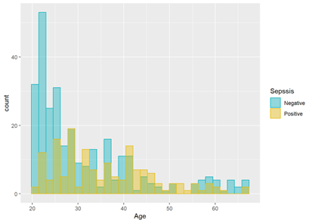
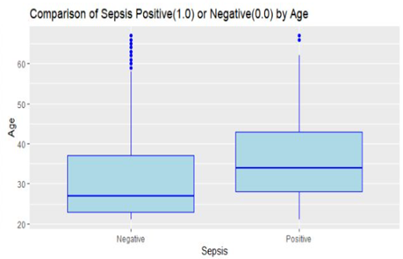
#### Diagram for Age ####
One of the most interesting attributes to look at is a patient’s Age . Quite obviously from the graph ,it is a rightly skewed distribution denoting that most of the negative responses of sepsis are coming from the age group of 20-25 years . Increasing age denotes increasing possibility of sepsis .
Boxplot interpretation is also intuitive . Outliers in the negative response suggests very few older people with age 65 and above are likely to be free from the risk of sepsis than the middle aged group of patients(35-50).

Slide 23
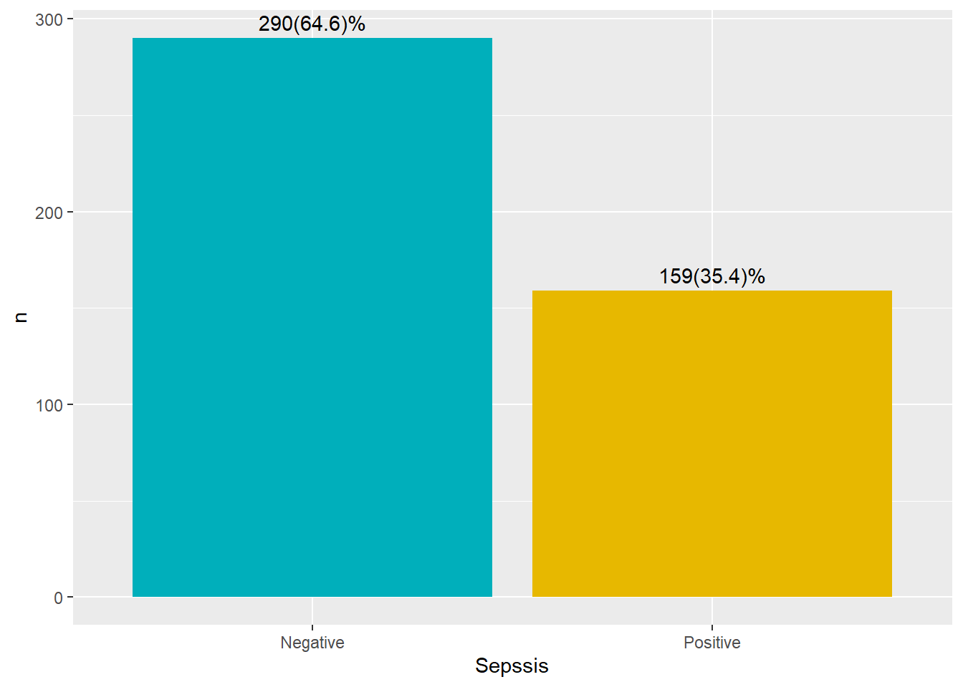
BAR PLOT:
From visualizing the bar plot we can see that 290 patients are sepsis negative and 159 s are sepsis positive out of 449 patients.

Slide 24
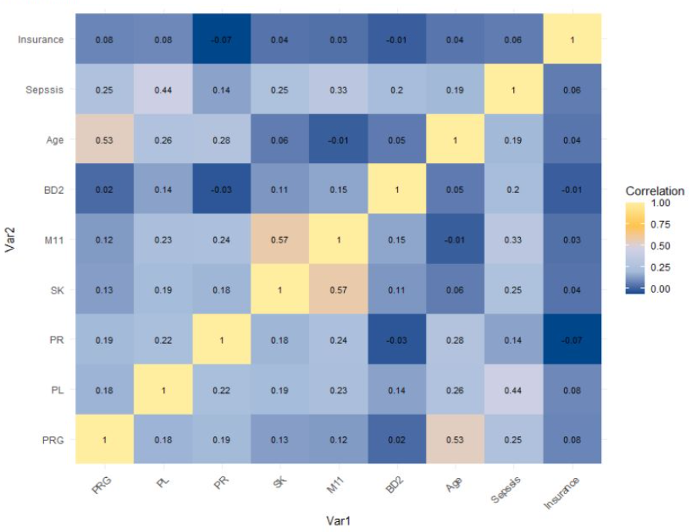
HEATMAP OF CORRELATION :
From the correlation heatmap of the train set, there is not many correlations between the features. The correlations are pretty weak, with the correlation coefficients wanders around 0.3 or less. The only exception is the Age-PRG pair (R=0.53=0.53) and M11-SK pair(R=0.57). This indicates that the older the patient, the higher their plasma glucose level is. However, the correlation coefficient of 0.53 is not necessarily very strong to say that age can predict PRG level accurately. Therefore, all features will be kept.

Slide 25
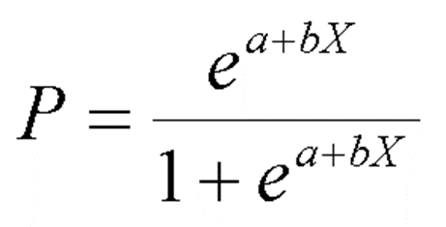
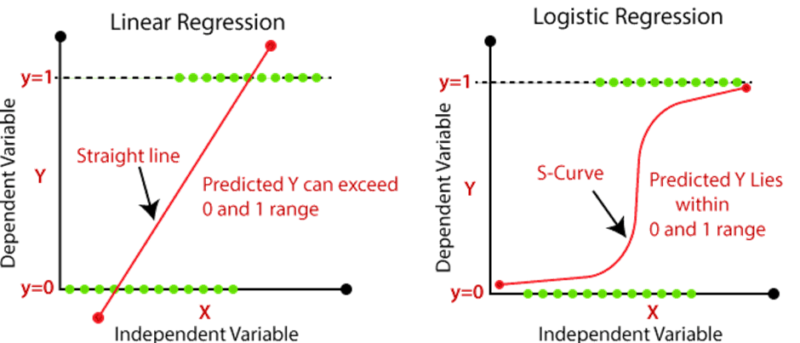
LOGISTIC REGRESSION
The use of Logistic Regression is to predict the categorical dependent variable with the assistance and knowledge of independent variables. The overall aim of Logistic Regression is to classify outputs, which can only be between 0 and 1.
Logistic regression function:
Difference between linear regression and logistic regression

Slide 26
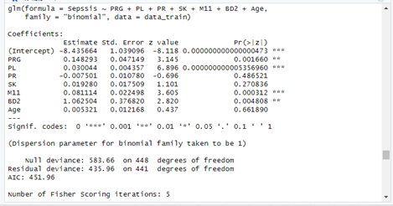
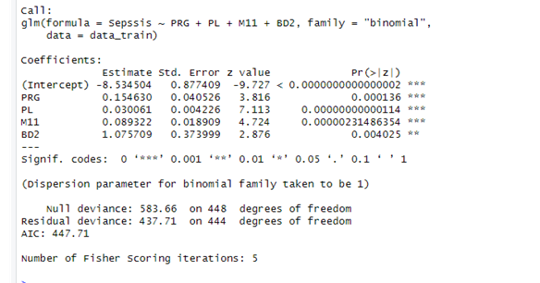
Logistic regression MODEL:
The disease Sepsis itself is a dependent variable. Where PRG , PL , PR , SK , M11(BMI) , BD2 and Age all are the combined set of independent variables
We can use the Chi-Square to P-Value Calculator to find that a X² value of 147.7 with 7 degrees of freedom has a p-value less than 0.000001.Since this p-value is much less than .05, we would conclude that the model is highly useful.
Here the AIC VALUE is – 451.96
We can use the Chi-Square to P-Value Calculator to find that a X² value of 145.95 with 4 degrees of freedom has a p-value less than 0.000001.Since this p-value is much less than .05, we would conclude that the model is highly useful.
Here the AIC VALUE is – 447.71

Slide 27
CONFUSION MATRIX FOR THE 2 MODELS:
TARGET | ACTUALLY NEGATIVE (0) | ACTUALLYPOSITIVE (1)
PREDICTED NEGATIVE (0) | 90 | 11
PREDICTED POSITIVE (1) | 17 | 32
TARGET | ACTUALLY NEGATIVE (0) | ACTUALLY POSITIVE (0)
PREDICTED NEGATIVE (0) | 96 | 5
PREDICTED POSITIVE (1) | 17 | 32
Accuracy of the given confusion matrix is the ratio of diagonal sum to the total sum of members of that matrix . Here our model is 81.33% accurate and 18.6667% is misclassified by the model. So we can tell this is a good model but if we ignore the insignificant variables, better model can be made.
Accuracy of the given confusion matrix is the ratio of diagonal sum to the total sum of members of that matrix . Here our model is 84.66% accurate and 15.33% is misclassified by the model. So we can tell this is a good model but if we ignore the insignificant variables, better model can be made.

Slide 28
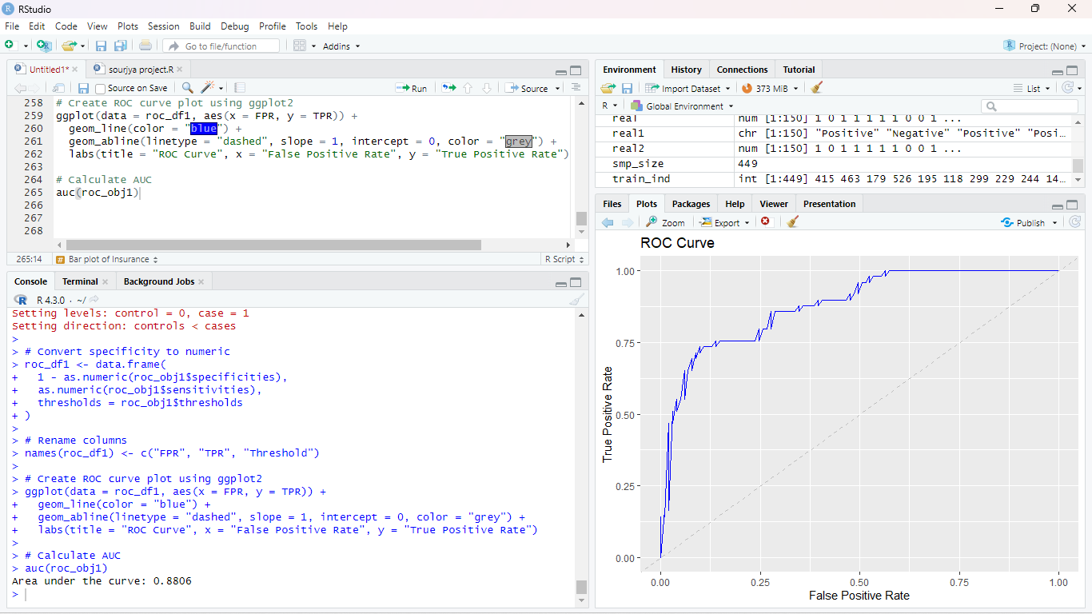
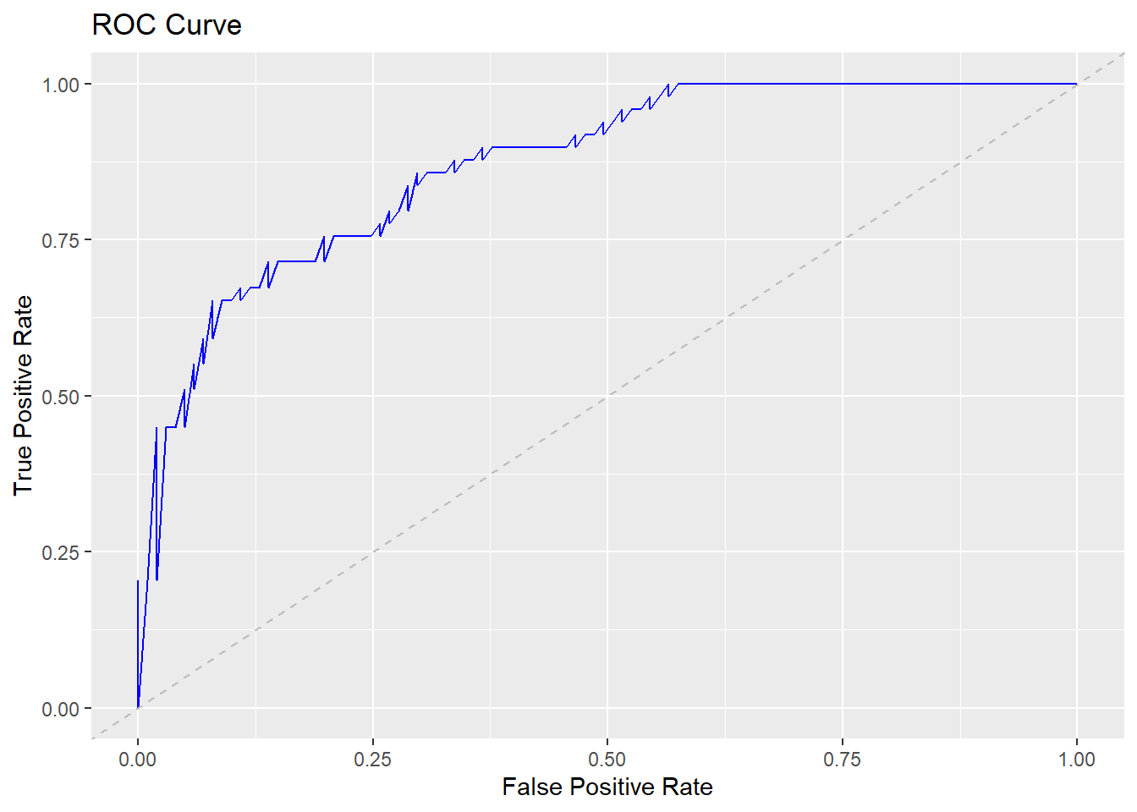

ROC curve
Area under the curve: 0.8705

Slide 29
# Now predicted a new data with this models:
Prediction for some new data(Example)
For model 1
(PRG= 10, PL = 150.03, PR=70, SK=38, TS=60, M11=57, BD2=0.923, Age=35)
I found probability of the being sepsis positive of the patient is 0.972.
For model 2
(PRG= 10, PL = 150.03, M11=57, BD2=0.923)
I found probability of the being sepsis positive of the patient is 0.9735601.

Slide 30

CONCLUSION
From normal density plot, we assume that variables PL,PR,M11 are approximately following normal distribution but Shapiro Wilk’s test concludes no variable comes from normal distribution.
We suspect by checking the heatmap there is a bivariate relationship between age and PRG, M11and SK.
From our 7 independent covariates in
the dataset and from the above study by fitting a generalized
linear model, we can conclude that “Plasma glucose rate(PRG) ,“Platelet count(PL)” and “Body mass(M11)” and “β Defensin-2(BD2)” are most significant factors in predicting the chance of being sepsis positive .

Slide 31
References
Books:
The Fundamentals of Statistics (Vol-I and Vol-II) – A.M. Goon, M.K. Gupta and B Dasgupta • The Fundamentals of Applied Statistics – Gupta and Kapoor
Websites: https://www.kaggle.com/datasets/chaunguynnghunh/sepsis?resource=download
• https://www.kaggle.com/datasets/uciml/pima-indiansdiabetes-database
• https://www.geeksforgeeks.org/
• https://www150.statcan.gc.ca/n1/edu/powerpouvoir/ch9/histo/5214822-eng.htm
• https://www.statology.org
• https://docs.scipy.org/doc/scipy/reference/generated/s cipy.stats.shapiro.html
• https://www.youtube.com
https://en.wikipedia.org/wiki/Pearson_correlation_coefficient

Slide 32


