Slide 1
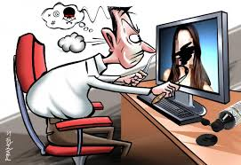
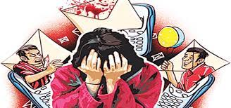
Is crime against women in india is influenced by internet.
Sumit Kumar
B.Sc (Sem-VI) Stat-22
Department of statistics,VisvaBharati

Slide 2
Contents
Introduction
Data description
Objective
Graphical Representation
Analysis
Regression
Time series
Conclusion

Slide 3
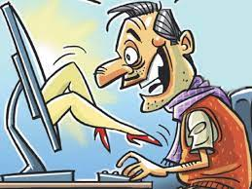
01
Introduction
Studies on whether using internet poses a greater risk for sexually aggressive behaviour have revealed conflicting results. This study aims to examine the relationship between the consumption of internet and the subsequent increase in sexual violence, thus testing the hypothesis that increase in consumption of internet is related to increased sexual crime against
women in the Indian scenario.

Slide 4
Cyber pornography This is the main risky to the female population. This may include pornographic websites or pornographic periodicals that are created to download & distribute pornographic photographs, pictures, writings, etc., “using computers to publish and print the material” on the Internet. Nearly 50% of websites currently contain pornographic content on the Internet. This makes the character of a woman unsafe as cyber criminals use women's images to fix them with bare photographs or the photos and videos resemble that the woman only.

Slide 5
General population studies include surveys of consumers and indirect data including comparison of consumption of pornographic material in a society against reported levels of sex crimes in that population. These studies assess the prevalence of violence after exposure to pornography using questionnaires. A study of the United States of America (USA), Denmark, Sweden, and West Germany during the period 1964-1984 showed that there was no increase in rape rates in the face of evidence that during this period, the availability of various forms of pornography had developed from extreme scarcity to relative abundance.

Slide 6
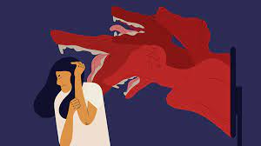
Laboratory studies involve recruitment of volunteers who undergo assessments (such as their attitude to women, violence, rape, aggression, and sex) pre- and post-exposure to pornography. Results indicated that the aggressive pornographic materials increase aggression against females

Slide 7
CRIME DATA
The relation between consumption of pornography and sexual violence remains inconclusive so We used the ‘number of internet users’ as a surrogate measure for ‘number of pornography consumers’ because the reliable estimates of this measure were unavailable. There are different categories of crime against women such as 1) acid attack, 2) cruelty by husband or his family, 3) kidnapping and abduction, 4) rape, 5) murder, 6) sexual harassment, 7) human trafficking(female) etc. Here I take only two major crimes in India against women one is rape and sexual harassment(verbal).

Slide 8

INTERNET USERS DATA Here I take my first year as 1998 because that’s where we got the data number of internet users although internet system was started from 1995, first 3 years there are no as such significance number of internet users’ presence in the recorded data and I take my last year as 2019, I didn’t consider covid19 period here because it was an irregular movement in this decade.

Slide 9
Idea of the study Last year in 2022, an article was published where the title of the article was Bihar Police Will Monitor Your Searches in Internet History. Will it Reduce Crimes Against Women? In the article it was written that Bihar Police said it has hired a company to “keep an eye" on people’s internet search data to monitor those looking up pornographic content. Meant to curb crimes against women, a new team called the ‘Bihar women helpline no 181’ has been set up that will be alerted if a person searches for pornographic material on the internet. So basically, from this article I thought is it really bad things in internet effect crime against women, how is this possible? So that were the thoughts in my mind at that time. In 6th semester, the time has come to do a project, then suddenly this idea strikes my mind and thinking about how can I relate this topic to statistics and then after some research in internet, I go with this Project.

Slide 10

Purpose of the study Studies on whether using internet poses a greater risk for sexually aggressive behaviour have revealed conflicting results. This study aims to examine the relationship between the consumption of internet and the subsequent increase in sexual violence, thus testing the hypothesis that increase in consumption of internet is related to increased sexual crime against women in the Indian scenario.

Slide 11
DATA DESCRIPTION
TYPE
The data is secondary.
It is time series data.
Source
1. https://ncrb.gov.in/en/crime-in-india
2. Crime in India 2019 | National Crime Records Bureau (ncrb.gov.in)
3. India Internet Usage and Telecommunications Reports
(internetworldstats.com)
4. • Total internet users in India | Statista
5. India Population 1950-2022 | MacroTrends

Slide 12
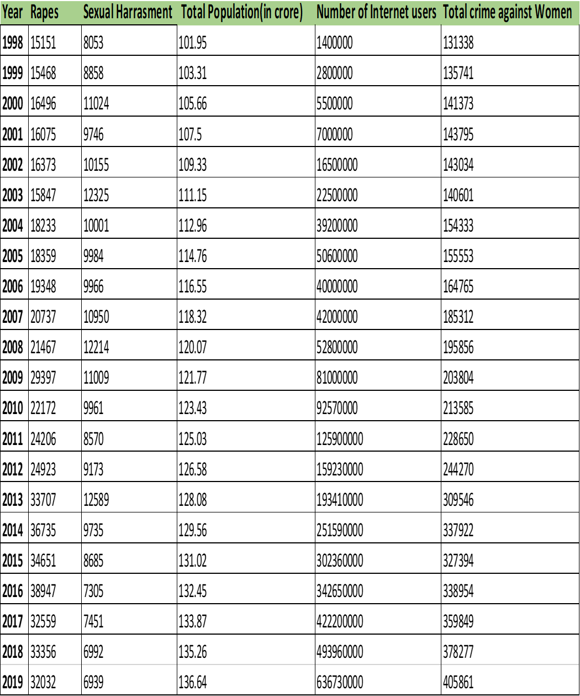
Dataset

Slide 13
OBJECTIVE
Relationship between the total number of internet users and crimes against women
[ For total crimes ]
To estimate the trend component
To find the Moving Average (centred) of the time series.
To check the data whether it is stationary or not.
To predict the future value based on the past and present data.

Slide 14
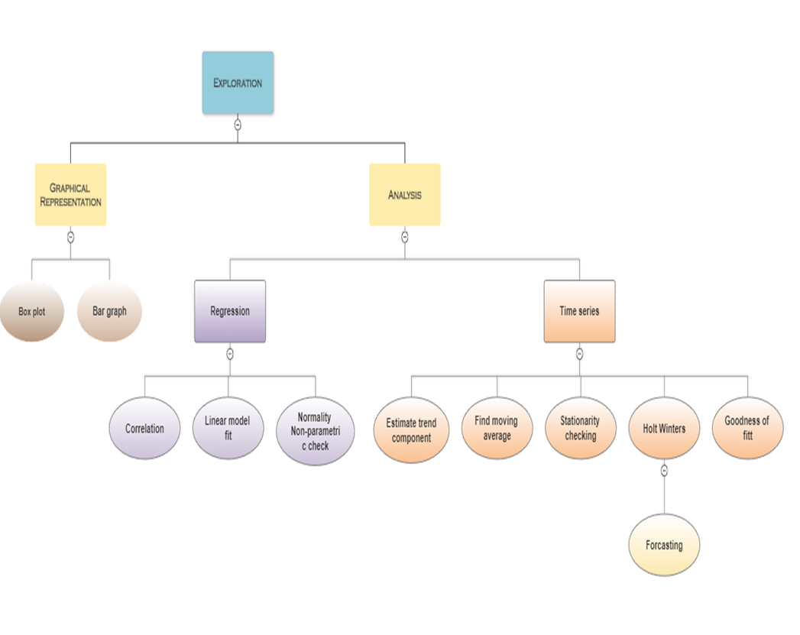
Synopsis of the Statistical Framework

Slide 15
GRAPHICAL REPRESENTATION

Slide 16
Rapes

Slide 17
Sexual Harassment

Slide 18
Total crime against women

Slide 19
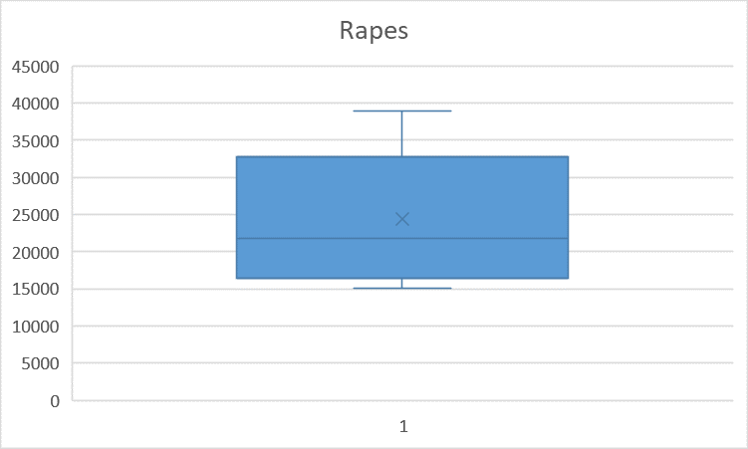
Rapes
The following boxplot represents the data in a visual
approach. The median of the data set is around 22000 which
means 50% of the data is both more and less than 22000.
Where as the 1st and 3rd quartiles are 16500 and 32600
The interquartile range is (32600-16500)= 16100
The whole Range of the data set is about 23950
Outliers are thus in the span of it

Slide 20
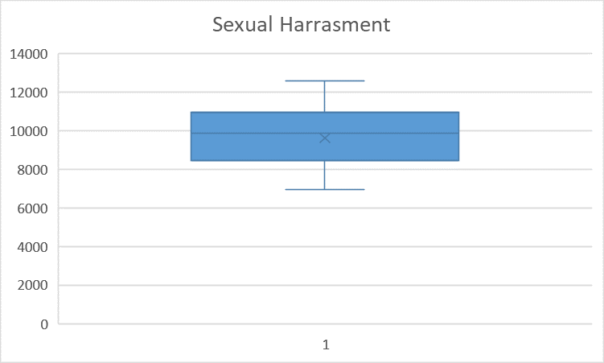
Sexual harassment
The following boxplot represents the data in a visual approach. The median of the data set is around 9500 which means 50% of the data is both more and less than 9500.
Where as the 1st and 3rd quartiles are 8500 and 11000
The interquartile range is (11000-8500)= 2500
The whole Range of the data set is about 5800
Outliers are thus in the span of it

Slide 21
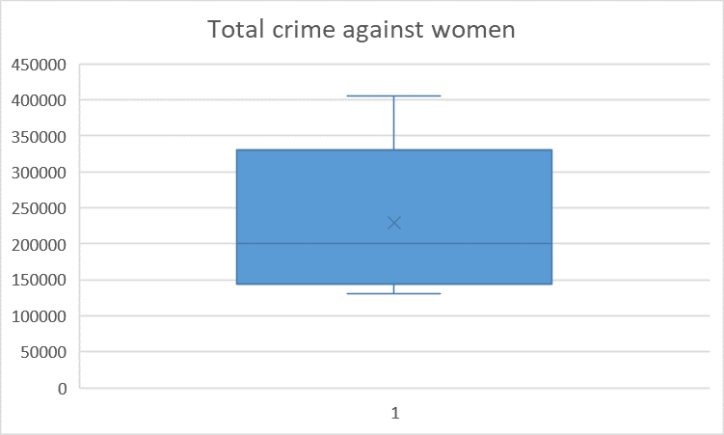
Total crime
The following boxplot represents the data in a visual approach
The median of the data set is around 150000 which means
50% of the data is both more and less than 150000.
Where as the 1st and 3rd quartiles are 320000 and 140000
The interquartile range is (320000-140000)= 180000
The whole Range of the data set is about 300000
Outliers are thus in the span of it

Slide 22
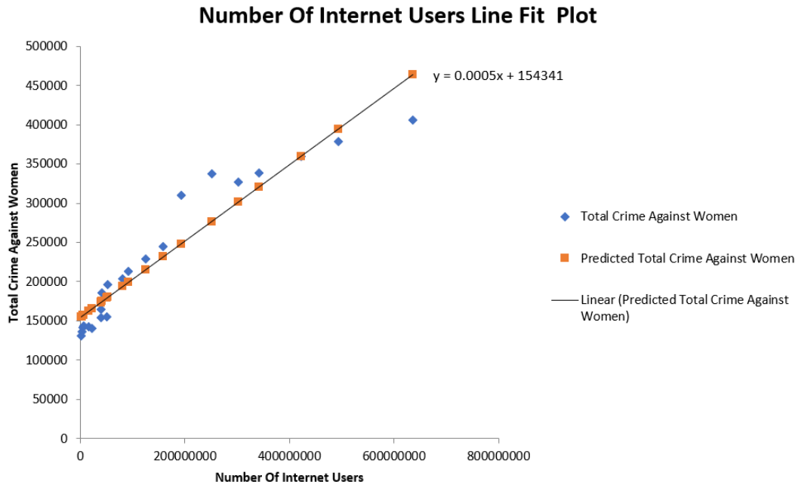
ANALYSIS

Slide 23
Results
1) There were statistically significant positive correlations between
number of internet users and total number of crimes against women
(r = 0.952). This tells us that these two variables have a strong linear relationship.
4. Further Research: -
I. We can also see that there is also a statistically significant
positive correlations between number of internet users and total
no of rapes(r=0.8328), and P value =0.00000151 < 0.005, so here
shortly we can also conclude that numbers of rape have a
significant effect of internet.
3. Standard Error of the regression is the average distance that the
observed values fall from the regression line, in our case it is 28721.2
2. Also, we can see that the value of Coefficient of Determination is
0.907 and it tells us that 0.907*100=90.7%, 90.7% of the variance
in total crime against women can be accounted for by the internet
user’s number.
II. Similarly, if we see for sexual harassment and no of internet
users we get our correlation coefficient, r = 0.65, so here we see
a negative correlation between these two variables.

Slide 24
Shapiro-Wilk normality test

Slide 25
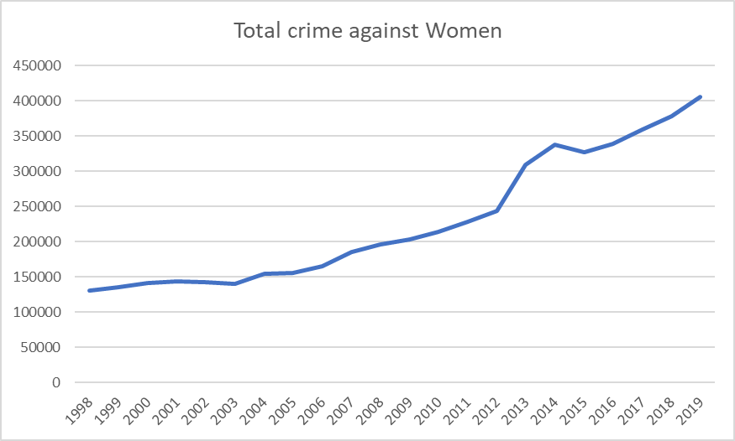

Slide 26
AUGMENTED DICKEY FULLER TEST
The ADF test was conducted on the time series "total crime" and the result was:
data: total crime
Dickey-Fuller = -3.9765, Lag order = 2, p-value = 0.02408 , alternative hypothesis: stationary
The p-value obtained from the test is less than 0.05, which suggests that we can reject the null hypothesis and conclude that the time series is stationary at the 5% significance level.
Therefore, we can assume that the series is not trended or seasonally adjusted and its statistical properties, such as mean and variance, are constant over time.

Slide 27
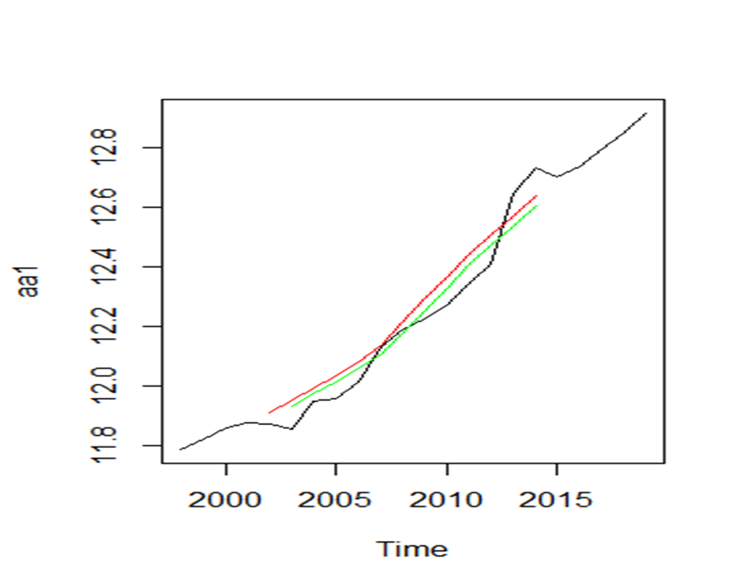
Moving Average Trend
This is a time series object with a start date of 1998 and an end date of 2019, with a frequency of 1 (i.e., annual data). The series has 24 observations, and the first 5 values are missing (coded as NA). The remaining values correspond to the rolling mean of the original series y3, computed with a window of size 2, aligned to the right (i.e., the first rolling mean corresponds to the average of the first 2 observations in y3), and with missing values filled with NA
Plot

Slide 28
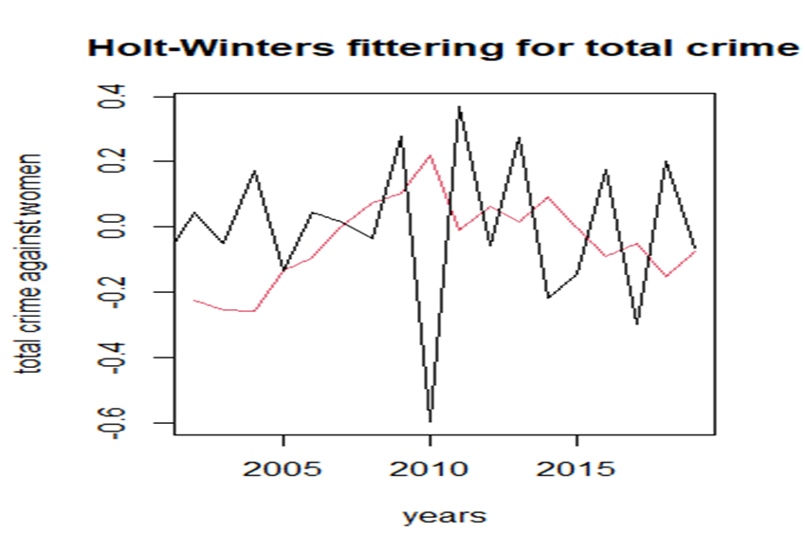
Holt-Winter
Plot

Slide 29
Forecasting using Holt-winter

Slide 30
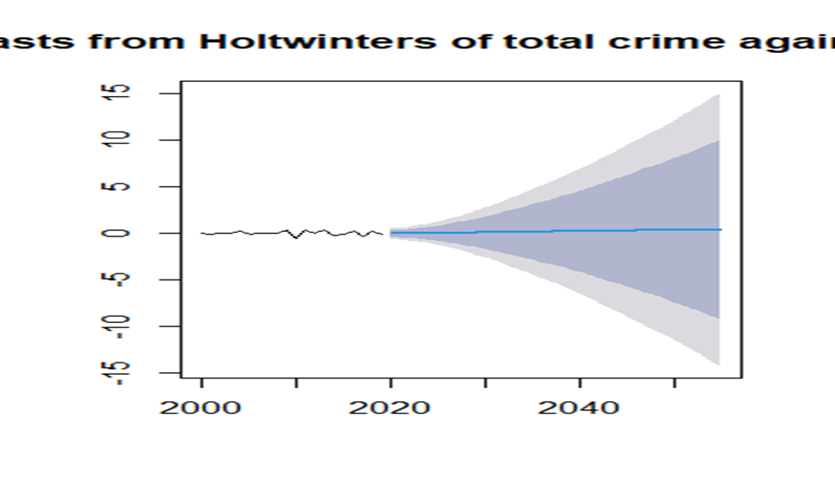
Plot

Slide 31
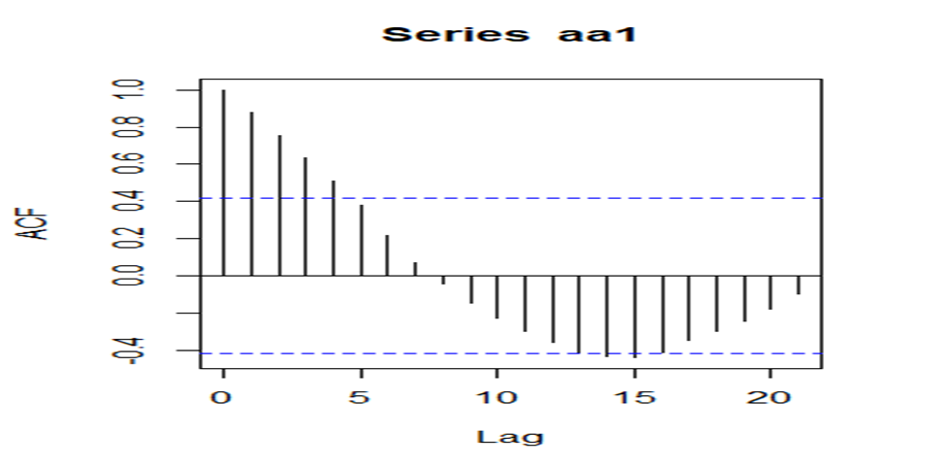
Goodness of fit Correlogram

Slide 32
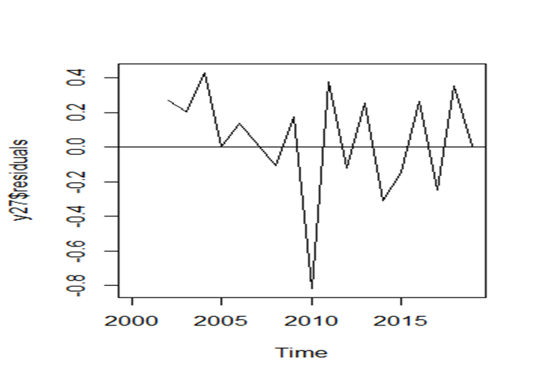
Ljung-Box test
Plot:
In your output, the Box-Ljung test was performed on the residuals of a time series, and the test statistic was X-squared = 3.5459 with 1 degree of freedom. The p-value associated with this test statistic was 0.05969.
Since the p-value is greater than 0.05 (assuming a significance level of 0.05), we fail to reject the null hypothesis, and we conclude that there is not enough evidence to suggest that the residuals are not independent and identically distributed. Therefore, we can assume that the time series model is a good fit for the data.

Slide 33
CONCLUSION
In our study we saw that internet plays a significant role in crimes against women but its not may always true, future research needs to focus on longitudinal research to evaluate how exposure to internet influences youth attitudes and sexual behaviours. However, because of ethical constraints, it is difficult to conduct studies in children and adolescents about the exposure to internet.
The indicator, ‘crime against women,’ measurement may not be the appropriate one to measure the impact of internet on the society. Other indicators such as abortion rate, teenage pregnancy rate, prevalence of sexually transmitted diseases, school and colleges drop out, time spent in procuring and watching, internet and pornography addiction, changing patterns of family, child marriage rate, impact on marriage, divorce rate, domestic violence, child and woman trafficking, tourism and economy needs to be explored before coming to any conclusion.

Slide 34
Acknowledgement
Many people assisted me in successfully finishing this project. I want to thank everyone involved in this initiative. I would want to convey my heartfelt gratitude to my supervisor Dr. Debashis Chatterjee for necessary guidance, for this presentation of this dissertation, valuable comments and suggestions.
I am extremely grateful to him for the necessary stimulus, support and valuable time. Special thanks to Dr. Sudhansu Sekhar Maiti, Head of the Department of Statistics, Visva Bharati University. I am greatly indebted to Dr. Arindam Chakraborty, Dr. Tirthankar Ghosh, Dr. Saran Ishika Maiti, Dr. Soumalaya Mukhopadhyay, Dr. Sourav Rana; Faculty members often took pain and stood by me in adverse circumstances. Without their encouragement and inspiration, it was not possible for me to complete this project. THANK YOU

