Slide 1
Analysis of Software Defect Prediction Models for Defect Categorisation

Slide 2
Objectives
To predict the predication accuracy of three classifiers (Random Forest, Logistic Regression and SVM)
To investigate the categories of individual defects those are predicted by them. As from previous studies it is quite visible that the defects detected by each classifier are different even though the prediction accuracy is almost same. This project will try and categorise the defects detected by each classifier.

Slide 3
Motivation
Defects in softwares cost industry billions of dollars each year.
Trying to improve the prediction performance so as to make defect prediction more efficient and reduce expenses spent on the rectification.

Slide 4
Literature Review
Traditionally defect prediction models had four main elements:
Independent variables used by model
Modeling techniques
Dependent variables
Scheme to measure the predictive power of model.
This project builds on Panichella’s study in 2014 where he detected different sets of individual defects that different classifiers can detect, by investigating different defects.

Slide 5
Independent Variables
Previously used independent variables mainly fall into the category of product metrics (e.g. static code) and process metrics (e.g. previous changes and defect data).
Most commonly used static code metric is LOC.
Process metrics like number of developers changing a file have significant impact
Studies suggest that process data in form of previous history data perform well, specifically reported that previous bug reports are the best predictors.

Slide 6
Datasets
Datasets can have significant impact on predictive performance.
Some datasets are difficult to learn from than others.
There are instances when very good modelling practices were used and still poor results are reported.
Quality of data should be considered, since normally datasets are noisy and contain outliers and missing values that can skew results.

Slide 7
Studies show that predictive power can be impacted if the data is not cleaned.
Features of data have to be considered, as related variables bias the prediction of models.
Data balance is significant. Normally there are many more non-defective units than defective ones. PC2 NASA dataset is the example. It has only 0.4% data points belonging to the defective class. Impact of imbalanced data varies from classifier to classifier.

Slide 8
Classifiers
These are mathematical techniques for building models which can then predict dependent variables.
Ensembles are used for software defect prediction.
Majority voting decision strategy is normally used in them.
Conflict remain over which study is the best suited for software defect prediction.

Slide 9
Many variations are proposed but this project builds on Panichell’s study.
Learning algorithm used in both studies is different as Panichella uses regression where probability of being defective is calculated. This paper deals with classification as it classifies as defective or not.
Confusion matrix is often used to measure the performance.
There is no best way to measure the performance of a model.
Performance depends on:
the distribution of training data
how model has been built
how the model will be used.

Slide 10
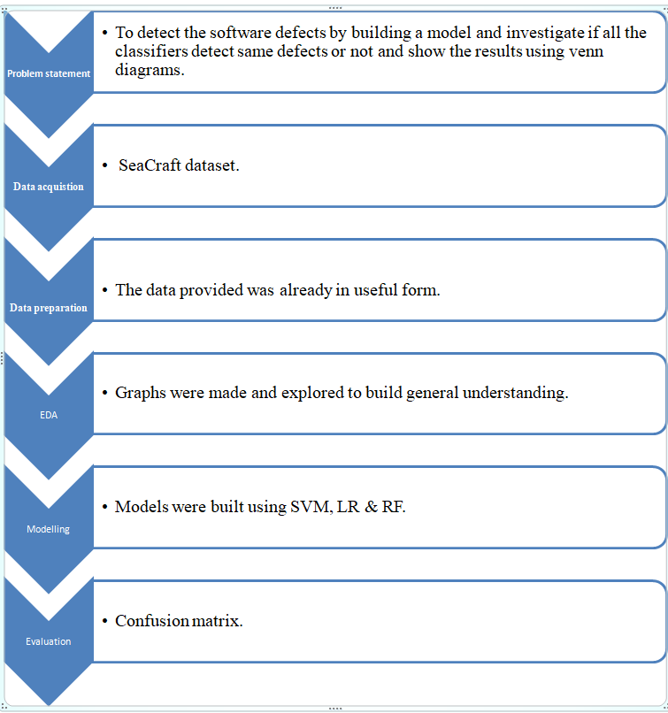
Project Flow

Slide 11
Problem statement
To detect the software defects by building a model and investigate if all the classifiers detect same defects or not and show the results using venn diagrams.

Slide 12
Data Preparation
Data preparing provides the direction to our research. It is extent to which we cleaned the data which decides how fruitful our algorithms will be. This quite clearly tells that cleaning the data is as significant to any firm as making good algorithms is. More often than not this turns out to be the point of differentiation between great enterprise data scientist and moderate enterprise data scientist. Here data provided was already in the useable format and it did not require cleaning.

Slide 13
EDA (Exploratory Data Analysis)
It is the approach to analyze data with the motive to summarize the main characteristics of the data and get vital insights. Mostly graphical methods like scatter plots, histograms, bar graphs, line plots etc. are used but it does have certain quantitative techniques as well.

Slide 14
Modelling
In machine learning we make computers learn from experiences. For this purpose we use training data to train our models which is called modelling and then use the learning to estimate or classify results.

Slide 15
Modeling techniques used:
Random forest: It is a collection or ensemble of trees which when given predictor values are capable of producing results. It classifies or associates the independent variables with the category of dependent variables associated to it. In regression problems estimate given by the dependent variables is the response of the tree
Logistic regression: It is used to separate kinds of data by using linear decision boundary. Number of errors in it can be reduced by gradient descent. But here the focus is on the reduction of log loss function which gives higher values to misclassified points as compared to that of the adequately classified ones. This is further explained in depth in next chapter.
Support Vector Machines: Out of the two possible regression lines the best is the one which is optimistically away from boundary point of each section. For this now we don't use 'Gradient Descent' rather we use 'linear optimization'. And on the whole this method is called 'Support Vector Machines'. Kernel Trick is used in Support Vector Machines when line is not enough to split. We either use different geometric curves or we can either use different planes for different sets (both of them are same).

Slide 16
Results
Test accuracy of different models when tested on different datasets:
 | Logistic Regression (in %) | Random Forest (in %) | SVM (in %)
Ant | 69.57 | 75.36 | 63.77
Ivy | 91.51 | 90.57 | 91.51
Jedit | 96.62 | 96.62 | 97.97
Redaktor | 81.13 | 84.90 | 86.79
Synapse | 71.42 | 74.02 | 75.32
Velocity | 79.71 | 79.71 | 75.36

Slide 17
Count of classes detected same by various combination of classes out of the originally non defective classes (target=0):
 | Logistic Regression | Random Forest | Support Vector Machine | LR & RF | RF & SVM | SVM & LR | SVM & LR & RF
Ant | 4 | 3 | 1 | 1 | 4 | 3 | 37
Ivy | 5 | 0 | 3 | 2 | 5 | 0 | 83
Jedit | 2 | 1 | 1 | 1 | 2 | 1 | 142
Redaktor | 2 | 9 | 6 | 1 | 4 | 9 | 37
Synapse | 0 | 2 | 4 | 4 | 0 | 2 | 43
Velocity | 4 | 4 | 7 | 7 | 4 | 4 | 35

Slide 18
Count of classes detected same by various combination of classes out of the originally defective classes (target=1):
 | Logistic Regression | Random Forest | Support Vector Machine | LR & RF | RF & SVM | SVM & LR | SVM & LR & RF
Ant | 2 | 9 | 5 | 5 | 2 | 9 | 8
Ivy | 2 | 0 | 1 | 3 | 1 | 0 | 12
Jedit | 0 | 0 | 0 | 0 | 0 | 2 | 0
Redaktor | 2 | 9 | 5 | 5 | 2 | 9 | 8
Synapse | 3 | 6 | 1 | 1 | 3 | 6 | 18
Velocity | 3 | 6 | 1 | 1 | 3 | 6 | 18

Slide 19
Venn diagram for ‘redaktor’ dataset:
target=0 target=1
Similar Venn diagrams were constructed for all the remaining datasets as well.

Slide 20
Conclusion
We see that the test accuracy for a particular dataset is almost same for each and every classifier used, with slight difference in performance across them. Such as in the case of ‘ant’ Random Forest performs the best whereas SVM the worst. Same goes in the case of ‘velocity’ where Logistic Regression and Random Forest perform the same but performs significantly better than SVM.

Slide 21
Results also show that predictive performance of classifiers is dependent on the quality of the data used. As it can be seen that it is high in case of ‘ivy’ & ‘jedit’ whereas it is moderate in case of ‘velocity’ and ‘redaktor’but it is poor in case of ‘ant’ and ‘synapse’. The results on ‘jedit’ dataset are quite above expectation with peculiar Venn diagram (when target=1).

Slide 22
In accordance to the study done by Bowes, Hall and Petric our research also suggest that even though the predictive performance of various classifiers is similar but there is a difference between the defects detected by various classifiers, which is only obvious as the three classifiers approach classification using very different techniques. So to conclude that each classifier performs similar is wrong as they differ in the individual defects being detected. This study quite clearly suggests that ensemble of heterogeneous classifiers will perform best.

Slide 23
Future Prospects
Out of all the possible additions the main would be to consider flipping in the future work and also to look for the quality in datasets due to which the classifiers perform badly on them.
Future work also includes implementing ensemble of classifiers.
To look for the pattern in defects detected by a certain classifier is one of the important things which have not been investigated by anyone yet.

Slide 24
Also to look for the set of classifiers which perform the best and are the most consistent.
Future work also includes to investigate whether there is some global ensemble which perform the best or does it remain local to the dataset.
Stacking is also the option which can be used. It doesn’t use majority voting system rather it uses another classifier to make the final prediction.
Explanation of peculiar behaviour of ‘jedit’ dataset with the help of precision and recall.

Slide 25
References
[1] Zhang, H. (2009). An investigation of the relationships between lines of code and defects. In Software Maintenance, 2009. ICSM 2009. IEEE International Conference on, pp 274–283.
[2] D’Ambros, M., Lanza, M., & Robbes, R. (2009). On the relationship between change coupling and software defects. In 16th working conference on reverse engineering, 2009. WCRE ’09., pp 135 –144.
[3] Gray, D., Bowes, D., Davey, N., Sun, Y., & Christianson, B. (2012). Reflections on the NASA MDP datasets. IET Software, 6(6), 549–558.
[4] Lessmann, S., Baesens, B., Mues, C., & Pietsch, S. (2008). Benchmarking classification models for software defect prediction: A proposed framework and novel findings. IEEE Transactions on Software Engineering, 34(4), 485–496.
[5] David Bowes1, Tracy Hall, Jean Petric(2017). Software defect prediction: do different classifiers find the same defects? The Author(s) 2017. This article is published with open access at Springerlink.com
[6] Random Forests [Online], Available: http://www.statsoft.com/Textbook/Random-Forest
[7] Sandeep Dayananda, What is logistic regression? [Online], Available: https://www.quora.com/What-is-logistic-regression
[8] David Smith, Over 16 years of R project history [Online], Availbale: http://blog.revolutionanalytics.com/2016/03/16-years-of-r-history.html
[9] Why data preparation is an important part of data science? [Online], Availbale: https://www.dezyre.com/article/why-data-preparation-is-an-important-part-of-data-science/242
[10] 2016 Data Science Report [Online], Avaialable: http://visit.crowdflower.com/rs/416-ZBE-142/images/CrowdFlower_DataScienceReport_2016.pdf

