Slide 1
Evaluating Significance of Emotion Classification in Emotion-Aware Empathetic Dialogue Systems
Akshen Kadakia (akshenhe@usc.edu )
Mrinal Kadam (mrkadam@usc.edu)
Swetha Sivakumar (swethasi@usc.edu)
Tanmey Saraiya (tsaraiya@usc.edu)
Yashwanth Reddy (gondi@usc.edu)

Slide 2
Abstract
Emotions are an important part of human communication.
Distinguishing between them is difficult because of the complexity of these different emotions.
Most dialogue systems present today aren’t good at judging the empathetic aspect of the conversation, leading to most responses coming out to be very robotic and, in a few cases, distasteful.
Our aim is to achieve more emotionally aware empathetic dialogue systems to make the conversation flow more naturally and to increase user engagement.
We have experimented by adding different variations of emotion classifiers like LSTMs and Transformers to aid the retrieval-based dialogue system in determining the appropriate empathetic responses.

Slide 3
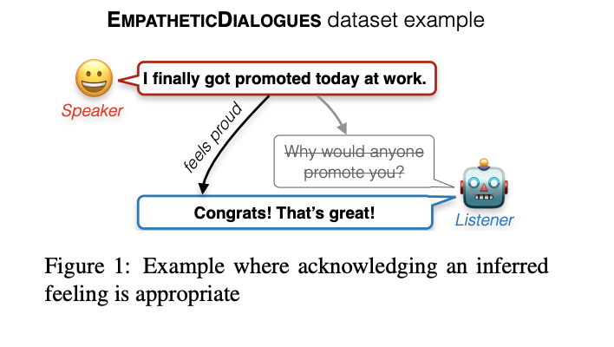
Introduction
A desirable trait in a human-facing dialogue agent is to appropriately respond to a conversation partner that is describing personal experiences, by understanding and acknowledging any implied feelings - a skill we refer to as empathetic responding.

Slide 4
Experiments
Our project aims to facilitate evaluating models’ ability to produce empathetic responses. We are carrying out two experiments that are different than that proposed by the original paper-
1. Changing the pre-trained emotion classifier used to train the ‘Emotional Awareness’ quotient of the dialogue system
2. Changing the EMPATHETICDIALOGUES (ED) dataset, a novel dataset with about 25k personal dialogues, given in the original paper, by reducing the number of categories of the target class(emotion) from 32 to a smaller subset of emotions,
following which have checked whether there has been any significant increase/decrease in our model’s performance or not.

Slide 5
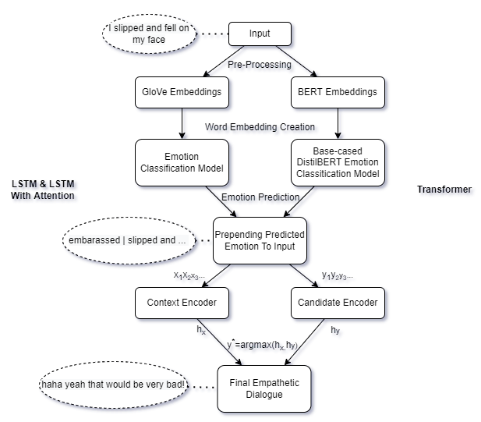
Block Diagram of Model

Slide 6
Results
Emotion Classification Results:
Model | 8 Labels | 32 Labels
FastText | - | 21.21
BiLSTM | 46.43 | 23.75
BiLSTM Attn | 46.7 | 24.36
DistilBERT | - | -
Stand-alone emotion classification performance comparison

Slide 7
Results
Performance Results for 32 Emotions (Multi-Class Emotion Classification):
 | BLEU 1 | BLEU 2 | BLEU 3 | BLEU 4 | Avg BLEU | P@1 | P@1,100 | P@3,100 | P@10,100
FastText | 14.10 | 5.16 | 2.55 | 1.42 | 5.81 | 53.03 | 65.08 | 83.60 | 95.63
BiLSTM | 14.16 | 5.20 | 2.55 | 1.40 | 5.83 | 53.05 | 65.17 | 83.42 | 95.67
BiLSTM/ATTN | 14.16 | 5.19 | 2.57 | 1.43 | 5.84 | 52.88 | 64.96 | 83.44 | 95.67
End-to-End retrieval system performance comparison with 32 emotion classes

Slide 8
Results
Performance Results for 8 Emotions (Multi-Class Emotion Classification):
 | BLEU 1 | BLEU 2 | BLEU 3 | BLEU 4 | Avg BLEU | P@1 | P@1,100 | P@3,100 | P@10,100
BiLSTM | 14.21 | 5.28 | 2.62 | 1.45 | 5.89 | 53.30 | 65.04 | 83.52 | 95.62
BiLSTM/ATTN | 14.24 | 5.30 | 2.66 | 1.49 | 5.93 | 53.07 | 64.79 | 83.38 | 95.62
End-to-End retrieval system performance comparison with 8 emotion classes

Slide 9
Conclusion
Even though conclusive results cannot be stated by running the script for just 15 epochs, the initial results show a scope for improvement by:
using better emotion classification models, and
moving from a larger set of emotions to a smaller set
Thus, prepending the emotion label to the input helps in retrieving empathetic responses with the appropriate emotions.

