Slide 1


College Name : Chandigarh University | Department : Computer Science & Engineering
Sorting Visualizer
Submitted By :
Mrinal Mayank (19BCS1605)
Date: 17th Nov2022

Slide 2
Our Proposed Solution
The proposed solution for the particular problem discussed above is the implementation of the mobile application / android application which will be used to visualize three different types of sorting algorithms including bubble sort, insertion sort and selection sort. A running time complexity calculator is also needed in order to analyze the running time complexity of the algorithm, master’s theorem is suitable for development of time complexity calculator. Apart from this the application is scalable thus any number of modules and activities can be integrated. In order to demonstrate this a stack conversion module is to be implemented along with the sorting visualizer.

Slide 3
Methodology
Selection of Application & System Programming Language
Features to support C++ & Java Integration (Android NDK & JNI)
Sorting Visualizer Algorithms ( Bubble Sort, Insertion Sort, Selection Sort)
Feature to calculate running time complexity (Master’s Theorem)
Interface and functionality (MP Android Chart, XML etc)

Slide 4
Goals
1
5
Ease of Usability
It should be easy to use even for a layman in the computer field, thus the design should be made as per the users point of view
2
4
Fast & Responsive
It should not lag or slow in its working. It should also be small in package size to load up faster. ( Native Development Kit) , Android Studio, C++, Java, JNI
3
Platform Independence
In the modern world, the software has to be platform independent in order to reach a mass audience. Thus java is used for platform independence. :
Interactive Animation
Users should be given control of the animation for better engagement.
No Programming Bounds
An ideal sorting visualizer should not require programming from the end-user to visualize a particular algorithm

Slide 5
Algorithm Modules
Bubble Sort Algorithm
1
C++
Selection Sort Algorithm
2
C++
Bubble sort repeatedly compares and swaps(if needed) adjacent elements in every pass. In i-th pass of Bubble Sort (ascending order), last (i-1) elements are already sorted, and i-th largest element is placed at (N-i)-th position, i.e. i-th last position.
Selection sort selects i-th smallest element and places at i-th position. This algorithm divides the array into two parts: sorted (left) and unsorted (right) subarray.
Insertion Sort Algorithm
3
C++
Master’s Theorem
4
C++
Insertion Sort is a simple comparison based sorting algorithm. It inserts every array element into its proper position.
Masters theorem is the most widely used method to analyse or compare various algorithms is by computing their time complexities.

Slide 6
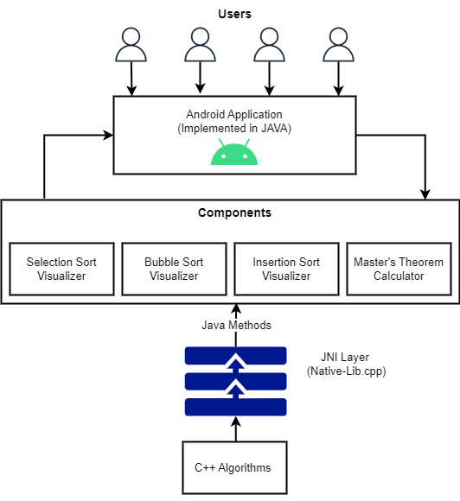
Framework

Slide 7
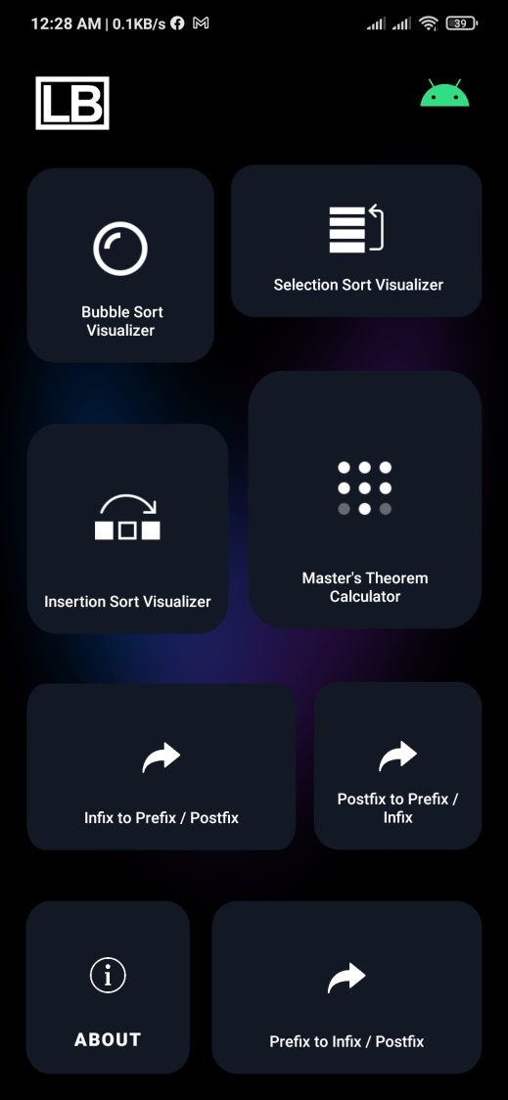
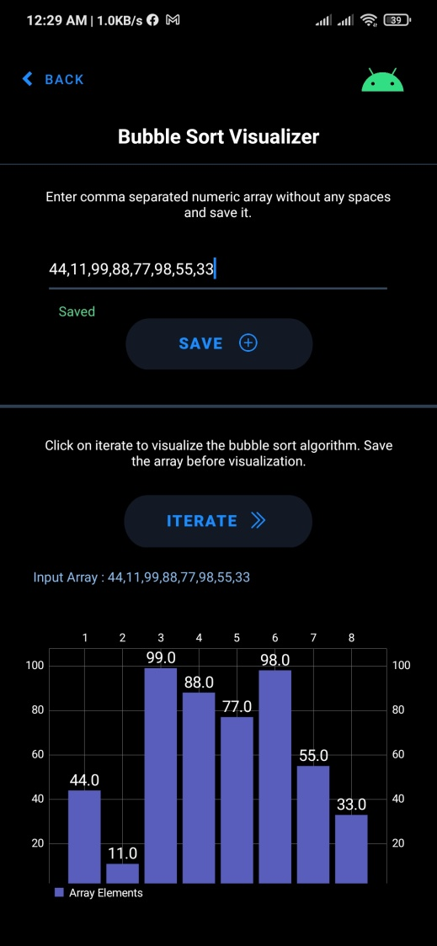
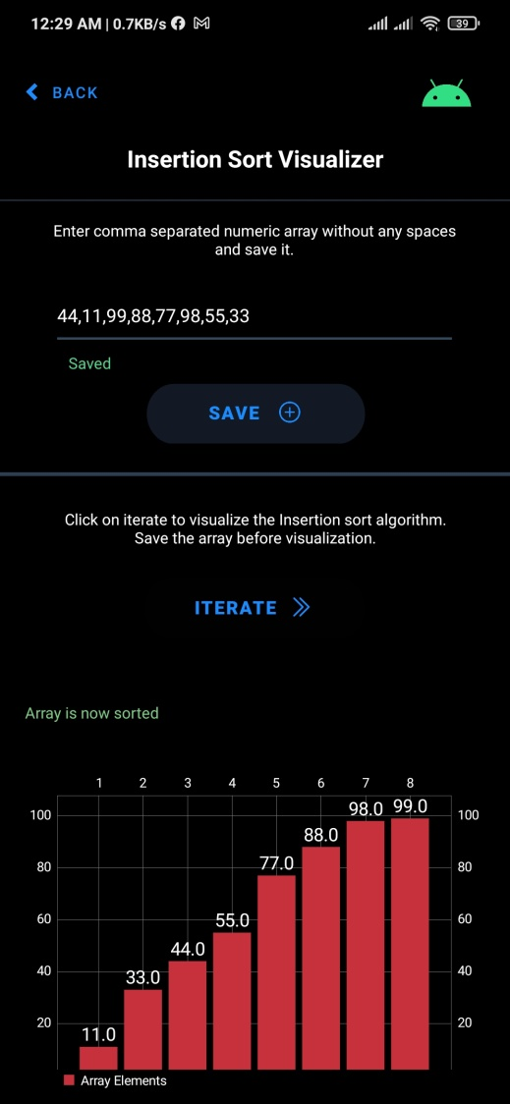
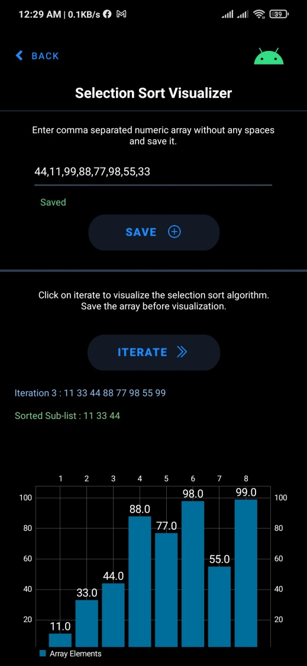
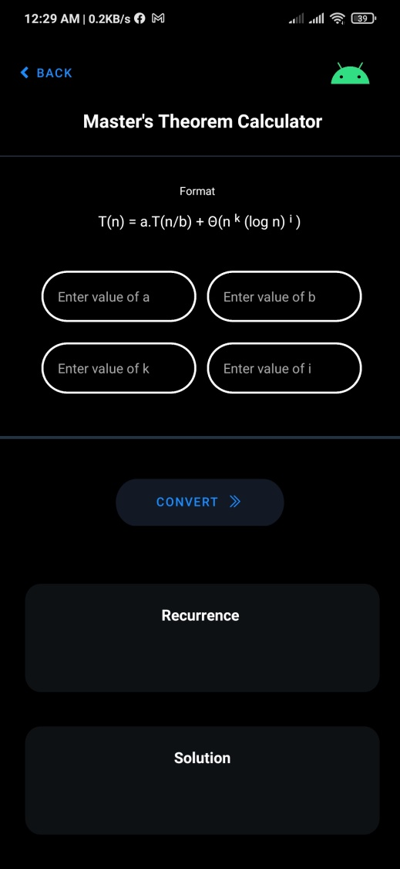
DESIGN

Slide 8
Project Timeline

Slide 9
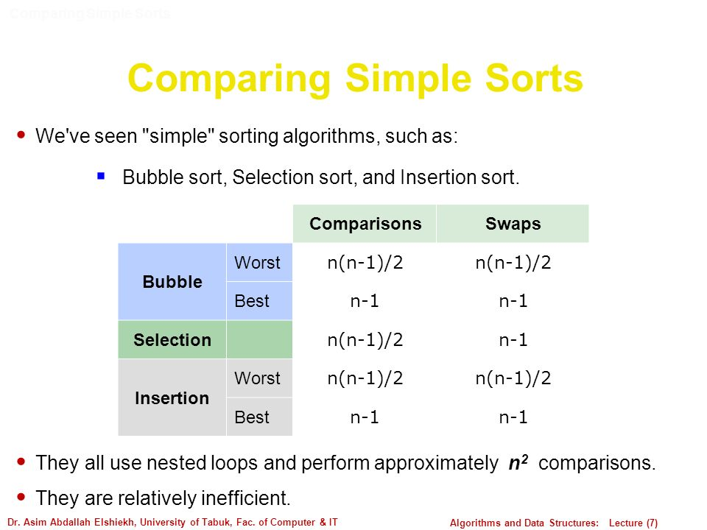
Complexity & Analysis
Swaps & Comparisons
Time & Space

Slide 10
Master’s Theorem Analysis
T(n) = aT(n/b) + f(n),
where,
n = size of input
a = number of subproblems in the recursion
n/b = size of each subproblem. All subproblems are assumed
to have the same size.
f(n) = cost of the work done outside the recursive call,
which includes the cost of dividing the problem and
cost of merging the solutions
Masters theorem is the most widely used method to analyse or compare various algorithms is by computing their time complexities. As the algorithm gets complex, the time complexity function calculation also complexities.
Recursive functions call themselves in their body. It might get complex if we start calculating its time complexity function by other commonly used simpler methods. Master's method is the most useful and easy method to compute the time complexity function of recurrence relations.
T(n) = aT(n/b) + f(n)
where, T(n) has the following asymptotic bounds:
1. If f(n) = O(nlogb a-ϵ), then T(n) = Θ(nlogb a).
2. If f(n) = Θ(nlogb a), then T(n) = Θ(nlogb a * log n).
3. If f(n) = Ω(nlogb a+ϵ), then T(n) = Θ(f(n)).
ϵ > 0 is a constant.

Slide 11
Native App (Android NDK)
Tools & Technology
Android Studio, Java, C++ , JNI(Java Native Interface), NDK(Native Development Kit)
The Android NDK App is developed using java and C++ Native Library Support, minimum version required to run this app is Android 5.0. This app shows the demo & implementation of Sorting Visualizer.
The Sorting Visualizer entitled “Logic Box” will be designed as an Android NDK (Native Development Kit) Application in order to visualize different types of sorting algorithms including bubble sort visualizer, selection sort visualizer, insertion sort visualizer, master’s theorem calculator in order to test the running time complexity of the algorithm and also an additional stack conversion module.

Slide 12
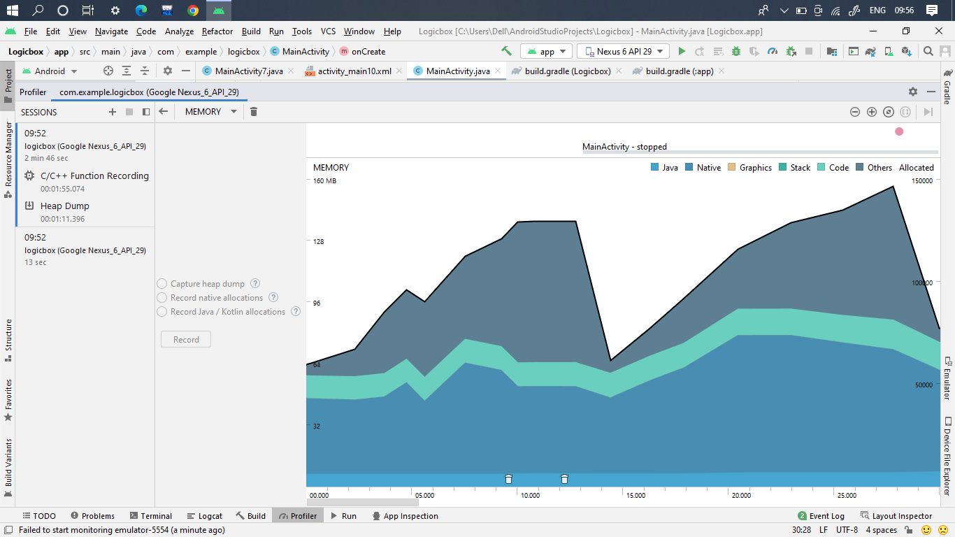
Memory Usage
Total Download Size of the App is 3.7 MB, The memory usage and performance of the app is shown below in the Android Profiler snapshot.

Slide 13
Conclusion
According to our findings, algorithm visualization can be seen as a valuable supporting tool, used in addition to standard ways of education in the field of computer science. Within the project we provided an overview of the Logic Box algorithm visualization platform as well as our practical experiences with the system. We believe (and the results of questionnaire support our belief) it helps to improve the quality of education in the field and contribute to the solution for some of the problems in higher education mentioned at the beginning of the report.
There are still open issues with using algorithm visualizations. Algorithm visualizations can help understanding the principles, but do not replace the need to implement algorithms by students is a chosen programming language. Another drawback of using algorithm visualizations within our subject is the lack of the tool offering required visualizations in a single package with the unified interface. The Logic Box platform can also be considered as a step in this direction. Generally, more systematic evaluation of algorithm visualization tools is required, as there is rather informal evidence available that applications of algorithm visualizations are useful

Slide 14
References
M.H. Brown, R. Sedgewick, A system for algorithm animation, Proceedings of the 11th annual conference on Computer graphics and interactive techniques, SIGGRAPH’84 (ACM New York, NY, USA, 1984)
W. C. Pierson and S. H. Rodger, Web-based animation of data structures using JAWAA, ACM SIGCSE Bulletin 30(1) (1998), 267-271.
G. Rößling, M. Schüler and B. Freisleben, The ANIMAL algorithm animation tool, 5th annual SIGCSE/SIGCUE ITiCSE conference on Innovatsion and technology in computer science education (2000), 37-40.
S. Khuri, Designing Effective Algorithm Visualizations, In proceedings of: First International Program Visualization Workshop, ITiCSE, Porvoo, Finland, July 7 - 8, 2000, Available: http://www.cs.sjsu.edu/~khuri/invited.html
T. L. Naps, Jhavé: Supporting algorithm visualization, IEEE Computer Graphics and Applications 25(5) (2005), 49-55.
E. Vrachnos and A. Jimoyiannis, Dave: A dynamic algorithm visualization environment for novice learners, 2008 Eighth IEEE International Conference on Advanced Learning Technologies (2008), 319-323
Krajci, I., Cummings, D. (2013). Creating and Porting NDK-Based Android Applications. In: Android on x86. Apress, Berkeley, CA. https://doi.org/10.1007/978-1-4302-6131-5_7
V. Karavirta and C. A. Shaffer, Creating engaging online learning material with the JSAV javascript algorithm visualization library, IEEE Transactions on Learning Technologies 9(2) (2015), 171-183.
Saurabh Singh, Agile or Waterfall: Which App Development Approach to Consider, https://appinventiv.com/ (May 23, 2022)

