Slide 1
Data
Strata 2022
Team - BruteForce

Slide 2
01
Problems

Slide 3

Problem Statement 01
Question :
What are the best ways to start in the field of Data Science and ML and the ways of staying strong in this field?

Slide 4
02
Solution

Slide 5
What are the best ways to start in the field of
Data Science and ML

Slide 6
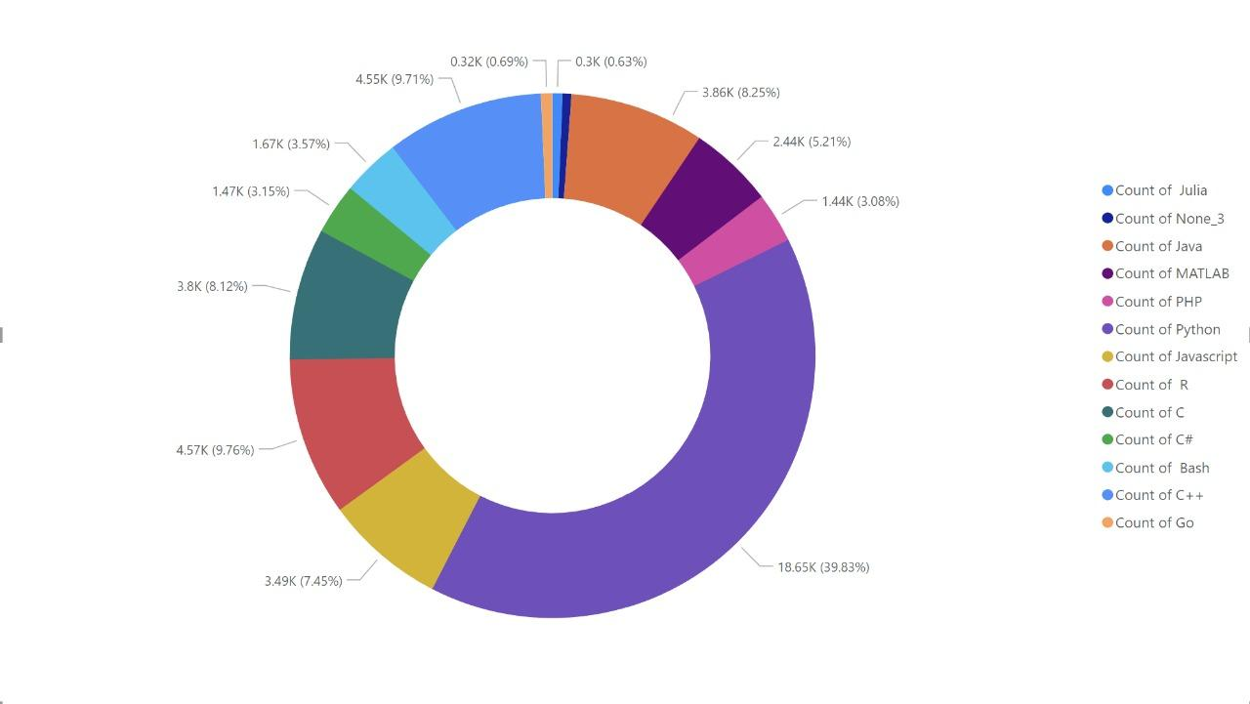
Most used language
Notes:
<mxGraphModel><root><mxCell id="0"/><mxCell id="1" parent="0"/><mxCell id="2" style="edgeStyle=orthogonalEdgeStyle;rounded=0;orthogonalLoop=1;jettySize=auto;html=1;entryX=0.072;entryY=0.03;entryDx=0;entryDy=0;entryPerimeter=0;fontFamily=Helvetica;" edge="1" parent="1"><mxGeometry relative="1" as="geometry"><mxPoint x="340" y="250" as="sourcePoint"/><mxPoint x="558.6400000000001" y="342.70000000000005" as="targetPoint"/></mxGeometry></mxCell></root></mxGraphModel>

Slide 7
Most used language
Python is the most widely used programming language for machine learning, making it suitable for beginners to kick start.
Python is easy to learn and has minimal syntax, making it the language of choice for beginners.
Languages like Java, javascript, and R are becoming popular language choices for many people in the industry for machine learners.
Notes:
<mxGraphModel><root><mxCell id="0"/><mxCell id="1" parent="0"/><mxCell id="2" style="edgeStyle=orthogonalEdgeStyle;rounded=0;orthogonalLoop=1;jettySize=auto;html=1;entryX=0.072;entryY=0.03;entryDx=0;entryDy=0;entryPerimeter=0;fontFamily=Helvetica;" edge="1" parent="1"><mxGeometry relative="1" as="geometry"><mxPoint x="340" y="250" as="sourcePoint"/><mxPoint x="558.6400000000001" y="342.70000000000005" as="targetPoint"/></mxGeometry></mxCell></root></mxGraphModel>

Slide 8
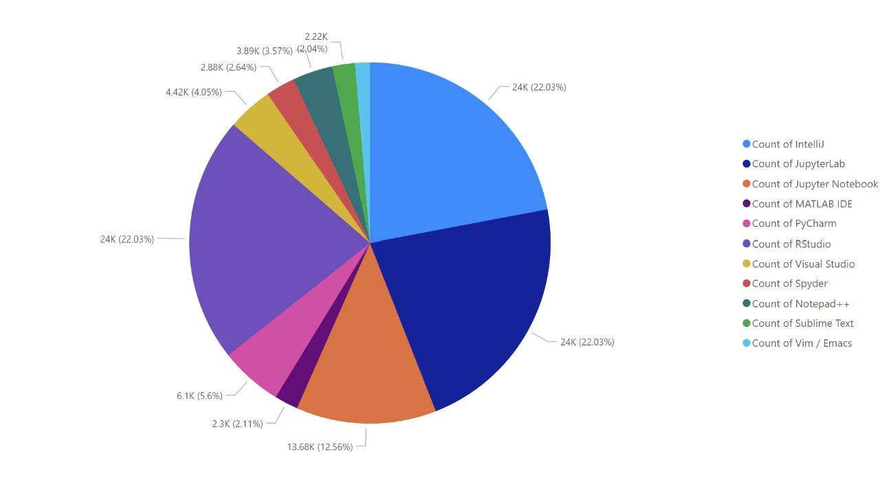
Most used IDE
Notes:
<mxGraphModel><root><mxCell id="0"/><mxCell id="1" parent="0"/><mxCell id="2" style="edgeStyle=orthogonalEdgeStyle;rounded=0;orthogonalLoop=1;jettySize=auto;html=1;entryX=0.072;entryY=0.03;entryDx=0;entryDy=0;entryPerimeter=0;fontFamily=Helvetica;" edge="1" parent="1"><mxGeometry relative="1" as="geometry"><mxPoint x="340" y="250" as="sourcePoint"/><mxPoint x="558.6400000000001" y="342.70000000000005" as="targetPoint"/></mxGeometry></mxCell></root></mxGraphModel>

Slide 9
Most used IDE
Okay, so you have started learning ML, but where will you code? An IDE is a tool for writing and managing code efficiently, making it easier to debug and execute the code.
Jupyter lab, Jupyter Notebook, Intellij, R studio are some of the most preferred Integrated development environments for developing machine learning algorithms.
Vim is the least preferred IDE as it has a higher learning curve
Notes:
<mxGraphModel><root><mxCell id="0"/><mxCell id="1" parent="0"/><mxCell id="2" style="edgeStyle=orthogonalEdgeStyle;rounded=0;orthogonalLoop=1;jettySize=auto;html=1;entryX=0.072;entryY=0.03;entryDx=0;entryDy=0;entryPerimeter=0;fontFamily=Helvetica;" edge="1" parent="1"><mxGeometry relative="1" as="geometry"><mxPoint x="340" y="250" as="sourcePoint"/><mxPoint x="558.6400000000001" y="342.70000000000005" as="targetPoint"/></mxGeometry></mxCell></root></mxGraphModel>

Slide 10
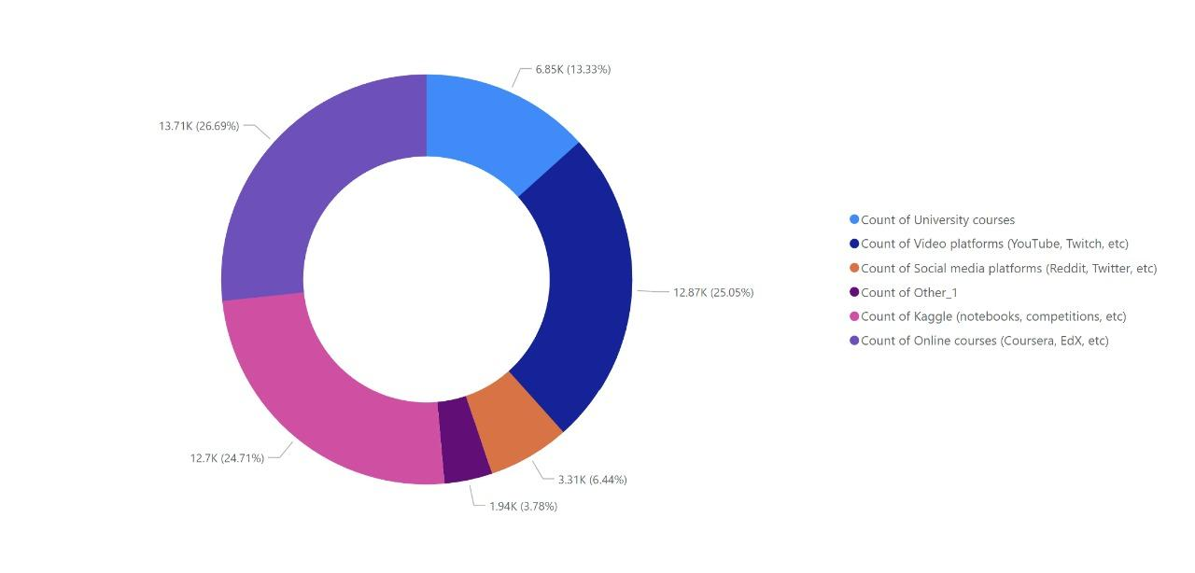
Preferred courses
Notes:
<mxGraphModel><root><mxCell id="0"/><mxCell id="1" parent="0"/><mxCell id="2" style="edgeStyle=orthogonalEdgeStyle;rounded=0;orthogonalLoop=1;jettySize=auto;html=1;entryX=0.072;entryY=0.03;entryDx=0;entryDy=0;entryPerimeter=0;fontFamily=Helvetica;" edge="1" parent="1"><mxGeometry relative="1" as="geometry"><mxPoint x="340" y="250" as="sourcePoint"/><mxPoint x="558.6400000000001" y="342.70000000000005" as="targetPoint"/></mxGeometry></mxCell></root></mxGraphModel>

Slide 11
Preferred courses
People generally preferred University courses and online courses due to extensive theoretical content and structured curriculum
Streaming platforms such as youtube, twitch contain information on specific topics which are helpful for practical application and hence are preferred.
Due to other distraction on social media such content gets overshadowed.
Notes:
<mxGraphModel><root><mxCell id="0"/><mxCell id="1" parent="0"/><mxCell id="2" style="edgeStyle=orthogonalEdgeStyle;rounded=0;orthogonalLoop=1;jettySize=auto;html=1;entryX=0.072;entryY=0.03;entryDx=0;entryDy=0;entryPerimeter=0;fontFamily=Helvetica;" edge="1" parent="1"><mxGeometry relative="1" as="geometry"><mxPoint x="340" y="250" as="sourcePoint"/><mxPoint x="558.6400000000001" y="342.70000000000005" as="targetPoint"/></mxGeometry></mxCell></root></mxGraphModel>

Slide 12
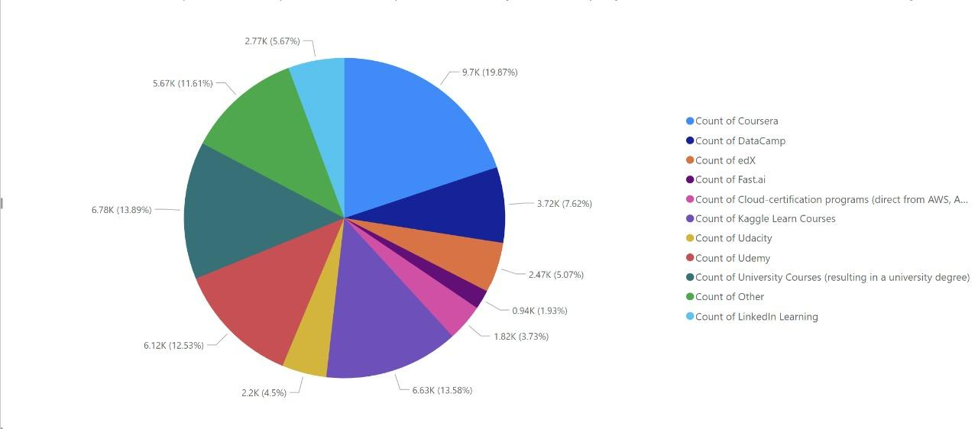
Online learning platform

Slide 13
Online learning platform
Online learning platform such as coursera, edx, udemy and Kaggle learning are most preferred platform to learn and apply theoretical and practical knowledge.
People generally prefer online learning course as they have structured learning courses which are self paced with smooth learning curve

Slide 14
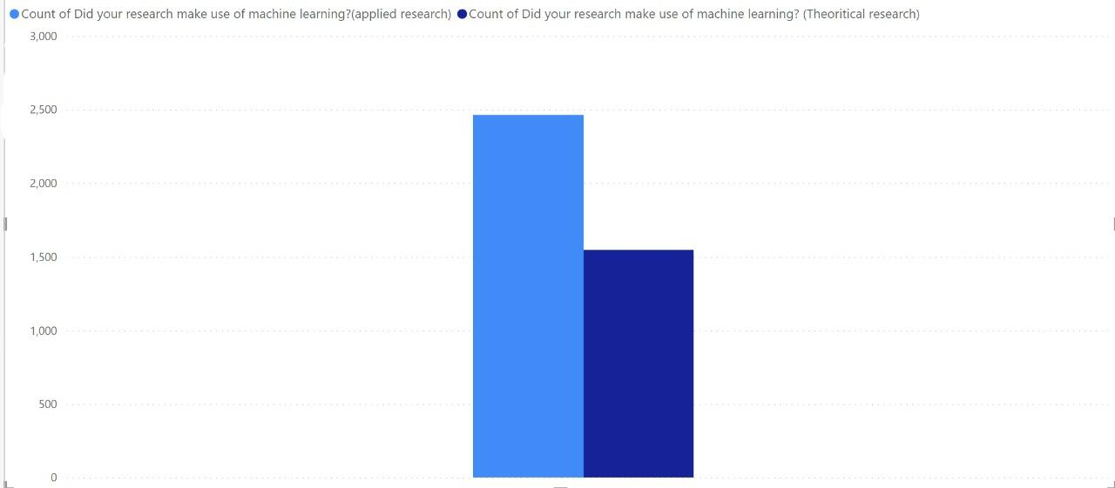
Research work

Slide 15
Research work
It is seen from the given dataset that people in the field of research use machine learning in their respective work.
Machine learning is applied to various research projects, whether it is theoretical or practical research.

Slide 16
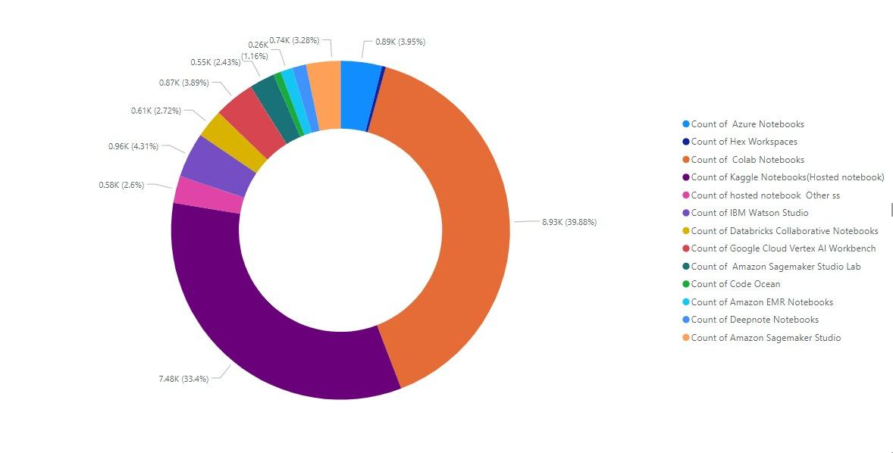
Preferred notebook

Slide 17
Preferred notebook
Google collab and Kaggle notebook are the most preferred notebooks among ML engineers due to their ability to execute high-performance algorithms with the option to collaborate with your team.
Apart from these two, there are a number of other notebooks which are easy to use and can execute high-level programs.

Slide 18
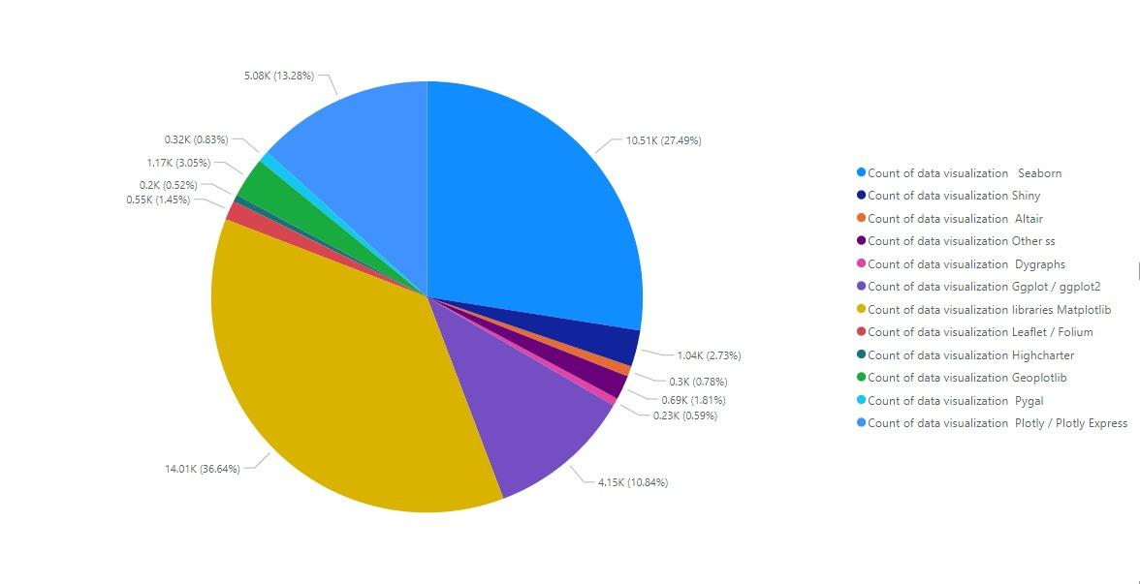
Data visualization

Slide 19
Data visualization
Data visualisation is the key to eliminating useless data and correlating useful information from a given dataset
Library such as Matplotlib is widely used by many researcher because of its ability to visualise the data efficiently

Slide 20
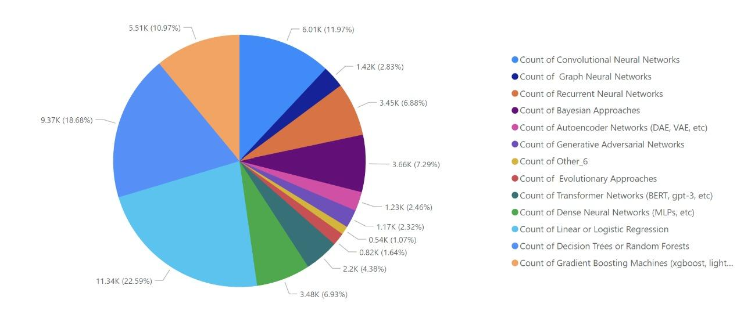
ML algorithm

Slide 21
ML algorithm
While learning machine learning, you will come across a number of algorithms which can be applied to different fields of research.
Plotted data shows widely used algorithms, which you must know if you want to master the art of machine learning.
Logistic or linear regression, CNN and RNN are among the most used algorithms by machine learning engineers.

Slide 22
How can we stay strong in
Data Science and ML

Slide 23
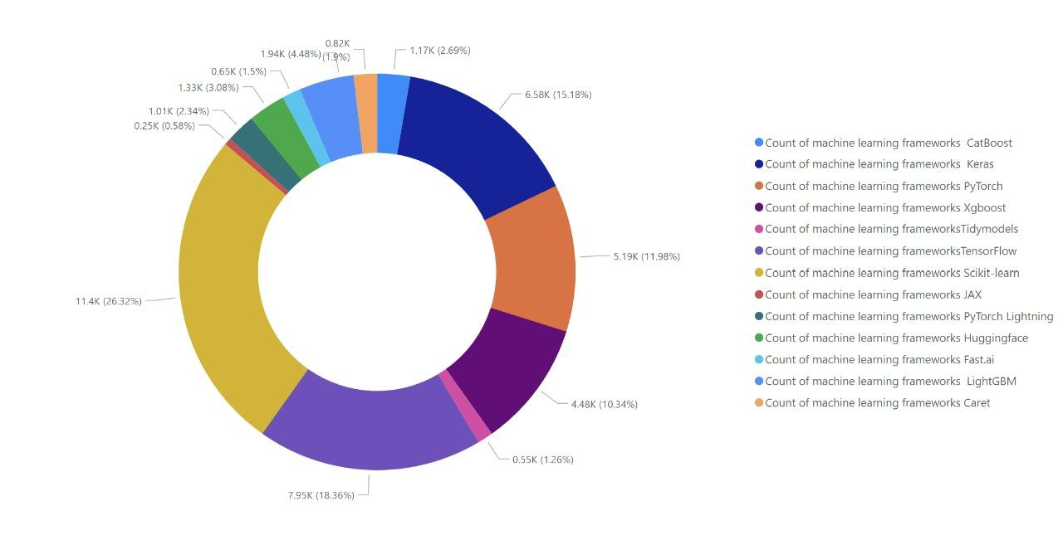
ML framework

Slide 24
ML framework
Tensorflow, Scikit-learn, and Pytorch are the most popular frameworks among research engineers because they offer algorithms for creating complex brains.
To keep up with the trend, it is essential to have knowledge of all these frameworks, which saves a hell of a lot of time from having to write the algorithm from scratch.
From the given plot, it is quite clear that machine learning has a high learning curve, so it takes time to master the art of modelling a brain.

Slide 25
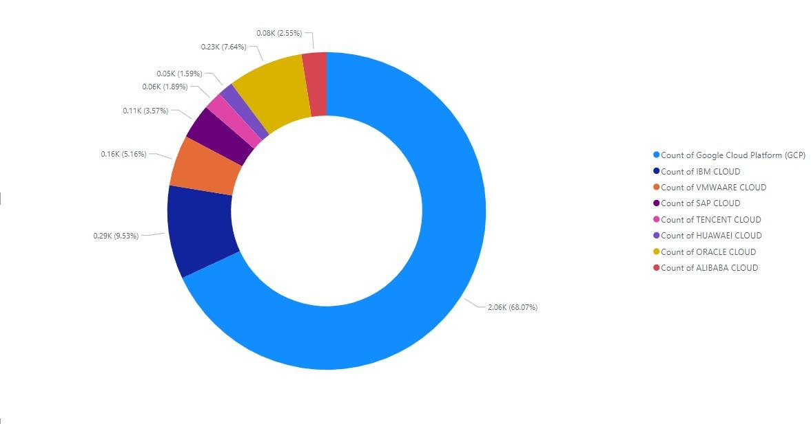
Cloud Platform

Slide 26
Cloud Platform
Cloud platform are some of the tools which makes training ml model easier. It has high performance GPU which can feed the hunger of ML algorithm
The Google cloud platform is known for providing top-performance GPUs and features that are essential for developing high-level models.

Slide 27
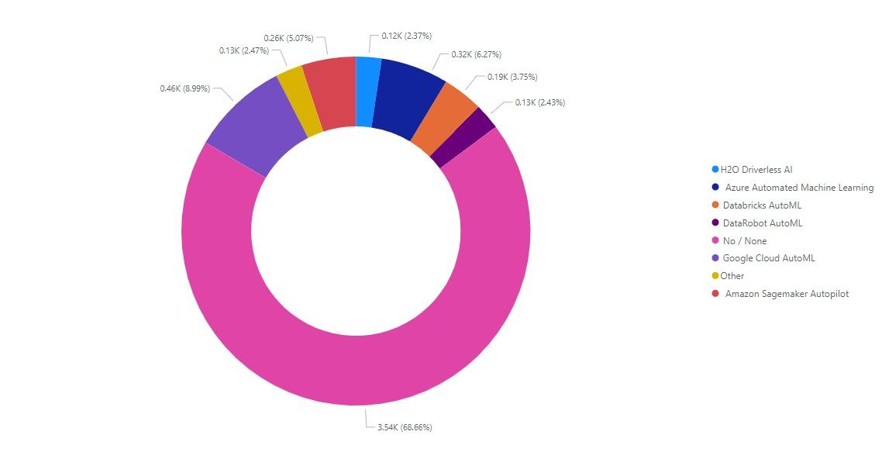
Automated machine learning tool

Slide 28
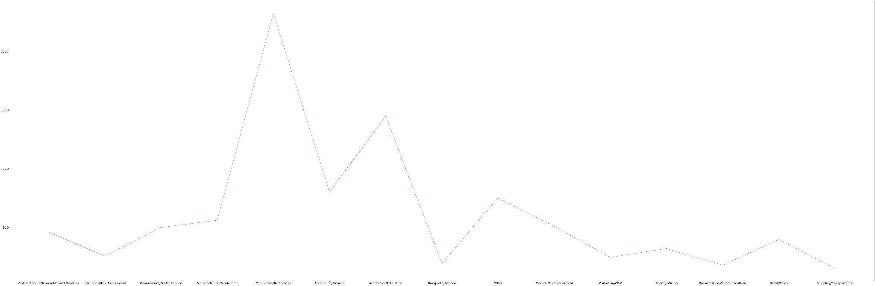
Industry of the employer

Slide 29
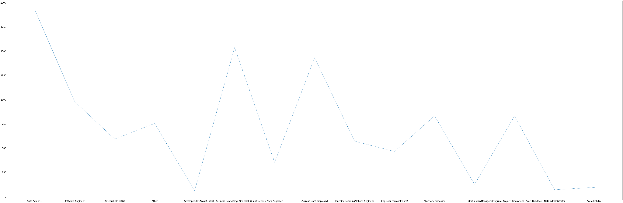
Current role

Slide 30
Thank
You

