Slide 1
CAmunda
Sanskar Dwivedi, Software Developer (DX1),
SmartOps CALA

Slide 2

Insight on Business Processes
- A Business Process is a series of steps performed by a group of stakeholders to achieve a precise goal.
- Each task in the Business Process is aligned to a participator.
- Further Business Process is the fundamental building block for several related ideas such as Business Process Management, Process Automation, etc.
- In simple words: A business process is a series of tasks that, when performed by humans or systems, can be repeated to achieve a business objective. It has the potential to significantly improve the visibility and flexibility of business logic.

Slide 3
Business Process Management
- Business Process Management is a discipline where an organization will look at its processes in total and individually. It analyses the current states and identifies the areas of improvement to create a more efficient and effective organization.
Business Process Management (BPM) is how an organization creates, edits, and analyses the predictable processes that make up the core of its business.
- In simple terms, each department in the organization is assigned responsibility for taking up some raw materials or data and transforming it into something else. Each department may handle dozen or more core processes.

Slide 4
What is Workflow?
- A Workflow consists of a set of technologies and tools that enables documents, information, activities, and tasks to flow appropriately in an organization.
- It consists of standardized symbols to describe the tasks of the process and you can design your business process from the very beginning to the very end step-by-step. Furthermore, It consists of user roles and responsibilities designated for each defined step.
- Workflows are useful to help people who are committed to the process, to understand their roles and the sequence of the execution.
- Ideally, a Workflow is a small portion of what a Business Process Management (BPM) can do for your organizations’ processes.
- Camunda's Workflow Engine executes processes defined by the BPMN (Business Process Model and Notation), a collective term for data modeling. BPMN (Business Process Modeling Notation) is the visual design methodology that can be used for automating critical business processes.

Slide 5
Business Process Modeling
Business Process Modeling or process modeling is a graphical representation or put simply an illustration of an organization’s business processes. This makes it a critical component for effective Business Process Management (BPM).
Business Process Model and Notation (BPMN) is a graphical representation for specifying business processes in a business process model.
Decision Model and Notation (DMN) designed to work alongside BPMN and/or CMMN, providing a mechanism to model the decision-making associated with processes and cases.
Case Management Model and Notation (CMMN) is a specification that defines a common meta-model and notation for modeling and graphically expressing a Case, as well as an interchange format for exchanging Case models among different tools.

Slide 6
BPM vs Workflow
- A workflow is typically a series of activities or tasks that centralize resources and personnel into a flow of work and roles toward the closing of a goal. Workflow management is the establishment of a process that gives the architecture for monitoring, automating, and enhancing a workflow. Workflow software is a process automation tool.
- BPM is a larger process-optimization system that incorporates works collaboratively, automation tools, and human capital. It is a system that gets all of the cogs turning in unison to produce the best possible result. Business processes are used by all businesses to produce results, and BPM software simplifies those approaches to improve a more agile and responsive business.

Slide 7
BPMN
- BPMN (Business Process Modeling Notation) is a graphical representation of a business process' phases.
- It is a collection of diagramming rules for representing business processes. It's made to show a wide range of process flow interpretations within a business process, as well as communication between separate processes.
- It is a flow chart method for modeling the steps of a planned business process from beginning to end.
- It is an essential piece of Business Process Management as it visually illustrates the series of business tasks and information flows required for completing a process.

Slide 8
What is Camunda?
- Camunda is an open-source, Java-based framework that generates workflow and determines the models by running implemented models in production, as well as allowing users to complete workflow tasks that have been allocated to them.
- Camunda can also be used as a single workflow engine server within a Java application, and it provides non-Java developers with the REST API as well as all the client libraries for connecting to the remote workflow engine.
- Camunda supports Business Process BPMN for Workflow and Process Automation, CMMN for Case Management, and DMN for Business Decision Management.
- The Workflow Engine and Complaint Decision Engine can be embedded into Java applications as well as other applications using REST API exposed by Camunda.

Slide 9
Features of camunda
Camunda is a lightweight material.
It is a Java-based platform that assists with the handling of engine servers.
It also provides the REST API and client frameworks for non-Java developers to develop applications.
Reports Dashboards.
Camunda is suitable for live editing.

Slide 10
Camunda cloud
- It offers software as a service (SaaS) for microservice automation.
- Camunda Cloud ensures that flows are completed in their entirety once they are started, retrying phases if they fail.
- Camunda Cloud maintains a thorough audit trail on the way, making it possible to track the development of flows.
- Camunda Cloud is a turn-key service that speeds up the implementation of your business.
- It's especially well-suited to connecting disparate systems and coordinating activities written in various programming languages.

Slide 11
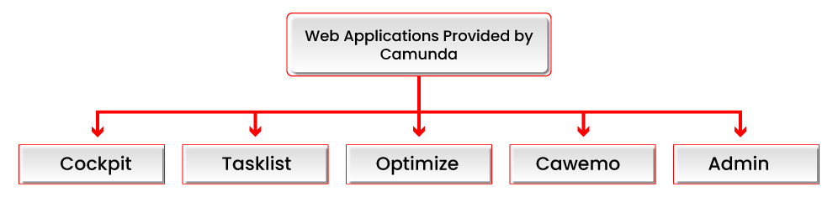
Web applications offered by Camunda
Cockpit – Assists all users in monitoring production workflows and processes, as well as analyzing and resolving technical issues.
Tasklist – Provides greater visibility to end-users, allowing them to allocate all tasks.
Optimize - Aids in the detection of workflow faults and bottlenecks.
Cawemo - Allows users to create, amend, and specify all BPMN workflows.
Admin - Helps users to manage Camunda Web Applications or REST API Users with the aid of Admin.

Slide 12
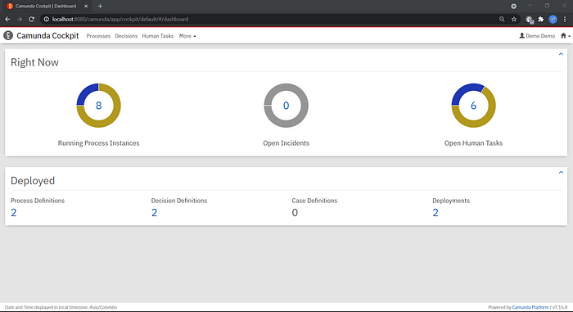
Camunda cockpit (What we use mostly)
Cockpit is a web-based application used for monitoring and operations. It provides access to deployed BPMN processes and DMN decisions, allows searching through running and ended instances and performing operations on them. You could access the Cockpit using the below URL:
http://localhost:8080/camunda/app/cockpit/default/#/dashboard

Slide 13
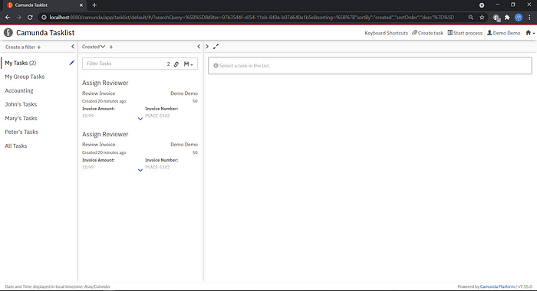
Camunda tasklist
The tasklist is an out-of-box web-based online application that integrates with Camunda's workflow automation functionalities.
You can build the business process in BPMN and upload it to Workflow Processor; the job will appear in Tasklist anytime a user requires to work on it. In short, it that allows you to work on User Tasks. Camunda Task & Activity: The activity is a global class that includes call activities, subprocesses, tasks, and so forth.
As a direct consequence, the task is also an activity, however not always an activity.
You could access the Tasklist using the below URL:
http://localhost:8080/camunda/app/tasklist

Slide 14
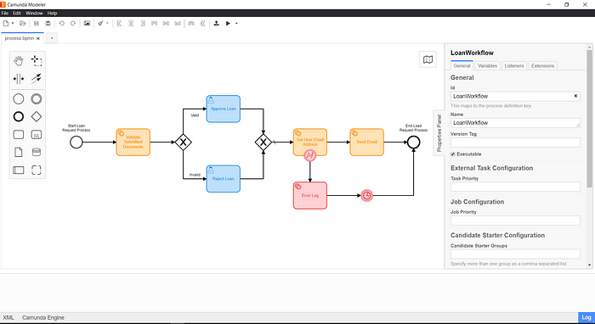
Camunda Modeler
- Camunda Modeler is a desktop application that is used for modeling BPMN and DMN. It allows you to model files directly on your local file system.
- In order to design and run your Workflow check out the getting started page on Camunda Official Documentation.

Slide 15
Camunda modeler: Features
It has the ability to develop and share reusable templates.
It can create forms without requiring the use of code.
It works in our preferred development environment.
It can be personalized to satisfy your particular requirements.

