Slide 1
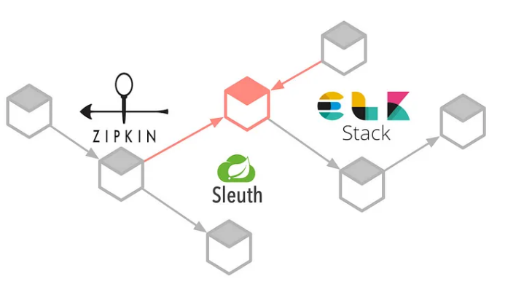
Distributed Tracing in Microservices using Zipkin, Sleuth and ELK Stack
- Sanskar Dwivedi | Software Developer (DX1) | SmartOps CALA

Slide 2
Context:
You have applied the Microservice architecture pattern.
Requests often span multiple services.
Each service handles a request by performing one or more operations, e.g., database queries, publishes messages, etc.

Slide 3
Problem:
How to understand the behavior of an application and troubleshoot problems?

Slide 4
Forces:
External monitoring only tells you the overall response time and number of invocations - no insight into the individual operations
Any solution should have minimal runtime overhead
Log entries for a request are scattered across numerous logs

Slide 5
Solution:
Instrument services with code that -
Assigns each external request a unique external request id
Passes the external request id to all services that are involved in handling the request
Includes the external request id in all log messages
Records information (e.g., start time, end time) about the requests and operations performed when handling an external request in a centralized service

Slide 6
Distributed Tracing: Summary
One of the major challenges in microservices is the ability to debug issues and monitor them. A simple action can trigger a chain of microservice calls and it would be tedious to trace these actions across the invoked microservices. This is because each microservice runs in an environment isolated from other microservices, so they don’t share resources such as databases or log files. In addition to that, we might also want to track down why a certain microservice call is taking so much time in a given business flow.
The Distributed Tracing pattern addresses the above challenges developers face while building microservices. There are some helpful open-source tools that can be used for distributed tracing, when creating microservices with Spring Boot and Spring Cloud frameworks.

Slide 7
Tools Used
Spring Cloud Sleuth: A Spring Cloud library that lets you track the progress of subsequent microservices by adding trace and span ids on the appropriate HTTP request headers. The library is based on the MDC (Mapped Diagnostic Context) concept, where you can easily extract values put to context and display them in the logs.
Zipkin: A Java-based distributed tracing application that helps gather timing data for every request propagated between independent services. It has a simple management console where we can find a visualization of the time statistics generated by subsequent services.
ELK Stack: Three opensource tools — Elasticsearch, Logstash and Kibana form the ELK stack. They are used for searching, analyzing, and visualizing log data in real-time. Elasticsearch is a search and analytics engine. Logstash is a server‑side data processing pipeline that ingests data from multiple sources simultaneously, transforms it, and then sends it to a “stash” like Elasticsearch. Kibana lets us visualize this data with charts and graphs.

Slide 8
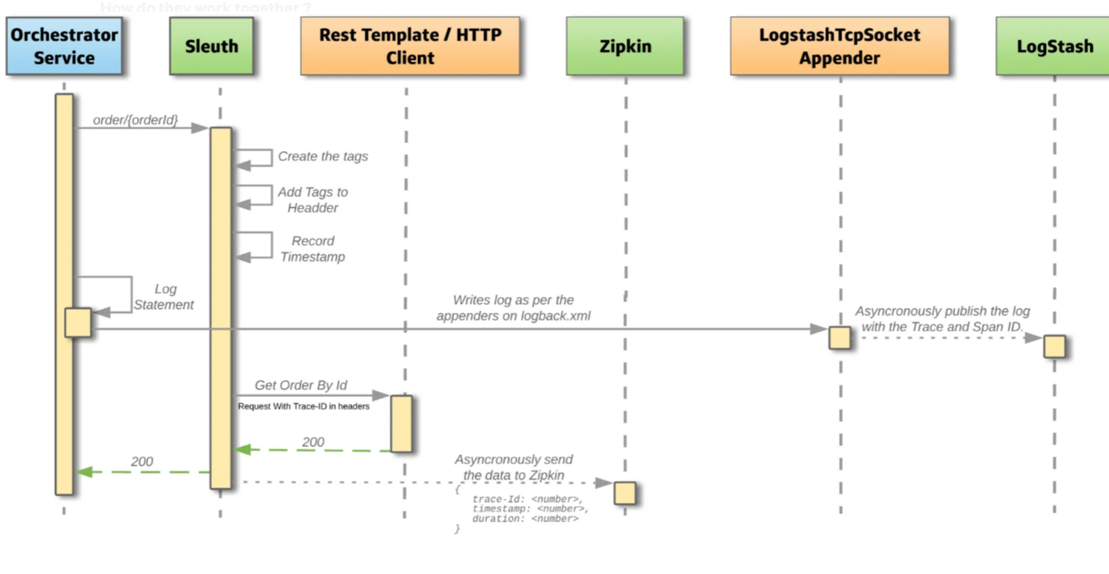
How do they all work together?

Slide 9
How do they all work together?
Based on the diagram:
When the Orchestrator Service makes a HTTP call on the service `/order/{orderId}`, the call is intercepted by Sleuth, and it adds the necessary tags to the request headers.
After the Orchestrator Service receives the HTTP response, the data is sent asynchronously to Zipkin to prevent delays or failures relating to the tracing system from delaying or breaking the flow.
Sleuth adds two types of IDs to the log file, one called a trace ID and the other called a span ID. The span ID represents a basic unit of work, for example sending an HTTP request. The trace ID contains a set of span IDs, forming a tree-like structure. The trace ID will remain the same as one microservice calls the next.
The logs are published directly to Logstash in this example for convenience, but we can also use Beats. Beats is a simple data shipper that either sits on servers or on containers, that listen to log file locations and ship them to either Logstash for transformation or Elasticsearch.

