Slide 1

Maven Multi Module Project
Sanskar Dwivedi, Software developer, SmartOps CALA

Slide 2
What is “Maven Multi Module Project”?
A multi-module project is built from an aggregator POM that manages a group of submodules. In most cases, the aggregator is located in the project's root directory and must have packaging of type pom.
The submodules are regular Maven projects, and they can be built separately or through the aggregator POM.
By building the project through the aggregator POM, each project that has a packaging type different from pom will result in a built archive file.

Slide 3
WHY?
There comes a time while the development phase of an application when some things get complex.
It becomes critically hard for managing the services, repositories, entities, etc.. of an application.
As we know that the Spring Boot was developed for the reasons like auto-configuration, efficiency, quick development, reduce cumbersome efforts, etc. To overcome this or a similar issue, we can use Spring Boot to make the application as the Multi-Module Project.
In a Multi-Module Project, an application is divided into multiple modules, where each module plays an important role in the certain functionality of an application. A module can be considered as an independent project or sub-project. Note: Multi-Module Project is just a set of multiple projects where each project has its own respective function.

Slide 4
Benefits of using Maven Multi Module
The significant advantage of using this approach is that we may reduce duplication.
Let's say we have an application that consists of several modules, a front-end module and a back-end module. Now imagine we work on them and change the functionality, which affects them both. In that case, without a specialized build tool, we'd have to build both components separately or write a script to compile the code, run tests, and show the results. Then, after we got even more modules in the project, it would become harder to manage and maintain.
In the real world, projects may need certain Maven plugins to perform various operations during the build lifecycle, to share dependencies and profiles, and to include other BOM projects. BOM stands for Bill Of Materials. A BOM is a special kind of POM that is used to control the versions of a project’s dependencies and provide a central place to define and update those versions. BOM provides the flexibility to add a dependency to our module without worrying about the version that we should depend on.
Therefore, when leveraging multi-modules, we can build our application's modules in a single command, and if the order matters, Maven will figure it out for us. We can also share a vast amount of configuration with other modules.

Slide 5
Advantages
It provides a great ability to build all sub-modules only with a single command.
We can run the build command from the parent module.
While building the application, the build system takes care of the build order.
Deployment of the applications gets very convenient and flexible.
Also, the code from the various modules across different projects can be re-used.
Last but not the least, with the help of Multi-Module Project architecture, we can gain benefits from the microservices architecture.

Slide 6
Working
Firstly, you have to create a Parent module.
The parent module acts as a container of sub-modules.
Also, you can use the Parent module for bootstrapping of the application ( main() method ).
Alternatively, you can also use any of the sub-module by implementing the main() method for bootstrapping the application and deleting the main() method from the parent module.
Your Parent module should have ‘pom’ packaging instead of jar and war.
When you create sub-modules, all of them get listed in the ‘<modules>’ tag in pom.xml of the parent module.
All the dependencies you have enlisted in the pom.xml of the parent module will be automatically inherited by sub-modules directly.
Therefore, you don’t need to add dependencies to sub-module’s pom.xml to use them.

Slide 7
Parent POM
Maven supports inheritance in a way that each pom.xml file has the implicit parent POM. It's called Super POM and can be located in the Maven binaries. These two files are merged by Maven and form the Effective POM.
We can create our own pom.xml file, which will serve us as the parent project. Then we can include in it all configuration with dependencies and set it as the parent of our child modules, so they'll inherit from it.
Besides the inheritance, Maven provides the notion of aggregation. A parent POM that leverages this functionality is called an aggregate POM. Basically, this kind of POM declares its modules explicitly in its pom.xml file.

Slide 8
Submodules
Submodules, or subprojects, are regular Maven projects that inherit from the parent POM.
As we already know, inheritance lets us share the configuration and dependencies with submodules. However, if we'd like to build or release our project in one shot, we will have to declare our submodules explicitly in the parent POM.
Ultimately, our parent POM will be the parent, as well as the aggregate POM.

Slide 9
Creating Multi-Module Project (STS – Spring Tool Suite)
Create a simple Spring Starter Project ( File -> New -> Spring Starter Project -> Next -> ( Select Dependencies ) -> Next -> Finish )
Change or add ‘<packaging>pom</packaging>’ .
Add a sub-module ( Right click on Parent Module -> New -> other -> Maven -> Maven Module -> Next ( Select both checkboxes ) -> Next -> jar or war -> Finish ).
After creating sub-modules, the parent module will contain the folders of sub-modules, and also independent projects of the already created respective sub-modules will be created.

Slide 10
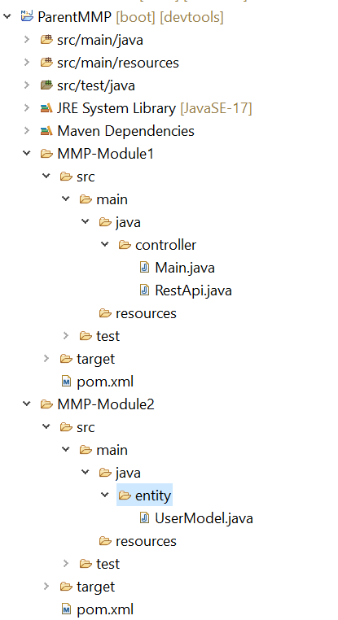
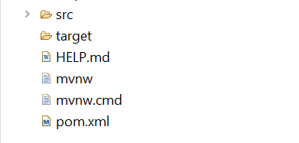
Demo
Let’s create project architecture like this:
A Parent Module (Packaging: pom)
2 Child Modules (Packaging: jar/war)

Slide 11
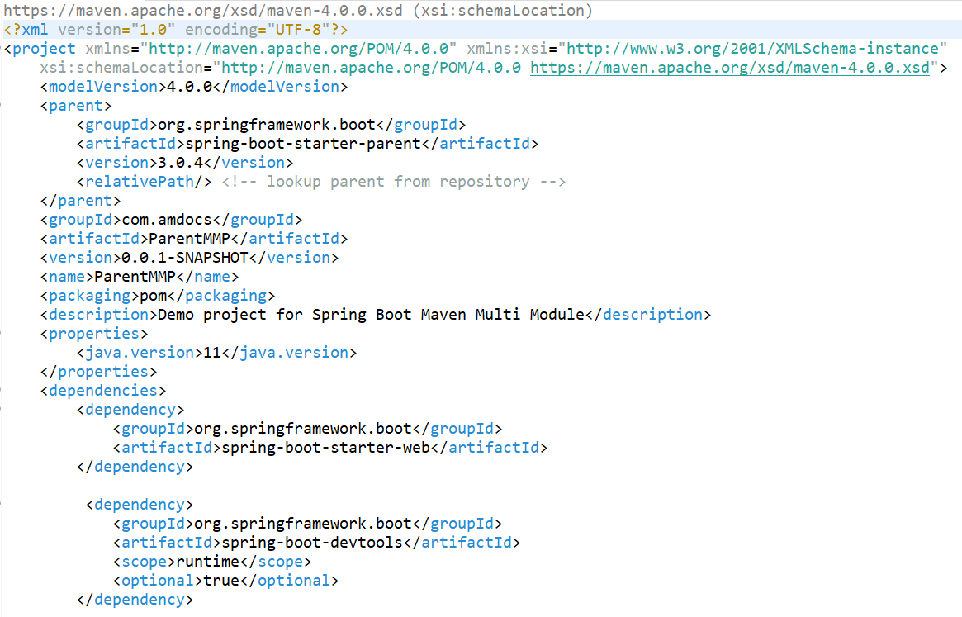
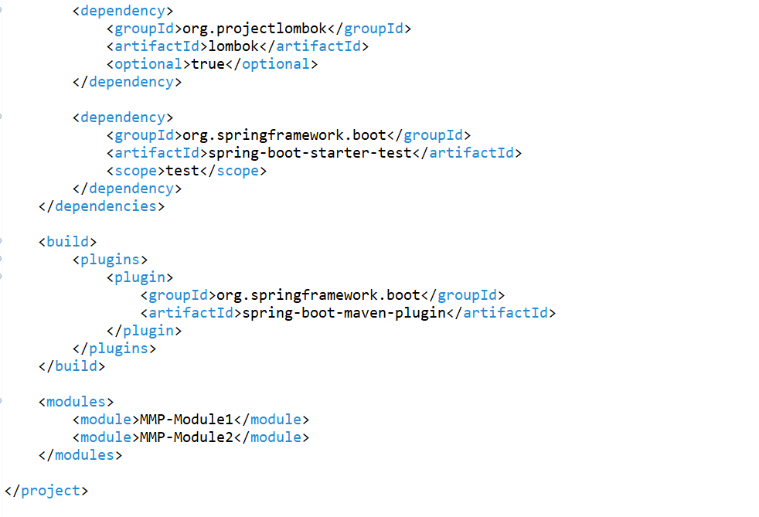
ParentMMP – Parent Module
pom.xml (Configurations)

Slide 12
Points to note
After creating Spring Starter Project with a jar or war packaging, make sure that you add or change the ‘packaging’ tag with ‘pom’ -> ‘<packaging>pom</packaging>’.
When you will create sub-modules, the ‘modules’ tag will automatically get generated with added respective modules.
You can also remove the ‘src’ folder from Parent Module after implementing the main() method in any of the sub-module, as the Parent Module can also act just like a container.

Slide 13
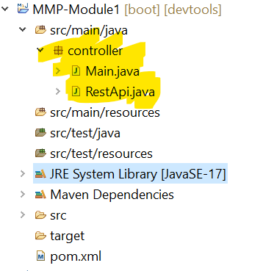
MMP-Module1 – Submodule (1)
Project Structure

Slide 14
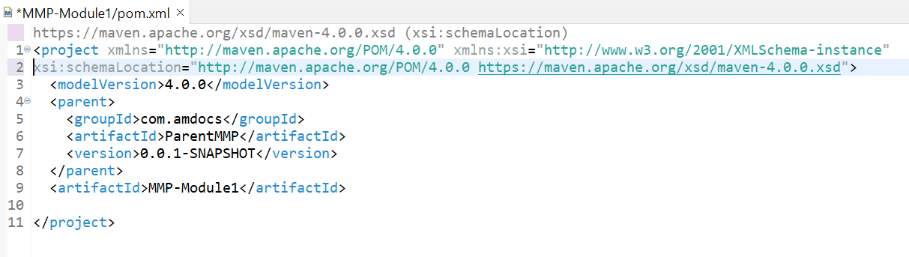
MMP-Module1 – Submodule (1)
pom.xml (Configurations)
Declares a parent module of which this sub-module will be a part.
Information tags of this sub-module are also initialized as well.

Slide 15
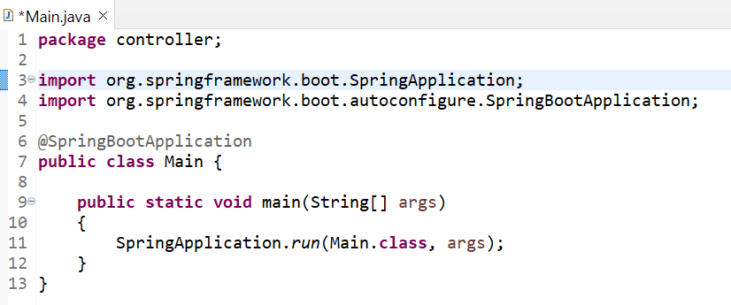
Main.java (Bootstrapping of the Application)

Slide 16
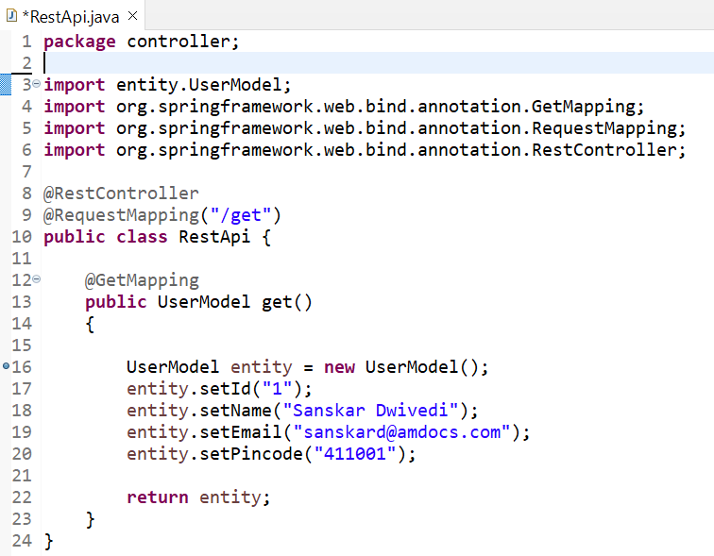
RestApi.java (Endpoint of the Application)
This class uses ‘Starter Web’ dependency which is automatically inherited from the parent module’s pom.xml.
This controller class accepts HTTP requests.
Here, the HTTP GET request is accepted by get() method.
This method uses an entity class that is created and declared in a sub-module ( GFG-Module2 ).
To import classes etc.… from different modules, you have to hover on the red error underline.
Click -> ‘fix project setup’ and select the respective sub-module where you have created the class in.

Slide 17
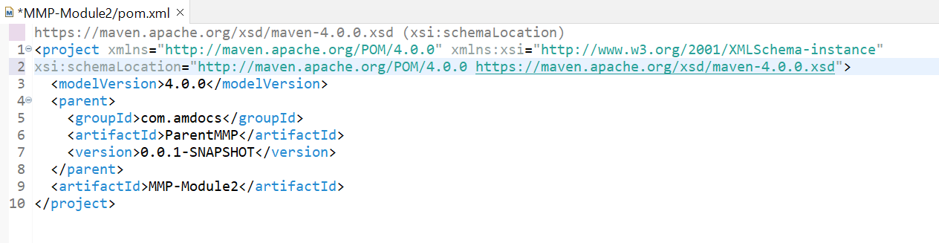
MMP-Module2 – Submodule (2)
pom.xml (Configurations)

Slide 18
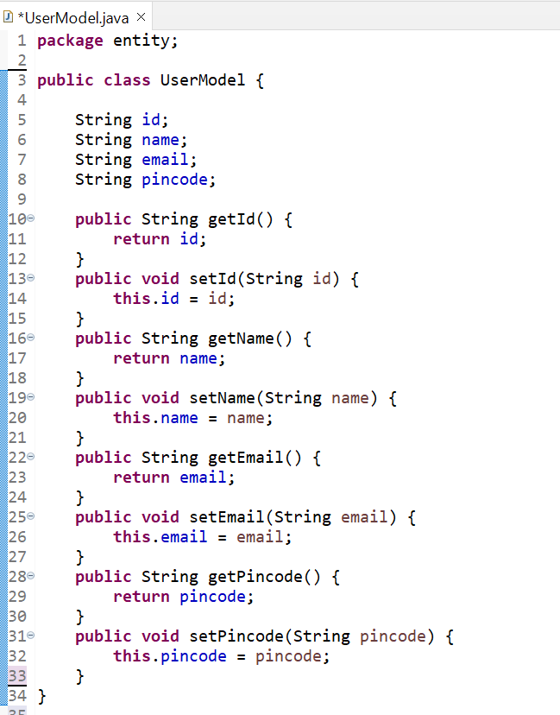
UserModel.java (User data entity class)
This class represents a user entity class, which has been used by the get() method of the RestApi.java class.
This class requires an important set of Getter and Setter methods of all instance variables fields.

Slide 19
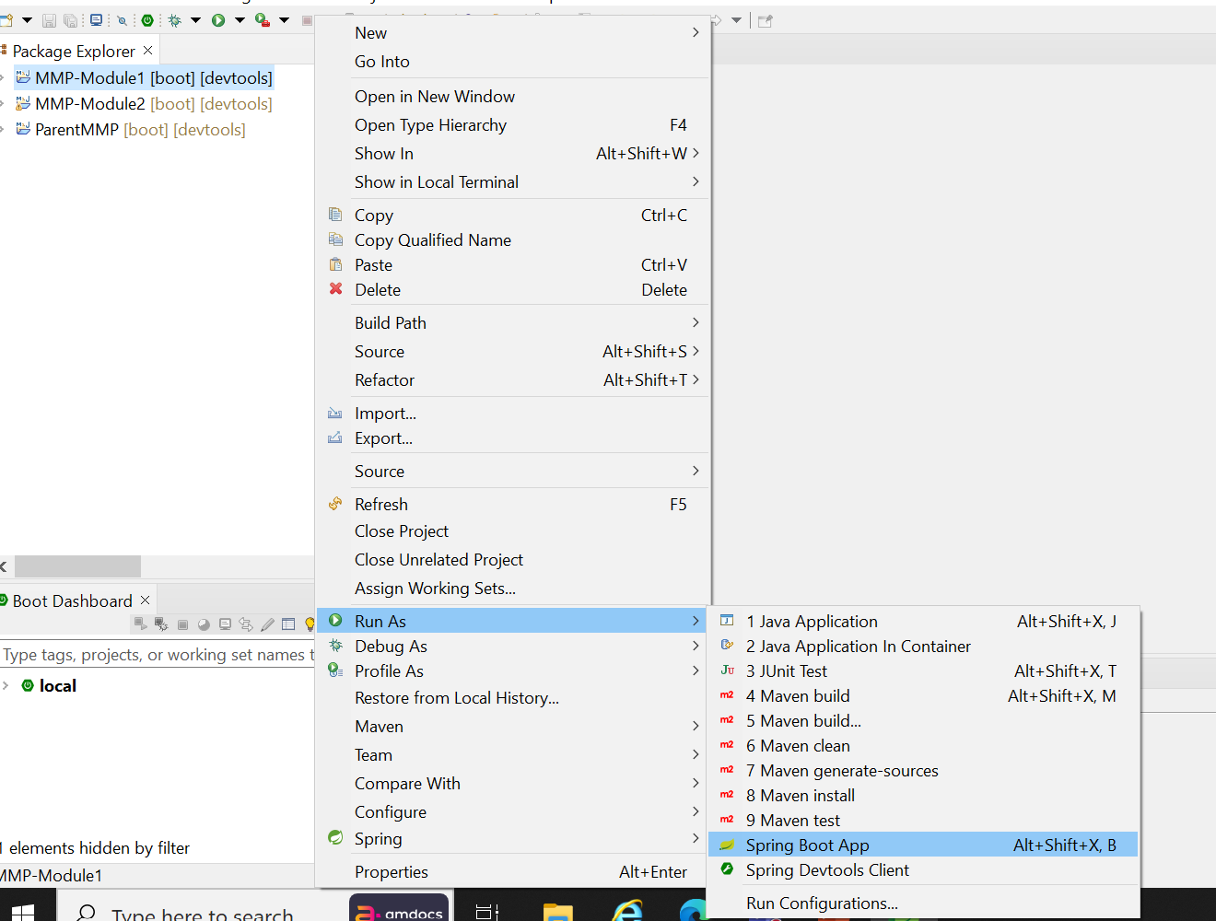
Running the Project
You will have to run the MMP-Module1 as the main() method and the controller class is in this sub-module.
Right Click on module -> Run As -> Spring Boot App

Slide 20
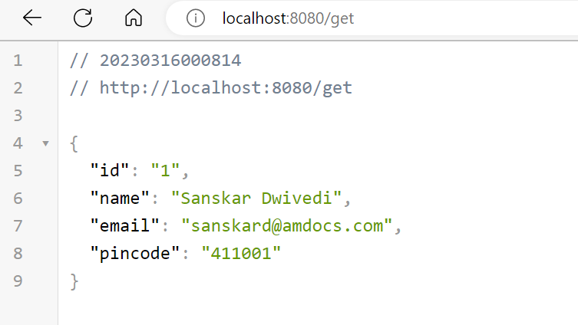
Output From calling RestApi.java of MMP-Module1
MMP-Module2 (sub-module) declares an entity (Data) object.
This data is used in the body of the response which is returned by the RESTful API of MMP-Module1 ( sub-module ).
Default JSON body output ( UserModel object ) from @RestController

