Slide 1
Production: Do’s & Don’ts
- Sanskar Dwivedi | Software Developer | SmartOps CALA

Slide 2
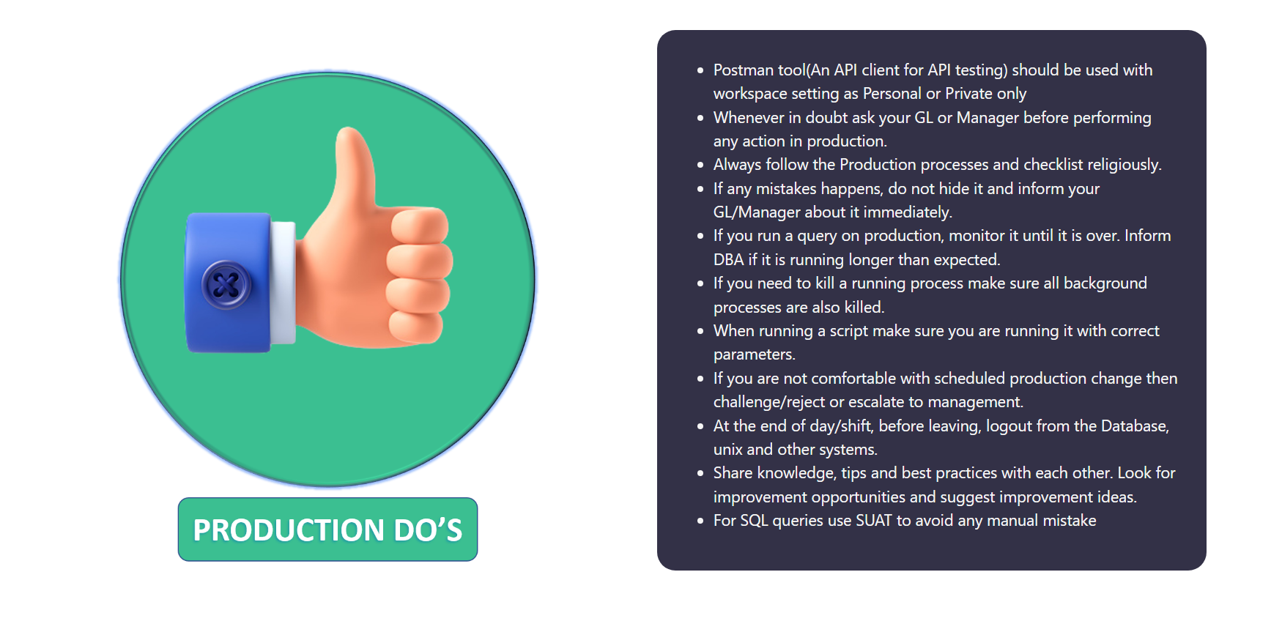

Slide 3
