Slide 1
WAITING ROOM
A clinic appointment system, shipped through a complete DevOps pipeline
BOOKED
CHECKED IN
IN CONSULTATION
DONE
Mrinmay Dev Sarma
DevOps · Instructor: Nensi Ravaliya
Notes:
Welcome. Waiting Room is a clinic front-desk system: reception books patients, checks them in, and a live board shows the queue. I built the app and then took it through the full DevOps path: tests, Docker, CI with a security scan, Terraform on AWS, Kubernetes with Helm, and monitoring. The four pills show the life of every appointment.

Slide 2
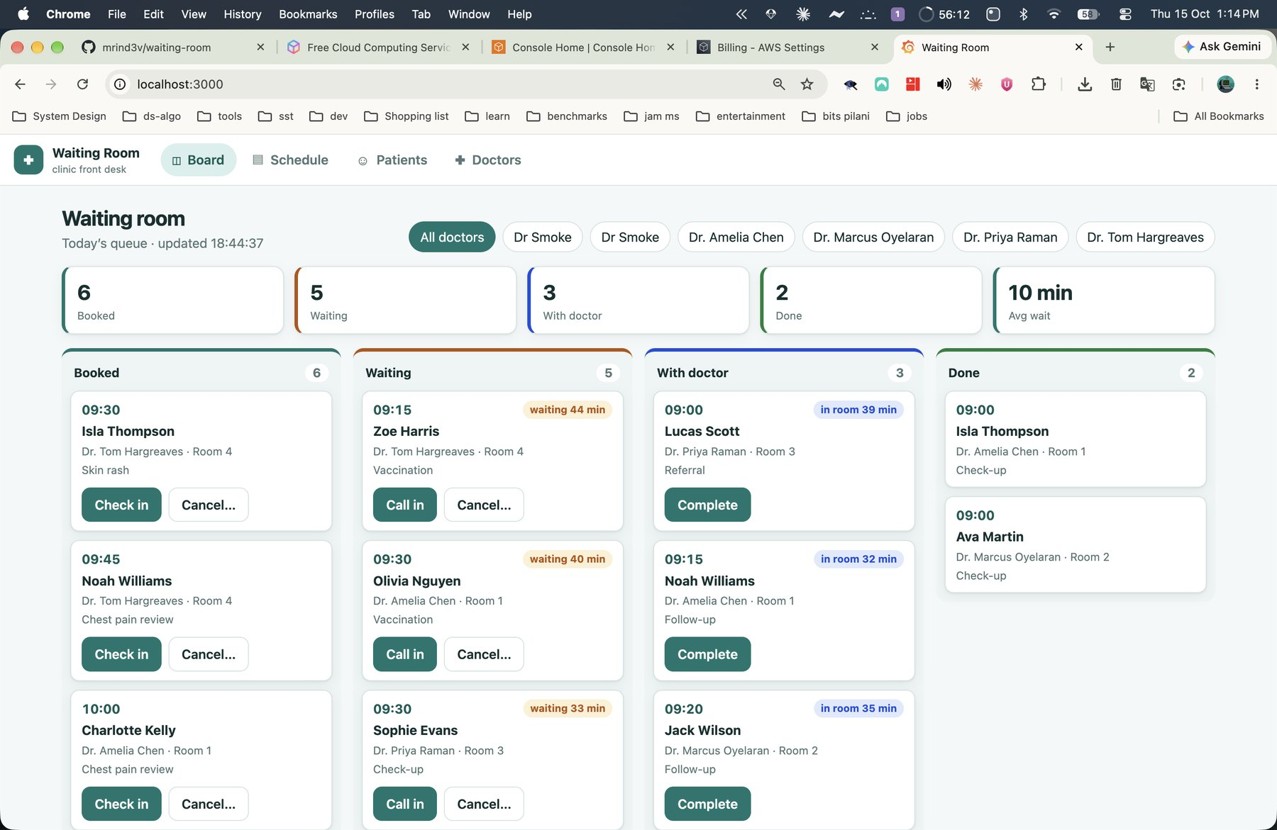
One desk. One live queue. Zero double bookings
Books appointments by doctor and time slot
Checks in patients the moment they arrive
Shows who waits, who sees a doctor, and for how long
Blocks double bookings inside the database
The live queue board
Notes:
Explain the product in one minute. Reception books slots per doctor, checks patients in, and the board shows who waits, who sits with a doctor, and for how long. The database itself refuses overlapping bookings.

Slide 3
The project in numbers
16
36
6
REST endpoints, plus health, ready and metrics
tests pass at 97% coverage
CI/CD jobs run on every push
50
$0.26
0
AWS resources: created and destroyed by Terraform
per hour for the whole AWS stack
secrets committed to Git
Notes:
A quick scorecard. Everything here is real and visible in the repository and in the screenshots that follow.

Slide 4
How it all fits together
Developer pushes to GitHub
GitHub Actions: test, scan, build
GHCR: images tagged by SHA
Helm deploy to EKS
AWS · ap-southeast-2 · built by Terraform · VPC + EKS
Frontend: nginx ×2
Prometheus
Grafana
Browser
NLB + Traefik Ingress
scrapes /metrics
Backend: FastAPI ×2–5
PostgreSQL + gp3 volume
Notes:
Walk left to right along the top: a developer pushes, GitHub Actions tests and scans, GHCR stores images tagged by commit SHA, and Helm deploys. Inside AWS, a browser reaches one load balancer. Traefik routes slash to the React frontend and slash api to FastAPI. The backend stores data in PostgreSQL. Prometheus scrapes the backend and Grafana draws the charts. Terraform builds the whole AWS box.

Slide 5
The application
01
FastAPI, React and PostgreSQL, built around one hard rule: never double-book a doctor
Notes:
Part one covers what I built: the screens, the lifecycle of an appointment, the database rule that prevents double booking, and the API.

Slide 6

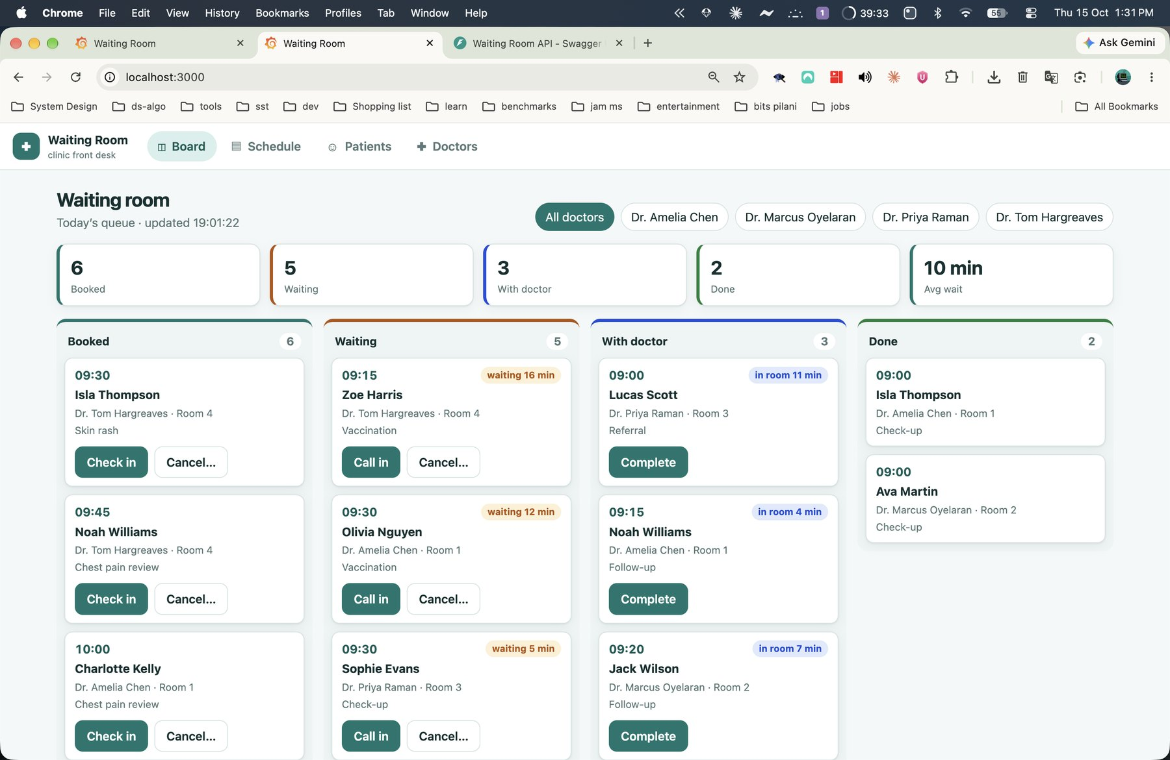



Four screens run the front desk
Board
Four live columns with waiting timers and KPIs
Schedule
Each doctor's day. Click a free slot to book
Patients
Search, register, edit and delete
Doctors
Specialty, room, hours and slot length
The Board, served from Docker Compose
Notes:
The Board is the centrepiece. Schedule builds each doctor's day from working hours and slot length. Patients and Doctors hold the reference data.

Slide 7
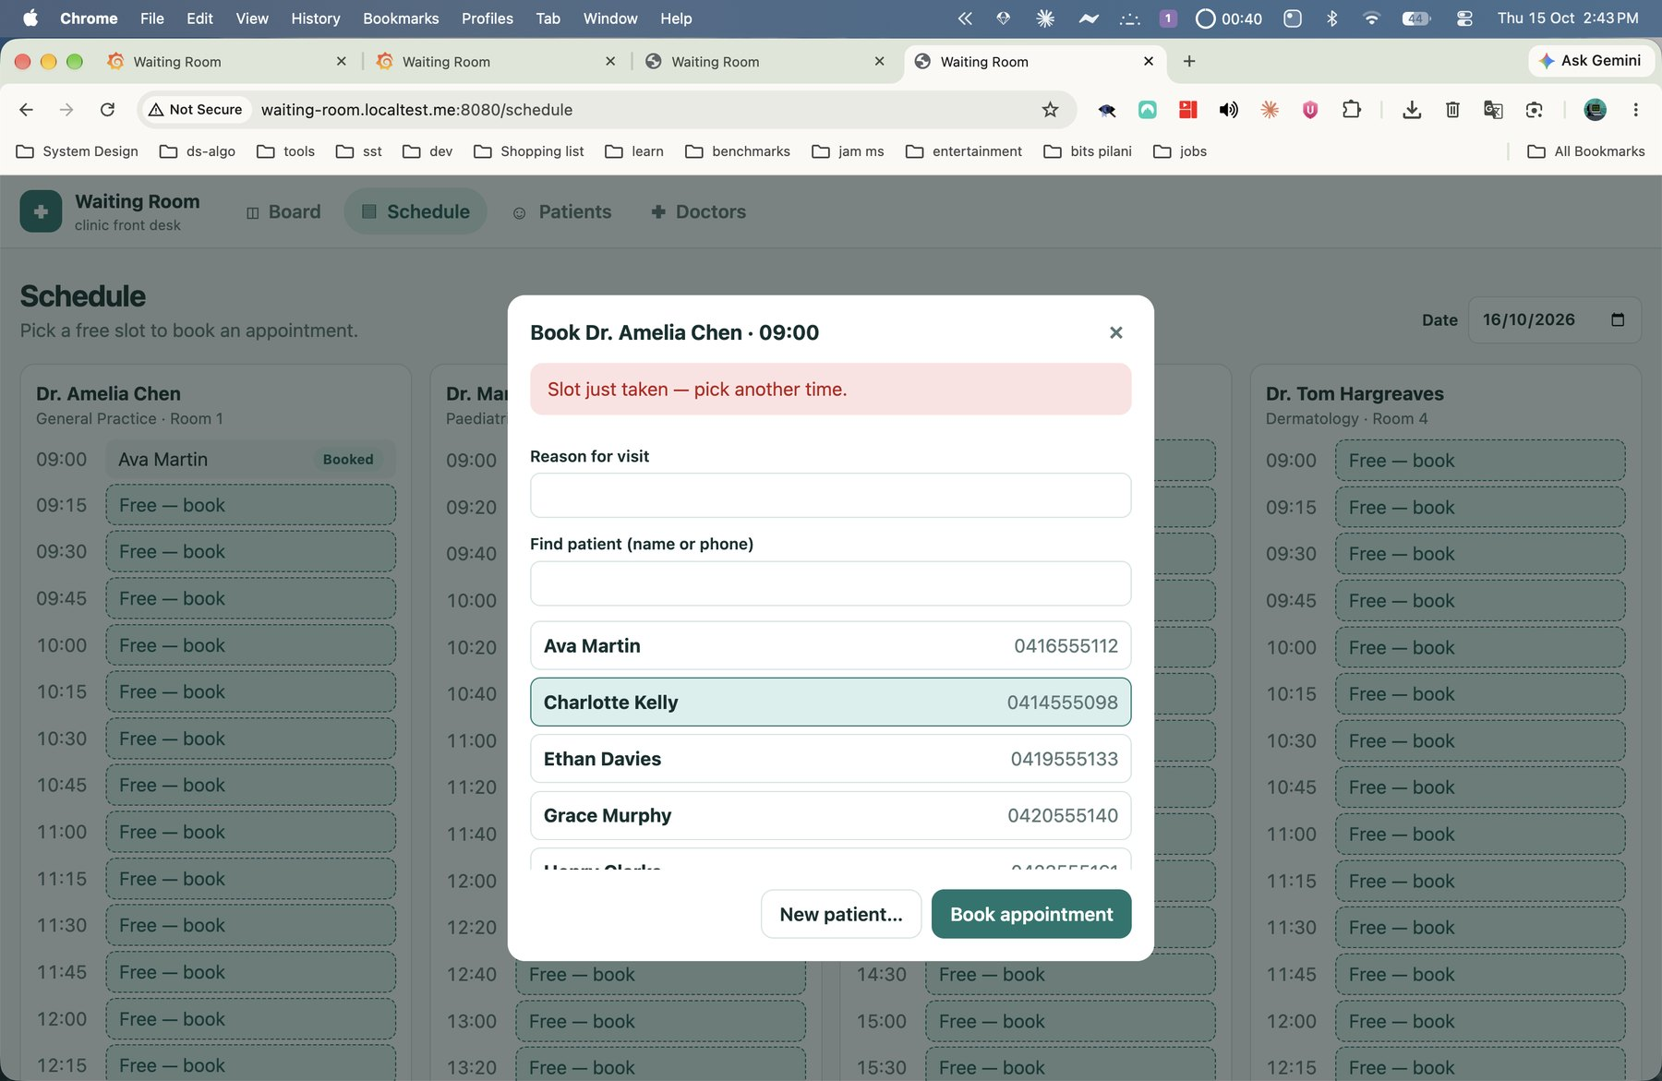
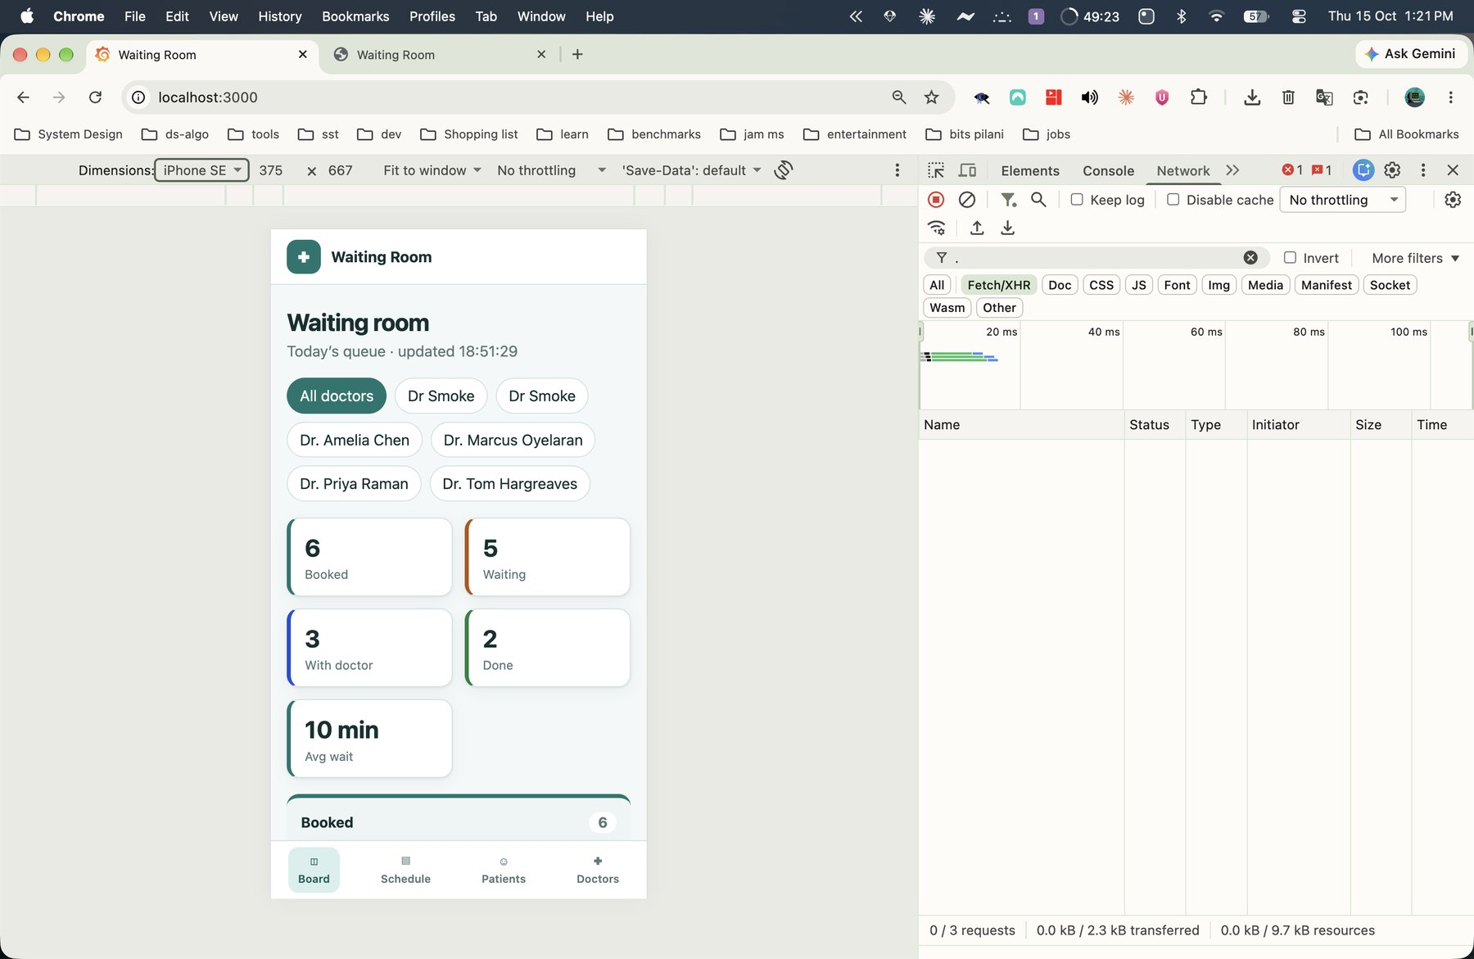
Users see conflicts instantly, on any screen size
A taken slot shows an inline error, not a crash
The layout adapts down to 375 px
Notes:
When two receptionists click the same slot, the second sees a clear message instead of a crash. The layout also works down to a 375 pixel phone width, with a bottom tab bar.

Slide 8



Every appointment follows one lifecycle
BOOKED
CHECKED IN
IN CONSULTATION
DONE
CANCELLED
Illegal moves return 409 and list the allowed next steps
Each move stamps a time, so the board shows live waiting
Cancelling frees the slot for the next patient
Notes:
Statuses move forward only. The transition table lives in one file, so the API, the board and the tests all agree. Every move stamps a timestamp, which lets the dashboard compute the average wait. Cancelling is allowed only before the consultation starts and frees the slot.

Slide 9
PostgreSQL blocks double bookings, not the app
EXCLUDE USING gist (
doctor_id WITH =,
tstzrange(starts_at, ends_at, '[)')
WITH &&
) WHERE (status <> 'CANCELLED')
Atomic: the database decides, so two clicks in the same millisecond cannot both win
Precise: partial overlaps fail, back-to-back slots pass
Self-healing: cancelling frees the slot at once
The proof: a concurrency test fires two bookings at once. One request returns 201 and the other returns 409 SLOT_TAKEN.
Notes:
A check-then-insert in Python has a race: two requests can both pass the check. A PostgreSQL exclusion constraint closes it, because the database checks atomically. Half-open ranges allow back-to-back slots. Cancelled rows are excluded, so cancelling frees the slot. My test starts two bookings at the same instant and asserts exactly one wins.

Slide 10
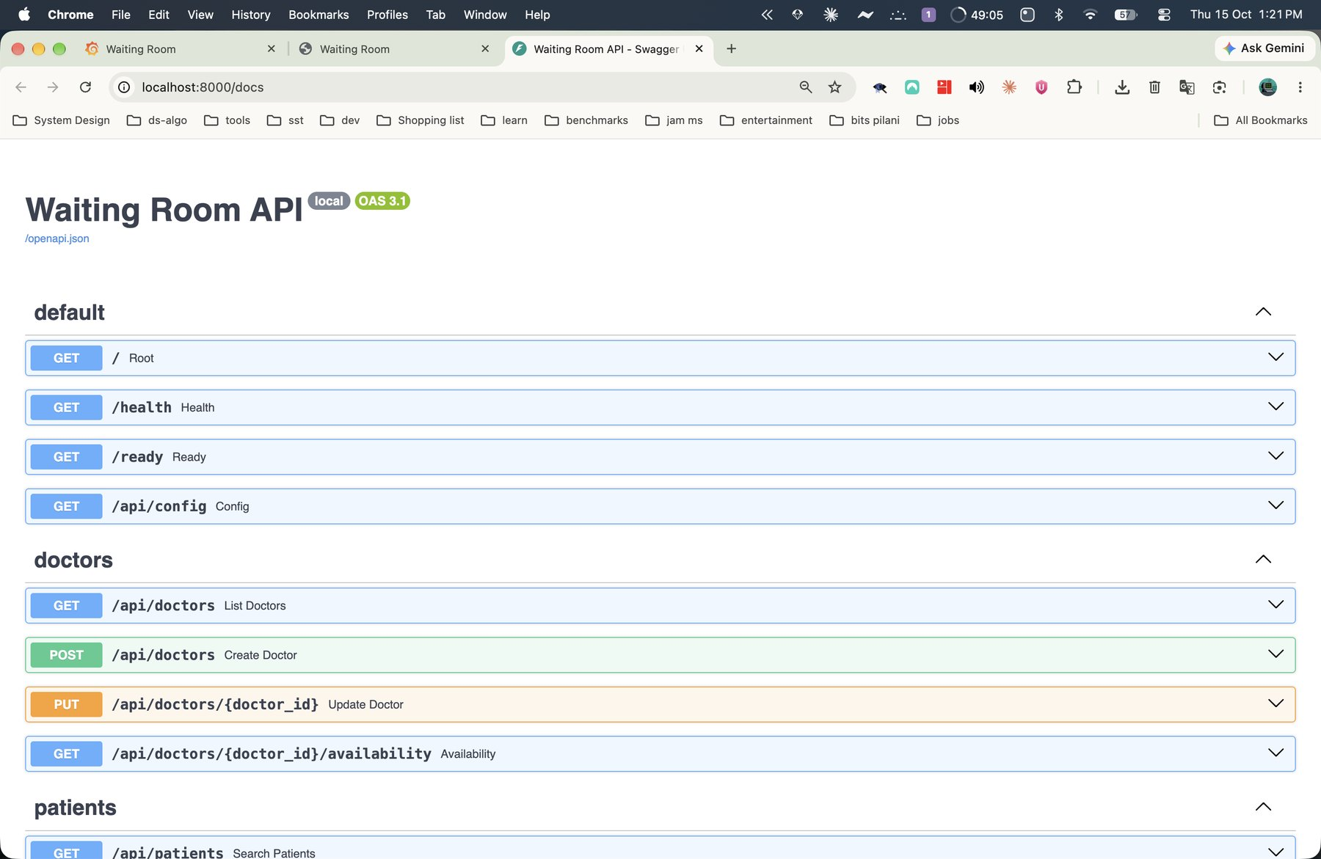
Sixteen endpoints plus three ops probes
Doctors
list · create · update · availability
Patients
search · detail · create · update · delete
Appointments
list · detail · book · reschedule · status · delete
Dashboard
today: counts, average wait, next up
Ops
/health · /ready · /metrics
Swagger documents every route at /docs
Notes:
The API groups into doctors, patients, appointments and a dashboard. Every error uses one JSON shape with a code. Health is cheap liveness, ready checks the database and the migration version, and metrics feeds Prometheus. Swagger documents everything automatically.

Slide 11
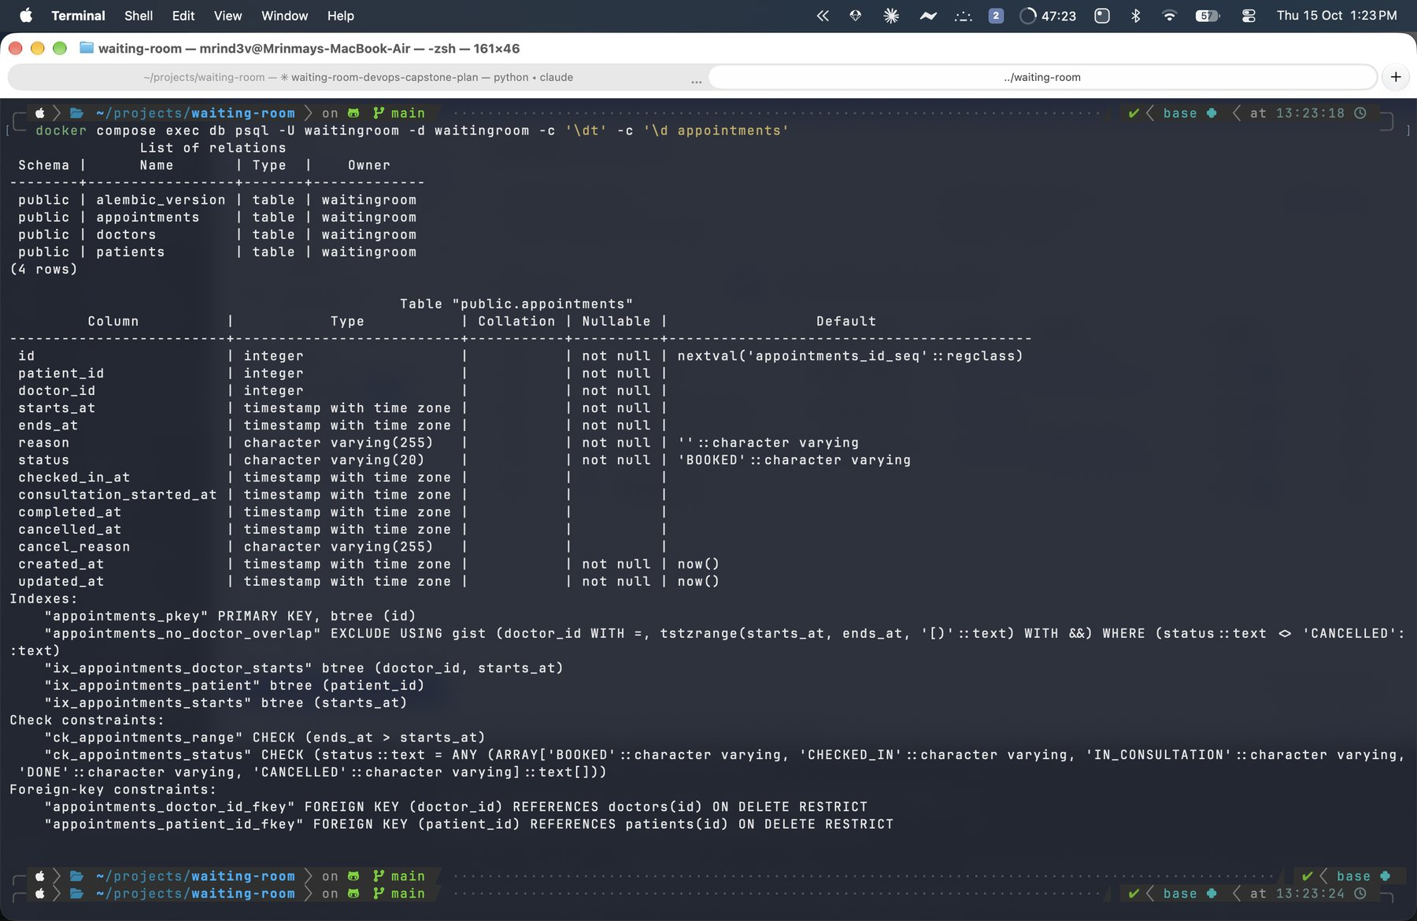
Alembic owns the schema
Two migrations create doctors, patients and appointments
Migrations only: the app never calls create_all
Advisory lock: concurrent pods migrate one at a time
Readiness: /ready returns 503 until the schema reaches head
Tables and the exclusion constraint in psql
Notes:
Two reversible migrations create the three tables. The application never calls create_all, so the database matches the migrations exactly. A Postgres advisory lock lets several pods start at once without racing. The ready endpoint reports 503 until the schema reaches the latest revision.

Slide 12
Quality and containers
02
Tests prove the rules. Docker makes the app run the same everywhere
Notes:
Part two covers the safety net: the automated tests and the container images.

Slide 13
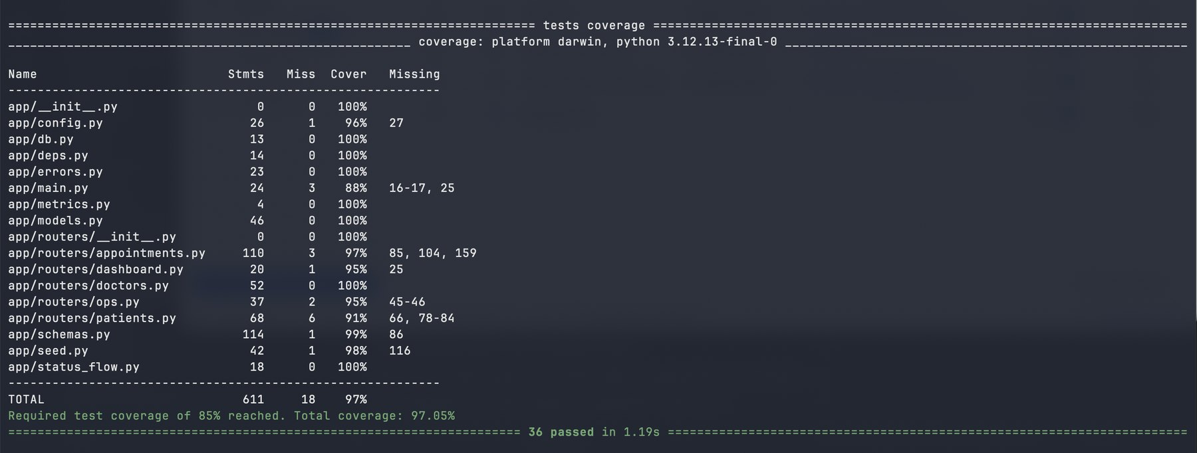
36 tests prove the rules
36
97%
tests pass
code coverage
Real PostgreSQL: the test database enforces the constraint
Frozen clock: time rules never flake
Race test: two threads, one winner
pytest -v with the coverage report
Notes:
The suite runs against a real PostgreSQL test database, not SQLite, because the exclusion constraint only exists in Postgres. A guard refuses to run unless the database name ends in _test. A frozen clock makes time rules deterministic. The coverage threshold of 85 percent fails the run if it drops.

Slide 14
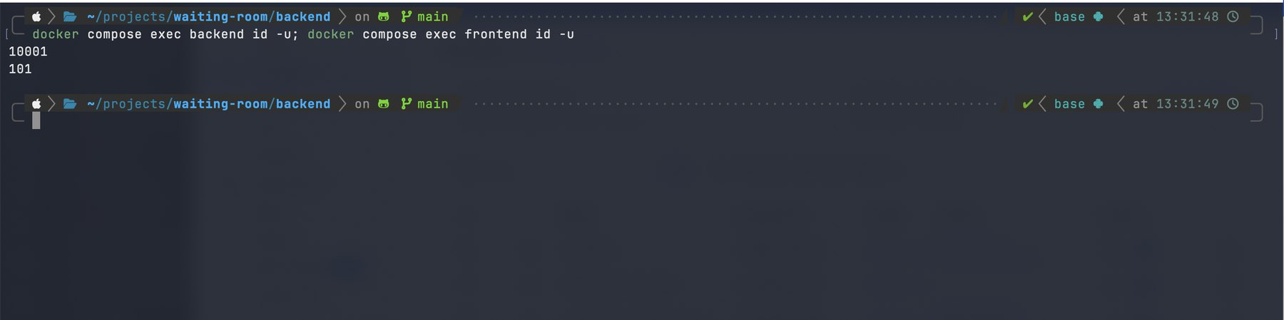



Docker images run as non-root
Multi-stage builds
Digest-pinned bases
Non-root users
Node builds. nginx serves. No build tools ship
Every build uses the same image bytes
uid 10001 for the API, uid 101 for nginx
Notes:
Both images use multi-stage builds. The frontend builds with Node and runs on nginx-unprivileged. The backend runs as user 10001 and the frontend as user 101. Base images are pinned by digest, so builds repeat exactly.

Slide 15
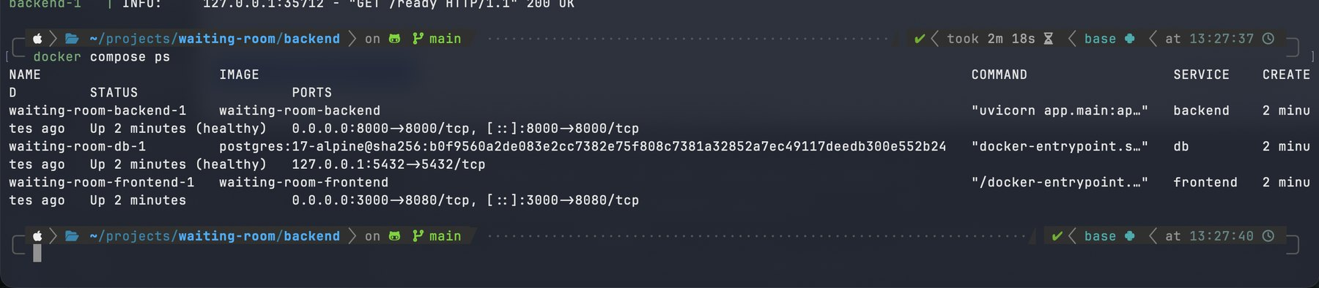
One command starts the whole stack
db → migrate → backend → frontend: each step waits for the previous one to be healthy
Secrets come from an ignored .env file, never from Git
Postgres listens on localhost only
Notes:
docker compose up starts four containers in order. The database must be healthy before the migration job runs, and the migration must finish before the backend starts. The frontend waits for a ready backend. Passwords come from an ignored .env file.

Slide 16
The pipeline
03
Every push to main is tested, scanned, built, published and deployed
Notes:
Part three covers GitHub Actions: how code travels from a commit to a running pod, and what stops bad code.

Slide 17



Every push runs six jobs
Backend lint + pytest
Frontend lint + build
Build · Trivy scan · push to GHCR
Deploy with Helm (atomic)
Terraform + Helm validate
On push and PR to main
Tag = full Git SHA, never latest
Deploy only when enabled
Notes:
Three jobs run in parallel as the quality gate: backend tests, frontend build, and Terraform plus Helm validation. If all pass, the build job builds both images, scans them with Trivy, and pushes them tagged with the Git SHA. The deploy job runs only when I enable it for the AWS window, and uses Helm with atomic rollback.

Slide 18
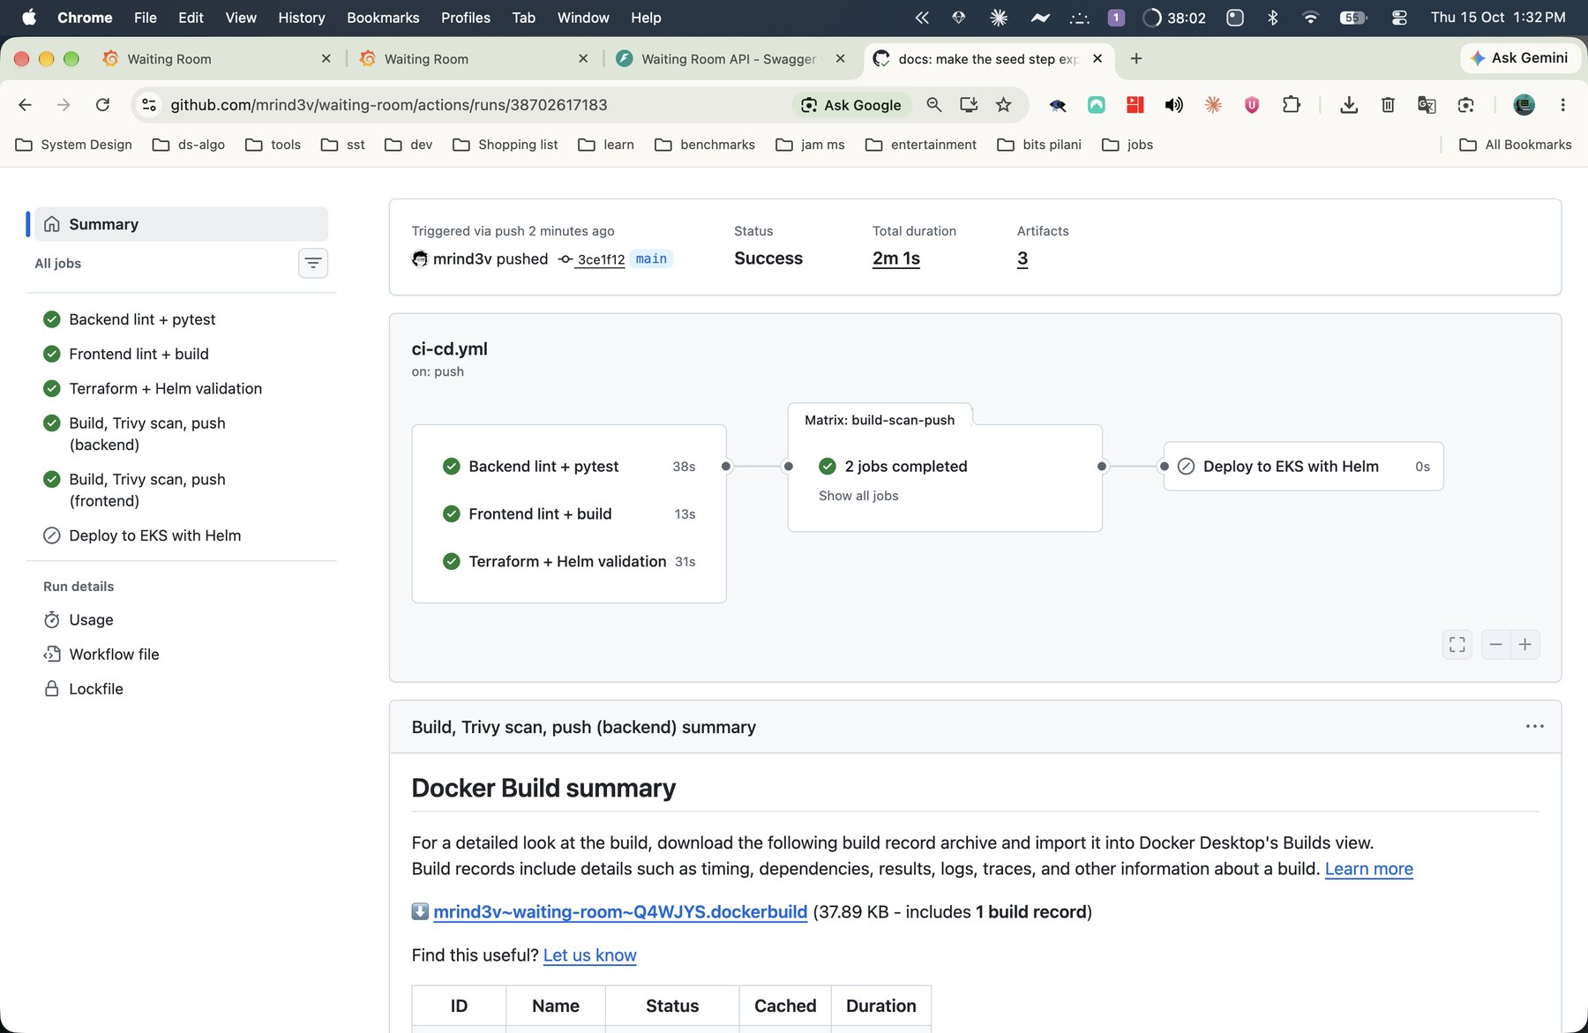
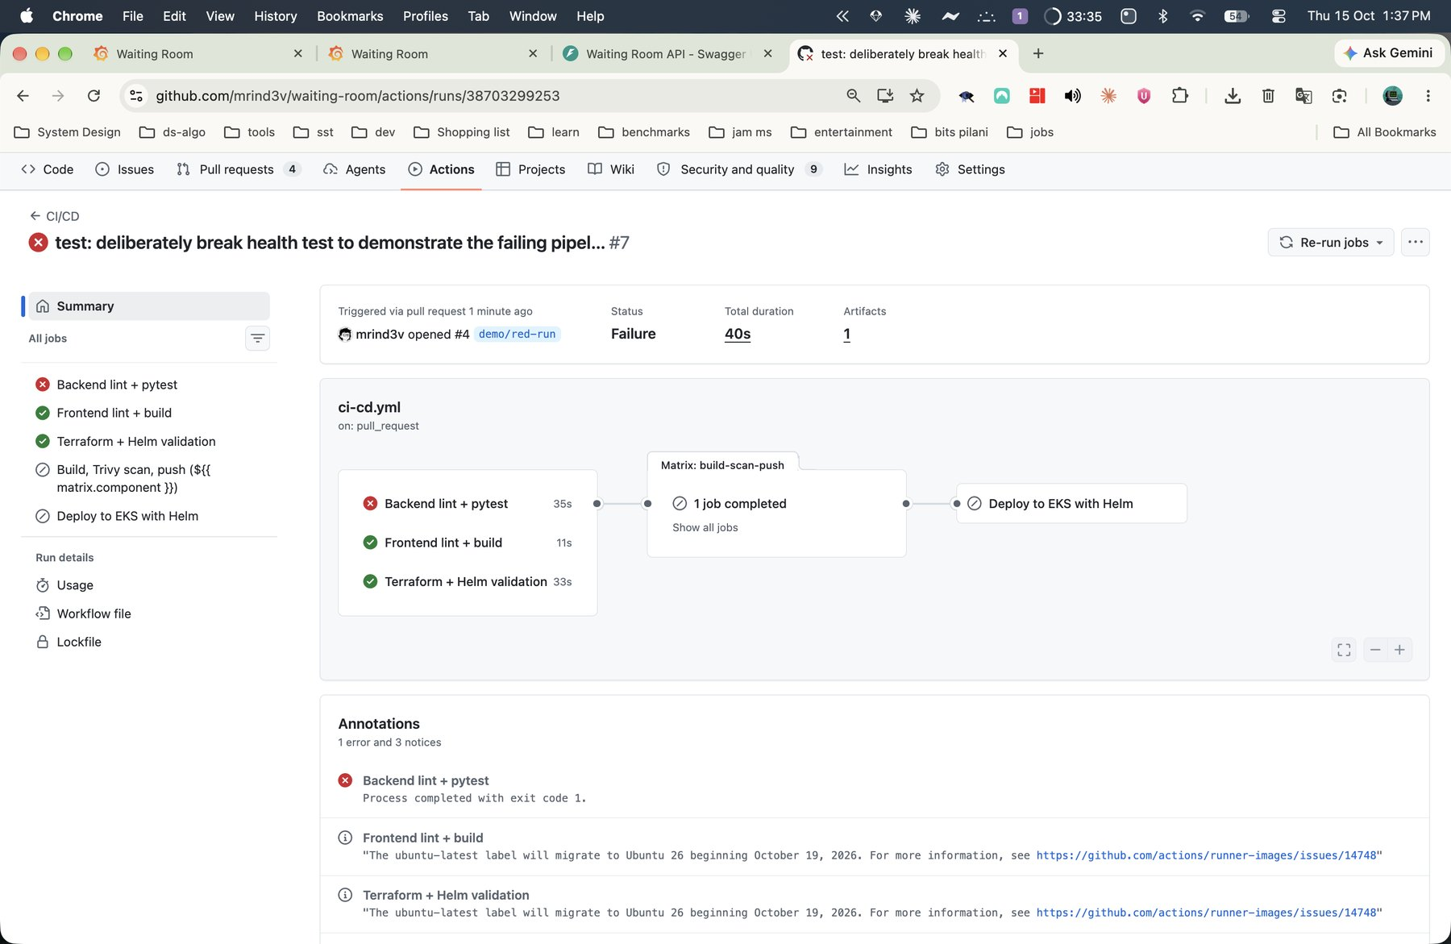
A failing test stops everything
Green: every job passes
Red: one failing test blocks build, scan and deploy
Notes:
On the left, a normal run: every job is green and the deploy runs. On the right, I broke one test on a pull request. The test job fails, so the build, scan and deploy jobs never start. No broken image ships.

Slide 19
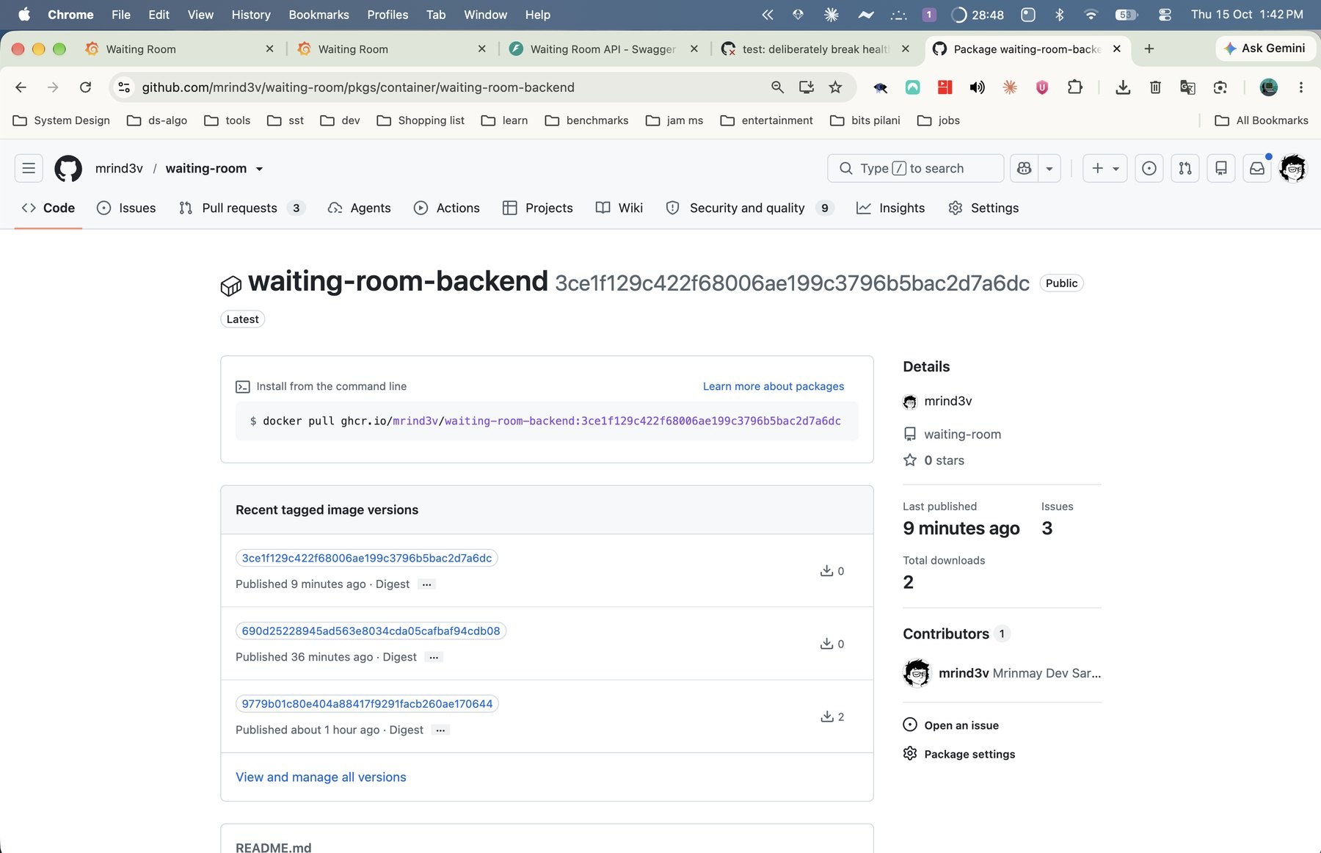
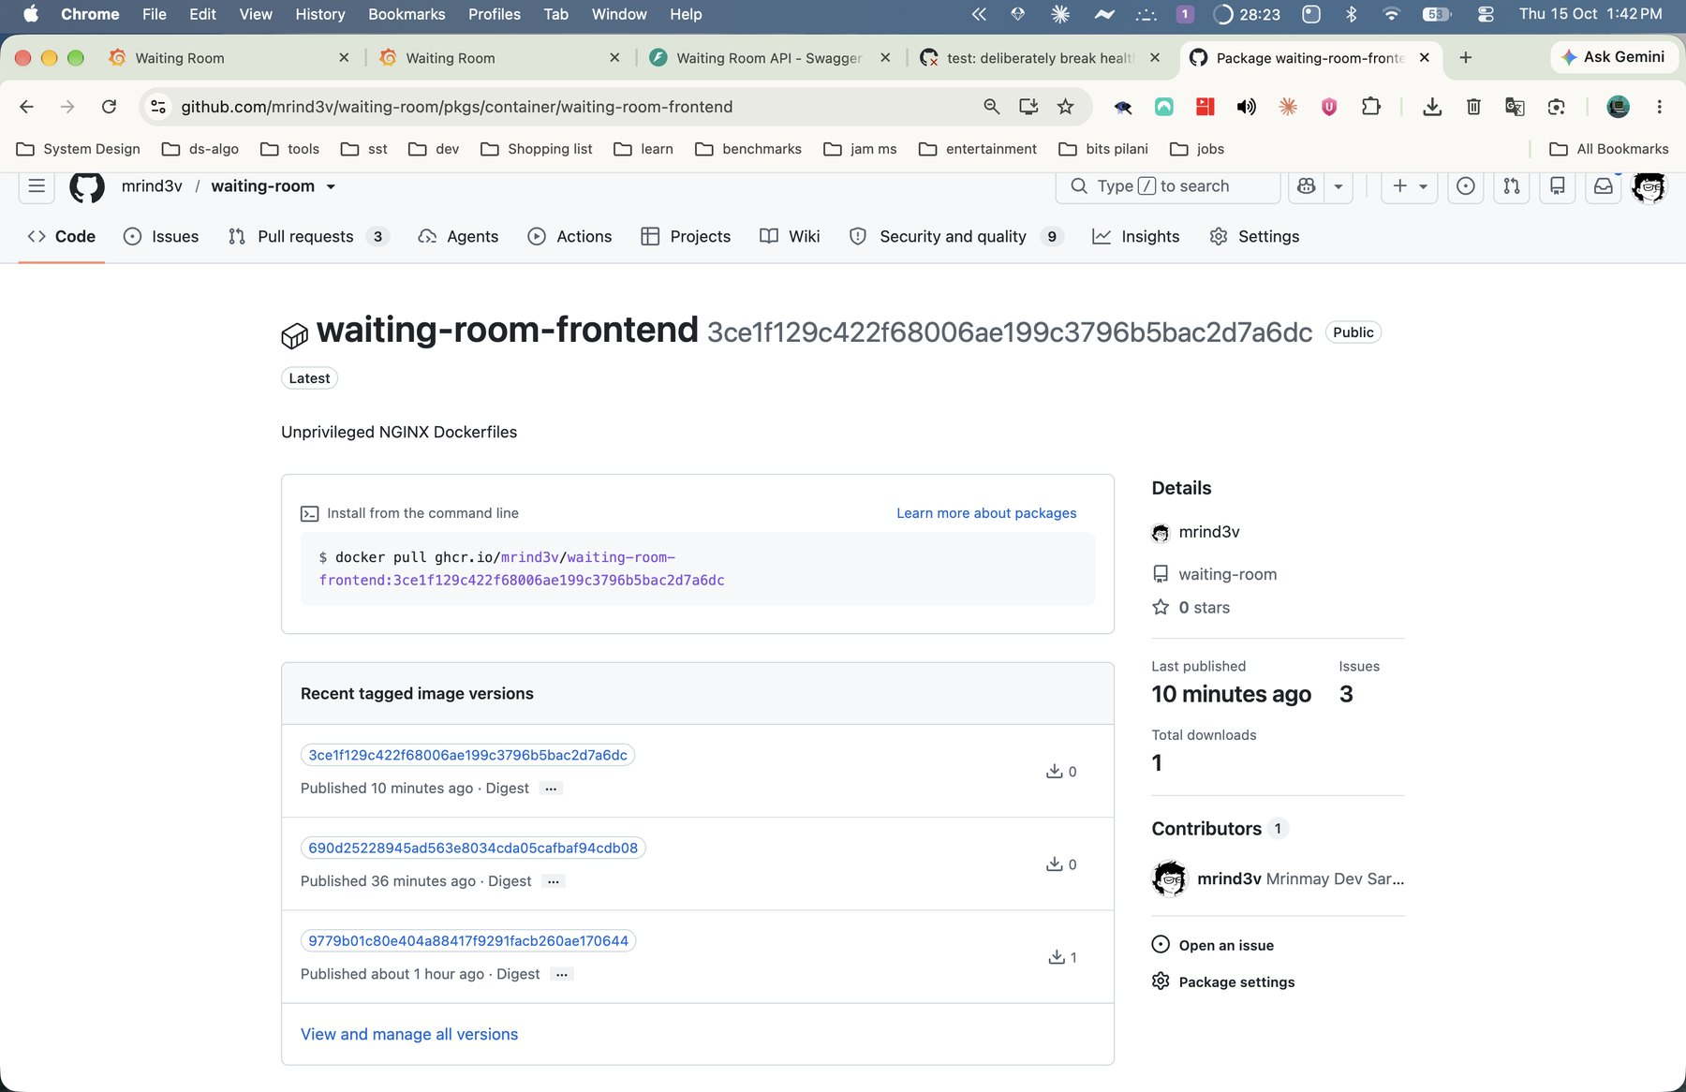
Images ship to GHCR tagged by commit SHA
waiting-room-backend
waiting-room-frontend
Notes:
GitHub Container Registry holds both images. Each tag is the full 40-character commit SHA. That gives traceability from a running pod back to the exact source commit, and makes rollback exact.

Slide 20
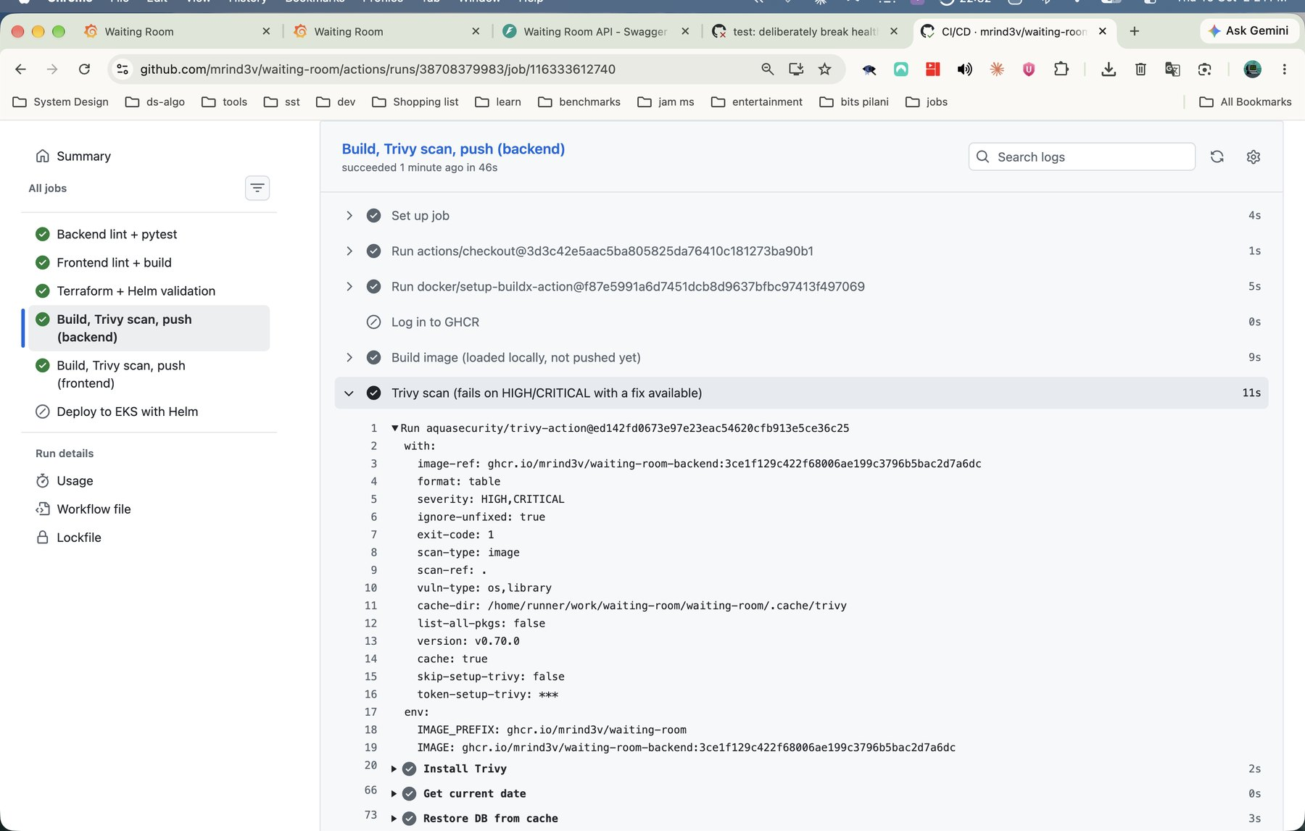
Trivy gates every image
Scans OS packages and dependencies in both images
Fails the build on fixable HIGH or CRITICAL CVEs
Latest result: 0 findings
Publishes a SARIF report to the Security tab
Trivy report from the pipeline run
Notes:
Trivy scans the operating system packages and the dependencies inside each image. The pipeline fails on any HIGH or CRITICAL finding that has a fix available. My latest scan found zero. A clean result means no known fixable vulnerability today, so the scan runs on every push.

Slide 21





Security runs through the whole pipeline
Non-root everywhere
Actions pinned by SHA
No secrets in Git
Containers drop all capabilities and use read-only root filesystems
A 2026 supply-chain attack hit a mutable scanner tag
Passwords are generated in-cluster; .env stays local
Dependabot weekly
Short-lived CI identity
CORS closed by default
Pinned versions and base images stay current
An IAM user that only exists during the AWS window
Same-origin through the proxy; no wildcard
Notes:
Security is layered. Containers run as non-root with read-only filesystems. Every GitHub Action is pinned to a commit SHA, because the Trivy action itself was compromised through mutable tags in March 2026. Secrets never touch Git: the database password is generated inside the cluster, and CI uses a short-lived IAM user.

Slide 22
Infrastructure and Kubernetes
04
Terraform builds AWS. Helm runs the app. Autoscaling and monitoring keep it healthy
Notes:
Part four moves from the pipeline to the platform: Terraform for AWS, then Kubernetes with Helm, autoscaling and monitoring.

Slide 23
The Free plan shaped every AWS decision
Constraint | My decision
Spot instances are blocked | One on-demand m7i-flex.large node
Only a few instance types are allowed | m7i-flex.large: 2 vCPU, 8 GiB
No IAM OIDC provider | EBS CSI uses EKS Pod Identity; CI uses a short-lived IAM user
Every dollar counts | Public subnets, no NAT gateway, no RDS, no KMS key
Old versions cost more | Kubernetes 1.35 on standard support
Notes:
My AWS project sits on the Free plan with managed policies that block certain things. Those limits forced better, cheaper choices. Spot instances are blocked, so I use one on-demand node. IAM OIDC providers are blocked, so the storage driver uses EKS Pod Identity and CI uses a short-lived IAM user. Public subnets and no NAT gateway save about six cents an hour.

Slide 24
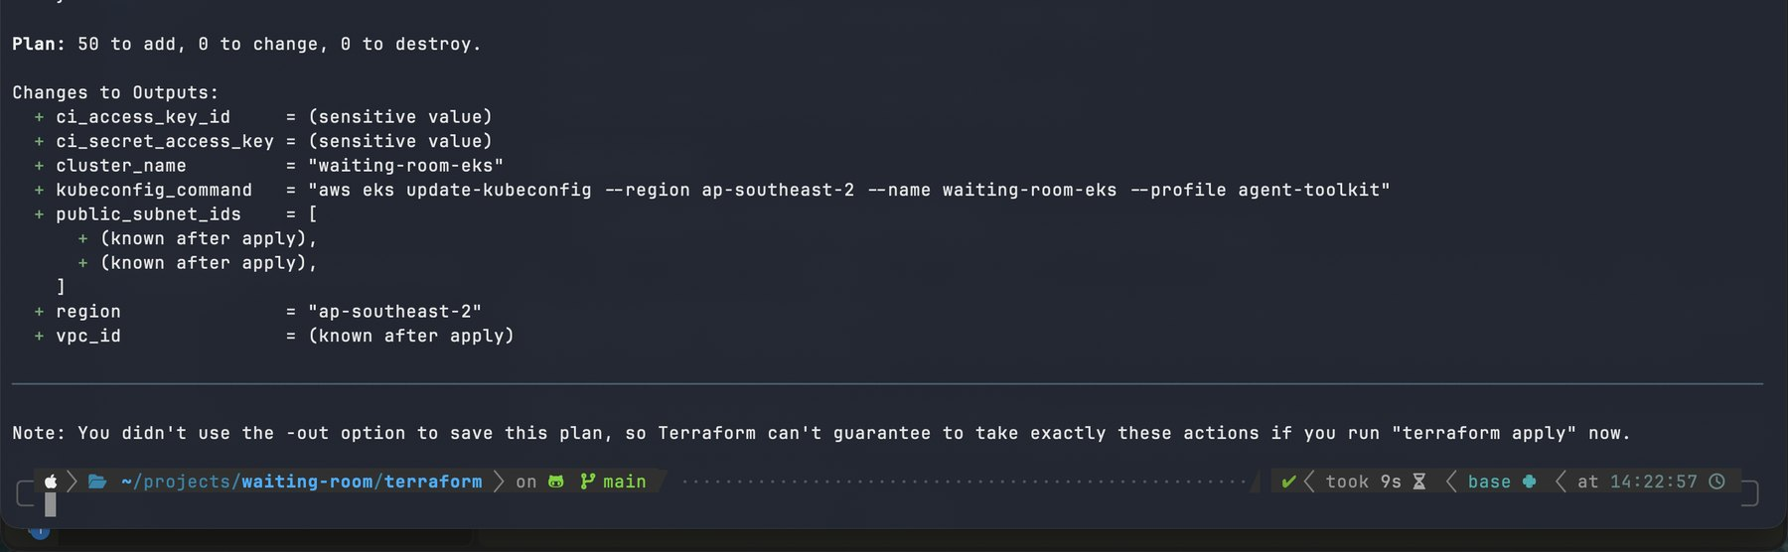
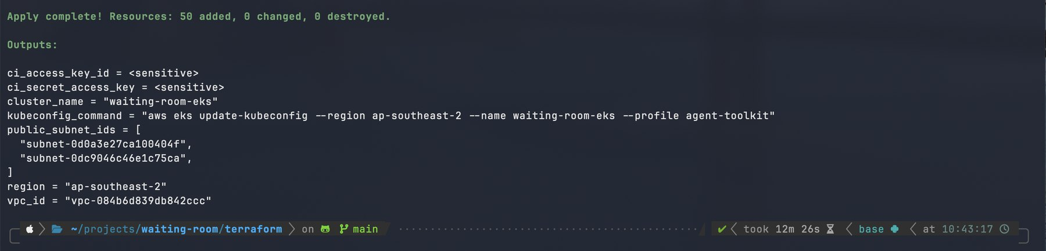
Terraform builds the whole stack from code
50
resources planned and applied
terraform plan: 50 to add, 0 to change, 0 to destroy
12 min
to create the EKS cluster
terraform apply: complete in 12 minutes
Notes:
I always read the plan first: 50 resources to add, none to change or destroy. I audited it for cost traps: no NAT gateway, no Elastic IP, no KMS key, no log group. The apply took twelve minutes, almost all of it the EKS control plane.

Slide 25
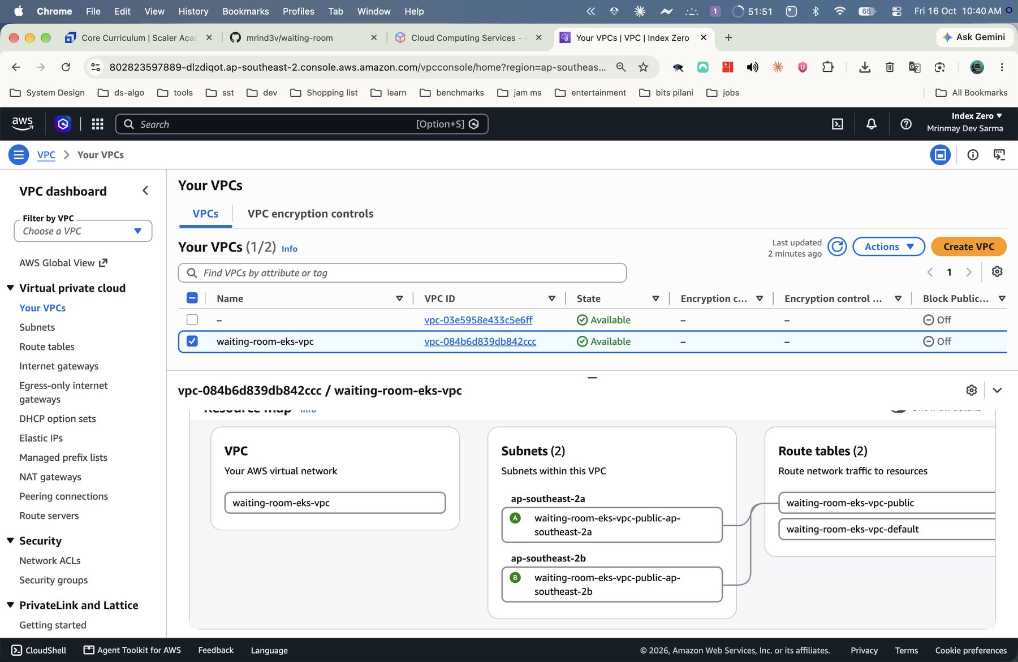
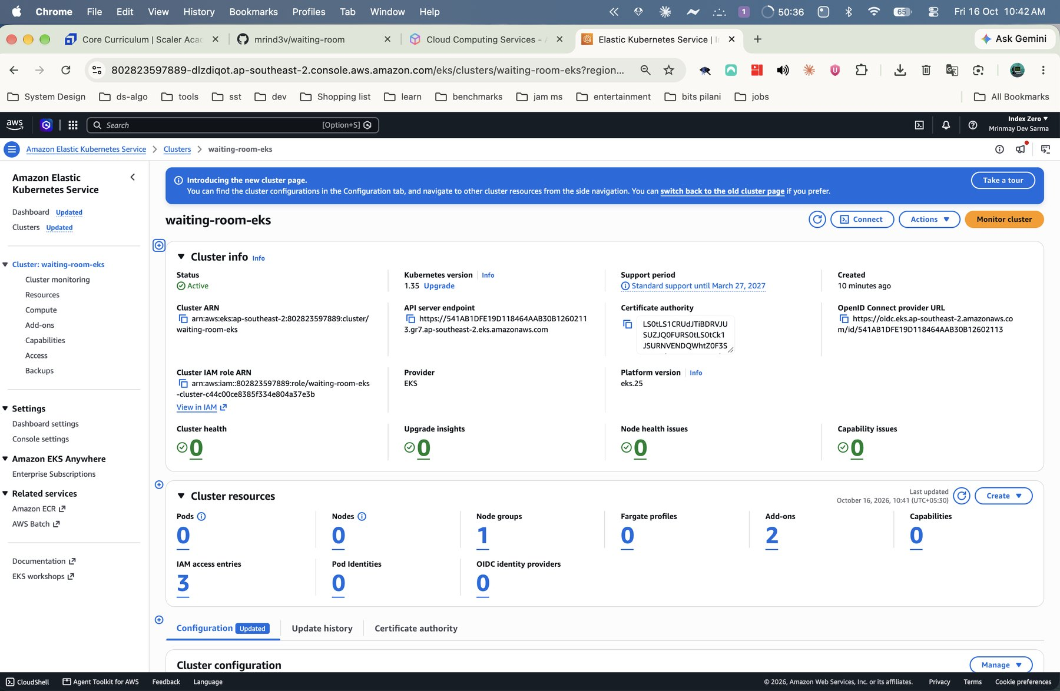
AWS Console confirms the VPC and EKS cluster
VPC with two public subnets
EKS 1.35 cluster, status Active
Notes:
These console views prove the infrastructure exists in the project's Sydney region: the VPC with two public subnets, and the EKS cluster in Active state with one node group.

Slide 26
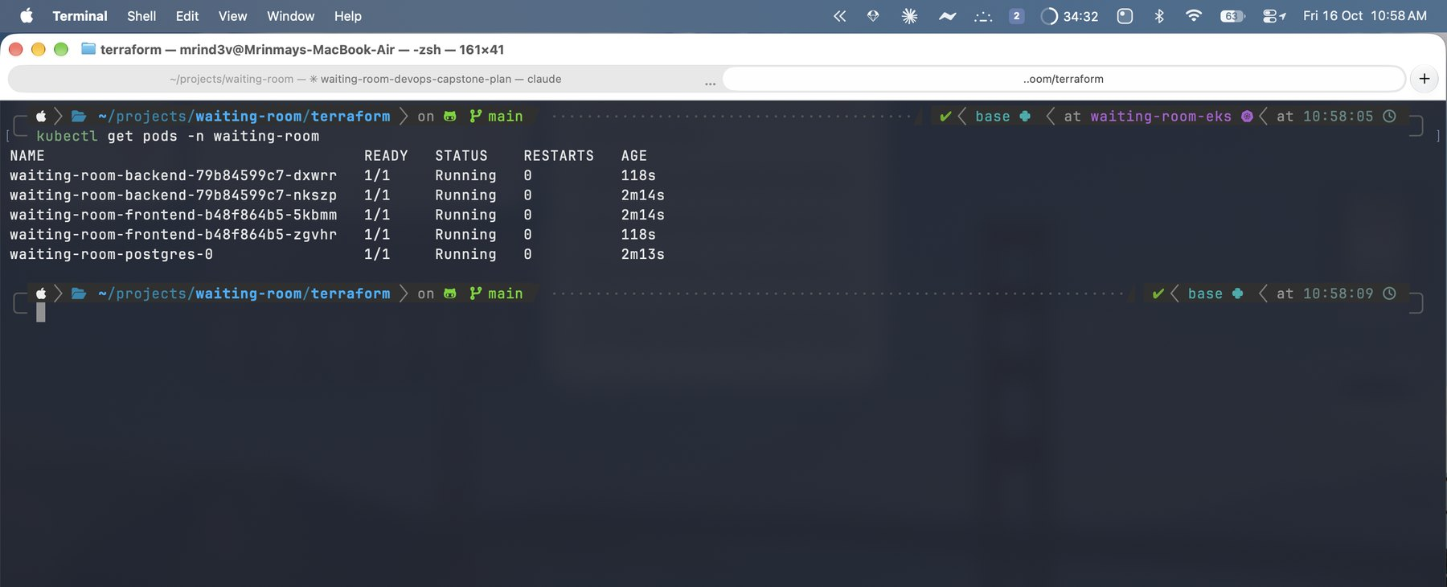
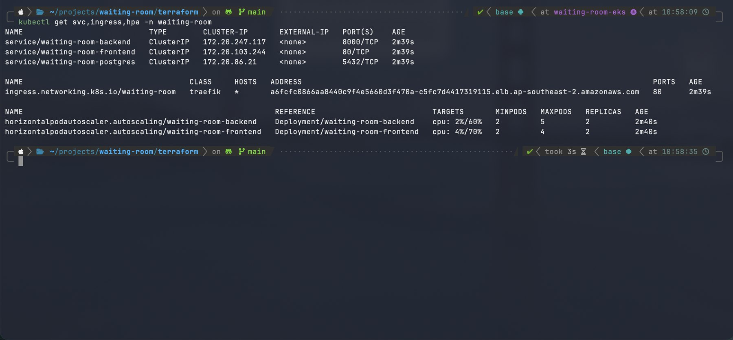
Helm packages the app for Kubernetes
Deployments: 2 backend and 2 frontend pods
StatefulSet: PostgreSQL with a gp3 volume
ClusterIP services plus one Ingress
Hardened pods: read-only filesystems, no capabilities
Autoscaling: CPU-based HPAs
kubectl get pods: everything Running
Notes:
One Helm chart deploys everything. Two backend and two frontend pods, a Postgres StatefulSet with a persistent volume, ClusterIP services, one Ingress, and horizontal pod autoscalers. Every pod runs with a restricted security context.

Slide 27
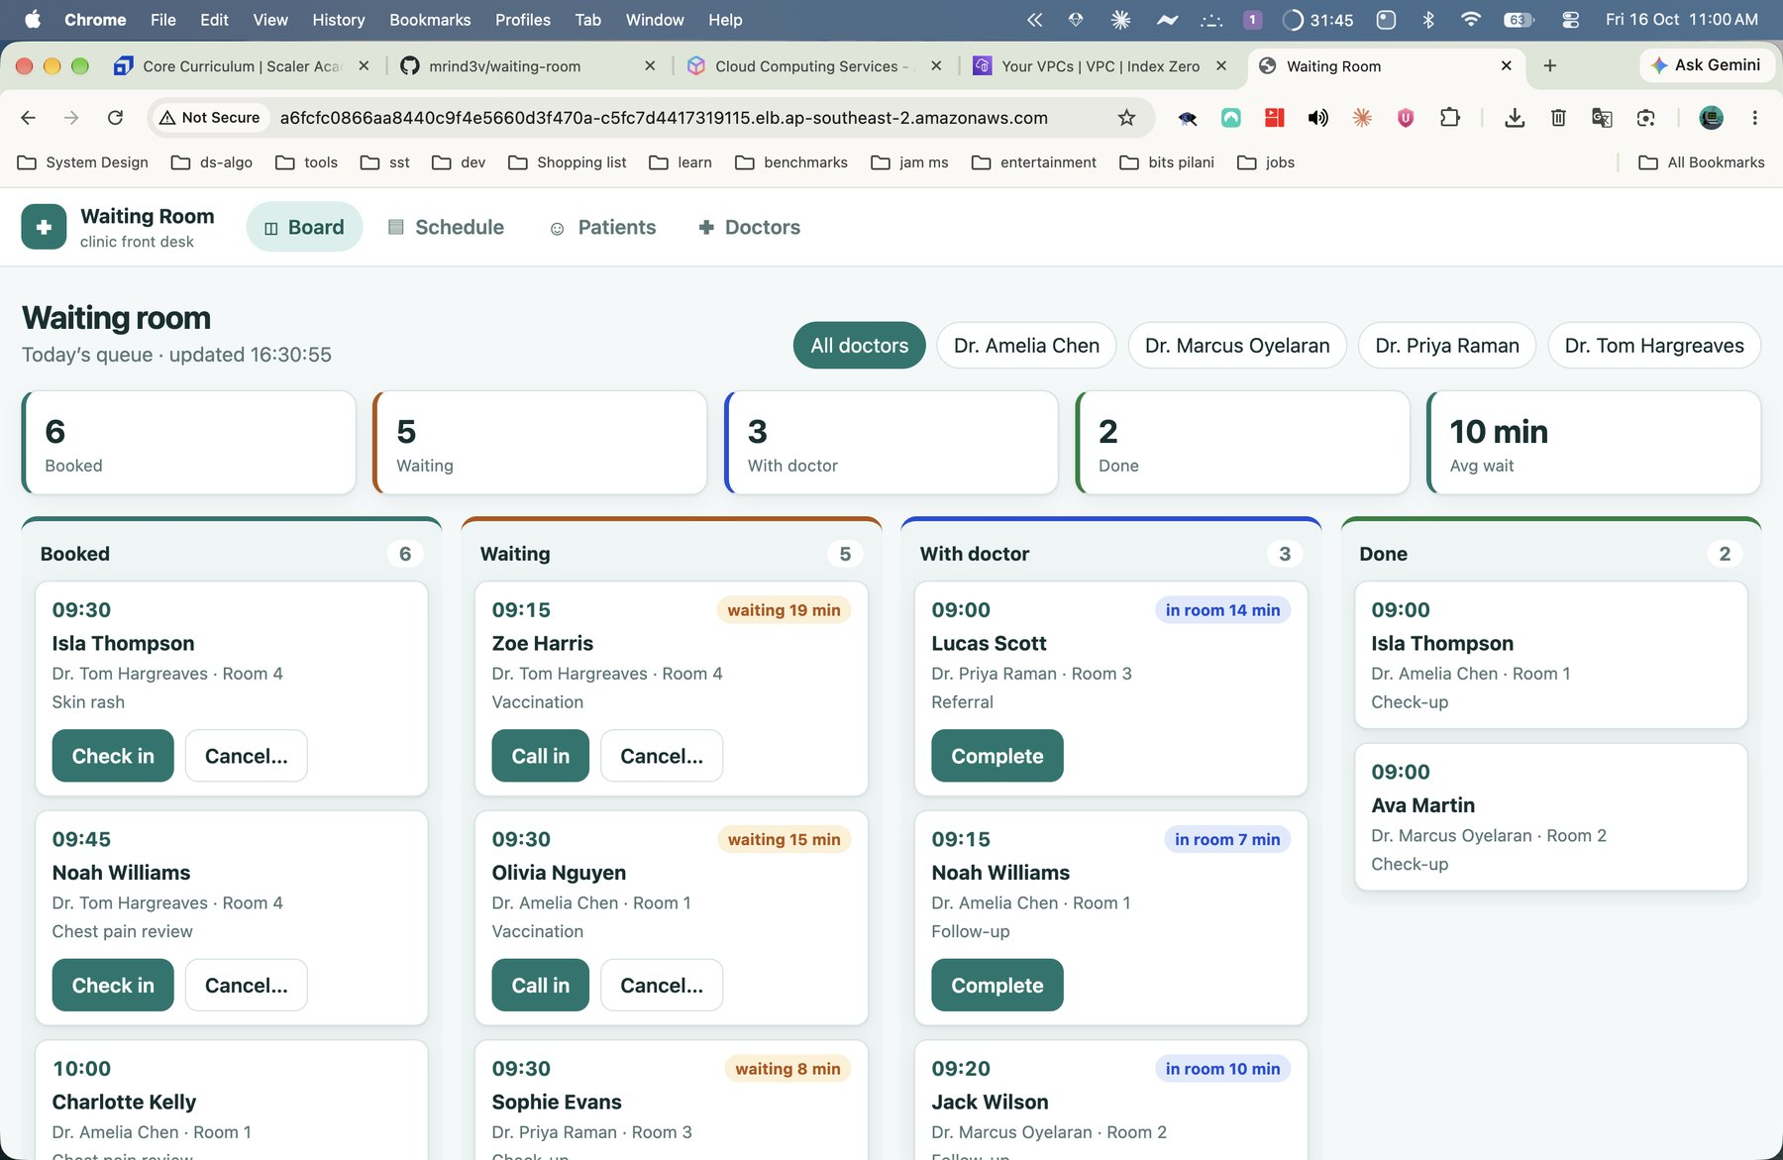
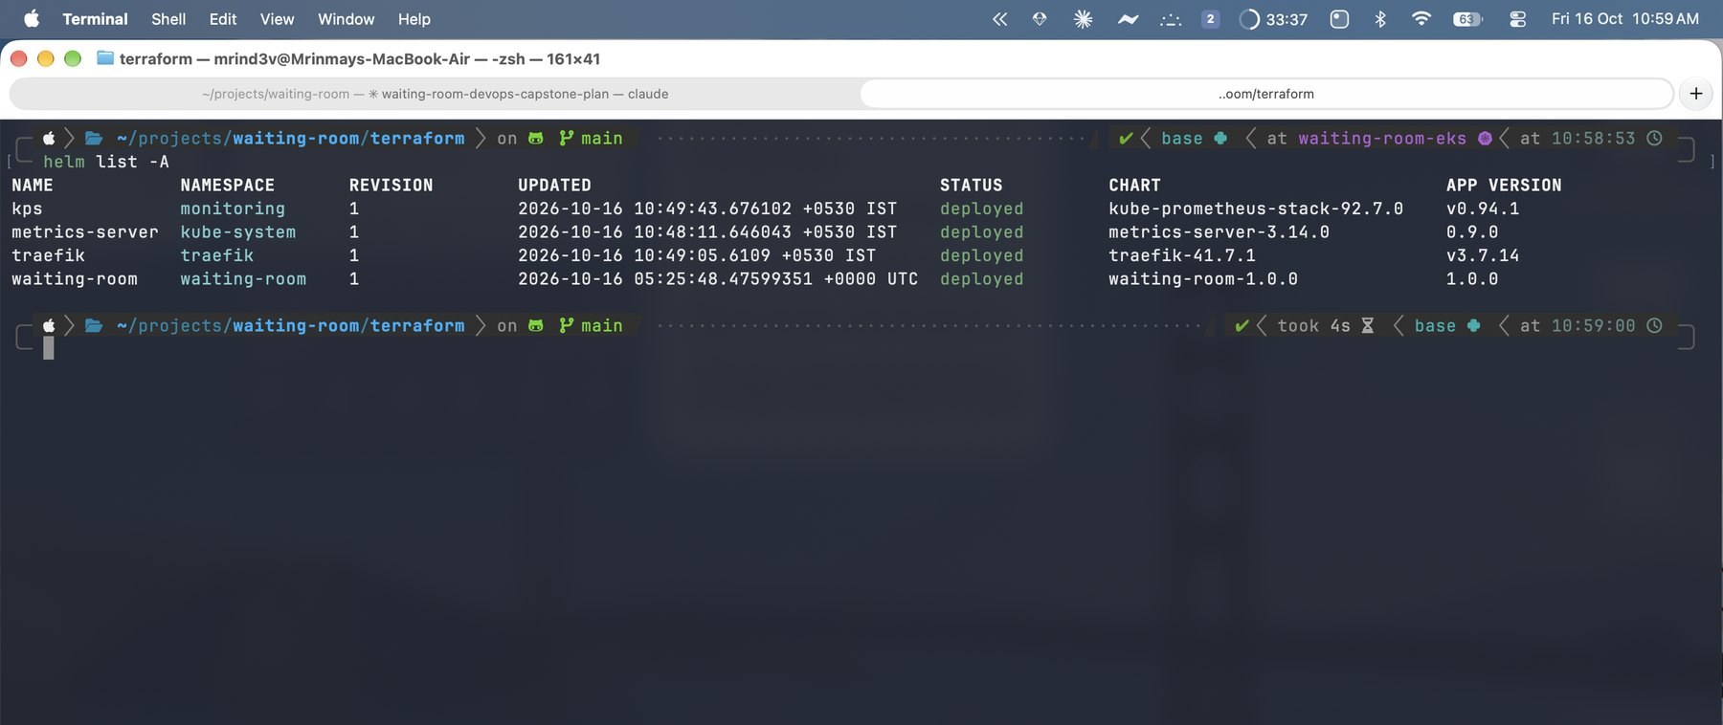
The app runs on EKS behind one load balancer
One NLB is the only public entry point
Traefik routes /api to FastAPI and / to nginx
Three Helm releases run the app, ingress and monitoring
Live on the NLB hostname
Notes:
The application is live on EKS, reached through a single network load balancer. Traefik sends slash api to the backend and everything else to the frontend. Helm lists the three releases: the app, Traefik and the monitoring stack.

Slide 28
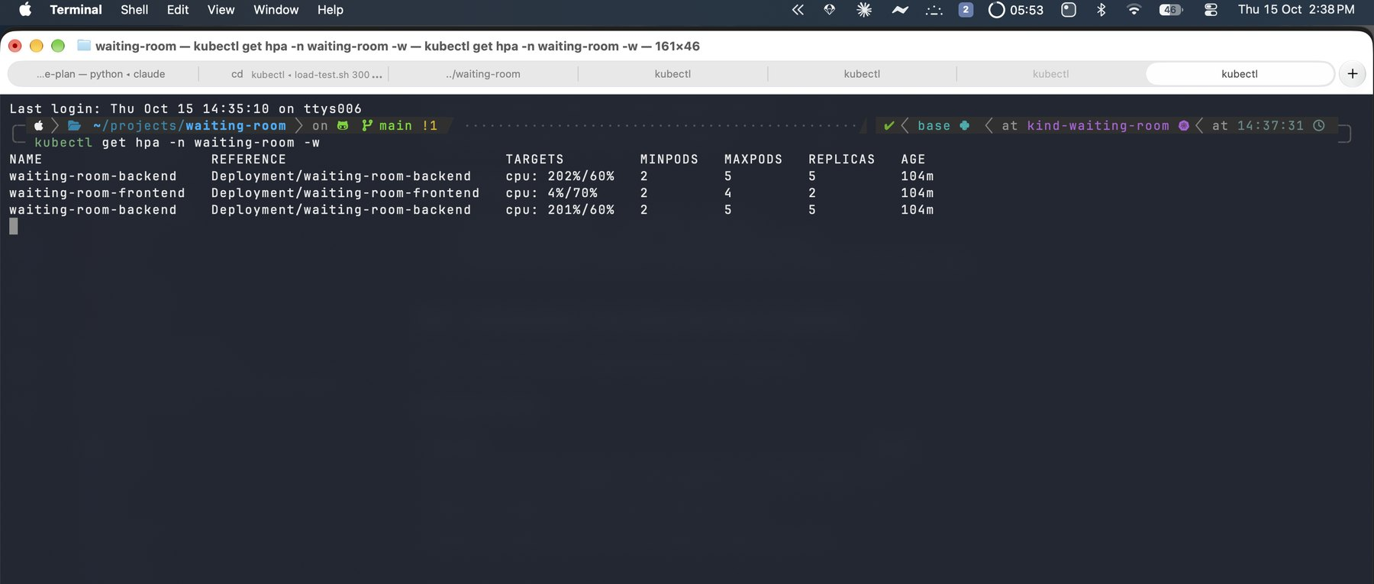
The autoscaler adds pods under load
2 → 5
backend pods under load
0
errors in 58,785 requests
HPA under load (kind rehearsal)
Target: 60% CPU · min 2 pods · max 5 pods
Notes:
I generated load with a small fortio job against a database-backed endpoint. CPU rose far above the sixty percent target, and the autoscaler grew the backend from two pods to its maximum of five. It served nearly sixty thousand requests with zero errors. I rehearsed this on the local kind cluster.

Slide 29
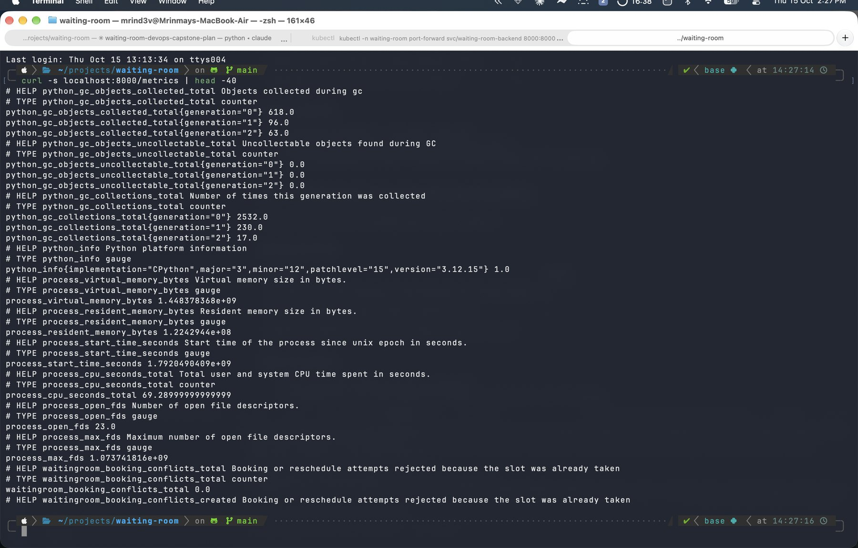
The backend exposes Prometheus metrics
HTTP metrics: requests, latency and status codes
Bookings counted as they happen
Conflicts: every 409 increments a counter
Transitions: counted per status
Notes:
The metrics endpoint serves standard HTTP metrics from the instrumentator, plus three business metrics I added: bookings, double-booking conflicts, and status transitions.

Slide 30
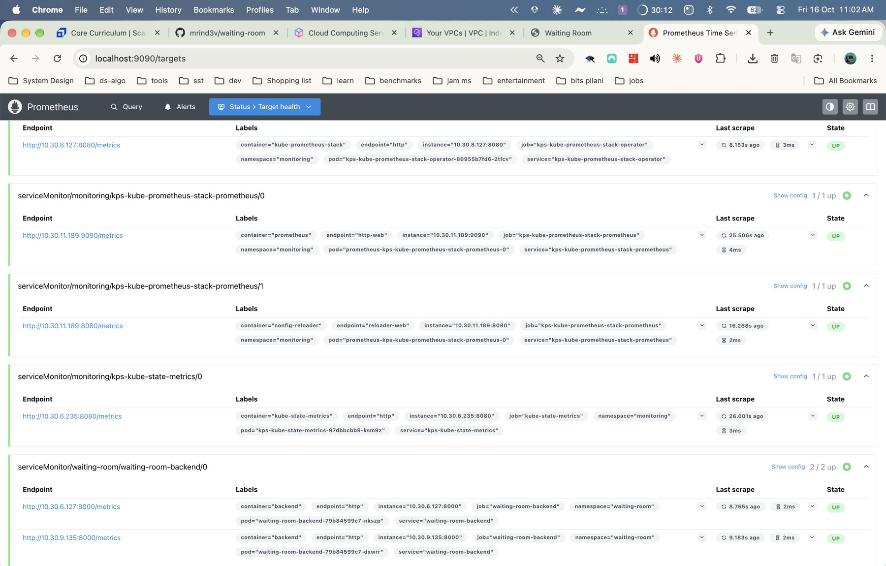
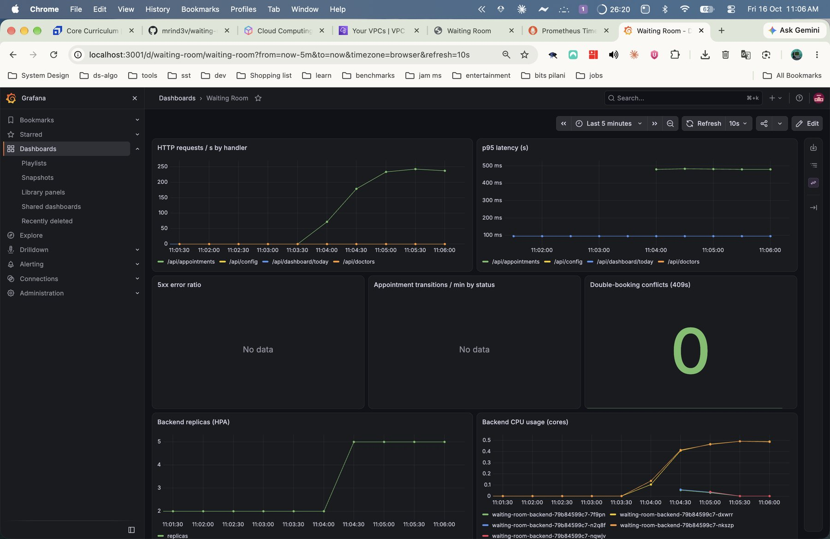
Prometheus scrapes it and Grafana shows it
Prometheus: backend targets UP
Grafana: the Waiting Room dashboard on EKS
Notes:
On the left, Prometheus lists the backend pods as UP targets. On the right, the Grafana dashboard I provisioned from the Helm chart shows request rate, latency, error ratio, transitions, conflicts, replicas and CPU, running on the EKS cluster.

Slide 31
Operate and learn
05
Ship a change. Diagnose failures. Control cost. Reflect honestly
Notes:
Part five shows the system in operation: a real change reaching production, the troubleshooting lab, the cost discipline, and what went wrong along the way.

Slide 32
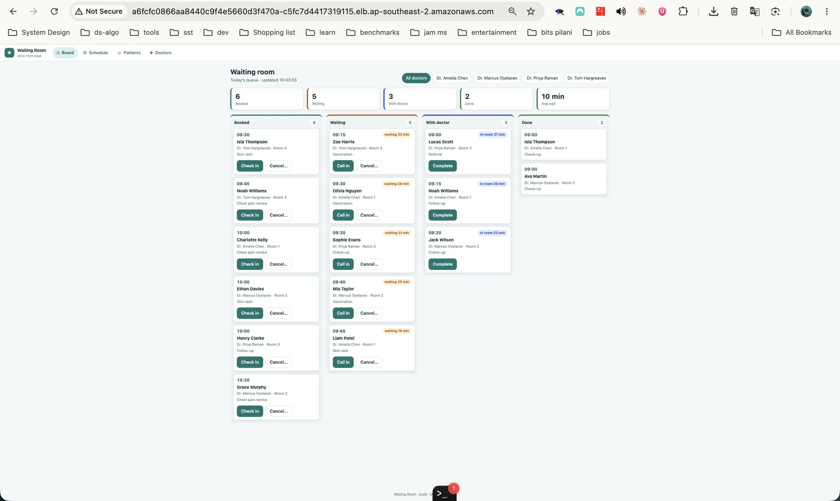
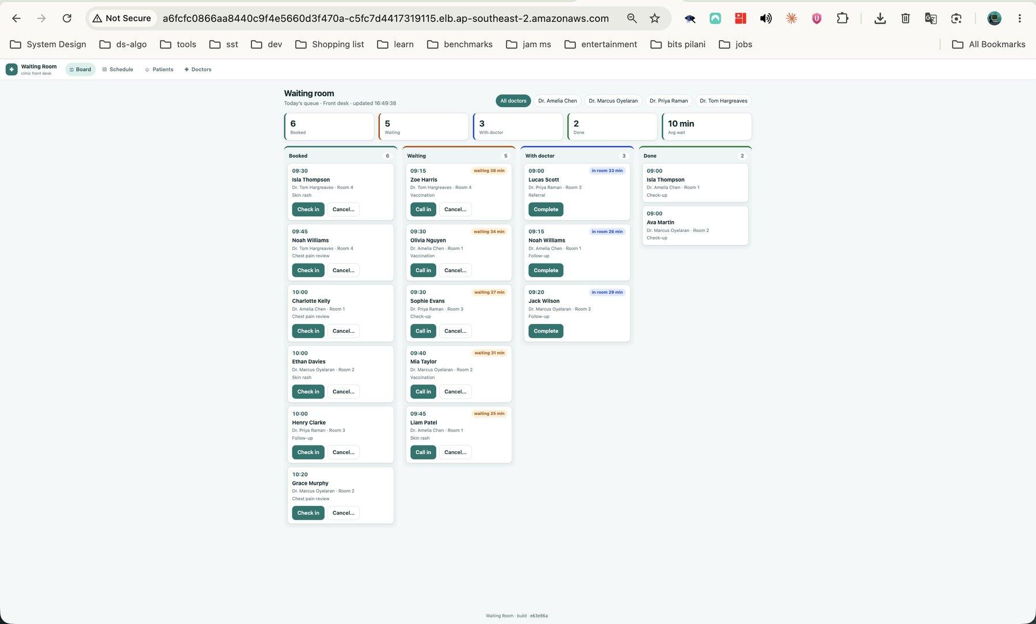
One commit became a live deployment
Before: build 10a6c28
After: build e63e86a, with the new subtitle
Notes:
This is the live-demo evidence. On the left, the running app shows build 10a6c28. I committed a one-line change to the board subtitle and pushed. After the pipeline ran, the right screenshot shows the new subtitle and the new build SHA in the footer.

Slide 33
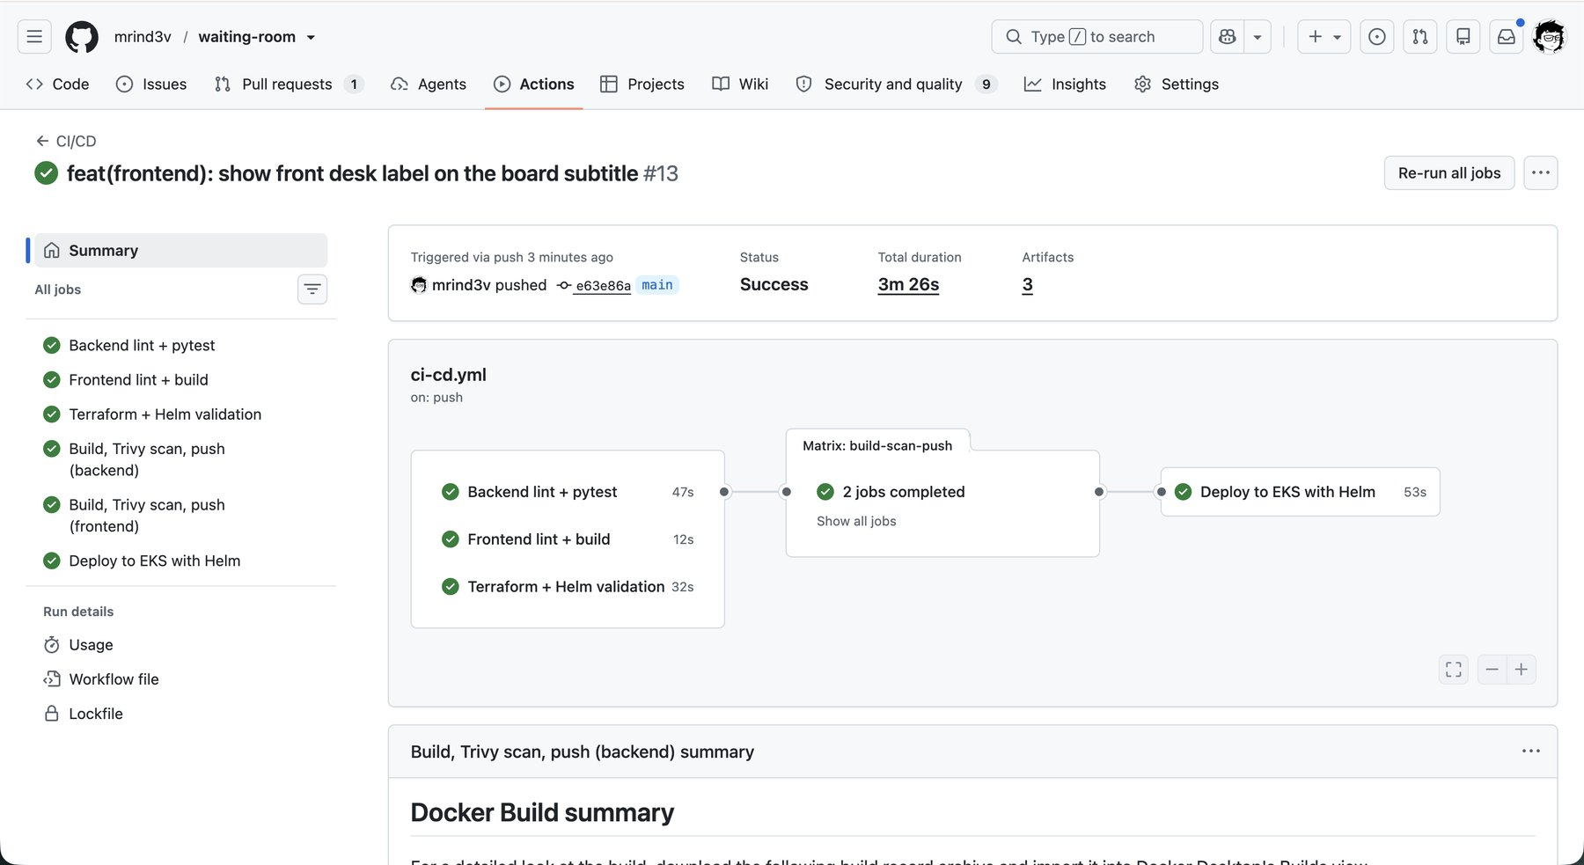
The pipeline ships the change in minutes
Tested, scanned and built in about three minutes
Pushed both images to GHCR, tagged with the new SHA
Deployed with a rolling, atomic Helm upgrade
All six jobs pass, including the Helm deploy
Notes:
The push triggered all six jobs. They passed, including the Trivy scan and the Helm deploy. The whole run took about three and a half minutes from push to rollout.

Slide 34
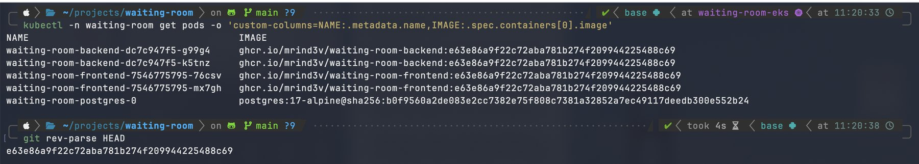



The cluster now runs the new image
Pod images match the commit SHA printed by git rev-parse HEAD
Commit to pod
Easy rollback
Atomic upgrade
The image tag equals the full Git SHA
Deploy an earlier SHA to go back
A failed rollout reverts automatically
Notes:
The terminal shows both backend and frontend pods running images tagged with the new commit SHA, and git rev-parse HEAD prints the same value. That chain, from commit to pod, is the traceability the SHA tags give me. Rolling back means deploying an earlier SHA.

Slide 35
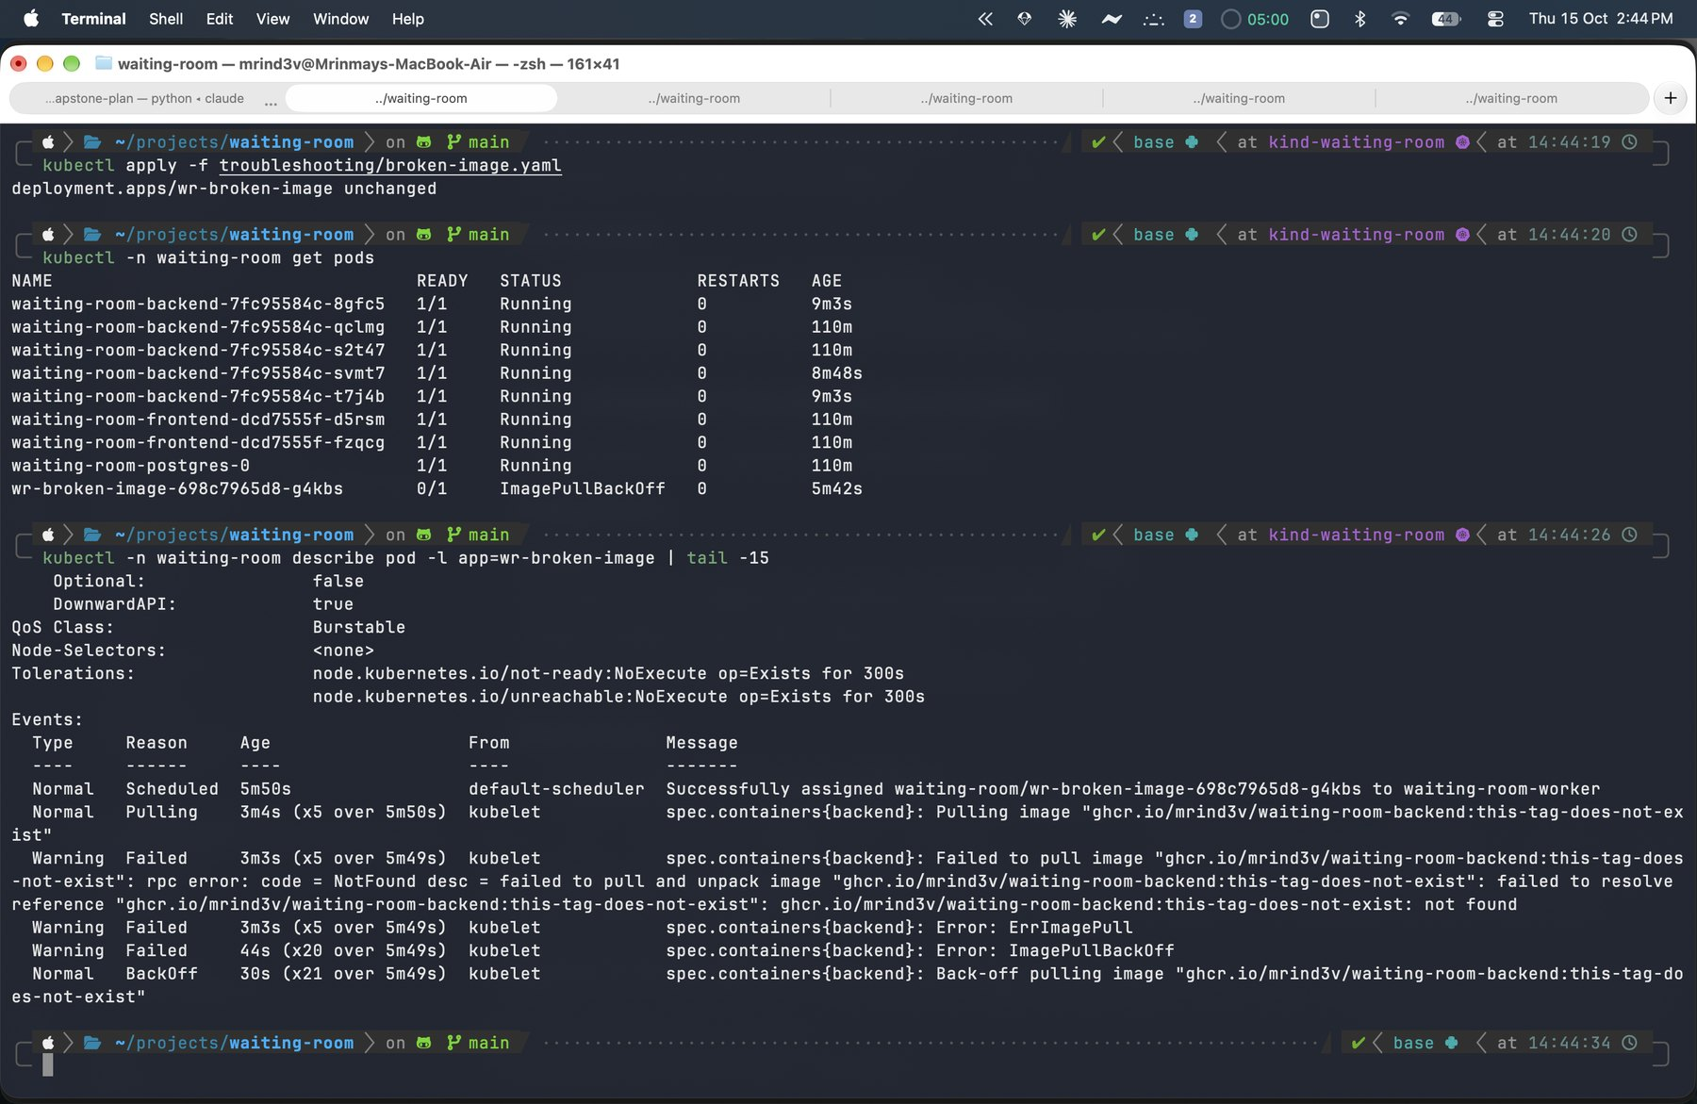
A troubleshooting lab trains the diagnosis
Symptom | Cause | Fix
ImagePullBackOff | Image tag does not exist | Set the right tag
Service has no traffic | Selector matches no pods | Patch the selector
Running, not Ready | Database host is wrong | Correct DB_HOST
ImagePullBackOff reproduced and diagnosed
Events first. Labels connect Services to pods. Liveness is not readiness.
Notes:
I wrote three deliberately broken manifests. A bad image tag causes ImagePullBackOff. A Service selecting the wrong label has no endpoints. A wrong database host leaves a pod Running but never Ready. Each has a documented diagnosis and fix.

Slide 36
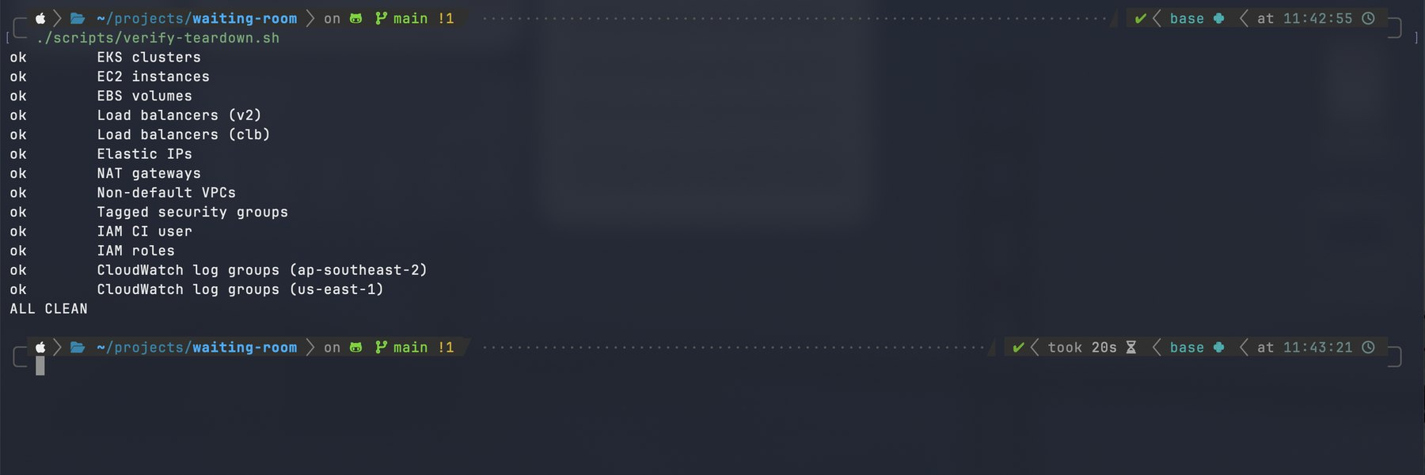
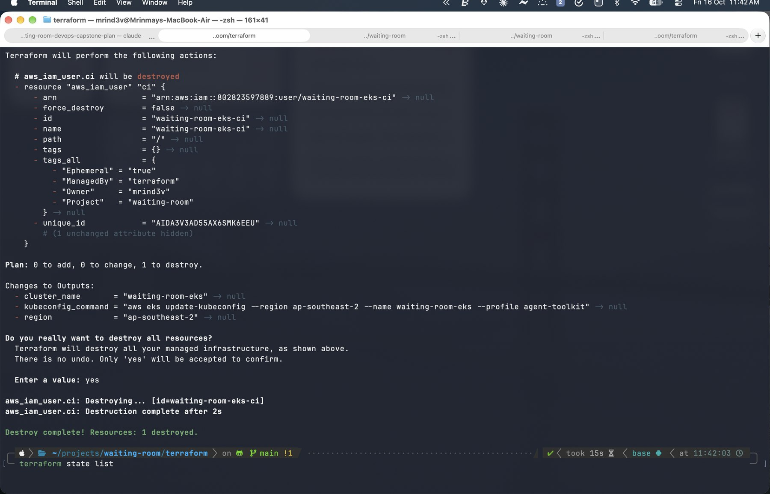
AWS cost stayed near zero, nothing runs now
$0.26
6
ALL CLEAN
per hour while running
budget alerts guard the account
after teardown verification
verify-teardown.sh: nothing left in either region
terraform destroy
Notes:
I treated cost as a requirement. A budget with six alerts watches the account. The AWS stack costs about twenty-six cents an hour and ran for a short window. I deleted the load balancer and volumes first, then ran terraform destroy, and verified with a script that checks every resource type in both regions.

Slide 37



Five problems that taught me the most
Grafana crashed repeatedly
Out-of-memory kills at 256 Mi. I raised the limit.
Docker build failed
email-validator was missing from requirements. I pinned it.
Bootstrap script failed on macOS
An empty array broke under set -u. I fixed the expansion.
Terraform destroy failed
force_destroy calls an API the Free plan blocks. I turned it off.
The load balancer URL timed out
The browser tried HTTPS; only HTTP is exposed. I used http://.
Notes:
These are the real problems I hit. Grafana ran out of memory. A missing dependency only surfaced in Docker. A bash quirk on macOS broke my bootstrap script. The cloud policy blocked a Terraform flag during destroy. And a browser upgraded my URL to HTTPS. Each fix is committed.

Slide 38
Where Waiting Room goes beyond the reference
Reference | Waiting Room
CORS allows every origin | CORS closed by default
create_all next to Alembic | Alembic migrations only
nginx runs as root | nginx-unprivileged, non-root
NAT gateway, 2 nodes, Kubernetes 1.31 | No NAT, 1 node, Kubernetes 1.35
Passwords in values and compose | Secrets generated in the cluster
Actions pinned by tag | Actions pinned by commit SHA
Tests on SQLite | Tests on real PostgreSQL
Notes:
The architecture follows the course, but the domain, schema, API and UI are my own. I also fixed weaknesses I found in the reference: wide-open CORS, deprecated startup hooks, create_all next to Alembic, a root nginx image, a NAT gateway, an old Kubernetes version, plaintext passwords, and tag-pinned actions.

Slide 39
Every grading module has evidence
Module | Evidence
M1 Application | 16 endpoints, React UI, Alembic migrations, /health
M2 Testing | 36 pytest tests, 97% coverage, a test database
M3 Git and GitHub | Public repo with meaningful commits and a complete .gitignore
M4 Docker | Multi-stage non-root images; compose starts three services
M5 CI/CD | Six-job pipeline; GHCR images tagged by SHA
M6 DevSecOps | Trivy on both images, fails on HIGH and CRITICAL
M7 Terraform | VPC, EKS and a node group: plan, apply, destroy
M8 Kubernetes + Helm | Chart, 2+ replicas, ClusterIP, Ingress, running on EKS
M9 Observability | /metrics, Prometheus targets UP, Grafana dashboard
M10 Documentation | README, runbooks and this presentation
Notes:
This maps each of the ten course modules to the concrete evidence in the repository and in these slides.

Slide 40
THANK YOU
What I would build next
HTTPS with a domain and ACM certificates
Managed PostgreSQL on RDS
GitHub OIDC instead of an IAM user
Alertmanager rules for failed bookings
github.com/mrind3v/waiting-room
Mrinmay Dev Sarma · DevOps · Instructor: Nensi Ravaliya
Notes:
Close with what I would do next: HTTPS with a domain, managed RDS, GitHub OIDC on a paid plan, and alerting rules. Thank the instructor. The repository holds the code, the runbooks and every screenshot.

