Slide 1
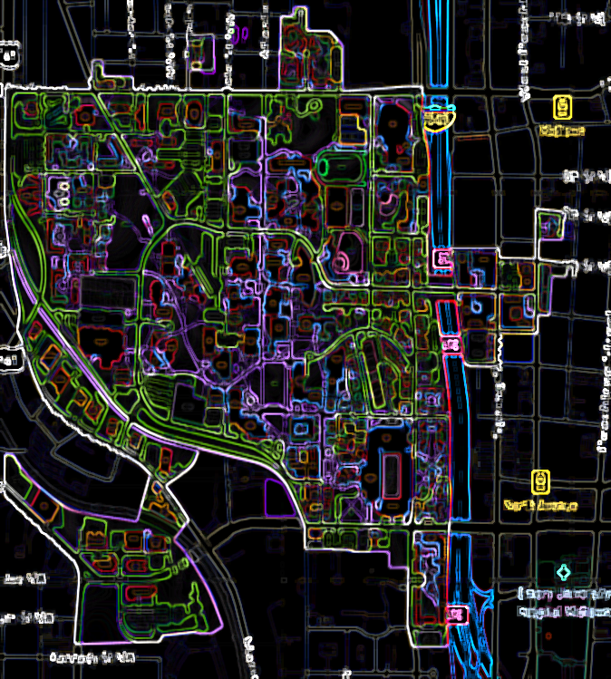
Commissioning

Slide 2
The commissioning scenario allows you to determine how frequently Georgia Tech pays to have campus systems inspected and fine-tuned.

Slide 3
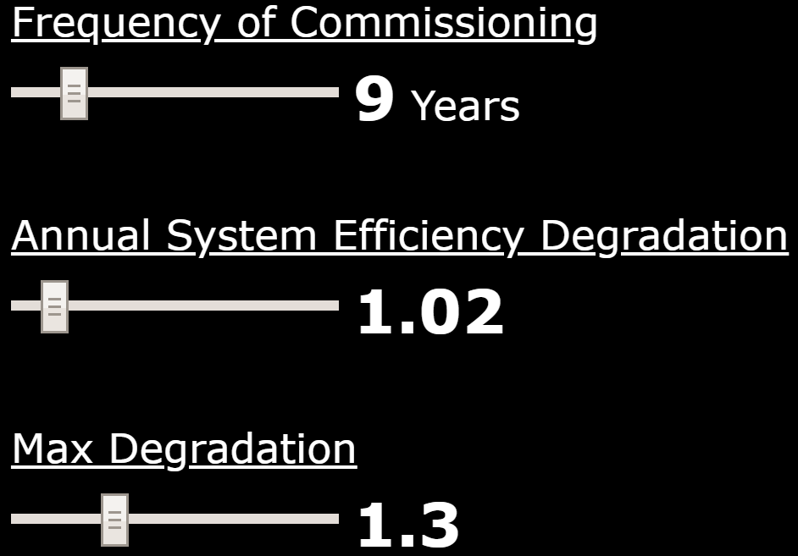
This setting represents the cost per kilo-Watt of solar panels installed. The default value can be altered with the slider bar.

Slide 4
The rate at which scope 1 and scope 2 systems degrade year over year. Ex. 1.02 = a yearly 2% efficiency decrease from the previous year. The default value can be altered with the slider bar.

Slide 5
This sets an upper limit on how bad the systems can get. The default value can be altered with the slider bar.

Slide 6

This setting represents the cost to have campus commissioned. The default value can be altered with the slider bar.

