Slide 1
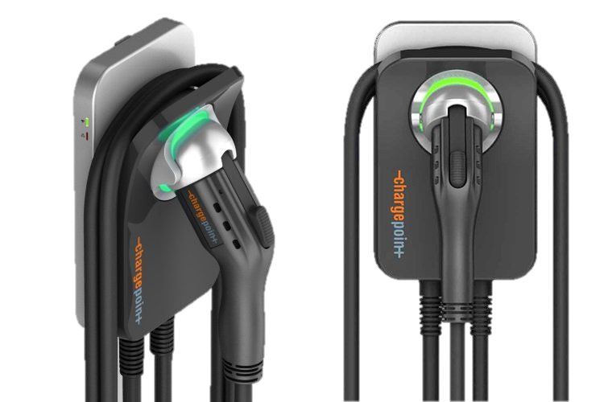
Electric Commute

Slide 2
The electric commute scenario models the vehicle conversion from internal combustion engine to electric of Georgia Tech’s faculty, staff, and students who commute.

Slide 3
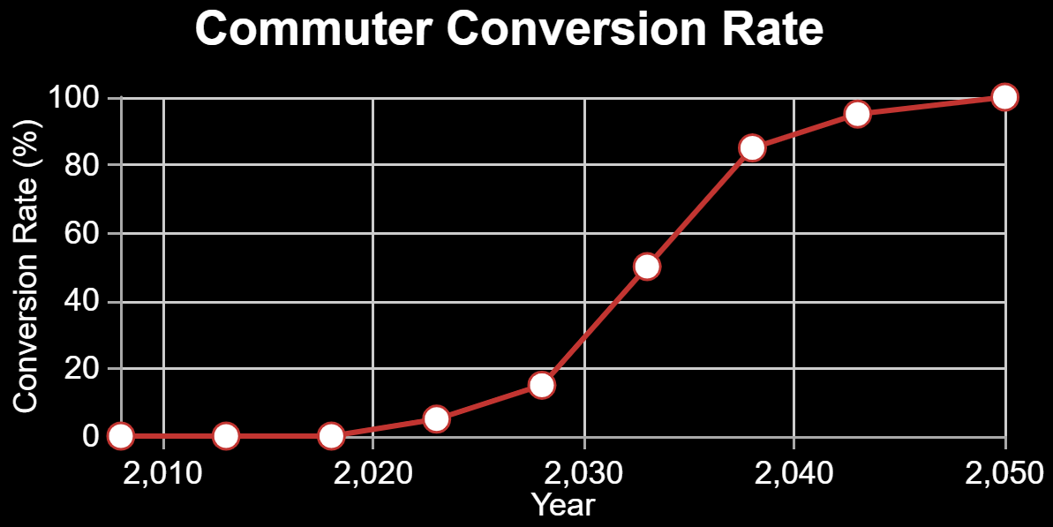
Press ‘Demo’ to use a default technology conversion rate. Drag the data points to alter it.

Slide 4
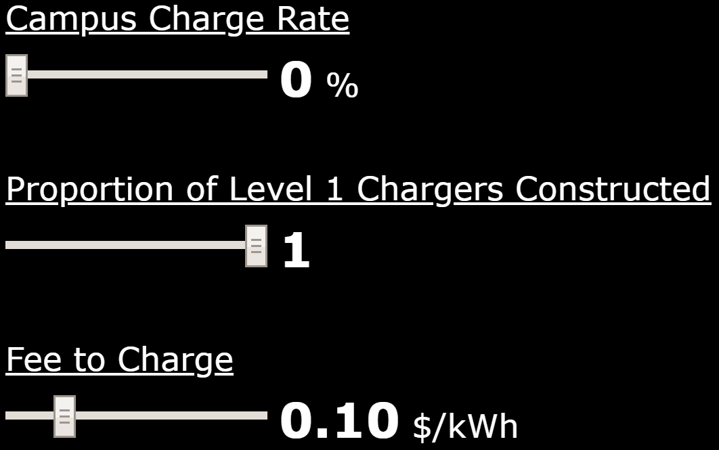
This setting represents the percentage of Georgia Tech commuters that charge their cars on campus. The default value can be altered with the slider bar.

Slide 5
This is the ratio of Level 1 to Level 2 chargers built on campus. Level 1 chargers are cheaper but require ~8 hours for a complete charge. The default value can be altered with the slider bar.

Slide 6
This is the fee that commuters wanting to charge on campus will pay to Georgia Tech. The default value can be altered with the slider bar.

