Slide 1
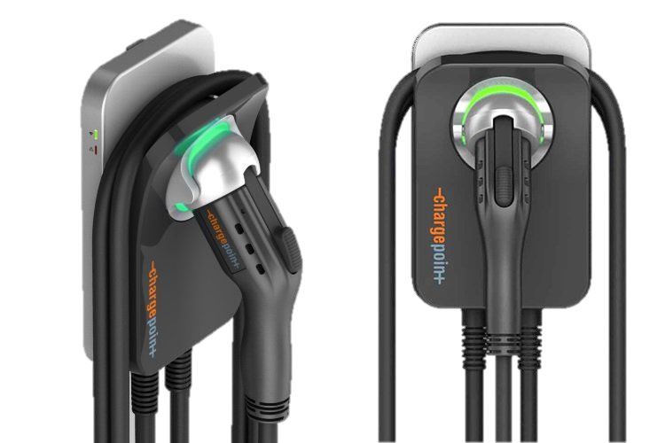
Electric Fleet

Slide 2
The electric fleet scenario converts Georgia Tech’s fleet of buses and service vehicles to their electric counterparts.

Slide 3
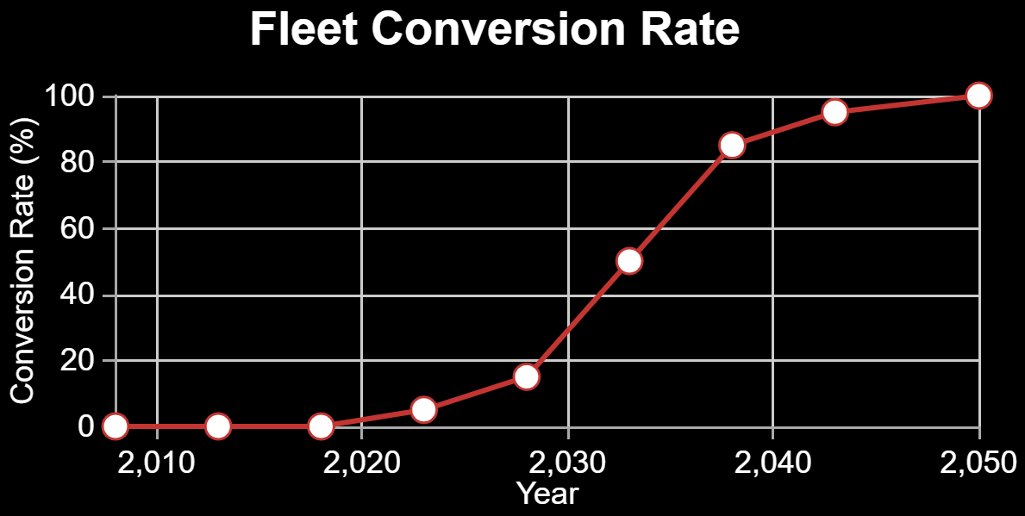
Press ‘Demo’ to use a default technology conversion rate. Drag the data points to alter it.

