Slide 1
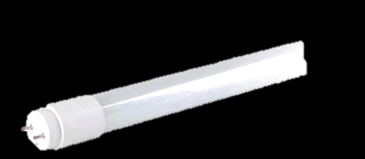
LED Lighting

Slide 2
The LED scenario simulates the conversion of campus lighting from CFL tubes to fixture-compatible LED tubes.

Slide 3
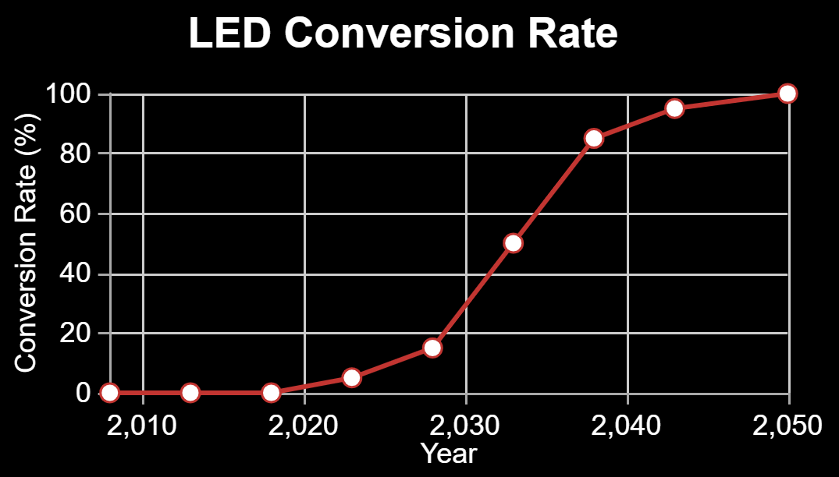
Press ‘Demo’ to use a default technology conversion rate. Drag the data points to alter it.

Slide 4
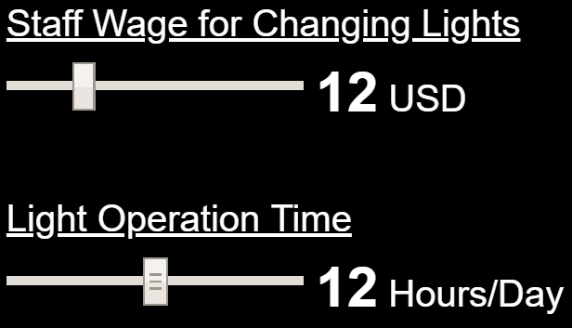
This setting represents the hourly wage that employees who change lights make and affects the cost savings of LED lighting. The default value can be altered with the slider bar.

Slide 5
This setting represents the average number of hours that lights are operated per day. The default value can be altered with the slider bar.

Slide 6
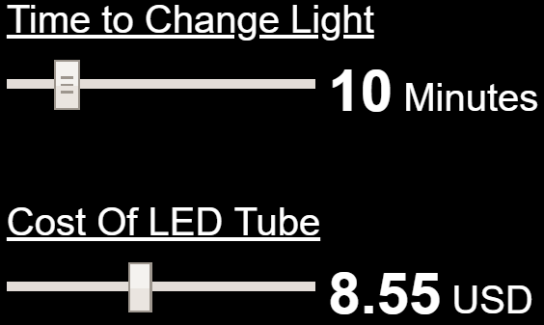
This setting represents the time it takes staff to change a light and affects the cost savings of LED lighting. The default value can be altered with the slider bar.

Slide 7
This setting represents the cost of a single LED tube. The default value can be altered with the slider bar.

