Slide 1
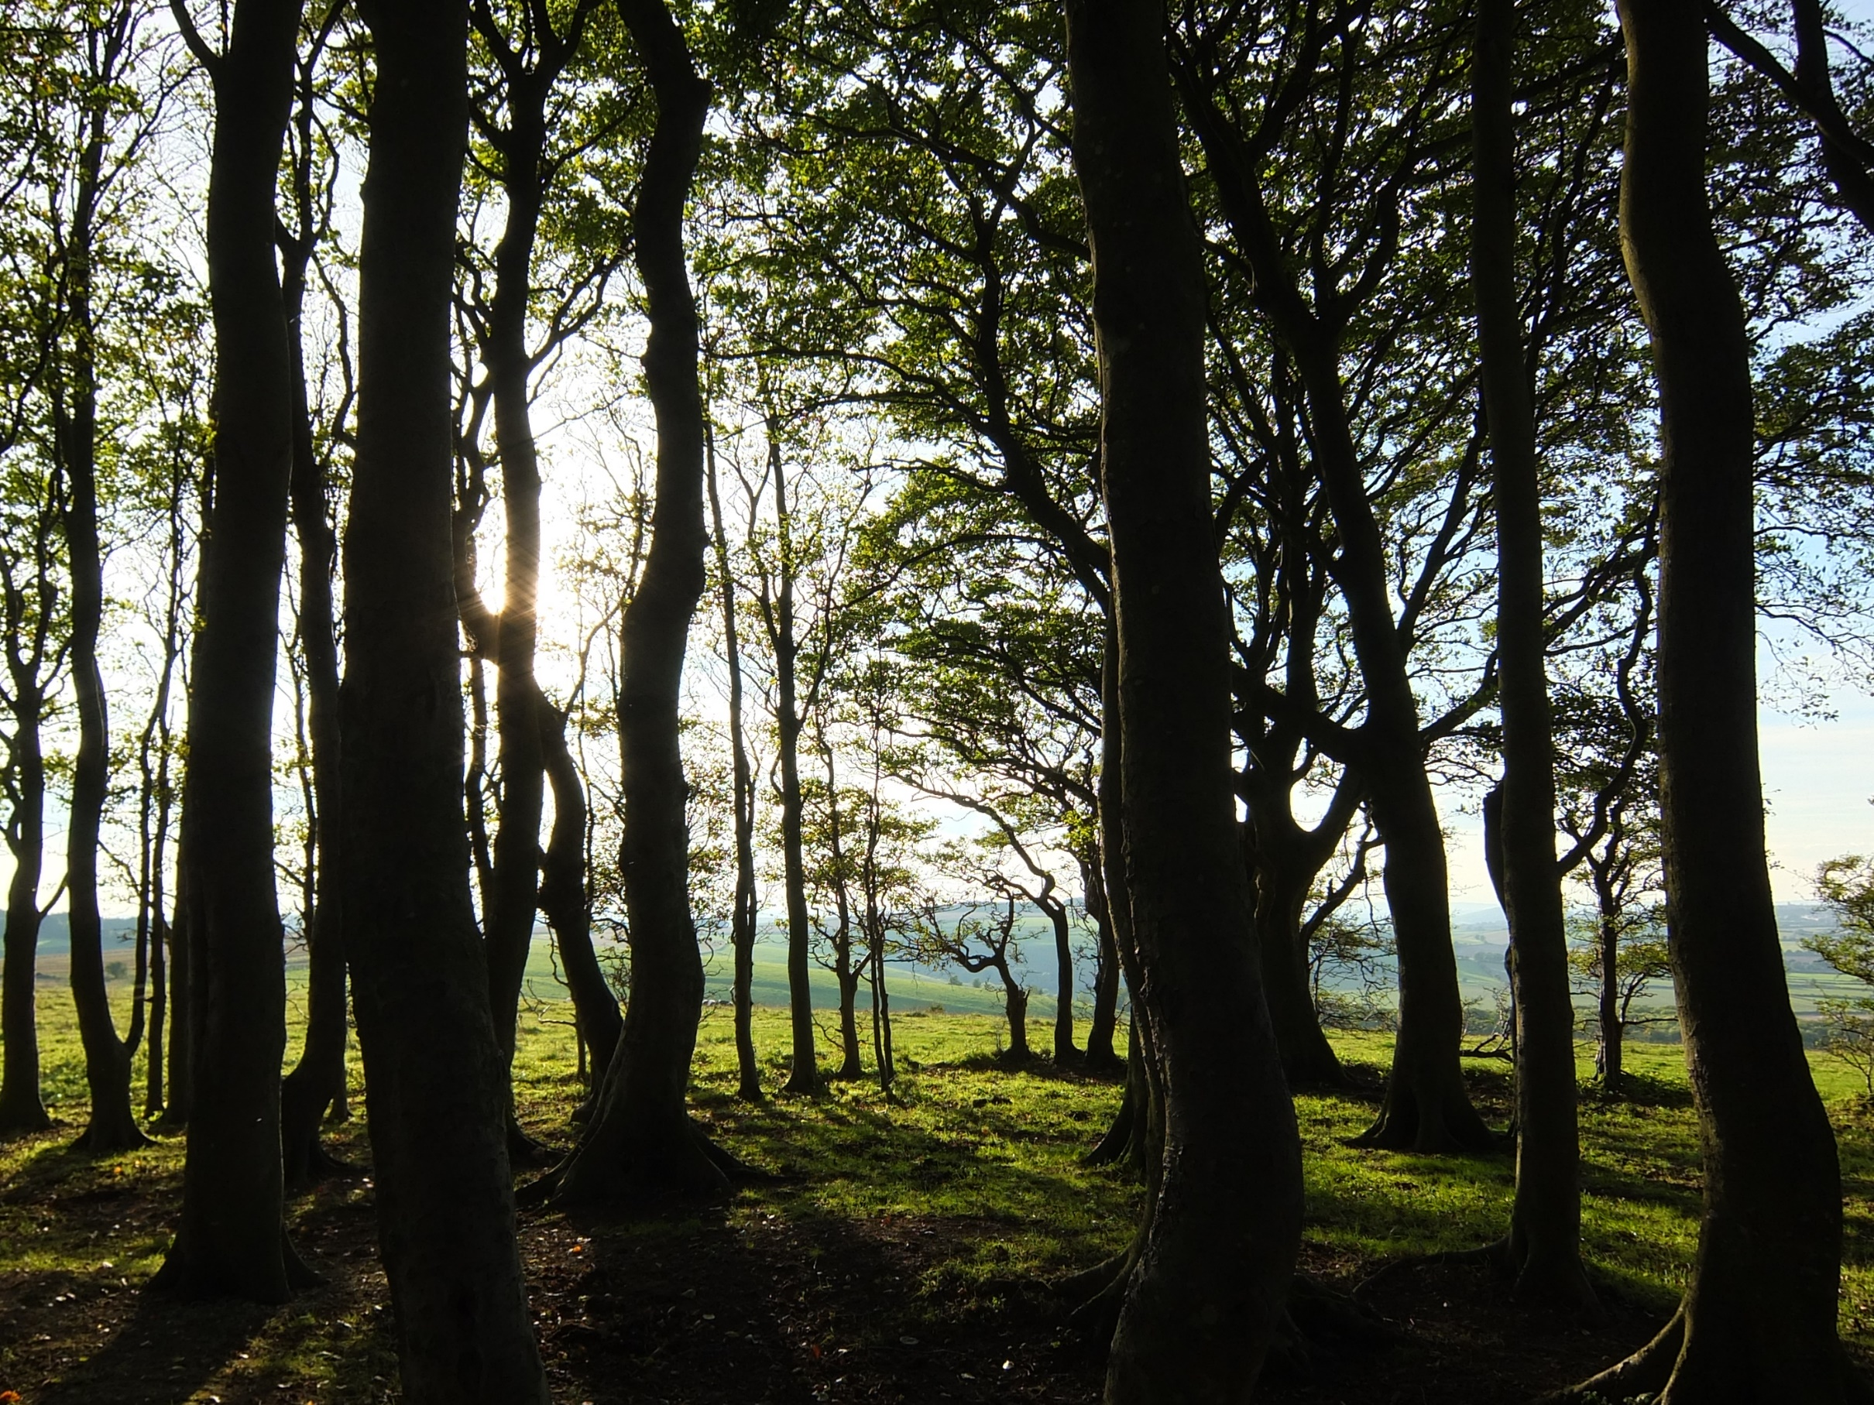
Offsets

Slide 2
Carbon offsets are used to counter campus emissions that couldn't otherwise be reduced. Many types of offsets exist, so the user is able to change the cost of these as desired.

Slide 3
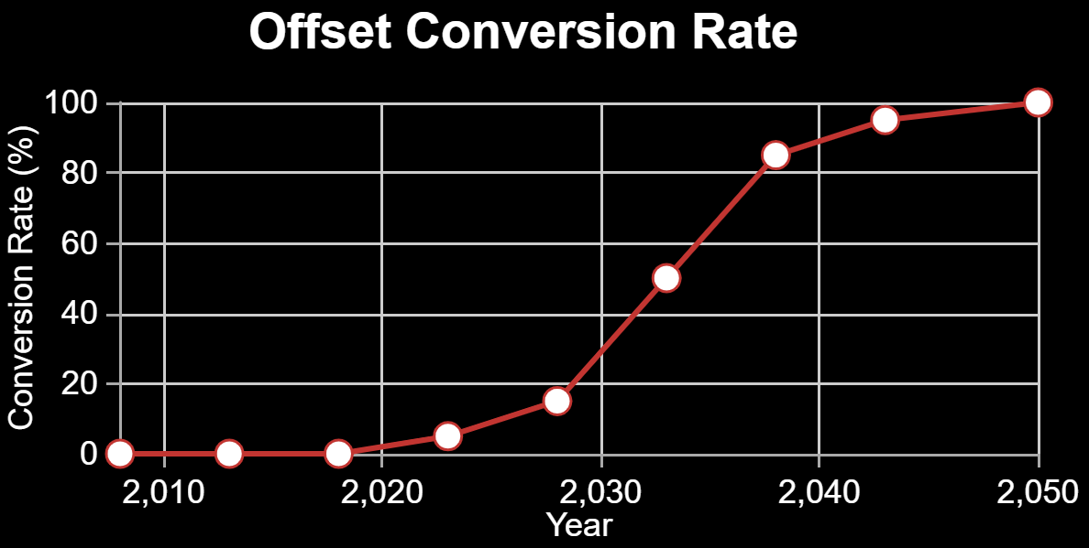
Press ‘Demo’ to use a default technology conversion rate. Drag the data points to alter it.

Slide 4
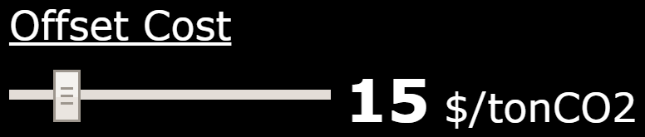
The cost of offsets varies greatly based on the type and location of impact. The default value can be altered with the slider bar.

