Slide 1
Plant Automation

Slide 2
The plant automation scenario implements efficiency improvements resulting from the Smart Energy Campus Initiative.

Slide 3
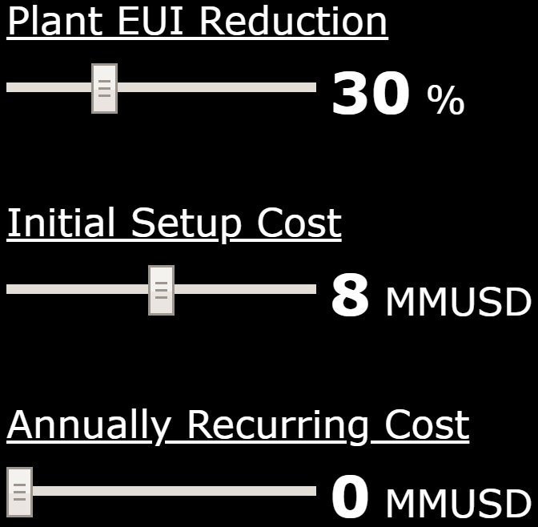
This sets the EUI (energy use intensity) reduction for campus plant operations for this scenario. The default value can be altered with the slider bar.

Slide 4
This defines the cost to setup this scenario. The default value can be altered with the slider bar.

Slide 5
This is the cost that Georgia Tech is expected to pay each year to maintain this scenario. The default value can be altered with the slider bar.

