Slide 1
Smart Labs

Slide 2
The smart labs scenario implements smart air recycling in laboratory spaces.

Slide 3
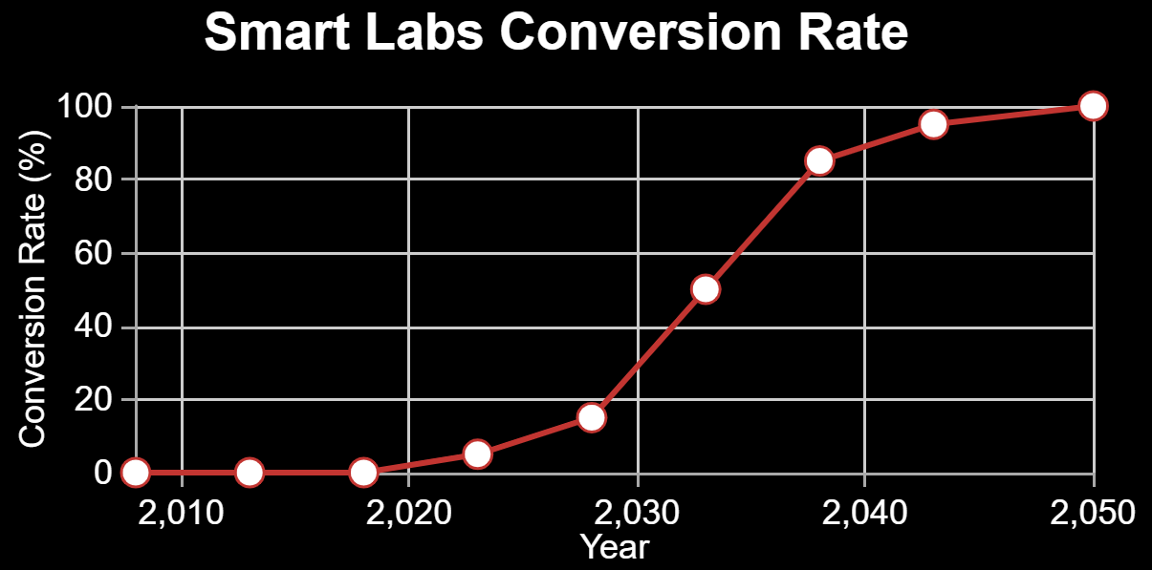
Press ‘Demo’ to use a default technology conversion rate. Drag the data points to alter it.

Slide 4
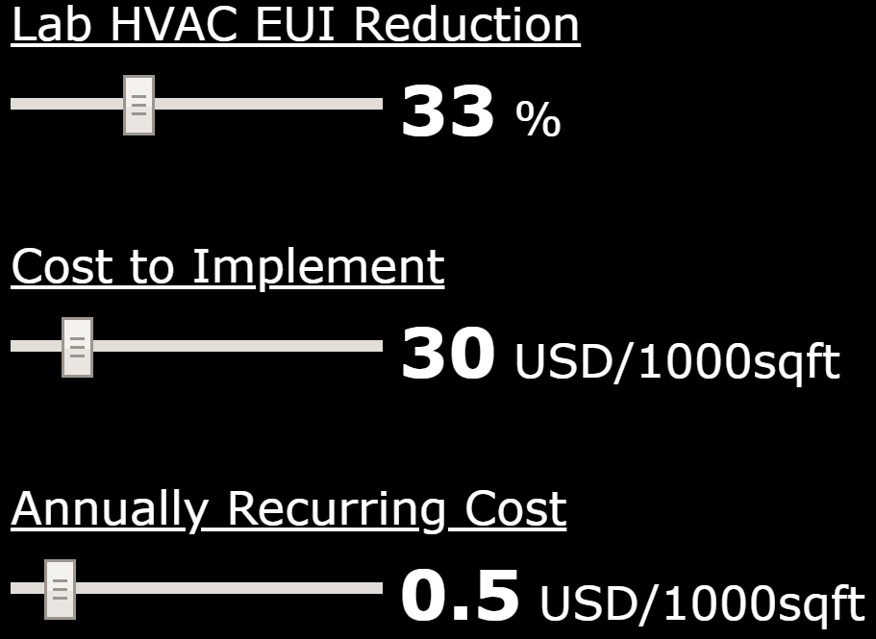
This sets the EUI (energy use intensity) reduction for this scenario. The default value can be altered with the slider bar.

Slide 5
This defines the cost for every 1000sqft of lab space to setup this scenario. The default value can be altered with the slider bar.

Slide 6
This is the cost per 1000sqft of lab space that Georgia Tech is expected to pay each year to maintain this scenario. The default value can be altered with the slider bar.

