Slide 1
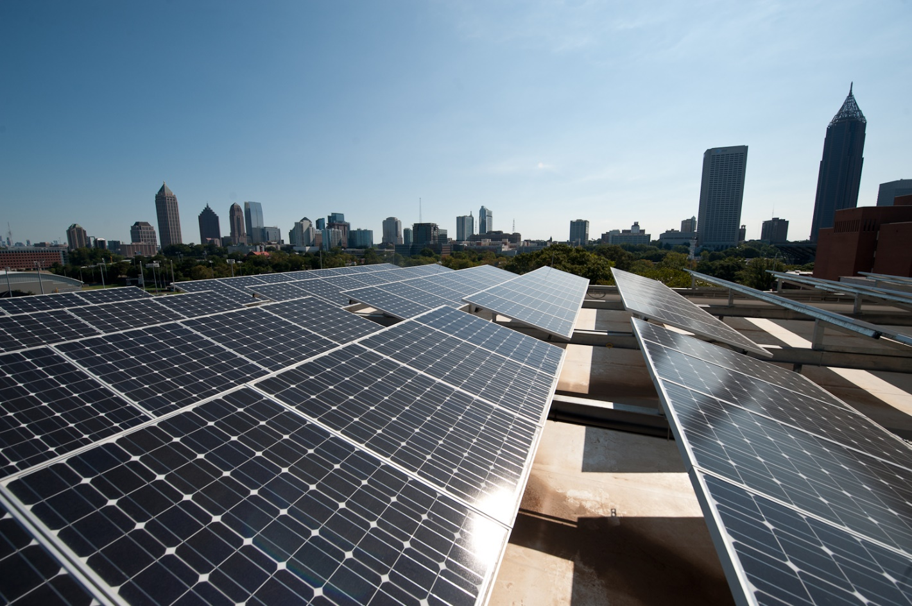
Solar Roof

Slide 2
The solar roof scenario simulates the addition of solar panels on campus building rooftops.

Slide 3
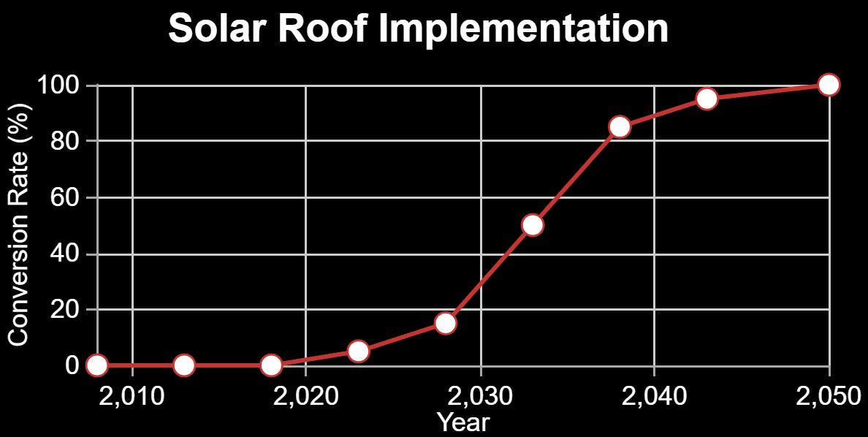
Press ‘Demo’ to use a default technology conversion rate. Drag the data points to alter it.

Slide 4
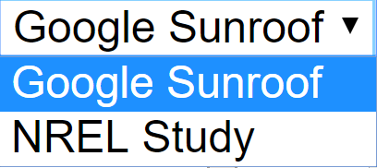
Google's Project Sunroof analyzes available roof space and estimates energy production. The NREL study conducted for Georgia Tech looks at ~12% of currently available roof space.

Slide 5

This setting represents the cost per kilo-Watt of solar panels installed. The default value can be altered with the slider bar.

