Slide 1
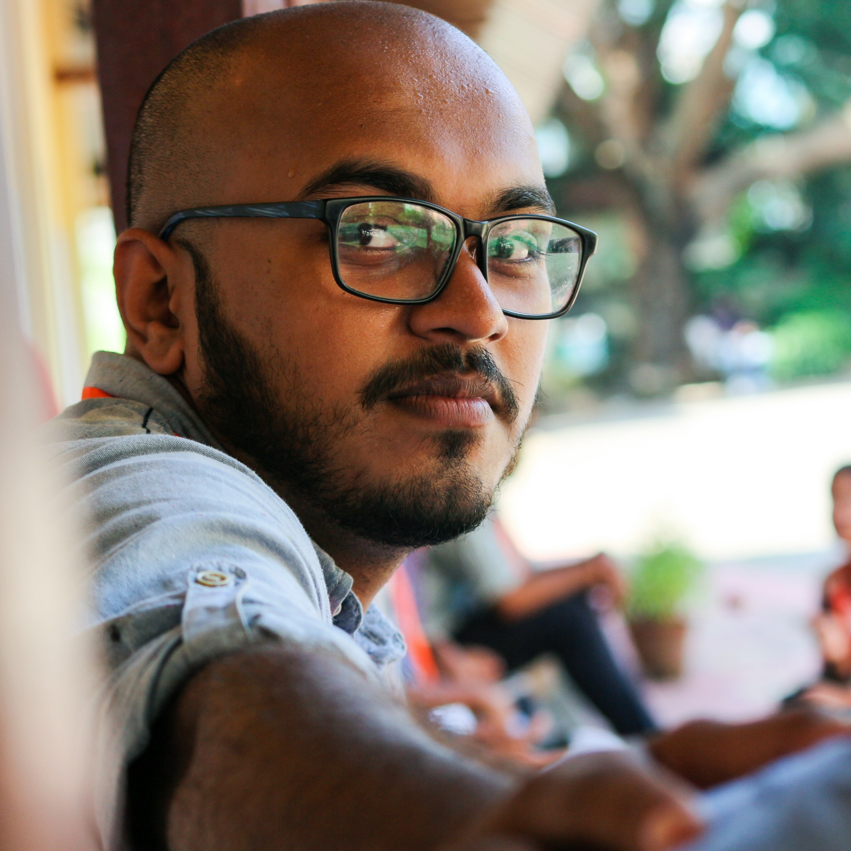





Rogin Cherian Regi
Photographer | Techie | Petrolhead
Dubai | Kerala

